Slide 1


Records Management:
Information Security’s New Best Friend
Caroline J. Walters
University Records Officer
Information Security, Policy
and Records Office
University of Virginia

Slide 2

Agenda
What is records management??
  What is a record?
World According to GARP
Benefits of Records Management
Collaboration Options
Resources
This work is the intellectual property of the author. Permission is granted for this material to be shared for non-commercial, educational purposes, provided that this copyright statement appears on the reproduced materials and notice is given that the copying is by permission of the author. To disseminate otherwise or to republish requires written permission from the author.

Slide 3
What is Records Management?
  Define
  Public vs. Private
  What is a record?
  Benefits

Slide 4
What is Records Management?
Records and Information Management
  Field of management responsible for the efficient and systematic control of the creation, receipt, maintenance, use, and disposition of records, including processes for capturing and maintaining evidence of and information about business activities and transactions in the form of records. (ISO 15489:2001)
  Means the creation and implementation of systematic controls of records and information activities from the point where they are created or received through final disposition or archival retention, including distribution, use, storage, retrieval, protection and preservation. (A.R.S. 41-1346.D.)

Slide 5
Public Universities
Most states have a public records law
  Defines “record”
  May or may not deal with access to public records
    Check for additional FOIA laws
  Penalties for non-compliance are weak/non-existent
  Retention Schedules usually created by agency responsible for RM – most likely state library/archives.
  Some require documentation of destruction or permission to destroy

Slide 6
Private Institutions
Not usually subject to state or federal records law
  Some federal statues can require retention of records or management of records as part of agreement for funding
Records Management driven by risks:
  Legal
  Financial/Resources
  Security

Slide 7
Records Management & Universities
Most Public Universities place records management in a library/archives, however, RM often lives in:
  Facilities
  Legal
  Business Operations
  Information Technology

Slide 8
What is a record?
ARMA: recorded information, regardless of medium or characteristics, made or received by an organization in pursuance of legal obligations or in the transaction of business.
VA Public Records Act: recorded information that documents a transaction or activity by or with any public officer, agency or employee of an agency. Regardless of physical form or characteristic, the recorded information is a public record if it is produced, collected, received or retained in pursuance of law or in connection with the transaction of public business. The medium upon which such information is recorded has no bearing on the determination of whether the recording is a public record.

Slide 9
The Records Management World According to GARP
And how CIA fits

Slide 10
CIA
Confidentiality – the need to ensure that information is disclosed only to those who are authorized to view it.
Integrity – the need to ensure that information has not been changed accidentally or deliberately, and that it is accurate and complete.
Availability – the need to ensure that the business purpose of the system can be met and that it is accessible to those who need to use it.
SANS Institute – Glossary of Security Terms, http://www.sans.org/security-resources/glossary-of-terms/

Slide 11

GARP (www.arma.org/garp)
  Created in 2009
  Provide framework for RM programs
  Maturity model/assessment
  Accountability
  Integrity
  Protection
  Compliance
  Availability
  Retention
  Disposition
  Transparency

Slide 12
Accountability
Senior Executive oversees records management program
Auditability – checking to make sure the program is meeting goals.

Slide 13
Accountability @ UVa
Records Management reorganized/aligned via a Process Simplification Study
  http://www.virginia.edu/processsimplification/teams/records.html
Reports to Information Security, Policy & Records
Auditability?? Not there yet
  Some metrics available:
    100 tons of paper destroyed
    approx. 100 training session reaching about 1000 employees

Slide 14
Integrity
Reliability of the records of the organization including trustworthiness through:
  Training & direction given to employees
  Acceptable audit trails on the records
  Reliability of the systems that control the records including, hardware, network, infrastructure and software.
  Integrity covers the life cycle of the records – from creation to disposition.
SANS: the need to ensure that information has not been changed accidentally or deliberately, and that it is accurate and complete.

Slide 15
Integrity @ UVa
Training & direction provided, although not required as part of employment.
Audit trails of records – some in place in electronic systems, others based upon designation of official record keeper.
Reliability of systems – leaving this up to Info Security/Networks, etc. to keep us reliable.
Reliable throughout the lifecycle:
  Training on electronic records/imaging system requirements
  Trustworthy Electronic Records System Standards – under development.

Slide 16
Protection (Confidentiality)
SANS: the need to ensure that information is disclosed only to those who are authorized to view it.
Records Management: ensures a reasonable level of protection to records and information that are private, confidential, privileged, secret or essential to business continuity.
  Includes destroying confidential information once retention has been met, destruction in a secure manner.
  Training personnel on what to keep and how to keep it.
  Look inside and outside.

Slide 17
Protection @ UVa
UVa Records Management:
  Communicates to staff and IT about the importance of knowing the what and where of confidential information.
  Identify what information is not longer required to be retained and destroy it (easy to secure!).
  Through records inventories/surveys, can identify where confidential information is stored (paper & electronic).
  Identifying the official record keeper for specific records.
  Support development of central information systems and reduction of rogue shadow systems.
  Assist with remediation of confidential data while maintaining information needed for reporting/statistics – think about the data differently.

Slide 18
Compliance
Ensure compliance with applicable laws and other binding authorities, as well as organization policies
  Balancing Act between competing requirements
  Records Management Policy is Key
  HIPAA, State Records Act, PCI, FERPA
  Loads of federal regulations

Slide 19
Compliance @ UVa
Virginia Public Records Act/Library of Virginia
  Records Retention & Disposition Schedules – ability to adjust to meet other
  One Stop Shop for answers on retention
  Consistency in communication about retention issues
Challenges:
  Getting central offices ( HR, Finance, OSP) to send questions to Records Management.
  Communication

Slide 20

Availability
Ensure timely, efficient & accurate retrieval of needed information.
  Response time should meet business needs
  Regular destruction enables reduction of the haystack
  Organization of information (paper and electronic) – use of indexing/metadata.
SANS: the need to ensure that the business purpose of the system can be met and that it is accessible to those who need to use it.

Slide 21
Availability @ UVa
Reducing the haystack of paper and electronic
Working with system development teams on indexing/metadata (classification)
Communicate through training and other methods about proper organization and destruction of the trash.
Email training because it all comes down to the user.

Slide 22
Retention
Maintain records and information for an appropriate time, taking into account:
  Legal & regulatory
  Fiscal – includes tax, financial audit
  Operational – to satisfy business needs.
  Historical Requirements – Permanent
  Format is not a consideration (paper, email, electronic).
Risk Assessment – awareness of what would happen if?

Slide 23
Retention @ UVa
Library of Virginia Records Retention Schedules
  Sets basic time periods
  Does not include everything at a U.
  Does not always meet our legal/reg, fiscal, operational or historical needs.
  UVa creating agency specific schedule – our terminology, our business process, our balance.
Records Management Office Communication:
  Training, mailing lists, updates, conference, email

Slide 24

Disposition
Provide for secure and appropriate disposition for records meeting retention.
  Secure destruction (paper and electronic) – sometimes documented – of records (and all copies) upon meeting retention.
  Documented transfer of intellectual and physical custody for historical records to an archival repository.
Disposition part of the Records Retention & Disposition Schedules – includes time and method.

Slide 25
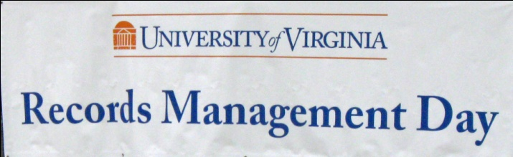
Disposition @ UVa
Specific UVa Schedule includes disposition
Communication: Guidance for destruction provided by all communication methods (email, website, training, phone).
Coordinating with Special Collections Library on the identification and transfer of historical records.
Annual Records Management Day:
  July each year
  Onsite shredding trucks
  Fun, Food & Prizes

Slide 26

Transparency
Processes and activities of the records management program shall be documented in an understandable manner and available to all personnel & appropriate interested parties.
  Shows due diligence
  Makes the rules clear to all
  Helpful in answering Public Records Requests

Slide 27
Transparency @ UVa
www.virginia.edu/recordsmanagement
  Provides public access to all information and guidance on records management policies and procedures
  Currently being updated as program is growing
Freedom of Information Act:
  Yes, at Virginia, we do provide access to email, ESI, and paper records upon request
    As long as the information is not confidential by law!

Slide 28
WHY BOTHER?
  Compliance
  Legal
  Resources
  Security

Slide 29
Benefits of Records Management
Compliance
  HIPAA regulations: Mass. General Hospital – fined $1,000,000 because a staff member took home some paper files of patients and left them on the bus!
  Privacy regulations: Can we talk about data breaches? Easy to protect when it does not exist.
  Required retention: Federal regulations (I-9’s, VISAs, etc, etc, etc.) & State regulations.

Slide 30
Benefits of Records Management
Manage Risk:
  Data Breach – less old data to protect
  FOIA Risk – follow the retention rules and data that does not exist is not turned over (documentation of destruction).
  E-Discovery Risk – until litigation is known/expected, retention rules reduce the data on a regular basis (shows due diligence)

Slide 31
Benefits of Records Management
Control Resources
  Storage costs reduced
    Paper storage costs reduced by 50-75% if destruction takes place regularly compared to “keep it all” mentality.
    Electronic storage costs reduced because less data retained
  Personnel costs reduced
    Time spent by individual offices/dept to find retention and disposition information.
    Time spent “looking” for information to do the work in a large haystack.
    Time spent moving old records to storage (destruction is easier)

Slide 32
Benefits of Records Management
Security
  If it does not exist you don’t have to secure it!
  Records inventories – knowledge of where records are stored and if they contain confidential information
  Identification of who is the official record keeper
  No confusion by staff on what to keep and what not to keep.
  Training can include review of policies and best practices for information security (passwords, encryption, storage).

Slide 33
Collaboration Options
  Step 1 – Who, What, Where
  Step 2 – (Options A, B & C) – How

Slide 34
Step 1 – Who, What, Where?
Do you have a Records Officer/Manager?
Who sets retention of records for your institution?
What is the current activity of records management?
What resources are currently available?
Where are they located in the organization?
Who do you have to connect with?

Slide 35
Step 2 – Option A
Step 1 answers: No records management program.
Actions:
  Find leader that supports development of records management program (legal, audit, finance)
  Propose a study (i.e. UVA Process Simplification)
  Propose alignment with IT Security
  Show scary pictures, tell scary stories, be a driver!

Slide 36
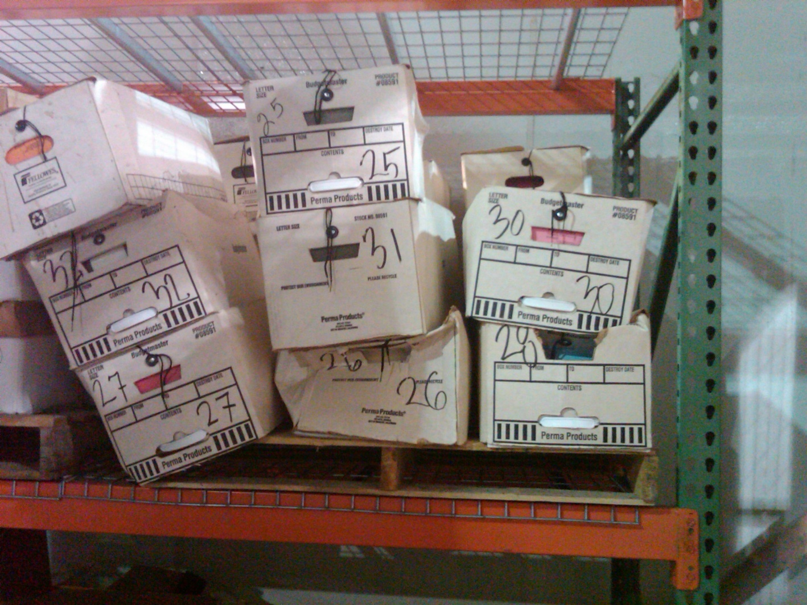
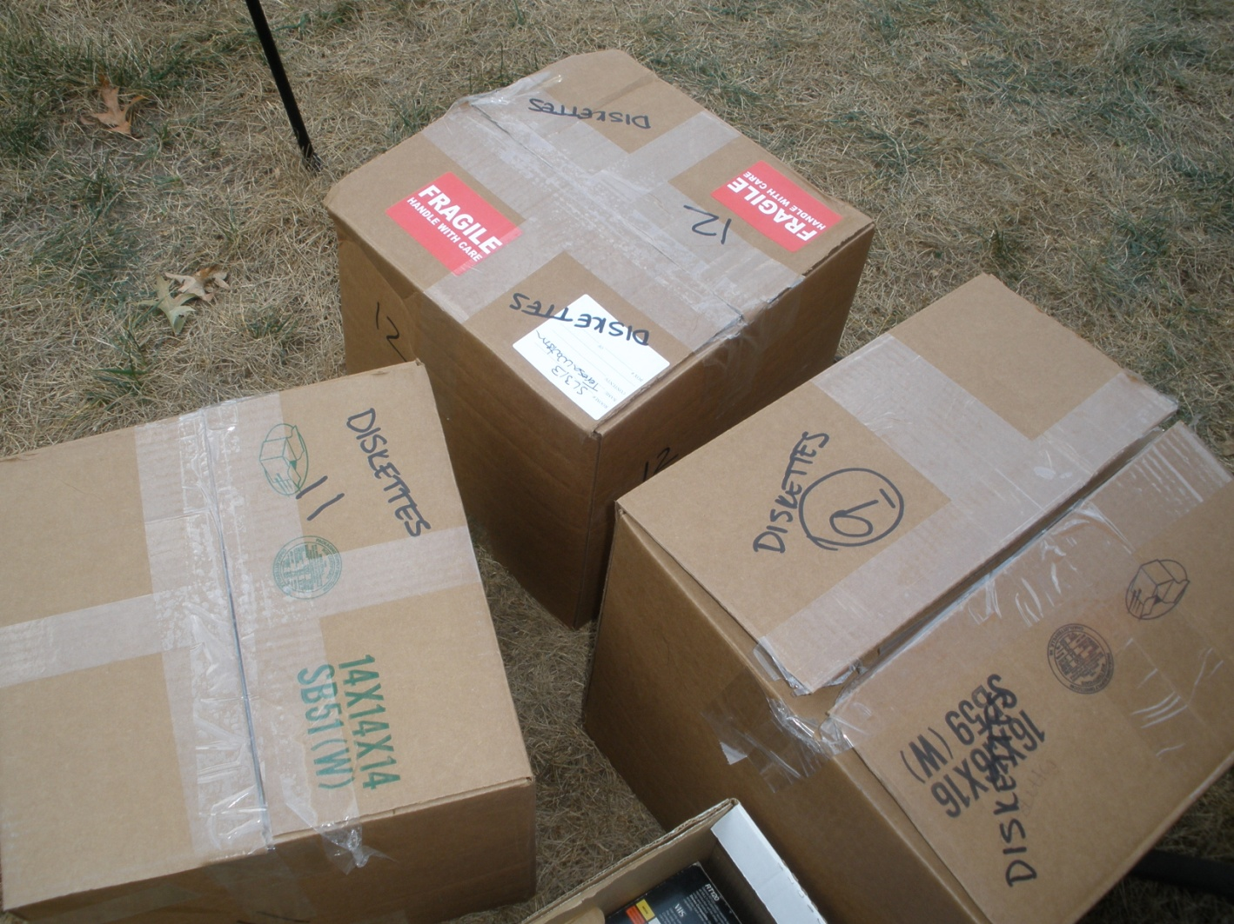
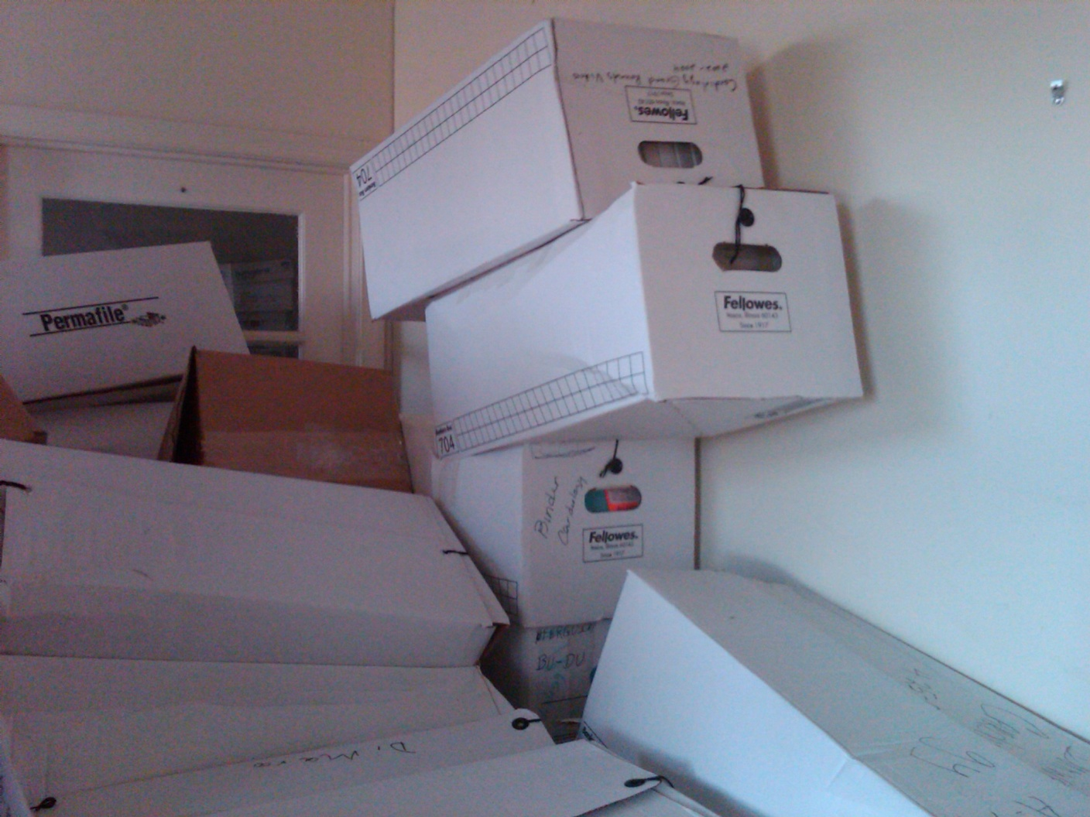
Scary Pictures

Slide 37
Step 2 – Option B
Institution has designated Records Manager but lacks support and does little with electronic records.
Actions:
  Discuss electronic information with records manager and supervisor.
  Finds ways to collaborate with records manager
    Consistent message to institution
  Discuss & support raising of awareness and position of records management.

Slide 38
Step 2 - Option C
Full functioning Records Management Program
Actions: Collaboration
  Coordinate training and communications to institution
  Involve Records Management in Information Security planning
  Cross train staff, define roles.
  Present a unified front to institution

Slide 39
Records Management Resources
  ARMA
  Other Organizations
  Publications

Slide 40
ARMA International
www.arma.org
Established in 1955
“Not-for-profit professional association and the authority on managing records and information”
Approximately 11,000 members worldwide.
State and Local chapters offer training/workshops
National conference (2011, October – Washington, DC)
Publications, webinars, research, listserv, white papers, etc.

Slide 41
Other Organizations
NAGARA – National Association of Government Archives & Records Administrators – www.nagara.org
AIIM (Association for Information and Image Management – aka Enterprise Content Management - ECM) – 1943 – www.aiim.org
SAA (Society of American Archivists) www.archivists.org
NARA (National Archives & Records Administration) www.archives.gov

Slide 42
Publications
Records Management in Higher Education: Ensuring Organization, Efficiency and Legal Compliance (2006, LRP Publications – includes CD with standard forms) http://www.shoplrp.com/product/p-31129.html
AACRAO's Retention of Records: Guide for Retention and Disposal of Student Records (revised 2010) http://www.aacrao.org/publications/catalog.cfm

Slide 43
Questions?
Caroline J. Walters, MA, MLS
University Records Officer
Information Security, Policy & Records Office
University of Virginia
Box 400898
Charlottesville, VA 22904
(434) 243-9162
cjwalters@virginia.edu
www.virginia.edu/recordsmanagement

