Slide 1
Using Capture the Flag For Teaching and Training
dr. Kees Leune cissp, gcih, gcfa, oscp, cism, cisa
"Copyright Kees Leune, 2012. This work is the intellectual property of the author. Permission is granted for this material to be shared for non-commercial, educational purposes, provided that this copyright statement appears on the reproduced materials and notice is given that the copying is by permission of the author. To disseminate otherwise or to republish requires written permission from the author."

Slide 2
Presentation outline
Introduction
Problem statement
Why CTF?
Types of CTF
Developing your own CTF
Running a CTF

Slide 3
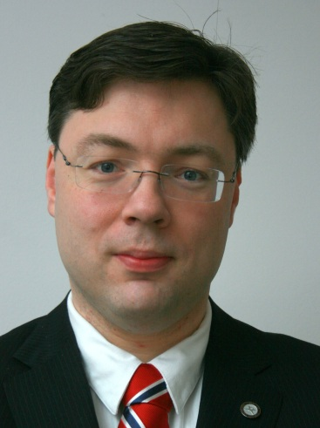
Adjunct Professor
CISSP
Mentor
GCIH
GIAC Gold adviser
GCFA
CISM
OSCP
Information Security Officer
Dr. Kees Leune
Open Source Developer
Thanks to Ed Skoudis for his feedback and encouragement!

Slide 4
Introduction
Notes:
Quick show of hands– which of the people here is here just because of the word “Capture the Flag”? Who is here because of the “Teaching and Training”? The rest of you just chose the least of all evils. Either way, thank you for being here ;)

Slide 5
I am an educator
Educator
Practitioner
Notes:
Thank you all for being here. Everybody in here works in education, in one way or another. Almost all of us are also actively working as security practitioners. However, somehow, those two worlds rarely collide, resulting in a general feeling of dissatisfaction about the way that information security is taught in higher education.
Most, if not all of us, have taken professional training in the field at some point throughout our careers. Some of us even greatly enjoyed that professional training and we all learned from it. Why then, is it, that there appears to be such a disconnect between the way we teach security to our undergraduate and to our graduate population?
In this talk, I will try to provide one solution that I have experienced makes things more enjoyable. I have also learned that the approach that I introduce will work well for technical training. Both to ourselves, as practitioners, as well as to system administrators, network managers, developers, an other professional IT staff that has a responsibility for building (and, as we will see, breaking things).

Slide 6
What are we doing wrong?

Slide 7
Boring
Ancient theory
Little or no practical relevance
Not technical enough
Too technical

Slide 8
WHY CTF?

Slide 9
High Impact Pedagogy
Experiential Learning
Games
Capture The Flag
An information security Capture The Flag is a simulation of a real-world situation in which participants are given the chance to test and develop their technical skills.

Slide 10
Gamification appeals to geeks technical people.
Gamification :
divides a problem into smaller pieces (challenges, flags)
measure progress (score)
create a sense of accomplishment (rewards, achievements)
instill a sense of competition (leader board)
directly applies theory
is great fun!
Notes:
According to the Extra Credits show*, Gamification is “taking the principles of play… such as those used in video games… and using them to make real-world activities more
engaging.”
According to Wikipedia, Gamification, can be used in,“encouraging users to engage in desired behaviors, by showing a path to mastery and autonomy, and by taking advantage of humans' psychological predisposition to engage in gaming.”

Slide 11
Game is not a bad word or something just meant for leisure.
Participating in a simulation sounds better than playing a game.

Slide 12
A well-designed
capture-the-flag
is a
realistic simulation of real-world scenarios
which allows the participants
to develop and apply
a wide range of skills
Notes:
Every emergency responder practices their skills in order to optimally respond to an emergency when it happens. This can take many forms, such as
procedure review
table top exercise
drill
functional test
limited exercise
all-out exercise
In information security, Capture the Flag sessions can fit anywhere on this gambit. Participating in a capture-the-flag helps to develop and maintain skills, while attracting the inner geek in most people with a technical background. Participants enjoy the experience and managers reap the benefits of motivated staff who have the skillset needed to face the challenges of today.

Slide 13
Types of CTF

Slide 14
Capture-the-Flag objectives
Assessment
Fun!
Teaching or training
Proof of concept

Slide 15
CTFs come in many different types.
Single-user vs. multi-user
Single targets vs. multiple targets
Competitive vs. collaborative
Short and focused vs. long-term
Local vs. remote
Defensive, offensive, analytical
Notes:
Single-User CTF, such as the de-ice.net

Slide 16
CTF-based Teaching and Training
Break stuff
Figure out why it broke
Teach methods to prevent breakage

Slide 17
Some Examples

Slide 18
de-ice.net live CDs
is a set of 3 bootable CD images that can be used for self assessment.
The machines test an attacker’s penetration testing skills in a single-user environment.

Slide 19
SANS courses
Very often lecture-style with some exercises throughout the course.
On the last day, individual Capture-The-Flag (or another technical challenge)
CtF is used to informally assess newly learned skills

Slide 20
Offensive Security Certified Professional
Individual remote Capture the Flag is an important factor in the final certification decision.

Slide 21
Netwars
Local or remote CTF that can be played competitively or individually.
Used for self-assessment and skill development.

Slide 22
Developing your own CTF
Telling a story

Slide 23
Tell the story
Decide on simulation model
Decide on architecture
Build it
Decide on scoring
Run it

Slide 24
A simulation is like telling a story
Determine the message to communicate
Introduce key players
Develop a scenario

Slide 25
All stories need a few essential components:
A message
“Obey your parents”
Characters “Grandma, bad wolf, hunter, Red Riding Hood”
A plot “Girl doesn’t listen, gets eaten, gets rescued, she lived happily ever after”
Props “Forest, basket, bed, knife”

Slide 26
Choosing a message is the easy part
Examples:
Plaintext passwords are bad
If using SSL, make sure you check the cert path
XSS really isn’t harmless
LANMAN is a weak password scheme

Slide 27
Develop your characters
Many weaknesses are introduced by human actors.
Notes:
Examples:
John is a senior DBA who is approaching retirement, but feels that he is underpaid. John has been in his position for 19 years.
Sarah is a 19-year old intern who is helping out the office manager. She has a whole lot of friends with who she likes to stay in contact via Facebook and Twitter.
Peter is the departmental manager. He is a road-warrior who needs access to everything at all times.
The CEO, Mike, is a busy man. His passwords needs to meet two requirements:
easy to type on his iPad
his secretary should be able to remember it

Slide 28
The plot describes the anticipated flow of the simulation.
Note: participants often deviate from the plot. Having one ensures that the scenario can be completed.

Slide 29
The props are where the exploitable vulnerabilities are hidden.
1 web app
1 intranet server
The domain controller
1 Email server
3 Workstations in varying degrees of patching
Adobe Reader, Java Runtime, VLC player

Slide 30
Determining vulnerabilities
Make sure you reflect back on the message you need to tell!
XSS in web app can be used for cookie stealing
SQLi will allow authentication bypass
Set up pop-client to download email with password
Password re-use for multiple system
etc.

Slide 31
building the environment

Slide 32
Now that all components are in place, it is time to determine architecture.
local/remote
physical/virtual
single/multi player
competition/collaboration/challenge
OS and application platforms

Slide 33
Things to consider:
Licensing
Isolation
Exploitability
Performance
Analytical capabilities

Slide 34
Review your license terms!
You cannot distribute everything
You may not even be allowed to run it without paying extra

Slide 35
Isolation is important
It was just a typo agent Smith, and I really did not really mean to take down that SCADA system…

Slide 36
Performance may be an issue
especially with virtual environments.
Virtualization is NOT always feasible
(it is hard to virtualize appliances)

Slide 37
If assessment is a goal of your CTF, you will need to build visibility into the environment.

Slide 38
Windows PC
Web server
Dev Server
BackTrack Server
Email server
Virtual Switch
Virtual Switch
Web Server
Linux workstation
File server
SSH bastion host
Campus network
Notes:
This example is how I built the CTF for an undergraduate computer security course that is taught by me. All components shown on the diagram are virtual machines running one a dedicated hardware platform. I used VirtualBox to run the machines. In order to not mix hostile traffic with production traffic, students would connect to a dual-homed SSH bastion host, and from that, to the target network. All attacks are launched from a single (shared) BackTrack 5 R2 images on which the students all have root access. The right-hand side of the diagram contains hosts that are available all semester long, while the right-hand side is a final project. With the exception of the bastion host, all virtual machines revert to a known-good state once per hour.
Remote
Multi-user
Individual
Physical
Teaching/assessment

Slide 39
running the ctf

Slide 40
Operationally, the least interesting phase of the process. Some decisions that need to be made are:
Credentialing
Duration of the simulation
Scoring
Ongoing maintenance

Slide 41
In a multi-user simulation, decide if participants share credentials, or if they have their own.
While all students have root on the BT5 system in the previous example, they will still log in with a dedicated account from which they elevate with sudo. Syslogs are sent off-network.

Slide 42
Metrics provide an objective assessment of the extent to which the participants complete the challenges.
Distinguish:
Assessing outcomes (e.g., Netwars)
Assessing process (e.g., OSCP)

Slide 43
Prevent cheating
guessing answers
borrowing artifacts from other players
brute-forcing
patching by players
denial-of-service
attack the scoring platform itself
etc.
Have a pre-determined response to deal with bad behavior and publish rules of engagement!

Slide 44
Stuff will break
Our tricks will often break the environment.
Do preventive maintenance.

Slide 45
SUMMARY
CTF is a high-impact practice that focuses on experiential learning. By letting participants work through a realistic scenario, they can develop skills, assess weaknesses, and be ready for unexpected situations.
Building a CTF is like telling a story. We need a message, cast, a plot, and props. Once the story is ready, we can start designing and building the environment.
When the environment is complete, the simulation can be run. Running a simulation requires ongoing maintenance, and a well though-out scoring method.

Slide 46
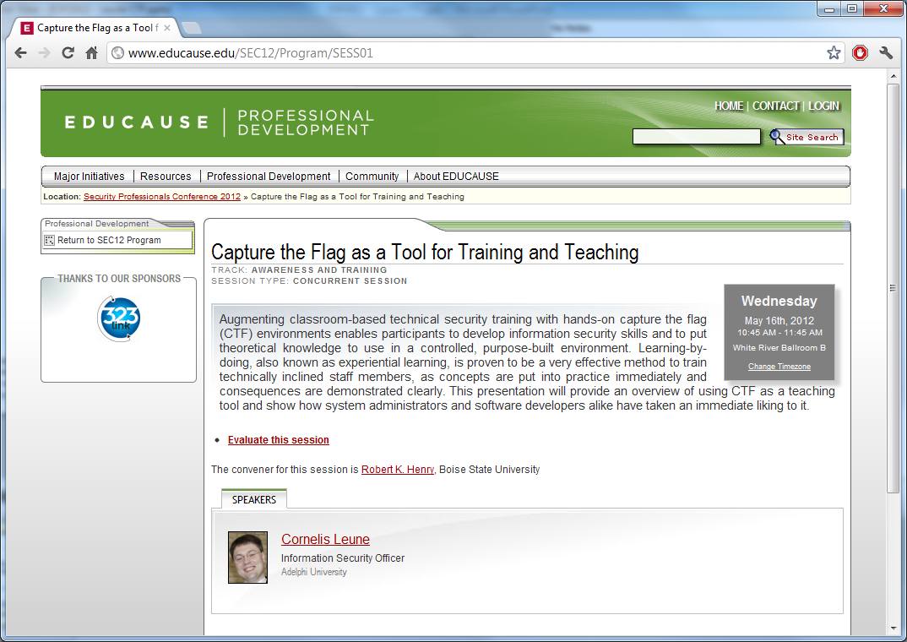

Slide 47
Questions?
Email: leune@adelphi.edu
Twitter: @leune
Blog: www.leune.org

