Slide 1
Building an Information and IT Compliance Program
Mike Chapple, Senior Director, Enterprise Support Services
University of Notre Dame
Thomas R. Davis, Chief Security Officer, Indiana University
Merri Beth Lavagnino, Chief Privacy Officer and Compliance Coordinator, Indiana University
May 17, 2012

Slide 2
Copyright Michael J. Chapple, Thomas R. Davis, and Merri Beth Lavagnino, 2012. This work is the intellectual property of the authors. Permission is granted for this material to be shared for non-commercial, educational purposes, provided that this copyright statement appears on the reproduced materials and notice is given that the copying is by permission of the authors. To disseminate otherwise or to republish requires written permission from the authors.

Slide 3
Agenda
Tom and Merri Beth, with an introduction to compliance
Mike, on tactical aspects of building a compliance plan

Slide 4
Introduction to compliance

Slide 5
What do we mean when we say compliance?

Slide 6
Key Criteria for an effective compliance program
Adequate compliance standards, policies, and procedures
Effective compliance oversight
Careful delegation of duties, and due care in hiring/screening employees
Effective training and education for roles and responsibilities
Effective communication to all employees
Monitoring, auditing, and hot lines
Investigation and enforcement for violations
Corrective action
Source: U.S. Sentencing Commission Guidelines, Chapter 8
http://www.ussc.gov/guidelines/2011_Guidelines/Manual_HTML/8b2_1.htm

Slide 7
COMPLIANCE Resources
Higher Education Compliance Alliance
Spearheaded by NACUA with 24 other associations including EDUCAUSE
http://www.higheredcompliance.org/
Society of Corporate Compliance and Ethics (SCCE)
http://www.corporatecompliance.org
Higher Education Compliance Conference, June 3-6 2012 - http://www.highereducationcompliance.org/
Open Compliance and Ethics Group (OCEG)
http://www.oceg.org/

Slide 8
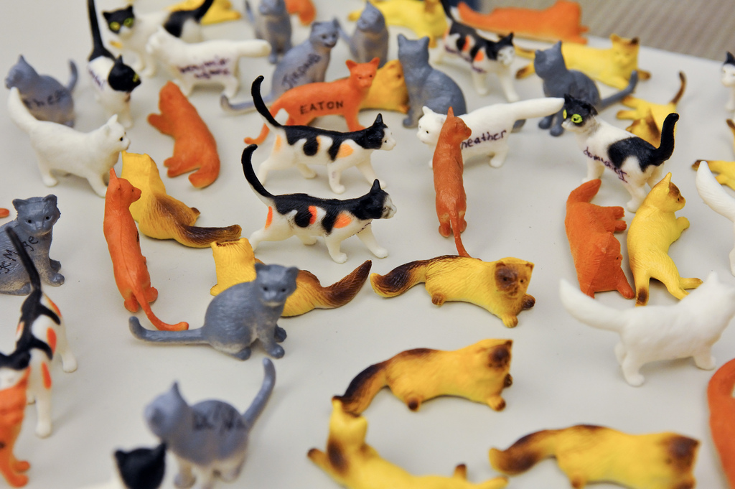
Problems with historical approach

Slide 9
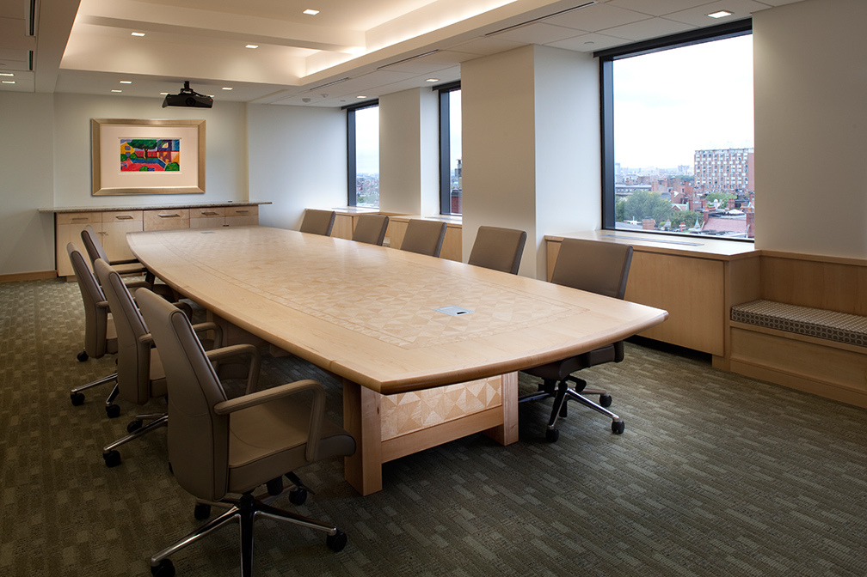
Export control
Red Flags Rule
Human Subjects
FERPA
CALEA
HIPAA/ HITECH
GLBA
PCI DSS
21 CFR Part 11
Thus, need for governance and coordination

Slide 10
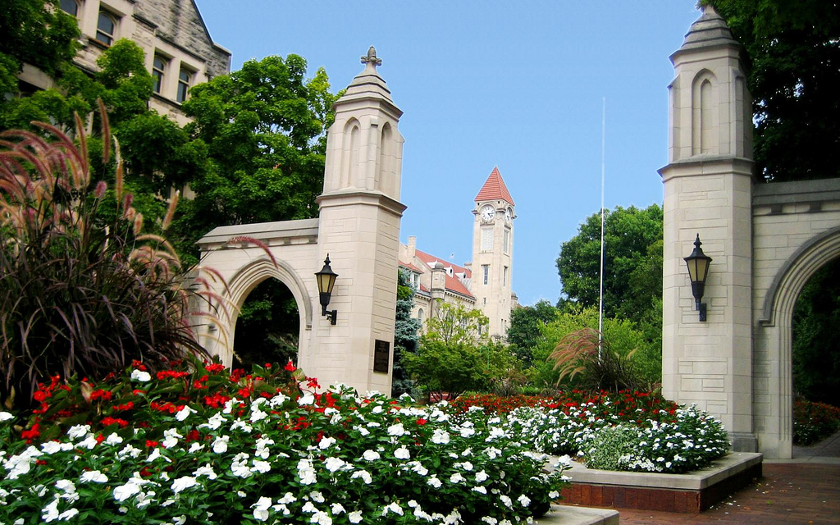
Sample Gates
Notes:
This is a picture of Sample Gates, a structure on the west side of our Bloomington campus. These gates serve as the campus’ ceremonial entrance and the primary pedestrian gateway between campus and the city of Bloomington. It marks where the “town” meets the “gown” (i.e., where the city ends and campus begins). Each of our campuses have similar features, but I’ll use our Bloomington campus as an example.
Whenever I think of external and internal expectations of the university, I often conceptualize those using Sample Gates. My perspective changes depending on whether I’m standing inside the gates looking out, or outside the gates looking in. Let’s take compliance as an example.
photo credit: http://www.flickr.com/photos/30649191@N00/3294653629/

Slide 11
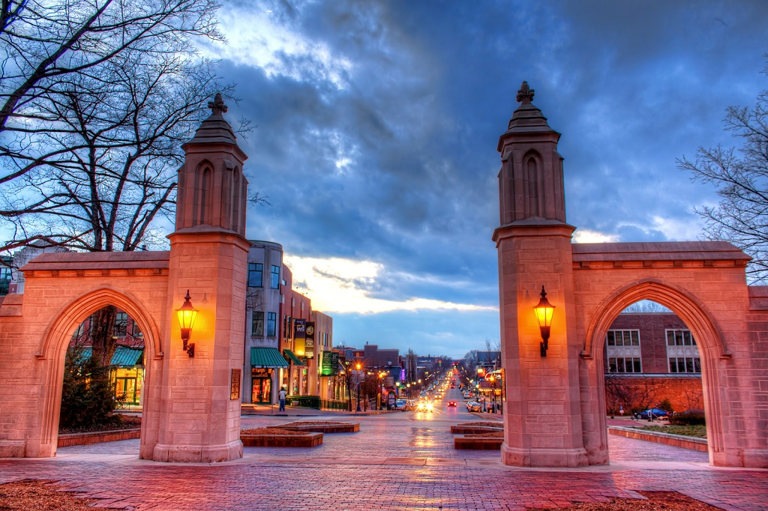
laws
regulations
contractual obligations
COMPLIANCE
external requirements
Notes:
Here we are standing inside the gates looking towards town. From this vantage point we can visualize the external compliance requirements that are placed upon IU. As Merri Beth mentioned, we have local, state, and federal laws, industry regulations (such as PCI DSS), as well as contractual obligations we must comply with (such as agreements with external entities).
photo credit: http://www.flickr.com/photos/solippeatsei/6783782930/

Slide 12
policies
procedures
standards
COMPLIANCE
internal requirements
Notes:
Stepping outside the gate and looking in, we can envision numerous university-developed and enforced policies, procedures, and standards that govern our activities. This combination of external and internal requirements set the stage for our compliance efforts.
However, how do we take this information and build a compliance initiative with the appropriate level of governance?
photo credit: http://www.flickr.com/photos/30649191@N00/3294653629/

Slide 13
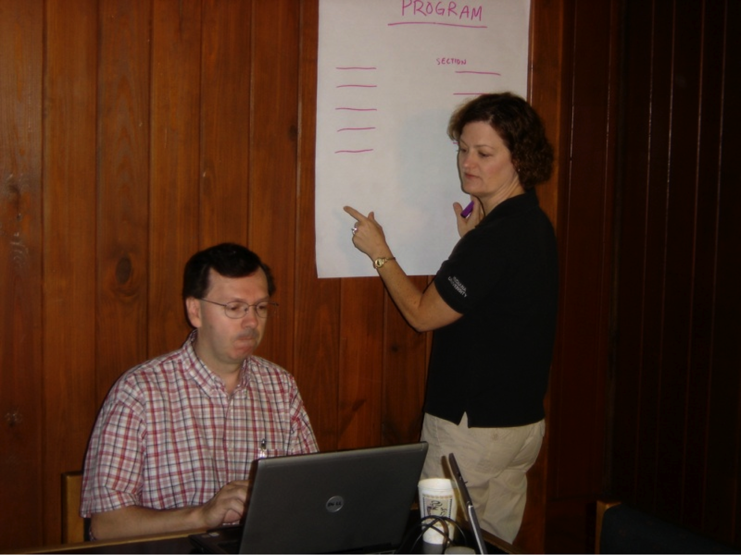
determine scope and responsibilities
develop “program”
establish governance
provide guidance
Notes:
I’d like to take the remainder of my time to describe our approach to compliance from a strategic level, how compliances integrates with our overall Information Security and Privacy Program, and how we have established an overarching governance structure.
This is a picture I snapped of Merri Beth and Eric Cosens at one of our retreats where we brainstormed what our approach (Program) should look like.
The four primary steps we came up with during those retreats – and ones you might consider taking yourself - to establish our compliance governance structure are:
determine scope and responsibilities
develop “program”
establish governance (of the program)
provide (compliance) guidance
Let’s take a look at each of the four in a bit more detail.

Slide 14
determine scope
Notes:
To tackle step 1, determine scope, Merri Beth and I jumped in the official Hoosiercopter to get a birds eye view of our Bloomington campus, in hopes that we’d get a better strategic view at the 10,000 foot level.
photo credit: http://www.flickr.com/photos/jamesclay/3663347872/

Slide 15
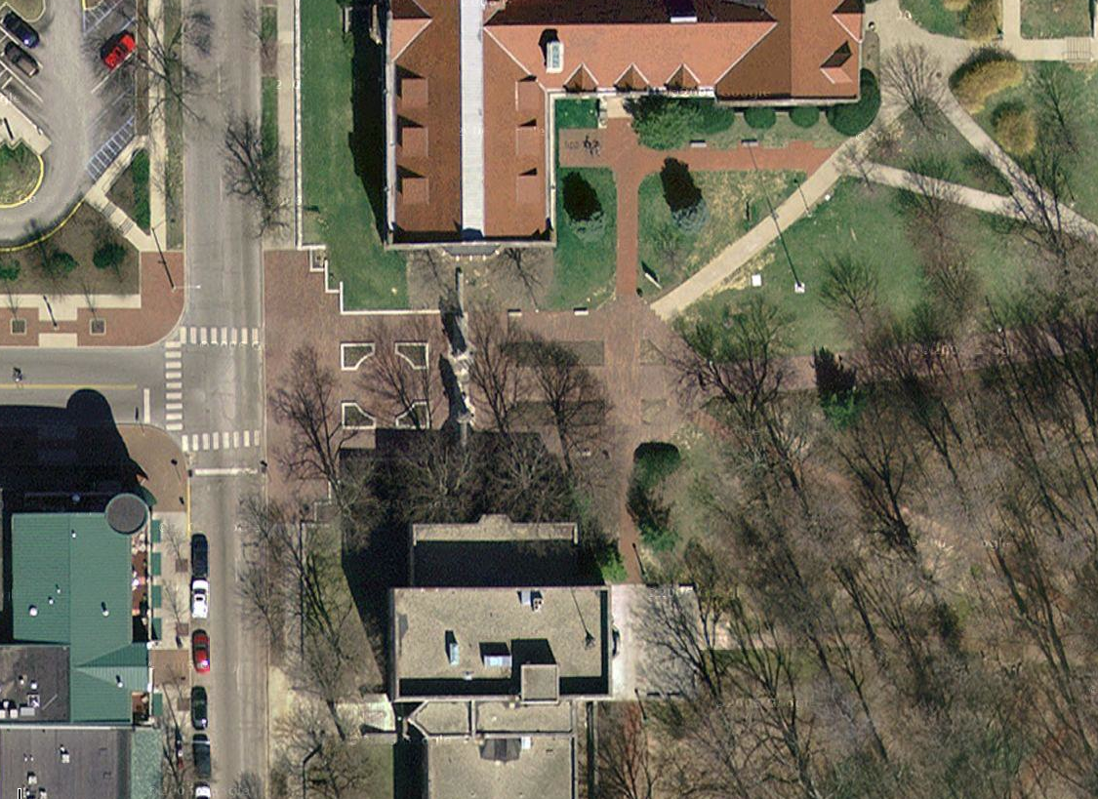
determine scope
inventory requirements
assign responsibility
COMPLIANCE
Notes:
Merri Beth snapped this picture of the Sample Gates while looking out the window of the Hoosiercopter. To the left is the city of Bloomington; to the right is the IU Bloomington campus. Remember that, when we think of the Sample Gates, we think of the intersection of both external and internal compliance requirements the university faces.
First, we need to determine our compliance scope. Are we talking IT only? Information and IT only? Or, is it even broader, to include all compliance (e.g., Clery Act reporting)? Are we looking at just a single campus, or university-system wide?
Next up, we heed to inventory all of the external and internal compliance requirements we face. A good reference is included in the HEISC Information Security Guide. And, Mike will be touching on these a bit later. We also need to work with our purchasing/procurement department to inventory and assess the types of contractual requirements we have. And, we can’t forget to include our internal policies, procedures, and standards in this inventory
Lastly, for each of those compliance requirements we inventoried, we need to identify those groups/units at the university who have compliance responsibilities.
photo credit: http://maps.google.com/

Slide 16
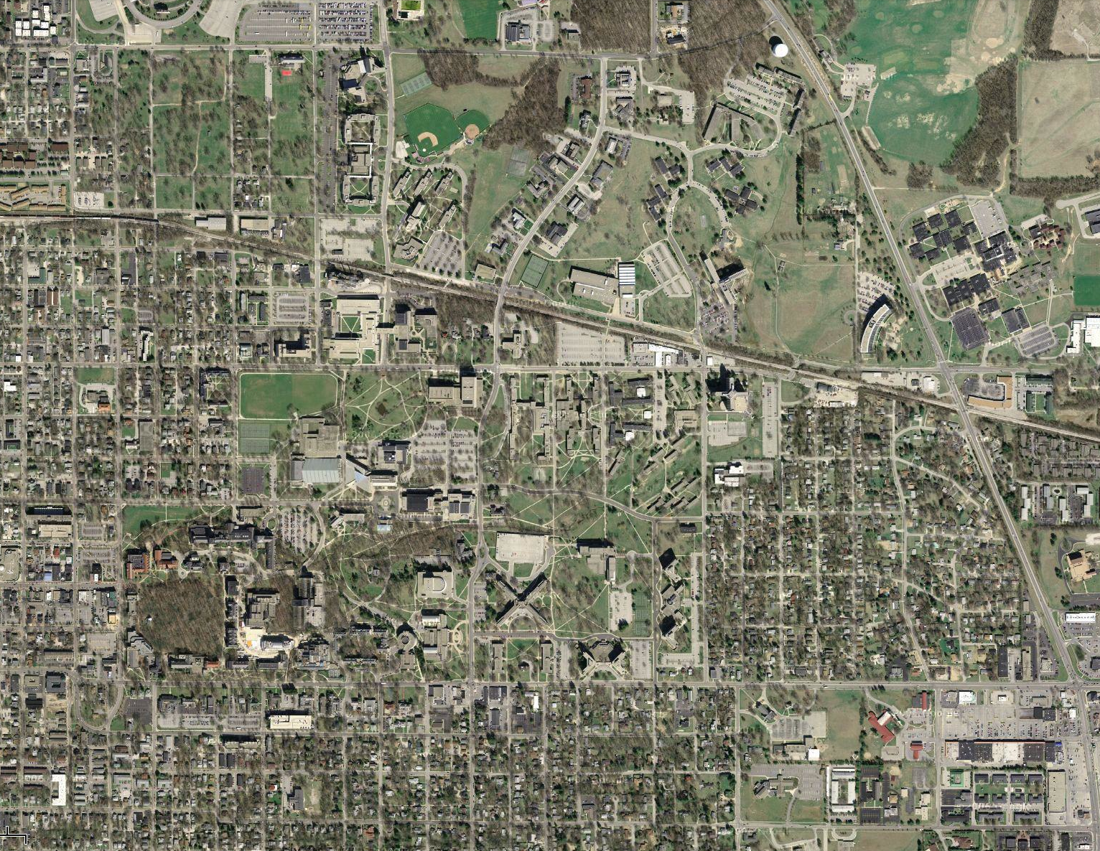
ASSET MGT.
PHYSICAL SEC.
INCIDENT MGT.
INFO.
SYS.
COM. & OPS.
DR/BCP
ORG.
HR
RISK MGT.
POLICY
ACCESS
CTRL.
COMPLIANCE
Notes:
We asked the Hoosiercopter pilot to climb even higher, so we could get a view of the entire campus. Merri Beth had to hang out of the door to snap this picture to make sure she didn’t capture the copter’s skids in the shot…
We realized we had compliance issues to address, but were there other areas we needed to cover in our program? As we looked across campus, the data center came into view. We need to worry about physical security issues (e.g., who has access to the data center; what kind of video surveillance do we use? do we require biometric access?). Also, how do we handle data breaches? What about ensuring our employees know what to do (Human Resources domain) to protect information and IT?
Pretty soon we had identified (with help from the ISO standards) twelve areas of information security and privacy activities. It was clear we needed to think strategically and cover more than just compliance. That led us in to develop our information protection program, or Information Security and Privacy Program.
photo credit: http://maps.google.com/

Slide 17
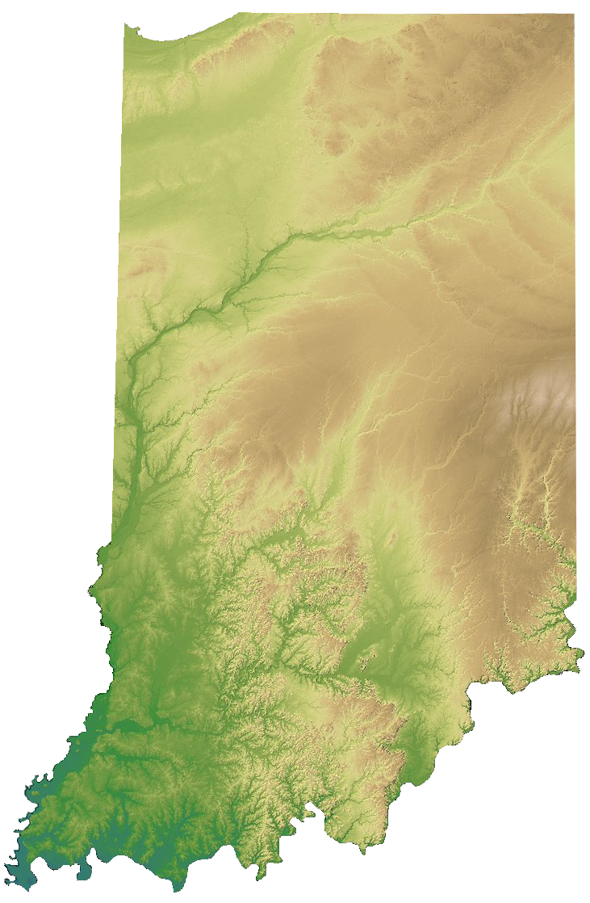
Notes:
The Hoosiercopter allowed us to get a good view of the Bloomington campus, but it is just one campus within our system. We have eight campuses spread throughout the state.
This scope review ensured we could accurately inventory our compliance responsibilities, assess where compliance fits in our overall information protection program, and ensure we could identify the “owners” of the individual compliance areas across our institution.
photo credits: http://maps.google.com/ and http://www.indianamap.org/

Slide 18
develop “program”
select a framework:
ISO 27000 series
NIST SP 800-53
PCI DSS
HEISC InfoSec Guide
http://www.educause.edu/security/guide/
“Practical Applications of the Information Security Guide” Carol Myers
Notes:
In step 2 we had to identify a framework we could use for our information protection program[1]. Turns out, there are many standards available that can be used, such as ISO 27000 series, NIST SP 800-53, HEISC Information Security Guide, and some people have even used the PCI DSS standard as a basis for their program.
I’d like to call out the Higher Education Information Security Council’s Information Security Guide. This guide is loosely based on the ISO standard and has been put together by your colleagues in higher education. You can find it at the URL listed here[2], and Carol Myers (a colleague of mine on the guide’s editorial board) presented “Practical Applications of the Information Security Guide” yesterday to provide an overview of the guide.
photo credit: http://www.flickr.com/photos/uwhealth/4290934472/
Footnotes:
[1] IU’s Information Security and Privacy Program: https://protect.iu.edu/privacy/program/
[2] http://www.educause.edu/security/guide

Slide 19
Risk Management
Security Policy
Organization of Information Security
Asset Management
Human Resources Security
Physical and Environmental Security
Communications and Operations Management
Access Control
Information Systems Acquisition, Development, and Maintenance
Information Security Incident Management
Business Continuity Management
Compliance
Notes:
Here is a list of the common areas of information security that are included in the HEISC Information Security Guide. They should look familiar, as these are the same areas that I overlaid earlier onto the aerial map of the Bloomington campus, as we were determining our scope.
And, to reiterate, notice that compliance is just one of 12 in this list…

Slide 20
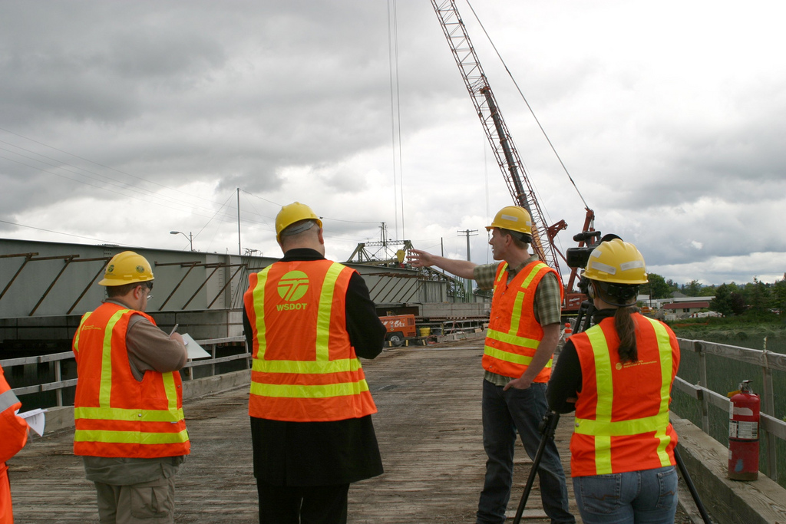
IU
establish governance
“… council members have compliance or oversight responsibility for information security and/or privacy.”
“… council has representatives from those areas which laws, regulations, standards and/or contractual requirements make it prudent to address [risks] university wide.”
IU’s Information Security and Privacy Risk Council
Notes:
We defined our scope, we selected our framework, and now in step 3 we needed to establish a governance structure for our program (and thus a governance structure for compliance).
As we inventoried the university’s compliance requirements, we identified council members as those who:
“have compliance or oversight responsibility for information security and/or privacy”
and we chose representatives from those areas:
“for which laws, regulations, standards, and/or contractual requirements make it prudent to address [risks] university wide”
Essentially, the role of the council regarding compliance is to make sure all important compliance requirements are identified, assigned, and addressed.
A few words about our governance council:
council members appointed by two VPs
Merri Beth and I co-chair the council
most council members are at the associate or assistant VP level
two “at large” members: faculty expert and the chair of our committee of data stewards
this is not an operational group
council charter[1] is available on the web
photo credit: http://www.flickr.com/photos/wsdot/5833937850/
Footnotes:
[1] http://protect.iu.edu/privacy/program/governance

Slide 21
FERPA Compliance
Student Records Expertise
GLB Act Compliance
Student Financial Aid
Loans Compliance
Student Lifecycle
HR Compliance
Employment Compliance
Benefits Compliance
HIPAA as it relates to HR
HR Records Expertise
Employee Lifecycle
Financial Management
Accounting
Accounts Payable
Payroll
Revenue Processing
PCI DSS Compliance
Debt
Collection
Research Compliance
Export Control
Human Subjects Compliance
HIPAA Compliance
Medical patient records expertise
Clinical Trials
International Records
Transborder Data Flows
International Data Protection expertise
Foundation Donor data
Trade secrets expertise
Internal Audit
Office of the VP and General Counsel
Internal Intellectual Property
Creative Works expertise
Commercialization and Technology Transfer
Government Relations
Regulatory Issues
Notes:
Council members cover these areas of responsibility. Notice how many times compliance is used in this list.
Now we’ve determined our compliance scope, identified a framework for our program, and have an established governance structure in place. Now, Merri Beth will discuss how we’re using all of this to address step 4 “provide guidance” to the university community.

Slide 22
Role of CISO and CPO
Provide guidance

Slide 23
Building a compliance plan

Slide 24
It’s a Jungle Out There

Slide 25
NORMALIZING YOUR Compliance Program
Identifying Compliance Requirements
Normalizing Requirements
Mapping Requirements to Controls
Compliance Maintenance

Slide 26
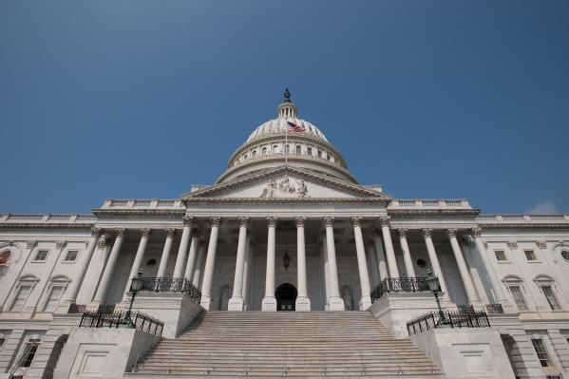
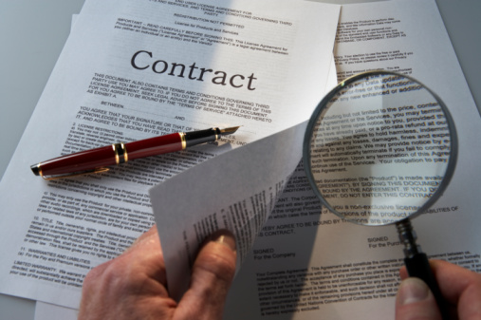

Slide 27
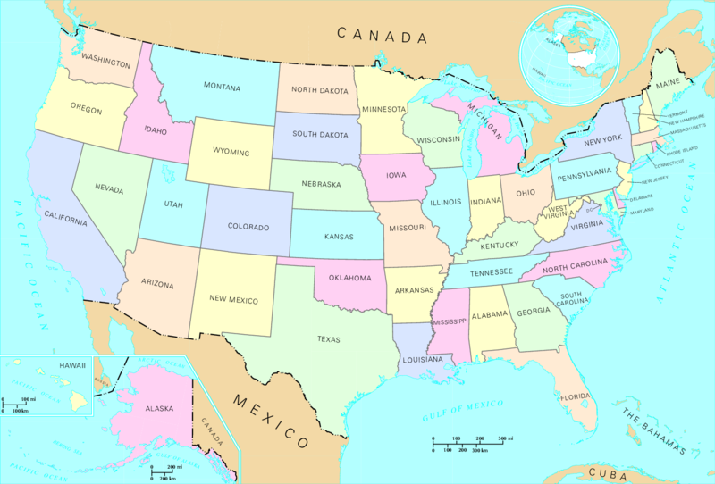
Don’t Forget the States
Data breach notification laws
Differing requirements for what constitutes a “breach”
What state are you in, anyway?

Slide 28
And That’s Only the Beginning
Transparency
Legitimate purpose
Proportionality

Slide 30
Work with Counsel

Slide 31
And Audit

Slide 32
NORMALIZING YOUR Compliance Program
Identifying Compliance Requirements
Normalizing Requirements
Mapping Requirements to Controls
Compliance Maintenance

Slide 33
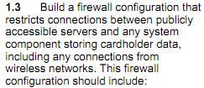
A Few Thoughts on Firewalls
164.308(a)(5)(ii)(B)
Implement procedures for guarding against, detecting, and reporting malicious software.
The firewall should be configured to ensure the organization's computers are not directly accessible to the Internet and the firewall should be appropriately patched.

Slide 34
Normalizing the Requirements
“We will maintain firewalls that restrict access from the Internet to all internal systems. Systems that require public access must be in the DMZ. No systems with credit card data may be in the DMZ. The firewall will filter for malicious code”

Slide 35
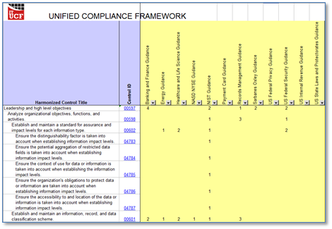
Unified Compliance Framework
http://www.unifiedcompliance.com/

Slide 36
NORMALIZING YOUR Compliance Program
Identifying Compliance Requirements
Normalizing Requirements
Mapping Requirements to Controls
Compliance Maintenance

Slide 37
Map Requirements to Controls
Section 1.3
164.308(a)(5)(ii)(B)
Page 33
“We will maintain firewalls that restrict access from the Internet to all internal systems. Systems that require public access must be in the DMZ. No systems with credit card data may be in the DMZ. The firewall will filter for malicious code”

Slide 38
Building Compliance Plans
Each plan should contain
Overview of the compliance requirement
Detailed listing of required controls
Explanation of the controls used to meet each requirement
Date of last validation

Slide 39
Mapping is a Two-Way Street

Slide 40
NORMALIZING YOUR Compliance Program
Identifying Compliance Requirements
Normalizing Requirements
Mapping Requirements to Controls
Compliance Maintenance

Slide 41
Maintaining Compliance is Hard Work

Slide 42
Don’t Cram for the Exam

Slide 43
Use Your Compliance Plans

Slide 44
Clearly Delineate Responsibilities
IT Compliance
IT
Security

Slide 45
Monitor the Changing Landscape

Slide 46
Compliance Must Be Auditable

Slide 47
This Requires Centralization
of organizations have at least one person dedicated to IT compliance
75%
of organizations have a corporate executive-level compliance office or council
76%
Source: Gartner, Inc.

Slide 48
Summary
Compliance is an ongoing process, not a project
IT compliance and IT security are separate, but related, issues
Untangling the web of overlapping requirements is difficult, yet important, work
Maintaining compliance requires a continued investment of time in monitoring and data collection

Slide 49
THANK YOU

