Slide 1
Enhancing Desktop Security in a Time of New and Evolving Threats
Copyright Brian Doherty 2012. This work is the intellectual property of the author. Permission is granted for this material to be shared for non-commercial, educational purposes, provided that this copyright statement appears on the reproduced materials and notice is given that the copying is by permission of the author. To disseminate otherwise or to republish requires written permission from the author.

Slide 2
Enhancing Desktop Security in a Time of New and Evolving Threats
Educause Security Professionals Conference
Indianapolis, Indiana
May 16, 2012
Brian Doherty
Director of Desktop Computing and Network Services
School of Arts and Sciences, University of Pennsylvania

Slide 3
Presentation Outline
Review of methods used to secure managed desktops in our environment
Overview of new threat types not addressed by those techniques
Review of project to deploy new defenses in the form of application control via Software Restriction Policies
Questions and Answers and Discussion

Slide 4
University of Pennsylvania Introduction
Located in Philadelphia, Pennsylvania
Four Undergraduate Schools
Twelve Graduate and Professional Schools
16,500 Faculty and Staff
Students (Fall 2011)
Full-time: 21,329
Part-time: 3,503
Total: 24,832
Full-time Undergraduate: 10,301
Full-time Graduate/professional: 11,028
Decentralized IT – many services and most support provided at School level

Slide 5
School of Arts and Sciences Information
Largest of 12 schools at the University of Pennsylvania
625 Faculty
715 Staff
1650 Graduate Students
6500 Undergraduate Students
School computing support also somewhat decentralized

Slide 6
Administrative Computing Support
Central School Administrative Units
Approximately 250 desktops
85-90% Windows desktops/laptops

Slide 7
Managed Desktop Environment
Active Directory domain members
Local data storage limited
Users do not run as administrators
Managed antivirus
GPOs for management of security settings
Windows firewall (managed via GPO)
Managed patching
Management model developed over last 15 years or so, initially started with NT 4.0 clients

Slide 8
Patching Approach
Managed patching in place since 2004 – implemented post-Blaster
Initial focus on patching Windows and Microsoft Office
3rd party apps initially patched/upgraded only as needed

Slide 9
Security Successes
Management approach had served well for a number of years
Limited user rights very effective at stopping most threats
Managed antivirus and patching add more layers of protection
System level compromises from user activities essentially non-existent
So far, so good…?

Slide 10
Development of New Threats
…or so we thought?
Change apparent to us around January 2009
Initial reports of apparent malware infections on home machines
Not detected by even up to date AV software
Users on campus also reported virus alerts, but no apparent viruses detected by our systems
Fake AV was starting to make the rounds

Slide 11
More Information About Fake AV
AKA rogue antivirus, scareware
Web-based pop-ups are usually first point of entry
Sometimes encountered at legitimate web sites or via search results
Realistic enough to fool many users

Slide 12
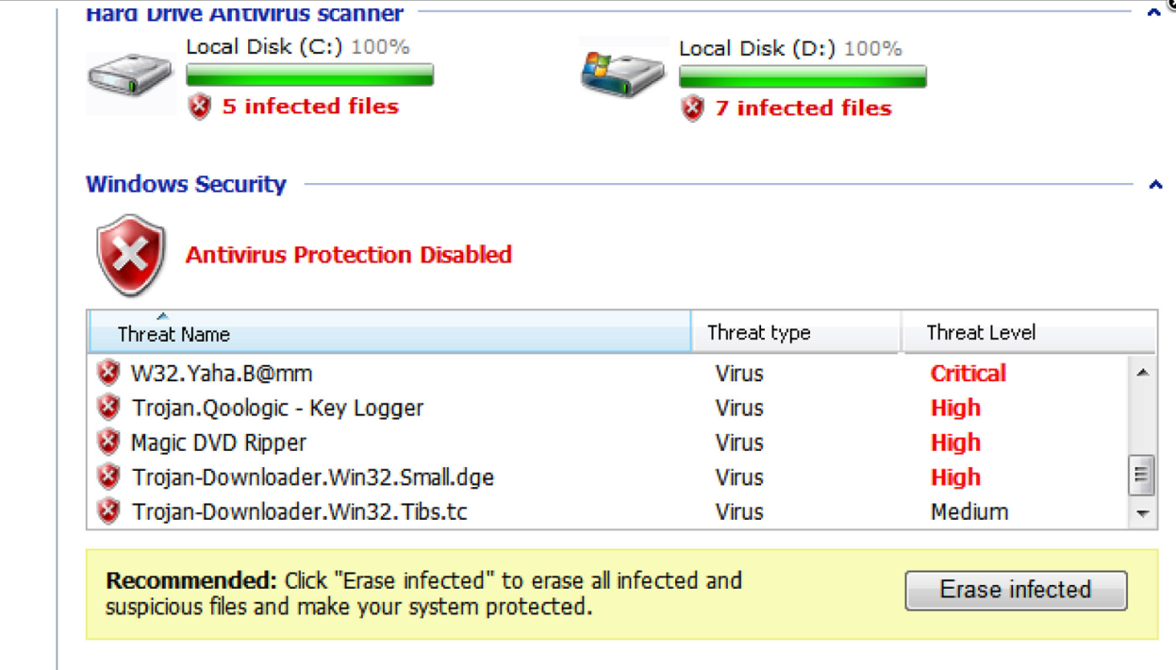
More Information About Fake AV
Generates false alerts re: infection

Slide 13
More Information About Fake AV
Attempt to induce users to subscribe for protection
May prevent other software applications from being used
Very disruptive even when contained
Various tools to remove it, but time-consuming

Slide 14
More Information About Fake AV
May also be used to deliver other malware such as keystroke loggers or trojan horses
Part of a profitable commercial enterprise

Slide 15
New Vectors of Attack
3rd party vulnerabilities exploited
Adobe Reader, Flash, etc
So-called “drive by” web attacks
Traditional defenses less effective
Malware often executes from user profile area
Can operate to some extent w/o “installing”
Evades definition-based antivirus detection
Only contained by usual defenses

Slide 16
Initial Approaches to Address New Threats
Increased patching of 3rd party software
Attempted web browser controls
Spent too much staff time cleaning up machines
Easier clean up than a system level compromise, but still too time consuming and uncertain as to effect
New techniques seemed to be needed

Slide 17
Introduction of New Defenses
New types of defenses seemed necessary
Traditional AV unable to keep up
Inadequacy of “blacklisting” apparent
Needed to consider “whitelisting”
Only allow specific code to execute

Slide 18
Introduction of New Defenses
Various commercial solutions becoming available for application control
Wanted a solution that would be:
Inexpensive
Easy to implement
Easily disabled if needed
Support for XP and Windows 7
Selected use of Software Restriction Policies

Slide 19
Essentials of Software Restriction Policies
Built-in to Windows
Available as of Windows XP
Allows control of executable content
Possible to disable execution for all but specifically allowed content
Managed via Group Policy
Can easily exempt administrators

Slide 20
Basic Configuration Options
Easily disallow all content not located in
C:\Windows or
Program Files [ and x86] directories
Exempt administrators
Safe to do so as NTFS permissions only allow admins to put content in those locations
Of course, system level compromise could also do so

Slide 21
Deployment Methods
Group Policies
Easily deployed to sub-OU in AD
Allows for:
gradual rollout
easy back out, if needed
Tested initially on our own machines
Implemented exceptions as needed
Gradual rollout to users over about 2 months

Slide 22
User Experience
When disallowed content attempts to execute, dialog box displayed:
Entry also logged to Application event log
Identifying need for exceptions relatively easy

Slide 23
Managing Exceptions
Default rules not sufficient
Some content must be allowed to run from other locations:
When path can not be changed
Web-based applications executing in user profile
GPOs easily modified to allow for such exceptions

Slide 24
Managing Exceptions Continued
Exceptions can be based on:
Executable name
Full path
Allows wildcarding
Calculated hash
Code signing certificate
Zone Rule - Uses the Internet Zone where the executable file originated (if it was downloaded using IE)

Slide 25
Managing Exceptions Continued
Exceptions required in our area:
Primarily for profile-based software such as web-based applications
WebEx, GoToMeeting, and similar
Mozilla Firefox/Thunderbird updaters
Some surprises with older software with licensing controls
Path-based exceptions not always easy to develop – rely on code signing as needed

Slide 26
Outcomes To Date
Very successful overall
Users have far fewer disruptions, and we spend much less time addressing problems
Fake alerts may still come up
Advice for user response to them unchanged
No effects beyond user profile areas to date

Slide 27
Outcomes To Date
Excellent ROI:
No cost for extra software
Less staff time required to implement than expected

Slide 28
Connections to Other Recommendations
Report from Australian Department of Defense – September 2011
“The top four mitigations are: patching third party applications; patching operating systems; minimising administrative privileges; and application whitelisting.”
“The CSOC estimates that around 85% of targeted cyber intrusions could be prevented by implementing the top four mitigation strategies as a package.”

Slide 29
Other Application Control Options
AV vendors and others offer many application control alternatives, including:
Bit9 Parity Suite
Lumension Application Control
McAfee Application Control
Sophos
Symantec Endpoint Protection

Slide 30
Other Application Control Options
New version of SRP for Windows 7 is App Locker - offers several advantages over SRP
Can apply specific rules to specific groups, not all users
Custom error messages
Wizards to create rules
Audit mode
Export/Import of policies
Powershell support

Slide 31
Future Directions
Expanding to more systems
Implementing App Locker for Windows 7
Deploying SEP 12.1 – for reputation data
Pilot of SafeDNS at Penn
Prevent users from even encountering the malicious code
Notes:
Others at Penn have implemented SRP as well, and in SAS we are also expanding it to more desktops
Now that we have mostly Windows 7 – will implement App Locker for those clients
Central IT Security group at Penn has been running a pilot of SafeDNS system – will redirect web traffic otherwise bound for sites that are known to host malicious software
Anyone else using an approach like Safe DNS ?

Slide 32
Questions and Answers and Discussion
Questions and comments welcome from those here in person and online attendees

Slide 33
Resources
More About Fake AV
http://www.sophos.com/support/knowledgebase/article/110379.html
More About SRP
http://www.nsa.gov/ia/_files/os/win2k/Application_Whitelisting_Using_SRP.pdf
Report from Australian Department of Defense
http://www.dsd.gov.au/publications/Top_4_Mitigation_Strategies_to_Protect_Your_ICT_System.pdf
http://www.dsd.gov.au/infosec/top35mitigationstrategies.htm
http://www.dsd.gov.au/publications/Application_Whitelisting.pdf

