Slide 1
Metrics 201:
Benchmarking and Security Metrics
Leah Lang, EDUCAUSE
Joanna Grama, Purdue University
May 15, 2012

Slide 2

Speaker Bio
Leah Lang
Senior IT Metrics and
Benchmarking Analyst
EDUCAUSE
llang@educause.edu

Slide 3


About EDUCAUSE and CDS
    A nonprofit association whose mission is to advance higher education by promoting the intelligent use of information technology.
A benchmarking service used by colleges and universities since 2002 to inform their IT strategic planning and management.

Slide 4

Speaker Bio
Joanna Lyn Grama, JD, CISSP
Purdue University
Information Security
Policy & Compliance Director
jgrama@purdue.edu

Slide 5
Purdue University
Main Campus (West Lafayette,IN)
Four Regional Campuses
  IUPUI, Indianapolis, IN
  IPFW, Fort Wayne, IN
  Purdue North Central, Westville, IN
  Purdue Calumet, Hammond, IN
Statewide Technology centers throughout IN (College of Technology)

Slide 6

Purdue University
Decent budget
5th Largest Employer in Indiana (and in all 92 counties)
Purdue Pete’s head weighed 13 pounds in 1980, but now averages 5 pounds

Slide 7

Agenda
General Metrics Development Methodology
IT Security Metrics
Benchmarking IT Security

Slide 8
Agenda
General Metrics Development Methodology

Slide 9


Why use This methodology?
1
Focus on root question, not data
No “So What?” metrics
2
3
Focuses on the Service – Not the Individual
Metrics developed by staff = more ownership

Slide 10
Metrics Development Methodology
1. Map Services
2. Identify Root Question(s)
3. Identify Measures
4. Metrics Development Plan
5. Gather data/measures
6. Analyze data, measures, and information
7. Publish Metric

Slide 11
Step 1 – Map Services
List services you (or your group) own
Define purpose and ID customers for each service
1
2

Slide 12
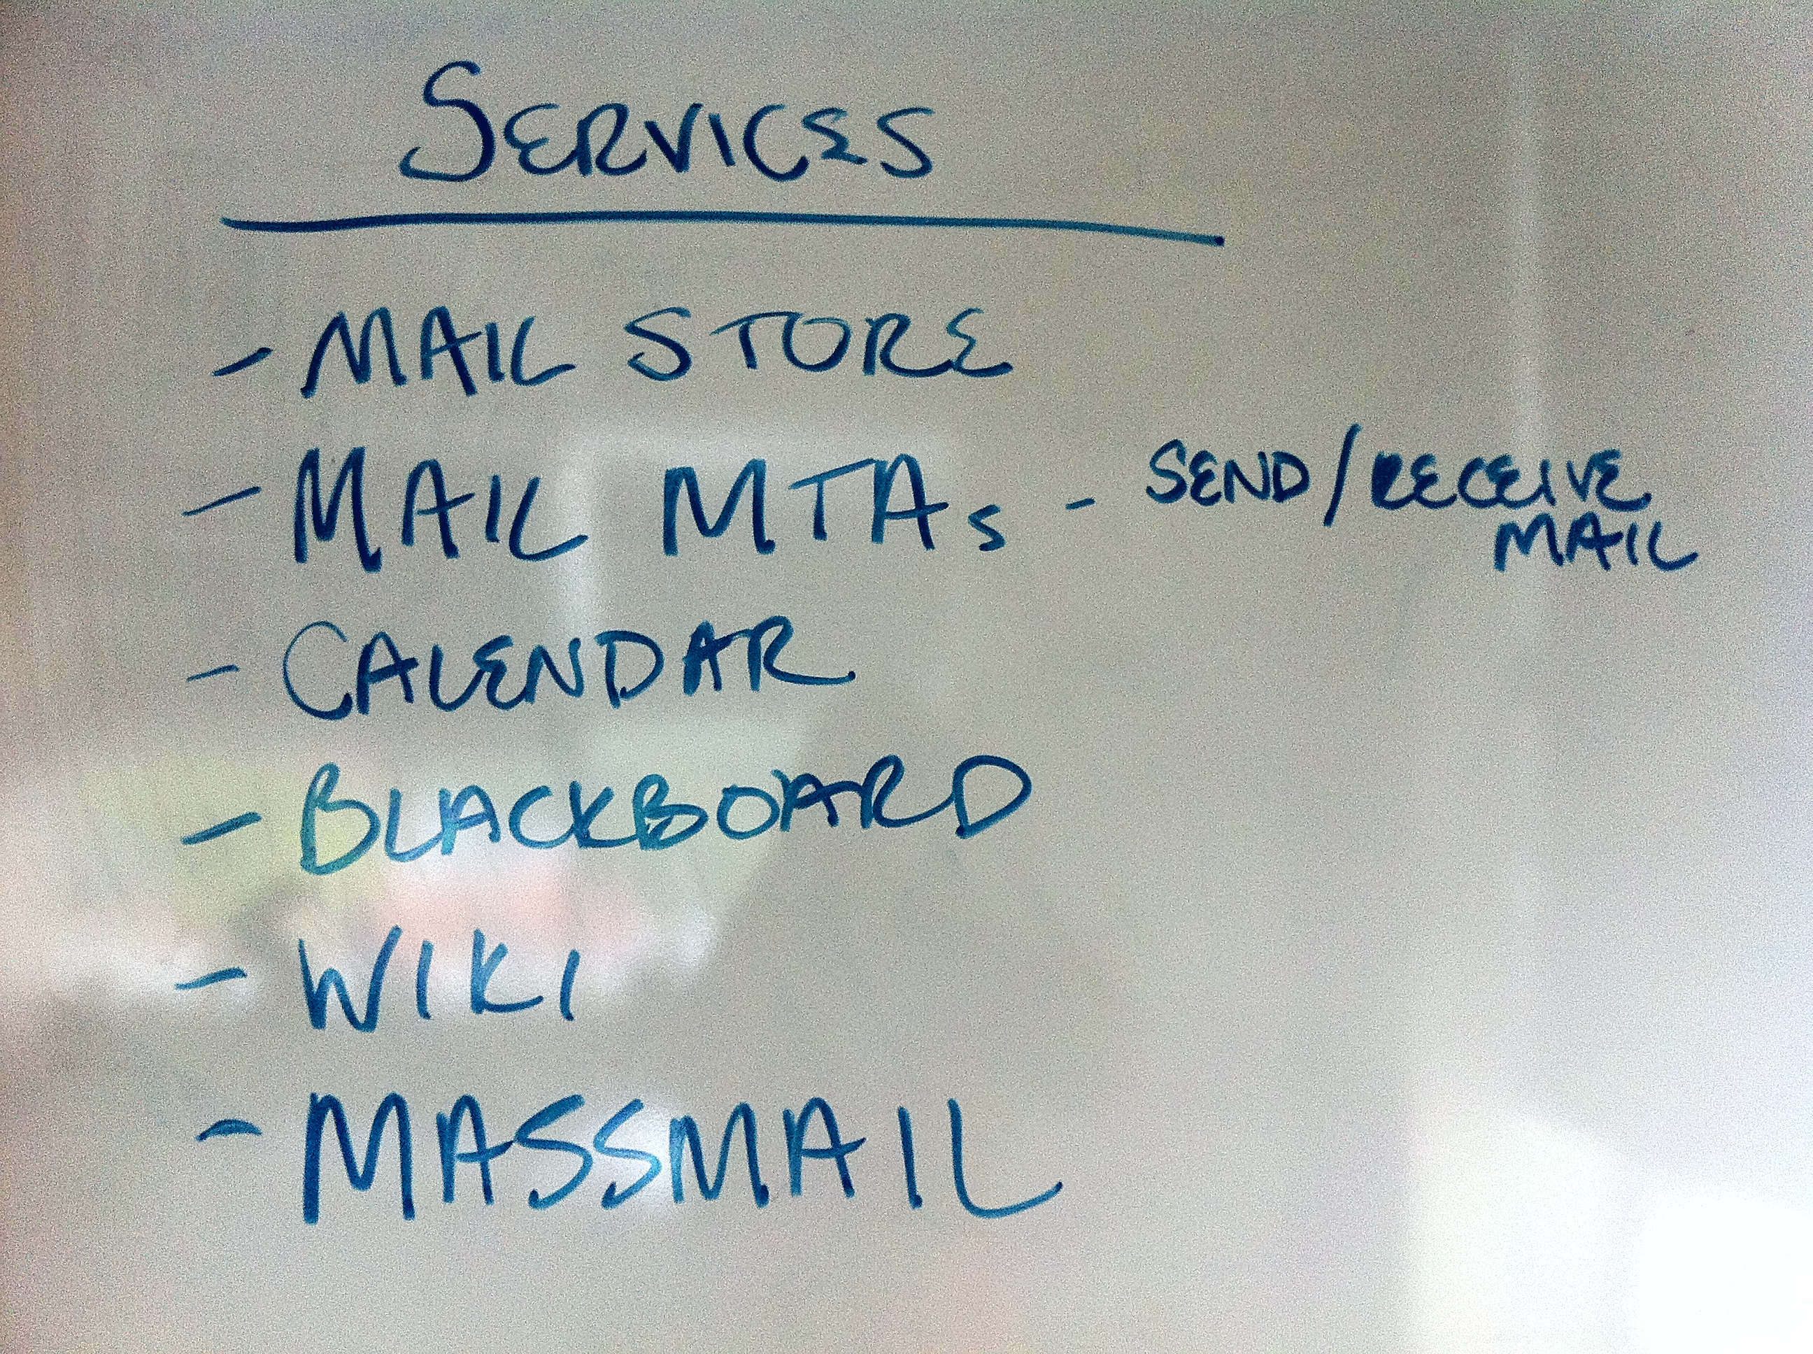
Step 1 – Map Services

Slide 13
Step 1 – Map Services
Calendar
Purpose – To coordinate schedules for people, rooms, groups, and other resources
Wiki
Purpose – To support documentation and collaboration within the department
Massmail
Purpose – To easily distribute email to large groups of people at a time
Customers – Staff, Faculty
Customers – Central IT Staff
Customers – University Administration and Central IT Staff

Slide 14
Metrics Development Methodology
1. Map Services
2. Identify Root Question(s)
3. Identify Measures
4. Metrics Development Plan
5. Gather data/measures
6. Analyze data, measures, and information
7. Publish Metric

Slide 15



Step 2 – identify root question(s)
What do we want to know?
Calendar
  Purpose – To coordinate schedules for people, rooms, groups, and other resources
  Customers – Staff, Faculty
  Question – What’s the usage pattern over time?
Wiki
  Purpose – To support documentation and collaboration within the department
  Customers – Central IT Staff
  Question – With what frequency is the content updated?
Massmail
  Purpose – To easily distribute email to large groups of people at a time
  Customers – University Administration and Central IT Staff
  Question – What’s the average number of recipients for a massmail? Does this change over time?
Notes:
Ask audience what we would want to know about these services?

Slide 16
Metrics Development Methodology
1. Map Services
2. Identify Root Question(s)
3. Identify Measures
4. Metrics Development Plan
5. Gather data/measures
6. Analyze data, measures, and information
7. Publish Metric

Slide 17

Step 3 – Identify Measures
Determine data, measures, and information you could use to answer the root question
Consider measures to answer the question
Use the Root Question

Slide 18
Metrics Development Methodology
1. Map Services
2. Identify Root Question(s)
3. Identify Measures
4. Metrics Development Plan
5. Gather data/measures
6. Analyze data, measures, and information
7. Publish Metric

Slide 19

Step 4 – metrics development plan
Purpose statement
How it will be used
How it won’t be used
Customers of the metric
  Who’s the data for?
Analysis
What and how.
Schedules
Metric template
What will it look like?
What will it say?

Slide 20
Metrics Development Methodology
1. Map Services
2. Identify Root Question(s)
3. Identify Measures
4. Metrics Development Plan
5. Gather data/measures
6. Analyze data, measures, and information
7. Publish Metric

Slide 21
Triangulation – another new paradigm
Automated Means
Quantitative
Better
Results!
Qualitative
Observation
Surveys,
Interviews,
Focus groups
Metrics: How to Improve key Business Results ~ Apress Dec 2011
Notes:
What are some quantitative/qualitative ways you might measure a service?

Slide 22
Metrics Development Methodology
1. Map Services
2. Identify Root Question(s)
3. Identify Measures
4. Metrics Development Plan
5. Gather data/measures
6. Analyze data, measures, and information
7. Publish Metric

Slide 23



Step 6 – Analyze data, measures, and information
Clean the Data
  Aggregate data appropriately
  Check for accuracy
Expectations
Benchmarks

Slide 24
Metrics Development Methodology
1. Map Services
2. Identify Root Question(s)
3. Identify Measures
4. Metrics Development Plan
5. Gather data/measures
6. Analyze data, measures, and information
7. Publish Metric

Slide 25

Step 7 – Publish metric
Service Purpose
Customers
Root Question
Measures
Graph/Analysis
Write-up with next steps

Slide 26

Resolved in 1 hour or less
Help Center –
Service Delivery Metric
Service Purpose – To provide fast, knowledgeable, and consistent support to the university community.
Customers: Students, Faculty, Staff, and Guests
Root Question – How fast are we delivering this service?
Measures - % tickets resolved in 1 hour or less
Summary: In September ’11 we fell below expectations for % resolved in 1 hour or less. The trend we notice throughout 2011 is a four month cycle of increasing % of resolved in 1 hour or less. This trend may occur because we hire new student workers at the beginning of each semester. The low performance in September may be a result of students returning to campus.
Next actions include: 1. exploring ticket type and number of tickets below expectations that were handled by new student workers. 2. revisions to our training procedures or hiring model.

Slide 27
Agenda
IT Security Metrics

Slide 28

IT Security Metrics
Reminder Metrics Definition: Measurement PLUS Analysis
Measurement is an activity
Analysis makes a “metric.”

Slide 29
IT Security Metrics
IT Security Metrics are metrics that intend to show:
  Degree to which security goals are being met
  Drive actions taken to improve security
Example IT Security Metric:
  The change in number of vulnerabilities rated as “high” on the IT department’s servers in FY 2011, as compared to the baseline established in FY 2010.

Slide 30
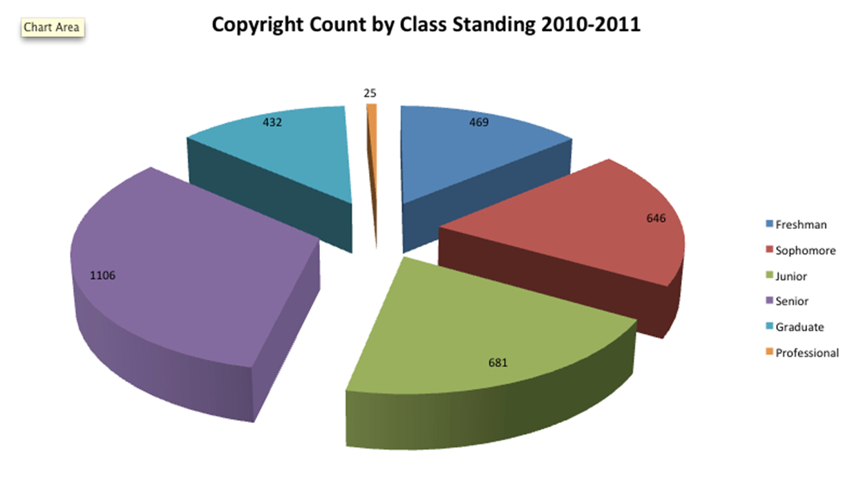
IT Security Metrics

Slide 31

Poll Question
True or False:
The only good metric is a qualitative metric!

Slide 32

IT Security Metrics
Quantitative Argument
  More precise
  Leads to better forecasting
  BUT: Requires context

Slide 33

IT Security Metrics
Qualitative Argument
  Provides context
  Based on the observational experience of many
  Can be backed by data
  BUT: Can be inaccurate

Slide 34
IT Security Metrics
Qualitative vs. Quantitative
  Religious argument
  Best approach depends on your audience
  Best approach contains elements of each type
  Best approach is also SMART:
  Specific ☻ Measurable ☻ Attainable ☻ Relevant ☻ Time-based

Slide 35
Poll Question
Which of the following IT Security Metrics are you already using?
  Risk
  Vulnerability & Incident Statistics
  ALE
  TCO
  ROI
  Go Fish!
Notes:
INTERACTIVE POLL QUESTION: Which of the following IT Security Metrics are you already using: Risk, Vulnerability & Incident Statistics, ALE, TCO, ROI

Slide 36
IT Security Metrics
Security metrics we already use (and should we?)
  Responsive requests
  Risk (assessments)
  Vulnerability and incident statistics
  Acronyms
    ALE
    TCO
    ROI
Notes:
IT Security Metrics that you might already be using
(And why they might not be such a good idea)
IT Security Metrics created in response to a request for a metric
Risk
Vulnerability & Incident Statistics
Alphabet Soup (ALE, TCO, ROI)

Slide 37
IT Security Metrics
  We need to understand:
  What is collected?
  Why is it collected?
  What decisions will it be used to support?
  (Do we understand it?)
  (Do we use it?)
  (Does it give insight?)
  How in the world do we do this?

Slide 38
IT Security Metrics
NIST SP 800-55
  http://csrc.nist.gov/publications/nistpubs/800-55-Rev1/SP800-55-rev1.pdf
  Short read for a NIST document, only 80 pages!
Three Main Categories of Metrics
  Implementation
  Effectiveness
  Impact

Slide 39
IT Security Metrics
Security Program Maturity | Most Effective Metric Category
Stage 1: Few policies, procedures and controls; little measurement data available | N/A - Should focus first on clear definition of security program goals and objectives
Stage 2: Some policies, procedures, and controls implemented; some measurement data collected | Implementation metrics
Stage 3: Well-established policies, procedures, and controls; measurement data readily available | Efficiency/effectiveness metrics
Stage 4: Policies, procedures, and controls are well-integrated within the security program and with other institutional programs; measurement data collected as a by-product of business processes | Impact metrics

Slide 40
IT Security Metrics
Implementation Metrics
  Measure the degree of progress in putting information security controls or policies into place.
  Entry level IT security metric, is the easiest type to measure and analyze.
  Over time, an institution could achieve 100% on implementation metrics.

Slide 41
Poll Question
Which of the following is an implementation metric?
  % increase of departments with BCP/DR plans from prior FY
  Number of incidents of storage of restricted data in unauthorized locations over past year

Slide 42
IT Security Metrics
Examples of Implementation Metrics
  Percentage increase of departments with BCP/DR plans from prior fiscal year.
  Percentage increase over time of workstations on which a data scanning tool has been deployed.
  Percentage of enterprise applications that can technically enforce the institution’s password expiration and complexity policy.

Slide 43
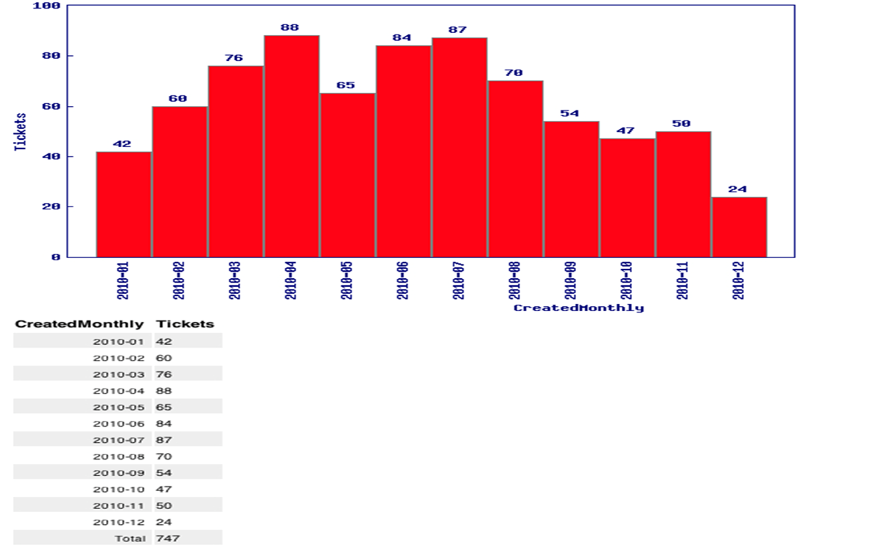
IT Security Metrics

Slide 44

IT Security Metrics
Effectiveness Metrics
  Measures whether security controls are implemented correctly or meet a desired outcome.
  Mid-level IT security metric, produces evidence that controls are working as intended.

Slide 45
Poll Question
Which of the following is an effectiveness metric?
  Number of incidents of storage of restricted data in unauthorized locations over past year
  Reduction in sensitive data exposures due to stolen laptops

Slide 46
IT Security Metrics
Examples of Effectiveness Metrics
  Number of incidents of storage of restricted data in/on unauthorized locations over past year
  Number of students receiving copyright violation notifications after attending copyright education sessions
  Number of end-users utilizing the password reset utility vs. calling into the helpdesk for password resets

Slide 47
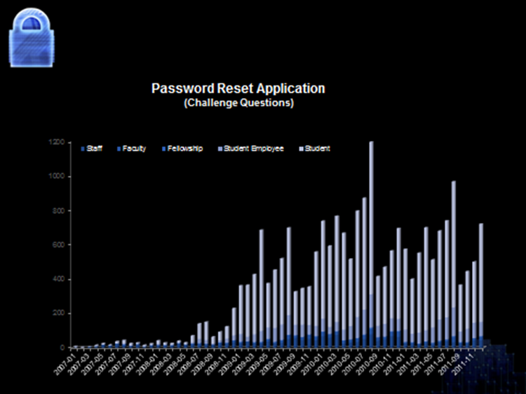
IT Security Metrics

Slide 48
IT Security Metrics
Impact Metrics
  Helps assess the overall impact of an institution’s information security program.
  Institution-specific and focus on specific information security goals.
  Can quantify the degree of institutional risk reduction.
  High-level IT security metric.

Slide 49
Poll Question
Which of the following is an impact metric?
  Reduction in sensitive data exposures due to stolen laptops
  % increase over time of departments with updated BCP/DR plans

Slide 50
IT Security Metrics
Examples of Impact Metrics
  Reduction in sensitive data exposures due to stolen laptops
  Outcome of a 48-hour power outage in a central administration building
  Change (over a defined period of time) of the number of enterprise system applications containing Social Security numbers

Slide 51
Poll Question
What type of IT Security Metrics are you using at your institution?
  None
  All (we rock!)
  Some
  Implementation
  Effectiveness
  Impact

Slide 52

IT Security Metrics
Who is your audience?
  Campus Executives
  Business Leaders
  IT Groups
  Peers
  Other Institutions

Slide 53
IT Security Metrics
For all audiences, it’s important to:
  Establish proper context
  Communicate growth (or reduction) over time
  Communicate long-term vision
  Transparency in creating the metric

Slide 54
IT Security Metrics
For campus executives and business leaders, you also must:
  Link security posture to the needs of the institution
  Tie in long-term strategy and mission/vision
  Communicate operational credibility
  Protect brand reputation
  Demonstrate compliance
  That’s a lot for a metric program to do!

Slide 55
Poll Question
What type of message is most important to your executive audience?
  Tie to mission
  Operational credibility
  Brand reputation
  Compliance posture
  Risk posture
  All of the above (we write a lot of reports)

Slide 56
Poll Question
What resources can help me out in designing IT Security Metrics?
  (It’s a trick question.)

Slide 57
IT Security Metrics
EDUCAUSE, “7 Things You Should Know about IT Security Metrics”
EDUCAUSE, “Guide to IT Security Metrics” https://wiki.internet2.edu/confluence/display/itsg2/Effective+Security+Metrics
NIST SP 800-55

Slide 58
Agenda
Benchmarking IT Security

Slide 59
A benchmarking service used by colleges and universities since 2002 to inform their IT strategic planning and management.
Notes:
CDS overview
Must complete m1 and m7 to get security data

Slide 60
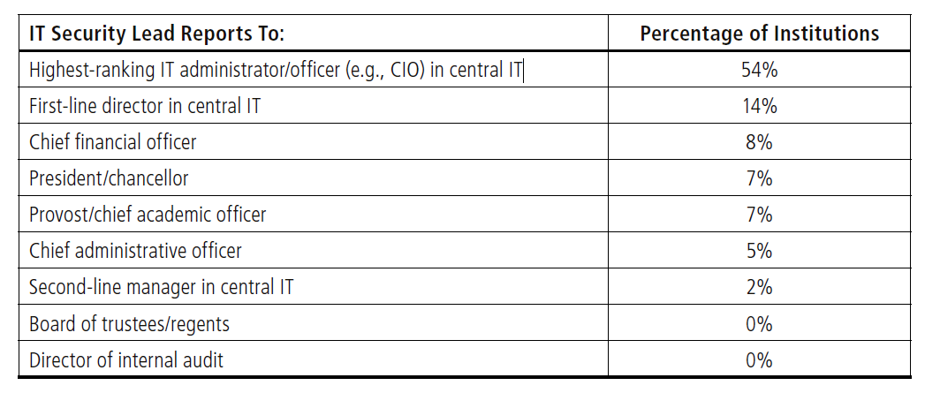
Reporting for Information Security Officers
CDS 2011 – Module 7, Question 3
Notes:
The institutional lead for information security generally reports into the IT organization,
most often directly to the CIO (see Table 21), but in more than one in four
institutions (27%), the information security lead reports to a non-IT officer, most
likely because in many cases the CIO also serves as the information security lead.
Even the title of the lead information security role is highly variable. It is difficult
to imagine another role so important to IT whose title ranges from vice president to
coordinator, but that is true of the lead information security role. Executive or officer
titles are most common (in 35% of institutions), but 8% of information security leads
are managers, and another 8% are line staff. Another 20% are directors, and 29%
of CIOs occupy the role. This latter arrangement is much less common in doctoral
institutions (5%) and more frequent in associate’s and non-liberal arts BA colleges
(34% and 39%, respectively). Module 7, Question 1

Slide 61
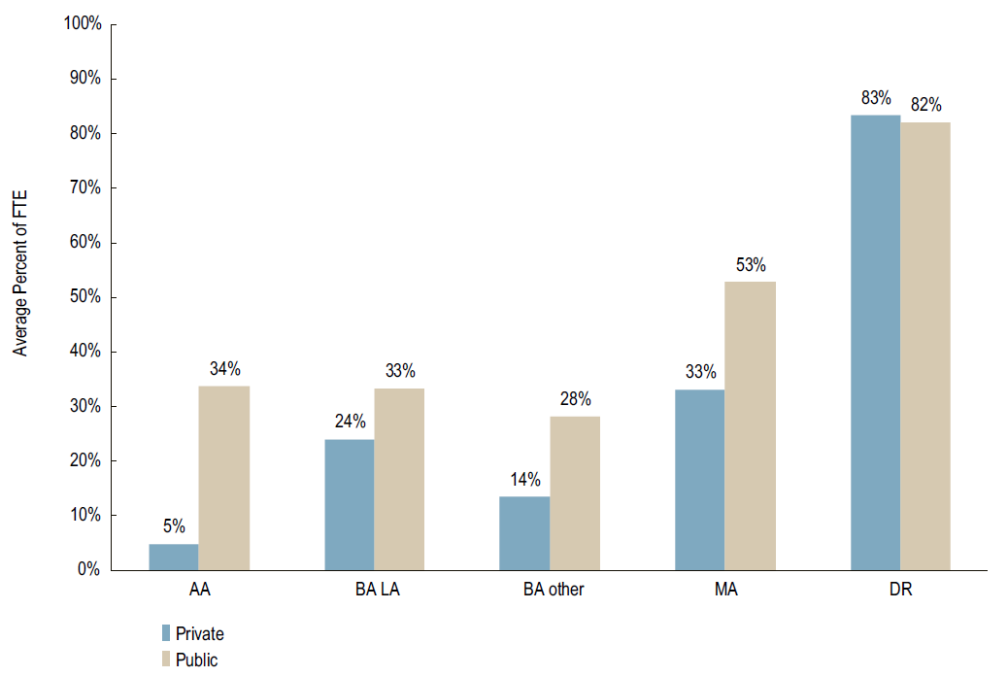
% of FTE Allocated to Lead Information Security Role
CDS 2011 – Module 7, Question 2
Notes:
Information security is a part-time role at most institutions, with only 29% dedicating
a full-time FTE to the role, and 22% devoting less than 10% of a FTE. The
allocation differs according to both Carnegie Classification and control, with public
institutions generally allocating more of an FTE to the lead information security role
than private institutions. Even at doctoral institutions, however, the average allocation
is less than full time (see Figure 34).

Slide 62
Information Security’s Responsibilities
Incident response, management, and communication
Security awareness, education, and training
Processing violations of the Acceptable Use Policy
Review or signoff on security protocols in research projects
79%
. . .
22%
CDS 2011 – Module 7, Question 5
Notes:
W hic h of the follow ing are responsibilities of IT sec urity in your institution?
Of 20 potential information security responsibilities, the most widespread are
incident response, management, and communication; security awareness, education,
and training; and processing violations of the acceptable use policy (all at 79%
of institutions). Least common is review or signoff on security protocols in research
projects (22%). There are often wide variations in Carnegie Classifications, but the
only significant difference in control was for liaison with law enforcement (at 66% of
public institutions and 52% of private) and firewall operation and management (at
60% of public and 74% of private). See Figure 35 for details.

Slide 63
Information Security Activities
14
Average number of security activities institutions employ
CDS 2011 – Module 7, Question 6 -10, 12
Notes:
W hic h of the follow ing are responsibilities of IT sec urity in your institution?
Of 40 information security activities listed in the survey, institutions employ an
average of 14. Even doctoral institutions do not average more than 18. The five
activities conducted in more than three-fourths of institutions are:
•• Set up and maintain a firewall at external Internet connection(s)
•• Require all critical systems to be expeditiously patched or updated
•• IT security personnel have authority and ability to disable a network port
if a device has been detected violating institutional policy or disrupting
network services
•• Require institutionally owned or leased computers to be expeditiously
patched or updated
•• Set up and maintain an enterprise directory
These practices vary based on institutional type (see Table 22).

Slide 64
Top 5 Information Security Activities
Set up and maintain a firewall at external Internet connection(s)
Require all critical systems to be expeditiously patched or updated
IT security personnel have authority and ability to disable a network port if a device has been detected violating institutional policy or disrupting network services
Require institutionally owned or leased computers to be expeditiously patched or updated
Set up and maintain an enterprise directory
CDS 2011 – Module 7, Question 6 -10, 12
Notes:
W hic h of the follow ing are responsibilities of IT sec urity in your institution?
Of 40 information security activities listed in the survey, institutions employ an
average of 14. Even doctoral institutions do not average more than 18. The five
activities conducted in more than three-fourths of institutions are:
•• Set up and maintain a firewall at external Internet connection(s)
•• Require all critical systems to be expeditiously patched or updated
•• IT security personnel have authority and ability to disable a network port
if a device has been detected violating institutional policy or disrupting
network services
•• Require institutionally owned or leased computers to be expeditiously
patched or updated
•• Set up and maintain an enterprise directory
These practices vary based on institutional type (see Table 22).

Slide 65
Topics coming in CDS 2012
Central IT’s responsibility for IT security practices vs. other departments (CDS 2012 – Module 7, Question 5)
Institutional membership to federations (CDS 2012 – Module 7, Question 8)
Network protection practices (CDS 2012 – Module 7, Question 9)
Support for certification (CDS 2012 – Module 7, Question 13)

Slide 66
Benchmarking with CDS
For IT Security Metrics
  Compares your institution to others w/r/t reporting structure (Q1-6)
  Helps benchmark progress (Q6-11)
  Help define additional resource needs (Q4-5, 11, 13)
  Validate your program (Q4, 5, 9-11)

Slide 67
THANK YOU

