Slide 1
EDUCAUSE Security Professionals Conference
Building a Culture of IT Security Awareness
May 7, 2014

Slide 2
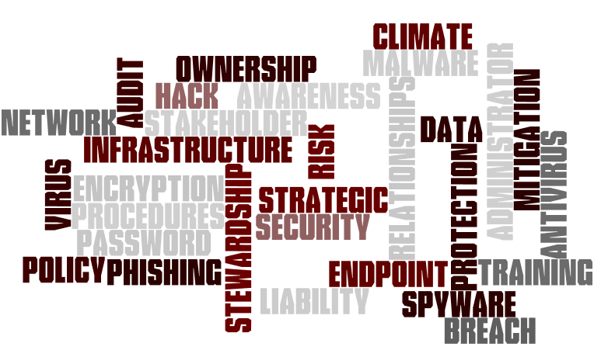
The tale of two campuses

Slide 3
IT Security Awareness a Process
Foundation
Build relationships
Build Culture
Resources, Training & Service
Multi-layer approach
Emerging Challenges
Opportunities
CISO Frustrations

Slide 4
Foundation
Start in ITS
Ensure CIO support
Establish Chief Information Security Officer
Establish IT culture
Develop program(s) in accordance with industry standards and generally accepted security principles
Understand environment and context as it relates to Security
Understand any decentralized organizations or other areas of sensitivity
Establish short and long term awareness goals and measures
Establish strategic buy in at the executive level

Slide 5
Build Relationships
Meet key stakeholders
Establish viable and robust working relationships
Create or utilize campus governance/organizations
Develop a community approach conveying the idea of "What's In IT For Me?"
Be supportive of the initiatives of others within the organization
Build infrastructure and services to support decentralized IT organizations
Formalize relationships and responsibilities

Slide 6
Activity: Governance & other organizations
Who are the key stakeholders?
What governance or other organizational structures do you use?
Who are the members?

Slide 7
Build Culture/Empower
Give the principal parties responsibility and resources/support for securing data
Develop an operational non-punitive climate that is information security conscious
Embed IT Security into everything
Offer training, support and services
Establish processes with units across campus
Provide debriefs and documentation if/when necessary
Be a resource; be proactive

Slide 8
Resources,Training & Services
Empower data stewards and others
Participate in faculty, staff and student orientation
Provide scans or other services for decentralized IT
Establish CBTs (or other training) for all (central and decentralized) System Admins
Provide just in time training
Develop presentations
Train administrators such as Student Affairs officers on DMCA

Slide 9
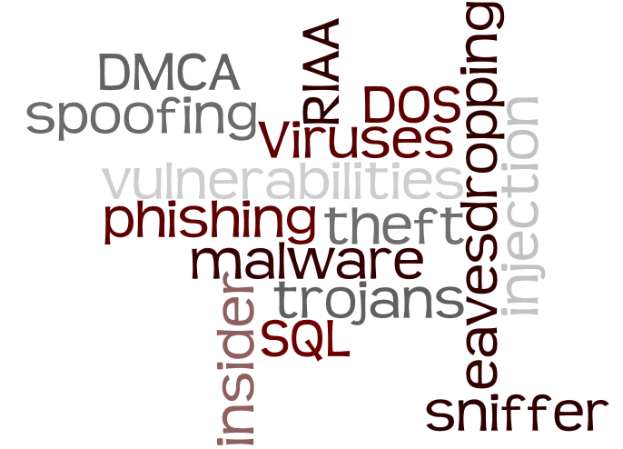
Activity: How do you keep your campus informed?
Phishing
Vulnerabilities
DMCA/RIAA
Viruses
Etc…

Slide 10
Layers
Orientations
DMCA & Safe computing in ITS comprehensive new student communication
Security Corner in every ITS Bulletin
Presentations across campus
Regional and National organizations and activities
Endpoint/data protection, free antivirus, anti-phishing campaign, Be Safe campaign

Slide 11
Emerging Challenges
BYOA
Work from anywhere
ID Management
Social networking
Cloud
Others?

Slide 12
Opportunities
Utilize these to establish ongoing buyin:
Educause
Cybersecurity month
DR/BC planning
Incidents in the news
Legal/Audit
Organizations/governance

Slide 13
Source of CISO Frustrations
Unresourced expectations
Inconsistency in policy/rule enforcement
"It won't happen to us" attitude
"It's gonna happen and we can do anything about it."
It's ITs problem

Slide 14
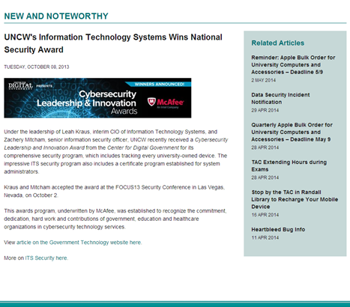
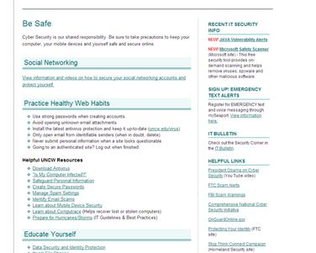
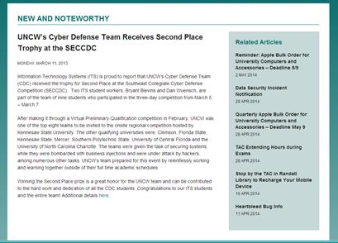
Samples

Slide 15
"Information Security is Everyone's Business"
Remember When It Comes to
se U R IT y

