Slide 1
Introduction to REN-ISAC
Notes:
Hello and Welcome to the Introduction to REN-ISAC. I’m Kim Milford and this is my debut as the newly appointed Executive Director for REN-ISAC. So this session is also my own introduction to REN-ISAC. Fortunately, I’ve got some great help here if needed – Doug Pearson is REN-ISAC’s Technical Director is on hand and Andrew Korty from IU who serves on REN-ISAC’s TAG.
I’m curious – how many of you are already members of REN-ISAC? Great, so there’s even more expertise in the room. You all can help me answer questions!
In this presentation, I’ll give a brief history of the organization, explain the mission of REN-ISAC and talk to you about the benefits of joining the REN-ISAC. We’ll also leave plenty of time for questions… and I have some questions for you. I’m sure many/most of you know Rodney Peterson from EDUCAUSE. In the upcoming months, Rodney and I will be reaching out to you and others in the higher ed information security community to find out how REN-ISAC and its partners, Internet2, EDUCAUSE can help better meet your needs. So please think about this question “What are your pain points and how can we help you?” Maybe you need pen-testing services or forensics analysis and you don’t have staffing or time to support it. Maybe you get too little information or too much information or inconsistent information about threats and vulnerabilities. So think about your pain points and we’ll have some time at the end of this presentation to discuss.

Slide 2
ISAC in general
Presidential Decision Directive 63: Protecting America’s Critical Infrastructures
Collect, derive, analyze and disseminate security threat information
Many examples:
Financial Services
Communication
Industrial Control Systems
Emergency Management and Response
And many more!
Notes:
ISAC stands for Information Sharing and Analysis Center. The development of ISACs was encouraged by President Clinton’s Presidential Decision Directive 63: Protecting America's Critical Infrastructures in 1998.
The ISACs would serve as a means for the gathering, analyzing, and sharing information related to critical infrastructure protection.
ISACs are set up by industry sectors in cooperation with the Federal government but they receive no federal funding. There are many different section ISACs, including Financial services, communications, industrial control systems, Emergency Management and Response, really any critical infrastructure that should be protected from cyber attack.
Were most of you at Harriet Pearson’s keynote this morning? She talked a little about the expanded view of “critical infrastructure” in the NIST Framework and also the need for information sharing. The utilization of the ISAC model has consistently been part of the federal government’ss cybersecurity plan for many years.

Slide 3
The REN-ISAC
http://www.ren-isac.net/
Part of the U.S. Higher education’s strategy to improve network security
Specifically designed to support the unique environment and needs of higher education
Participates in the formal U.S. ISAC structure
NOT government funded
Membership fees
In-kind contributions from Indiana University, Louisiana State University, EDUCAUSE and Internet2
Notes:
You can read the formal mission statement on the REN-ISAC website but I wanted to point out that the REN-ISAC is primarily focused operational protection and response. While we have some member benefits in the Awareness, Policy and Compliance, the heart of the REN-ISAC is operational security.
The REN-ISAC (Resesarch and Education Networking Information Sharing and Analysis Center) was specifically designed to support the unique environment of higher education.
While the REN-ISAC is involved in the National Council of ISACs, we receive no government funding. We have membership fees and we receive sponsorship from Indiana University, Louisiana State University, EDUCAUSE and Internet2.

Slide 4
The REN-ISAC
Four main components to the REN-ISAC
CSIRT
Research & Development
Member Services
ISAC
Notes:
How do we accomplish our mission?
REN-ISAC supports four primary components:
- The REN-ISAC is a small organization with full time staff members that act as a CSIRT (computer security incident response team for higher education. We notify institutions regarding compromised systems and other cyber incidents at their organizations. I’ll will cover more of this in the next slide.
- Next is the ISAC, in which the full time REN-ISAC staff participate in many trust communities, including the ISACs I mentioned on the last slide, on behalf of R&E. This enables the REN-ISAC to build data sharing partnerships which helps secure all of .edu. We get advanced information on threats or data on compromises from relationships that we have established in these trust communities.
- Those relationships also help drive the research and development activities at the REN-ISAC. Our big R&D project is the Security Event System, which we talk more about later. What is important is that we have others in the global security community using our tools and helping to improve them, which then benefits the edu as a whole.
- And lastly, are the member services we provide. We’re a large community of trusted security staff at higher education institutions working toward a common goal of improv security at our home organization. We do this by participating in discussions and information sharing with our peers around the world.

Slide 5
CSIRT
Send daily notifications regarding compromised machines
> 12,000 notifications a month
> 1700 institutions notified since 2003
Security Operations Center for Internet2 Network
24X7 Watch desk
Notes:
The REN-ISAC sends between 12,000 and 15,000 notifications a month. Some percentage of those notifications will generate emails and phone calls from people looking for assistance in solving the issue; We have front-line support available to answer questions and do research to help people solve the issue. We have 24x7 phone and email support so those calls can come in at any time.
You don’t have to be a REN-ISAC member to receive notifications from us. We do this for all educational institutions, whether they are in the US or elsewhere. While we mainly focus on North America, we have sent notifications all over the world. Notifications can be for malware infections, open DNS resolvers, scanning complaints, anything that somebody finds abusive. Some of the notifications come from data from partners, some of it is proactive searching by REN-ISAC staff.

Slide 6
The REN-ISAC
Four main components to the REN-ISAC
Member Services
ISAC
CSIRT
Research & Development
Notes:
Now, I am going to talk about the broad security community in which the REN-ISAC participates.

Slide 7
ISAC == Global Community
Trusted Partner for the R&E community
High quality actionable data
Examples of those relationships:
Internet2
EDUCAUSE
Higher Education Information Security Council
Other sector ISACS
DHS/US-CERT and other national CERTS/CSIRTS
Vendors such as Microsoft
NCFTA (National Cyber-Forensics and Training Alliance)
SANS
APWG (Anti-Phishing Working Group)
Notes:
The REN-ISAC staff are the “face” of the Research and Education community in the global trust networks. We act on behalf of R&E when creating relationships with commercial, governmental and private sector information sharing entities. It is important to remember that the REN-ISAC works very hard to protect your anonymity. We will never mention an organization by name in any trust community but will instead use “a higher education institution.”
We create these relationships so we can receive high quality, actionable data regarding security threats, protection and response.
Because of our relationships, we can offer data feeds with high quality data that can be used in to analyze threats and allow you to take proactive steps to protect your organization.

Slide 8
The REN-ISAC
Four main components to the REN-ISAC
Member Services
ISAC
CSIRT
Research & Development
Notes:
Lets move on to the Research and Development component of the REN-ISAC.

Slide 9
SES – Security Event System
Threat Intelligence repository
Many data sources, public and private
Generate IDS rules
Data analysis to spot emerging patterns to write better IDS rules
Incident response data
The public version:
http://code.google.com/p/collective-intelligence-framework/wiki/WhatisCIF
Notes:
The SES is our living breathing example of R&D. The goal of SES is to improve timely local protection against cyber security threat, by sharing security event information, in near-real time, within a trusted federation, and among federations.
I’ve got a little bit of history here. In the early 2000’s, there was a mailing list in which security professionals traded information (Unisog) about threats and bad actors. Sec pros would send a warning out to their peers “hey, watch out for traffic coming from this IP address” or “Watch out for traffic that looks like this coming on this port.” or “if you see THIS, BLOCK IT!”. Sec Pros would take that information and set up blocking rules to protect their envirnoments. It was decided that a more formal group should be created and the REN-ISAC was born. Fast forward a few years and people are still trading information over mailing list, albeit, in a more private location (vetted/private mailing list) so there’s an opportunity to provide additional info without fear of exposure. Then the problem of phished user accounts and spammers hit the Universities and the mailing list alone is no longer adequate for sharing the information.
There are too many IP addresses, too many usernames, lots of messages to be read to glean all the relevant information. So, the information was moved to a wiki but it was still cumbersome to manage. A human had to log in to the page, cut and paste the relevant information and write the IDS/IPS/Detection rules.
The idea for SES was born, leveraging machine to machine communication. Set it up and monitor for problems and let it run. Near real-time threat information gets put into the system (mostly automated, some human interaction), and out comes feeds of data that can be put directly into most detection devices. It’s all automated. Set the script to grab the latest data once an hour, once every 12 hours, once a day - whatever you are comfortable with. It is easily scalable and we cut down on the chance of human error.

Slide 10
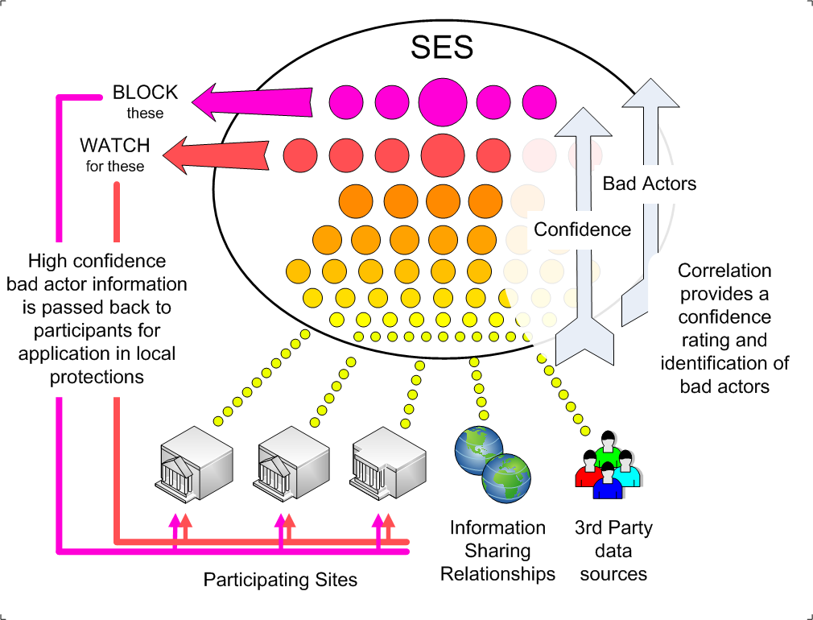
Notes:
SES is where the relationships that REN-ISAC has forged over many years is really paying off. We have data sharing agreements with many partners, both public and private, which has created an influx of highly actionable data to flow into the REN-ISAC. Once the data is in SES, that information can be used to generate data feeds which can be input into various IDS devices at organizations.
Example of Incident Response using SES Data:
Let’s say I have this machine that I think is infected. It has been seen talking to a remote IP address and the traffic is suspicious looking but I don’t have any proof. In the SES interface, I could query for an IP address or domain name and see if any other entity has flagged that IP address as bad – it could be that it was serving up malware, or it could be a link in a spam message, or maybe it is the command and control server for a botnet. Whatever data that has been collected on that IP address can be queried and displayed so I can make a decision on the level of risk that my possibly infected system poses.

Slide 11
The REN-ISAC
Four main components to the REN-ISAC
Member Services
ISAC
CSIRT
Research & Development
Notes:
We are now going to talk about the benefits of joining REN-ISAC.

Slide 12
Establish relationships with known and trusted peers
Notes:
If you think about the average infosec security operations at a higher ed institution, there may be only a small number of people that can be relied upon to help troubleshoot a problem or bounce ideas off of. Perhaps you’ve had to deal with incidents that require some advice on forensic. If you’re new to information security and as new threats crop up, you likely have questions… What are the proper steps for generating a timeline in Autopsy? How do I make sure I grab the unallocated space on this disk? Why the hell can’t I get the working copy of my image to mount?
REN-ISAC members include forensic experts in the your community, someone you can trust to answer questions. Not only is the collective brain power in this community impressive, but they are responsive, thoughtful, and generous with their time.

Slide 13
Receive and share practical and actionable defense information in a private community of trusted members
Notes:
We now have over 1000 members to share information with. Put a question out to the community and you’ll get an answer back.

Slide 14
Benefit from information sharing relationships in the broad security community
Notes:
Then REN-ISAC has developed relationships with partners other than Universities which enlarge our community of pracctic. While many of these partnerships are kept confidential, you can trust that the REN-ISAC has fostered relationships that are in Higher Ed’s best interest and keep the actionable information flowing. Both ways. By paying it forward (having the opportunity to share information we know out to others), the world of computing can be a safer place.

Slide 15
Benefit from vendor relationships, such as the REN-ISAC and Microsoft Security Cooperation Program relationship
Notes:
Securing Microsoft systems is a necessity and the amount of insight that consumers get from MS update bulletins leaves much to be desired. Because of the size of the R&E community and the REN-ISAC, we can also build strong vendor relationships such as with the Microsoft Security Cooperation Program. Also, if there is a problem with a patch or if the community feels that the impact is wrong (should be critical instead of medium), we have a way of bringing our concerns to Microsoft. The REN-ISAC is working on other vendor relationships, too, ways we can amplify your voice and bring vendors to the table.

Slide 16
Participate in technical educational security webinars
Notes:
How many of you have a certification that requires continuing education, like a CISSP? Want some CPE’s? Come and get ‘em… every month the REN-ISAC membership hosts webinars full of bright ideas and a little bit of snark thrown in for entertainment value.

Slide 17
Participate in REN-ISAC meetings, workshops, & training

Slide 18
Access to threat information resources ("data feeds") that can be used to identify local compromised machines, and to block known threats
Notes:
If I haven’t sold you on the benefits of joining the REN-ISAC yet, then you’re probably sleeping so… wake up! This is one of the most important benefits of all… SES. Because of the data sharing agreements, we are receiving data that can be used for immediate mitigation. Data feeds are ready to be imported into many different IDS, including snort, iptables pcap filters, etc.

Slide 19
Information Products
Daily Watch Report provides situational awareness.
Alerts provide critical and timely information concerning new or increasing threat.
Notifications identify specific sources and targets of active threat or incident involving R&E. Sent directly to contacts at involved sites.
Advisories inform regarding specific practices or approaches that can improve security posture.
TechBurst webcasts provide instruction on technical topics relevant to security protection and response.
Feeds provide collective information regarding known sources of threat; useful for IP and DNS block lists, sensor signatures, etc.
Monitoring views provide summary views from sensor systems, e.g. traffic patterns on Internet2, useful for situational awareness.
Notes:
In addition to the information sharing that happens among the members, the REN-ISAC also provides more formal information sharing products including:
The Daily Watch Report, which helps collect important news items, vulnerability information and exploit information.
We will provide alerts and advisories when a new or increasing threat is detected and we believe the community needs a heightened awareness or there is a specific practice that can improve security posture.
We have mentioned our daily notifications and the training that REN-ISAC members provide.

Slide 20
Membership Qualifications
Membership is open to colleges and universities, teaching hospitals, R&E network providers, and government-funded research organizations.
The institution is the “member”, and is represented by a management representative who nominates one or more member representatives.
Very specific job responsibility requirements define who is eligible to become a member representative.
Membership is tiered (General and XSec). The tiers differ in eligibility criteria, the degree of trust vetting, sensitivity of information shared, information products shared, and the commitment-level of the institution.
Notes:
Now that you have heard of all the great things you can get with your REN-ISAC membership, how do you actually join?

Slide 21
Joining REN-ISAC
Membership is initiated by a CIO or equivalent, who becomes the “management representative”. During registration the CIO can delegate the management representative role.
The management representative nominates “member representatives”
Member representatives must be FTE with institution-wide responsibilities for operational security protection and response, etcetera.
http://www.ren-isac.net/membership.html

Slide 22
Questions?
Kim Milford
kmilford@ren-isac.net
soc@ren-isac.net
Notes:
So now back to my question for you – what are your pain points and how can we help?

