Slide 1
GUIDANCE FOR CLOUD SERVICES TO HIGHER EDUCATION INSTITUTIONS: SECURITY, PRIVACY, AND COMPLIANCE Panel discussion 2014 Security professionals conference
7 May 2014
Robert Brammer, Ph.D.
Senior Advisor to the Internet2 CEO

Slide 2
INTERNET2 NET+ Security Initiative
Primary objective -- develop guidance to meet the security, privacy, and compliance needs of our NET+ participants, while helping to enable the service providers to manage their costs and to offer discounted prices
Approach
Focus on those issues most relevant in cloud-computing environments
Develop material to aid in creating institutional cloud security strategy*
A team of security experts from both higher education institutions and service providers continue to develop the guidance.
Base on the Cloud Security Alliance (CSA) GRC Stack and NIST SP800 – 53, 144, 146
Tailor content to requirements for higher education
Major milestones – Began in June 2012, delivered initial version of security controls in December 2012, now in use by NET+ Program, next version update with CSA CCM 3.1
*Fewer than 30% of the 9300+ respondents to the PWC Global State of Information Security® Survey 2013 said that their organizations have a cloud security strategy

Slide 3
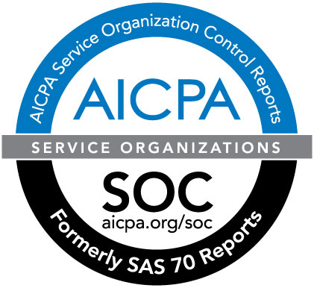
NIST, CSA, and AICPA
NIST – Part of the Dept. of Commerce, chartered to develop national standards
CSA – not-for-profit consortium, 43,000 individual members, ~150 corporate members, 20+ affiliate members, 60+ chapters globally
AICPA -- world’s largest member association representing the accounting profession, with nearly 400,000 members in 125+ countries
Opportunity to complement their work with government and industry with our work with higher education institutions

Slide 4
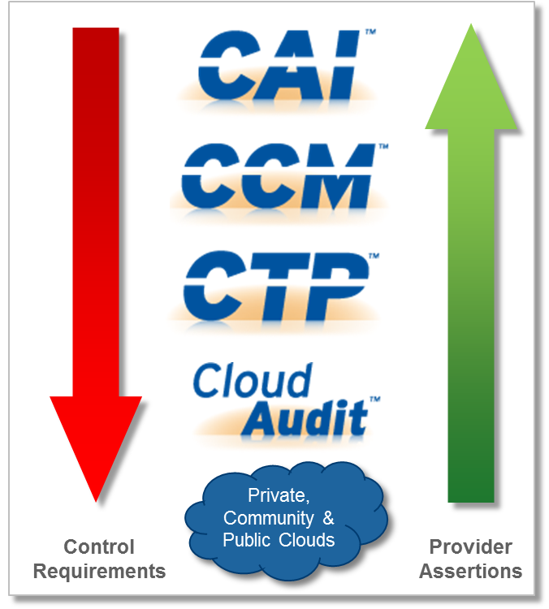
CSA GRC Stack
Tools for governance, risk, and compliance management
Consensus Assessments Initiative
Cloud Controls Matrix
Cloud Trust Protocol
Cloud Audit
https://cloudsecurityalliance.org/research/grc-stack/
“Although it does not consider itself to be a standards body, as a global organization with high levels of participation from both cloud services buyers and providers, the Cloud Security Alliance (CSA) is the entity that is most likely to provide generally accepted control standards for public cloud computing.”
Jay Heiser and Rob McMillan, “Cloud Security and Risk Standards Are Maturing, Gartner Research Note, 26 December 2012

Slide 5
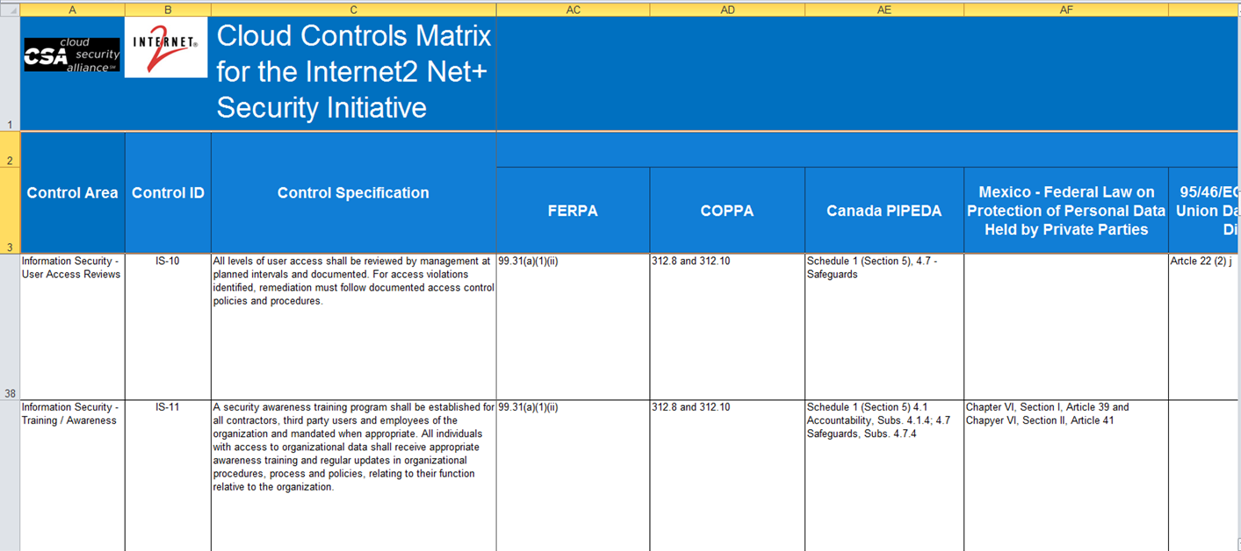
NET+ Security Initiative Deliverable -- Extended CCM 3.0
Controls derived from NIST, CSA guidance, compliance requirements for higher ed, etc.
Mapped to familiar frameworks: ISO 27001, COBIT, PCI, HIPAA, FISMA, FedRAMP, etc.
Our extensions to CSA CCM V3.0 include FERPA, COPPA, ITAR/Export, international privacy, NIST SP800-53 R4 Appendix J, …
Current 136x28 modular structure provides flexibility
Our extensions and the AICPA Trust Principles will be in CCM V3.0 and beyond

Slide 6
CCM 3.0 Controls and Mappings
136 controls (risk mitigation)
28 mappings to various standards, regulations, other requirements
ISO standards, FedRAMP, HIPAA, ENISA, …
Our NET+ Security Team has added seven mappings for requirements significant to higher education
Mappings include large majority of 136 controls
FERPA, PCI DSS, ITAR/EXPORT, international data privacy
NIST 800-53 R4 Appendix J privacy controls

Slide 7
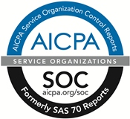
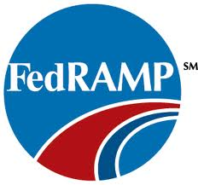
3rd Party Audit/Assessments are Significant for NET+
We are working with the AICPA and various FedRAMP 3rd party firms to ensure that there are firms that can provide services based on our controls matrix
The AICPA is collaborating with CSA and Internet2 to create a standardized industry attestation engagement provided by CPAs that incorporates the CCM
The attestation is based on an existing, and proven, SOC Framework https://www.aicpa.org/INTERESTAREAS/FRC/ASSURANCEADVISORYSERVICES/Pages/SORHome.aspx
Nearly 50 cloud services included in CSA STAR, including some NET+ CSP’s
Amazon AWS, Box, Microsoft (Azure, Office 365), SHI - more to come
“As more buyers demand it, and as the standards mature, such questionnaires will increasingly be treated as normal practice, as evidenced by the growing number of SaaS providers that are registering their questionnaire responses on the Cloud Security Alliance's (CSA's) Security, Trust & Assurance Registry (STAR) site.”
Jay Heiser and Alexa Bona, “Cloud Contracts Need Security Service Levels
to Better Manage Risk,” Gartner Research Note, 15 March 2013

Slide 8
Current Status and Future Directions
Our strategy is to have our developments integrated with major standards and to maintain a presence for higher education with their ongoing evolution
We have released the first version of our guidance and are working with the higher education community to get feedback and are beginning implementation
Currently working on further extensions for privacy and identity
Draft mapping for NIST SP 800-53 R4 Appendix J with higher ed extensions
Draft additional controls for federated identity in development
We are in discussions with training firms for users and 3rd party assessment firms
Your feedback and support are important to us

Slide 9
Today’s Panelists
Robert Brammer – Internet2
Beth Chancellor – University of Missouri System
Paul Howell – University of Michigan
Audrey Katcher – American Institute of CPA’s and RubinBrown LLP
Kathy Kimball – Penn State University
Michele Norin – University of Arizona

