Slide 1
Splunk quick start
Mark Runals
Sr Security Engineer

Slide 2
About Me
Have been using Splunk for ~2 years
ArcSight admin for 3 years medium size deployment
Motto – Solve for 80% and move on

Slide 3
Presentation Focus / Caveats
Specific
Use Cases
Get
funding
Getting
Started
ROI
Focus:
High level tips on architecture and methodologies that have worked for OSU (potentially best practices)
Caveats:
I don’t work for Splunk
Everyone’s environment is different
This brief won’t be sufficient to answer all questions =)

Slide 4
Agenda
Misc stuff
How many FTEs are needed?
General server architecture
Premade content
Commonly used config files
Keeping configuration files updated
Index creation strategy
Misc stuff

Slide 5
The value of visualization
External Threats!!!1!!1!1
Are you doing this sort of reporting?
Alerts in the last <timeperiod>
Bro
Snort
14727
41691
Blocked IPs: Action taken on 3,225 external IPs attacking us in the last <timeperiod>
Top 5 Countries
China
United States
India
Brazil
1818
262
238
44

Slide 6
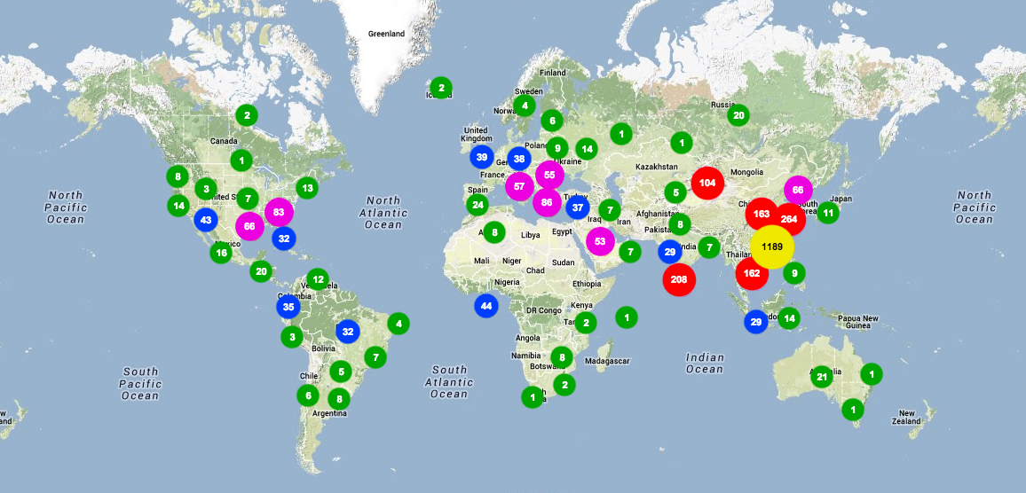
The value of visualization
Blocked IPs: Action taken on 3,225 addresses in the last <timeperiod>

Slide 7
What is Splunk? / Why use Splunk?
Do we need to cover this?

Slide 8
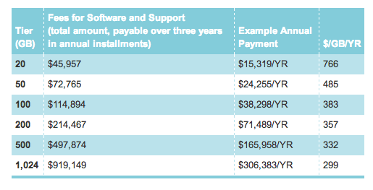
Internet2 Splunk Deal
3 year term license
1 TB Max
More information
http://www.internet2.edu/products-services/cloud-services-applications/splunk/#service-overview

Slide 9
How many FTEs?
Algorithms I’ve heard
1 FTE per 7 servers
1 FTE per TB daily volume
Lots of data
Complexity
(not 1:1)
Data diversity
Log volume
Environmental Complexity
Who creates content
User diversity
What’s your end game?
Little data

Slide 10
FTE Requirements
Centrally Managed Service - Large Environment
Service Work List
New client interaction
Onboard new data
Data Management
Knowledge Management
Deploying apps
Training
Content Creation
Testing
Tuning Splunk
Customer interaction
Deployment Management
Politics
Data requests
General Program Management
Planning
Services Support
Fixing stuff
General & random BS
Program &
Service Management
3 FTE
2 FTE
1 FTE
Content Creation
Care and Feeding

Slide 11
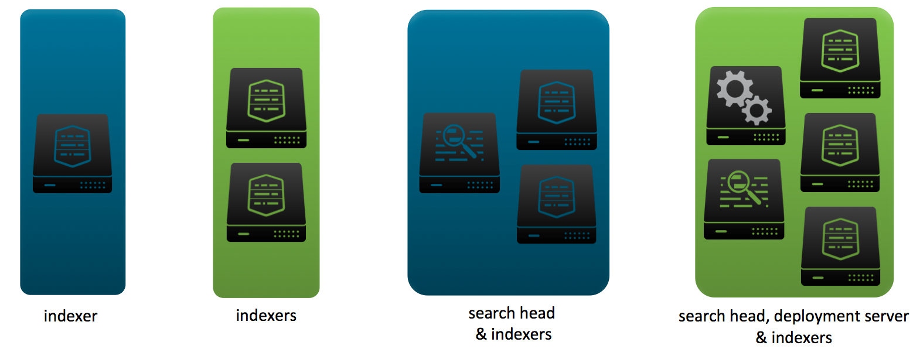
Server Architecture
Graphic from .conf2013 Best Practices: Deploying Splunk on Physical, Virtual and Cloud Infrastructure

Slide 12
Server Architecture
Functional Overview
Search heads
User interacts with Splunk, searches, alerts, etc
Indexers
Ingests and stores data, responds to queries
Forwarders
Collects and send data to indexers
Note: a single server can perform all three functions depending on data volume

Slide 13
Server Architecture
General Guidance
CPUs / Cores
3 Ghz
12 – 20 total cores
General rule of thumb for indexers
1 indexer per 100GB of logs (daily throughput)
Physical or Virtual
Virtual: 20 – 30% in indexing performance reduction
Storage: Local vs SAN vs NAS vs other
>> IOPS is a big performance constraint <<
Production – if IOPS < 800 you need a different solution
RAID 1+0 arrays
Windows or Linux
Windows: 10 – 20% in indexing performance reduction

Slide 14
Server Architecture
Growth Factors
How much incoming data?
How many concurrent active users?
Lots of real-time searches?
What types of searches?
1:1 Search to core ratio
Add indexers before search heads
More servers > fewer beefy servers
(similar to FTE questions)

Slide 15
Content Development
SplunkBase
SplunkBase: great place to get started
App can fulfill three types of functions
Data management (i.e. getting data in)
Knowledge management (i.e. define fields)
Data visualization
Suggested apps
Splunk on Splunk (SoS)
Fire Brigade
Windows Security Operations Center
Windows / Nix Apps - at least the TAs
Deployment Monitor – (if using Deployment Server & on 5x)

Slide 16
Splunk Configs
Lots and lots – beyond the scope of this preso
Mostly use:
inputs.conf – what is ingested: file paths, TCP/UDP ports, scripts.
Typically live on forwarders
props/transforms.conf – data management instructions (next slide)
Live on indexers/search heads

Slide 17
Splunk Configs
inputs.conf
Tells Splunk what data to collect
monitor – directories or specific directories
TCP/UDP – ports listening
batch – read and then delete data
script – run a local script
Common Attributes
sourcetype
host_segment
index
disabled
ignoreOlderThan
crcSalt
General use
explicit sourcetyping
especially useful on syslog servers (path split by host)
where should ‘this’ monitored data go
some troubleshooting uses
good for limiting system load
read Splunk’s doc; especially useful for small files

Slide 18
Splunk Configs
Two main data management configs
Capabilities (not complete list)
Timestamp recognition
Linebreaking
Host override
Sourcetype override
Simple Field Extractions
Complex Field Creation
Props.conf
Transforms.conf

Slide 19
Splunk Configs
Props/Transforms Recommendations
Place both config files in same folder (why? note DS slides)
Use a common naming convention
Keep in mind alpha sorting
Way to ID the type of configs
Splunk uses ‘TA’ = Technology Addon
…/deployment-apps/<group>_<technology>_TA
Technology x
props.conf
transforms.conf
osu_shibboleth_props
osu_netflow_props

Slide 20
Splunk Configs
Field Definitions – props.conf
Three Options
Relatively simple search time field extractions via regex
[my_sourcetype]
EXTRACT-name_field = (?<name>\S+)
EXTRACT-device = device_id=(?<device>\S+)
Both call transforms.conf
Report = search time fields
Transforms = index time fields
[my_sourcetype]
REPORT-<class> = <transforms_stanza_name>
TRANSFORMS-<class> = <transforms_stanza_name>
Note: defining fields isn’t required to search logs

Slide 21
Splunk Configs
Field Extraction
Define fields inline
[my_sourcetype]
EXTRACT-data_fields = user (?<user>\S+) logged in from (?<device>\S+)
[sourcetype_stanza_1]
REGEX = user (?<user>\S+) logged in from (?<device>\S+)
OR
[sourcetype_stanza_1]
REGEX = user (\S+) logged in from (\S+)
FORMAT = user::$1 device::$2
props
transforms
transforms
Pro tip: Fields for new data source
Create search with rex
Email to SME for validation
Plug into configs
Profit

Slide 22
Splunk Configs
Use EXTRACT or REPORT?
Generally speaking Extract and Report do the same thing. However there are times to use report to call transforms.conf or use transforms.conf in general
Delimiter based field definition
Concatenate fields
Reuse field extractions across multiple data sources/types
Perform additional extraction within a particular field
Setup configs for multi-value fields (requires use of fields.conf as well)

Slide 23
Update Configs
Do you have anything in-house? Chef, Puppet, Other ?
Our Challenges
Each College IT shop is autonomous
Nothing is standard
No centralized asset management
Splunk
Deployment Server
At what point should you use an automated update mechanism?
Forwarders on servers out of your direct control
More than one indexer or search head
More than a handful of forwarders

Slide 24
Update Configs
What to manage with Deployment Server?
Smaller environment
Medium to Larger environment
eg: single server indexer/search head
eg: multiple indexer or search head servers
More focused on forwarder inputs
Forwarder inputs
Keep server configs in sync

Slide 25
Update Configs
Setting up Deployment Server
Can be installed on any Splunk server (ideally not an indexer)
Put some content in SPLUNK_HOME/etc/deployment-apps
Create a serverclass.conf file in SPLUNK_HOME/etc/system/local
Create a deploymentclient.conf file on local agent in SPLUNK_HOME/etc/local
Typical serverclass.conf* entry
[serverClass:some_servers]
whitelist.0 = server_name
restartSplunkd = true
[serverClass:some_servers:app:some_content]
Typical deploymentclient.conf
[target-broker:deploymentServer]
targetUri = splunk_ds.mycompany.com:8089
* $SPLUNK_HOME/etc/system/local/serverclass.conf

Slide 26
Update Configs
Whitelisting Servers (serverclass.conf)
Options:
Hostname
Considerations:
Can use wildcards / regex
Hostname collision (DC1)
Requires upfront list of servers
Did they use a (rational) naming convention?
[serverClass:psychobotany_servers_win]
whitelist.0 = psychobotany_dc01
whitelist.n = random_server_name
[serverClass:psychobotany_servers_win:app:win_inputs]

Slide 27
Update Config:
Whitelisting Servers (serverclass.conf)
Options:
Hostname
IP address
Considerations:
Can use wildcards / regex
Doesn’t support CIDR
Multiple private IP space?
[serverClass:psychobotany_servers_win]
whitelist.0 = 10.10.10.*
[serverClass:psychobotany_servers_win:app:win_inputs]

Slide 28
Update Configs
Whitelisting Servers (serverclass.conf)
Options:
Hostname
IP address
clientName string
Considerations:
Can use wildcards / regex
Key to rollout success at OSU
[serverClass:psychobotany_servers_win]
whitelist.0 = psychobotany_win_*
[serverClass:psychobotany_servers_win:app:win_inputs]
Local Deploymentclient.conf
[deployment-client]
clientName = psychobotany_win_dc01

Slide 29
Update Configs
Random Deployment Server Tips
One DS can manage
~3k check-ins per minute (Linux)
500 check-ins per minute (Windows)
Change default phonehome interval via Deployment Server package
Great for troubleshooting
Default is every 30 seconds
Can use DS to manage index.conf file on idx/sh
Put technology X props/transforms in same package; deploy to both idx/sh

Slide 30
Update Configs:
Splunk Deployment Server
Why bundle props/transforms together?
Both files have settings that might be applied at index or search time
Easier to just send updates out once
[serverClass:all_search_heads]
whitelist.0 = search_head_0*
restartSplunkd = false
[serverClass:all_search_heads:app:company_sso_props]
[serverClass:all_search_heads:app:company_firewall_props]
[serverClass:all_indexers]
whitelist.0 = indexer_0*
restartSplunkd = false
[serverClass:all_indexers:app:company_sso_props]
[serverClass:all_indexers:app:company_firewall_props]
Set restartSplunkd to false to avoid inopportune service restarts
If initial point of entry is heavy forwarder and you need to change index time fields send the props/transforms file to it – eg syslog server

Slide 31
Index Creation
splunk >
index = ??

Slide 32
Index Creation
General
Don’t send data to ‘main’
Default out-of-the-box location for data
Create an alert to let you know when data IS in the main index
Give some consideration to log volume
No need to be overly granular but can help search performance
e.g. finding rare events
Create indices with logical / role based boundaries
Groups or units, technologies (e.g. database, web, etc)
Easiest way to grant permissions to data
Use to set retention
Age out data based on storage or date

Slide 33
Index Creation
General
Don’t send data to ‘main’
Default out-of-the-box location for data
Create an alert to let you know when data IS in the main index
Give some consideration to log volume
No need to be overly granular but can help search performance
e.g. finding rare events
Create indices with logical / role based boundaries
Groups or units, technologies (e.g. database, web, etc)
Easiest way to grant permissions to data
Use to set retention
Age out data based on storage or date

Slide 34
Index Creation
OSU’s General Strategy
Colleges
1 – 5 admins for entire technology stack
Primary focus – audit compliance
Large variety of log sources
Easy RBAC!
Office of the CIO
Service organization
Dedicated teams at various tiers
RBAC about to become a PITA
Apache
Middleware
IIS
IDS
Firewall x
DC Firewalls
Firewall y
Syslog
Servers
Servers
Server Management
Basketweaving
Psychobotany
Xenopsychology

Slide 35
Miscellaneous
Random Thoughts
Field creation
Can create fields using eval statement in props.conf
i.e. calculations, case statements, etc
Shared resource for users?
Consider removing user’s schedule search and real-time search ability
Something to consider based on size/complexity of environment
Create an app for each group
Ability for each group to create and share content ‘internally’
Gives group a sense of ownership
Lots of syslog data?
Don’t send it directly to the indexers
Receive it on a server and ingest with a local universal or heavy forwarder
Universal forwarder – more efficient with high loads
Heavy forwarder – can adjust index time fields w/o restarting your indexers (ie host field)

Slide 36
Miscellaneous
Splunk Config Order of Precedence
On boot
SPLUNK_HOME/etc/default/…
SPLUNK_HOME/etc/apps/default/0-9…
SPLUNK_HOME/etc/apps/default/a-z….
SPLUNK_HOME/etc/apps/local/0-9…
SPLUNK_HOME/etc/apps/local/a-z….
SPLUNK_HOME/etc/local/…
Quick Takeways
Upgrades overwrite ../default/.. files
Make all modifications in ../local/.. might mean making a file
Last attribute read in ‘wins’ if exists in multiple config files

Slide 37
Miscellaneous
Random Admin Queries
Check for agents phoning home (lots of troubleshooting opportunities)
index=_internal source=*splunkd_access.log POST phonehome
Watch for packages being installed/uninstalled
index=_internal sourcetype=splunkd deployedapplication (removing OR installing OR uninstalling) NOT "removing app at location" | rex "DeployedApplication - (?<Action>\S+)\sapp(\=|\S+\s)(?<App>\S+)" | eval Action = case(Action="Removing" , "Removing" , Action="Uninstalling" , "Removing" , Action="Installing" , "Installing" , 1=1,"Fix me") | rex "(Removing|Installing) app=(?<Version>\S+)" | eval Version = if(isnull(Version),"5x","-= 6x =-") | dedup _time host Action App Version | table _time host Action App Version | sort -_time
Busy agent processing a lot of files
index=_internal "File descriptor cache is full" | rex "is full \((?<fd_limit>\d+)" | stats count by host, fd_limit | sort -fd_limit, -count

Slide 38
Miscellaneous
Random Admin Queries
Check for agents pushing a lot of content
index=_internal "current data throughput" | rex "Current data throughput \((?<kb>\S+)" | eval rate=case(kb < 500, "256", kb > 499 AND kb < 520, "512", kb > 520 AND kb < 770 ,"768", kb>771 AND kb<1210, "1024", 1=1, "Other") | stats count sparkline by host, rate | where count > 4 | sort -rate,-count
Check for file/folder monitoring permission errors
index=_internal "permission denied" | stats count by host | sort –count
Alert on missing apps relative to serverclass.conf (i.e. spelling issues)
index=_internal source=*splunkd.log (component=application OR component=serverclass) warn OR error

Slide 39
Miscellaneous
Random Admin Queries
Events of Interest (accounts created, deleted, delete command used, etc.)
(index=_internal "No space left on device") OR (index=_audit "| delete" NOT "index=*_audit") OR (index=_audit action="login attempt" info=failed sourcetype="audittrail") OR (index=_internal source=*splunkd.log component=serverclass warn NOT "machineTypes in app * is deprecated") OR (index=_audit action=edit_user (operation=create OR operation=remove)) | eval Alert = case(action="edit_user" AND operation="create", "User account created", action="edit_user" AND operation="remove", "User account deleted", match(_raw, "Unable to load application"), "Serverclass.conf issue", match(_raw, "delete"), "Delete used", action="login attempt" AND info="failed", "Failed local login", match(_raw,"No space left on device"), "No space on device", 1=1, "fix me" ) | eval Message = case(Alert="User account deleted", "User: " .user. " Deleted: " .object, Alert="User account created", "User: " .user. " Created: " .object, Alert="Failed local login", "User: " .user, Alert="Delete used", "User: " .user. " Search: " .search, Alert="Serverclass.conf issue", message. " (Probably a spelling issue)", Alert="No space on device", "Diskspace or inodes issues", 1=1, "fix me") | eval a_time = strftime(_time,"%m/%d/%y %k %p") | stats count by a_time host Alert Message

Slide 40
?

Slide 41
Resources
runals.3@osu.edu
runals.blogspot.com
SplunkBase: apps.splunk.com
Splunk Forum: answers.splunk.com
Splunk Installation Manual (reference architecture, supported OS, etc)
http://docs.splunk.com/Documentation/Splunk/latest/Installation/Whatsinthismanual

