Slide 1
Litigation Holds: Don’t Live in Fear of Spoliation
Jason Pufahl
@jasonpufahl
CISO – University of Connecticut
May 8, 2014
Information Security Office

Slide 2
Presentation Materials
http://s.uconn.edu/presentation
http://s.uconn.edu/guidelines
http://s.uconn.edu/flowcharts
Information Security Office

Slide 3
Spoliation of evidence
The intentional or negligent withholding, hiding, altering, or destroying of evidence relevant to a legal proceeding
Information Security Office

Slide 4
Court decisions and rules place substantial obligations on public and private organizations to:
(1) preserve all electronic materials that could be relevant to pending or anticipated lawsuits
(2) retrieve and produce such materials in litigation
Information Security Office
Notes:
Court decisions and rules place substantial obligations on public and private organizations to (1) preserve all electronic materials that could be relevant to pending or anticipated lawsuits, and (2) retrieve and produce such materials in such litigation. These obligations apply to the University of Connecticut. Failure to meet them may subject the university and the individuals involved to sanctions and liability.
The scope of these preservation and disclosure duties are broad. They apply to business-related electronic information wherever it is stored – on a University workstation, a laptop or PDA, and even a social networking site or an employee’s home computer– and whatever it is from– email, work processing, spreadsheets, calendars, voice or text messages, wiki sites, videos, photographs, or any other type of digital information.
Although these legal duties require that information must be preserved, the reserved information need not be disclosed to the other party without first being appropriately reviewed to be sure that legally protected information is removed. The University and its attorneys still can and will take steps to see that information legally protected will not be disclosed to the opposing party.
The rules concerning preservation of hard copies of records have not changed. All printed documents under the control of involved individuals must also be preserved. These preservation and retrieval rules do not require the university to change any general records retention policies

Slide 5
Example and Catalyst
Doe v. Norwalk Community College, 2007
• Plaintiff sued a community college for injuries suffered as a result of a sexual
assault by an employee.
• The court found that the college failed to preserve ESI on the computers of key
witnesses.
• The court held that a duty to preserve arose before the action was filed, when
the college received a demand letter announcing plaintiff’s intention to sue.
• The court held that the Rule 37(f) good faith exception was not available because it found that the defendant made no effort to put relevant information on “litigation hold.”
• The court also said that the good faith exception was not available because the
college had no routine system or consistent policy in place regarding the
destruction of ESI.
UConn’s Process Prior to 2011 :
Process for hard drive collection
Email maintained for only one year
Information Security Office

Slide 6
Electronic Discovery Committee
To help meet its obligations, the University created an Electronic Discovery Committee, made up of representatives from:
Information Security Office
The Office of the Attorney General
Privacy Office
Records Management
Human Resources
General Counsel
Committee serves as a resource to assure approach is:
Consistent
Compliant with applicable laws and University policies
Information Security Office

Slide 7
Additional parties involved in the process:
ISO Administrative Assistant (ISO Admin)
ISO Rep
Mail and File Admin
IT Technician (IT Tech)
User Services/Accounts Desk
IT Staff
Information Security Office

Slide 8
Guiding Principles
Cease destruction of relevant documents
Preservation of relevant documents
Ensure data are available for discovery
“Reasonableness”
When a case enters discovery, we can produce the expected documents consistently and within reason.
Information Security Office

Slide 9
Factors to Consider in Records Retention
Severity of litigation
Operation efficiencies
Individual privacy
Risk of data loss
Information Security Office

Slide 10
Data to be Considered
Business-related electronic information
Location
Content
University workstation
employee’s home computer
mobile device
online
email
word processing
spreadsheets
calendars
voice/text messages
wiki sites
Videos
Photographs
any other type of digital information
Files must be maintained in their original form
Information Security Office

Slide 11
Other Requirements
Litigation Hold Tracking
Legal Files
General Counsel's Application
Report Tracker (RT)
Manages all of UConn’s incoming requests
UConn maintains a separate file from the AG’s office. Looking to go to Legal Files as a single clearinghouse for data.
Secure Storage Location
Physical – Safe/Locked space
Electronic - Protected
Information Security Office

Slide 12
Process Components:
Initial Litigation Hold Notice Process
Drive Imaging Process
Hard Drive Re-Image Process
Departmental IT/3rd Party Vendor Collection Process
Voluntary/Involuntary Termination Process
Litigation Hold Release Process
Information Security Office

Slide 13
Initial Litigation Hold Notice
Information Security Office

Slide 14
Highlights/Considerations
Every notice originates from the General Counsel’s Office
Pre-litigation step captures email
Notification is sent to custodian
It is the custodian's responsibility to ensure all relevant data is maintained regardless of location
Initial scope discussion between IT staff and legal staff
administrative IT data
Collection always errs on side of “reasonable”
Information Security Office

Slide 15
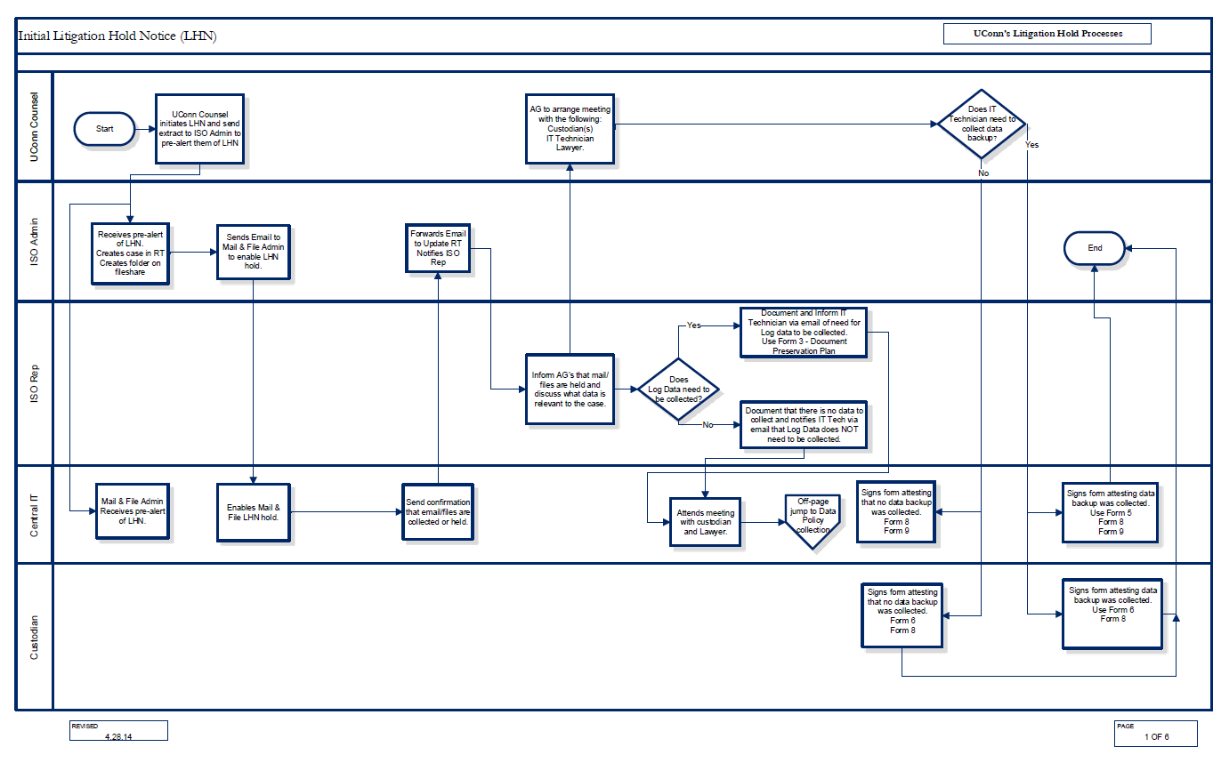

Slide 16
Drive Imaging Process
Information Security Office

Slide 17
Highlights/Considerations
Activation is determined by employee separation, computer repair or case severity
Flow identifies who is imaging: internal staff or 3rd party
Complexity of case
Skill set of staff
Contracts
Encryption keys collected and stored
Is the original drive retained or recycled?
i.e.: removable hard drives vs. SSD
Information Security Office

Slide 18
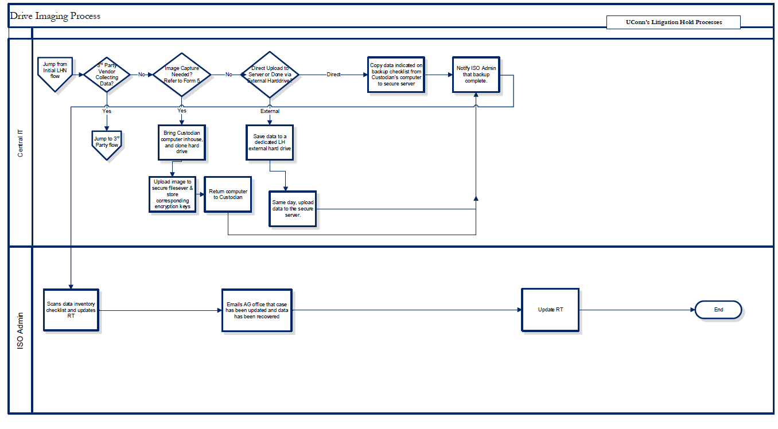
Information Security Office

Slide 19
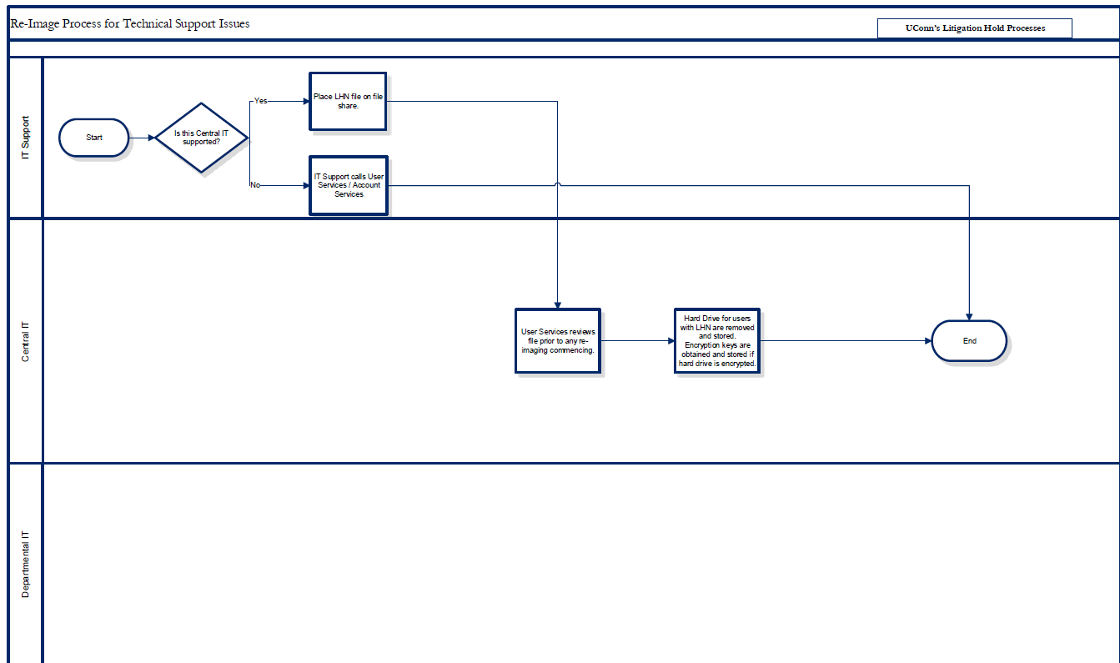
Information Security Office

Slide 20
Departmental IT/3rd Party Collection Process
Information Security Office

Slide 21
Highlights/Considerations
Activation is determined by case complexity
Flow identifies who is collecting: Departmental IT or 3rd party
Collection is done based off of completed survey
Information Security Office

Slide 22
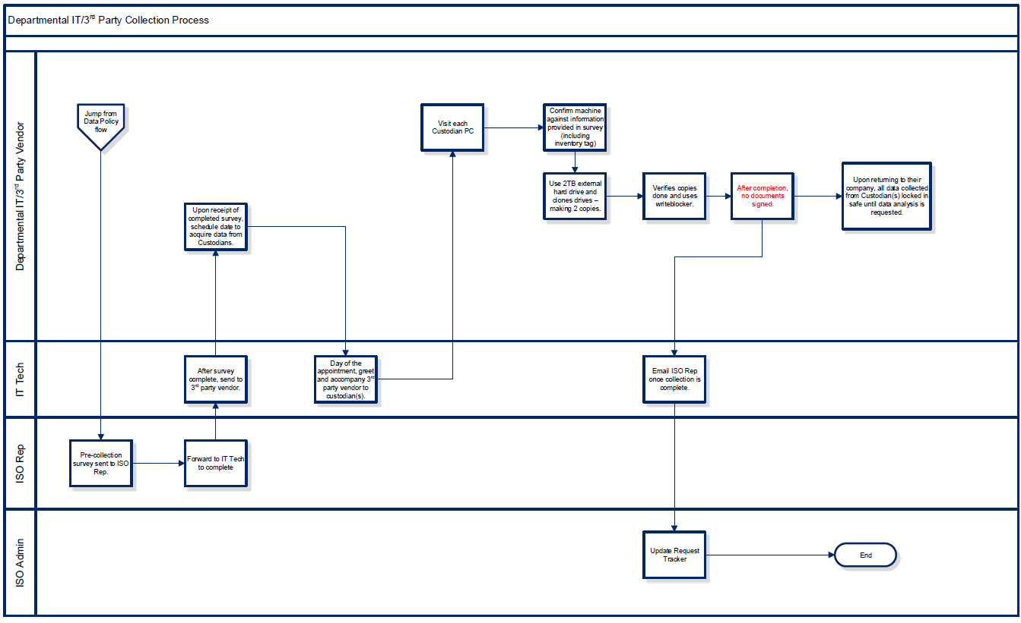
Information Security Office

Slide 23
Voluntary/Involuntary Termination Process
Information Security Office

Slide 24
Highlights/Considerations
Validates that at separation, relevant data are retained
Information Security Office

Slide 25
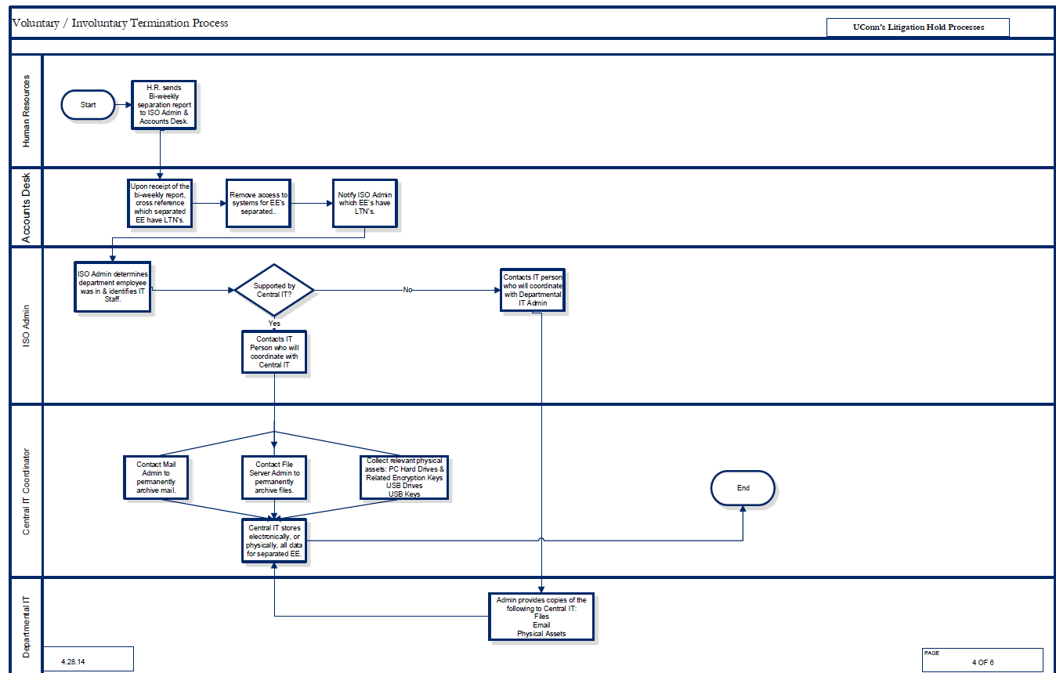
Information Security Office

Slide 26
Litigation Hold Release Process
Information Security Office

Slide 27
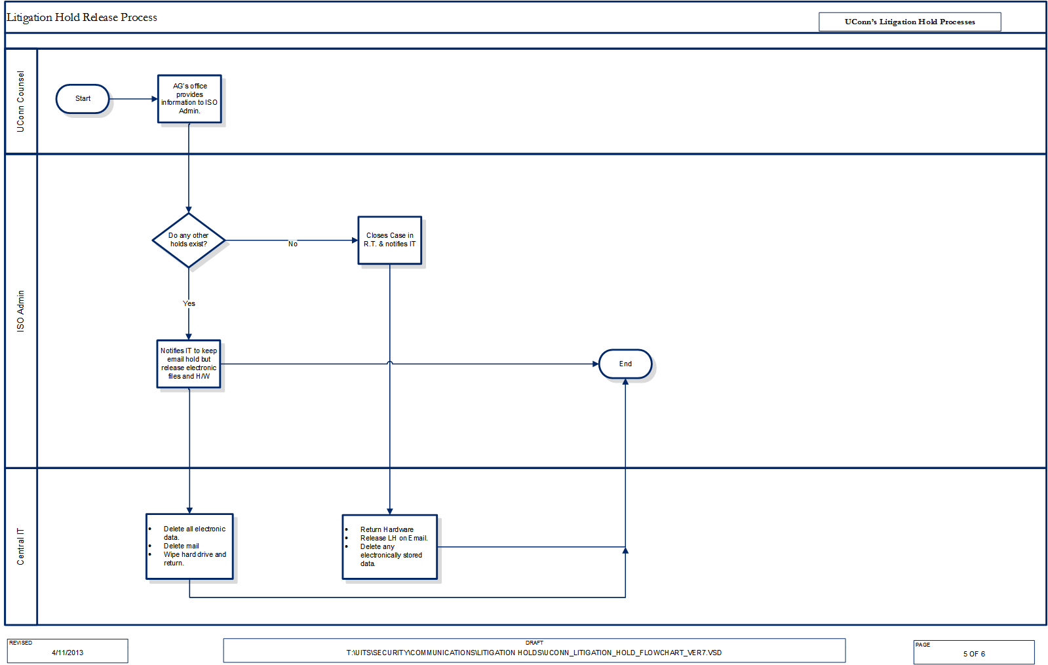
Information Security Office

Slide 28
Highlights/Considerations
ISO receives notification from the General Counsel's Office that the case is settled
Dispersal of electronic records
Information Security Office

Slide 29
Critical Points
Relationship with General Counsel
Process must satisfy both General Counsel and IT staff
Define reasonable processes
Adhere to those processes
Information Security Office

Slide 30
Attachments
Information Security Office

Slide 31
Information Security Office

Slide 32
Information Security Office

Slide 33
Information Security Office

Slide 34
Information Security Office

Slide 35
Information Security Office

Slide 36
Information Security Office

Slide 37
Information Security Office

Slide 38
Information Security Office

Slide 39
Thank You Jason Pufahl CISO jason.pufahl@uconn.edu 860-486-3743
Information Security Office

Slide 40
Our sincerest thanks to all attendees joining us in person and online.
On behalf of the 2014 Security Professionals Conference Program Committee

Slide 41
A few important reminders:
Complete the overall conference evaluation. You’ll receive an e-mail reminder soon.
Lunch for REN-ISAC Member Meeting & postconference seminar attendees will be held in the Arch View Ballroom, 12-1 pm.
We hope you’ve been inspired by your peers, made new connections, and identified some tangible takeaways.

Slide 42
May the force be with you!

