Slide 1

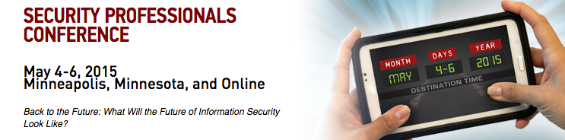
Building Awareness:
A Guide to Establishing a Successful Information Security Education Program
Notes:
Dan

Slide 2
Brief Outline
Dan/Ash Intro
Michigan Tech; Info, Org, History
Basics of a good security awareness program
Building the program (what, how, who)
Information security survey and metrics

Slide 3
Who we are:
Dan
I work for the SANS Institute
I’m not in Sales !
My role involves mixing technology and training in cool ways.
My goal is to help people and organizations be more secure. Period.
I worked for Michigan Tech University for 25 years.
I started as a student programmer and CAD operator in the 80s
I finished as the University’s CTO with responsibility for running IT, including infrastructure, services, telecom, security and compliance
I held many positions in the middle, Systems Programmer, Unix Administrator, Network Engineer, IT Services Director
And touched many, many technologies in the “pre-role days” of IT; pre-DBA, email, cable, network, storage, etc.

Slide 4
Who we are:
Ash
Chief Information Compliance Officer (CICO) at Michigan Technological University
IT Audit Background
  CISA (Certified Information Systems Auditor)
  IT Management Consultant
    Security Assurance-Plante Moran, PLLC
  Internal IT Auditor
    SOX 404-Dana Corporation
Notes:
Dan

Slide 5
Where we come (came) from:
Michigan Tech Basics
Public University
Total Enrollment: 6,957
Graduate Enrollment: 1,484
50 Majors
Carnegie Foundation Doctoral II status
400 Faculty, 1000 staff
Ranked programs in Environmental, Mechanical, and Metallurgical Engineering
Notes:
Dan

Slide 6


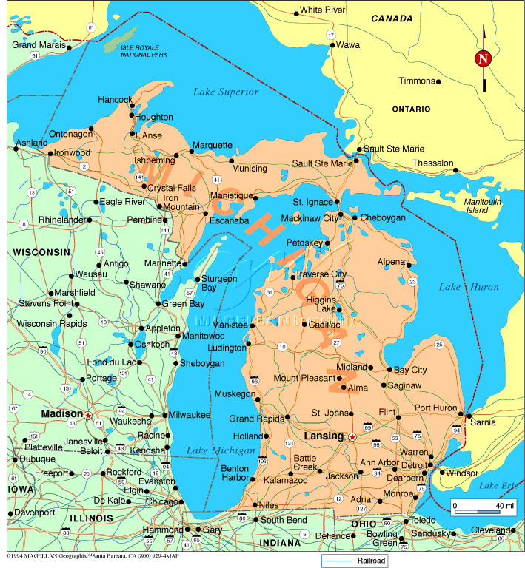
Where we come (came) from:
Wait…Where?
MTU CAMPUS
U.P. of Michigan
Lots and lots of snow
Far from everywhere
Average Snowfall - 180"
Record 396" (1978)
2013-2014 Snowfall – 333.5+”
Notes:
Dan

Slide 7

Evolution of Michigan Tech IT:
Organizational Pendulum
80’s Centralized
Mainframes, shiny shoes, slacks, even ties
90’s De-Centralized
Unix, PCs, Computer “Labs”
Interop, Networks, Email, Internet, Web
Jeans & T-Shirts
00’s Semi-Centralized
Economy of Scale
Chaos fatigue
10’s Re-Centralized
IT as a professional
predictable, professional partners for research and education
and, yes, even ties again
Notes:
Dan

Slide 8
Evolution of Michigan Tech IT:
Culture around Computing
Notes:
Dan

Slide 9
Evolution of Michigan Tech IT:
Culture around Computing
Notes:
Dan

Slide 10
Evolution of Michigan Tech IT:
Culture around Computing
Notes:
Dan

Slide 11
Evolution of Michigan Tech IT:
Culture around Computing
Notes:
Dan

Slide 12
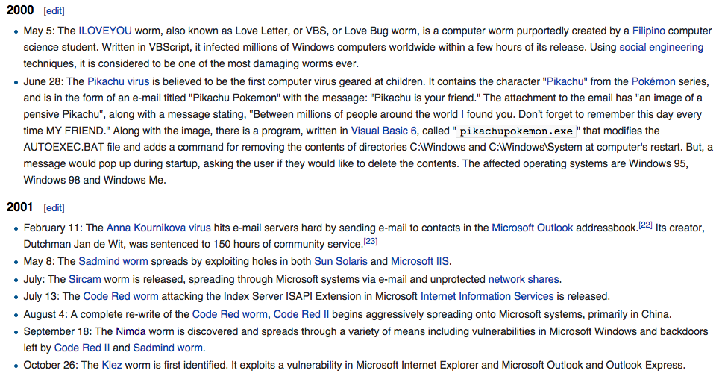
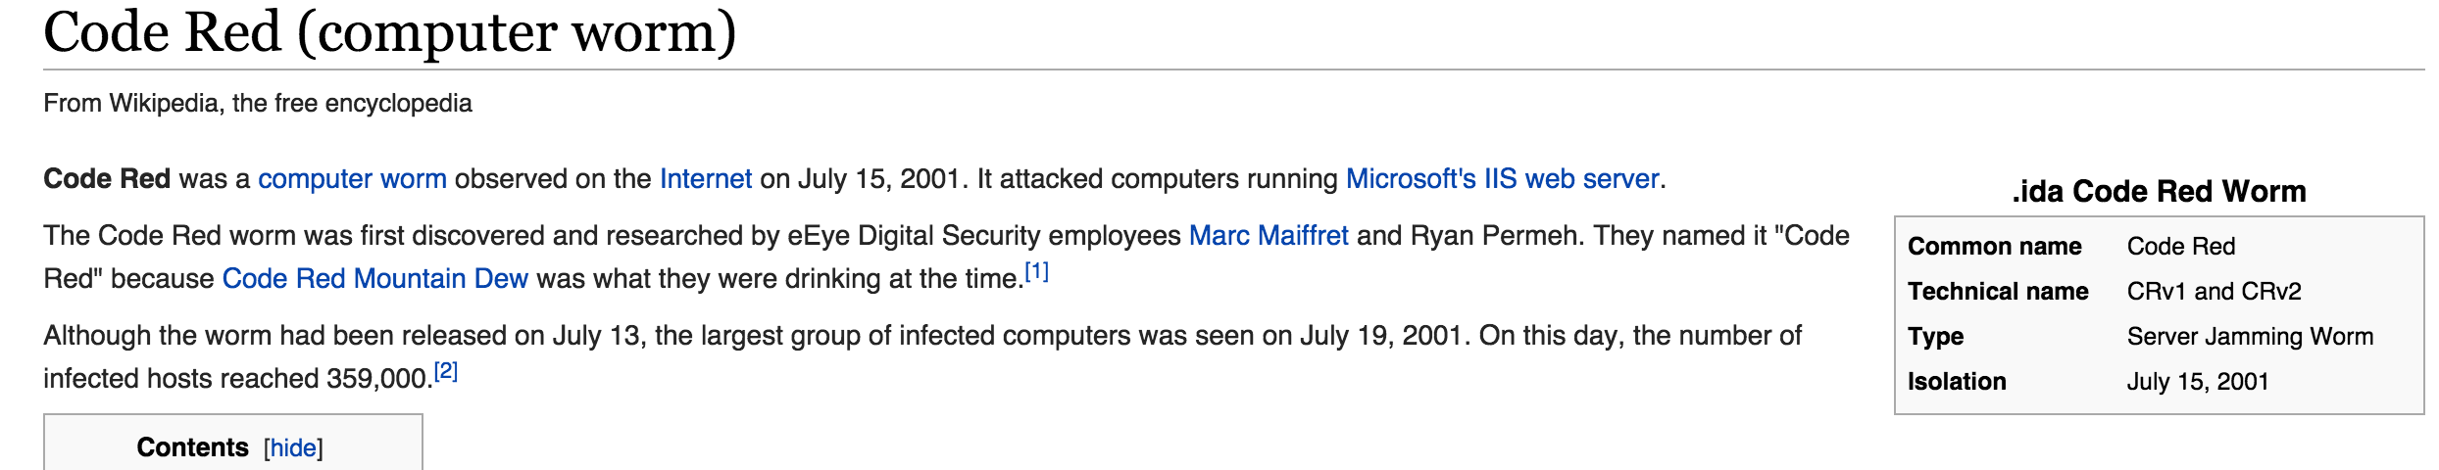
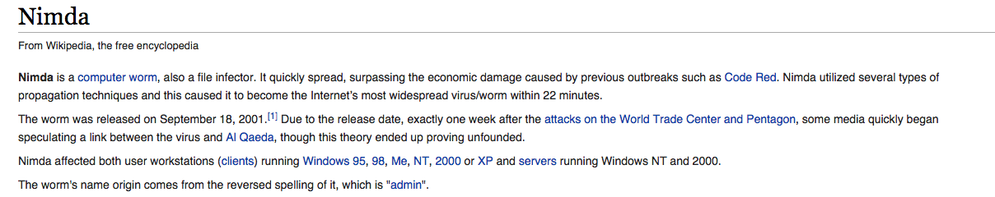
Evolution of Michigan Tech IT:
Early 2000s emerging threats
Notes:
Dan

Slide 13
Evolution of Michigan Tech IT:
Other “Kicks in the Pants”
IT became daily-life important
Privacy and information security became a thing
“garage band” became ITIL complient
Budget, project, security management became professional IT expectations
When the dust settled, we were around 6-10% of the University budget. (big target)
Notes:
Dan

Slide 14

Current State:
Unified IT, InfoSec, and Compliance Governance
“Normal” IT Stuff
Infrastructure
Telecommunications
IT Services
Operations
User Services
Media Technology
Enterprise Computing
Also
IT Project Management
IT Budget Management
CISO – “Technical” Security
CICO – “Information” Security
Notes:
Dan

Slide 15
Current State:
How we see the CISO role
Typical “Technology Oriented” Cyber Security Role
  Computer Security
  Network security
  Forensics
  Incident Response
  IDS/IPS
  Perimeter defense
Notes:
Dan

Slide 16
Current State:
How we see the CICO Role
Chief Information Compliance Officer
  Overall responsibility for compliance with information security laws, acts, contracts, etc.
    (PCI, FERPA, GLBA, HIPAA, RFR, etc.)
  Responsible for Info Sec and Cyber Policy
    (ISP, Data classification, retention, access, AUP, etc.)
  Responsible for all security awareness training
  Point on breach response, risk, legal
Notes:
Dan

Slide 17
We are here to talk about User Security…
Not Technical security (firewalls, VPNs, AV, etc.) is justified, specified and PURCHASED.
Not Operational security (patching, CM, coding) is proceduralized, centralized and MANDATED.
But User Security (i.e. Human Behavior) This is encouraged , coaxed, and “hoped for”… How do we fix that?
Notes:
Dan

Slide 18
A few items:
What is “successful”?
Getting it Done:
  Why relationships matter.
  Partnering for resources.
  Gaining consent.
  Be greedy long-term.
Prelude to an Awareness Program

Slide 19

Defining Success: Security Awareness
Maturity Model
Metrics Framework
Long Term Sustainment &
Culture Change
Promoting Awareness & Behavior Change
Compliance Focused
Non-Existant

Slide 20
Hallmarks of InfoSec Maturity
It’s a process, not an event
It’s a culturally understood necessity
It’s empathetic
  To people
  To “the business”
It’s also insistent
It helps document progress and success
It reduces, not increases fear

Slide 21
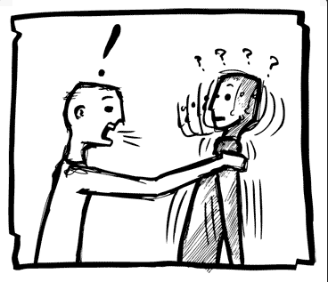
Getting it done
Support is needed across many levels
  Staff respond to awareness, carrots and sticks
  Middle management need to understand
  Executives expect value

Slide 22

Know your partners
Style: old-school
Likes: Excel, white shirts, ties, company lapel pins
Dis-likes: techno-babble, acronyms, IT deep dives
Listens to: Things expressed as Risks, Returns, Value, Costs
Core Values: ROI, “the bottom line”, Analytics
Ready for a real partnership which will produce meaningful progress toward reducing risk, measuring progress, getting things done. Seeking solutions, not big, scary problems.
Executive Team
“…I’m really busy, but would gladly take the time for someone to get to know me, my world, and my challenges.”

Slide 23
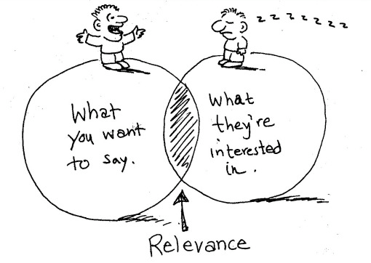
It’s not me it’s you…
Listen to your partners
Learn what matters
Help meet challenges without creating to many

Slide 24
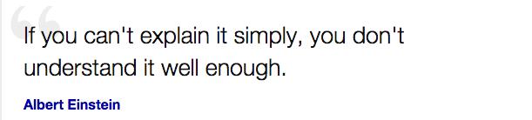
Talking to Execs, Managers, and Staff
Things I needed to remember…
This (the U) IS a business, our business!
Technology is a part of our business
Technology can be a threat!
Customers are customers, not simply users
At any rate, keep it simple
….and wear shiny shoes ☺

Slide 25
A Few Examples
Establishing and resourcing a CICO
Attaining policy but-in
Getting resources
…In other words: How we got the people, policy, authority, and, $ to make a difference…

Slide 26
How we did it
Example 1: Hire a CICO
Connect with the right partners: Executive Team, Risk Management, Internal Audit, IT Security
Note that we were already considered for “information security” by association with computer and network security
Connect to University priorities and “hot” topics
FUD was used, but carefully
Bring them a plan not a problem

Slide 27
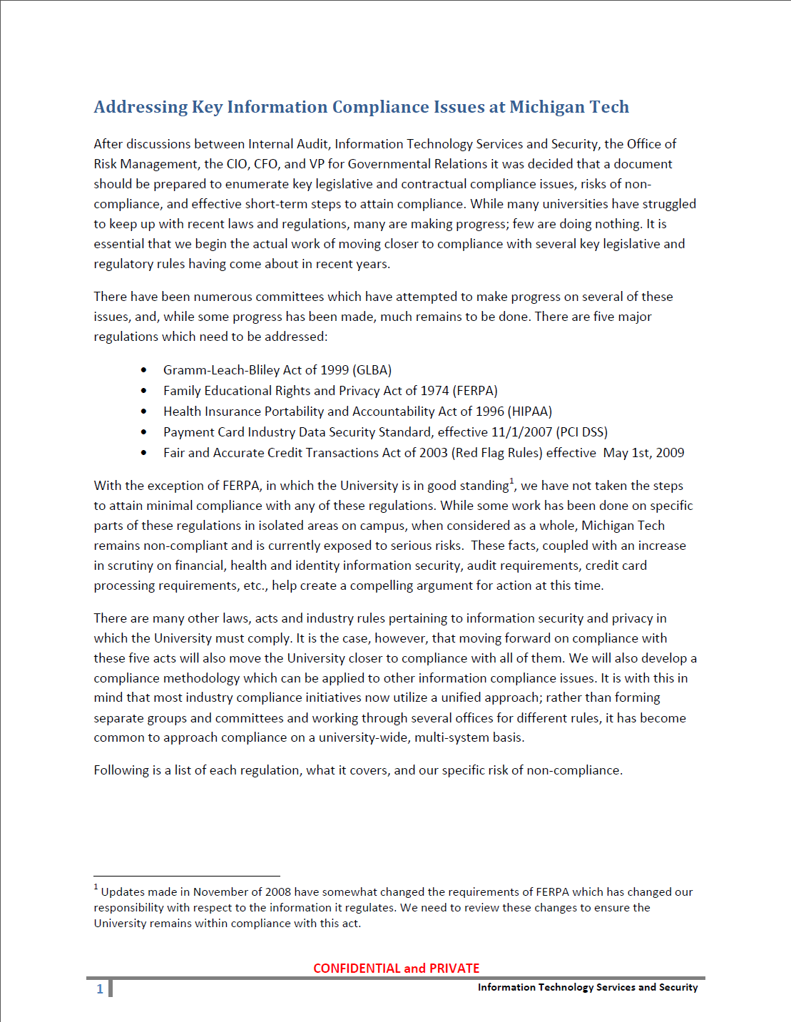

Slide 28
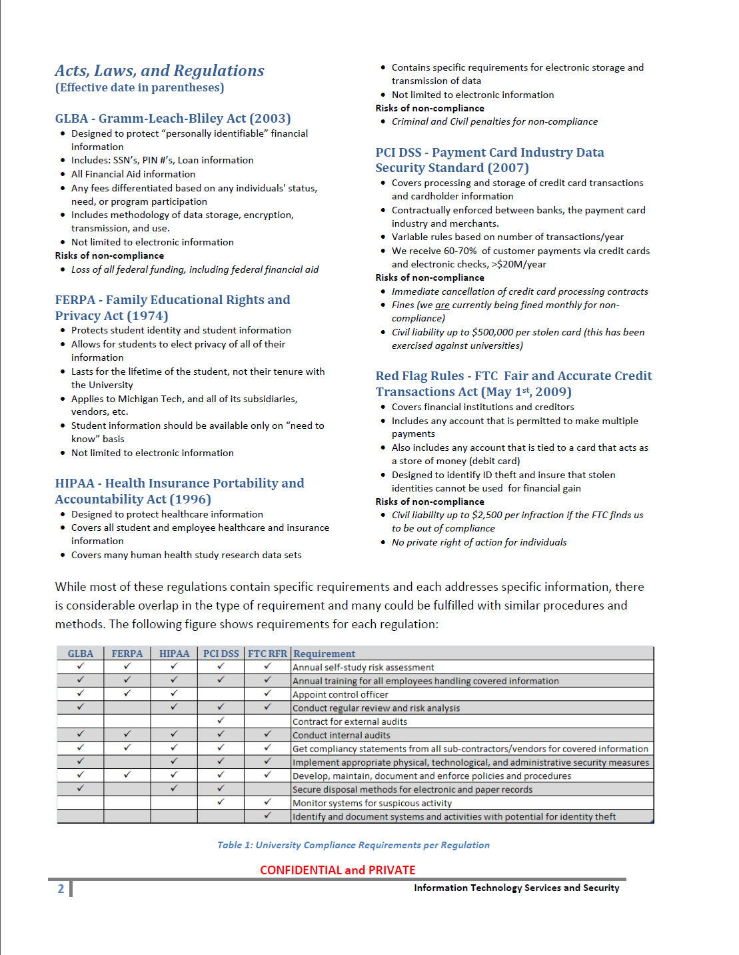
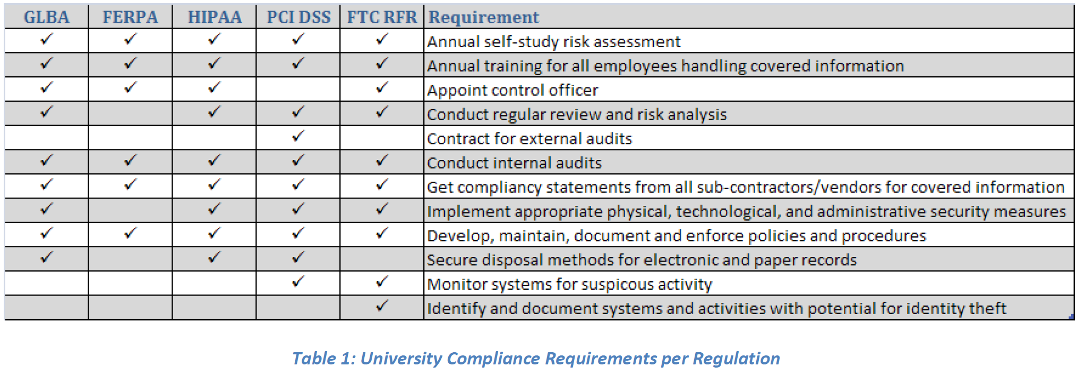

Slide 29
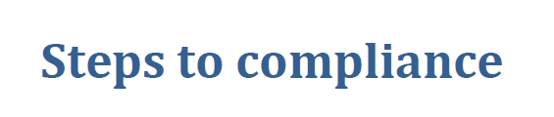
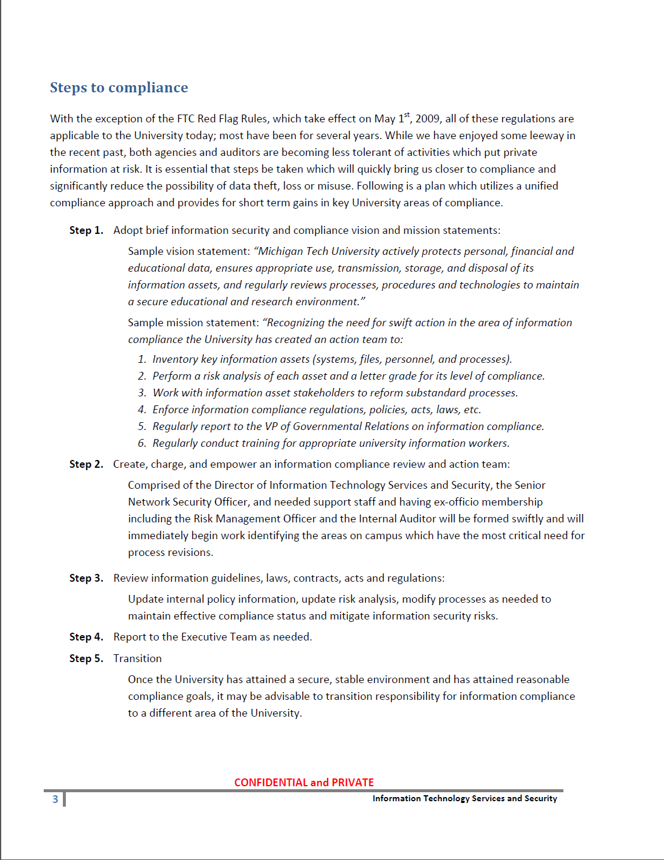
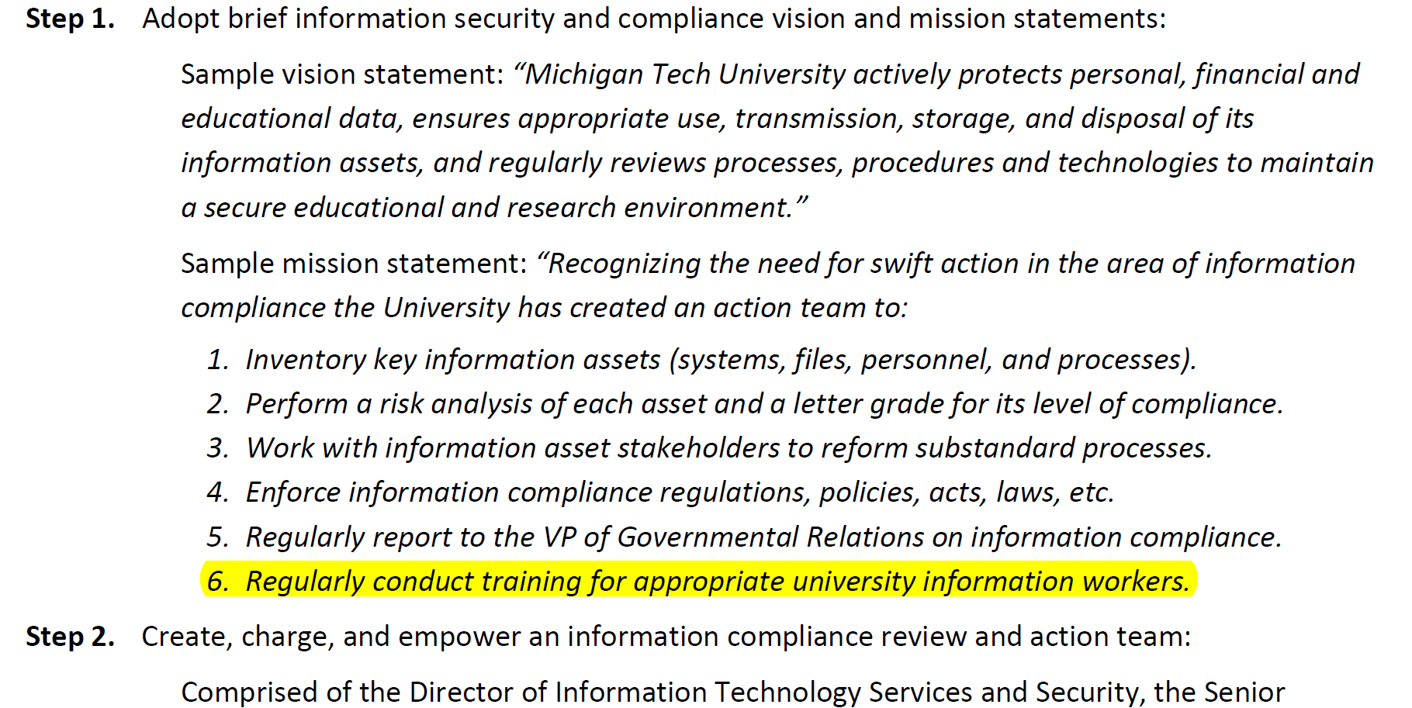

Slide 30
Example 2:
Getting Consent, Buy-in and Authority
NSTF (Network Security Task Force) 2001
  Cross campus group to deal with computer and network security
  Established resources for “Network Security Officer” (pre-CISO)
  Establish central IT authority over security policy and enforcemet
Special Executive Committee Group - 2008
  Identified need to treat Information Security differently than Technology Security
  Resourced Staff for Information Compliance
  Establish Authority of ISBR
ISBR (Information Security Board of Review) 2009
  CTO, Risk Management (EVP), CICO, CFO
  Authored and reviewed policy
  Endorsed (and enforced) training policy

Slide 31
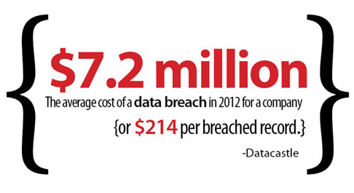

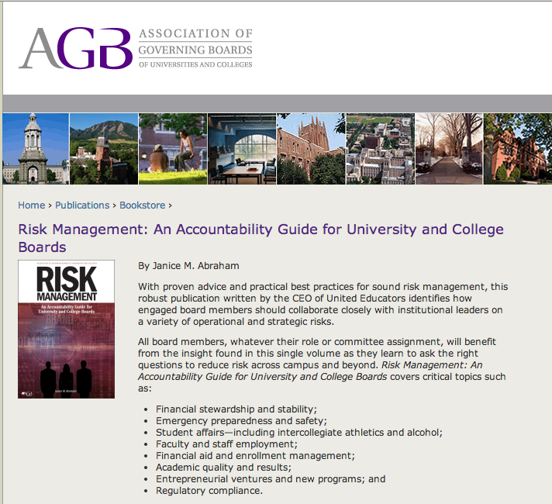
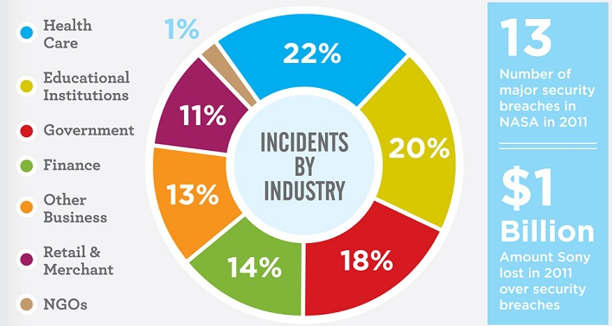
Remember, Use the Tools of the Day
Compliance needs (I have FERPA, GLBA, HIPAA, PCI…)
Risk assessments
News (especially of peers)
Case studies
Remember (again):
Don’t bring problems, bring solutions

Slide 32
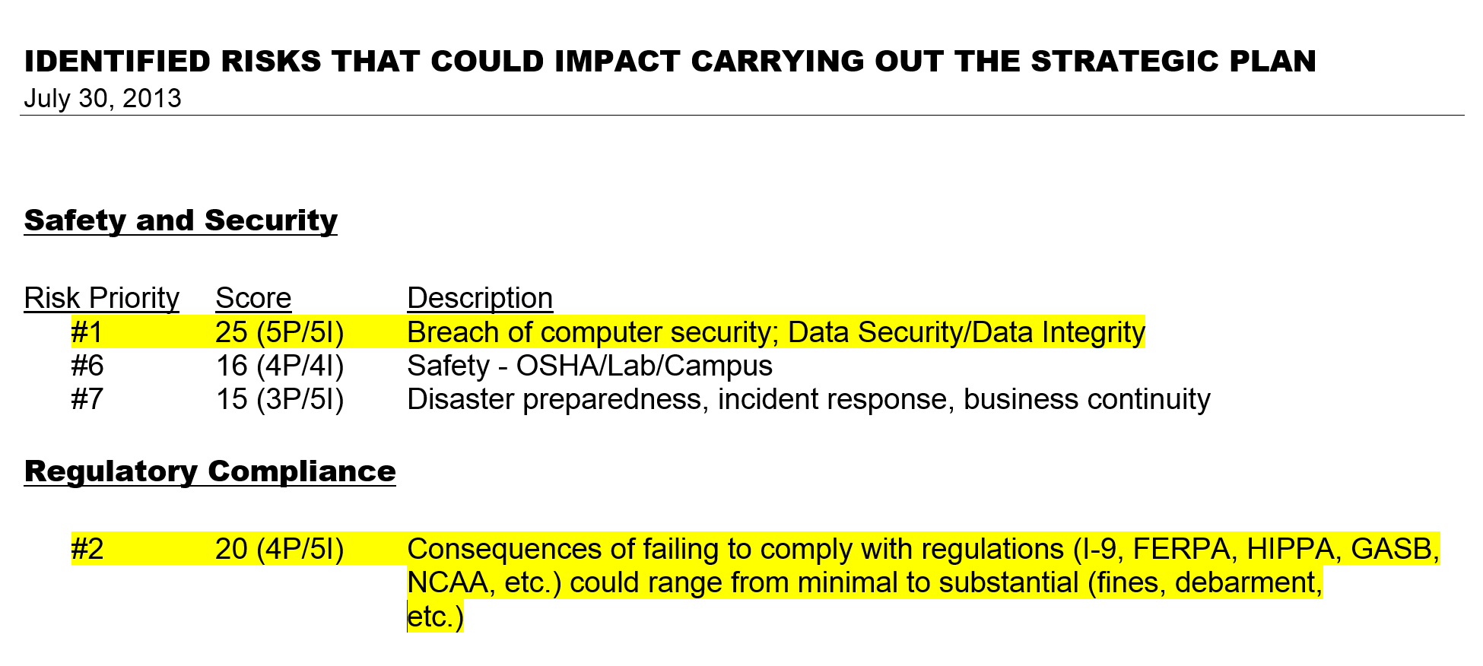
It never rains…
From BOC mandated risk assessment
Summer 2013

Slide 33
Example 3: 2013 External Review

Slide 34
Project scope.
KICK-OFF MEETING
The following is the scope of the engagement:
IT General Controls Review
Logical Access
Security Access Management
Administrative Security
System Password Management
Access Privilege Review
External Threat Management
Security Policy Administration
IT Security Awareness and Training
Device & Media Controls
Change Management
IT Program and System Modification
Change Authorization
Development Testing
Implementation Access
Emergency Change Management
Vendor Release Management
IT Operations
Data and IT System Backup
Antivirus Administration
System Patch Management
Data Center Physical Security
Data Center Environmental Controls
IT Operational Monitoring and Reporting

Slide 35
Project scope.
KICK-OFF MEETING
Engagement Scope Continued
Internal Network Security Assessment
External Security Assessment
Firewall
Remote Access (i.e. VPNs)
Internet Accessible Servers
Web Applications
Social Engineering
Internet Postings/Social Media
Internal Security Assessment
Servers
Workstations
Storage Systems
Multifunction Devices
Virtual Environment
Password Strength
Databases
Data Encryption
Infrastructure
Wireless

Slide 36
Review results….
(controls, IDM, CM, DR/BC)
Lesson Learned: Be careful what you ask for ☺

Slide 37

2002-2014 Resources Results
Staffing
  Hired Chief Information Security Officer,
  Hired Chief Information Compliance Officer
Authority (IT-CISO-CICO)
  Broad responsibility for policy, enforcement, audit, and training
  Covering both technology and information
Accountability (to ET)
Budget
Partnership
Charge includes *all* information (student, finance, healthcare, etc.)

Slide 38
More than Money: Culture Shift
University IT staff became the accepted experts to help address information security challenges.
The expectation simply became that IT could and would address the myriad of privacy, policy and security concerns.
We “got good” at getting resources by establishing common cause with the leaders at many levels of the University; Execs, HR, Audit, Risk, Deans, Registrars, Students, and on and on…

Slide 39
Early CICO work: Precursors to Security Awareness Program
Started with PCI DSS compliance (this was a critical-care item)
  Needed to understand processes, procedures, and key players
  Questioned EVERYTHING & EVERYONE
  Performed initial (informal) risk assessment of current state
    HIGH RISK
    As it turned out, change was needed
Notes:
Ash

Slide 40
Early CICO work: Precursors to Security Awareness Program
Reviewed risk assessment findings with Executive Team
  Creation of the ISBR (Information Security Board of Review)
  Provided oversight and direction regarding information systems security and privacy assurance university-wide
  Got a new hammer: the ability to literally shut down non-compliant CC processing environments.
  ***New position- “Expert”
Notes:
Ash

Slide 41
Early CICO work: Precursors to Security Awareness Program
Developed remediation plan and strategies to mitigate high risks identified
  Roughly 100 dial up or networked terminals across campus
  Worked with CTO and the rest of IT to develop a complaint solution that provided the same functionality, with limited business process change
    Virtual Cashiering Stations
Notes:
Ash

Slide 42
Early CICO work: Precursors to Security Awareness Program
Drafted Information Security Plan
Notes:
Ash

Slide 43
Early CICO work: ISP
University Policies
  Information Security Compliance Policy
    University Confidentially Agreement
    Training
  Acceptable Use of Information Technology Resources
Notes:
Ash

Slide 44
Early CICO work: ISP
IT Policies
  Data Classification and Protection
  Identity & Access Management
  Password
  Backup & Recovery
  IT Incident Handling
Notes:
Ash

Slide 45
Zoom out
We have basic cyber security, information security, well underway.
We have policy and authority
We were ready to formalize and organize our information security training program!
And to MEASURE it’s results
Notes:
ash

Slide 46

Reducing People Risk
•••••••••••••••••••••••••••••••••••••••••••••••••••••••••••••••••••••••••••••••••••••••••• … phishing… bad browsing… social media… password discipline… data security standards… incident response… information handling… mobile device data… cyber attacks… byod…•••••••••••••••••••••••••••••••••••••••••••••••••••••••••••••••••••••••••••••••••••••••••••••••••••••••••••
Managing and Measuring Human Behavior
Notes:
Dan

Slide 47

Compliance is a step toward the goal, not “the” goal.
…hmmmm
security…
Compliance
Tech
Ops
Training
Awareness
Behavior
Notes:
Dan

Slide 48

The big deal…
User security depends on user behavior; not on compliance, or training, or awareness.
If behavior does not change the awareness has no real value.
If this change is real it must be measured.
Notes:
Dan

Slide 49
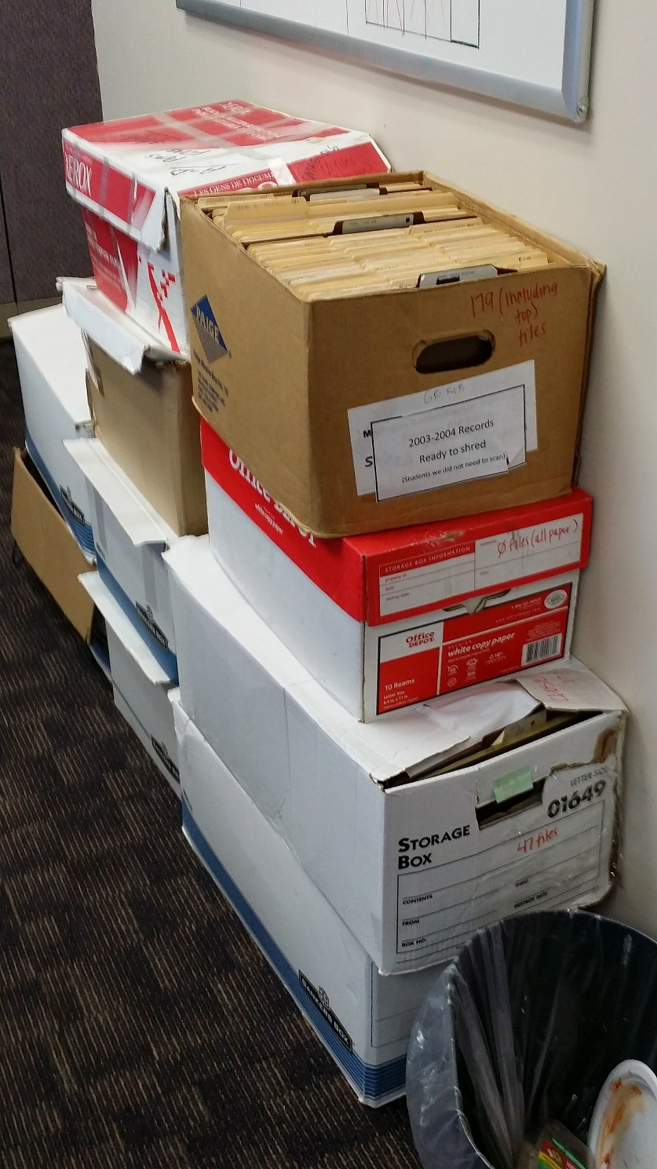
Ever Seen This?

Slide 50
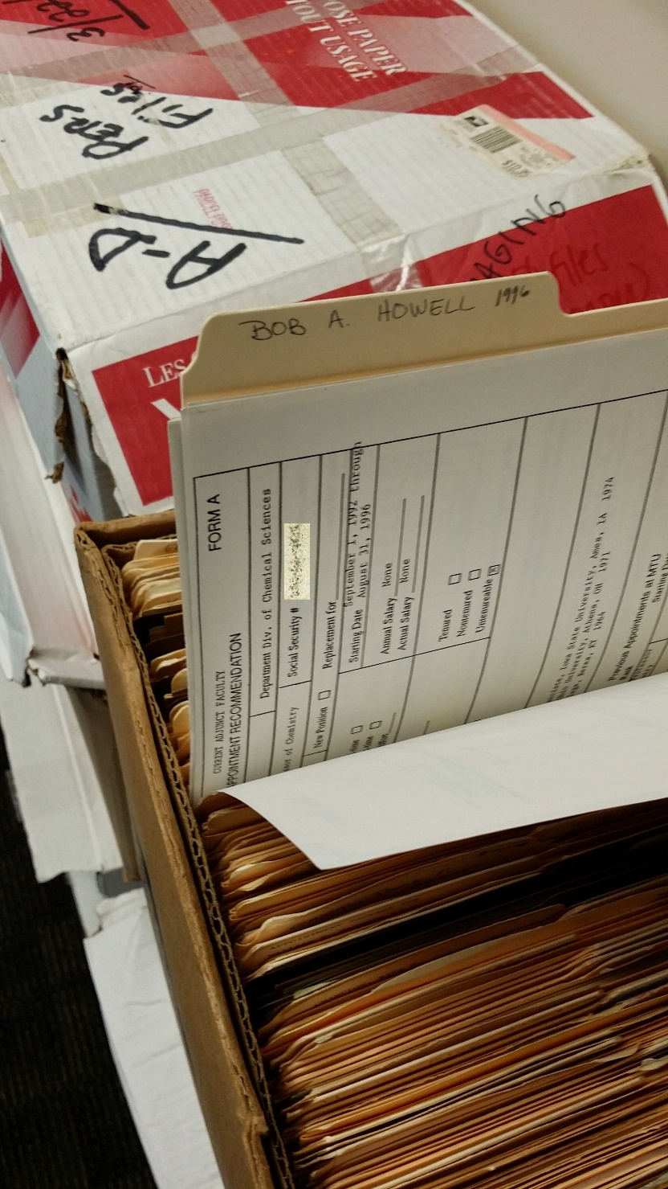
User Behavior Confirmed ☹

Slide 51

Goals
Develop comprehensive training and assessment system which will:
#1 - Improve Behavior
#2 - Apply training appropriately
#3 - Develop metrics and analytics
#4 – Rinse and Repeat (process, not event)
Notes:
Dan

Slide 52
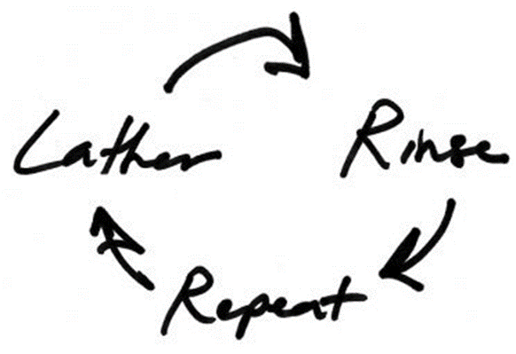
Our Solution: TARR System
(Train, Audit, Review, Remediate)
Combine HR, people, and security survey data
Score risk: per person, department, division
Target training where appropriate
Audit where needed
Implement business or technology changes where necessary
Rinse / repeat (2010, 2012, 2014,…)
Notes:
Dan

Slide 53
First, Remember Our Partners
We modeled institutional organizational data
People, Org Structure, Supervisors
Divisions and VPs/Execs
Got divisional support
Had VPs send emails (we wrote them)
Had them take the survey first
Emailed all supervisors (No Surprises!)
Notes:
Dan

Slide 54
Yikes! Not another Survey
Average survey time: 4 Minutes
2014 Participation Rates by Group
Group | Surveyed | Responded | Pct
Custodial | 176 | 102 | 58%
Faculty | 480 | 338 | 70%
Staff | 1140 | 779 | 68%
Student Employees | 2069 | 1072 | 52%
Grand Total | 3865 | 2291 | 59%
Notes:
Dan

Slide 55
Survey Construction
What do you handle?
Where do you get it?
Where do you keep it?
How is it destroyed/discarded?
Notes:
Dan

Slide 56
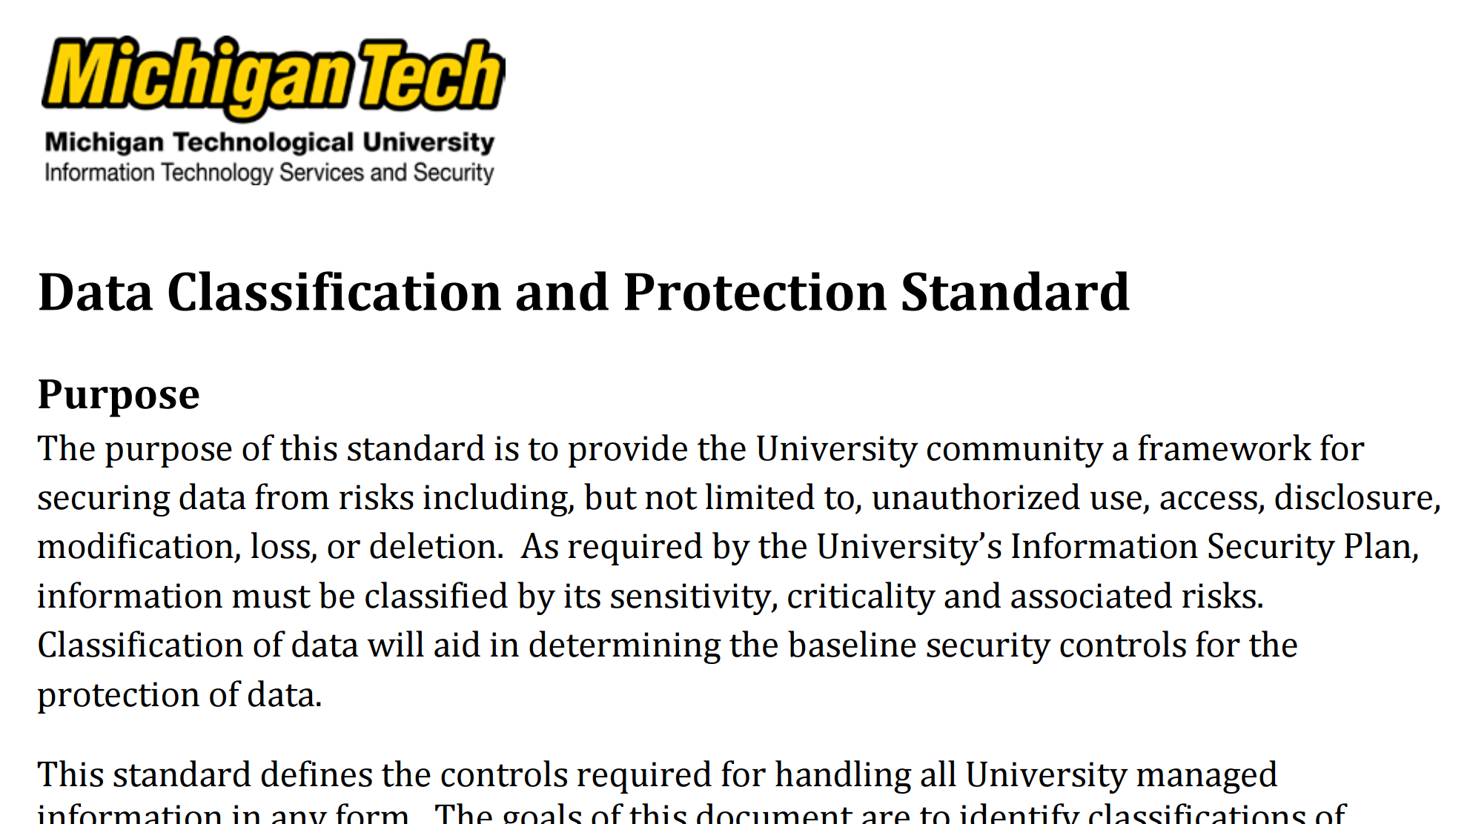
Consider Information Classification Policy
Notes:
Ash

Slide 57
Information is broken into three buckets
Tier 3 (public)
  Directory information
  Salary information
Tier 2 (private or internal)
  Student id numbers
  Class schedules
Tier 1 (confidential)
  Credit card information
  SSN
  Banking
Notes:
Ash

Slide 58

Scores Calculated for “In Scope” Data
Code | Tracked Information
PIFI | PI Financial Information
HCI | PI Healthcare Information
SSN | Social Security Numbers
DIR | Directory Information
Crim | Criminal History
GovID | Government Issued ID
Photo | Photographic or Biometrics
CC | Credit Card Information
VclID | Vehicle ID
Mnum | University ID Number
Notes:
Dan

Slide 59
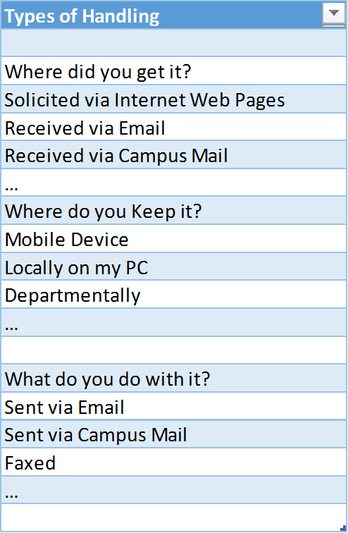
Information Handling Types
Notes:
Dan

Slide 60
Mix The What With The How
Combine handling practice with information tier to produce rough risk estimate
For Example:
Directory Information + Web = “Low”
SSN + email = “High”
Anything + Credit Card = minimum of Medium
…and Audited
Notes:
Dan

Slide 61

Let’s take a look at the Survey

Slide 62
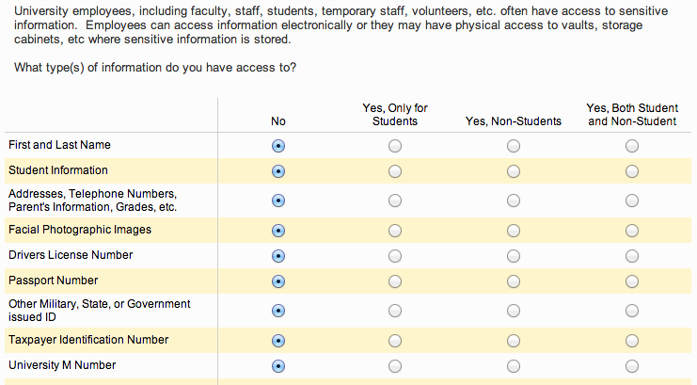
Survey Part 1: What do you handle?

Slide 63
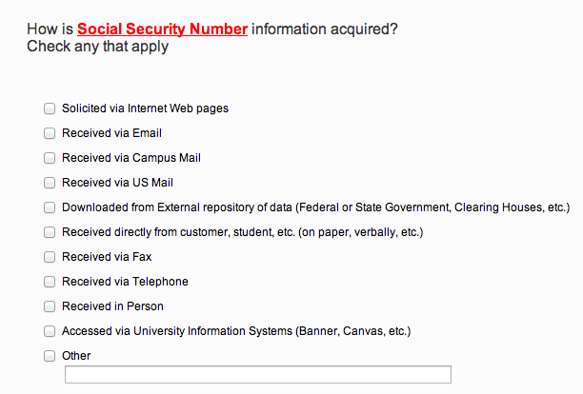
Survey Part 2: Where do you get it?

Slide 64
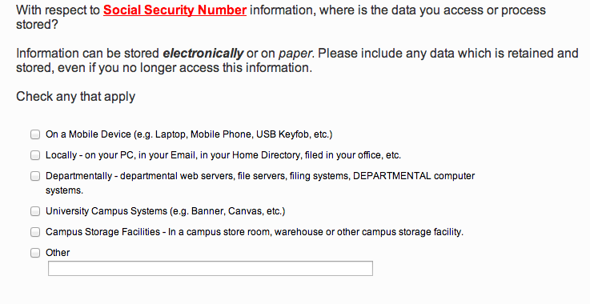
Survey Part 3: Where do you keep it?

Slide 65
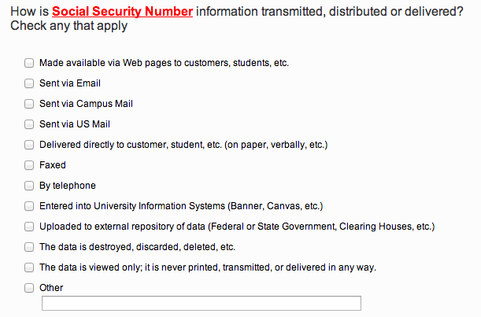
Survey Part 4: What do you do with it?

Slide 66
Responses

Slide 67
How We Calculated a Security Score
Each “usage” type has a score and a risk value
Scoring:
add 1 for low-risk answer
add 100 for medium-risk answer
add 10000 for high-risk answer
Sum by Group (CC/PIFI/HCI), Risk level, or score

Slide 68
Example Score Calculation: PIFI
Sally Mnumber
Sally’s PIFI Score
Gets PIFI from 1 low risk place
Stores PIFI in 1 low risk place
Transmits via 3 ways (1 high risk, 2 low risk)
Score is thus 10004 (1x10000+4)

Slide 69
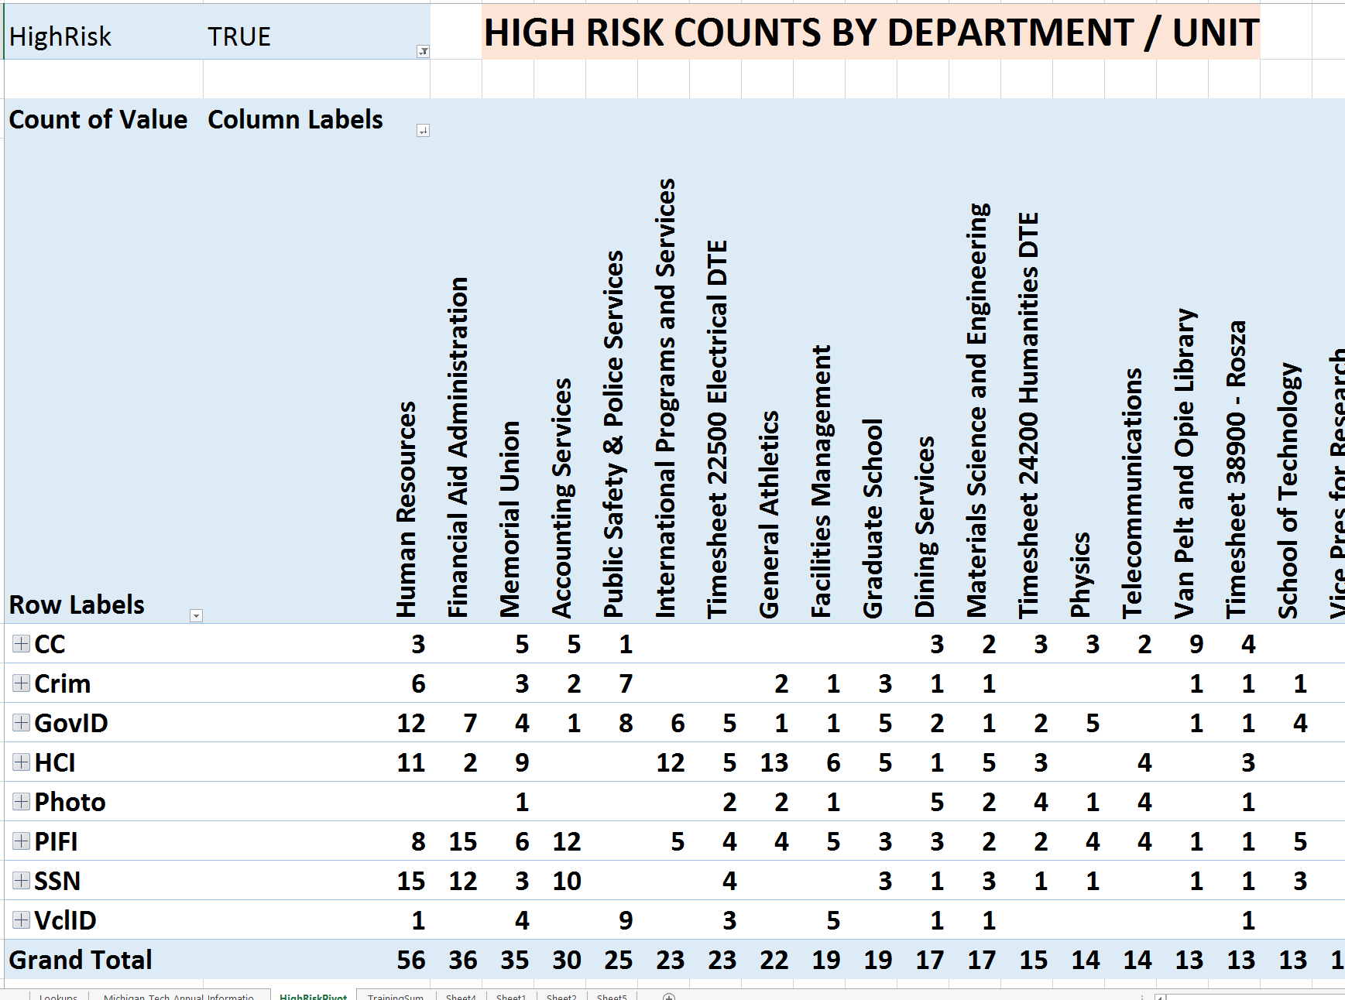
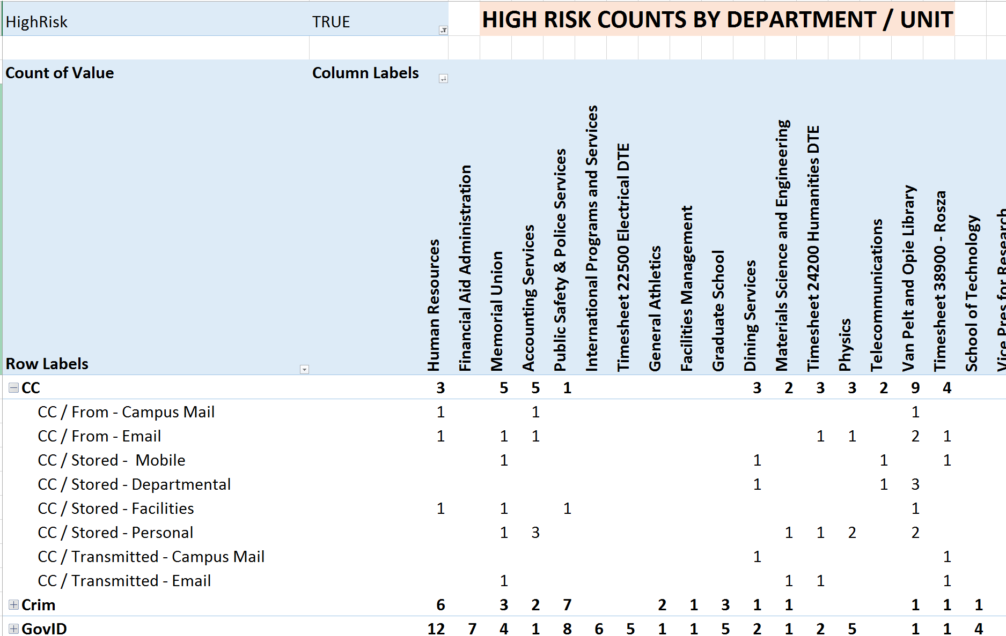
Risk: Summed.

Slide 70
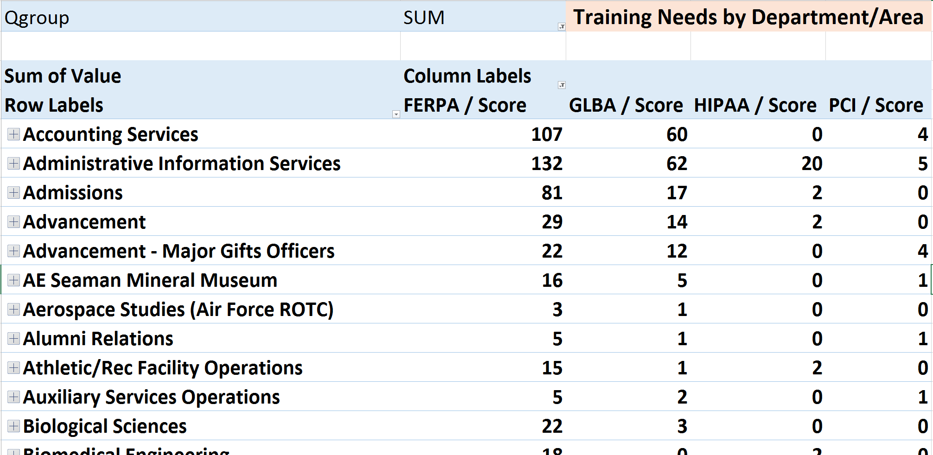
Training Directed by REAL Access
Estimated campus-wide training: $2,000/Minute

Slide 71
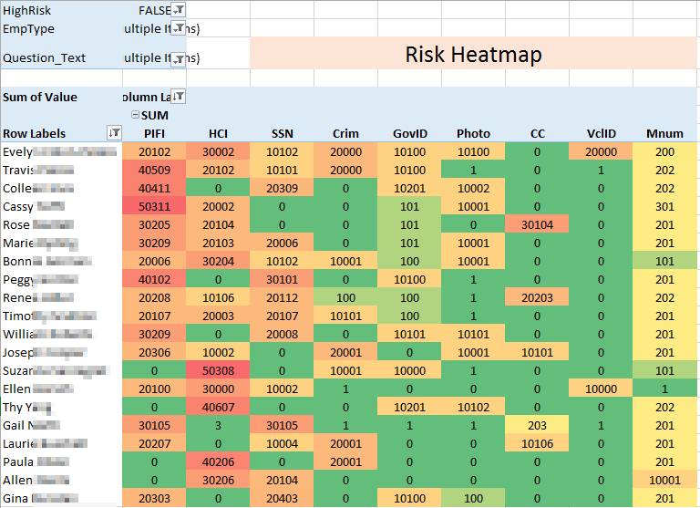
Risk: Measured.

Slide 72
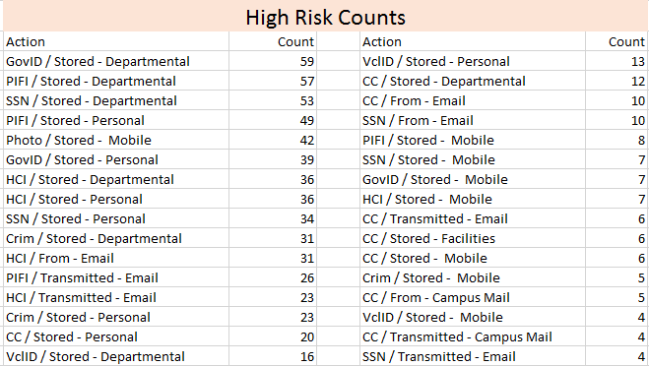
Risk: Counted.

Slide 73

Finally…
Training is directed by access (by department/unit)
Audits are directed by risk (not reputation)
Reviews and remediation can be swift
Risk can be accessed at person, department, division levels

Slide 74
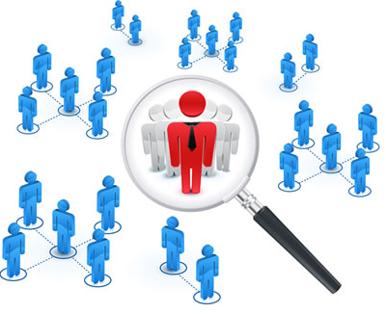


In other words
We developed a repeatable, measureable process that helped us address risk by the appropriate application of IT, IT Security, and Compliance Resources.
And, we were able to actually show if it worked!

Slide 75
Human Risk Metrics
•••••••••••••••••••••••••••••••••••••••••••••••••••••••••••••••••••••••••••••••••••••••••• … phishing… bad browsing… social media… password discipline… data security standards… incident response… information handling… mobile device data… cyber attacks… byod…•••••••••••••••••••••••••••••••••••••••••••••••••••••••••••••••••••••••••••••••••••••••••••••••••••••••••••
The Impact of Awareness

Slide 76
Measured Multi-Year Effect

Slide 77
Trend in Score by Department/Area

Slide 78
Individualized Trend/Training Data

Slide 79

Danger!

Slide 80
Complex Year-by-Year Risk Path

Slide 81
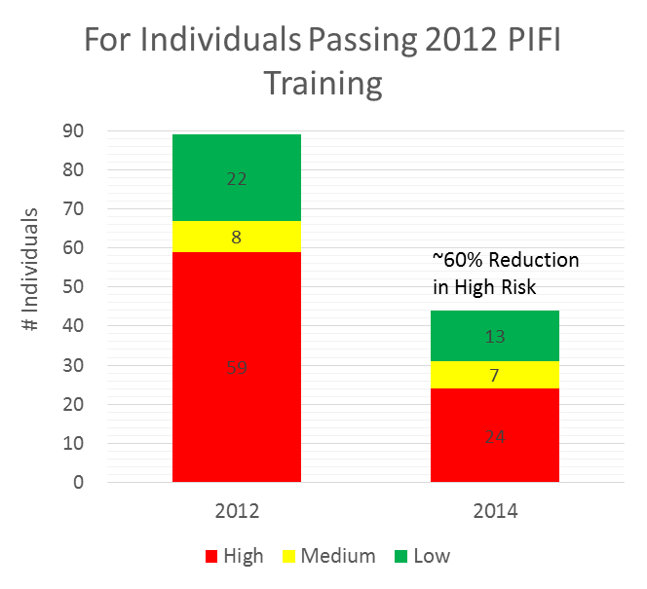
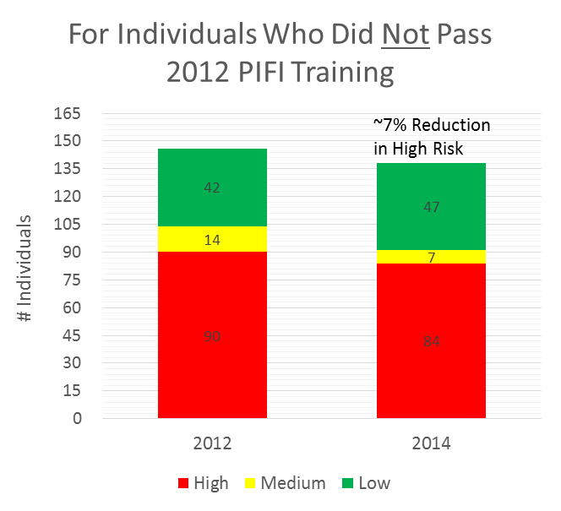
Overall Effect of Training
End User Risk Pool
End User Risk Pool

Slide 82
Important Finding: We Can do This
We can measure what people do do… it’s not perfect, but it’s pretty darn good.
We can show changes in behavior as a result of our security awareness training program.
We can develop a plan and demonstrate success.

Slide 83
Looking Back
How to develop training content?
  First started with narratives and talking points
  Recorded Dan talking with a whiteboard as a tool
  STH came along thanks to our CISO
  Training was kept in-house (blackboard)
  Worked with STH to develop required content
  Moved to Canvas- SCORM issues
  Moved to hosted solution
Notes:
Ash

Slide 84
Looking Back
How to determine training needs?
  Initially had no idea who had access to what
  Developed first survey using Lime survey (free)
    More functionality than survey monkey but still limited
  Reviewed with Executive Team and got support
  Advertised and promoted survey
  Executed
    I got lots of hate mail
  Sent reminder notifications….even more hate mail!
Notes:
Ash

Slide 85
Looking Back
How to determine training needs (2)?
  Extended survey deadline…imagine that!
  Sent report of those who did not complete training to respective EVP
  Understanding was that who did not complete would be enrolled in all training modules
Notes:
Ash

Slide 86
Looking Back
How to determine training needs (3)?
  Analyzed survey data
    What a mess!
    All (or most) of our “logical” assumptions were wrong
  Created 4 basic groups
    General (included FERPA)
    HIPAA
    PCI DSS
    GLBA
Notes:
Ash

Slide 87
Where we are today
Survey
  Currently being reviewed by “experts” to enhance survey questions to make more clear
Training Needs
  Survey produced baseline, working with department's to define training by job function
Training
  Face to face and STH
Notes:
Ash

Slide 88
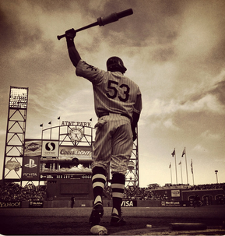
On deck
Integrate all data regarding user risk score
  TARR
  STH
  Phishing
Connect to HR position control and IT IDM systems
Add employee change and lifecycle logic
Train all incoming students
Notes:
Dan

Slide 89
A few more specifics
STH license for all of campus
STH Phishing for all of campus
HR/SIS/ERP system = Ellucian Banner
IDM = Fischer International
TARR tool = Qualtrics + (a lots) of Excel
Notes:
Dan

Slide 90
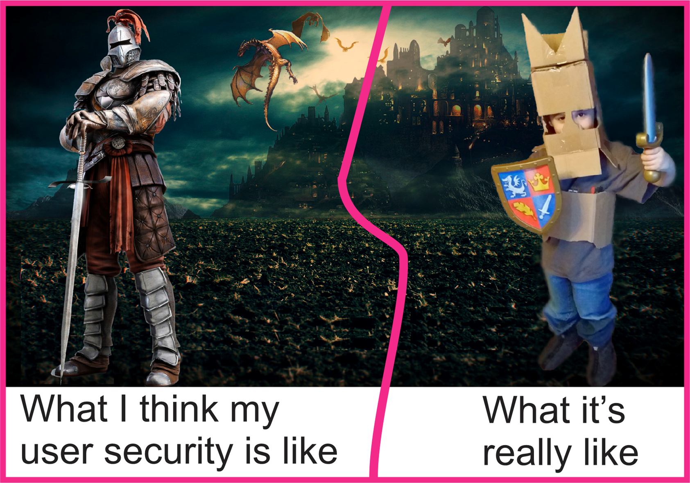
Questions?
Dan deBeaubien – dan@sans.org
Ashley Sudderth – ashley@mtu.edu
Notes:
Dan/Ash

