Slide 1
From Data to Wisdom
Transforming Security Events into Actionable Incidents
Allison Henry, Security Operations Manager, akhenry@berkeley.edu
Steven Hansen, Security Operations Developer, runner@berkeley.edu
Information Security and Policy at UC Berkeley

Slide 2
Presentation Outline
About Information Security and Policy at UC Berkeley
Overview of DIKW Model
DIKW model for Security Operations
Example: DIKW for Intrusion Detection
Demonstration of tools
Q/A and discussion

Slide 3
Information Security and Policy (ISP)
Provides wide range of information security services for UC Berkeley
Led by Paul Rivers, UC Berkeley CISO
Security Operations
Assessments and Compliance
Contracts and Legal Services
IT Policy
Key services and capabilities
Intrusion detection
Vulnerability detection
Incident and breach response
Security assessments
Application pen testing
Data privacy and security in contracts
Compliance support
Policy support
DMCA compliance
Consulting and architecture reviews
Notes:
UC Berkeley campus has a large, open, and highly decentralized network and IT infrastructure. Due to the challenges of securing a large and open network, we take a risk based approach and focus our IT security resources on areas where risk is highest. We offer a wide range of information security services to address risk at every level. In order to maximize the impact of our limited resources, we continually evaluate the effectiveness of our programs. Using layered models such as the one we will describe helps us to understand where we are rate limited and how we can best allocate our resources.

Slide 4
DIKW Pyramid
https://commons.wikimedia.org/wiki/File%3ADIKW_Pyramid.svg
By Longlivetheux (Own work) [CC BY-SA 4.0 (http://creativecommons.org/licenses/by-sa/4.0)], via Wikimedia Commons
Notes:
Pyramid view of DIKW. It is not really a pyramid – although lines of log are filtered out during processing, human interaction enriches and expands each step in the process

Slide 5
DIKW Model
WISDOM
KNOWLEDGE
INFORMATION
DATA
Notes:
Visualized as a tower instead of pyramid

Slide 6
DIKW Model
WISDOM
KNOWLEDGE
INFORMATION
DATA
Fills disk and databases
Alone it has no meaning
Simply gathering data accomplishes nothing
Notes:
Data is collected, processed, and stored. Lines of log accumulate on disk, and processes may change data elements and move data from system to system. Taken alone, the collection of data has no meaning and accomplishes nothing.

Slide 7
DIKW Model
WISDOM
KNOWLEDGE
INFORMATION
Data transformed through human interaction
A human understands what data represents
Unless shared or acted upon, information has no value
DATA
Fills disk and databases
Alone it has no meaning
Simply gathering data accomplishes nothing
Notes:
When a human or intelligent process is presented with data, what the data represents can be understood. Presentation tools enhance this understanding and allow for better interpretations. Intelligent understanding transforms data into information.

Slide 8
DIKW Model
WISDOM
KNOWLEDGE
Information transformed through social interaction
Sharing information from multiple sources informs action
Knowledge = Action
INFORMATION
Data transformed through human interaction
A human understands what data represents
Unless shared or acted upon, information has no value
DATA
Fills disk and databases
Alone it has no meaning
Simply gathering data accomplishes nothing
Notes:
To be useful, information must lead to real world action. Information which is shared and enhanced by social interaction is transformed into knowledge.

Slide 9
DIKW Model
WISDOM
Knowledge transformed through analysis
Synthesis of knowledge from multiple sources
Informs better decision making and future action
KNOWLEDGE
Information transformed through social interaction
Sharing information from multiple sources informs action
Knowledge = Action
INFORMATION
Data transformed through human interaction
A human understands what data represents
Unless shared or acted upon, information has no value
DATA
Fills disk and databases
Alone it has no meaning
Simply gathering data accomplishes nothing
Notes:
Once action is complete, further analysis of knowledge gained during action leads to deeper understanding, such as root cause analysis and future mitigation. As analysis of knowledge informs future behavior, it is transformed into wisdom.

Slide 10
DIKW Model for Security Operations
Security Metrics
Security Incidents
Security Alerts
Security Events
Notes:
Using this model to understand Security Operations, I will define 4 terms for our processing pipeline. These terms are often used in different ways so as we walk through the examples, I will explain how I am defining them

Slide 11
DIKW Model for Security Operations
Security Metrics
Security Incidents
Security Alerts
Security Events
Raw output from detection, network, threat data feeds
Fed into central storage and processing systems
Parsed, normalized for presentation to analyst tools
Notes:
Security Events are collected from detectors and other log sources, including intrusion detection systems, vulnerability scanners, system event logs, netflow collectors, network access logs, authentication logs, and threat feeds. These log sources must be collected, parsed and normalized, and fanned out to additional systems for the information phase of processing.

Slide 12
DIKW Model for Security Operations
Security Metrics
Security Incidents
Security Alerts
Events selected, correlated and presented for analyst review
Enriched with other data helpful to analyst
Analyst identifies alerts representing actionable incidents
Security Events
Raw output from detection, network, threat data feeds
Fed into central storage and processing systems
Parsed, normalized for presentation to analyst tools
Notes:
Tools for Security Event and Information Management (SEIM) allow data to be processed and presented to analysts in the form of Security Alerts. This includes the application of pre-defined rulesets and correlations with related events, along with tools for presentation and tracking analyst decisions. Presentation tools may be as simple as a console-based scripts, or as complex as 3-D VR visualization environments. When an analyst determines that a Security Alert is actionable, it moves up the processing pipeline to become a Security Incident.

Slide 13
DIKW Model for Security Operations
Security Metrics
Security Incidents
Adverse security conditions requiring corrective action
Shared with security contacts responsible for remediation
Follows a defined workflow and tracked until resolution
Security Alerts
Multiple events correlated and presented for analyst review
Enriched with other data helpful to analyst
Analyst identifies alerts representing actionable incidents
Security Events
Raw output from detection, network, threat data feeds
Fed into central storage and processing systems
Parsed, normalized for presentation to analyst tools
Notes:
We define a Security Incident as adverse security conditions requiring corrective action. Some alerts may indicate adverse conditions, but they are not incidents unless there is action required. For action to be taken, Security Incidents must be shared among all those responsible for remediation. To coordinate this work, Incident tracking systems must assign contacts for Incidents, define workflows or “action plans”, and allow for communication and tracking until the Incident is Resolved. Examples of different action plans: “fire and forget”, escalate to block 5-2, DMCA offense count, high protection level escalation.

Slide 14
DIKW Model for Security Operations
Security Metrics
Summary statistics on Events, Alerts, and Incidents
Identifies trends and areas of increasing risk
Informs information security business risk decisions
Security Incidents
Adverse security conditions requiring corrective action
Shared with security contacts responsible for remediation
Follows a defined workflow and tracked until resolution
Security Alerts
Multiple events correlated and presented for analyst review
Enriched with other data helpful to analyst
Analyst identifies alerts representing actionable incidents
Security Events
Raw output from detection, network, threat data feeds
Fed into central storage and processing systems
Parsed, normalized for presentation to analyst tools

Slide 15
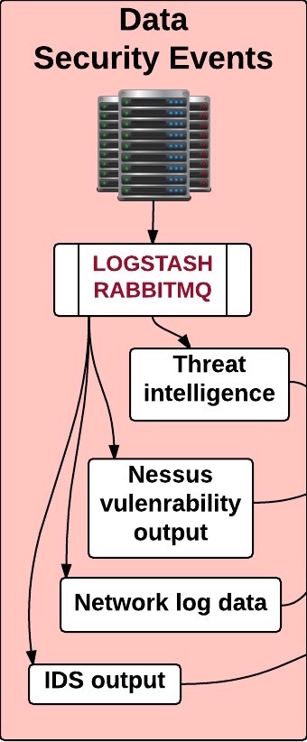
DIKW Model – Intrusion Detection Example
Notes:
Intrusion Detection Systems are generating Events (many IDS systems call these “alerts” but they are Events under our definitions for this model). We also have other data sources which will be correlated to IDS events, in order to enhance the analyst’s interpretation and understanding. All these Events must be collected and distributed to the appropriate tools for analysis.

Slide 16
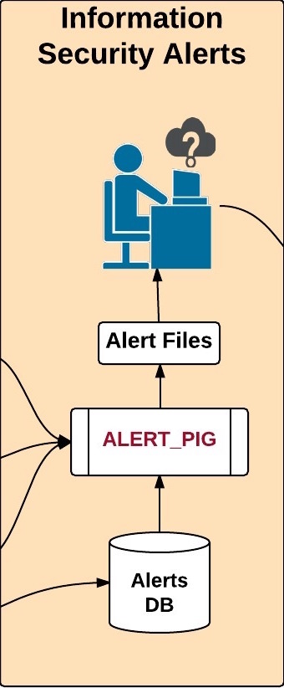
DIKW Model – Intrusion Detection Example
Notes:
Output from IDS is stored in a database, then processed into Alerts, enriched with additional data (“metadata”), and presented to an analyst for review. The analysts use their experience to determine whether or not an alert is actionable. Alerts marked as actionable become Security Incidents.

Slide 17
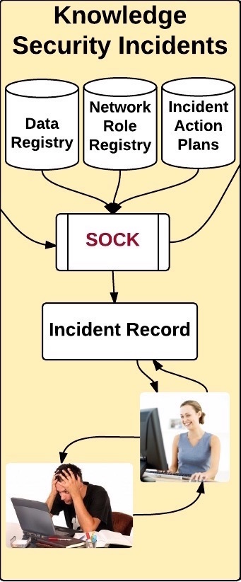
DIKW Model – Intrusion Detection Example
Notes:
Incidents are tracked in our Incident Management system, known as SOCK. SOCK assigns an Incident to a security contact and determines the appropriate action plan, based on severity of the incident and the classification of the host system. We communicate with the security contacts and track status on the Incident until it is fully resolved.

Slide 18
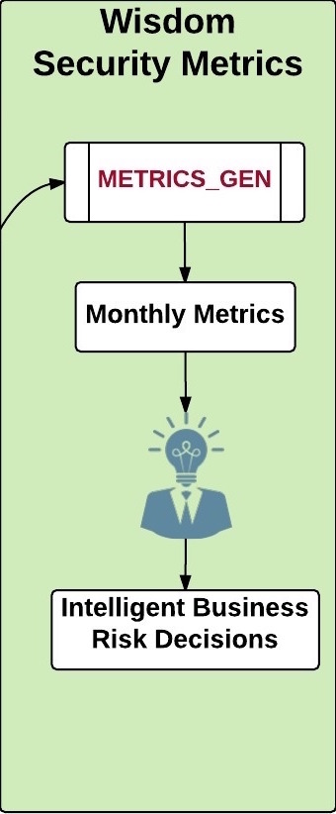
DIKW Model – Intrusion Detection Example
Notes:
Storing Incidents in a structured format allows us to generate post-incident Metrics. We also generate Metrics on the Events and Alerts processing phases, to measure both our activity levels and the effectiveness of our programs. We still have a lot of work to do at this processing stage, but already our metrics have informed real decisions on resourcing for information security on our campus.

Slide 19
Tour of the Sausage Factory
Events
Alerts
Incidents
Metrics

Slide 20
Network Packets
Events
Alerts
Incidents
Amount of data decreases at each step in the process, but actionable knowledge increases

Slide 21
Snort:
Snort is a packet sniffer. You install it on a server and configure
a rule set. It then examines each incoming packet against the
configured rule set. When matches occur a “snort event” is
generated and, in the general case, written to a log file.

Slide 22
Events
Alerts
Incidents
Metrics

Slide 23
Snort Cluster
Taps
CPacket
1
2
Span
3
N
N = 5
10 Gbps
CPacket is a packet broker. Similar products exist: Gigamon, Arista

Slide 24
HTTP Request
HTTP Response
This will generate 2 or more
packets and we need to ensure
that the same snort instance sees
all of those packets

Slide 25
Snort Cluster
Taps
CPacket
1
2
Span
3
N
N = 5
10 Gbps
CPacket is a packet broker. Similar products exist: Gigamon, Arista

Slide 26
Snort Box
Snort Instance (1)
pf_ring
Snort Instance (2)
Snort Instance (3)
Snort Instance (4)
Snort Instance (N)
N = 10
pf_ring: load balances data between snort instances.

Slide 27
HTTP Request
HTTP Response
This will generate 2 or more
packets and we need to ensure
that the same snort instance sees
all of those packets

Slide 28
unified2
1 file per
snort
pf_ring
snort
event 1
packet 1
packet 2
packet 3
unifiedbeat
Read new event
event 2
event 3
sends JSON
Each event’s data
Is packed binary similar
to a network packet
queue

Slide 29
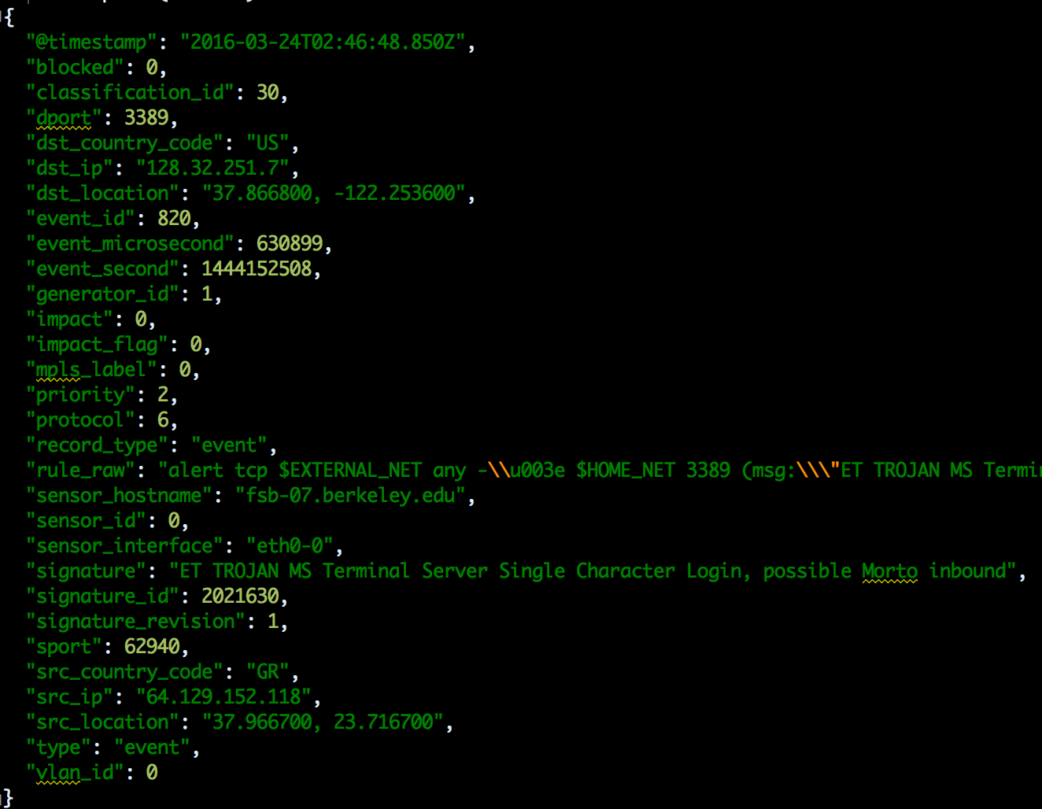
Event JSON

Slide 30
Rabbitmq
Workers
DB
worker 1
event 1
worker 2
packet 1
worker 3
packet 2
worker 4
packet 3
event 2
Jobs
enrich events
with metadata
event 3
metadata

Slide 31
Metadata for each IP:
Host type
MAC address
Security contact emails
Protection level
User email
Calnet UID
Reputational score

Slide 32
1) Host Type
dhcp
static
vpn
wireless
etc …

Slide 33
2) MAC Address
Unique identifier assigned to your computer’s network interfaces for communications on the network.

Slide 34
3) Security Contact Emails
Email addresses of various parties that are responsible for a given IP address or MAC address.

Slide 35
4) Protection Level
Devices must register their PL with campus registry
Data protection level of a given device ranges between 0 – 3
Ranges from data intended for public access to data elements with a statutory requirement for notification in case of a breach.
https://security.berkeley.edu/data-classification-standard

Slide 36
5) User’s Email and
6) Calnet UID
User’s email address and the user’s unique single sign-on ID.

Slide 37
7) Reputational Score
If the user was visiting a website that has a history of malicious activity: phishing attacks, hosting malware, aggressive scanning, etc.

Slide 38
Events
Alerts
Incidents
Metrics

Slide 39
Generate Alert Files
DB
Analyst Review Alerts
Analyst Creates Incidents

Slide 41
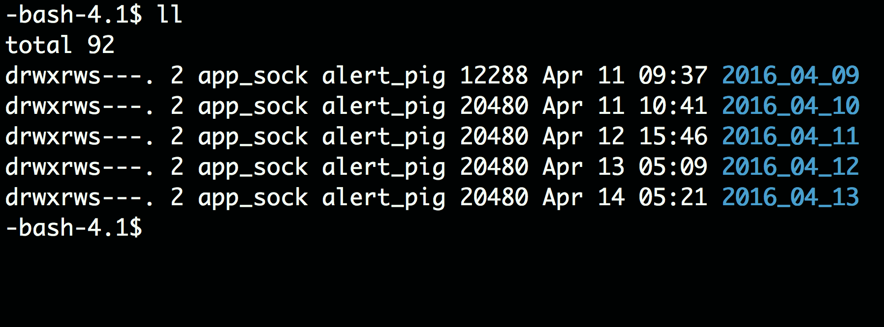

Slide 43
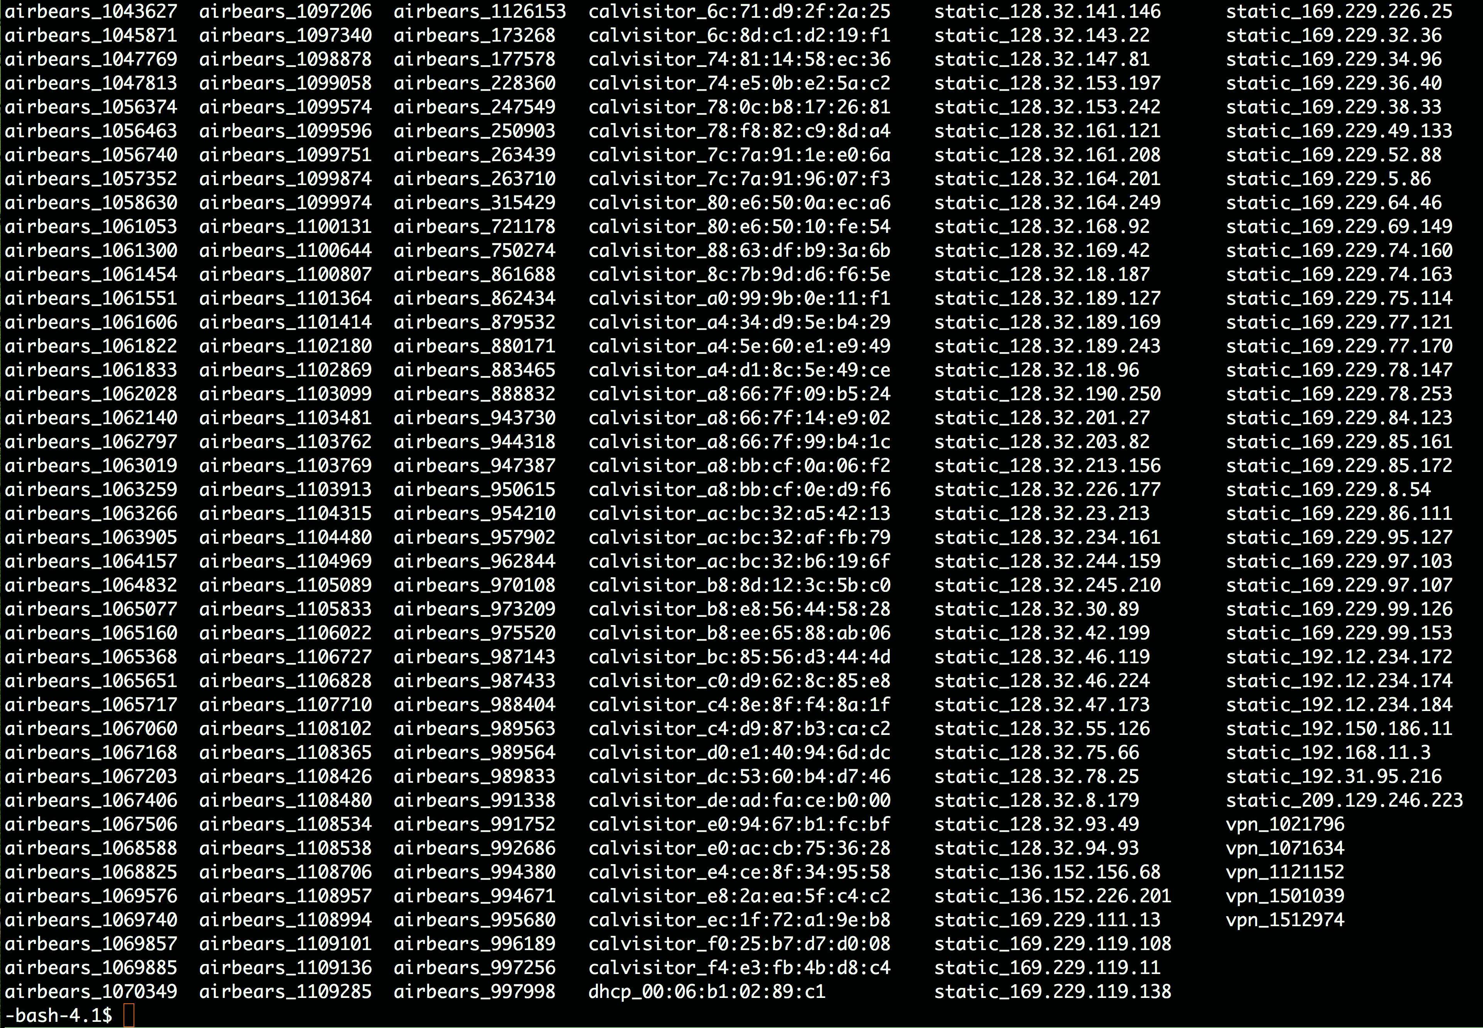

Slide 47
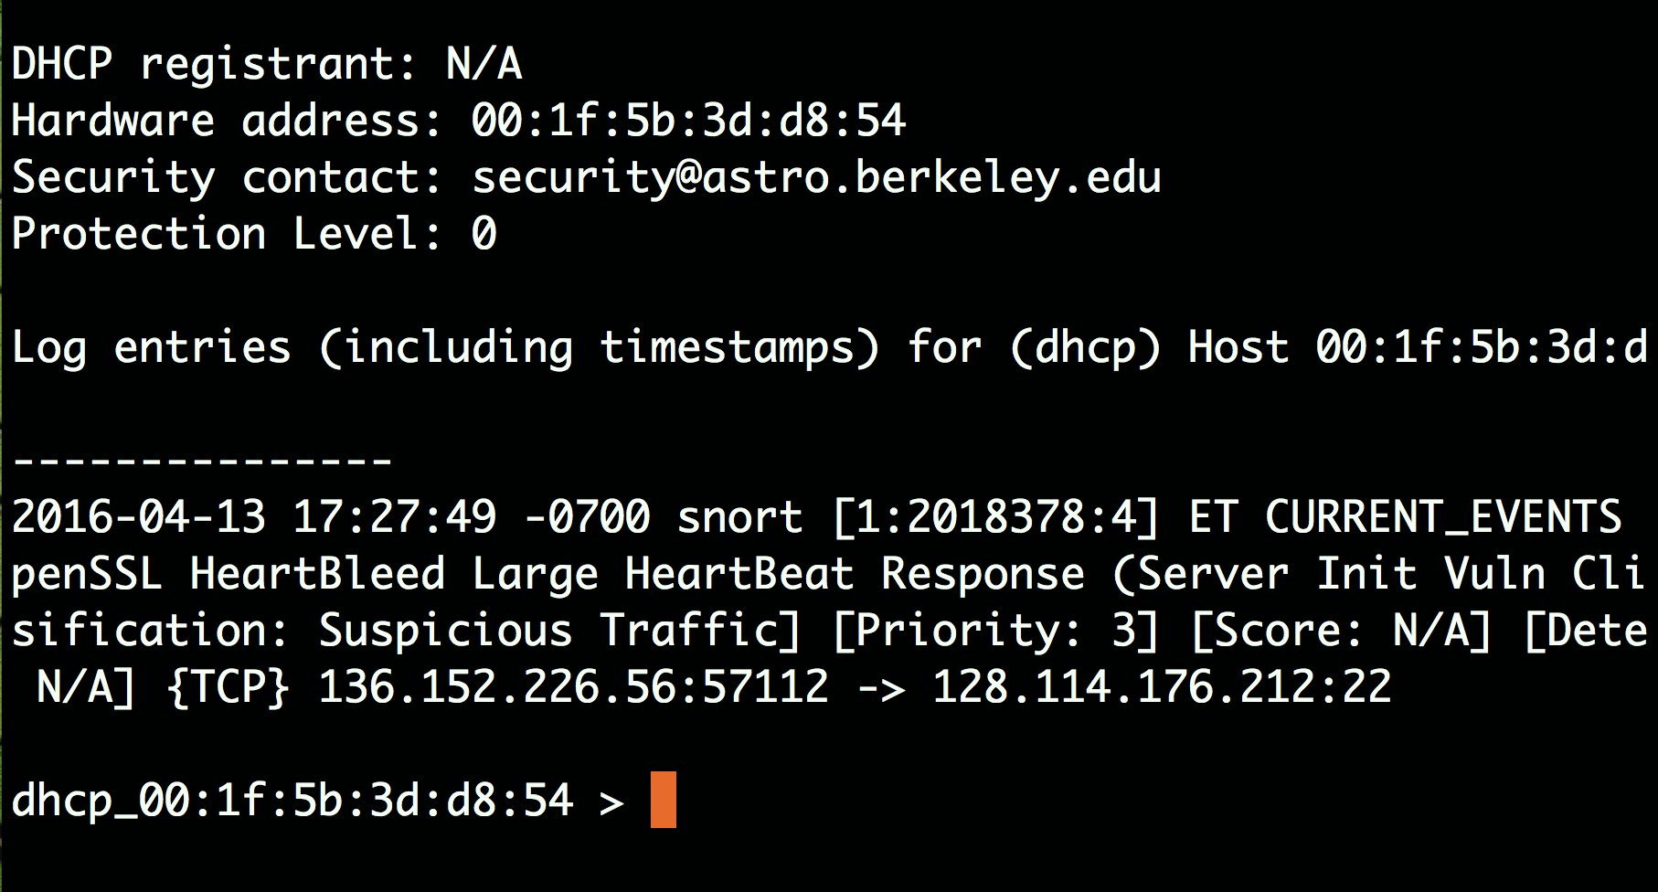

Slide 48
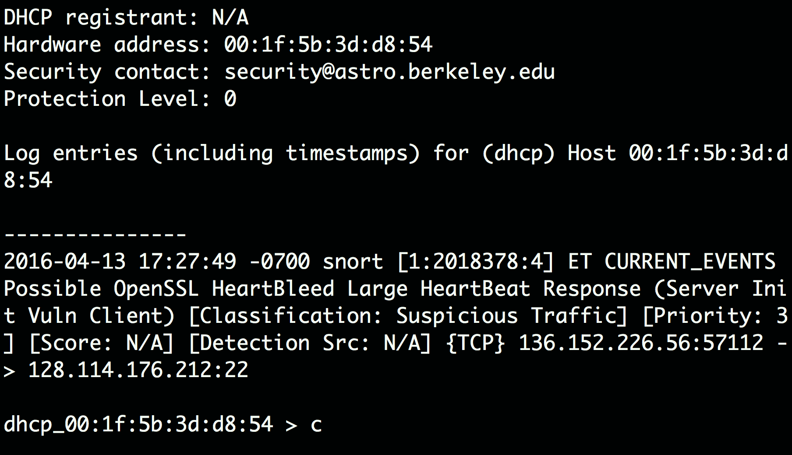

Slide 49
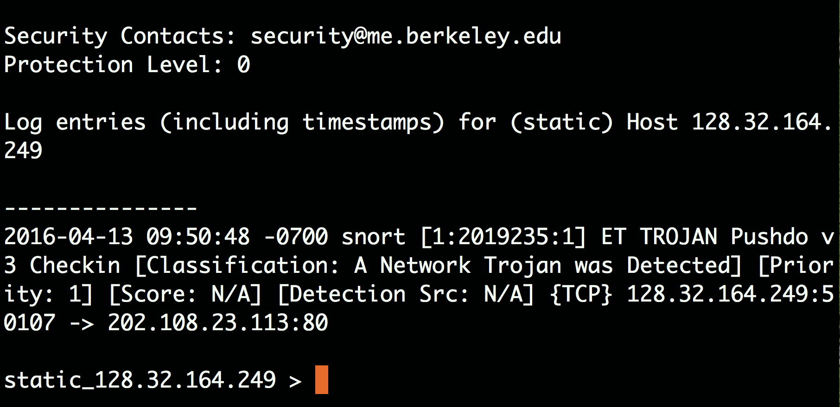

Slide 50
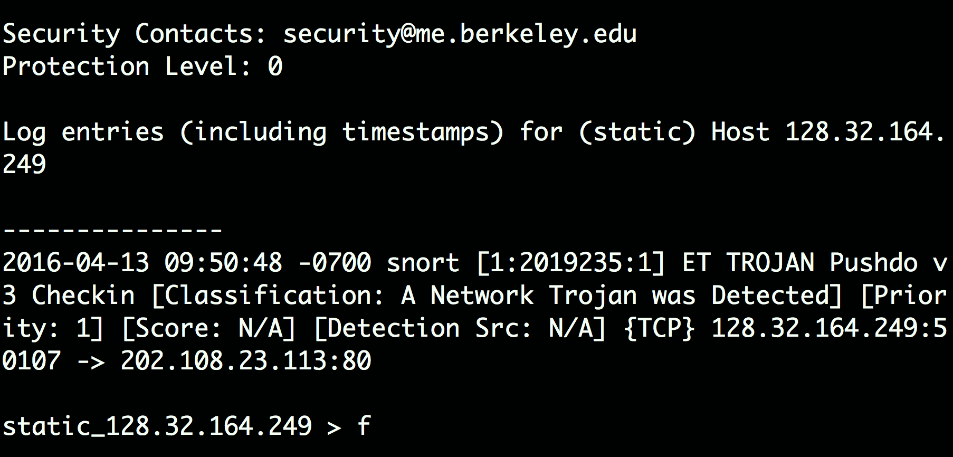

Slide 51
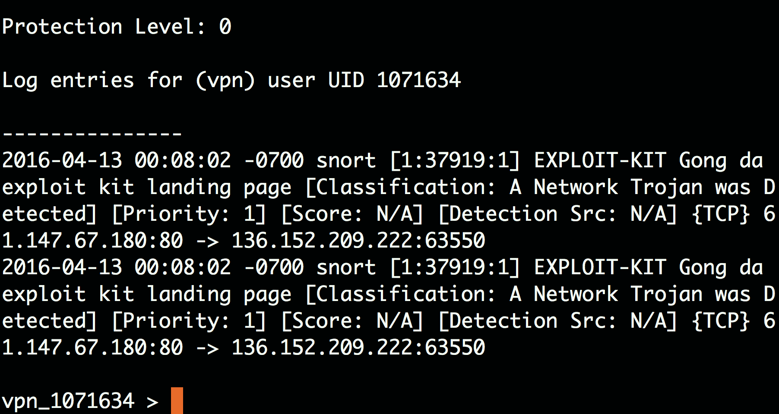

Slide 52
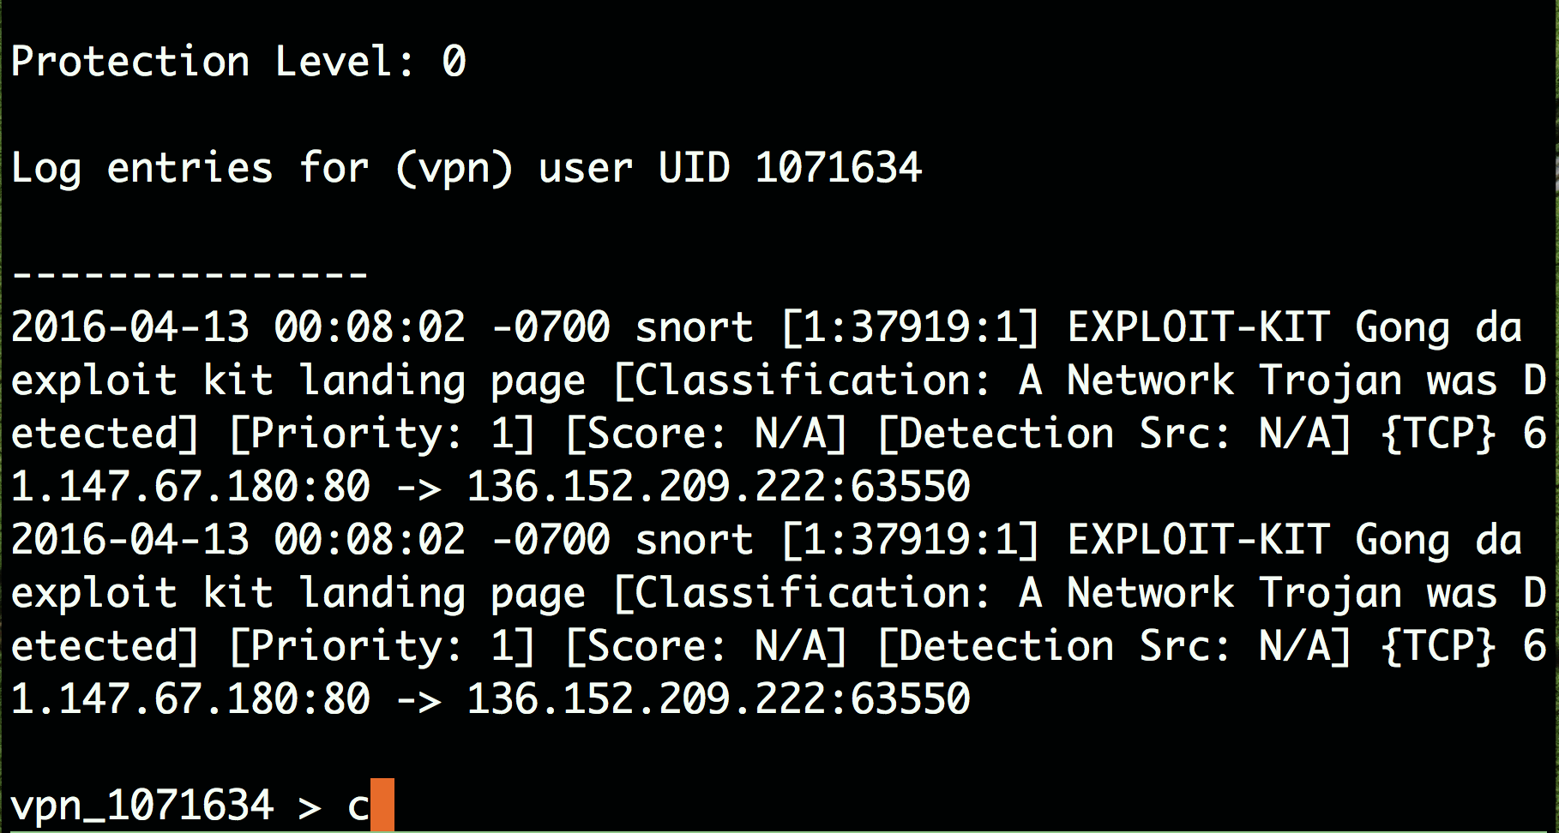

Slide 56
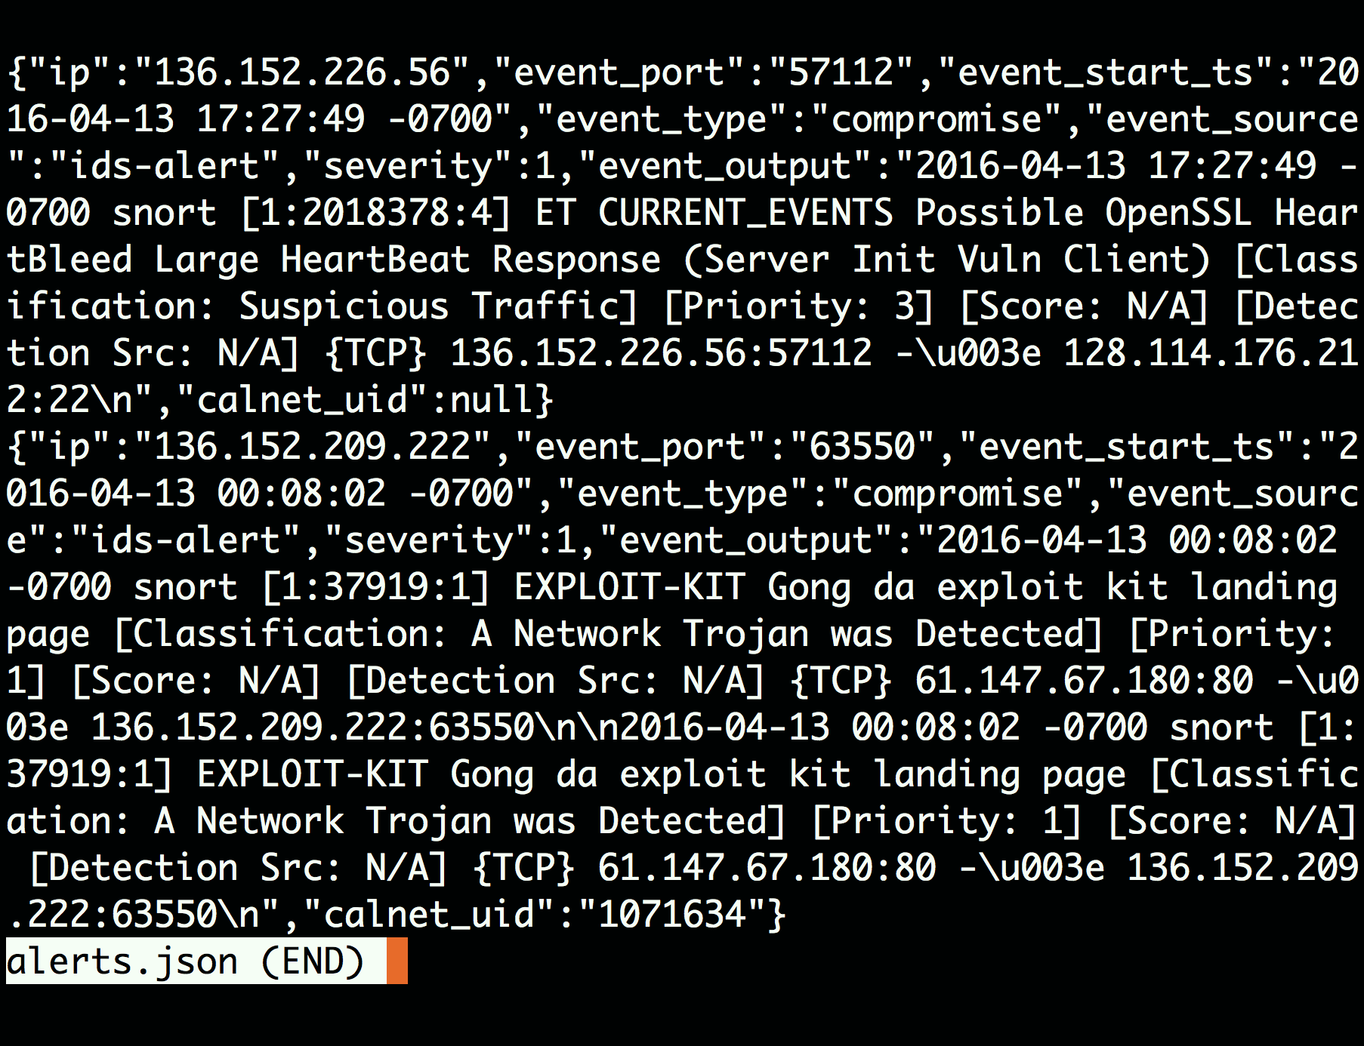

Slide 59
Events
Alerts
Incidents
Metrics

Slide 60
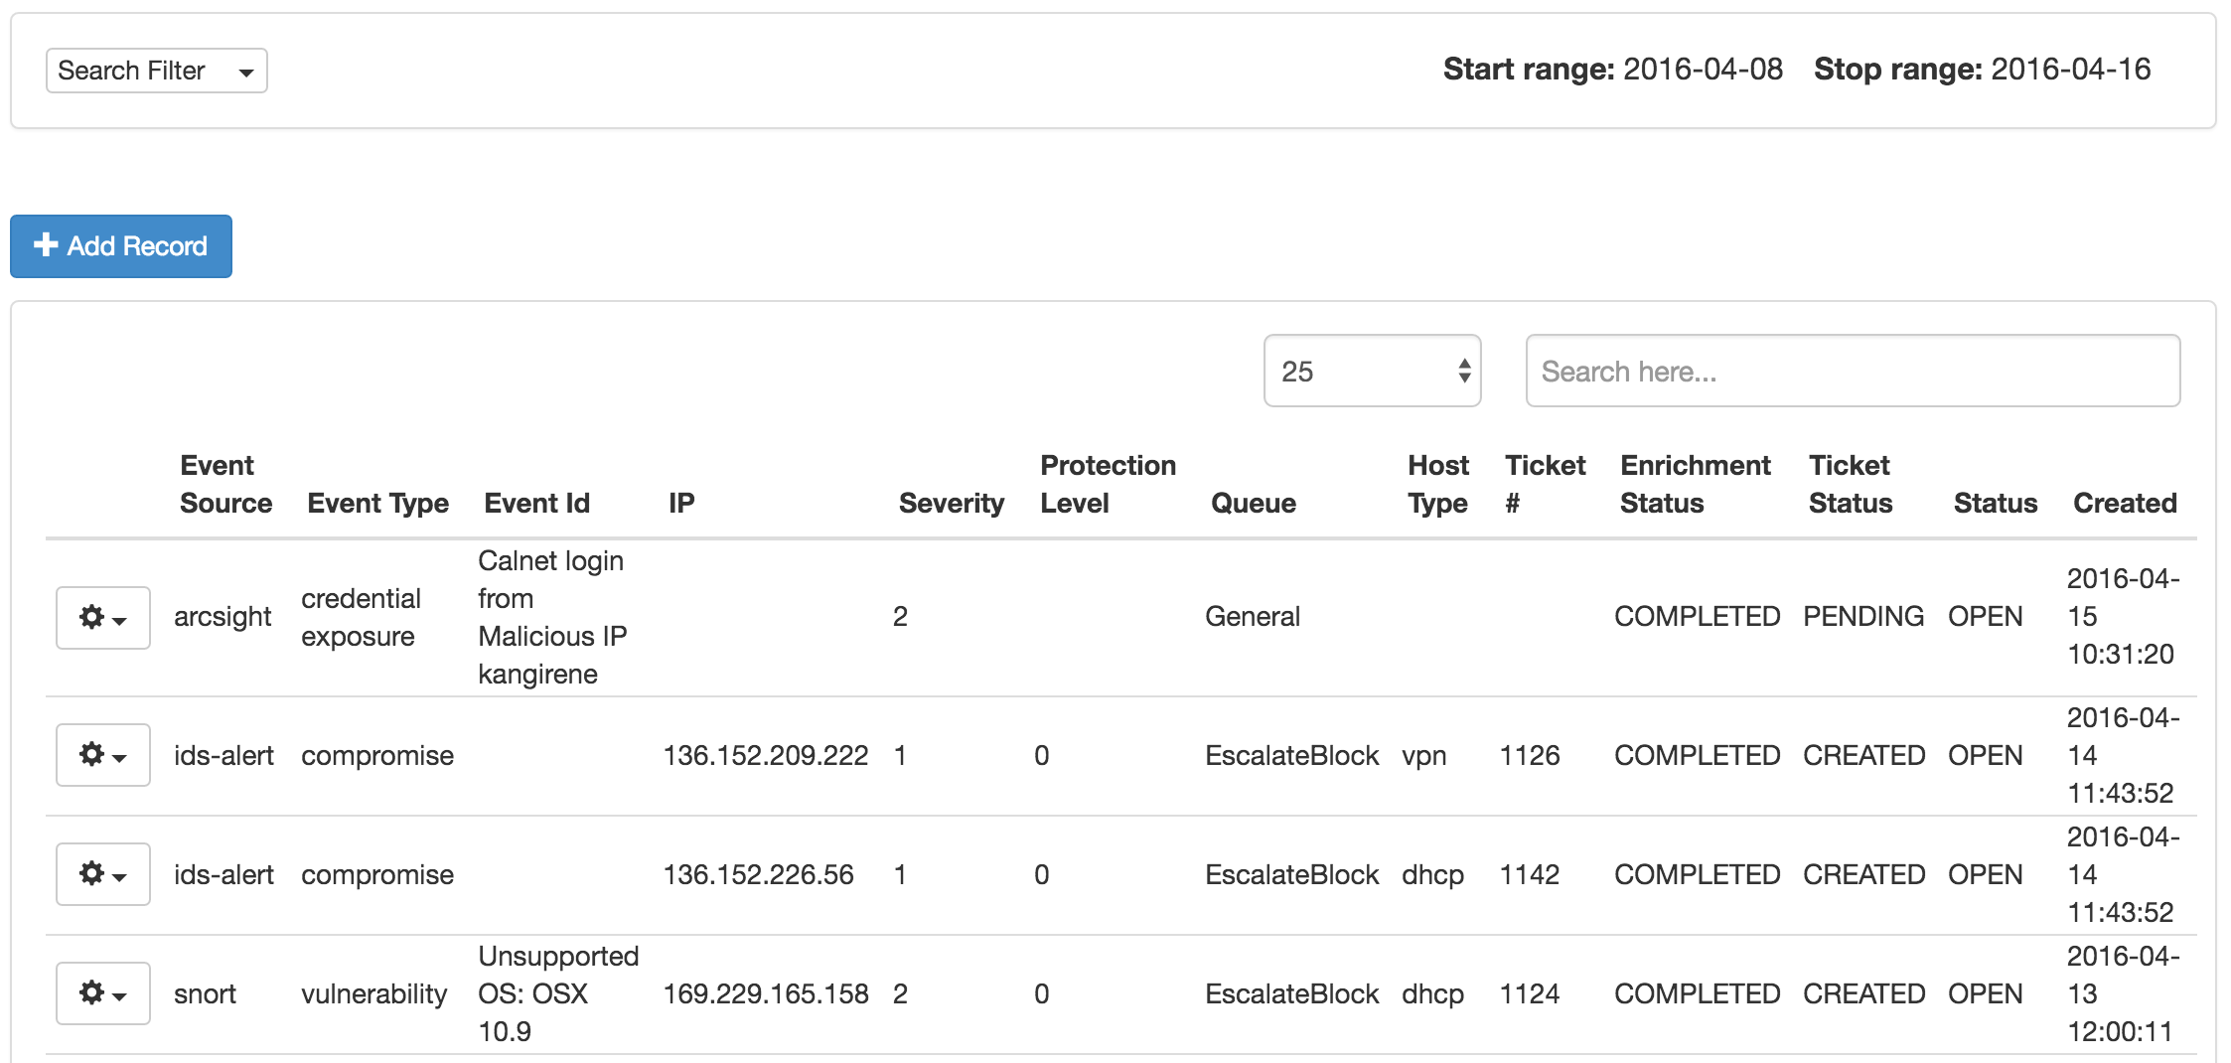

Slide 61
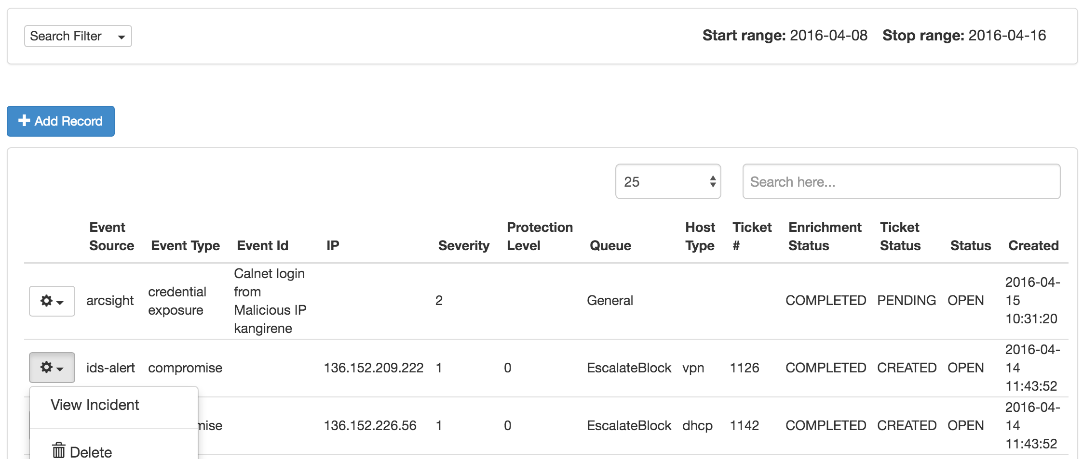

Slide 62
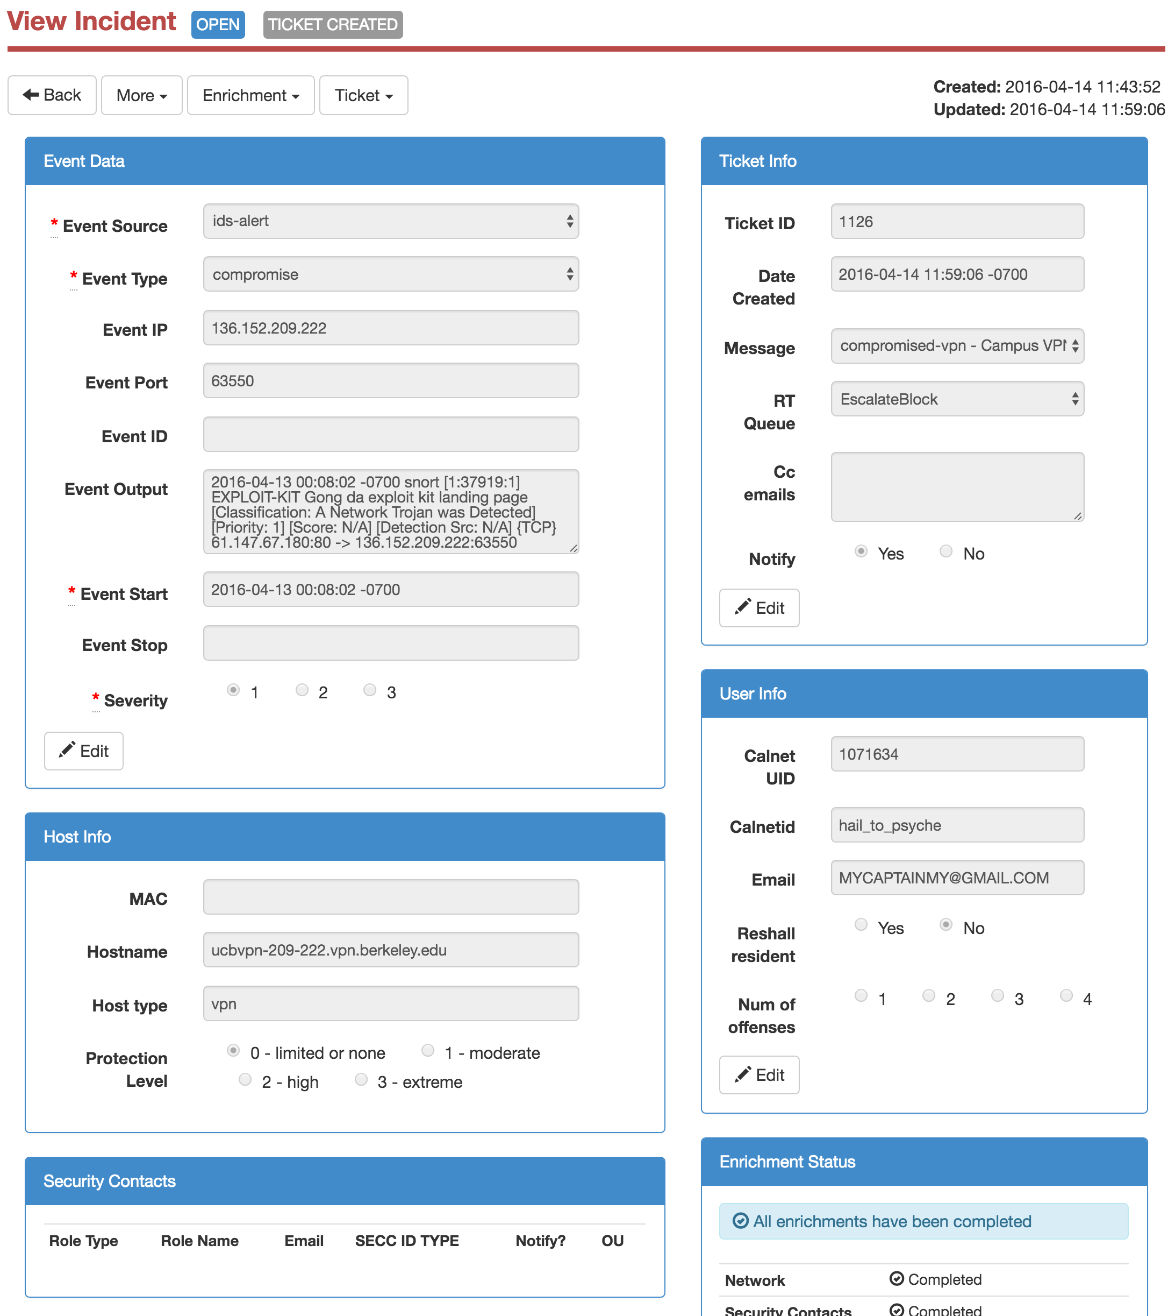

Slide 63
Incident Lifecycle
Evaluate Incident Fields
Trigger 1 or more actions
Close Incident

Slide 64
Possible Actions Include:
Simple Notification: you visited a sketchy website
Notification which requires resolution: unsupported version of OSX
Notification which requires resolution otherwise user will be blocked off the network: hey your computer is participating in a DDoS attack.
Automatic block: user must resolve problem to get block removed

Slide 65
Incident Lifecycle
Evaluate Incident Fields
Trigger 1 or more actions
Close Incident

Slide 66
Events
Alerts
Incidents
Metrics

Slide 67
Security Metrics
Description | 15-Oct | 15-Nov | 15-Dec | 16-Jan | 16-Feb
Total number of notices for compromise hosts sent | 152 | 266 | 120 | 142 | 130
Total number of notices for vulnerabilities sent | 375 | 345 | 1270 | 885 | 256
Number of accounts known to have been compromised | 33 | 14 | 110 | 36 | 6
Number of hosts blocked by ISP for security issues | 97 | 84 | 64 | 90 | 74
Number of IDS alerts (lines of log) processed for analysis | 192,316,195 | 98,633,419 | 40,531,655 | 29,200,946 | 20,922,823
Number of general host IDS cases reviewed by analyst | 4,164 | 8,764 | 5,712 | 9,029 | 15,983
Number of RDM host IDS cases reviewed by analyst | 4,784 | 4,017 | 3,462 | 3,291 | 2,951
Notes:
What do these metrics tells us? We are generating plenty of IDS Events, and there is considerable workload on our security analysts to interpret the large number of Alerts generated by these events. We experience a significant number of compromised hosts and there are more reported vulnerabilities than staff FTE to correct them. These metrics made a strong case to executive leadership on our campus that we need to resource for *preventative* rather than additional detection technology.

Slide 68
Key Takeaways
Tools and data alone do not improve security
Understand your processing pipeline
Learn where you are rate-limited or resource constrained
Invest in process improvements that have the most impact
Share metrics as an effective motivator for change

