Slide 1
In this workshop we will…
Explore the value of effectively managing priorities and productivity.
Indentify contexts where you can get the greatest benefit.
Understand & apply effective techniques that are useful in higher education contexts.
Learn how to grow these skills into the future.

Slide 2
About Your Instructor
S. J. (Sandy) Schaeffer, III Director, Advanced Learning Center - University of Memphis email: sandy.schaeffer@memphis.edu
Education & Professional Experience:
MS in Computer Science
Doctoral Studies in Higher Education Leadership & Adult Education (ABD)
27 years as an IT professional (20 in private industry in software development, sales, technical support, networking, project management)
IT experience in technology start-ups, large banks, healthcare, IBM, and launched a ‘dotcom’ before moving to higher education in 2002
Teaching Experience:
Managing Software Development Projects (TN Online Degree Program)
Senior projects for IT students (University of Memphis)
Certificate Program in College Teaching (University of Program)
Continuing Education in Technology Skills and Leadership (Industry)

Slide 3
Why are you here?
? ? ? ?
How effective do you believe you are in managing priorities & productivity? Your organization?
What would you like to accomplish in this session?
? ? ? ?

Slide 4
Learning Objective #1
Increase awareness of the value of effectively managing priorities & productivity.

Slide 5
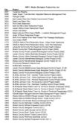
Sometimes the biggest gains in productive energy will come from cleaning the cobwebs, dealing with old business, and…cutting loose debris that’s impeding forward motion. (David Allen - Ready for Anything)
Why is it important to manage priorities and productivity?
It’s OK to not get everything done. What is critical is making sure the important things get done. …and…
What you do with your time is more important than how much time you have.
(David Zeller – Time Management for Dummies)

Slide 6
Good prioritization leads to working on the right things at the right time.
Working on the right things at the right time, leads to increased productivity.
So…prioritization is not an end in itself; rather it is a means to an end…Productivity!!

Slide 7
Case Study: Potential Value
Moderate State University:
18,000 students
Annual E&G budget of $150-million
IT division operating budget of $10-million
70% of budget goes to personnel costs (Thus, $7M of IT budget goes to labor)
Question: What is a 1% increase in productivity worth to the IT budget? …a 3% improvement?

Slide 8
Case Study: Moderate State U.
Question: What is a 1% improvement in productivity worth to the IT budget? …a 3% improvement?
Answer:
$7M x 1% = $70,000 per year ($350,000 in 5 yrs)
Thus, a 3% gain would be worth ~$210K/yr or >$1M over 5 years.

Slide 9
Productivity benefit at your institution
Exercise
Estimate the total personnel costs in the IT organization at your institution using an average labor cost of $50,000 per professional and calculate the value of:
2% boost in productivity
5% boost in productivity
Discuss as a group how your institution could benefit from such a boost in productivity

Slide 10
Learning Objectives #2 & #3
Identify contexts in which managing priorities can provide the most payback and explore techniques for improved productivity in those areas.

Slide 11
In this section we will:
Discuss practical tips & techniques to help ensure you are giving maximum attention to the things that are most important.
Increase your overall productivity via simple and practical activities & behavior changes.
Increase the productivity of others through improvements in communication.
Use meetings as a tool to increase productivity; not drain energy.

Slide 12
Recalling/describing highly productive experiences.
Exercise
Describe a highly productive experience at your institution that you can recall:
Why did it stand out as unusually productive?
Who was coordinating the activity and how did they make it productive?

Slide 13
Common contexts & activities that can consume time and create inefficiencies in the IT organization at your campus.
As an individual, you work very hard on things that are not really very important.
Being disorganized in your personal work.
Working with others in meetings and on projects in ways that are inefficient & ineffective.
Getting caught in common productivity mistakes.

Slide 14
Group Discussion
Exercise
Activity Trap | Question to Address | Discussion Notes
As an individual, working hard on the wrong stuff | Examples in your own work
Inefficiency through disorganization | How does disorganization manifest itself in terms of lost productivity?
Inefficiency through poorly managed meetings / projects | Symptoms of a poorly run meeting? …project?

Slide 15
Prioritization at the Personal Level: The 80/20 rule to personal productivity
“Generally speaking, only 20% of those things you spend your time doing produces 80% of the results you want to achieve.” (Allen – Dummies)
Step 1: Size up your current situation – take a honest look at how you use your time.
Observe how you currently use your time. (Self-observation of those activities, habits, & skills that both positively and negatively affect your productivity. What consumes most of your day? How far through your ‘to-do’ list do you get each day?)
Assess your personal productivity trends. (When during the day is your energy level the highest? What habits can you change to take advantage of this awareness?)
Take a look at regular interruptions. (When are you most likely to be interrupted? What/who/why?)

Slide 16
Prioritization/Productivity at the Personal Level, cont…
Step 2: Identify the top tasks that support your goals.
Most people try to accomplish too much overall and fall short. Try to identify your “80%” - or those results over time that you really want to achieve. For example, create a list of the top 12 goals for the next three months. Then, think about how much time you actually devote to activities related to those goals. Is it 20% of your time? Less? More? Be conscious of what you really need/want to get done!!
Step 3: Prioritize your daily objectives.
After you know what your 80% priorities are, assign a value to each of them. Then decide how to order your daily task list relative to those goals. Make sure those “80%“ items get your attention before the others.

Slide 17
Personal Prioritization Exercise (Allen / Dummies)
Exercise
Step 1: Collect everything that is on your mind (big or small)
Step 2: Process the “pile of stuff” and assess each item for being actionable. If it is “yes” then what would be the outcome of completing it? (1 = very important, 2 = useful, but not immediate, 3 = of marginal value)
Step 3: Organize the list of actionable items into the three groups (1, 2, or 3)
Step 4: Do. Begin working on the “1” items.

Slide 18
Using the time of others
Improving productivity through better communications and more effective meetings

Slide 19
Message processing: Non-verbal means of communicating are far more important than words:
The words you choose deliver only 7% of your message.
Your tone of voice delivers 38% of your message.
Body language delivers the remaining 55% of what you want to convey.
Therefore, when you use only words, your recipient is missing 93% of the message! How can you make that up when we are so dependent on email for work communications?

Slide 20
Making email work
Goal: Be effective in all communications and get results (action) in a timely manner.
Method: Provide complete & clear communications when engaging with others in order to generate a clear understanding of what is needed to induce quick action towards a desired action (or result).
Technique: Create a sense of urgency on the part of the recipient to take action.

Slide 21
Pointers for More Effective Emails
Write a meaningful subject line
e.g., “Invitation to project meeting on 6/5: reply needed”
Make the message clear & concise
Keep it on one screen to avoid scrolling
Write in active voice using direct language
Immediately state the action required
Avoid dependency on attachments
Paste into body for short attachments
If still needed, include summary points in body of message
Clearly identify yourself
Thorough signature line

Slide 23
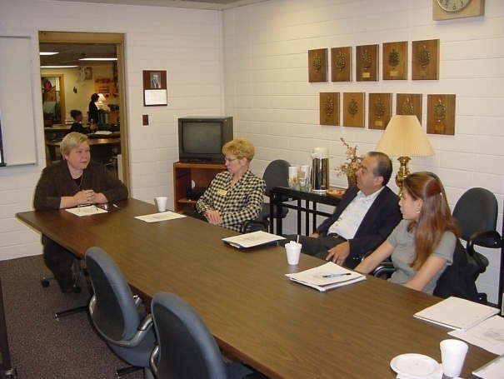
Meetings – Friend or Foe?

Slide 24
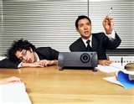
Facts About Meetings (Allen, p. 206)
The average professional worker in the US spends an average of 1.7 hours/day in meetings.
Executives spend almost 50% of their time in meetings.
The most productive meetings take less than 1 hour. (But the average meeting lasts almost 2 hours!)
Surveys found that 91% admit to daydreaming during meetings; 39% have dozed off, and 71% bring other work to meetings.

Slide 25
So - If they are so important, why don’t we do a better job at running effective meetings?

Slide 26
Good meetings:
Start on time & end on time
Are less than an hour in length
Have a structure (e.g., agenda)
Have someone who leads the meeting and ensures it stays on track
Are clear & realistic in scope

Slide 27
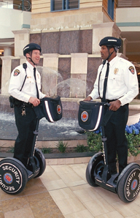
Consider a Meeting “Style” for technical projects Ideation v. Execution
Segway Corporation CTO presentation in 2003

Slide 28
Tips on Meeting Agendas
Logically organized.
Provide a clearly-stated purpose for the meeting.
Have specific time-blocks for items and assigned parties for items.
Ensure that action items are identified, captured, and distributed.

Slide 29
Meetings Exercise
Exercise
Team A
Team B
Think about good meetings you have attended. Describe them. What made them effective? Who organized and led the meeting? What were the outcomes of the meeting? What are the characteristics of a “productive” or “good” meeting? What are some descriptive terms you’d associate with a productive meeting?
Think about bad meetings you have attended. What made them not effective? How were they organized and led? What were the outcomes of these meetings? What could have been done to make them effective and productive? Why do we so often celebrate a cancelled meeting?

Slide 30
Quick Tips & Techniques
Simple & quick ways to increase productivity

Slide 31
The 4-D Solution (Canfield et al)
Dump it – Learn to say “No – I choose not to do this.”
Delegate it – This needs to be done, but you are not the right person. Hand it off.
Defer it – This is needed, but no right away. Schedule a time later to handle it.
Do it – Do it now. This is important – now, not later. Move forward & complete.

Slide 32
The “11am Rule”
Most employees report that they are the most productive before 11am. Thus, you should work on the most critical & complex activities before 11am each day.
Before 11am:
Focus on “80%” items.
Avoid “general” meetings in AM. (Instead, use AM for project or task-specific work.)
Do not do low-value tasks like cleaning up email. (Instead, move them to last thing in the day.)
Work on ‘cream puff’ items only if getting them off the list frees up significant time to focus on high-value activities.

Slide 33
Odd Start-Time for Meetings
Consider starting meetings at odd hour intervals, but end on-the-hour to shave off time. Example: Instead of a 9:00-10:00am meeting that requires 60 minutes, start at 9:15, but still end at 10:00 to grab an additional 15 minutes of your day.

Slide 34
“Highly productive people know exactly what they should be working on during their discretionary time.” - Laura Stack, Leave the Office Earlier
Closing Thoughts on Maximizing Productivity
Be enthusiastic about what you are working on. You will get it done better & faster; plus you will enjoy the work more.
Tackle the hardest items first – every day. (Corollary: Don’t procrastinate – particularly on the toughest items)
Avoid accumulation of incomplete tasks. (Corollary: Complete what you start and then move on to the next item.)
Build in time for unforeseen catastrophes.
Use your calendar to block out explicit time for high priority items. (Treat them as a meeting on your schedule.)
Compartmentalize email: Work off-line, then schedule specific blocks of time for email work each day.
Don’t be afraid to say “No – I don’t have time to chat right now.”

Slide 35
Learning Objective #4
Continue applying & growing your productivity skills .

Slide 36
Discussion Exercise:
Exercise
How can your campus adequately measure the value of productivity improvements?

Slide 37
Application of Learning
Write down one new idea that you gained from today’s session that you will go back and try on your campus.
Also consider:
What are some impediments to pursuing the change?
What will be the gain to you? To your organization?
How soon and in what context will you try it?
Exercise

Slide 38
Self-Development Ideas
Make productivity a priority in your work.
Join a project management professional organization (e.g., PMI).
Try some of the ideas covered in this workshop.
Pick up a book (see: References)

Slide 39
References
Allen, David (2003). Ready for Anything. (Penguin)
Canfield, Hansen & Hewitt (2000). The Power of Focus: What the World’s Greatest Achievers Know about the Secret to Financial Freedom & Success. (Health Communications)
Hoover, John (2007). Time Management: Set Priorities to Get the Right Things Done. (HarperCollins)
Zeller, Dirk (2009). Successful Time Management for Dummies. (Wiley)

