Slide 1
Overview of the COE Virtual Lab Project
Didier Contis
didier.contis@coe.gatech.edu
EDUCAUSE Southeast Regional Conference 2010

Slide 2
What problems are we trying to solve?
Getting funding for computer labs is becoming more challenging every year but is necessary due to growing enrollment.
Computer lab usage is increasingly inefficient (low usage during summer, lack of capacity during end of Fall semester).
Accommodating a more and more mobile student population is daunting…
Students are required to purchase a laptop, but still need to use computer labs because of licensing issues, defeating the approach to BYOC (Bring Your Own Computer).
Increased demand from the students for 24x7 access generates issues from a physical security, support point of view.

Slide 3
Some of our requirements
The focus must be on cost efficiency and a sustainability (even 1,000 blades have to be replaced at some point).
One solution: to make use of virtualization and other technologies to maximize hardware usage.
Access must be reliable and secure, and must integrate with the campus authentication and authorization framework.
Students need to have access to the right resource when they need it (no wait time / no need to reserve a resource).
System must be accessible from anywhere, at anytime and from any devices

Slide 4
How do we measure success ??
Ability to support multiple virtual computer labs (one for each of the nine Schools in the College of Engineering).
System resources can be accessed from different platforms (MAC / Linux / Windows) and different devices.
Perception of ease of use, reliability.
End user experience similar to traditional brick and mortar computer labs wherever possible.

Slide 5
Project Timeline
December 2006: Technology Fee Proposal Approved
Fall 2007: First small deployment using Citrix Desktop Server 1.0
Phase 0 limited success
Spring 2008: Start Beta-Testing XenDesktop 2.0
Fall 2008: Two desktop groups are launched with XenDesktop 2.1
December 2008: Phase 2 Tech Fee funding approved
Spring 2009: Upgrade to XenDesktop 3.0
Fall 2009: Run 6 large Desktop groups under XD 3.0 FP1 / add 80 cores + 480GB mem
December 2009: Phase 3 Tech Fee funding approved
Present: Execution of Phase 3. Hardware acquisition.

Slide 6
WHERE ARE WE TODAY?

Slide 7
Some screenshots of what our students see…

Slide 8
Architecture as of June 2010

Slide 9
Usage Data for Fall 2009
Note: a session can last up to 12 – 24 hours based on access desktop group.

Slide 10
Usage Data for Spring 2010
Note: a session can last up to 12 – 24 hours based on access desktop group.

Slide 11
Students feedback – the good
“This is very useful for grad students like myself who have struggled to access costly applications while off-campus. Thanks to you and your team for making this happen, Frank”
“As far as speed/performance, it's a tiny bit slower than being at the lab, but really not that noticeable (which is much better than last summer--then, it seemed I was always getting kicked out of the program or freezing it or something and it was very frustrating. Now, it's GREAT!)”
“One suggestion, spread the word. This is great, especially for non-windows users (Im on Linux). Unfortunately I did not discover this until my Junior year, but then I forgot all about it.”

Slide 12
Students feedback – the bad
“I do not like it. It is too slow to work with the 3D modeling program.”
“I'm using this from my laptop in the student center over wireless and the performance is horrible. Latency with the mouse, total lock ups, trying to use arena on this is almost impossible. I used this a while back and it was much more responsive. Hope this feedback helps, let me know if there's anything specifically you guys need to know in order to troubleshoot. The idea behind the system is awesome, just needs tweaking.”

Slide 13
Other elements to note
The Georgia Tech Library is using Citrix Provisioning Server to stream a base image (WinXP + Office + base tools) to 24 x Dell Optiplex 160 in its 24 x 7 computer lab.
Good alternative to Thin Clients to preserve server resources for engineering apps while focusing on ease of management.
Still working on deploying a pool of HDX 3D workstation. Primarily lack of time.
Surprisingly several CAD programs are running fine in our current VMs (with small to medium models).
Research licensing implications (Microsoft VECD / VSA but also with your application software vendors) !!! *
*[Microsoft has indicated possible plans to modify their educational licensing starting on July 1 that may favorable impact Virtual Desktop licensing. To be confirmed.]

Slide 14
SOME LESSONS LEARNED

Slide 15
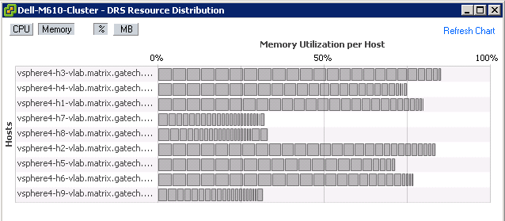
Did I say we need more memory???
Snapshot
1/26/2010 10:56PM

Slide 16
Memory and Storage
You will consume memory faster than cpu ! (Our upcoming nodes will have 96GB of memory for 12 cores).
Our current VMs are running Win XP with ~2GB of memory. We expect to run VMs with 3GB or more under Win 7.
Do not under-estimate storage:
Use Citrix Provisioning Server whenever you can.
Configure your storage for small random IOPS. Expect more write than read IOPS.
Ask storage vendors for their NDA roadmap…
Watch for a tighter integration in the future between storage and hypervisors.

Slide 17
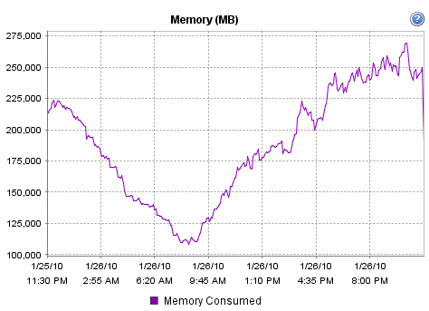
Early Trend Analysis
➔ Students work during the evening / night.
➔ Interesting optimization problem !!!

Slide 18
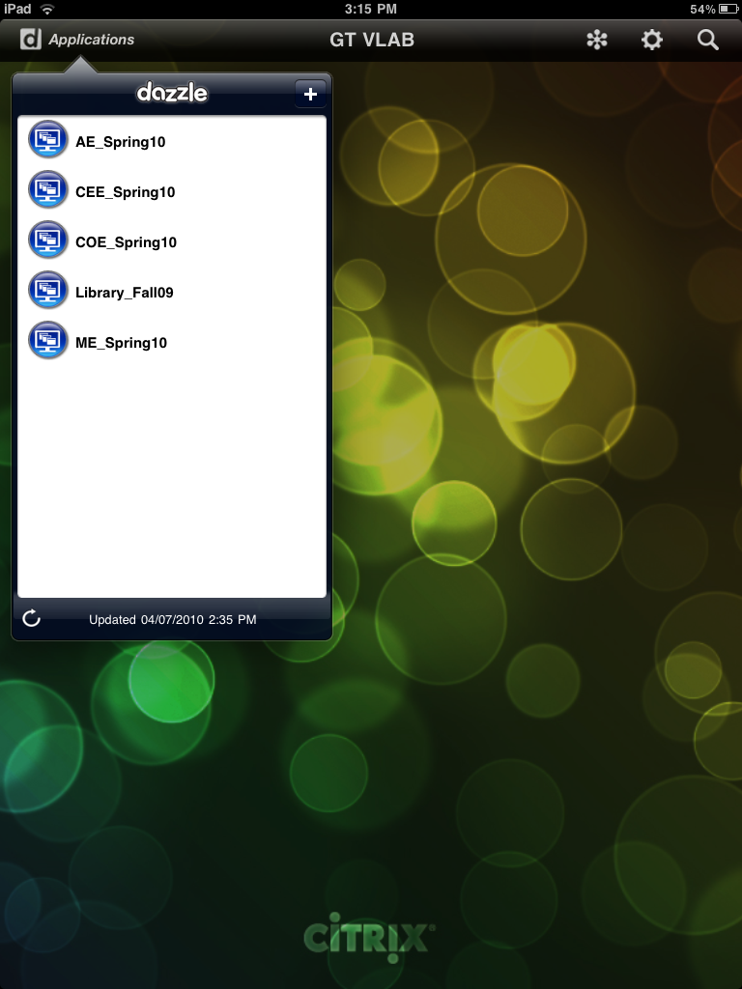
Be prepared to give access from any devices…
Sunday 4/4/2010 – 11:20am. “I see that there is a citrix app for the iPad and I was wondering how I need to configure it to work with the citrix servers hosted here.”

Slide 19
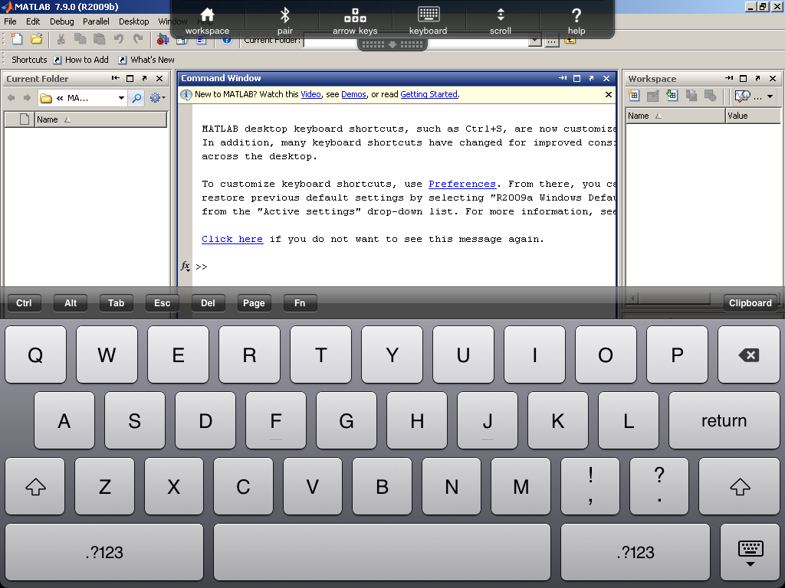
Access from any devices…. iPad example
Sunday 4/4/2010 – 11:20am. “I see that there is a citrix app for the iPad and I was wondering how I need to configure it to work with the citrix servers hosted here.”

Slide 20
Becoming a service provider is not easy…
Implementing a “from anywhere, at anytime and from any devices” vision is not simple.
Like providing remote access to e-mail, offering web hosting…. We are being blamed when something is not working ☺
Some thoughts:
Work with your backbone network team to understand current peering with “local Internet providers”;
Talk with the team in charge of your campus wireless network;
Install at a minimum HDX monitor in your virtual desktops.

Slide 21
FUTURE DIRECTIONS…..

Slide 22
Short Term… next 6 months
Deploy new pool of servers (Intel Westmere) and storage with latest available technologies (96 cores / 768GB memory / 34 TB EMC SAN Storage).
New desktop groups for Fall 2010 to be using Win 7 x64.
Evaluate Hyper-V 2008 R2 SP1 and deploy when it reaches GA. Investigate potential benefits of Remote FX with CAD applications.
Strengthen infrastructure:
Address single point(s) of failure (dual fabric network for example)
Deploy Citrix NetScalers to gain greater flexibility / scalability (potentially multi-farms distributed geographically in the future)
Deploy hosted and streamed Applications (XenApp 6.0 ).
XenClient + XenDesktop synchronizer…..
Address students windows profile to improve overall experience.

Slide 23
Long Term… next 12 to 18 months….
Desktop virtualization is moving very quickly. Hard to make long term plans.
Prepared to run multiple Hypervisors…. (KVM / Hyper-V / vSphere….).
Investigate possible convergence of HPC / Desktop Virtualization farms (10GB / Infiniband support & debate).
Re-use unused resources of hypervisor farm to support multiple desktop virtualization projects (staff / grad students / research…).
Provide dedicated virtual desktops to each students?
Investigate self-serving provisioning of virtual desktops.
Investigate dynamic elasticity of public / private clouds.

Slide 24
Some closing thoughts
A computer lab desktop virtualization project is different from virtualizing administrative desktops.
We introduced Vlab as a complement to existing COE computer labs, bringing additional resources and flexibility.
We will start closing some computer labs this year starting progressively with a couple of older labs.
Do not confuse virtual desktops and desktop virtualization.
Do not forget about leveraging the computing power of endpoints whenever possible…. Especially when the endpoints are student laptops.

Slide 25
DISCUSSIONS

