Slide 1
IT and the New Normal
EDUCAUSE Southeast Regional Conference
Atlanta, GA
June 3, 2010
Jim Bottum, CIO
Clemson University

Slide 2
Outline
The New Normal
Change
Keeping our focus
Some thoughts & experiences

Slide 3
Definitions
I use IT and cyberinfrastructure interchangeably
Infrastructure - used since the 1920s to refer to the roads, power grids, telephone systems, bridges, rail lines, and similar public works required for an industrial economy
Cyberinfrastructure refers to distributed computer, information and communication technology . . . necessary for a knowledge economy

Slide 4
New Normal

Slide 5

Globalization

Slide 6
New global university marketplace for students …
……U.S. market share of international students fell to
19% in 2007 from 25% in 2000.
WSJ, May 28, 2010

Slide 7

The Great Recession

Slide 8
Budget Impact

Slide 9
Technology Treadmill…….
“ . . . new normals” come at the IT world all the time

Slide 10
Change Drivers:
Our technological environment is continually being redefined and a “new normal” frequently occurs for various reasons with varying impact: one constant is change.
“Natural” Evolution
  Moore’s law: compute power doubles every two years
Disruptive Change
  Mosaic and WWW, Hackers, Economy
Administrative Mandates – aka “unfunded”
Economics – “central vs. distributed”
Competitiveness – Top 20
User Driven
. . . and every once in a while, strategic planning

Slide 11
Computing

Slide 12
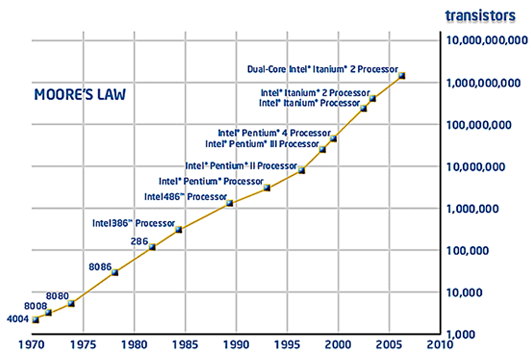
Moore’s Law
  Moore’s Law: The observation made in 1965 by Gordon Moore, co-founder of Intel, that the number of transistors per square inch on integrated circuits had doubled every year since the integrated circuit was invented.

Slide 13
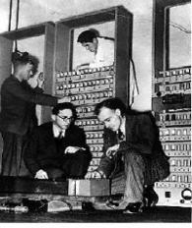
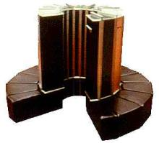
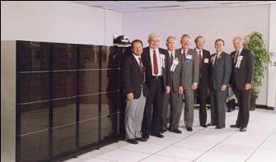
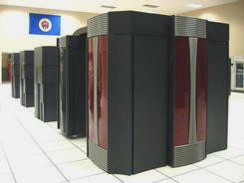
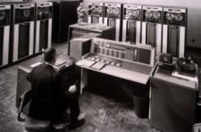
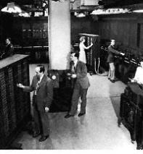
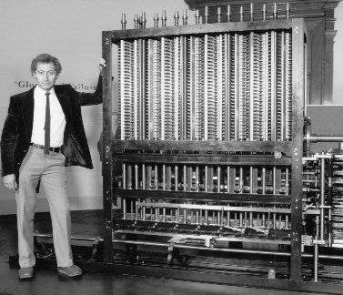
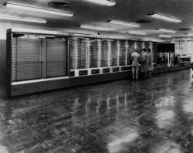
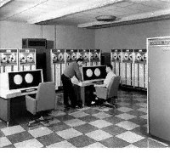
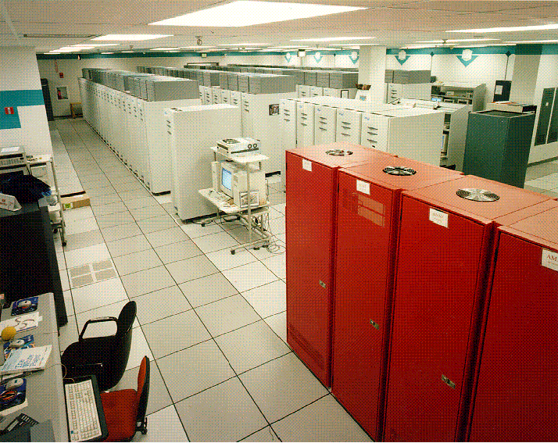
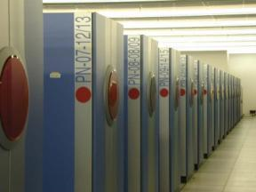
A Growth-Factor of a
Billion in Performance in a Single Lifetime
1959
IBM 7094
1976
Cray 1
1991
Intel Delta
1996
T3E
2003
Cray X1
1949
Edsac
1
10³
10⁶
10⁹
10¹²
10¹⁵
One OPS
KiloOPS
MegaOPS
GigaOPS
TeraOPS
PetaOPS
1823
Babbage Difference Engine
1951
Univac 1
1964
CDC 6600
1982
Cray XMP
1988
Cray YMP
1997
ASCI Red
2001
Earth Simulator
1943
Harvard Mark 1

Slide 14
Mr. Moore and his Law
Hit limit on clock speed (power, leakage)
  Sound of screeching halt to clock speed
Moore’s Law is still progressing
Industry chose the route of multi-core
  6-cores in 2009
  12-cores now
  Possibly 16-cores in 2011
But still people are screaming for more performance!
Dr. Jeffrey Layton, Enterprise Technologist, Dell HPC

Slide 15
Enter Accelerators – Stage Left
The Impact of Games and GPUs on HPC

Slide 16
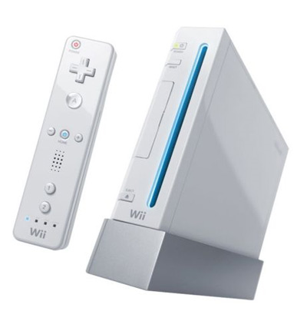
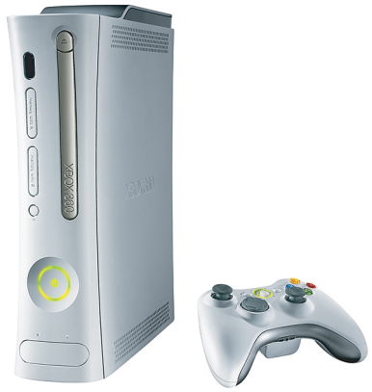
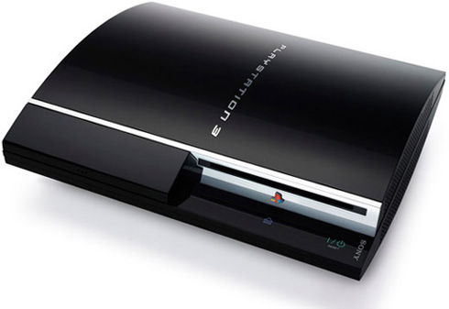
GPUs – Graphical Processing Units
“Those Darn Kids!”
Courtesy Jeffrey Layton

Slide 17
History of CPU/GPU Performance
Double Precision
ATI
Evergreen
ATI
Firestream
C1060
3.2. GHz
Harpertown
2.3 GHz 12-core
AMD 6100
Courtesy Jeffrey Layton

Slide 18
History of CPU/GPU Performance
Single Precision
ATI
Evergreen
ATI
Firestream
M2050
(Fermi)
GT200
G80
Ultra
G80
G92
2.3 GHz 12-core
AMD 6100
NV40
G70
G71
3.0 GHz
Core 2 Duo
3.2 GHz
Harpertown
NV35
Nvidia Fermi
ATI Evergreen
Courtesy Jeffrey Layton

Slide 19
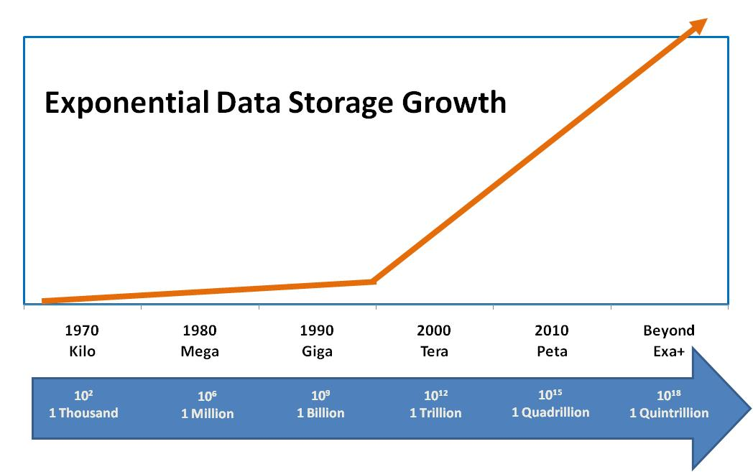
Data Storage
Data growth much faster than ability to move the data

Slide 20
Data Perspective
History: According to Kevin Kelly of the New York Times, "the entire [written] works of humankind, from the beginning of recorded history, in all languages" would amount to 50 petabytes of data.^{[1]}
Internet traffic
In 1993, total Internet traffic amounted to approx. 100 TB for the year.^{[4]}
As of June 2008, Cisco Systems estimated Internet traffic at 160 TB/second (which assuming to be statistically constant comes to 5 zettabytes for the year).^{[5]}
Telecoms: AT&T has about 16 petabytes of data transferred through their networks each day.^{[4]}
Physics: The 4 experiments in the Large Hadron Collider will produce about 15 petabytes of data per year, which will be distributed over the LHC Computing Grid.^{[8]}
Social networks: Facebook has just over 1.5 petabytes of users' photos stored, translating into roughly 10 billion photos.^{[9]}

Slide 21
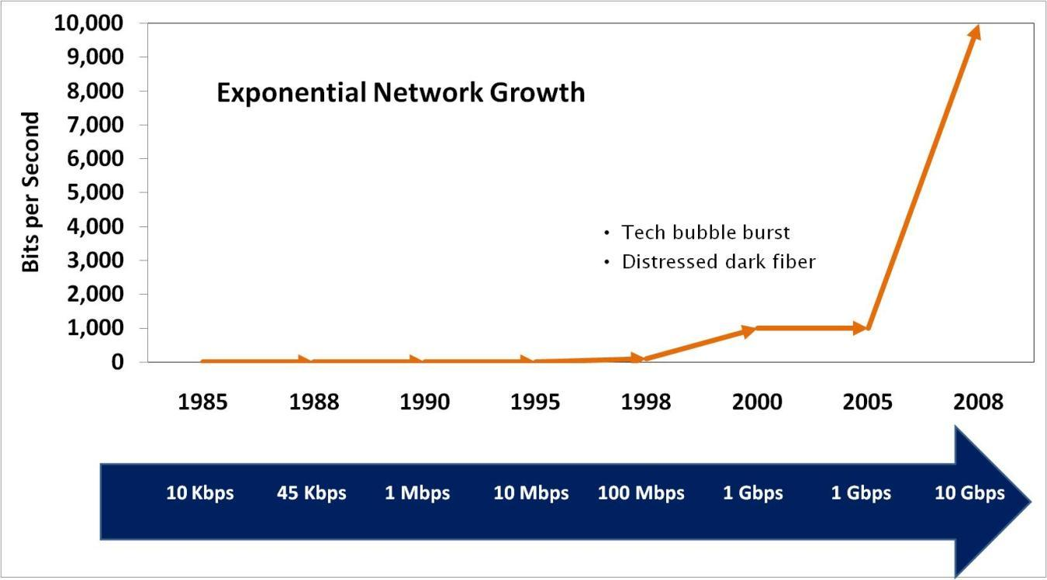
R&E Networking

Slide 22
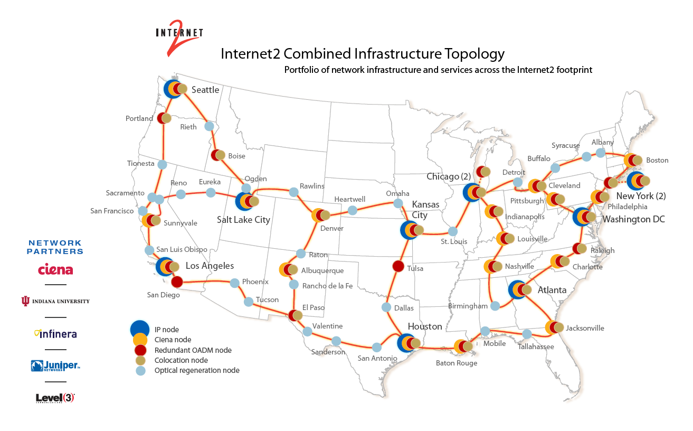

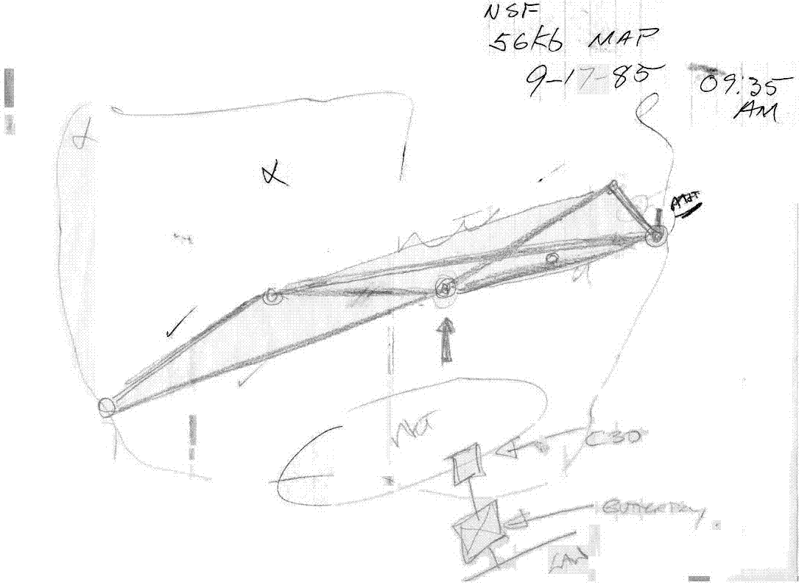
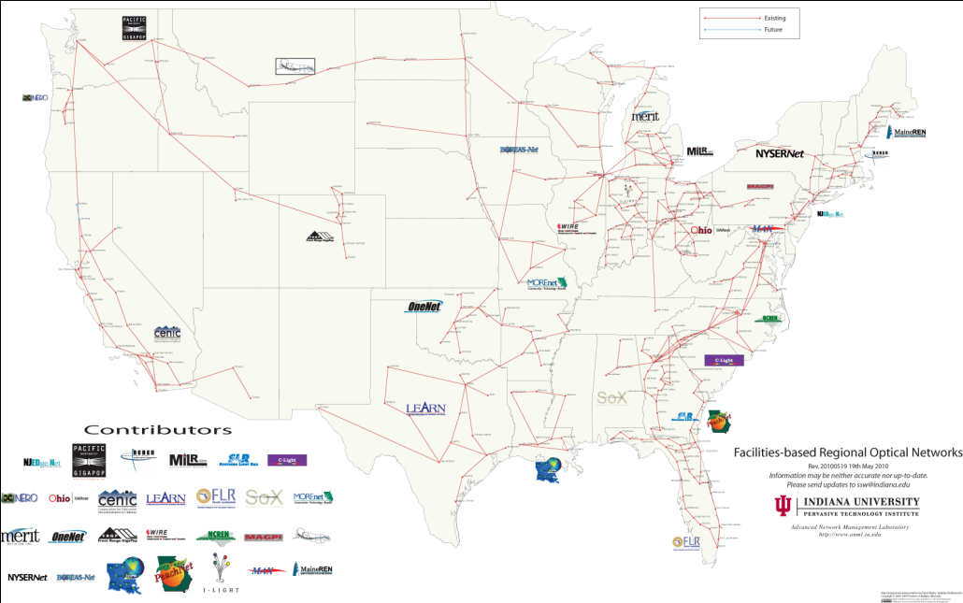
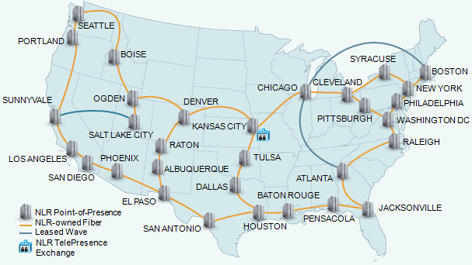
National Network Evolution
Original NSFNet design,
NCAR, Boulder, CO,
September 17, 1985
Facilities-Based Regional Optical Networks
Map of
U.S.
CTC
JvNC
NCAR
NCSA
PSC
SDSC
http://paintsquirrel.ucs.indiana.edu/fiber_map.pdf/history.html
56,000 Bps (your home today has 26x)

Slide 23
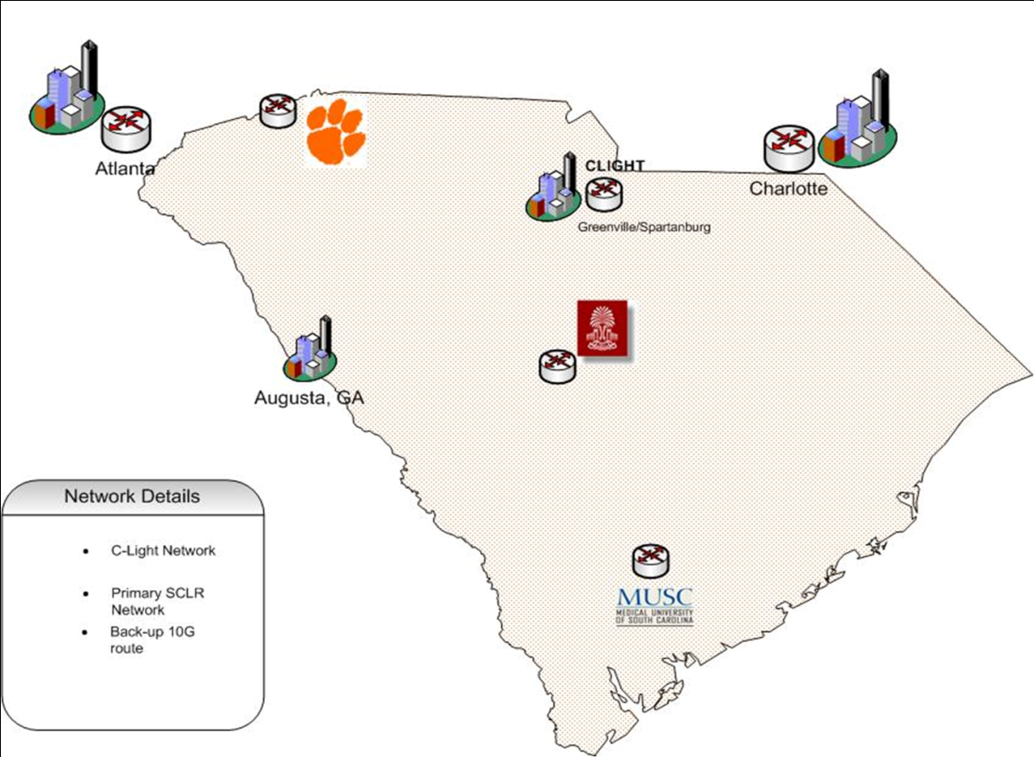





South Carolina:
An Evolving Network of Networks
Clemson
CU-ICAR/BMW
Pee Dee REC
USC
Baruch REC
Sandhill REC
Savannah
River Labs
Edisto REC
C-Light Network
Primary SCLR Network
Back-up 10G rout
Partners
Coastal REC
CURI Lasch
PSPN: 50 hospitals and 35 mental health clinics Part of FCC’s Rural Healthcare Pilot program

Slide 24
Academic Digital Divide 2010
Faculty at a comprehensive university in South Carolina have access to less bandwidth than a K-12 student in North Carolina or Florida!
Faculty at a comprehensive university drive 4 hours to Clemson because their data takes > 2 weeks on the state network (Interstate26net)
Students at a SC comprehensive university taking a common course with students at Clemson are visually limited because they can only turn on 1 of their 3 video cameras at a time due to bandwidth limitations

Slide 25
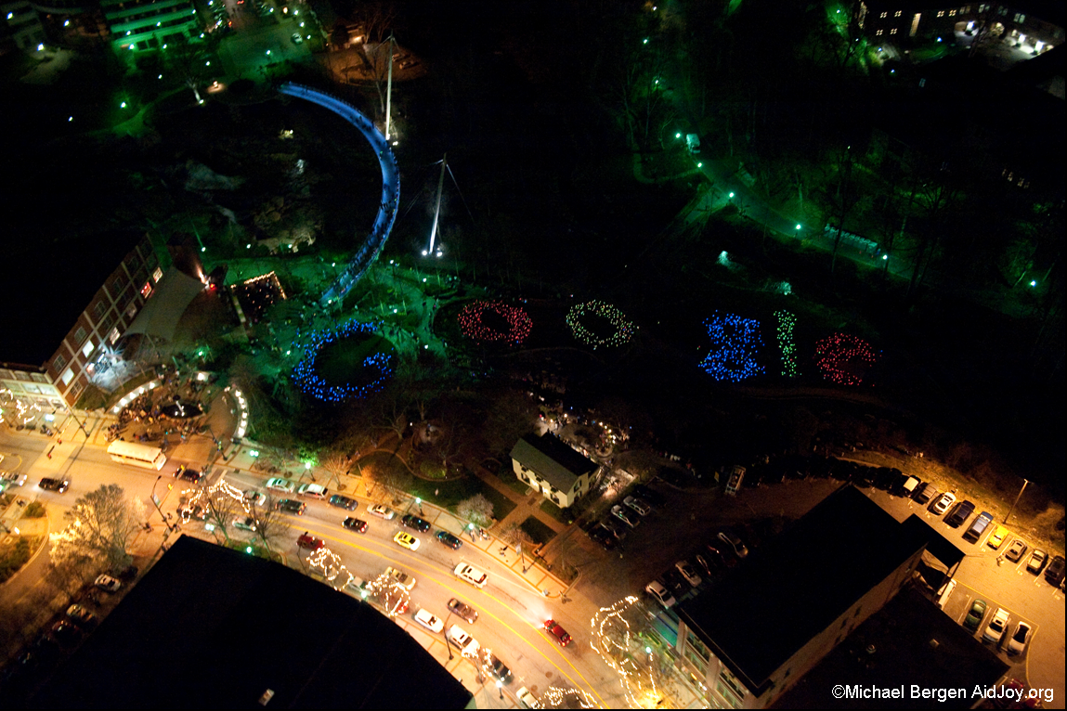
Will universities continue to lead innovation?

Slide 26
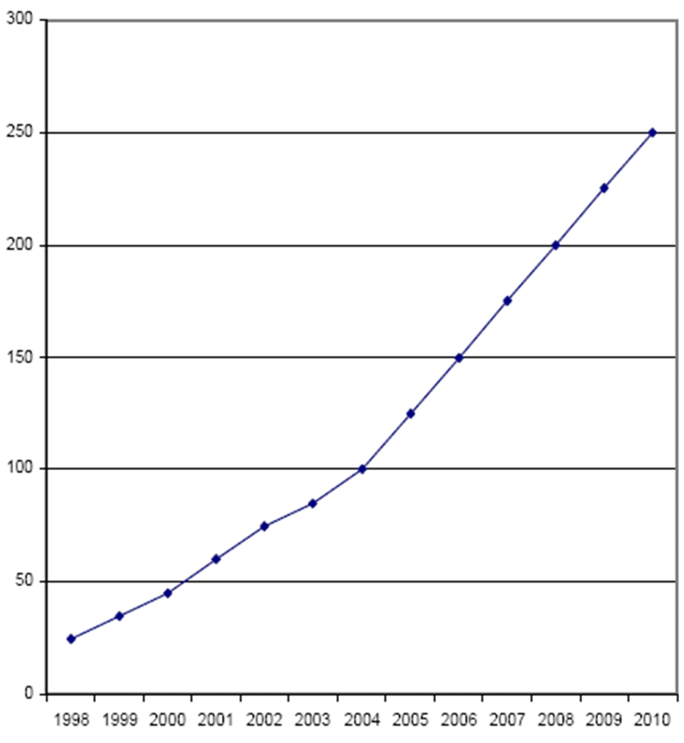
Power Consumption in Data Centers
Watts per
Square Foot
Source: www.utilityeda.com/

Slide 27
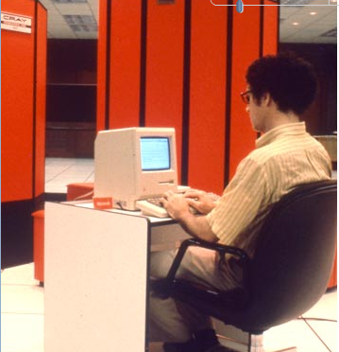
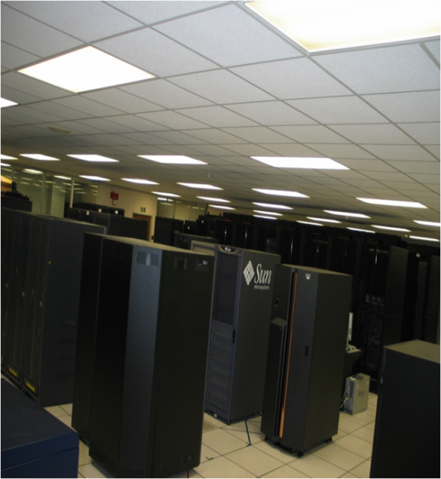
Effect on power over 25 years
UIUC 1985 - had to install a direct feed from Illinois Power to run the system
Clemson – from ½ MW in 2006
to 4 ½ MW in 2010 to support computational environment

Slide 28
How HPC is Driving Power at Clemson

Slide 29
It may be a treadmill and we may have money issues . . .
. . . but we have to keep up!

Slide 30
Some thoughts……..
Understand the business that we’re in
Reassess, reset
Do your own ROI . . . don’t wait for the consulting group to show up
Process is good but temper it http://www.itsmwatch.com/itil/article.php/11700_3607926_1
Be careful of fads . . . crowd
Crossover the silos
Be creative

Slide 31
Use a framework that non-IT people can understand…..
….helps to tell a story

Slide 32
Investment and Measurement Framework
Planning, timelines, budgeting, decision-making
Maslow’ Hierarchy
Productivity & Discovery Enabled
Self-Actualization
Applications, Tools, Consulting
Software Stack/Middleware
Servers, CPU, Storage, …
Safety
Networking/Connectivity
Power & Cooling
Physiological
†Maslow, A. H. (1943). A Theory of Human Motivation. Psychological Review, 50, 370-396.
Courtesy: John Cobb, ORNL
Notes:
Used with our BoT along with the “4 legged stool” to explain strategy, timing and investments and progress

Slide 33
Business Model

Slide 34
Diversification . . .
. . . how many legs are on your stool?
Customers
Entrepreneurial activities
Tap root
Co-investors
Notes:
NCSA
Started in 1985 with 90-95% NSF
State – created a “funding principle”
“Bloch doctrine”
4th leg is “other” funding sources
Result balanced portfolio
focus
Clemson
Institutional strategy
Research partnerships
External partnerships
Public
private

Slide 35
Budget Impact

Slide 36
Experiences…..

Slide 37
National Center Evolution – one case
1985
Two user communities
Funding: 95%+ from single source
1990
Early MPP (R&D); viz; industry; network; software tools
1995
2000
No network; 4 processors
Dozen+ user communities
Funding: 70/30
User communities growing
Early clusters; WWW; Internet2; centers “mission creep” - NSF cancels centers; PACI created
Funding: 50/50; PACI hubs as funding agencies
PACI phased out; Terascale - TeraGrid beginning
Funding: 40/60 center funding fading
Staffing: 75+
Staffing: 175+
Diversification growing
Staffing: 400+ (center) PACI partners
Capability computing at centers
Campuses picking up users
Notes:
What I got from Stan was that they really wanted to hear some history from me…
be nice to have some old pictures here ….I have two and will look for more
NSF HPC Center
1985 - 4 processors; 2 user communities; no network; 90+% funding from one source
1990 - early MPP; viz; industry; dozen+ user communities; network 70/30 funding
1995 – early clusters; user communities growing; 40/60 funding; WWW; I2; centers “mission creep”; NSF declares success, cancels centers program and creates PACI – begins trend toward more of a distributed notion of centers
2000 – PACI on way out and TeraGrid on way in; concept of an NSF center
2010 - past decade – what is a center

Slide 38

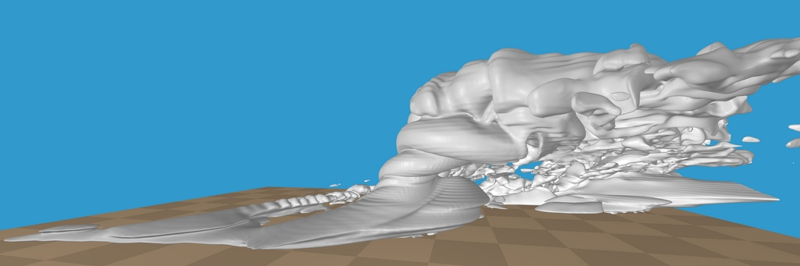
Necessity is the mother of invention
Notes:
Problems with being “too focused”

Slide 39
Career Change………
….became a CIO in 2001

Slide 40
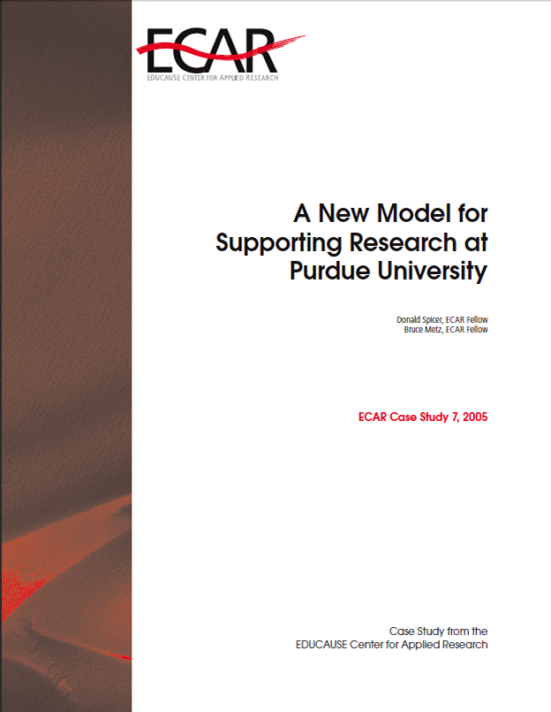
IT Strategy: Purdue
Notes:
Will this collaboration provide MUSC researchers better access to resources and faster turnaround?
Will high speed single application processors be made available through this collaboration?

Slide 41
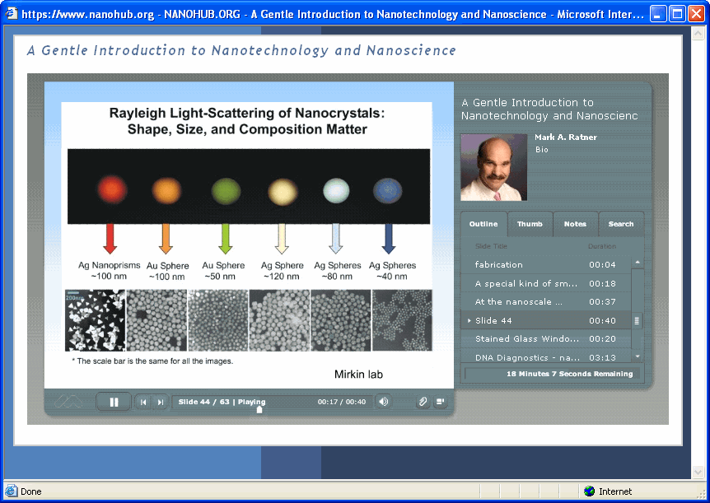
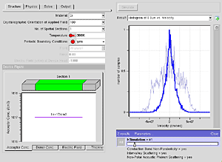
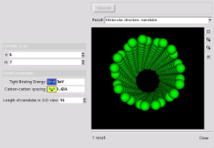
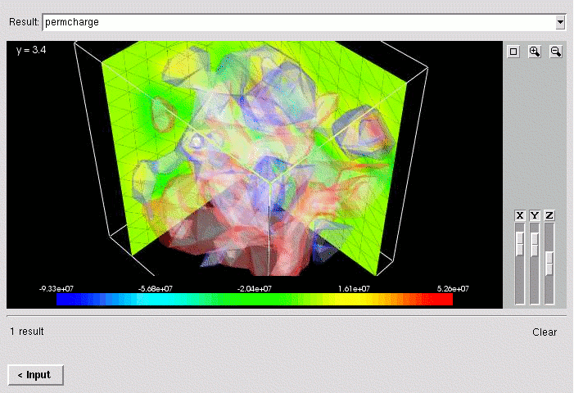
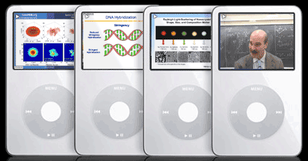
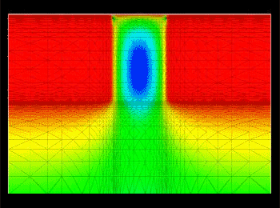






nanoHUB.org: created and hosted by the Network for Computational Nanotechnology (NCN)
Online simulation…
…and more!
nanoHUB:
A vibrant community
NCN - A Research and Infrastructure Network
Aiming To Move Nanoscience towards Nanotechnology

Slide 42
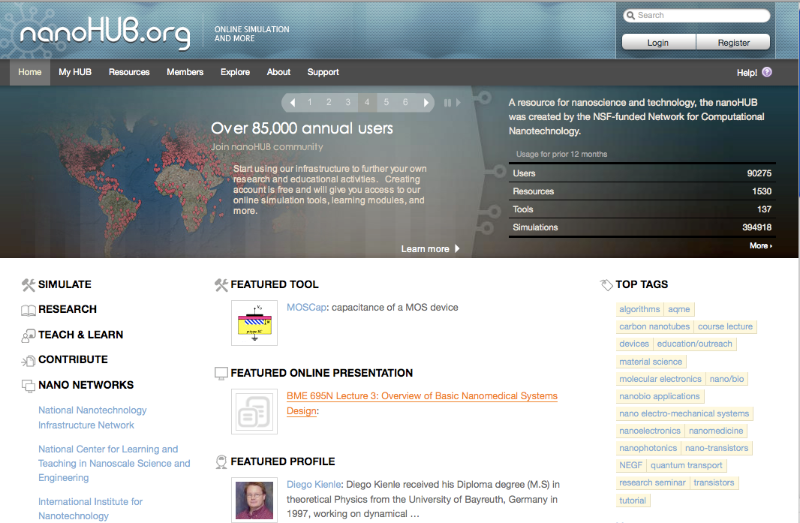
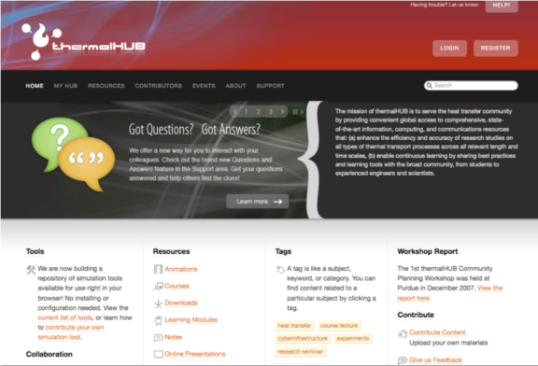
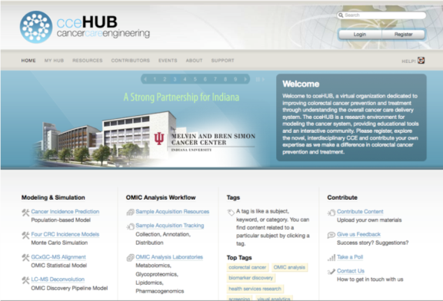
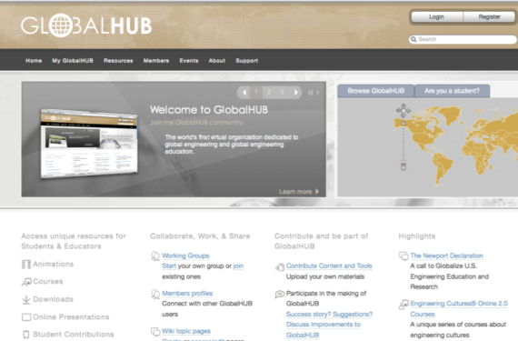
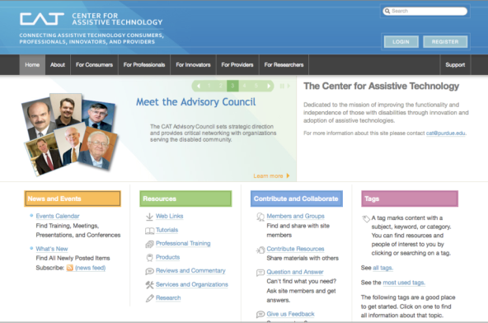
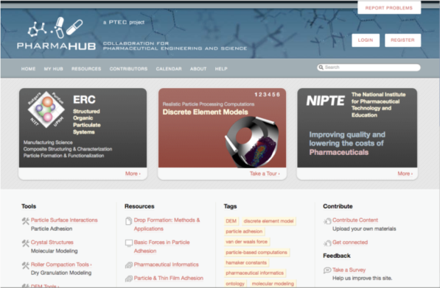
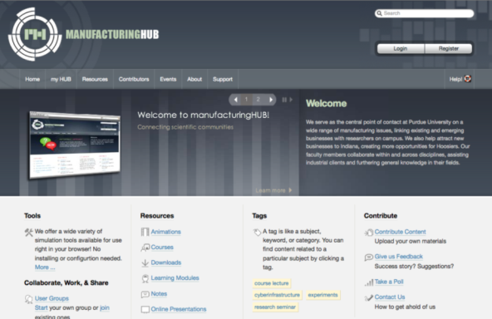
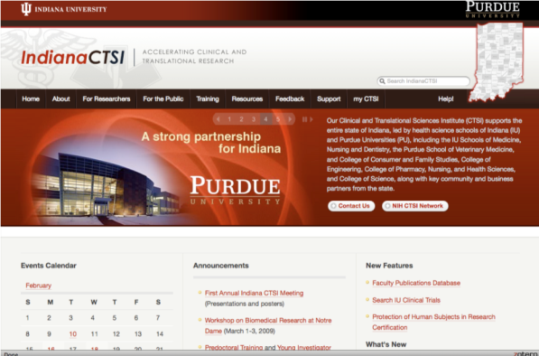



Slide 43
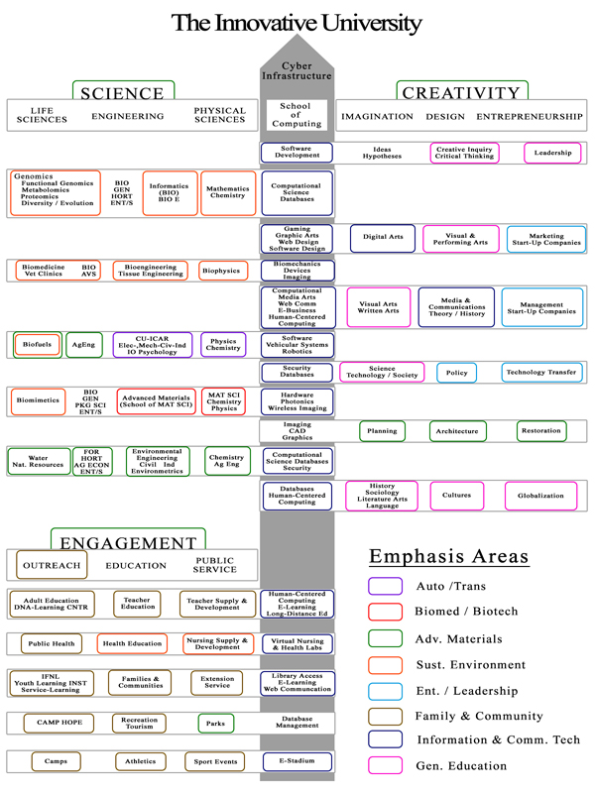
Clemson CI Vision
“Cyberinfrastructure is the primary backbone that ties together innovation in research, instruction, and service to elevate Clemson to the Top 20”
Dori Helms
Provost
Notes:
Goal of Top 20
Growing research base
Growing industrial involvement
CU-ICAR with BMW
Emphasis on cyberinfrastructure as a strategic advantage
50%+ faculty turnover - state early retirement
New faculty are increasingly data & computationally driven
Creative Inquiry
Jim Leylek, a Clemson engineering professor who will be director of the computing center, said its system will be able to perform 10 million millions calculations per second, making it "one of the most powerful university-based systems in the country.“
http://greenvilleonline.com/apps/pbcs.dll/article?AID=/20070111/NEWS01/701110323/1004
CU Computational Center for Mobility Systems (CU-CCMS)

Slide 44
The IT Reality—Clemson 2006
Underfunded IT by $12-14M/yr for over a decade
Capability gaps: HPC, storage, optical fiber, WAN, project & process management
Fragmented infrastructure
Leadership void—no IT plan
Gap with users—non-responsive
Lack of clear policies, process
Inward looking—not engaged or visible nationally
No IT focus on research support
Source: consultant’s report; personal observation

Slide 45
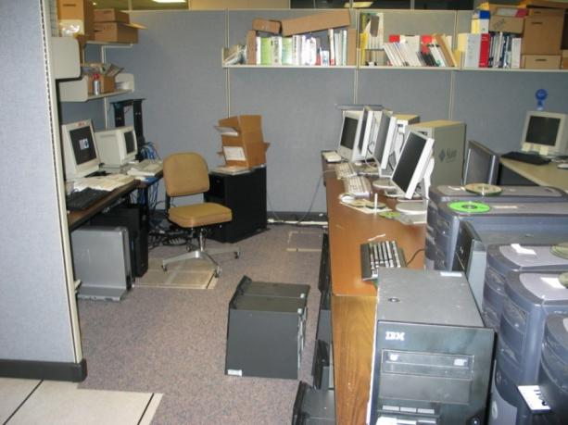
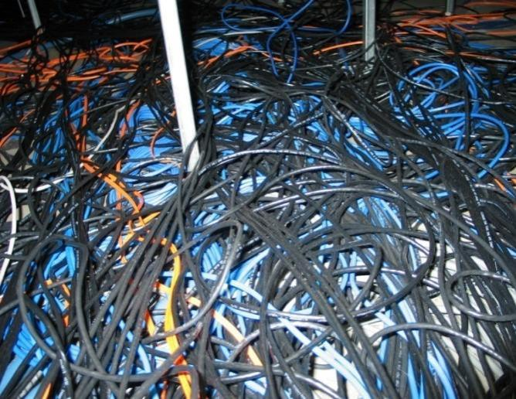
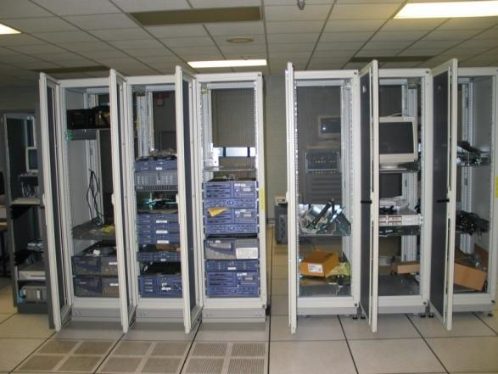
Data Center 2006
Notes:
Much effort, but no enforced standards.
The problems we’ve encountered in the ITC were in no way a lack of effort by CCIT staff. Many practices such as labeling, change control and system identification have long been in place.
Our shortfall has been in the area of documented standards in the areas of space usage
(Click)
cabling practices
(Click)
and rack utilization.
45

Slide 46
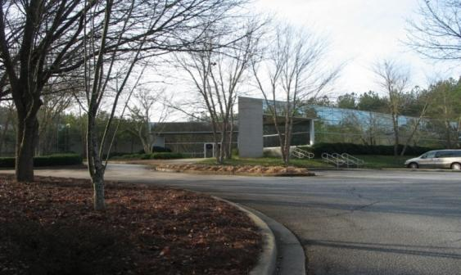
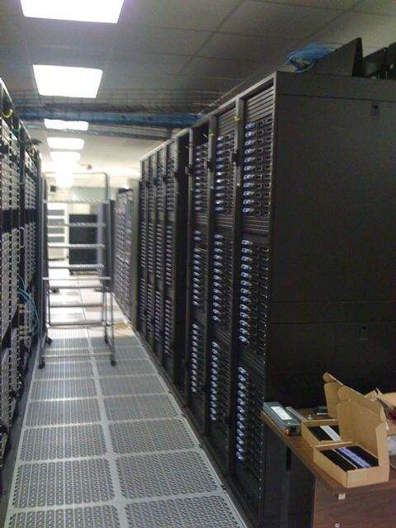
Evolving Campus HPC Business Model
8216 cores in our Linux pool – research funding driven
do in minutes what used to take days, weeks, or months
New paradigms for scientific discovery
2006 <1 TF to 100 TF: #89 in world; 9th in academia (6/09)
Clemson University HPC Center
Notes:
$245823 CCIT
$368734 Faculty

Slide 47
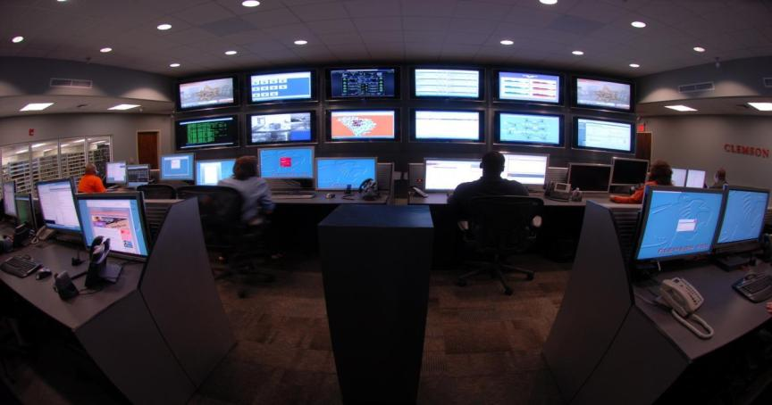
Network Operations Center (NOC)

Slide 48
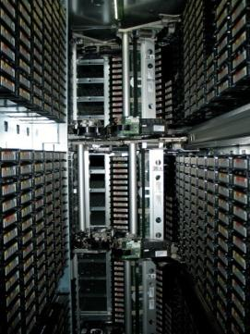





Clemson Change – Data Storage
Growth in data analytics
Visualization
Storage cover story
  New model
  Economical
Source: John Ballato,
Associate VP for Research &
Economic Development FY09
ExLM Expert
Library Manager
Identity Manager

Slide 49


. . . broader impact
Architecture students using Condor Render Farm
  Up to 300 graduate and undergraduate students
  All students regularly use computer aided drafting tools
    Autodesk VIZ, Maya, and Rhino
  Rendering large scenes with multiple light sources
  Allows larger projects to get done in less time
    Must “dumb down” if project done on laptop or lab computer
. . . which side of the bread is the butter on . . . HPC v. HTC – who cares!

Slide 50



Slide 51

Faculty Engagement
Over 200 Faculty
Base of 1000
Colleges Participated:
AAH, BBS, E&S, HEHD,
AFLS & Libraries
Dean of Arts &
Humanities chaired a panel
National Panel & CNI

Slide 52





. . . try new things and don’t be afraid to fail . . .
South Carolina Cloud
4 universities, 1 high school
  STEM Teaching—Parallel Computing—Grid Classroom
  HPC remote access & remote system administration
  Application hosting
  DR and Business Continuation

Slide 53




. . . can lead to new funding sources . . .
Testing & evaluating technologies & services
  CoEE Endowed Chair in Cyberinfrastructure ($4M)
    Home in Electrical and Computer Engineering
  Department of Energy ($2.5M)
    South Carolina “Cloud Testbed”
  National Science Foundation
  Research Information Infrastructure
  Track 2 ($6M)
    Clemson leads partnership
    between SC and Tennessee
  Industrial partnerships
  being developed
NSF EPSCoR $6 M Award

Slide 54


Efficiency Through Integration
Example:
Project Blackbird: Deploying Condor in a Blackboard Environment
Reduced total archive time
from > 85 hrs to < 24 hrs
Job scheduling – all servers finish
at the same time
Zero impact to Blackboard Performance
Load balancing – archive jobs are distributed as cores become available
Takes advantage of all available CPU cores instead of just one core per server
Commercial potential
Reference: http://www.educause.edu/eq/

Slide 55
Checking the pulse……….

Slide 56
From the Students
The Tiger
September 14, 2007
I've been greatly impressed by the improvement in general IT service to students here at Clemson over the last 3 years of my time here. Offering Mac computers, revamping the student help desk, making gmail an official email option, overall network stability and other items attest to the fact that student concerns are being heard and acted upon. Student input has also been actively sought out in IT changes like the Student IT Fee and upcoming Print Management System. As an engineering student, I'm also proud that our University's newfound commitment to supercomputing has really put Clemson on the map as a research institution. From a student's perspective, I think computing at Clemson is headed in a great direction! Garrett Bounds, Senior, Mechanical Engineering
Over the past couple of years, there have been great strides in making me more efficient as a student. Programs like iPrint, as well as available licenses to a medley of software such as Maple, Solidworks, and Microsoft Campus have enabled me, as a student, to be on the cutting edge and to maximize my daily productivity. And I'd be most remised to forget to mention the amazing convenience of an on-campus Apple Store and the great discounts available through them. All in all, certainly steps in the right direction. Rory Goosen, Senior, Economics
When I first made the decision to come to Clemson, my daughter, a sophomore at the time, told me that the technology on campus was really bad. She said that the wireless was iffy at best and the system would crash on a regular basis. Over the three years that I have attended classes here I have seen the system get continually better. The wireless works across the majority of campus, the system does not crash on a regular basis and when it does, I am notified and it is back online quickly. The improvements from what my daughter experienced and what I have seen are nothing short of incredible. Does that mean that we are where we need to be? No, but I am encouraged that we are heading in the right direction. Tammy Vaught, Graduate Student, Education Leadership

Slide 57



From the Faculty
"The concept of an interactive teaching style has been around for a long time, but recent advances in technology allow us to still deliver content but we do that outside of class. In class we can interact, solve problems with the students, etc. We have moved from disseminating knowledge to our students, to our students really understanding and applying knowledge. Technology has enabled our going beyond knowledge to critical thinking.“
Bob Barcelona (assistant professor in PRTM's Youth Development Leadership Program)
“The high-performance computing resources available at Clemson have enabled world-leading calculations of plasma-wall interactions in the Stuart research group, of relevance for next-generation thermonuclear fusion reactors. …….of interest for nanotechnology applications, have also benefited enormously from the computing resources available at Clemson. In this application, we are able, for the first time, to match the experimental energy, time, and temperature scales used in the collisions that lead to novel nanostructures.”
Steve Stuart, Professor, Chemistry
“The computational resources now available greatly enhance my competitiveness when it comes to applying for grant support from national sources”
Dr. Robert Latour, McQueen-Quattlebaum Professor of Bioengineering

Slide 58


Barbara Hoskins, Assistant Dean, HEHD
The whole blended approach to teaching has changed everything. The things we are doing now (or doing more now) that we couldn't do three years ago are the following:
Sandbox Classroom (Holtzendorff Teaching with Technology Experimental Classroom)—ability to project students' work from their tables on one, two or all three projection surfaces; ability to walk around the room to coach students as they work in teams to solve problems and still control the technology in the room with the wireless control panel; student use of digital ink on tablet PCs.
Tablet PCs for students--through various grants, faculty have secured tablet PCs for math, nursing, general engineering, and chemistry. Plus other disciplines use them when teaching in the sandbox classroom and eventually M302 Martin. Has led to collaboratively developed web-based applications such as OrganicPad, MathPad, Replay Ink.
Grid Classroom— M302 Martin — Faculty thinking about the possibilities and building collaborative relationships at other institutions in anticipation of teaching in that room, taking advantage of the Access Grid and computing power
Technology connections at University Center at Greenville
Second Life and the Carolina Virtual World Consortium—
multiple projects in teaching and research; lots of collaboration
among faculty and students
Using wikis, blogs, and social networking in class, being more
immersive
Podcasting and iTunes U— MediaSite, Echo360, Podcast Producer, audio only, enhanced audio, video — being used by faculty to deliver content and by students to complete assignments.

Slide 59





From the Faculty
“The impact of Clemson’s high-performance computing capability on our group’s research can be summarized in two phrases: increased scale and improved fidelity.”
Dr. Dan Noneaker, Professor, Electrical and Computer Engineering
“I would not have come to Clemson if it were not for the computing resources and infrastructure”
Dr. Juan Gilbert, Professor & Chair of Human Centered Computing, School of Computing
"I had all but given up on this line of research, when I was approached with this Condor idea. Now I am doing work at a scale larger than is usually done.“
Dr. Mary Beth Kurz, Assoc. Professor, Industrial Engineering
“As a single investigator receiving $1.5 million in awards last year, I could not have done it without Clemson’s CI.”
Dr. Krishna Madhavan, former Asst. Professor, Engineering Education
“This transformative research would not have been possible without the recent advancements of Clemson University into the supercomputing arena”
Dr. Gene Eidson, Principal Investigator, Intelligent River, Baruch Institute, PSA

Slide 60


From the Faculty
“..the new focus on computing has established our reputation in the HPC community that has ultimately resulted in about $1M in computer systems research funding. We've gone from "up and coming" to a recognized leader.”
Dr. Walter Ligon, Associate Professor, Electrical and Computer Engineering
“Three years ago if I wanted to set up a cluster of computers for high performance research computing I had to find space, power, cooling, negotiate with vendors, deal with state regulations, receive the shipments, build the system, figure out why it doesn't work, pay graduate students to support it, train the students, hire new students every couple of years, deal with dead hardware, and eventually do it all over again then I needed to upgrade. Now there is a professional team that does all that for me so I can write proposals, do research, write papers, and teach students, like faculty should.”
Dr. Walter Ligon, Associate Professor, Electrical and Computer Engineering
“Three years ago, there was no hope for using clouds to compute large GIS datasets. Because of the work of David White and Ed Duffy we have been able to use the program Condor to run a huge analysis of the impacts to protected areas in North America, rapidly. We believe this is the first such application anywhere - we know of know published examples. I use a lot of large GIS datasets to answer ecology and conservation questions: their work in CCIT to make this happen, and their fantastic collaborative attitude, promises great dividends for research.”
Dr. Robert Baldwin, Assistant Professor, Forestry and Natural Resources

Slide 61

What is ahead
Clouds?
Outsourcing?
Leverage the
  Feds?
  Colleagues?
  Industry?
Being entrepreneurial

Slide 62

Massachusetts HPC Investment
Combined with commitments from academic partners, the University Consortium, a total of $65 million in funding will be leveraged . . .
"These investments are critical to ensuring that the High Performance Computing Center will move forward to support job growth and advances in innovation, technology and research," said Governor Patrick.

Slide 63
South Carolina Cloud
A highly leveraged, integrated set of infrastructure and activities—future looking partnership among IT leaders in the State
Base infrastructure = South Carolina Light Rail
  Shared, expandable and nimble
Next level = shared data centers; shared virtualized server farms; shared storage facilities; federated identity; security;
Economic conditions have changed
and so must we!
Why do all these things by ourselves?

Slide 64
The end……….
……is just another beginning

