Slide 1
Rapid Fire Delivery
Copyright - Peggy Jasper -2010. This work is the intellectual property of the author. Permission is granted for this material to be shared for non-commercial, educational purposes, provided that this copyright statement appears on the reproduced materials and notice is given that the copying is by permission of the author. To disseminate otherwise or to republish requires written permission from the author
Notes:
Welcome -
Introductions – Marjorie Campbell, Mgr Integration role was scrum master
Nancy Griffis – Mgr Student team role was SME (IT)
Clemson has begun to incorporated Agile into Software / Application Development lifecycle –
we have not taken on major projects, but 3 very work intensive processes and streamlined and automated the process and have two more follow up projects
We are tuning our process to make improvements not only in our customers processes, but our development lifecycle
Give practitioner’s guide on how we implemented agile
Explain the reason why we needed this change
How we got involved Agile/ Scrum
Discuss lessons learned
Each time we do a project there are improvements that can be made and we continue to refine our process with these improvements
But first, i would like to get a feel for the audience knowledge of Agile - -
How many people have heard of agile?
How many are using agile?
Heard of SCRUM?
In using agile we incorporated the use of Scrum. Will explain scrum later
But first, we want to begin with our case for change.

Slide 2
Why the Change?
change
Notes:
Show video

Slide 3
Reasons for Change
Deliver Business value quickly
Customer commitment
Focused Resources
Quick response to change
Cross training / Knowledge Share
Notes:
These were the pain points that we were experiencing
Weren’t able to deliver Business value in a timely fashion –
Needed customer commitment to projects.
We were getting more of a hand-off to developers
Focused Resources
Minimal thrashing for programmers.
Spend a lot of time going back and forth on multiple assignments (prioritization)
Quick response to change during development–
getting to a change sometimes took time.
The waterfall approach where all at the end requirements have changed.
Cross Training / knowledge share
Spread IT system knowledge. We’re 1 person deep in many areas

Slide 4
What is Agile ?
Disciplined Project Management
Frequent Inspection and Adaption
Teamwork with self-organizing and cross- functional teams
Engineering best practices allows for rapid delivery of high quality software
Business approach that aligns development with customer needs and company goals
Notes:
In our discovery phase we continued to come back to Agile as the method that best address our issues.
Talk a little bit about what Agile is…
Agile software development refers to a group of software development methodologies based on iterative development, where requirements and solutions evolve through collaboration between self-organizing cross-functional teams.
disciplined project management process that encourages
frequent inspection and adaptation,
Provides incremental review of what’s being developed for customer validation of business rules
Differences between agile & waterfall
Teamwork with self-organinizing and cross-functional teams
a leadership philosophy,
Collaboration
Self-organizing
Close, daily cooperation
Projects are built around motivated individuals
accountability
Set of engineering best practices that allow for rapid delivery of high-quality software,
Test driven design
Lean
Continuous integration
Code re-factoring
Business approach that aligns development with customer needs and company goals.
Business value
Customer commitment

Slide 5
Software Development Governance
Adaptable Applications
Self Documenting Application
Administrative Functionality Managed by Customer
Modularized Code for Reusability
Test Driven Design
Notes:
Adaptable applications
We needed to be able to build one framework and allow many areas to use the same structure
Common practice was to find an application worked the same and copy it to another application
Now you have 2 applications that need to be maintained.
An Example
Assessment test –
Allows test to be set up by different departments
Used as placement test
Assessment testing
Departments can’t see other dept test
Audience for test can be different for each test type
Self Documenting applications
Develop ways to have customer help at the finger tips
Using links out to documentation
Bubble popups
audio
Administrative functionality managed by Customer
For each area provide administrator functionality
To provide common functions such as access set up
Tables that manage the module – date accessible, audience, on/off switch,
Modularize code for reuseibility
When designing functions create simple one purpose actions to build on
This provides common building block logic to build your next application
Allows only one place to maintain code for many applications
Test Driven Design
Not sure we have mastered this component yet
We have a QA representative participate on the project to document the business rules
Develop test scripts based on the rules
Reuse each time a change is applied to the application

Slide 6
Agile Manifesto
Individuals and interactions over processes and tools
Working software over comprehensive documentation
Customer collaboration over contract negotiation
Responding to change over following a plan
While there is value in the items on the right,
we value the items on the left more.
Notes:
Individuals and interactions over processes and tools
Not that all processes and tools are eliminated
Goal is to have more focused and intimate relationship with the team in order to achieve successful results
Working software over comprehensive documentation
Not to throw away documentation,
But to develop a standard set of documentation in order to have clear understanding of technical mechanics
Customer collaboration over contract negotiation
Not to have a rigid agreement
But to work closely together to be able to adjust as we move through the project
Responding to change over following the plan.
Not that there isn’t a plan
But being flexible to adjust as new details are uncovered

Slide 7
How we changed
Management attended an Agile seminar
All development staff were invited to training webinar
Clemson’s Process Improvement officer workshop
Held Brown Bag lunches to determine our use
Selected several pilot projects
Put our version of Agile to the test
Notes:
We had heard about Agile being a quick results oriented methodology and it seemed to address the situations that we were having ….
Management attended an Agile seminar
Three mgmt team members attended an Agile seminar to further understand and discuss our concerns with the Agile approach
This group determined that Agile was able to address our concerns and there were tangible benefits we could gain by using this approach
All development staff were invited to training webinar
There were a series of 6 webinars
These were held one every 2-3 weeks
All development staff were asked to attend
Copy of the webinar were used for new staff or those who missed
Clemson’s Process Improvement officer lead a workshop
Held Brown Bag lunches to determine our use
Round table discussions of how we would use Agile in our process were outlined
How we would use this at Clemson
Selected several pilot projects
There were 3 projects that fit our ‘pilot ‘ criteria
Small manageable project
Customer enthusiasm
Quick Wins
Put our version of Agile to the test

Slide 8
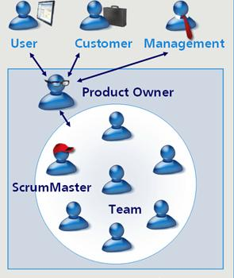
Agile Team
Business
Product Owner
Subject Matter Expert
IT
Scrum Master
Architect
Developers, Analysts
Designers
Technical Writers
Both
Quality Assurance
Testers
Notes:
Team:
Product Owner (Business)
Subject Matter Expert (Business)
Developers, Analysts, Designers (IT)
Quality Assurance, Testers (Both)
Technical Writers (IT)
Scrum Master (IT)
Note: Teams are small (~7)

Slide 9
Our Agile Process
Customer gathers the business requirements
Entire team meets to refine the requirements
IT group develops an initial design
Entire team works to validate the design
Develop stories & tasks
Use Scrum Principles
Notes:
Customer brings their business requirements, rules, design concepts.
Customer meets with IT and provides detailed requirements
Developers make best guess at process flow
Team meets to refine requirements, clarify, validate. Collaborative effort to come to a best understanding of what’s required, expected, needed.
This can take a week or two – the refinement of the design.
Scrum Principles
IT Team develops Stories & Tasks
Daily Communication – https://connect.clemson.edu/____
Identify access needs
Authentication
Data sources
Security authorization

Slide 10
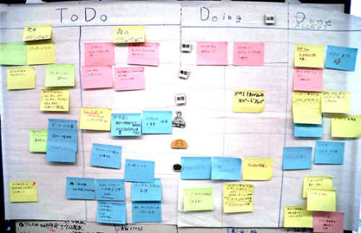
Development Product Backlog
Write all stories & tasks
Estimate time per task
Notes:
Each function is a story.
Break story down into single task, usually no more than 8 hours work packet.
Estimation of time – at first the times were off because over estimated ability in new environment. Got better as involved in next applications.
These stories and tasks are used in developing the product backlog which feeds the scrum process.

Slide 11
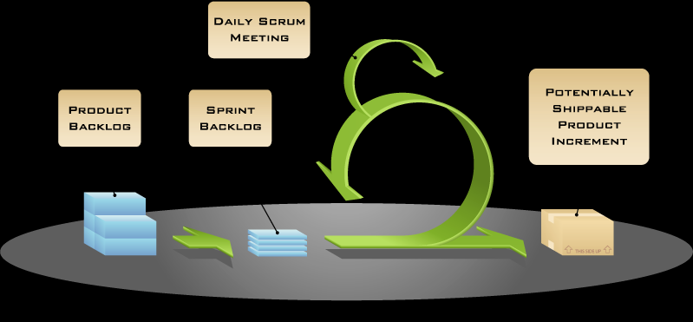
What is Scrum?
Notes:
Scrum is a framework for managing agile projects.
A deliverable is determined for each sprint.
From the product backlog each Team member chooses tasks of the spring based on hours, expertise, interest.
Scrum master facilitates the sprint, works to remove impediments and keep team moving.
Sprint is time-boxed deliverable. If a task is not completed, it moves into a sprint backlog and is picked up in a future sprint.
Scrum has three documents: product backlog, sprint backlog, and burn charts
Scrum has three meetings: sprint planning, sprint review, sprint retrospective
Scrum also has a daily stand-up for the team
Daily Communication – https://connect.clemson.edu/____

Slide 12
Development Phase
n Sprints of 2 weeks each
Sprint Backlog
Team members select tasks
Daily Scrum Meeting
Document Details
Sprint Review & Refinement Meeting
Prioritize stories and tasks for next sprint
Notes:
Sprint Backlog – sprint deliverable
Burn chart – means to measure progress on stories and tasks and time
At Sprint Review there was a customer review of the sprint Deliverable.
In sprint review Determine whether want to deploy for use or wait for next sprint.
In sprint review there can be new stories and tasks that will be added to product backlog for new prioritization.

Slide 13
Stories | Tasks | Initial Estimate in hours | Actual hours Used | Task Owner | Status
S1: Get FSW DATA Ready | S1-T1: prepare the table for MF load | 3 | 1 | Laurel | Complete
 | S1-T2:load data from MF to oracle table | 8 |  | Nancy | Complete
 |  |  |  |  | Complete
S2: Super User, dept user, CRUD | S2-T1: Database table create | 3 | 10 | Laurel, Nate | Complete
 | S2-T2: Backend persistance for super user CRUD | 7.5 | 10 | Laurel, Nate | Complete

Slide 14
Burn Down Chart
 |  |  | Work To-Date
 |  |  | 16-Mar | 17-Mar | 18-Mar | 19-Mar | 20-Mar | 23-Mar | 24-Mar | 25-Mar | 26-Mar | 27-Mar | 30-Mar
 |  |  | Day | Day | Day | Day | Day | Day | Day | Day | Day | Day | Day
Task | Task Owner | Initial estimate in hours | 1 | 2 | 3 | 4 | 5 | 6 | 7 | 8 | 9 | 10 | 11
S1-T2:load data from MF to Oracle table | Nancy | 4 | 4 | 4 | 4 | 4 | 4 | 0 | 0 | 0 | 0 | 0 | 0
S3-T1: Sprint 1 Backlog | Nate | 5 | 3 | 2 | 0 | 0 | 0 | 0 | 0 | 0 | 0 | 0 | 0
S3-T2:Every page has right authorization | Laurel | 6 | 6 | 6 | 6 | 6 | 6 | 6 | 6 | 6 | 6 | 6 | 6
S4-T1: Get Data permission to Grab Department Info | Marjorie | 1 | 1 | 0 | 0 | 0 | 0 | 0 | 0 | 0 | 0 | 0 | 0
S4-T2: DataBase Table | Laurel, Nate |  | 2 | 0 | 0 | 0 | 0 | 0 | 0 | 0 | 0 | 0 | 0
S4-T3: Persistances Job Posting CRUD | Laurel, Nate | 7.5 | 7.5 | 7.5 | 7.5 | 7.5 | 5 | 4 | 3 | 3 | 0 | 3 | 0
S4-T4: Front End Create/Update Job Info | Nate | 4 | 4 | 4 | 4 | 4 | 4 | 4 | 4 | 4 | 2 | 0 | 0
S4-T5: Front End.Job Info Listing/Deleting | Nate | 4 | 4 | 4 | 4 | 4 | 3 | 0 | 0 | 0 | 0 | 0 | 0
S4-T6: Test | Laurel, Nate, Deb | 5 | 5 | 5 | 5 | 5 | 5 | 5 | 5 | 5 | 5 | 5 | 5
S5-T1: Grab FAQ from File on sever, then display to user. | Nate | 4 | 3 | 3 | 2 | 1 | 0 | 0 | 0 | 0 | 0 | 0 | 0
S5-T2: Database Table | Laurel | 5 | 5 | 0 | 0 | 0 | 0 | 0 | 0 | 0 | 0 | 0 | 0
S5-T3: Persistance for profile create | Laurel | 3 | 0 | 0 | 3 | 0 | 0 | 0 | 0 | 0 | 0 | 0 | 0
S5-T4: Front End, student profile create | Nate | 7.5 | 4.5 | 4.5 | 2 | 0 | 0 | 0 | 0 | 0 | 0 | 0 | 0
S5-T5: Create/Edit FAQ page | Laurel, Nate | 15 | 12 | 12 | 11 | 11 | 7 | 7 | 5 | 3 | 2 | 1 | 0
S5-T6: Test | Laurel, Nate, Deb |  |  |  |  |  |  |  |  |  | 5
 | Total | 71 | 61 | 52 | 48.5 | 42.5 | 34 | 26 | 23 | 21 | 20 | 15 | 11

Slide 16
Federal Work Study Metrics
Business Savings
Hours: 250 to 20
Elapsed time: 5 ½ weeks to < 1 week
Postage & Materials: $400.00 to $0.00
Agile Benefits
Software Delivery Cycle: 3 mos to 6 weeks
Knowledgeable IT staff: 1 to 6
Software Toolkit: 0 to 5 reusable modules
Maintenance: IT to Business Owned
Notes:
It takes approximately 10 – 12 minutes to match student’s job information to a departmental job description and build a work record on the mainframe. We placed approximately 1000 students. So this takes about 200 hours or 5 ½ weeks (if we just work strictly on placing and do nothing else). We begin this process usually in late May after FWS awarding and continue until mid September. This is also Response Services’ highest volume time with calls and visitors. Most of the FWS placement takes place after office hours. This involves compensatory time for me and Debra.
Placement letters are run two weeks before the Fall semester begins. There are four copies of each placement letter (one for student, one for FAO file, one for supervisor/budget center and one to attach to CUBS paperwork..HR). It takes approximately two full days to match student job info sheet, collate, and mail. The cost is approximately $400 to mail.
This takes two staff members (Debra and me) and two student workers.
Student workers then file these placement letters, job info sheets and screen prints of CUBS hiring documents.

Slide 17
Lessons Learned:
The Good
No frills
Adobe Connect
Task Assignments
Customer Involvement
Sprint deliverables
Customer Sponsored Training
Joined SCRUMU
The Bad
Better Demo
Technical Writing
Internal Tension with other developers (resistance to change)

Slide 18
Federal Work Study Agile Project
FWS live
Notes:
CHECK ALL THESE LINKS. SET UP TABLES
http://www.clemson.edu/fws
http://www.clemson.edu/capp
http://www.clemson.edu/lifews

Slide 19
Questions
Peggy Jasper, Exec Director of Application Services – pjasper@clemson.edu
Marjorie Campbell, Manager of Integration Services – marj@clemson.edu
Nancy Griffis, Academic Services – nancyg@clemson.edu

