Slide 1
Mind the Gap: Advancing Teaching and Learning Through Strategic Alliances
Christopher Waters
Assistant CIO and Director of Teaching and Learning Technologies
Scott Hildebrand
Assistant Director of Teaching and Learning Technologies

Slide 2
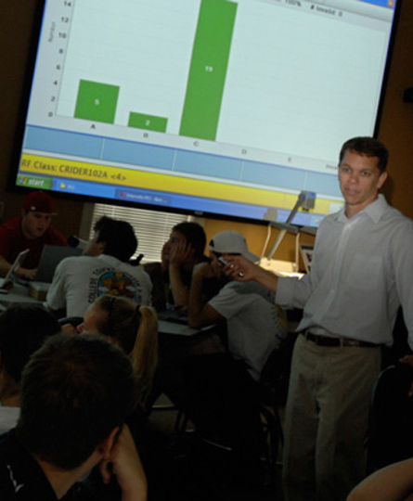
Enrollment 2009-2010
Undergraduate: 4,992
Graduate: 636
Students from 43 states, the District of Columbia, and 51 other nations
343 full-time faculty
51 undergraduate majors
Graduate programs in business, education, interactive media, law, and physical therapy

Slide 3
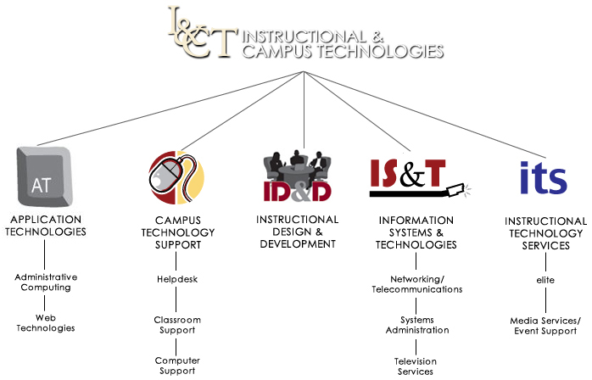
Technology Support for the Academics (previous structure)

Slide 4
Technology Support for the Academics (previous model)
Waited for faculty to come to us
Support was somewhat divided;
Some technology staff “did it” for the faculty
Some technology staff showed faculty “how to” do it
Any idea became a project
Workshops were offered, but attendance was low

Slide 5
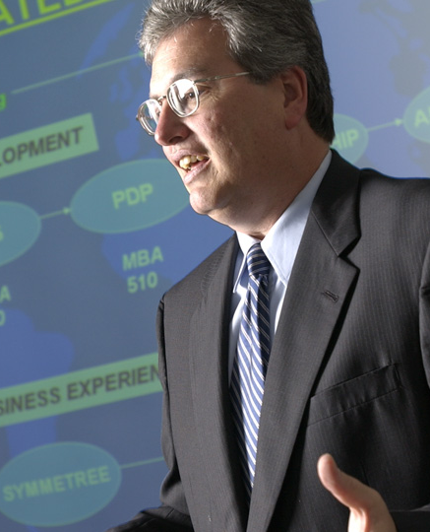
Changing Faculty Perceptions
“Who cares about your name?”
“Just want help!”
Newer Faculty – “Do it for me!” or “Leave me alone!”
“We are all IT” (Information Technology)

Slide 9
Goals for Teaching and Learning Technologies
Enhance triage for ideas/support
Build on CATL referrals
Continue to improve communications
Provide clear levels of support
Innovate with new learning technologies
Ensure deliverables through project management

Slide 10
Front Door
Technology and campus initiative training
Support
Creative
Services
Training/
Development
Creative
Project Management
Center for the Advancement of Teaching and Learning referrals
Notes:
Marketing
Website
Wiki

Slide 11
What is Teaching and Learning Technologies
Multimedia/web design
Video & web conferencing
Event support: traditional AV & university productions
Course management: operation/support
Electronic test grading
Blogs, wikis, podcasts & Web 2.0 tools
Video production: course support & professional
Software training & support
Print/poster design
Equipment circulation
Summer online recruitment & training
Student software support
Facilities management

Slide 12
Immediate Strategies for Success
Promote www.elon.edu/teaching website
Support new Strategic Plan
Transform individual projects to departmental initiatives
Reorganize staff resources
Clarify teaching & learning support with CATL
Partner with faculty on grants
Define technology training solutions

Slide 13
Project Development Process
Levels of support
1 Training only (quick help)
2 Training Assistance with ongoing support
3 Project development with staff resources
4 University initiatives requiring resources/deployment
Collaborate with faculty on design
CATL scholars/grants
Sponsored Programs/external grants

Slide 14
Key Questions
What is the perfect staff mix of project leads, designers and creative staff to support teaching and learning in 2020?
What is the appropriate method/approval process of technology grant funding for good ideas?
How much training do we provide faculty? Students? Staff?

Slide 15
Key Questions
What is the priority of faculty vs. staff support in design/training?
How important is it to deliver “just in time” support to faculty, students and staff?
How do we best promote TLT services considering the financial climate?

