Slide 1
TALENT MANAGEMENT
Thomas Danford | June 3, 2010
@tdanford #SERC10
http://www.slideshare.net/tsdanford
"Copyright Thomas Danford 2010. This work is the intellectual property of the author. Permission is granted for this material to be shared for non-commercial, educational purposes, provided that this copyright statement appears on the reproduced materials and notice is given that the copying is by permission of the author. To disseminate otherwise or to republish requires written permission from the author."

Slide 2
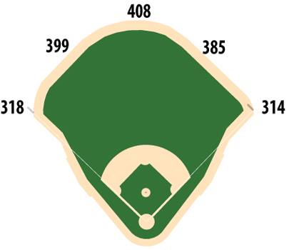
Some Ground Rules & Background
Presentation Disclaimers
Practitioner vs. Professional
Geared for IT Organizations
No Legal Advice
Motivation to Employ Talent Management
Talent Requirements
Entitlement Issues
Compensation Concerns
Recruitment & Retention Needs

Slide 3
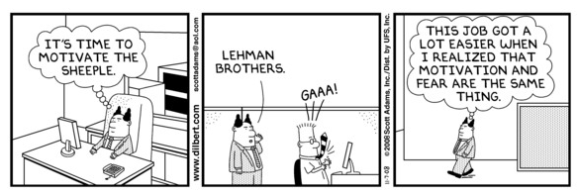
What is Talent Management?
Talent Management is Organizational …
Philosophy
Model
Focus
Driven by a Process …

Slide 4
Philosophy
Holistic view of the employee population
Regarding the workforce as a valued entity
Providing guidance and support to achieve full potential
Employee and organizational goals are not mutually exclusive
Shared vision within a supportive culture

Slide 5
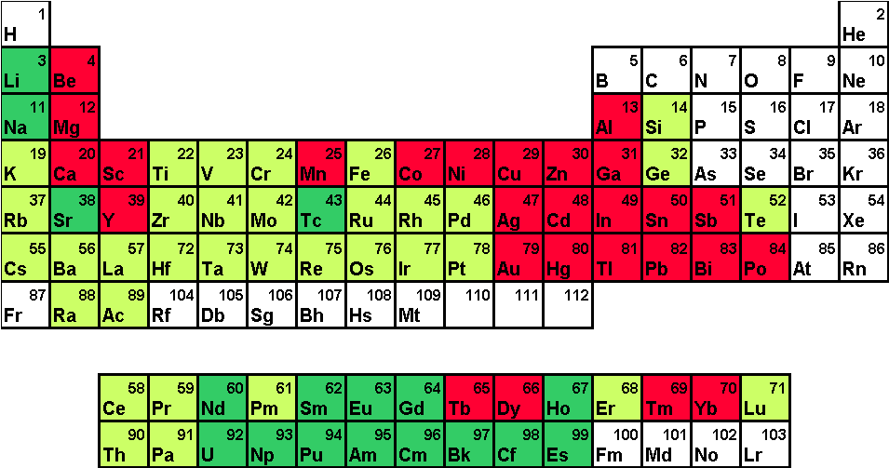
Key Elements of Talent Management (employee’s perspective)
Understanding the a model …
What does developing a match between employee talents and organizational roles & requirements mean, and …
What measures, mentoring & opportunity …
Our “simple” model was based upon:
10 Determinants of Service Quality
13 Ground Rules for Success in the Information Age

Slide 6
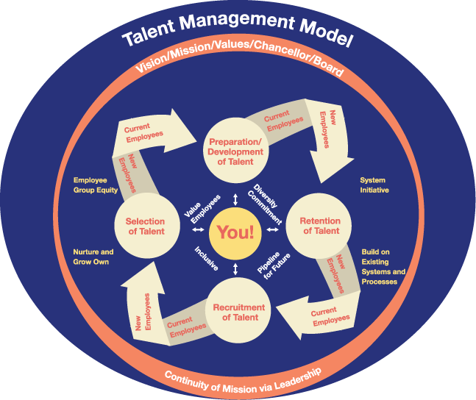
Source: Maricopa CCD - http://bit.ly/cJxzyZ

Slide 7
Traditional Employment vs. Talent Management Focus
Traditional Employment Focus
Skills & education
Duties & responsibilities
Some characteristics (strength, repetitive, endurance, etc.)
Experience
Talent Management Focus – Traditional plus more scrutiny on …
Traits
Behavior
Talent …

Slide 8
What is talent?
Skills
Traits
Behavior
Characteristics
Equate to … Talent

Slide 9
Baseline vs. Mission Specific Talents
Baseline – skills, traits, characteristics, and behavior that is required of all roles e.g.
Lifelong Learner
Self-starter
Ability to work with minimum supervision
Role Specific – additional skills, traits, characteristics, and behavior required for a specific role e.g.
Technical & end user support
Technical writing & documenting

Slide 10
Process of Talent Management
OnBoarding
Performance management
Training & performance support
Succession planning
Critical skills gap analysis
Compensation and benefits
Workforce planning
Recruiting
Strategic
Plan
Job Roles
Job Descriptions
Competency Models
Learning Content
Source: Bernsin & Associates - http://bit.ly/cFN5ox

Slide 11
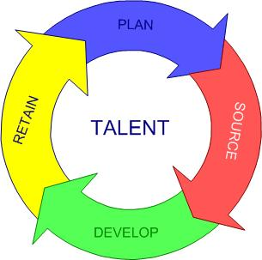
Five Basics in Implementing Talent Management
Identify and Assess Existing & Needed Talents
Hiring and Developing Staff
High Value Appraisals
Understanding Compensation & It’s Impact
Turnover and Succession Planning for the Future

Slide 12
Identify and Assess Existing & Needed Talents
Identifying the competency skill sets needed in the organization
Develop competency matrices to capture talent issues within a role and describe
Develop a rating scale with scoring and weighting options based on requirements
Track, evaluate, and manage competencies across the organization
Implement a performance/competency management system

Slide 13
Inventory & Matrix Example
Name / Skill | Quick Change Artist |  |  |  | Job Commitment |  |  |  | Sense of Urgency |  |  |  | Ambiguity & Uncertainty |  |  |  | Innovation |  |  |  | Lifelong Learner |  |  |  | Accountability |  |  |  | Value Add |  |  |  | Service |  |  |  | Manages Morale |  |  |  | Kaizen |  |  |  | Takes Ownership |  |  |  | Expectations
Ruth
John
Bill
Fred
Mary
 | Not Exhibited |  |  |  |  |  |  |  |  |  |  |  | Familiar |  |  |  |  |  |  |  |  |  |  |  | Needs Help |  |  |  |  |  |  |  |  |  |  |  | Competent |  |  |  |  |  |  |  |  |  |  |  |  | Can Mentor/Teach

Slide 14
Recruiting and Developing Staff
Recruiting vs. Hiring the need to “choose well” in the process …
Employer vs. Employee “gap analysis” with respect to position
Development opportunities – in an outside the organization
Reinforcing development with obligations
Involve top performers in mentoring and coaching

Slide 15
High Value Appraisals
Top-Down Employee Performance Evaluations
Peer-to-Peer Employee Performance Evaluations
360-Degree Performance Reviews
Self-Assessment Performance Reviews

Slide 16
Understanding Compensation
What motivates who?
Comparing “apples to apples”
Non-financial compensation
Managing expectations …

Slide 17
Turnover and Succession Planning
Turnover has to happen and is a two way process
Turnover is an opportunity
Internal candidates may or may not be appropriate for vacancies
Transparency minimizes ancillary issues associated with turnover

Slide 18
ADDITIONAL RESOURCES

Slide 19
Talent Management Software
http://bit.ly/96VC8T
http://bit.ly/9i2Cq7
http://bit.ly/9x13xQ
http://bit.ly/aTsGYj
http://bit.ly/aspCBD
http://bit.ly/cho7Vv
http://bit.ly/aWdebK
http://bit.ly/bSjeEg
http://bit.ly/aYS2xP
Top 10 Talent Management Software vendor report:
http://bit.ly/911sFD

Slide 20
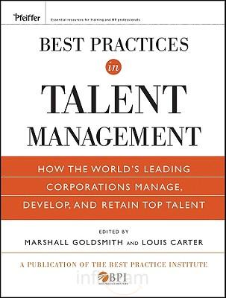
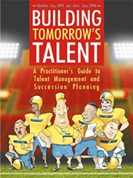
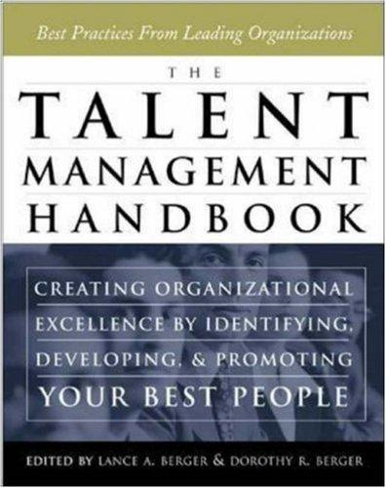
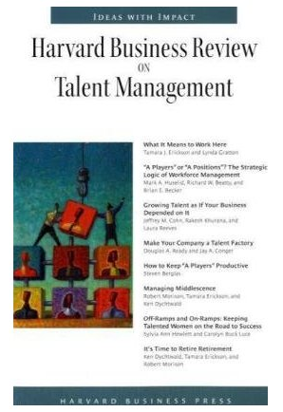
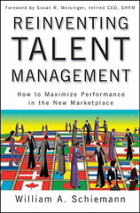
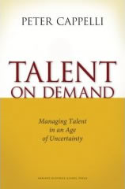
http://twitter.com/coachgoldsmith
http://twitter.com/Doris2700
http://twitter.com/HarvardBiz
http://twitter.com/wschiemann

Slide 21
Research, News, Best Practices in Talent Management, Training, and HR
http://twitter.com/Bersin
The global association of strategic HR professionals in the world's leading organizations
http://twitter.com/HRPS
American Management Association is the world leader in management development, advancing your skills to boost your business success
http://twitter.com/AMAnet
Resource for best practices in Learning Management, Performance Management, and Succession Planning
http://twitter.com/talentdevuniv

Slide 22
THANK YOU
I would very much like to learn about your successes and challenges with talent management.
Drop me a line using e-mail: tdanford@tbr.edu
or …
http://twitter.com/tdanford
This presentation will be available on:
http://www.slideshare.net/tsdanford

