Slide 1
Computing@UNCW
Jeff Stanfield and Jarrett Piner
Information Technology Systems Division
UNC Wilmington
June 4th, 2010

Slide 2
UNCW Vital Stats
Campus Locations:
Main campus is in Wilmington, NC
660 acres in size
Satellite locations:
Key Largo, Florida (850 miles)
Center for Marine Sciences (15 miles)
Alumni, Advancement, Marketing & Business Affairs Offices (< 5 miles)
The Diverse Campus Population:
Students (active): 13,000
Employees and part-time workers: 2,000

Slide 3
Training Program - History
Began as an off shoot of the Help Desk
Application specific workshops:
Adobe (Acrobat, InDesign, Photoshop, Contribute etc…)
Microsoft Office 2007
Microsoft SQL Server Reporting Services
Remote Computing
Almost purely instructor-led
Previously used student employees as instructors
Collaborated with HR training program

Slide 4
Computing@UNCW
ITSD created the Computing@UNCW program to help faculty and staff make the most of the IT services available at UNCW.
Currently these sessions are all instructor led, with online sections under development.
This program is free to all faculty and staff.

Slide 5
Process
November - December: Task Force
January - February: Content Development
February - March: Identification of Trainers
March: Pilots
Computing Orientation
Networking @ UNCW
IT Security @ UNCW

Slide 6
Feedback
Revisions from pilot sessions
Content suggestions
Add web addresses instead of hot linking text in document
Consulted with subject matter experts:
Carrie Clements
Kris Anderson
Todd Bartlett
Lauren Brunell
Colin Chapman
Jeanne Cole
Terri Cook
Kevin Farver
Toni Gazda
Bob Greene
Ellen Gurganious
Key Hammonds
Dali Hiltebeitel
Ray Humphries
Carlene Jackson
Cindy Kaiser
Leah Kraus
Bobby Miller
Zach Mitcham
Jim Mothershed
Johnny Nipper
Dan Noonan
Jarrett Piner
Emily Richardson
Sandie Sue
Tara Thompson
Beverly Vagnerini
Bill Vereen
Tami Violette
Kevin Violette
Dana Ward
Michael Yelverton

Slide 7
Computing 101 program
Computing Orientation
Computing Orientation II for Staff
Computing Orientation II for Faculty
Computing from Off Campus
Networking@UNCW
IT Security@UNCW

Slide 8
Computing Orientation
Learning Objectives | Table of Contents
Upon completion of this course, you will be able to: Recognize the essential applications available to faculty and staff at UNCW Identify information technology services at UNCW Demonstrate basics of how to protect your computer and personal information through safe computing. | An Introduction to Computing at UNCW The Technology Assistance Center –TAC E-mail accounts Unified Messaging File Management Storage vs. Backup SharePoint mySeaport MS Office Overview B1NAR1ES Virus/Spyware Technology in the Classrooms Video Network Services Registering for Emergency Text Messaging UNCW Alert Intercoms in the Classrooms iPrint For More Help Appendix Safe Computing Announcements from the TAC E-mail Etiquette Searching the Internet PC/Mac keyboard shortcuts

Slide 9
Computing Orientation II for Staff-Applications you will use
Learning Objectives | Table of Contents
Upon completion of this course, you will be able to: Know what specific applications are available to them at UNCW Know how to access those apps and how to get further assistance in using the apps Demonstrate how to access mySeaport, SkillPort, OWA, and SharePoint | Introduction Banner Contribute Event Management System ImageNow mySeaport Remedy Reporting (SSRS) Select Survey SharePoint SkillPort TealWare Wimba Additional IT Training Opportunities

Slide 10
Computing Orientation II for Faculty-Applications you will use
Learning Objectives | Table of Contents
Upon completion of this course, you will be able to: Know what specific applications are available to them at UNCW Know how to access those apps and how to get further assistance in using the apps Demonstrate how to access mySeaport, SkillPort, OWA, and SharePoint | Introduction Course and Classroom Technology Blackboard ‘Clickers’- Student Response System Podcasting and iTunes U Scanning of Tests and Exams SkillPort Technology in the Classroom TealVision TealWare Wimba Supporting Technologies Contribute Event Management System ImageNow mySeaport Remedy Reporting(SSRS) Select Survey SPOTS Additional Training Opportunities Appendix IT Services Matrix

Slide 11
Computing from Off Campus
Learning Objectives | Table of Contents
Upon completion of this course, you will be able to: Explain how to install Antivirus on a home computer Identify how to access free software for faculty and staff through check out and TealWare Describe how to use VPN from off campus | Antivirus Remote Desktop Virtual Private Network – PC Compatible Virtual Private Network – Macintosh Compatible Tealware Tealware – How to Save Microsoft Office software for home use

Slide 12
Networking@UNCW
Learning Objectives | Table of Contents
Upon completion of this course, you will be able to: Describe the devices used on a network Define networking terms and policies Differentiate between the different UNCW wireless networks | Introduction to Networks Netcom Services Types of Traffic on UNCW’s Network Networking Basics Devices Terms Wireless Protocols UNCW Wireless Networks Wired vs Wireless Security Speed Network policies Register VPN (Virtual Private Network)

Slide 13
IT Security@UNCW
Learning Objectives | Table of Contents
Upon completion of this course, you will be able to: Understand peer-to-peer file sharing and UNCW policies Be able to create a secure password and modify SPAM settings Be familiar with spyware removal and UNCW’s free AntiVirus | Peer to peer file sharing Legal options for downloading media Policies Information Technology Policies (RUP, etc.) Process for email security question setup Computrace How to create secure pw and keep private Spyware removal and free antivirus Spyware removal Antivirus How to modify SPAM settings

Slide 14
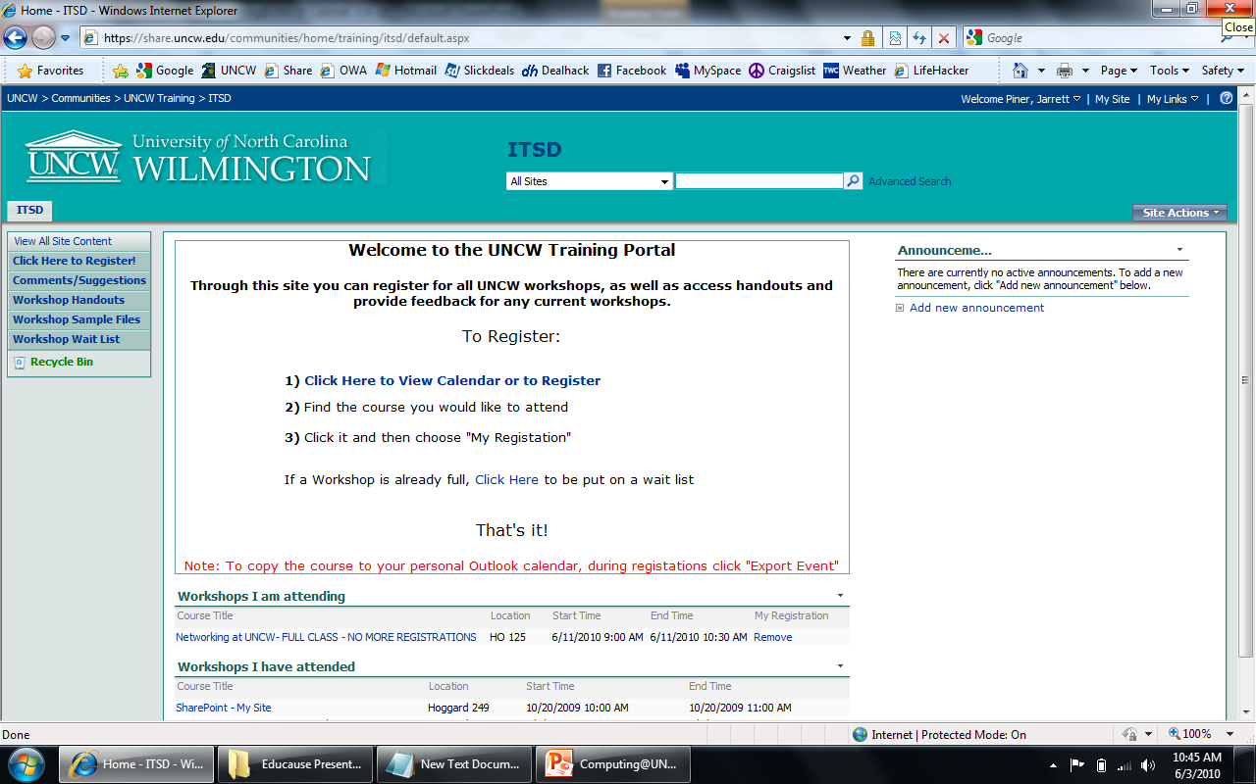
Training Registration

Slide 15
Assessment
SharePoint survey available on desktop in training room ~LINK
Attendees complete after every workshop (optional)
Follow up e-mails after training
Want to ensure ITSD is sending a better person back to their office after the training
Share course completion information with HR and managers for performance reviews
Maintain course relevance to University needs.

Slide 16
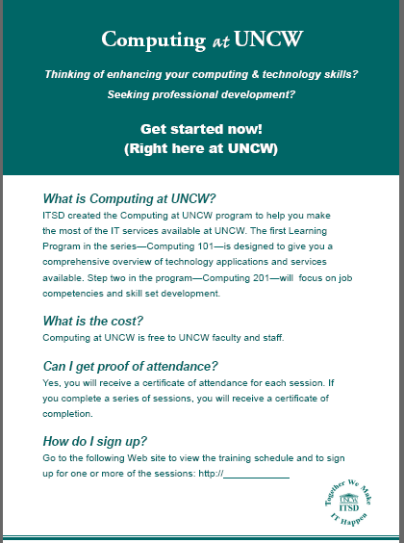
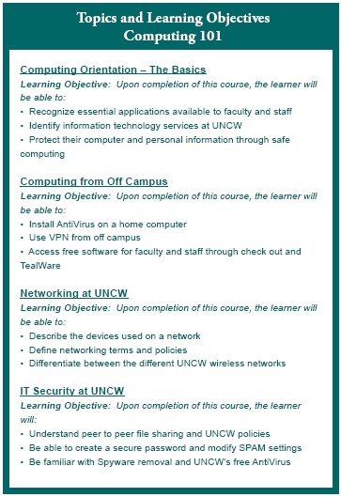
Communication Strategy
Program runs May 18 - July 15th
Post Card
Tech Corner May 11th
Staff e-mail May 11 - 12th
HR Liaisons
Staff Senate
Certificate awards
ceremony

Slide 17
Sustainability/Next Steps
Sustainability of program: Getting new information to Computing 101 alumni after program completion
SharePoint community
Blackboard refresher course next year
Refresh content regularly

Slide 18
Sustainability/Next Steps
Computing 201
Collaborating with Human Resources to develop learning programs
Focus on job competencies and skill set development
Blend of SkillPort and Instructor led training

Slide 19
What didn’t work?
Current training area is being used as a pilot for nComputing devices.
Slight pushback from non-training employees who are being asked to train.
Timing: Faculty are mostly not around during summer months.
Otherwise it’s been a hit!

Slide 20
For More Information
Computing@UNCW website:
http://www.uncw.edu/itsd/help/computing.html
Please send any questions or comments to:
Jeff Stanfield – stanfieldj@uncw.edu
Jarrett Piner – pinerj@uncw.edu

