Slide 1
Computer Services & Telecommunications
BI is Really BL (Business Intelligence is Really Building Leaders)
Bob Yanckello, Aaron Streimish, Jeanne Henningsen
June 2, 2010

Slide 2
BI is Really BL (Business Intelligence is Really Building Leaders)
About University of Central Florida (UCF)
Established in 1963 in Orlando, Florida (1968 – first
classes) Metropolitan Research University
Over 54,000 students – 45,800 undergraduate and
8,450 graduate
Academic Programs - 90 Bachelor’s, 91 Master’s,
3 Specialist, 29 PhD, 1 Professional (Medicine)
2,860 faculty, 340 adjuncts and 6,950 staff
Computer Services & Telecommunications

Slide 3
BI is Really BL (Business Intelligence is Really Building Leaders)
About University of Central Florida (UCF) – cont.
One of Florida's 11 public universities
Located 13 miles east of downtown Orlando
Main Campus is 1,415 acres with 164 buildings
2009-2010 Operating Budget approximately $1.8 billion
Third largest university in the US
Computer Services & Telecommunications

Slide 4
BI is Really BL (Business Intelligence is Really Building Leaders)
About Computer Services & Telecommunications
Operating unit within UCF’s Information Technologies
and Resources (IT&R) division
162 staff members - seven operating units
Develop and maintain enterprise computing and
communications services for the UCF community
Responsible for PeopleSoft ERP System, Enterprise
Data Center, LAN, WAN, Telecommunications,
Computer Store and Information Security
Computer Services & Telecommunications

Slide 5
BI is Really BL (Business Intelligence is Really Building Leaders)
Outline
Building Leaders – Putting It
All Together
Strategy and Planning
Business Operations
Professional Development
Professional Development
Small investment yields
BIG Return
Leadership Coaching
Leadership Development
Workshops
Assessments
Business Operations
Key Performance Indicators
Project Management
Performance Management
Strategy and Planning
Strategy Articulation Map
ITIL
Reorganization
Business Intelligence
Strategy and
Planning
Business
Operations
Building
Leaders
Professional
Development
Computer Services & Telecommunications

Slide 6
BI is Really BL (Business Intelligence is Really Building Leaders)
Agenda
Strategy and Planning
Building Leaders
Strategy and Planning
Business Operations
Professional Development
Professional Development
Why Leadership Coaching
How Does it Work and
what’s in it for me
Leadership Development
Workshops
Business Operations
Key Performance Indicators
Project Management
Performance Management
Strategy and Planning
Strategy Articulation Map
ITIL
Reorganization
Business Intelligence
Strategy and
Planning
Business
Operations
Building
Leaders
Professional
Development
Computer Services & Telecommunications

Slide 7
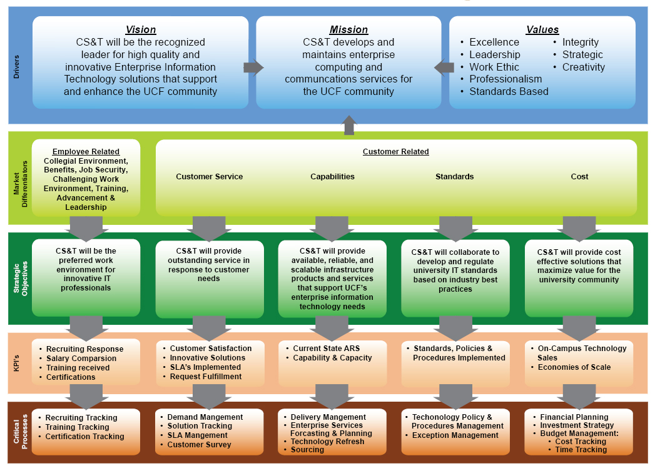
BI is Really BL (Business Intelligence is Really Building Leaders)
Strategy and
Planning
CS&T Strategy Articulation Map (SAM)
Computer Services & Telecommunications

Slide 8
BI is Really BL (Business Intelligence is Really Building Leaders)
Strategy and
Planning
Why ITIL?
Improve our ability to meet compliance and audit
requirements
Increase response to new business challenges
Minimize risk and reduce operational and support cost
Ability to anticipate and respond to changing internal
and external conditions
Increase ability to meet Service Level Agreements (SLA)
Reduce technical support staff requirements
Increase customer satisfaction
Computer Services & Telecommunications

Slide 9
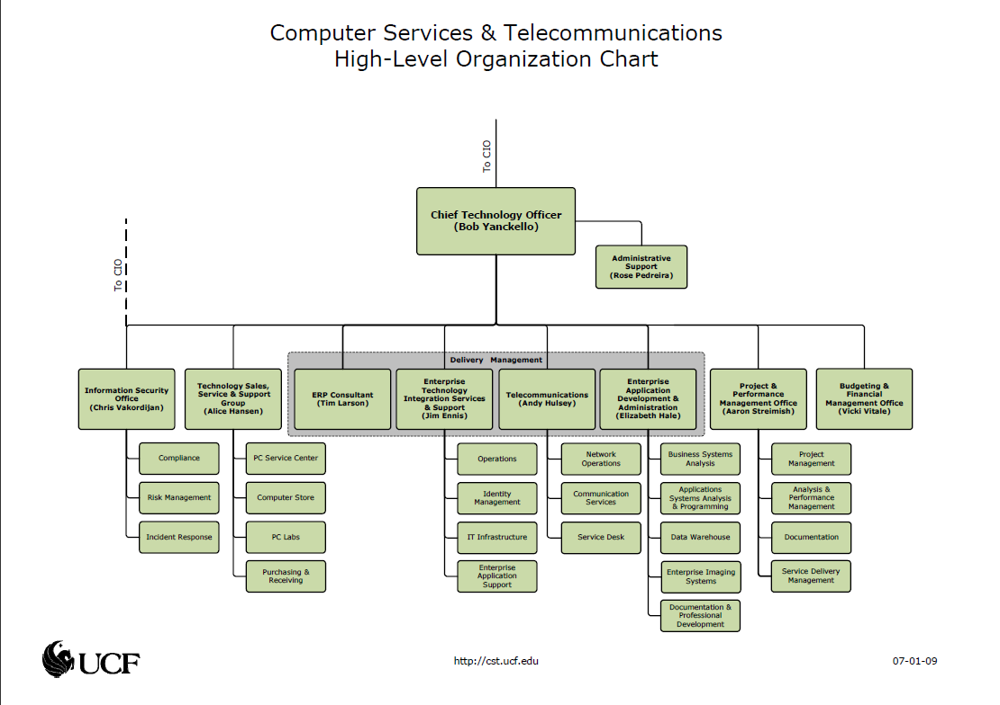
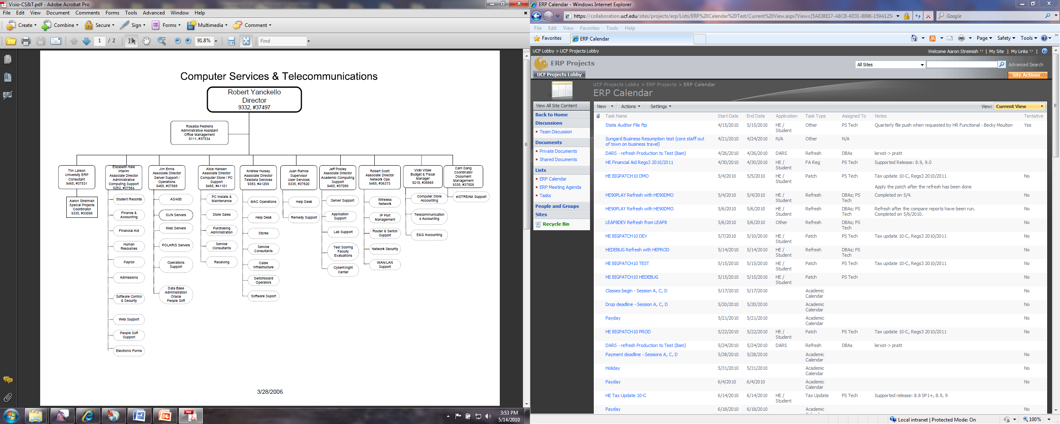
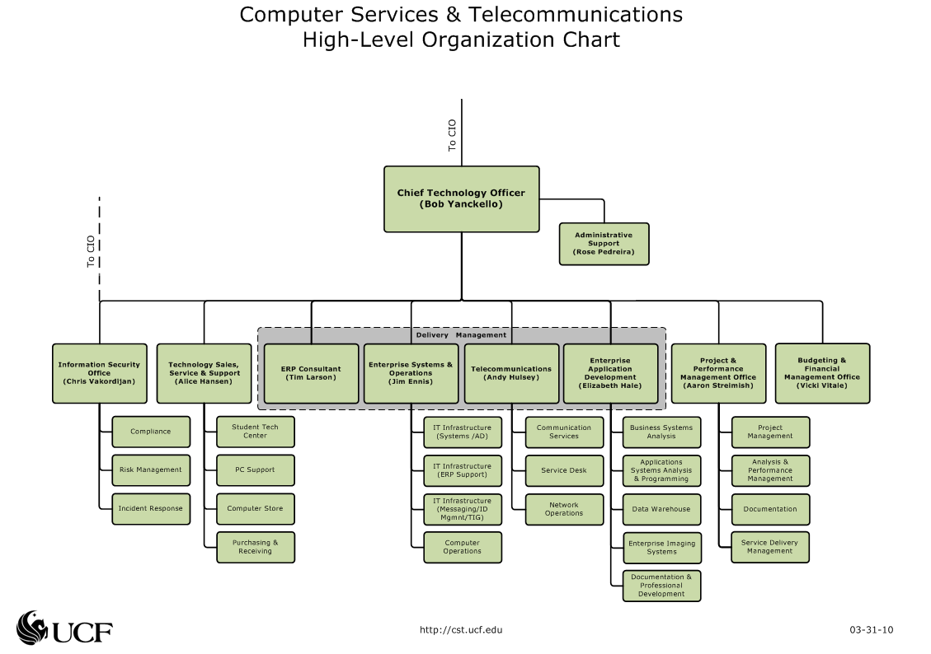
BI is Really BL (Business Intelligence is Really Building Leaders)
Strategy and
Planning
CS&T Organizational Structure
Computer Services & Telecommunications

Slide 10
BI is Really BL (Business Intelligence is Really Building Leaders)
Business Operations
Building Leaders
Strategy and Planning
Business Operations
Professional Development
Professional Development
Why Leadership Coaching
How Does it Work and
what’s in it for me
Leadership Development
Workshops
Business Operations
Key Performance Indicators
Project Management
Performance Management
Strategy and Planning
Strategy Articulation Map
ITIL
Reorganization
Business Intelligence
Strategy and
Planning
Business
Operations
Building
Leaders
Professional
Development
Computer Services & Telecommunications

Slide 11
BI is Really BL (Business Intelligence is Really Building Leaders)
Strategy and
Planning
CS&T Strategy Articulation Map (SAM)
Computer Services & Telecommunications

Slide 12
BI is Really BL (Business Intelligence is Really Building Leaders)
Business
Operations
CS&T Key Performance Indicators (KPI)
Days to Hire
Interviews Offered
Interviews Conducted
Preferred Qualified
Candidates
Customer Satisfaction
Employee Training /
Travel
SLA Management
Project Tracking
National Salary Comparison
Florida Salary Comparison
Regional Salary Comparison
UCF Salary Comparison
Innovative Solutions Implemented
Availability , Reliability, Scalability
On Campus Technology Sales
Campus IT Spend per UOS
Capability to Fulfill Request
Capacity to Fulfill Request
Computer Services & Telecommunications

Slide 13
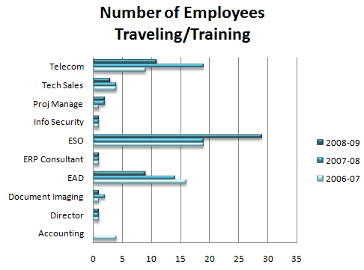
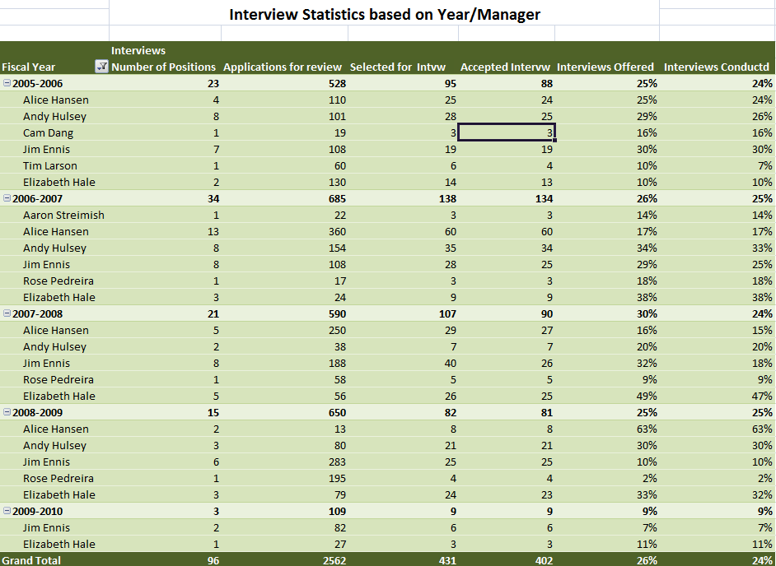
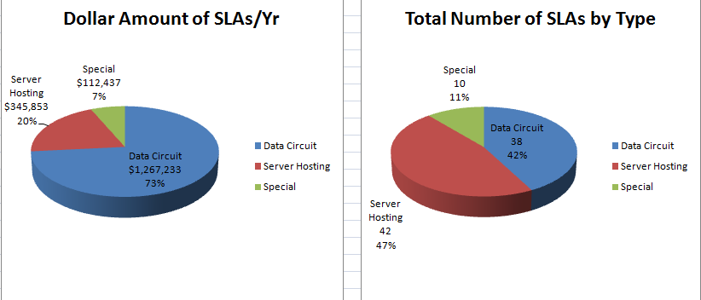
BI is Really BL (Business Intelligence is Really Building Leaders)
Business
Operations
CS&T Key Performance Indicators (KPI)
Computer Services & Telecommunications

Slide 14
BI is Really BL (Business Intelligence is Really Building Leaders)
Strategy and
Planning
CS&T Strategy Articulation Map (SAM)
Computer Services & Telecommunications

Slide 15
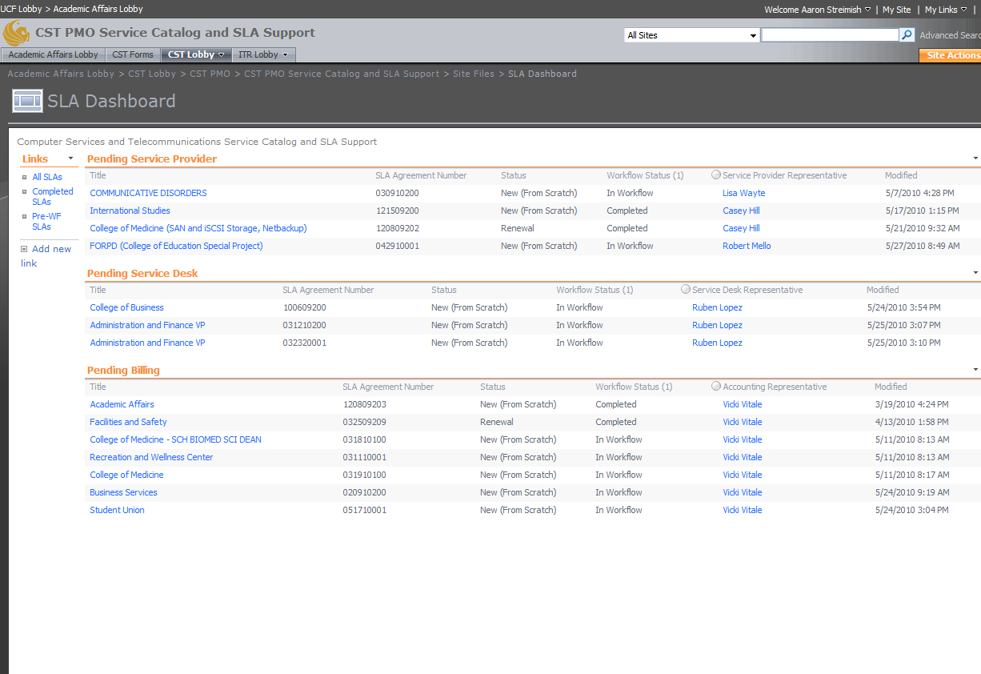
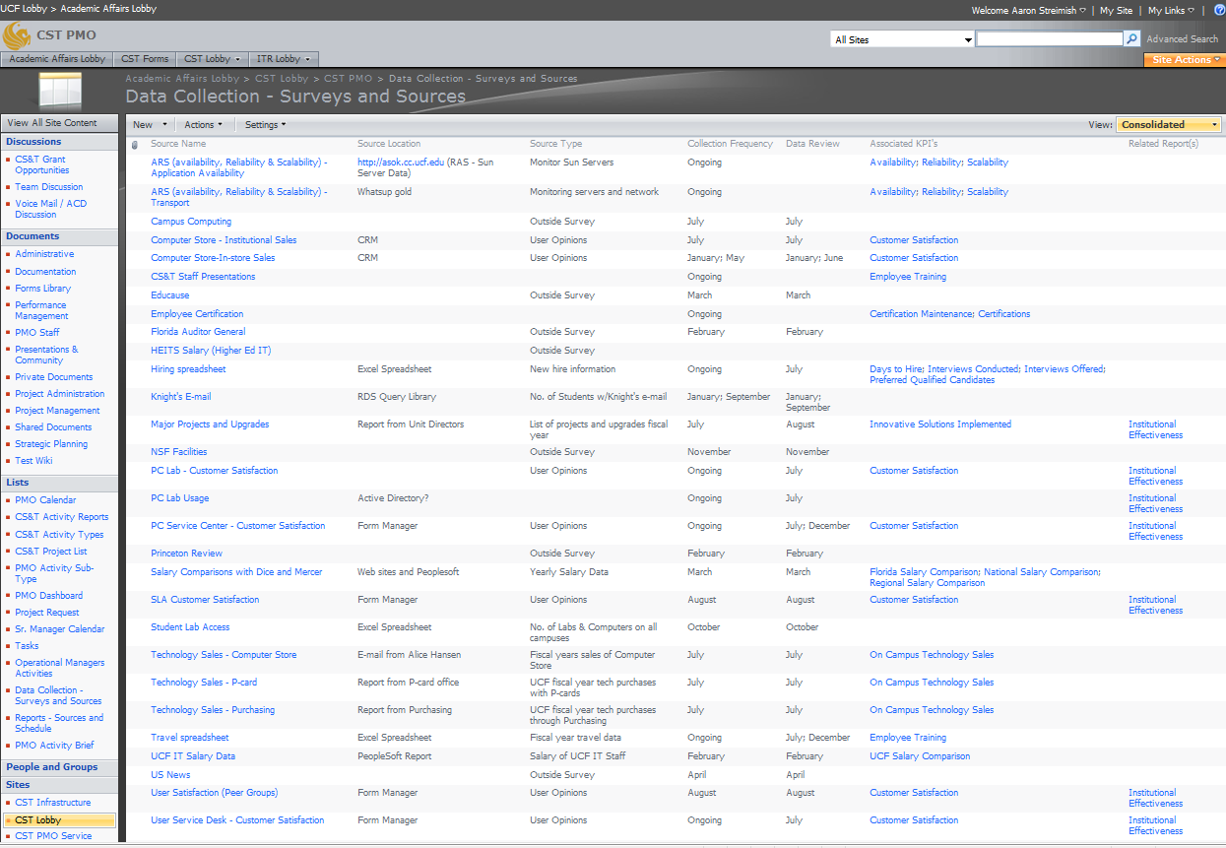
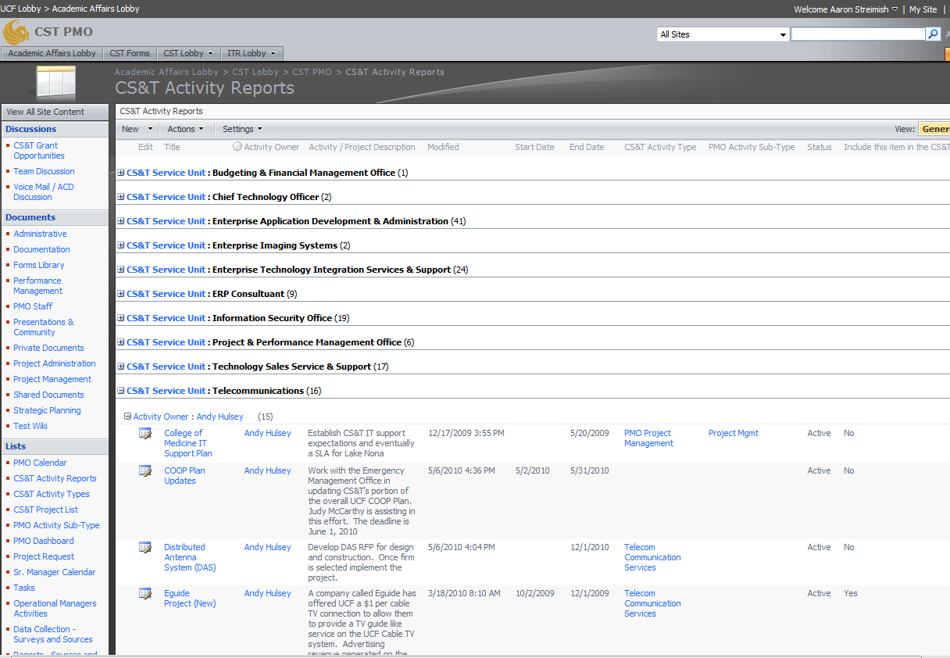
BI is Really BL (Business Intelligence is Really Building Leaders)
Business
Operations
Page Title Goes Here
Computer Services & Telecommunications

Slide 16
BI is Really BL (Business Intelligence is Really Building Leaders)
Agenda
Professional Development
Building Leaders
Strategy and Planning
Business Operations
Professional Development
Professional Development
Why Leadership Coaching
How Does it Work and
what’s in it for me
Leadership Development
Workshops
Business Operations
Key Performance Indicators
Project Management
Performance Management
Strategy and Planning
Strategy Articulation Map
ITIL
Reorganization
Business Intelligence
Strategy and
Planning
Business
Operations
Building
Leaders
Professional
Development
Computer Services & Telecommunications

Slide 17
BI is Really BL (Business Intelligence is Really Building Leaders)
Professional
Development
Why Leadership Coaching, Workshops and Assessments?
A small investment
Yields A BIG Return
Computer Services & Telecommunications

Slide 18

BI is Really BL (Business Intelligence is Really Building Leaders)
Professional
Development
How Does Leadership Coaching Work?
Coach and client are partners
Coach and client choose focus,
format and outcomes
Typical coaching sessions
Assessments and resources
Computer Services & Telecommunications

Slide 19

BI is Really BL (Business Intelligence is Really Building Leaders)
Professional
Development
Leadership Development Workshops
All leaders within CS&T
Topics included:
  Work-Life Balance
  ITIL
  Motivating Self and Others
  Myers-Briggs Type Indicator Step II
  Communication and Collaboration
Computer Services & Telecommunications

Slide 20

BI is Really BL (Business Intelligence is Really Building Leaders)
Professional
Development
Assessments
Myers-Briggs Type Indicator Step II
Leadership Practices Inventory 360
Thomas Kilmann Conflict Mode
Instrument
Firo-B (Fundamental Interpersonal
Relationships Orientation Behavior)
Computer Services & Telecommunications

Slide 21
BI is Really BL (Business Intelligence is Really Building Leaders)
Professional
Development
What’s My BIG Return?
Improved leadership skills
Greater retention of leaders receiving coaching
Increased goal completion and productivity
Improved customer service and quality of work
Greater ability to deal with difficult situations
Improved working relationships
Reduced stress and greater job satisfaction
Computer Services & Telecommunications

Slide 22
BI is Really BL (Business Intelligence is Really Building Leaders)
Agenda
Building Leaders - Putting It All Together
Building Leaders
Strategy and Planning
Business Operations
Professional Development
Professional Development
Why Leadership Coaching
How Does it Work and
what’s in it for me
Leadership Development
Workshops
Business Operations
Key Performance Indicators
Project Management
Performance Management
Strategy and Planning
Strategy Articulation Map
ITIL
Reorganization
Business Intelligence
Strategy and
Planning
Business
Operations
Building
Leaders
Professional
Development
Computer Services & Telecommunications

Slide 23
BI is Really BL (Business Intelligence is Really Building Leaders)
Questions???
Thank you!
Computer Services & Telecommunications

