Slide 1
Managing Library Chat for Ultimate Service Outcomes & Staffing Efficiencies
Heather McCullough, Ph.D. & Bridgette Sanders
University of North Carolina at Charlotte
June 2, 2011
Abstract
This presentation outlines how one university library recently reconfigured its chat (IM) delivery & the impact of those changes on service & cost. Usage statistics reveal trends such as when chat is most heavily used, what kinds of questions chat is used for, and where patrons access chat (on- or off-site).
Background
IM (Chat) provided using a commercial library product, LibraryH3lp, to answer patrons’ library reference questions
Prior to 2010, reference services offered via walk-up, in-person, telephone, & email.
2010, Chat added to suite of reference services
Chat staffed from 10:30 am – midnight, M - Th
Fall 2010: Individual librarians scheduled to monitor chat (usually from their offices)
Spring 2011: Chat staffed at our public research services desk by librarian also answering walk-up, face-to-face research questions, telephone research questions, and email research questions
We reviewed Chat statistics and logs from 2010 -2011
Conclusions
Significant increase in use of chat from 2009-2010
Research & non-research questions asked via chat
Students asking simple & complex research questions via chat
Students accessing chat from on- & off-campus equally, smaller % accessing chat from inside library
Missed questions increased in Spring 2011
Next Steps
Address missed chat questions through schedule adjustment:
Chat in office OR shared chat monitoring at Info Desk
Address increased interest in online assistance:
Test text-a-librarian
Implement additional training for librarians to deliver instruction using these methods
Objective
Our goal is to understand and assess how chat is being used in order to determine most effective and efficient staffing scenarios.

Slide 2
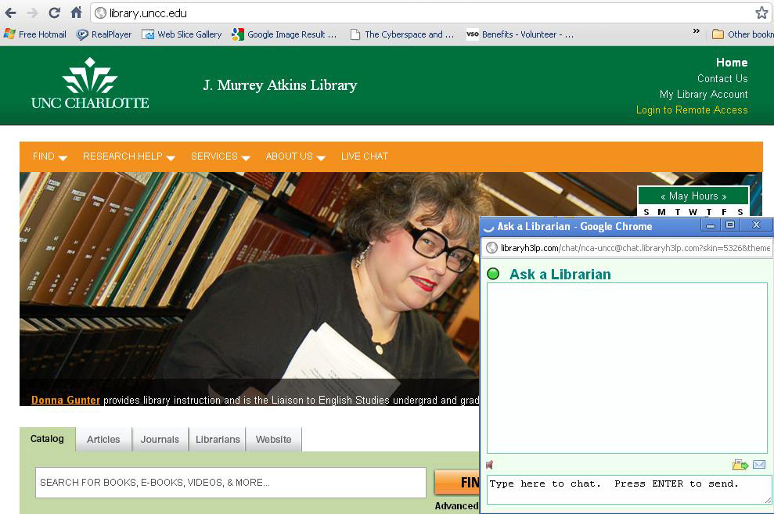
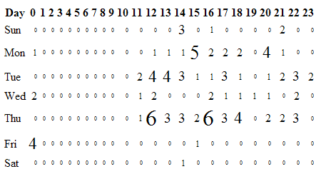
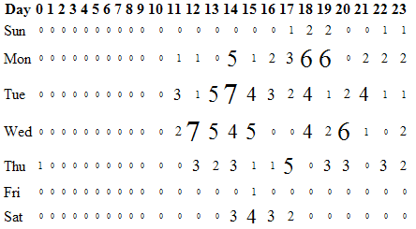
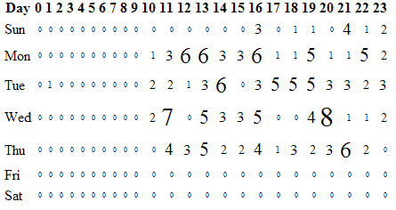
Additional Chat Data
Examples of Research Questions
11:23 guest598373@libraryh3lp.com hi i was getting assistance yesterday on how to find informaton for my research paper. yesterday i found over 600 articals today i am only finding less than 50. The librarian suggested the type in i used and i failed to write it down can you possibly assist me with what i should be typing in through the academic search premier
14:09 guest603214@libraryh3lp.com I'm looking for a journal article from 1957, titled "When Splines need stress Control" by Darle W. Dudley, published 12-23-57. can you help me?
16:12 guest608629@libraryh3lp.com Hello. How can I look up the stats of a business (e.g. annual profit) through ebsco?
14:23 guest608219@libraryh3lp.com I'm a doctoral student seeking articles on how to critique autobiographies.
16:40 guest616830@libraryh3lp.com I am wanting to write a 5 page history paper on the JFK assassination and also incorporating the Warren Reports into it somehow. Can you help?
18:36 guest691043@libraryh3lp.com Would you be able to help me with a citation that I cannot figure out?
15:44 guest836938@libraryh3lp.com Hello, I am trying to find 2010 impact factor for a specific scientific journal. Is there an online source that I can use for this reason?
Examples of Non-Research Questions
16:23 guest585760@libraryh3lp.com is there a fax machine in the library and if so how much?
12:40 guest594352@libraryh3lp.com A book I need is available in UNC chapel Hill, If i wish to issue it (through interlibrary loan) will I have to pay anything?
12:37 guest594342@libraryh3lp.com hi.. is there anywhere in the library w/ color printing?
14:54 guest616421@libraryh3lp.com how do i "log in" from off campus on the newly designed website?
15:08 guest621442@libraryh3lp.com I am taking a class with Proff Robert E. Guinn Acct 3350. He said he had some materials on the library website but I can't find them. (Course Reserves)
13:57 guest630119@libraryh3lp.com I am trying to access H:\ remotely but when I try to log on I get a message that access is blocked, contact systems administrator. Can you help?
Chat Use by Time of Day
January 2011
February 2011
Chat is on the library’s
main web page
March 2011
Questions? Comments?
Heather McCullough: hamccull@uncc.edu
Bridgette Sanders: btsander@uncc.edu

