Slide 1
CIO and Executive IT Leader Roundtable
Fred Miller
Furman University
Jeanne Skul
USC Upstate

Slide 2
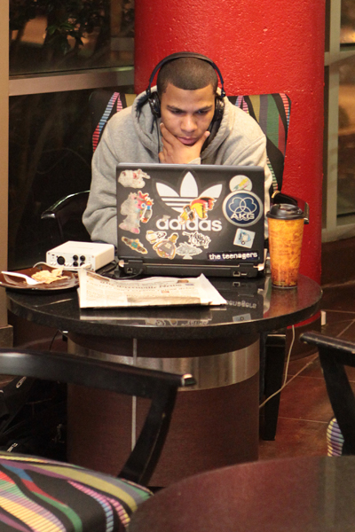
Session Overview
What would you like to accomplish?
Networking?
Share challenges & solutions?
Other?
Format: 3 discussion sessions
Leadership and Management
Technology Services
Lighting Round!

Slide 3
Suggested Topics
Organizational Structure of IT (who are you closely aligned with)
Models of IT Governance
Best practices for collaboration between Provost / Faculty and IT, specifically with regard to direct / indirect reports
Tips for cultivating and improving the IT leadership/academic leadership relationship
Managing "shadow IT" in the enterprise (departmental self-maintained projects, etc.)
De-centralizing or Centralizing IT assets on campus: What is best for the college/university, and what is best for IT?
Shrinking Budgets with Increasing Enrollments

Slide 4
Topics Continued
How do we ensure that IT leaders are viewed as valuable contributors in all areas of university administration and not just “techies” that are consulted when there is a technology problem?
Strategic vs. Tactical
With technology becoming less of a mystery and less centralized, how does a CIO maintain his/her relevance?
Acquiring and retaining talent
Managing expectations / employee enrichment in an academic setting
Mentoring IT professionals to assume leadership (possibly CIO) roles

Slide 5
More Topics
Best practices for deciding when to provide services internally or outsource
Cloud Computing
Informal vs. Formal channels of communication on IT initiatives and projects
Appropriate level of involvement for IT in non-core areas of the College/University, such as Distance Learning, Library, Classroom Technology
Consumer focus of Technology and adoption in the education environment

Slide 6
1. Let’s Get Started!
Choose a table with a number of a characteristic that describes you:
1. Work at PUBLIC institution
2. Work at a PRIVATE Institution
3. Work at a SMALLER Institution (< 5,000 student FTE)
4. Work at a LARGER Institution (> 5,000 student FTE)
5. See yourself more as a STRATEGIST
6. See yourself more as a TECHNICIAN
7. See yourself more as an INNOVATOR

Slide 7
LEADERSHIP and MANAGEMENT
Table discussions
Choose topics from list →
List chosen topics and discuss
Challenges
Opportunities
Choose one person to take notes and one person as table spokes-person
Strategic Planning, Vision, and Values
Communication
Governance
Budget
Organization: centralize/decentralize
Project Management
Relationships
Collaboration
Mentoring
Other leadership topics

Slide 8
2. MIX IT UP A BIT
Choose a DIFFERENT table...
1. Work at PUBLIC institution
2. Work at a PRIVATE Institution
3. Work at a SMALLER Institution (< 5,000 student FTE)
4. Work at a LARGER Institution (> 5,000 student FTE)
5. See yourself more as a STRATEGIST
6. See yourself more as a TECHNICIAN
7. See yourself more as an INNOVATOR

Slide 9
Technology Services
Table discussions
Choose topics from list →
List chosen topics and discuss
Challenges
Solutions
Choose one person as table spokes-person
Mobile Computing
Outsourcing and Cloud Solutions
Security and Privacy
Support for Teaching, Learning &Research
Enterprise Systems
Innovation
IT Staff

Slide 10
3. LIGHTING ROUND!
Write down a problem, you’d like entire group to consider
Problems selected by random draw
One minute to write a solution
Read your solution to the group
Select a new problem and repeat
Let’s find some good solutions!
Notes:
Quick discussion on solutions – pick another problem and go again

Slide 11
CONCLUDING THOUGHTS...
Key takeaways?
How can EDUCAUSE help?

