Slide 1
Connectivity 24/7 for 21st-Century Success: going Mobile in Health Science Education

Slide 2
Plan, Implementation, and Results:
Fall 2009 Pilot

Slide 3
Can students always have resources available?
Can students study "on the go"?
What tools are available to facilitate learning away from the classroom and computers?

Slide 4
The use of handheld devices in education is increasing as more and more resources and software becomes available.
The use of iPods will support students’ learning by giving them a means of reviewing needed nursing knowledge over and over again to become more proficient.

Slide 5
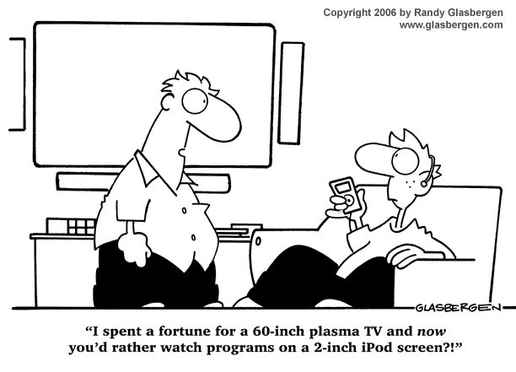

Slide 6
All students have access to a computer
Many have handheld devices
Many students are visual learners
Provides constant review of nursing knowledge
Notes:
6

Slide 7
FACULTY
Some faculty will be more in tune with new technology
Show others the necessity of the technology
Stress convenience without sacrificing quality
Breaking new ground
Notes:
7

Slide 8
First, let’s get some money…

Slide 9
Grant Sources
Duke University
Technology Integration Program/Nursing Education and Practice
GPC Office of Information Technology
Student Tech Fee

Slide 11
Pilot Setup
10 iPod Touchs
Nursing Central app from Unbound Medicine
Create Podcasts of Lectures
Used Instructional Technologist to assist faculty and students with managing their devices.

Slide 12
We tracked the students to see if learning was enhanced, if the resources were utilized, and if exam scores improved.
We discovered that the iPod touch is an excellent tool to present and reinforce content.

Slide 13
Implementation
Commercial software:
Davis Drug Guide
Davis Lab and Diagnostic tests
Diseases and Disorders
Handbook of Nursing Diagnosis
Medline Journals
Taber's Dictionary
Notes from the lectures, and podcasts of the classroom lectures were downloaded on the devices.

Slide 14
Implementation
Worked with Instructional Technologist
Students
Faculty
Research
Surveys and student logs
Focus Group

Slide 15
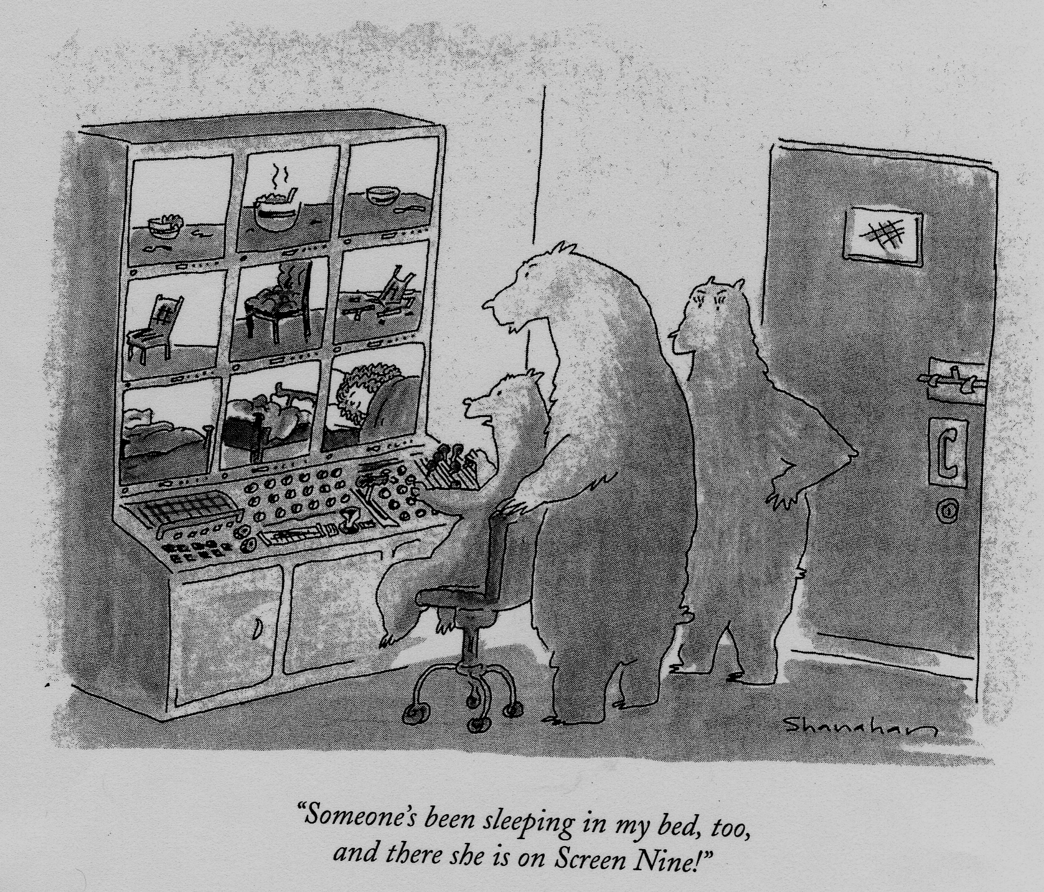
Notes:
15

Slide 16
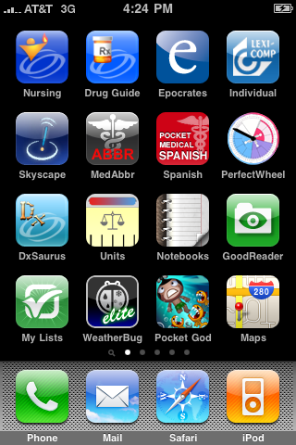
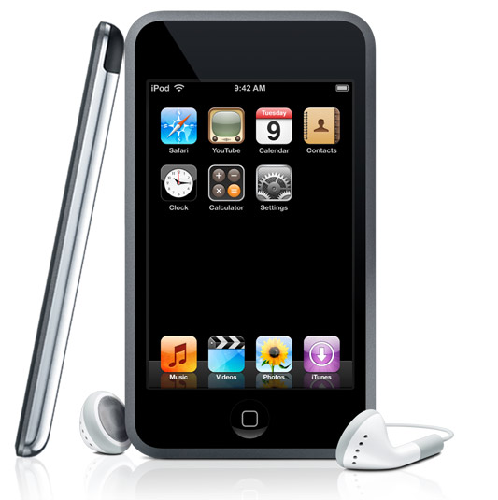
iPhone
iPod Touch

Slide 17
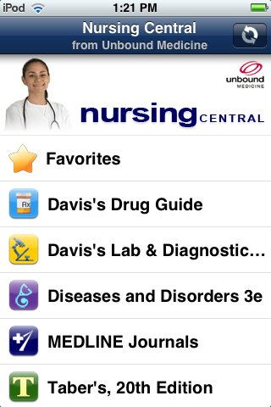

Slide 18
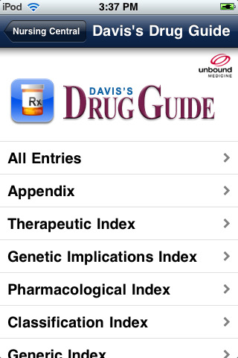

Slide 19
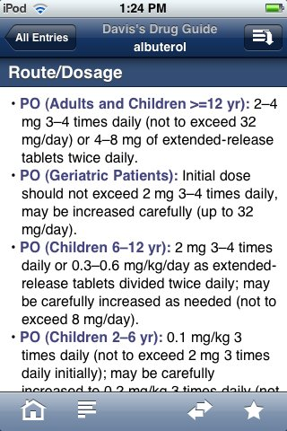

Slide 20
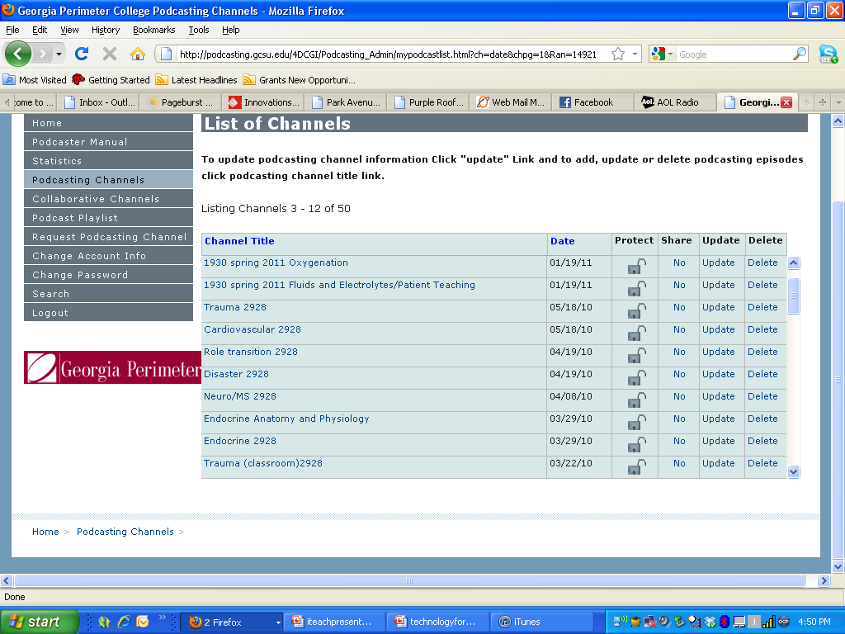

Slide 21
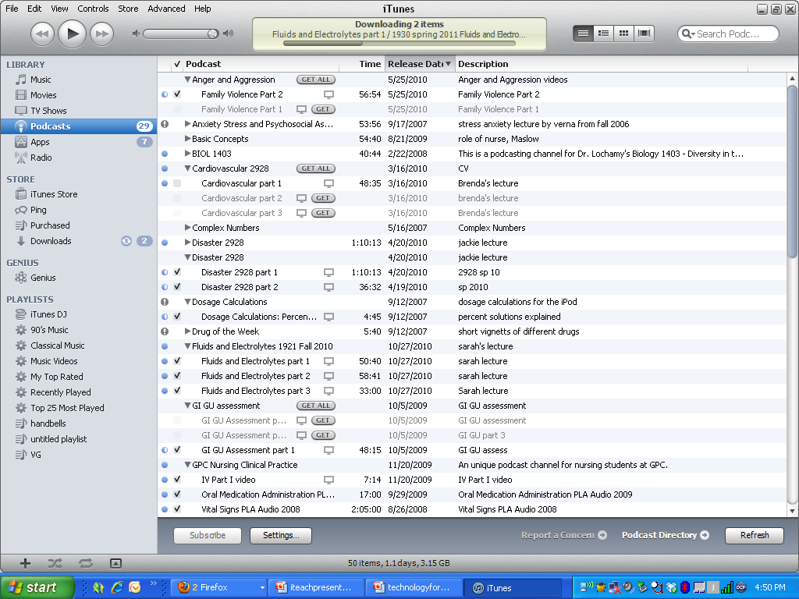

Slide 22
So what?
Convenience
Instant review (podcast)
More accountability on our part!
Podcasts can be used as “lecture” and class time for other activities
Podcasts used in hybrid or online courses

Slide 23
Disadvantages
Cost
Annual renewals/updates
Learning curve (podcasts!/nursing central)
Wireless problems
Varying computers/computer software/internet connections/knowledge level

Slide 24
Results

Slide 25
Results

Slide 26
Results

Slide 27
Focus Group: What Was Good About This Device/Software?
“Nursing notes were amazing (from nursing central). We used it a lot during clinical. Everybody borrowed it, even the nurses on the floor (nursing staff).”
“Davis Drug Guide at my fingertips”
“Podcast of lectures was very helpful listening while driving because this in normally downtime.”
“The math review podcast was good.”

Slide 28
What did you find Frustrating or Difficult to use about the iPod Touch
“Not being able to download lecture powerpoints, and other podcasts on recent lectures from exam 3 till date…”
“I am having problems downloading podcasts as well as powerpoints.”
“I had a hard time downloading podcast to the ipod, I had misunderstood some directions.”
“Trying to download podcasts.”
“…downloading podcasts.”

Slide 29
What Features of the iPod Touch Helped You in Class
“Only the podcast I was able to download onto the itouch, i.e., Pharmacology (one episode”, Legal-Ethical (one episode)”.
“I think it will be helpful in that I can hear the lectures as many times as I need while walking, running errands, etc.”
“Reviewing for an exam…more for clinicals”

Slide 30
Focus Group
Should we continue this project? Why or why not?
“Yes, I cannot see anyone that would not find this helpful.”
Are you planning to buy an iPod Touch?
Yes from the whole group
“Could we buy the iPod Touch and software (Nursing Central).”
“I told my husband that I need one for nursing school!”
“I asked for one for Christmas!”

Slide 31
Plan, Implementation, and Results:
Fall 2010 Pilot

Slide 32
Fall 2010 Pilot is expanded to include Dental Hygiene… so this is now the “Health Science Mobile Device Pilot”
iPod Touch and iPad devices
Additional Apps
Dental hygiene faculty included

Slide 33
Mission and Goals
Strengthen health science student outcome and success rates?
Explore and develop technology enhanced, student centered learning environments that are relevant and responsive to the needs of today’s diverse student populations.
Use mobile, electronically based equipment and applications to increase student access to information and communication, thereby preparing our students for their roles as healthcare providers in the 21st century.

Slide 34
Participation in Pilot
All faculty/students will be asked to sign a pilot participation document stating that they will use the device in a manner that is consistent with the mission of the pilot, in compliance with GPC’s acceptable use policy, and will participate in the research portion of the pilot.
Faculty/students will also be asked to sign an “Informed Consent” document to participate in the research component of this pilot.
Participation in this pilot is not mandatory but strongly encouraged.
Students may use their own device

Slide 35
Devices Provided…
Faculty
Half of the health science faculty will receive an iPod Touch with case and the other half will receive a 64GB (wireless only) iPad with case
The department chairs along with the pilot sponsors will make the decision on who will receive a particular type of device.
Faculty will be required to sign a user agreement for the device which will include information on your responsibilities for using the device, how to return the device, and what to do in the event the device is lost or stolen.
* Faculty will be able to retain their device throughout their employment.

Slide 36
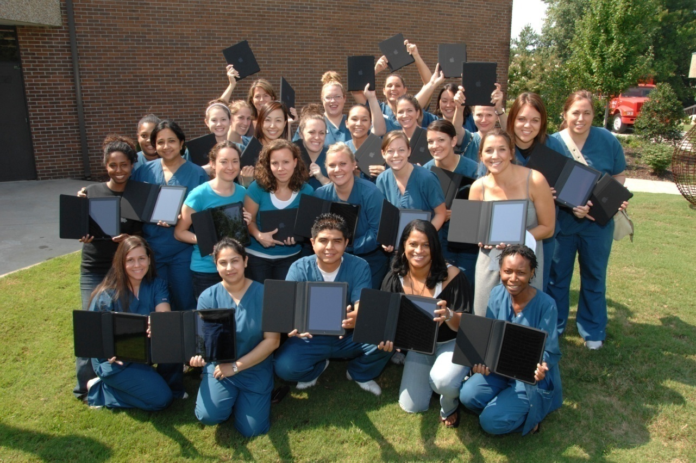
Devices Distributed
64GB WiFi iPad
28 DH students
7 DH faculty
27 Nursing students
12 Nursing faculty
64GB WiFi iPod Touch
30 DH students
135 Nursing students
12 Nursing faculty

Slide 37
Apps Provided By The Institution
Lexi-Comp Dental Select for dental hygiene students and faculty
Nursing Central for nursing students and faculty

Slide 38
Other Content:
Apps
Faculty may also recommend and/or require some free apps that they have found useful.
Faculty may recommend some low cost apps that they have found useful. Students will not be required to purchase these apps.
Podcasts
Faculty may choose to make some of their lectures available to students as podcasts.

Slide 39
Non- Program Specific Content
Apps
Turning Technologies Responseware App
Licensed by College for students.
Faculty and students are welcome to purchase or download content that they find interesting.

Slide 42
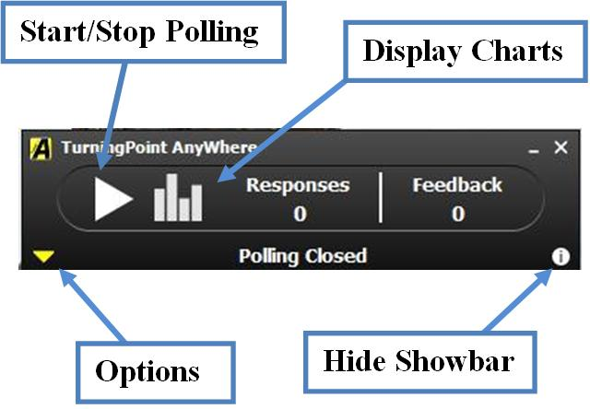

Slide 44
Research
Pre-training Survey (Faculty & Students) – this survey will evaluate participants experience with use of mobile devices and the internet prior to the study. This survey should be quite short and we can deliver this online or paper and pencil
Post-Training Survey (Faculty & Students) – will evaluate participants experiences and skills with using the devices mid-way the semester
The Weekly Usage Logs (Students) – this weekly log will allow students to document their use of the devices and gather any other relevant qualitative data during the semester. This will be an online survey
End of Project Evaluation (Faculty & Students) – this survey will allow faculty and students to provide any feedback on the project; we will also evaluate their use of the devices at this point
This survey data will be used in conjunction with quantitative data on
student’s performance in select courses and on standardize examinations;
Retention rates will be compared for both the control and the experimental
groups.

Slide 45
Training for Faculty
How to Create a Podcast
How to use your Mobile Device and Manage it with iTunes
How to use the Apps that are Provided by the College (provided by vendors)
How the Pilot will be Conducted including the Research Component
How to get Help

Slide 46
Training for Students
How to use your Mobile Device and Manage it with iTunes
How to use the Apps that are Provided by the College (conducted by faculty)
How to Access Podcasts
How to Pilot will be Conducted including the Research Component
How to get Help

Slide 47
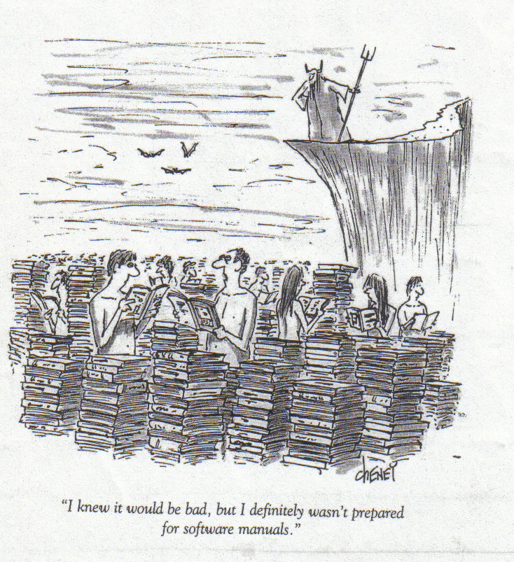

Slide 48
Nursing Mobile Devices Results

Slide 49
Impact on Course Grades

Slide 50
Impact on Course Grades

Slide 51
Course Outcomes
1921-fundamentals nursing course:
More “A’s” and less “C’s” in the pilot group (iTouch)
no academic failures in the pilot group
Interesting: less “B’s” and more “D’s” (“D’s” were due to non –academic failures)
2928-Advanced nursing course:
No change in pilot group. Same percentage number of “B’s” and “C’s”.
No failures of any kind in pilot group.

Slide 53
Notes:
Graphs 1 and 2 compare the cumulative/final grades received in each course for students without a mobile device (2009) with those using a mobile device (2010).

Slide 54
The final course grades in DHYG 1901 and 1921 suggest that for those students who are relatively strong academically the devices supplement student performance; however, use of the devices by average to below average students may not enhance course performance. This line of reasoning is supported since students who perform better academically typically utilize their available resources more efficiently than less successful students.
Further analysis of individual student grades is warranted for a more detailed analysis of student outcomes following introduction of the mobile devices.

Slide 55
Health Science Mobile Device Pilot Survey Results

Slide 56
Health Science Mobile Device Pilot Survey Results

Slide 57
Health Science Mobile Device Pilot Survey Results

Slide 58
Student Comments- Focus Group
“Very helpful when you need the information in a split second and are able to have it in a little device rather than carrying a huge book around.”
“Looking up questions that were brought up that no one knew a direct answer to on the spot...provided an on the spot answer ”
“Listening to podcasts on my commute really helps me solidify the material I need to learn.

Slide 59
What happens after the pilot?
After the pilot ends, OIT (technology)will reclaim all mobile devices from students.
After the pilot is over, faculty/students have the option to purchase their own iPod Touch or iPad then continue to use the apps that they have purchased.
At that point, faculty/students will have the option to extend the subscription for the apps that the college has provided at their own expense.

Slide 60
OIT will talk with bookstore about purchase and rental programs for mobile devices.
OIT will not provide access to mobile devices or purchase additional app subscriptions beyond this one year pilot.
OIT together with Health Science and OIRP (Research) will talk about how to move out of the pilot stage and into a “production’ environment if necessary.

Slide 61
App Recommendations

Slide 62
In addition to the software applications provided by the institution, students and faculty utilized many applications available for purchase and download.
Reference
Medscape
Note Taking
Penultimate
Noterize
Student Study Tools
Flashcard Share
myHomework
Open Culture
Communication
Whistle
Text Plus
Data Storage
Diigo
Dropbox
USB Disk
Presentation
2Screens
Mobile Presenter
E-Book Access
VitalSource Bookshelf
Coursesmart

Slide 64
Dropbox
This app is free and you will gain 2 GB of online storage.
Share files with others
Back up your important files
Sync files between your handheld device and other computers
Have your files in a format you can retrieve them quickly
Notes:
Let us say that you are working on a lecture at home and you save it to your Dropbox folder and to your flash drive. Upon your drive to work, you realized that you left that flash drive at home. No need to be sad because you can go online to the Dropbox website, access your Dropbox account, and now you have access to this lecture at work thus disaster is avoided.
Your committee is working on a document that all members need access to afterhours. You can have one folder that all members will have access to so the document can be edited to your heart’s content.
The only downside is that GPC will not install this program to your work computers, but you can always go online and download your document in seconds; I have been using this app for two years and have been satisfied with it. You also cannot edit the document on your handheld device, but there is an app to allow you to do this. I will report on this app soon. J

Slide 65
What We Have Learned…

Slide 66
Lessons Learned…
Murphy’s Law will usurp all other laws….
Herding Cats….
Learning Curve.
Better training needed for students
Survey compliance
Make research component more realistic
Compatibility
PDF files problem now solved
WMV Video viewing problems on computers
No Flash player
Technology will change
Buy in from faculty. Other students

Slide 67
Lessons Learned….
Campus WiFi connection
No home internet access
Screen is too small on Ipod Touch
Students afraid to bring Ipad to hospital setting
Battery life
No USB port

Slide 68
Future Implementation
All nursing students to have handheld
devices and applicable apps to provide
Point of Care
Possible Book Store Rental Program
Additional Grant Funding
Educause
HIT
Look at other handheld devices
Viewing videos on web-use class for other activities (hybrid type class?)
Reviews, activities for students
Who knows?

Slide 69
FUTURE iPOD PROJECTS
Dosage Calculations
Participatory Learning Activities
Physical Assessment
Lectures
Online Fundamentals course
Other Ideas??
Notes:
69

Slide 70
Acknowledgments
Produced by the Department of Nursing, Georgia Perimeter College
Dean, Health Sciences: Dr. Diane White
Project Managers:
Tracy Adkins, Assistant Director, Instructional Technology
Wakita Bradford, Nursing Community Outreach and Educational Technology Coordinator, Clarkston campus
Sue Buchholz, Associate Professor, Clarkston campus
William (Ken) Moss, Instructional Technologist, Clarkston campus

Slide 71
Contacts
Sue Buchholz: susan.buchholz@gpc.edu
Wakita Bradford: wakita.bradford@gpc.edu

Slide 72
