Slide 1
Backchannel example
http://visibletweets.com/
#SERC11
Notes:
Run this while people are coming in.

Slide 2
Backchannel Conversations with Twitter
EXPERIENCE IT: HANDS-ON LAB
Dan Reis
Multimedia Designer North Carolina Central University
Melinda Livas
Distance Services Librarian
Winston-Salem State University
Notes:
Hi everyone,
You may have seen they are running that in the lobby next to the information desk. It’s called visabletweets.com and it is great for that use – a public location where people will be walking by and will glance at a tweet. It is less useful in a classroom settings - and that is what we will be talking about today. Looking at and demoing tools to integrate a backchannel into a class or training session.
I’m Dan Reis from NC Central University in Durham, NC and Melinda Livas is from Winston-Salem State University. I’ve worked with a few faculty at NCCU for the past 3 semesters on integrating Twitter in their classes.
This is an experience IT session so it is meant to be very hands-on so get out of your laptop, iPad, iPhone, Android, Palm or even Blackberry and login to Twitter. Because this is educause and because of our limited time, I was planning on skipping an introduction to Twitter segment. Is that OK with the group?
How many of you currently use a Twitter account?

Slide 3
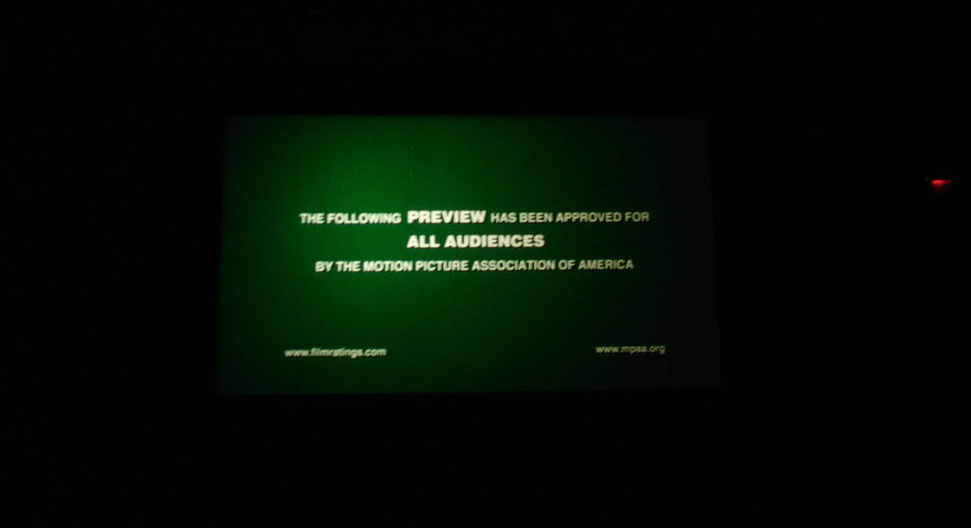
Preview
Quick overview of backchannel communications
Hands on with HootCourse
Backchannel/HootCourse/Twitter discussion
Notes:
Here is a quick preview of what we’ll be covering in the next 45 minutes. First, just so we’re all on the same page, we’ll do an overview of backchannel communication. What it is, what it looks like and how to do it. Then we’ll get into the hands-on part of the session and talk about two tools we’ve used in classrooms at NCCU with Twitter – mainly HootCourse. Then we’ll talk about some other tools and open it up to a broader discussion about HootCourse, backchannels and anything else Twitter or otherwise. As you think of questions, please either raise your hand or tweet it. We’ll periodically check the Twitter board for questions.
As you can see, this session and every session at Educause has it’s own hashtag. This sessions’ is #SERC11_SESS16. If you are tweeting about this session, please include that hashtag. If you are tweeting about the conference generally, you can use the #SERC11 hashtag. Will talk more about hashtags a little later. So we encourage you to start tweeting. If you don’t know what to tweet, we’ll talk about that shortly.

Slide 4
How do you use Twitter?
Notes:
To get us started, let answer this question on Twitter so we have some content on our backchannel. Be sure to include the hashtag #SERC11_SESS16 in your response. If you don’t have a Twitter account, hold tight, we’ll may have a way for you to participate later.

Slide 5
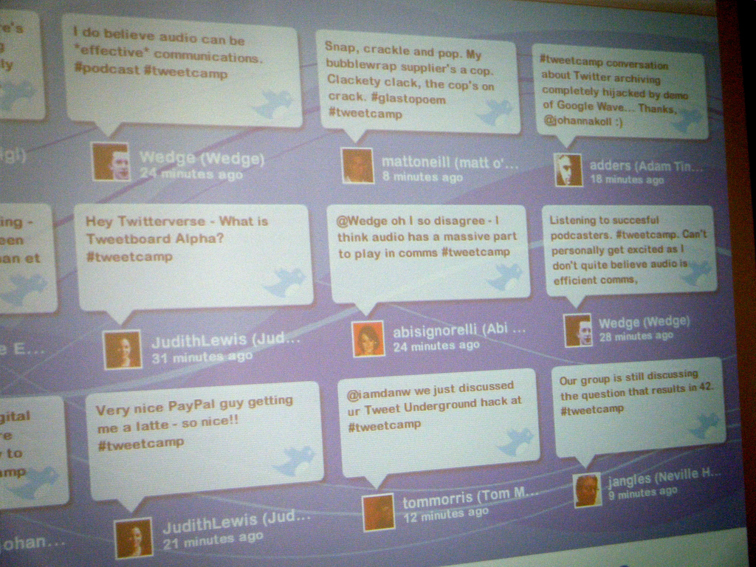
What is a Backchannel?
Notes:
So while everyone is responding to that, let’s start on the quick overview. What is a backchannel?
Educause defined it in their 7 Things you Should Know about the Backchannel handout as "a background conversation brought into the foreground. “ Or a conversation that is happening while the event, presentation or class is happening. It is not the focus of the event, but is in the background. Simple enough right?

Slide 6
When are they used?
Conferences
Webinars
Classrooms
Notes:
They are used in a number of places. Backchannel at conferences are popular right now.
If you’ve participated in a webinar recently, you’ve probably read or participated in the chat feature. That is another form of the backchannel, it is not the focus of the presentation but usually accompanies it.
Backchannels can also be used in the classroom. There are examples of this from across the country of classes integrating Twitter and other systems into their classrooms to encourage more engagement in the course, both during the class and out of the classroom.
Where else?

Slide 7
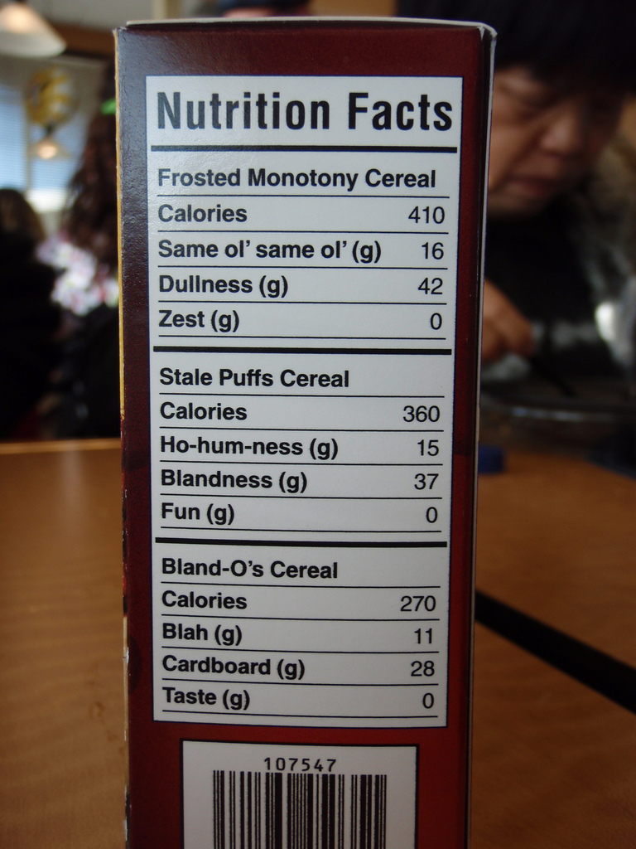
What is in the backchannel?
Key points
Links
Q/A
Networking/Social
Collaboration
Technical trouble-shooting
List modified from the Twitter 101 for the 2010 Lilly Conference Prezi by Derek Bruff, Vanderbilt University.
Notes:
What is in the backchannel? Here are some examples of what is usually in the backchannel and what you can post when you’re at a conference or webinar.
- Key points from lectures, keynotes and sessions
- Share links to resources and related materials
- If the presenter is looking at the backchannel, it is a great way to ask and answer questions related to the presentation without interrupting the presenter.
- Opportunities for networking and social interactions
- Collaboration – participants become a part of the presentation, similar to a in-person session. Also, it’s sometimes less intimidating than raising a hand and offering a thought.
- In webinars, it can also be used for technical trouble-shooting advice and help
What else do you use the backchannel for?

Slide 8
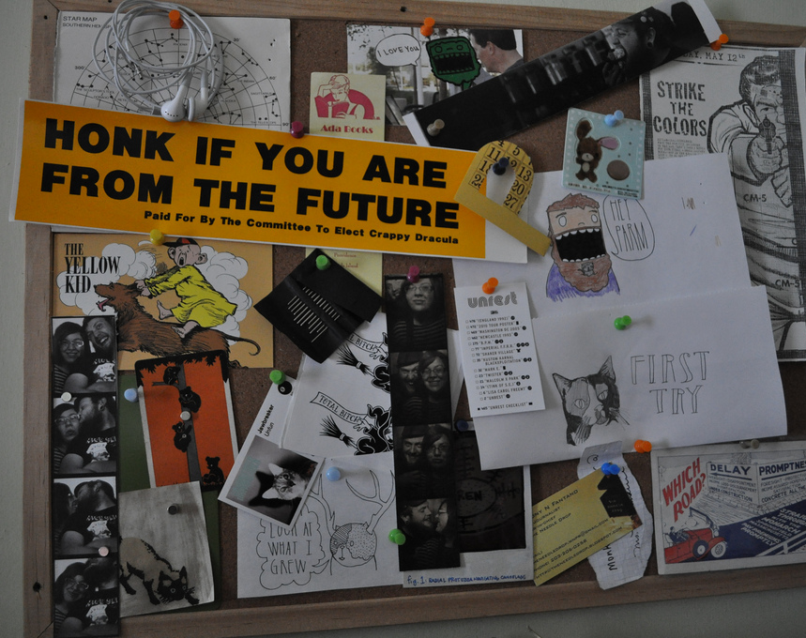
How does it work?
#
Notes:
Backchannels typically need two ingredients – a tool so participants can add content and a way to organize the content.
The tool can be Twitter, Facebook, blogs, wikis, group chats and other systems. The key is that they are accessible by everyone participating in the event, they are quick and easy to add content to.
If your tool is Twitter, the way to organize content is using Hashtags. For example, Educause is doing this by giving the entire conference and each session their own Hashtag. Then anyone attending the conference or individual sessions, can label their tweet with a hashtag. During and immediately after the event, participants and others can find information about the event by searching for the hashtag. So, if you tweet something right now and include the #SERC11 you will make your tweet available to anyone who is following that hashtag – even if they aren’t following you. It’s also a great way to find new followers.
You can go ahead and search for it on Twitter.com. Demo this on Twitter – search for #SERC11_SESS16. A more visual way to do this would be using twitterfall.com. (Demo search for #SERC11). If you are interested in Twitterfalls, I can talk about how we used that for student critiques in a marketing class.

Slide 9
Not ideal for classroom use
Twitter account
Public tweets or follow
No student tracking
Unwanted noise
No archive
Notes:
Both Twitter.com and TwitterFall work well. But if you wanted to use a backchannel in a classroom, we’ve learned that this isn’t ideal.
Some of the limitations of using Twitter to manage a backchannel for your classroom include:
Your students will all need a Twitter account – if they don’t already have one that may complicate things. From our semi-formal surveys, a majority of our students are not on Twitter. But nearly all are on Facebook.
They will have to have all their tweets public or allow the professor to follow them – which neither of you may be comfortable with. Requiring the tweets be public could also run into FERPA issues.
There is not way to keep track of which of your students have tweeted and no way to keep out unwanted noise.
Plus, Twitter is about what’s happening now – not what happened 3 months ago so they don’t have a reliable way to see old tweets. There are applications that will help with this but you’ll have to set them up separately. This could be crucial if you need to prove a student has/has not been participating.
If you want to establish a backchannel in your class, we’ve used a different tool that has features specifically for education that archives the tweets and helps you keep track of which of your students are using it.

Slide 10
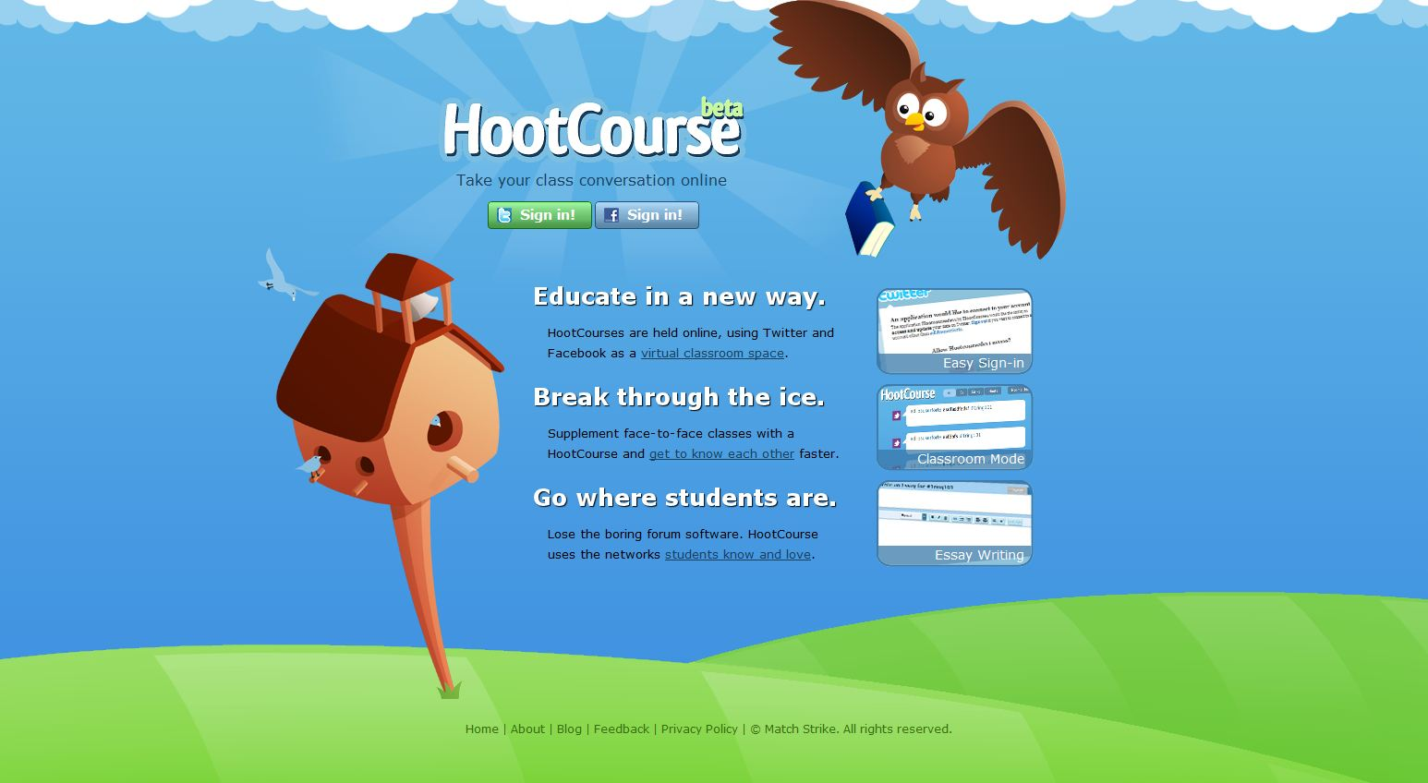
HootCourse
Notes:
And to do that, we’ve used HootCourse. HootCourse is a Twitter-like application designed specifically for education. Students login with their Twitter or Facebook accounts and it keeps all course related tweets and Facebook posts in one place. It works like Twitter. You can RT, reply, mention, add links, etc.
Let’s jump right in and start using the HootCourse to organize and manage our backchannel.

Slide 11
Let’s get started!
Go to cutl.posterous.com and join our classroom.
Post something, anything!
Notes:
I’ve created a HootCourse Classroom so we can try this out.
Go to our blog cutl.posterous.com and you’ll find a little widget I’ve embedded. You can choose to login with either your Twitter account or Facebook.

Slide 12
Joining the Classroom
Sign-in with Twitter or Facebook
You are now enrolled
Notes:
When you sign in on the widget with your Facebook or Twitter account, you are enrolled in the course and you are added as a student (show some of the students as they appear). So now, as the instructor, I can easily see who is participating in the backchannel, who is asking questions and who is posting links.
Now, once you are added to the course, your tweets will appear in the Hootcourse page.
Another nice feature of HootCourse is that you don’t have to clog your Twitter feed or Facebook account. You can choose whether or not to post to those accounts. When would this be appropriate? Maybe if you’re posting for a conference, like we are now, you would want to also post to Twitter. But if you have signed in with Facebook, maybe you don’t want to make that your update.
Answer this question:

Slide 13
Many ways to posts
Widget on any webpage - BB
HootCourse.com
Twitter.com
Any twitter client
Dumb phones via text message
Posting directly on Facebook DOES NOT work.
Notes:
The instructor have multiple ways to make it very easy for them to add content to this backchannel.
You can share the link that takes them directly to the course on HootCourse.com.
Embed a widget on any webpage. This way they don’t have to remember a link or new website. It can be embedded directly in their course website or learning management system.
Once they are enrolled in your HootCourse class, they can post directly on Twitter.com. As long as they are enrolled and they use the course hashtag, it will appear in your HootCourse stream.
They can also use any twitter client they choose. As long as they are enrolled and they use the class hashtag, it will appear on HootCourse.com.
Students can even tweet with their dumb phone via a text message.
Posting directly on Facebook with the course # DOES NOT work.
Go ahead and try posting using a different method. Remember, you need to have signed in once via HootCourse or the widget once first then you can use any other method.

Slide 14
Hashtag
HootCourse’s website or widget, hashtag will auto add.
Twitter.com or a Twitter client, you add the hashtag.
Notes:
Remember, one of the ingredients for a backchannel using Twitter or Facebook are hashtags to organize the content. If you tweet from HootCourse’s website or widget, it will automatically add the course’s hashtag. If you use Twitter.com or a Twitter client, you’ll need to add the hashtag.
If you are enrolled and you use the hashtag, your posts will appear in the HootCourse feed.

Slide 15
It’s your turn
Questions?
Links to similar tools you’ve used.
Find new people to follow.
What is one thing you hope we cover in the next 20 minutes?
Notes:
For those who haven’t posted anything yet, go ahead and test it out. Post a question, link to similar tools you’ve used, new people to follow, if you’re having problems, etc.
And – what is one thing you hope we cover in the next 20 minutes?
Feel free to use this throughout the presentation to post the things that are usually found in the backchannel.

Slide 16
9 reasons why HootCourse is great at managing a course-related backchannel.
One place
Archive
Twitter OR Facebook account
Won’t clog their feeds
Private tweets stay private
Classroom mode
Widget
No strangers, less noise
Track students
Notes:
All course-related tweets and posts in one place
Keeps an archive of the tweets for the class, even when the students Twitter account is erased.
Students don't need to create a new account because they have the option to use either a Twitter or Facebook account.
Students can post to the HootCourse classroom without it showing up on their Facebook walls or Twitter feeds
Students can keep their private tweets private and still post content to the class. They do not need to give the class or their instructor access to their private tweets.
Create a classroom discussion on class-related tweets with Classroom mode
Widget can be embedded on Blackboard, Moodle, blog or any webpage to seamlessly integrate it into other class technologies.
No strangers - less likely that tweets from people not in the class will appear
Easily view how many students have tweeted and how many tweets each one has posted.

Slide 17
Possible issues
Free software
Limited official support
Can not delete courses
Not completely private
Tweets still need to be monitored
Privacy Policy - http://hootcourse.com/privacy/
Notes:
Same as with other free software – no guarantee the service will stick around
Limited official support, though they have been responsive via Twitter.
Can not delete courses
Not completely private - links can be shared. You can control who posts content, you can’t control who can view the content.
Requires time to manage and monitor the tweets
The privacy policy may cause issues. Since it does tie in with Facebook and Twitter, it has the ability to see other information – though they say they don’t.
Other legal concerns

Slide 18
Tips for Using Twitter in Classroom
Set expectations
Assign points
You determine when the backchannel is displayed in class
Build a relationship
FERPA form
Have a backup
Abbreviations, grammar, Twitter-speak
Unusual names
Notes:
If you are going to use this in a classroom, or help your faculty use it a class here are some tips from our experiences at NCCU:
Important to set expectations for use - language, etc. Incivility with the tweets wasn’t an issue because the students are not anonymous.
Assign points to the tweets - not necessarily individual tweets are worth points, but work it into the syllabus. But if your class is active, you may not need to be this explicit.
You determine when the backchannel is active and when to display it in class.
Build a relationship with the students before using it in a course. May not be a good idea to use it on the first day of class.
We ask our students to sign a FERPA form - because their assignments are being posted to HootCourse
Be aware you will have students will unusual Twitter names.
You may need to brush up on your abbreviations, Twitter terms.
Like with any technology, have a backup. Twitter is down a fair amount and may interfere with your students posting content. Also, what will you do if you building wireless is down?

Slide 19
TweetDeck demo
Notes:
Are there tools that you use?

Slide 20
One thing you found interesting about this session.
Notes:
One more question:

Slide 21
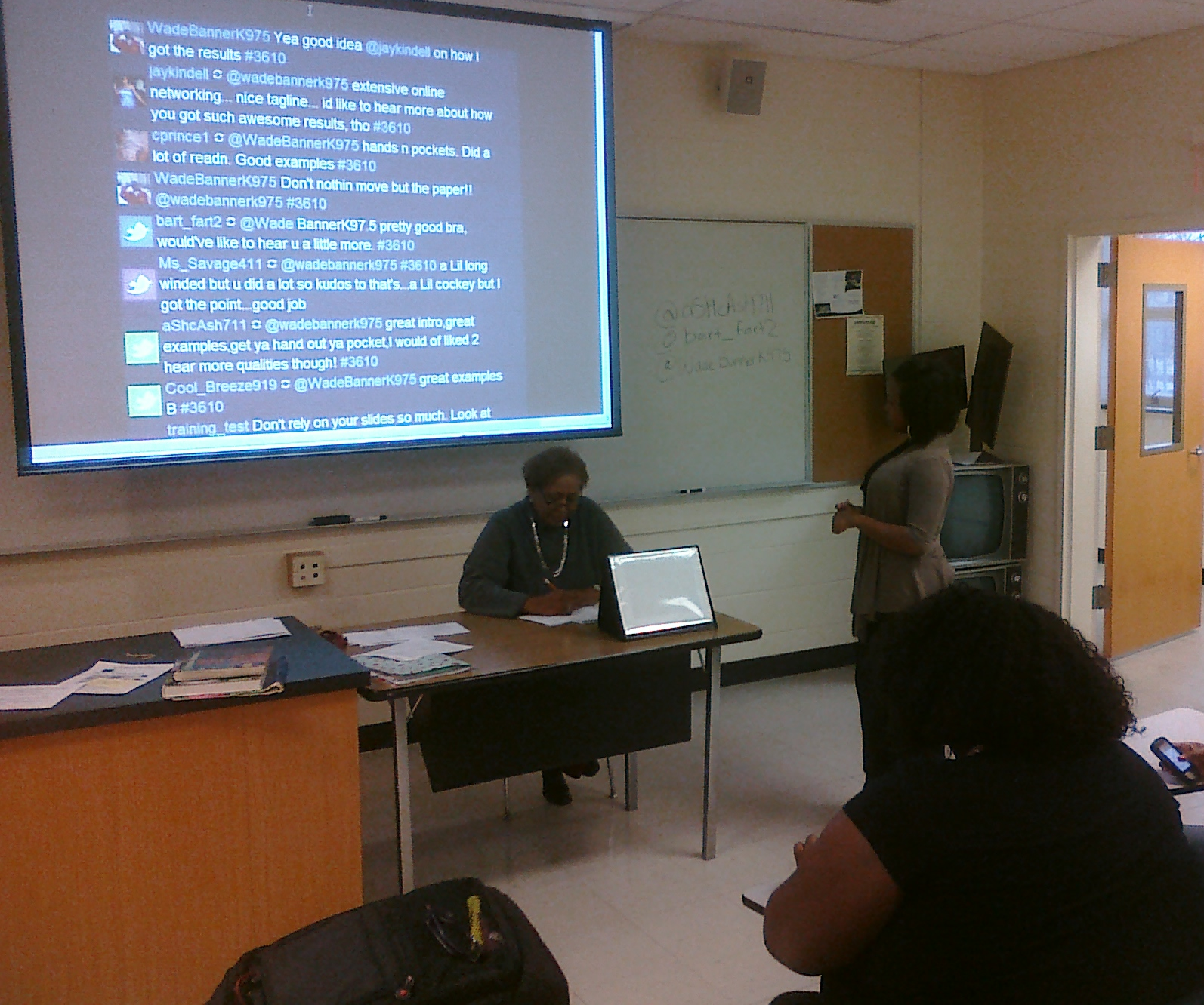
In-class Backchannel example
Notes:
Here is an example of using a backchannel in a course that we did. In this case, we used Twitterfall – only because we hadn’t discovered HootCourse yet.
Example: The way we used it was as a way for students to give peer feedback immediately after a in-class presentation. In this sales and marketing course, the first assignment was to sell yourself in an interview type presentation to a potential employer, played by the professor. After the presentation, while the professor was writing notes about the presentation, students would tweet a comment about the presentation with their laptop or cell phone. Usually cell phone because our wireless is unreliable.
To make this work:
Students wrote their Twitter handle on the board.
They would give their 2-3 minute presentation to the professor.
After the presentation, the comments rolled out on the screen. The professor read them and made additional comments.
TwitterFalls was not up while the presentations was being given as to not distract the student.
This works well if you’re only going to use tweets occasionally, around specific assignments. If you’re going to use it all semester, as a communication channel then I would recommend a different tool that has features specifically for education that archives the tweets and helps you keep track of which of your students are using it.

Slide 22
References
Backhannel. Retrieved May 11, 2011 from Wikipedia: http://en.wikipedia.org/wiki/Backchannel
Bruff, D. (2011, February 10). Encouraging a Conference Backchannel on Twitter. Retrieved from http://chronicle.com/blogs/profhacker/encouraging-a-conference-backchannel-on-twitter/30612
Bruff, D. (2011, April 26). The Backchannel – Dealing with Distraction, Incivility, and Unfairness. Retrieved from http://derekbruff.com/teachingwithcrs/?p=963
Bruff, D. (2011, February 2). The Backchannel – Opening the Classroom, Managing the Stream. Retrieved from http://derekbruff.com/teachingwithcrs/?p=899
Bruff, D. Twitter 101 for the 2010 Lilly Conference [Prezi presentation] Retrieved from http://prezi.com/dy_vdnlm9flm/twitter-101-for-the-2010-lilly-conference/
Educause. (2010, February 9). 7 Things You Should Know About Backchannel Communication. Retrieved from http://net.educause.edu/ir/library/pdf/ELI7057.pdf

Slide 23
Images
Backchannel, from the Back of the Room photo by Flickr user justin, available under a Creative Commons License.
Twitter icon from Twitter.com.
Wall o’ Tweets photo by Flickr user Adam Tinworth, available under a Creative Commons License.
Classroom photo by Flickr user Velkr0, available under a Creative Commons License.
Nutritional Info Parody photo by Flickr user GizmoDoc, available under a Creative Commons License.
Bulletin board photo by Flickr user ancient history, available under a Creative Commons License.
46/365 - Have you seen this face? photo by Flickr user acousticgirl, available under a Creative Commons License.
We think you need a magnifying glass to see droids photo by Flickr user Kalexanderson, available under a Creative Commons License.
High-five photo by Flickr user Nick J Webb, available under a Creative Commons License.
Hash-tag photo by Flickr user svenreed, available under a Creative Commons License.
#19 – Too Many Choices photo by Flickr user elviskennedy, available under a Creative Commons License.
Approved photo by Flickr user starlen, available under a Creative Commons License.
you photo by Flickr user gcfairch, available under a Creative Commons License.
Risk Factory photo by Flickr user kyz, available under a Creative Commons License.
Question mark in Esbjerg photo by Flickr user alexanderdrachmann, available under a Creative Commons License.
TweetDeck at IDF photo by Flickr user niallkennedy, available under a Creative Commons License.

Slide 24
More Information
Dan Reis
Multimedia Designer North Carolina Central University
dreis@nccu.edu | TWITTER: TheCenter_NCCU
Resources from this presentation are at cutl.posterous.com.

