Slide 1
Roadmap for Implementing Online Training Tutorials: Sharing Our Campus Experiences
Sara Pitts – Savannah College of Art & Design
Christine L. Vucinich – Duke University
Karen W. Sirman – Louisiana State University
June 2, 2011
Notes:
Copyright Pitts, Sirman, Vucinich 2011. This work is the intellectual property of the author. Permission is granted for this material to be shared for non-commercial, educational purposes, provided that this copyright statement appears on the reproduced materials and notice is given that the copying is by permission of the author. To disseminate otherwise or to republish requires written permission from the author.

Slide 2
What’s lynda.com?
Leading education provider –
online digital library.
1,025 courses; over 61,000 movies.
Topics include: Microsoft Office, Adobe Creative Suite, video editing, computer programming, web design, database design and more.
New titles added each week. Two theory style courses: Pitching Products & Time Management Training were added to the library in spring 2011.
Available 24x7.

Slide 3
Our Presentation will address…
How we each are using lynda.com at our institutions.
Best practices for piloting and implementing the tutorials on our campus.
Strategies for promoting online training on campus
Approaches to building a user community.
q&a
Notes:
Intro. to you/your school/dept, how you are using lynda.com, best Practices for piloting and implementing, strategies for promotion on campus, approaches to building a user

Slide 4



Slide 5

Savannah College of Art & Design
Sara Pitts - spitts@scad.edu
Director of Online Student Success
Liaison between college and eLearning students
Outreach to students in need of assistance
Ensure students have access to resources they need for success
Building active online community

Slide 6

at
five user license for student use
2007
IT training purchases 10 user license
2008
explore academic site license
2009
launch
lyndaCampus
2011
2006
single user license for staff training
2008 increase to 10 user license
2010 implement academic site license

Slide 7
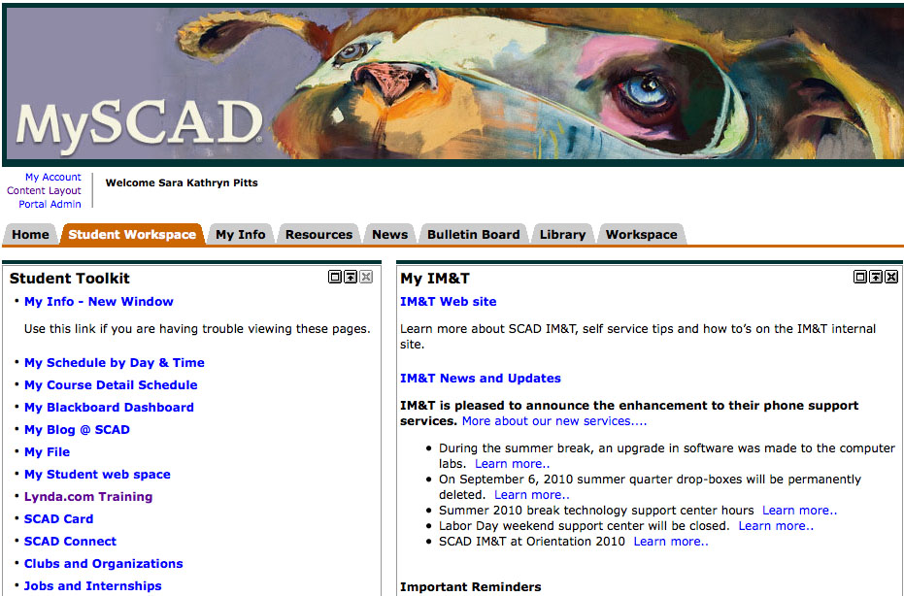
Access via MySCAD Portal
Easy access via portal, single sign on
Available to students, staff and faculty
iPhone and iPad applications with single sign on

Slide 8

Leveraging lynda.com
Use in admission talking points
Include lynda.com promos in welcome bags
Work with professors for referrals
Integrate into eLearning course materials
Use as platform to engage with students outside the classroom
Notes:
Admission talking point to attract prospective students
Welcome bags are sent to students before their first quarter, becomes a retention strategy

Slide 9
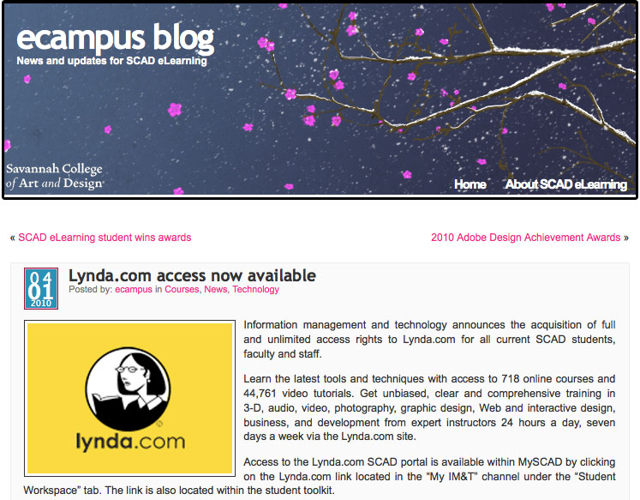
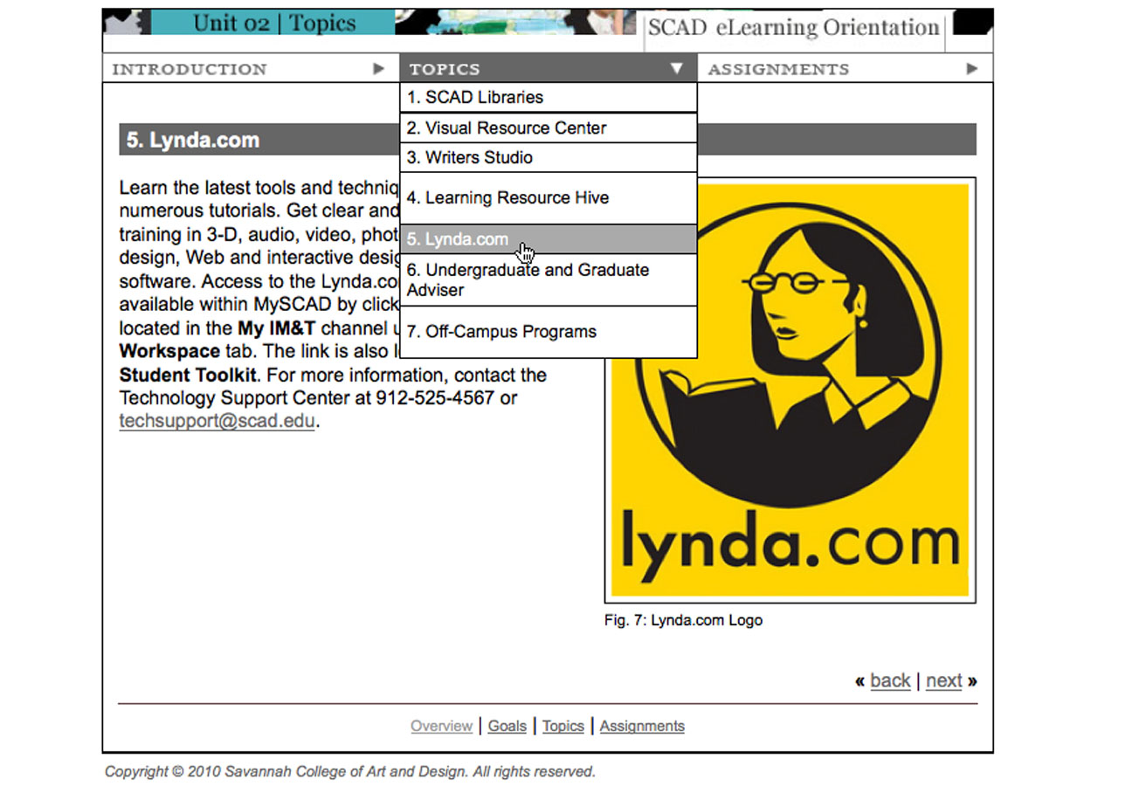
Promoting lynda.com
eCampus blog
Facebook, Twitter
MySCAD announcements
Email newsletters
SCAD eLearning
New Student Orientation

Slide 10
Ideas for collaboration
Time management workshop series
Faculty roundtable during National Distance Learning week
Resume building with
career services
Creative Inspirations Club

Slide 11


Duke University
Christine L. Vucinich - clv4@duke.edu
Technical Education & Outreach Coordinator
Office of Information Technology
Duke University Photography - Les Todd

Slide 12

ABOUT Duke University
Private research university established in 1838
Located in Durham, North Carolina.
10 schools and colleges (inc. Duke Law School, School of Nursing, Nicholas School of the Environment, Divinity School and more…)
Population:
  Students 14,248 (Undergrad: 6,504; Grad: 7,744)
  Faculty – 3,138; staff - 33,525 (includes campus, School of Medicine/School of Nursing and Hospital staff.)

Slide 13

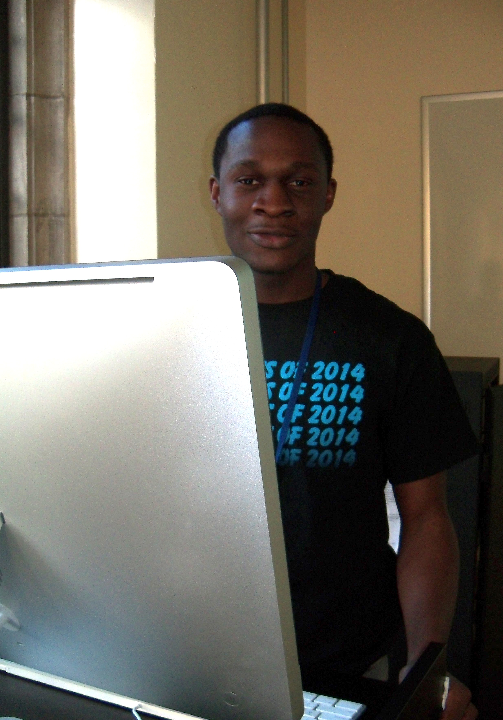
About OIT Training
Training Department within the Office of Information Technology (OIT).
We offer pre-scheduled instructor-led seminars, brown bag lunch sessions, OnDemand Training opportunities for academic software & Duke-specific topics.
1 full-time staff, 6 student trainers (inc. 1 student supervisor), several full-time IT staff who offer training in specialized areas (Scalable Computing, security, design, etc.)
http://www.oit.duke.edu/training/
Notes:
One full time staff and 5-6 student trainers/semester

Slide 14
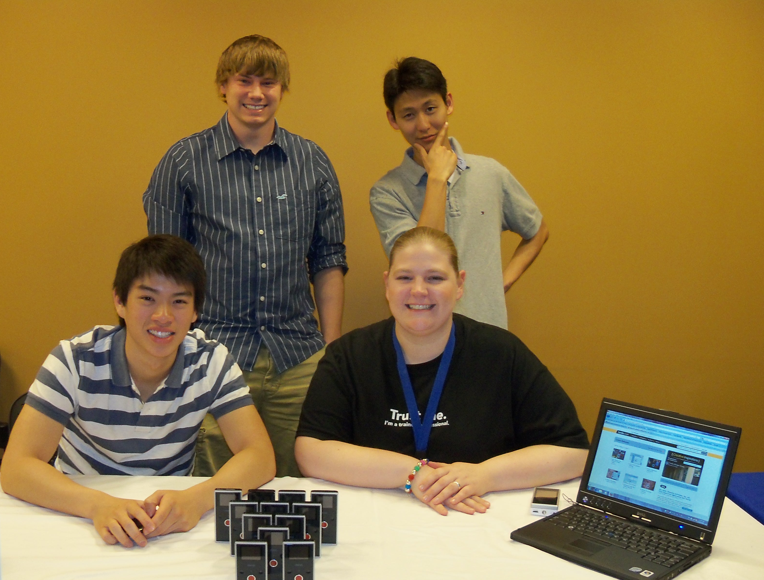
lynda.com – Resource @ Duke
A complement to in-classroom technology training.
Just-in-time training/support.
Allows us to focus our training on more Duke specific tools.
Examples campus-wide: Computer Science Dept., OIT, Duke Health System, students preparing for internships, coursework and more.
Case Studies: www.oit.duke.edu/training/online/lynda_casestudies.php
Notes:
Richard Lucic, Assoc. Chair – Dept. Computer Sciences uses it to demonstrate concepts to students in the ISIS program.
Alumni Affairs used it for OneNote Training for several staff.
OIT Collaborative Services is referring staff to Outlook training vs. recreating/reinventing documentation.
Nancy Walden, Duke Health System wanted to help her office transition to new version of Word. They watched tutorials together – and ate popcorn!
One of our student staff used it to learn & develop Illustrator skills to help land a summer internship!

Slide 15
Accessing lynda.com @ Duke
www.oit.duke.edu/training/online
Users are directed to a getting started page!
Notes:
Insert new screen cap of getting started page

Slide 16
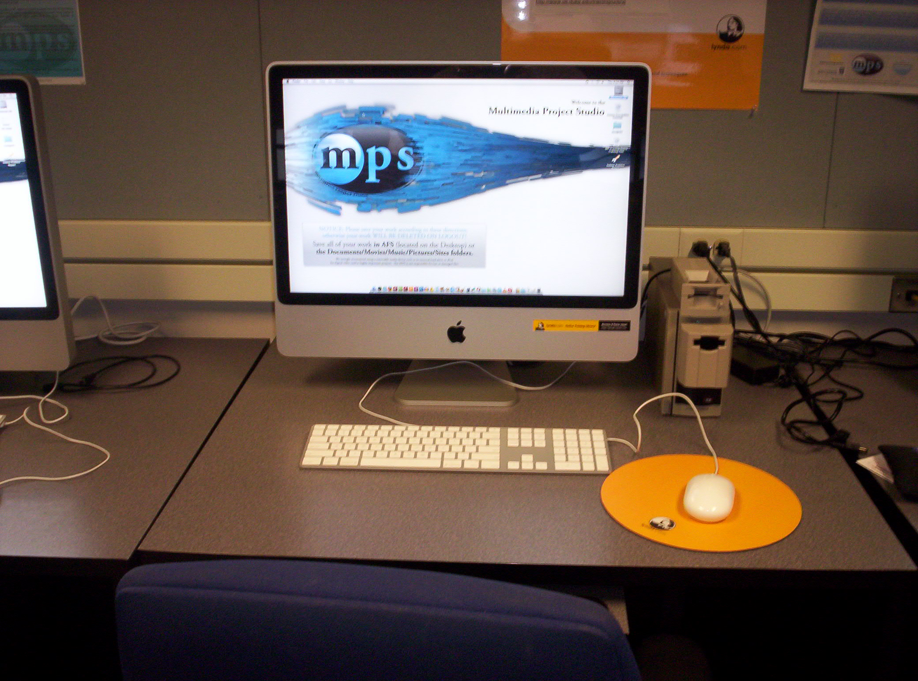
History of Lynda.Com @ Duke
  2 yr. pilot (2008 – 2010)
    Year 1: October 2008 – October 2009 We purchased 60 Managed Multi-user accounts (managed these manually) & 10 designated workstations.
    Year 2: November 2009 - June 2010 Shibboleth (web single sign-on) integration became available.
    Over 76,000 movies were viewed during the pilot.
  July 2010 – present
    30 IP - Shibboleth Integrated accounts and 20 multi-user accounts.
    Over 77,000 movies viewed and over 6,000 training hours.
    Our current model is being phased out. We are working on an overall training roadmap & discussing a long-term growth path.

Slide 17
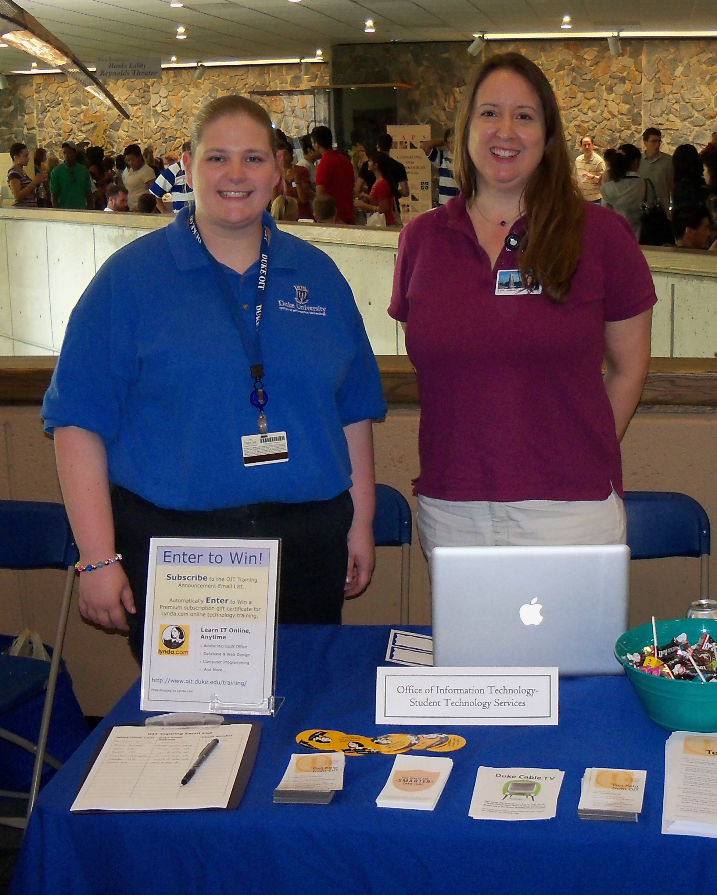
Best Practices & Approaches
Building a User Community
Work directly with faculty and trainers to blend tutorials with existing learning experiences.
Find & communicate regularly with key stakeholders: Library, Career Services, HR, Service Desk.
Find ways to keep this resource “fresh” in user heads.
Have an ambassador/cheerleader on staff!
Notes:
Casey Alt, Faculty in Virtual Forms & Space recommended lynda.com in his ARTSVIS 108 course where students were learning to use Maya.
Terry Banfich, Trainer - University Development conducted “lunchbox” sessions for administrative staff in her area.

Slide 18
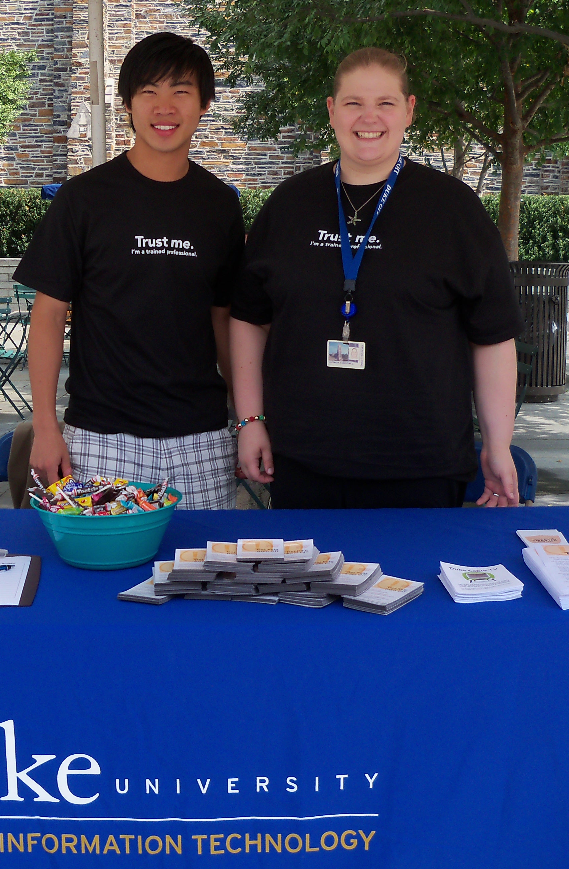

MARKETING STRATEGIES
Give lynda.com goodies/mention this resource - in workshops & brown bags.
Participate in orientations & departmental fairs.
Communicate/announce in newsletters. (Worked with OIT News & Info. staff to write articles in Working @ Duke, a monthly publication for staff.)
lynda.com sponsored this year’s Froshlife, first year movie festival.
Posters & bookmarks (customized by the lynda.com Marketing Department)
Notes:
Mention that I wrote article for July 2010 lynda.com Academic Newsletter than I can share.

Slide 19

Louisiana State University
Karen W. Sirman – karen@lsu.edu
Senior Manager, LSU Information Technology Services
Project Manager and Outreach, Emerging Technologies
User Support & Student IT Enablement

Slide 20

About LSU
29,000 students for Fall 2010
14 academic colleges
Approximately 5,000 faculty and staff
Budget: $645M for 2010

Slide 21
LSU Budget Situation
Since January 2009, LSU’s state appropriations cut by more than $45 million
Elimination of programs and the loss of about 376 positions, 140 faculty.
Less than 50 percent of LSU’s operating budget is coming from the state. Two years ago it was at 58 percent.
Potential 3-5% cut for 2011/2012

Slide 22
Current LSU IT Training
Classroom
24x7 online
START program
  Student Technical and Resource Training
  Offered at selected times
  Free - In classroom
  Dedicated student instructors
Tech Talks
Microsoft IT Academy
  Mostly technical Microsoft topics
  Available 24x7
  Geared toward MS certifications
  NOT user friendly
NO end user training online, other than at Microsoft, Apple, Adobe sites

Slide 23
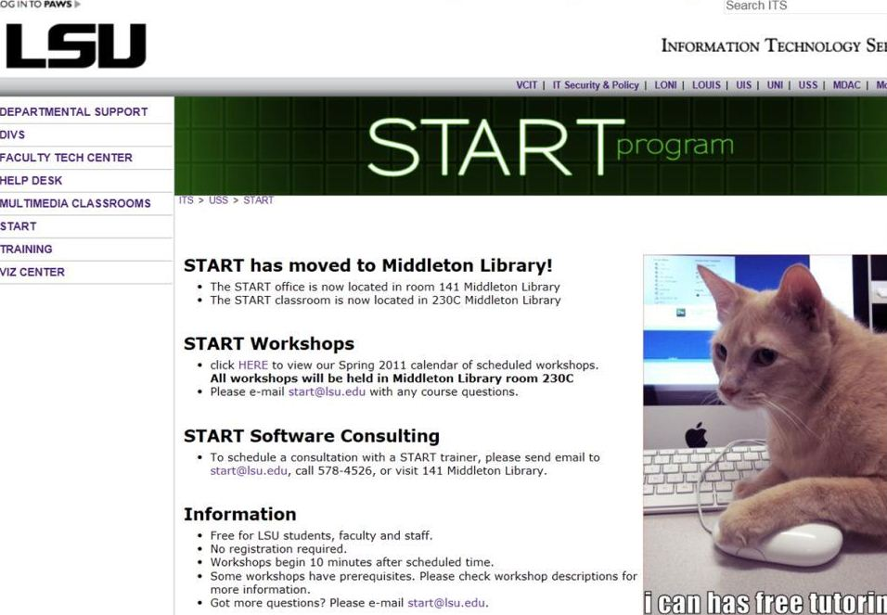

Slide 24

Bringing online training to LSU
Tech fee funding
  Getting on Tech Fee meeting agenda…delayed
  Approval process to redirect funds…delayed
Bid process…another delay
lynda pricing model changed.
  No longer offered concurrent model option
Contract wording ….another delay!

Slide 25
Contract wording: 5,000 limit user base
Track and Limit the 5,000 users by the following
The point of entry for all LSU users will be the GROK knowledge base, http://grok.lsu.edu When the requestor clicks the Lynda link, an Active Directory Lynda Pilot group will be checked to see if the user belongs. If so, they will be passed to Lvnda.com through Shibboleth authentication. If not, the system will verify their association with LSU and add them to the Active Directory group, which will be limited to 5,000 users and then redirected to a survey of usage and a registration process.
Shibboleth will be used for user authentication, which will allow both on and off campus access, including wireless. Shibboleth will not pass any attributes to Lynda for a user if they fail to authenticate or if the 5,000 user limit has been reached.
All requests (students, faculty, staff) will follow the same procedure. The group of 5,000 users is static and LSU will not be rotating users.

Slide 26
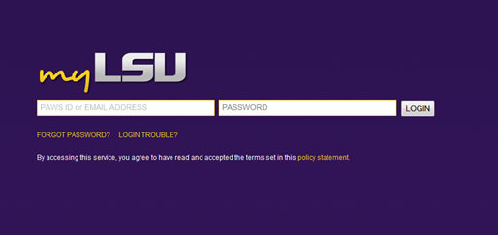
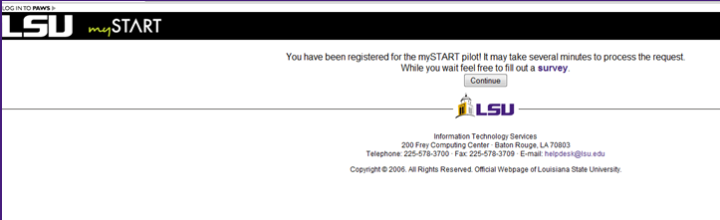
LOGGING IN TO lynda.com
Shibboleth for authorization
Must login through myLSU portal!

Slide 27
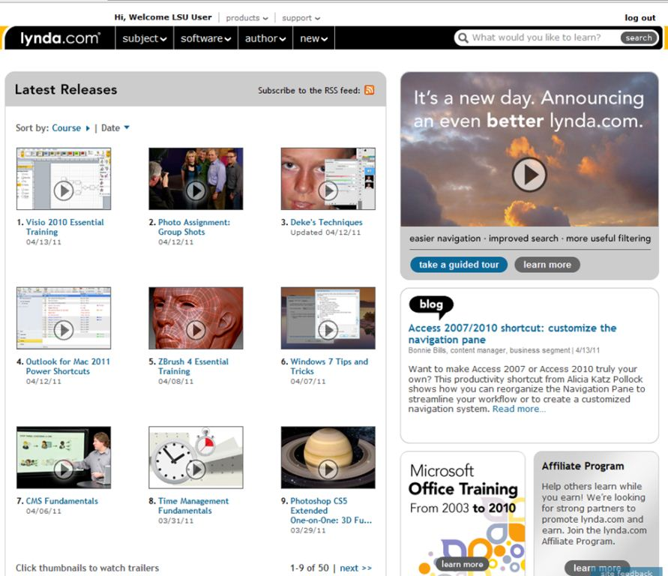

Slide 28



Branding & Marketing Issues

Slide 29

Who is using lynda.com?
  March (400) , April (573)
Registered users: 573
437 unique IPs logged in during April
5628 movie views.

Slide 30
Problems
Shibboleth access does not allow us to track PAWS IDs with lynda.com courses
Student must keep track of their progress
Would really like concurrency!
Controlling access through Active Directory group clunky, not able to email in mass.
Pricing models changing…cost effectiveness?

Slide 31

Marketing Plans
  Spring 2011
    To specific faculty & their students
    To Technology Support Professionals
    Through web pages, LSU documentation, screen savers, ITWire newsletter, myLSU portal
    Through word of mouth, promote at meetings
  Fall 2011
    To Bengal Bound students
    To Mass Communication and Business Residential life students
    Campus Banners/ads
    Faculty Senate

Slide 32
Questions? Thank you!

