Slide 1
Virtualization at VSCC
Brian Kraus
Brian.kraus@volstate.edu

Slide 2
Background
Volunteer State Community College
Serves 25 counties in middle Tennessee
Approximately 8,500 students
Approximately 2,000 computer on campus
4 full-time client services technicians

Slide 3
Background (cont.)
The Learning Commons
State of Tennessee mandated new emporium approach to math and developmental courses
All courses computer based, rather than instructor led
VSCC needed to add about 500 additional computers
No money for additional IT support staff

Slide 4
Doing More with Less
Virtualization
VSCC partnered with Cisco and Citrix to virtualize emporium computers
Cisco UCS blade servers
Microsoft Hyper-V
Citrix Xen Desktop
Citrix Xen App
EMC storage arrays
Cisco VXC terminals

Slide 5
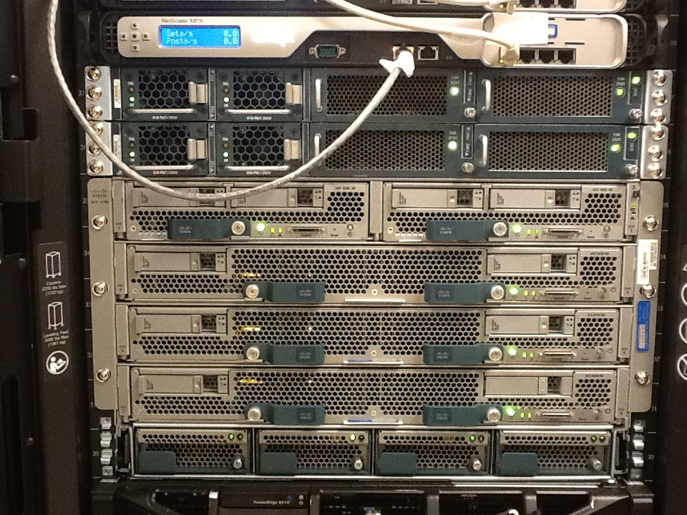

Slide 6
Doing More with Less (cont.)
Pilot
Replaced half of the computes in Emporium with thin clients
Students reported faster login times than PCs
Biggest complaint was lack of desktop shortcuts
Very few issues reported
Go-Live
Originally started with 200 thin clients

Slide 7
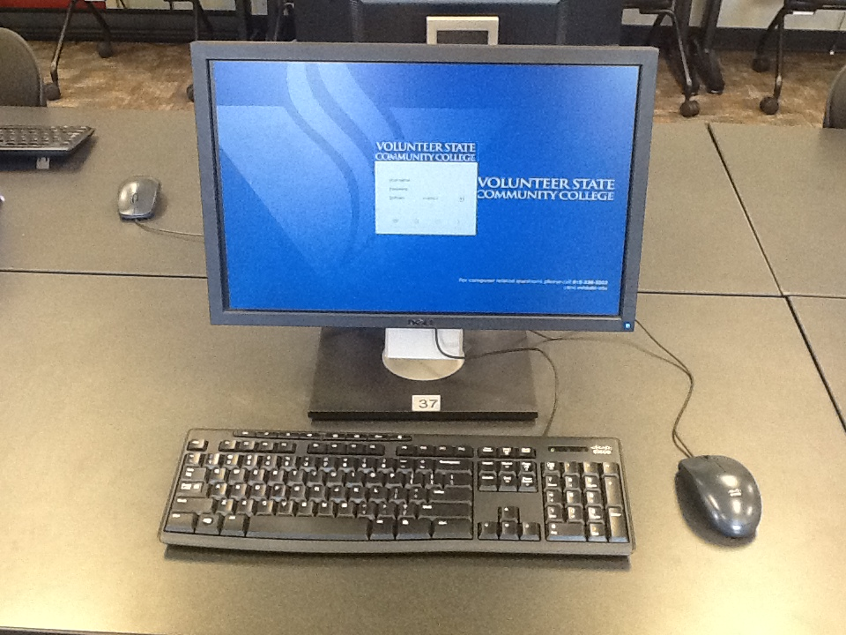

Slide 8
Benefits
Benefits of the Technology
One image to update and maintain
New software or new image can be pushed to entire lab in less than 10 minutes
Less to maintain
Thin clients do not have hard drives
Pretty much either works or doesn’t
Technicians do not have to maintain or repair individual units
Bring your own device
Full windows desktops or individual applications can be loaded on any device

Slide 9
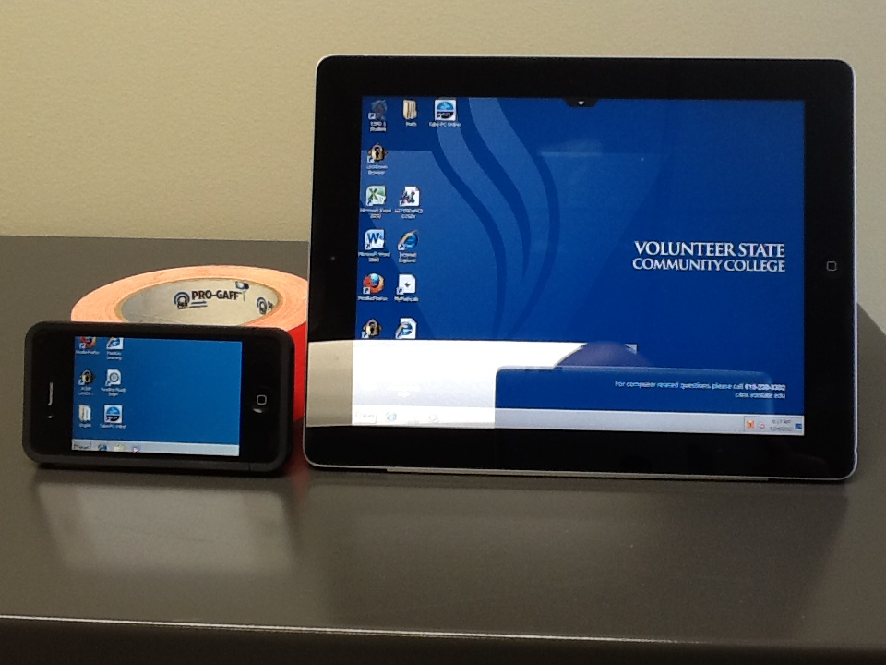

Slide 10
Cost Implications
VXC terminals
Power Over Ethernet (POE)
Less electrical outlets required in remodels
Can easily be scheduled to shut down during off hours and to turn on before classes start
Less need for client services staff

Slide 11
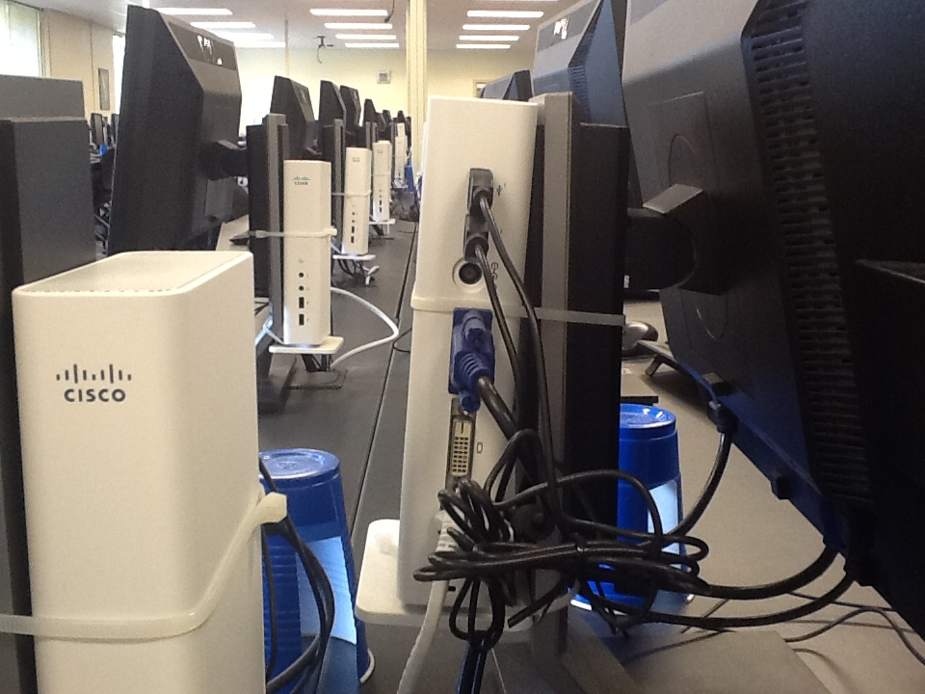

Slide 12
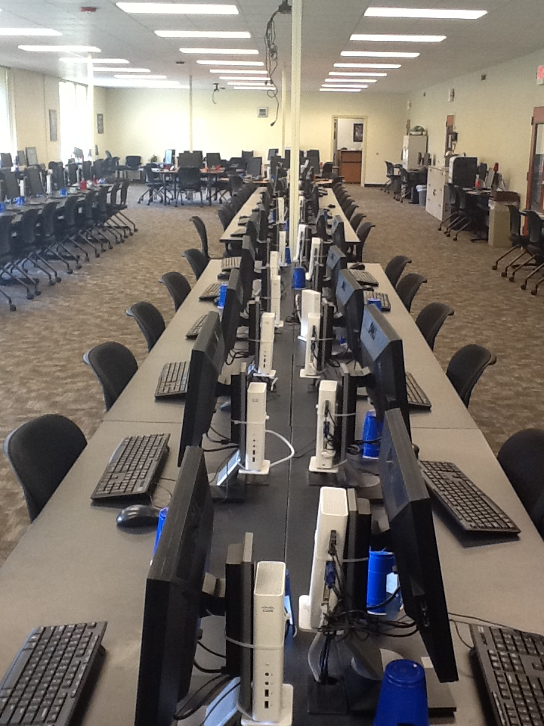

Slide 13
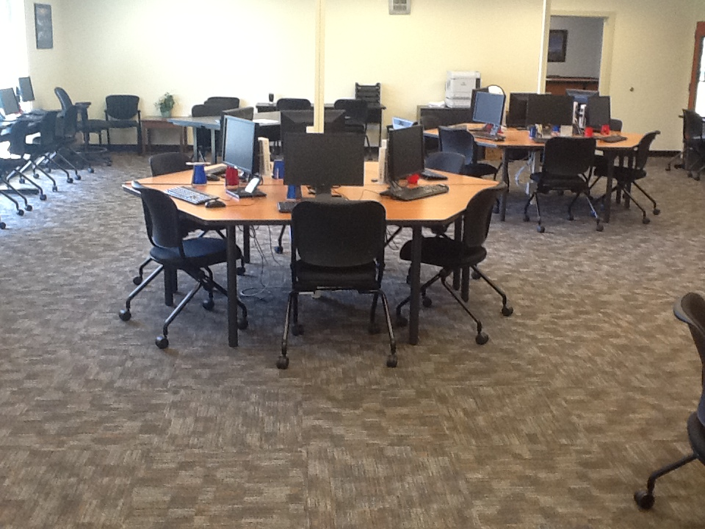

Slide 14
Cost Implications (cont.)
Client Type | Cost | Replacement in Years | Cost per Year
PC | $980 | 3 | $326.67
VXC | $360 | 5 | $72
VXC | $360 | 7 | $51.43

Slide 15
Cost Implications (cont.)
Based on the significant cost investment in the backend, we currently estimate our per thin client cost at $650.
As we add more the cost will go down
Mid-range goal is thin clients in all computer labs and kiosks
Long-range goal is to virtualize majority of faculty and staff computers as well

Slide 16
Conclusion
Virtualization has greatly reduced VSCC’s costs for computer labs
Labor has been reduced as well as the time necessary for changes
For more information about VSCC’s architecture
http://www.cisco.com/en/US/solutions/collateral/ns340/ns517/ns224/volunteer_community_cs.pdf

