Slide 1
Copyright Harriette L. Spiegel, 2012. This work is the intellectual property of the author. Permission is granted for this material to be shared for non-commercial, educational purposes, provided that this copyright statement appears on the reproduced materials and notice is given that the copying is by permission of the author. To disseminate otherwise or to republish requires written permission from the author.

Slide 2
Engaging Technologies and Reflection to Prepare Students (for Membership in the Larger Global Community)
Harriette L. Spiegel, PH.D.| May 31, 2012

Slide 3
STATEMENT OF THE PROBLEM OR ISSUE
Three facets of higher ed IT challenges –
how to provide students with basic information about learning technology and computer literacy;
how to prepare students to use online resources in responsible, knowledgeable and effective ways;
how to promote reflective thinking about one’s learning in a world of technological developments.

Slide 4
“at the end of this workshop…”
experiencing the development of the course
an opportunity to have hands-on practice in designing elements of such a course
a guidebook for designing such a course to contribute to preparing students for the today's global workplace.

Slide 5
CRUCIAL ELEMENTS
Familiarity with:
common computer applications and security issues,
the services offered by an institution’s library, including:
use of the library’s online resources
awareness of security, copyright and plagiarism issues.
Reflection assignments to produce the desired awareness of one’s learning

Slide 6
ORIGINAL INTENT, EXPANDED
to address the necessity to teach students the proper use of APA style in research writing
to provide activities for students to explore their own learning as Nurses (or other disciplines)
expansion of the content into the realm of basic computer literacy
available to students in other disciplines

Slide 7
THE COURSE: Learning Technology for Nurses
Overview of learning technology used in training and practice
Delivered online
Orientation to learning tools in Blackboard, on the Web and in basic applications (Word, Excel, PowerPoint)
Reflective activities: one’s own learning, Security, Copyright and Plagiarism

Slide 8
IMPACT OF COURSE
The importance of IT to an institution’s goals (implications for libraries of digital developments):
“The institutions and governments that fund academic libraries want to understand if we are advancing college/university goals, supporting users' objectives….” James G. Neal of Columbia University
(http://www.educause.edu/EDUCAUSE+Review/ EDUCAUSEReviewMagazineVolume46/ProspectsforSystemicChangeacro/226178) -

Slide 9
IMPACT OF COURSE
The 2011 ECAR National Study of Undergraduate Students and Information Technology – http://www.educause.edu/ecar.
Diana Oblinger - The common assumption that students are technology gurus is challenged in the study. The majority of students are not advanced technology users. (Foreword)
Notes:
In the Foreword, Diana Oblinger
The common assumption that students are technology gurus is challenged
in the study. The majority of students are not advanced technology users.
The Executive Summary on p. 2
If there is one resounding message about undergraduate perceptions
about technology in higher education, it is this: Technology could be
used much more strategically to engage students in academic life.

Slide 10
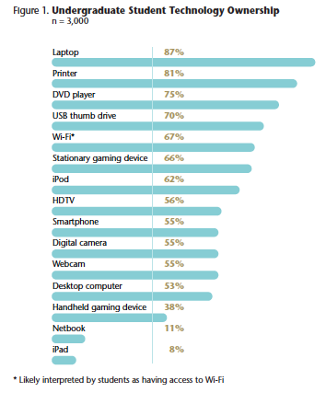
p. 8

Slide 11
TEACHING STRATEGIES
Guided, independent exploration of technology
Use of communication tools to reflect one’s learning with technology
Five three-week modules
Variety of activities and assignments: wiki, blog, voice tools, discussion board, mobile applications

Slide 12
Course Structure
I. Orientation and exploration of course and Blackboard;
II. Word Processing and presentation applications;
III. Research;
IV. Spreadsheet applications;
V. Copyright, Plagiarism & Security; Final Project. A Final Project provided both an opportunity for students to apply the knowledge learned and a means of evaluation of their progress.

Slide 13
COURSE MENU
Introduction – Start Here
Five 3-week modules
Variety of tools – Bb Email, Blog, Discussion Board, Wiki, Voice Tools, External Links.

Slide 14
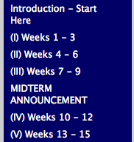
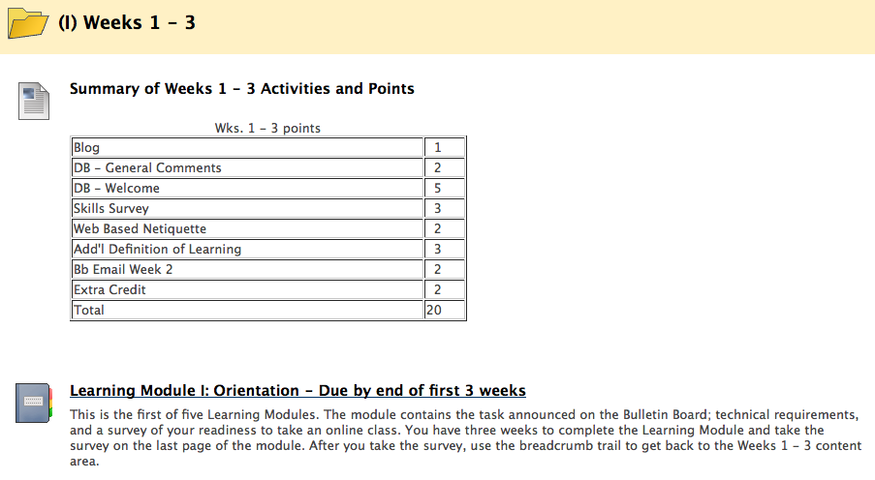

Slide 15
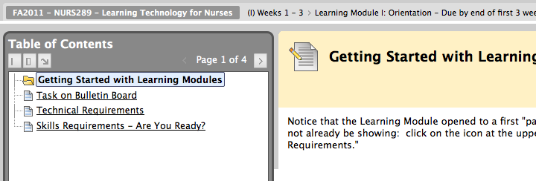
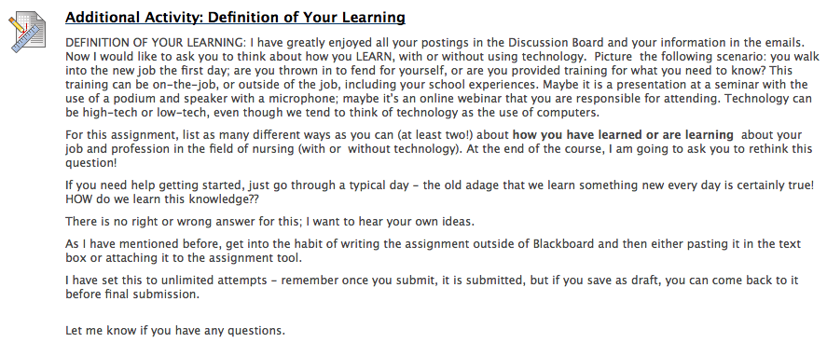

Slide 17
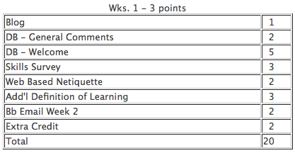
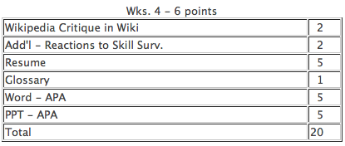
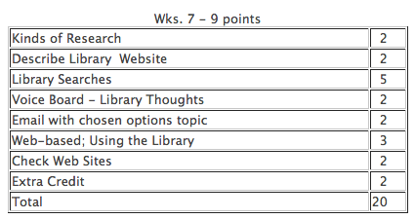
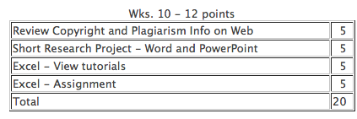
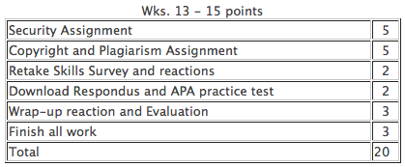

Slide 18
Example assignment: Orientation to learning tools in Blackboard, on the Web and in basic applications (Word, Excel, PowerPoint)
--Send instructor a message using Blackboard email
--Critique of Wikipedia in Bb Wiki (compare results from searches)
--Create a Word document using APA style; create an Excel spreadsheet; create a PowerPoint using guidelines.

Slide 19
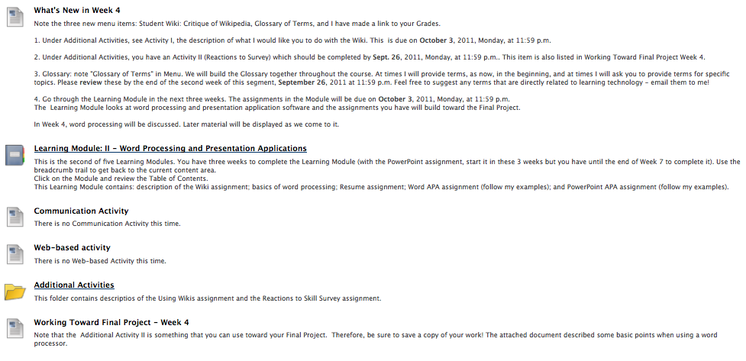

Slide 20
Example Reflective activities: one’s own learning, Security, Copyright and Plagiarism
--Reflecting on before/after results of survey on computer literacy
--Reflecting on personal experience with computer security, guided questions
--Reflecting on copyright and plagiarism after reviewing assigned material on library site

Slide 21
Security Assignment
Using the Web sites in the menu area of the course, AS WELL as your own searches, click on the Assignment tool and answer the questions below regarding computer security.
1. Which organization provides an Internet connection to your computer(s)?
2. Describe what it was like the first time you lost data - either by forgetting to SAVE, or as a result of a virus attack or similar happening.
3. Do you regularly change your password? after reading the computer security information, describe in your own words WHY it's important to change your password regularly.
4. What kind of security protection does your computer have? (Macafee, Microsoft Forefront, Norton or many more - check with your computer administrator or Internet service provider.)
5. In your own words, describe what computer security is and what the computer user should do to be secure.

Slide 22
STUDENT REFLECTIONS
I learn new knowledge and retain information best by doing it and this class helped me in that aspect of learning
I was completely at a loss with Blackboard, Excel, and other programs before this class.
What is most important is to know where to find information, if the answer is not known. This course has been very valuable in making me aware of resources available to me.

Slide 23
STUDENT REFLECTIONS
Now I will have no problem with research on future papers since I know how to use various resources
I hope that nursing programs will incorporate more learning technology into their curricula.
I personally see being technologically literate as a component of being a professional
this course should be required of all students before graduating….
it needs to be a prerequisite for online courses

Slide 24
THINGS THAT WILL CHANGE, I WILL DO DIFFERENTLY
Simplifying the modules
Be stricter on deadlines
Final Project will be cumulative
See Additional Resources

Slide 25
WORKSHOP EXERCISE
Think of the ways that your students could benefit from more orientation to the technology they use in their learning (and everyday use)
What are some online resources students should know about?
What is missing in your students’ knowledge about how to use online resources?
How does knowledge of learning technology impact preparation for the future?

Slide 26
Workshop topics – your turn
1 Think of ways that your students could benefit from more orientation to the technology they use in their learning (and everyday use). What would be the objectives of the course you would design to provide this orientation? | 2 What are some online learning resources at your institution that students should know about? How would you include the use of these resources in a technology orientation course?
3 What is missing in your students’ knowledge about how to use online resources? What kinds of online resources do your students use? What is done at your institution to orient students to issues in online resources: library resources, security, copyright, plagiarism)? | 4 How does knowledge of learning technology impact students’ preparation for “membership in the larger global community”? How does reflection play a part? Describe how you would use reflection in a technology orientation course.

Slide 27
Guidebook
Who are the students?
What is the material to be included?
When (how often) is work due, new material presented?
Where does the course take place – face-to-face, online?
How is the material presented; how do students learn?
How much is “just enough,” or “too much,” or “not enough”?
WHY is the course being developed and taught?

Slide 28
What else?
What are the basics that all students should know about technology use? Why does it matter? What can you do about it?
What does the future of education look like if these issues are not addressed?
How do all the developments in social networking and mobile applications affect course design in the context of the presentation?
How does the growing use of online courses impact the quality and depth of instruction – online or face-to-face?
How can the perceived conflict between the “digital natives” and “digital immigrants” be resolved in terms of “how much do how many and who need to know?”
How will such a course grow and change as digital developments continue?
How can I apply what I have learned to my own institution?…

Slide 29
resources
The 2011 Horizon Report (The New Media Consortium and ELI) - http://www.educause.edu/Resources/2011HorizonReport/223122.
Marc Prensky – Twitch Speed
http://www.games2train.com/site/html/article.html
The 2011 ECAR National Study of Undergraduate Students and Information Technology - http://www.educause.edu/ecar

Slide 30
additional
On INSTTECH listserv: 16 May 2012 to 17 May 2012 (#2012-91) -information literacy/library skills tutorial at Northshore Community College:
http://libguides.northshore.edu/InformationLiteracy_Tutorial

Slide 31
THANK YOU hspiegel@utm.edu

