Slide 1
Social Media on Campus SERC12
Patsy Carruthers
Director, Academic Technology Group
University of Kentucky
Information Technology
EDUCAUSE SE
May 31, 2012

Slide 2
pcarr3@uky.edu @connectedcampus patsy.carruthers@gmail.com
© Patsy C. Carruthers 2012
Permission is granted for this material to be shared for non-commercial, educational purposes, with attribution.

Slide 3
Social Media on Campus
Landscape – Where We Live Online
The Big Two Facebook, Twitter
Plus One Google, Google Plus
Using Media YouTube, Flickr/Flickr Commons
#getorganized – Making Sense of It
Pull It Together Tags, Hashtags, Circles
Tell a Story Storify
Put It Together Flipboard
Much More to Explore

Slide 6
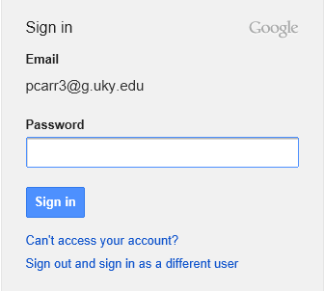
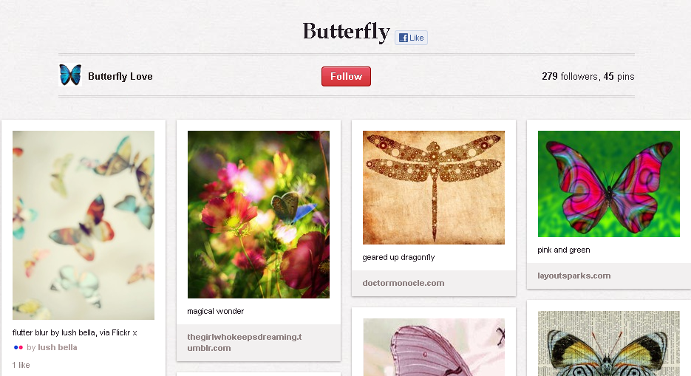

Slide 7
Beware the “Creepy Treehouse” …
By Bernard Ferrell / Flickr

Slide 8
#getorganized
Tags/Circles/Groups/Closed vs. Open
Twitter
Flickr
Google Plus
Facebook
And others
Choose Tools and Apps that can help
Storify
Flipboard
Find your favorite

Slide 9
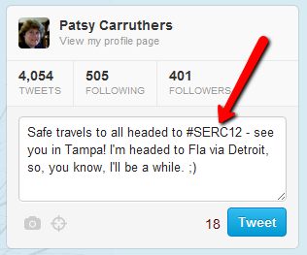
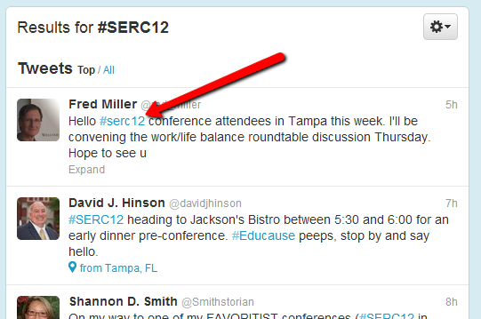
Twitter
Use hashtags: a word preceded by a #
Before deciding on a hashtag to use, search in Twitter to see if anyone else is using it.
If not, start using it. It’s that simple

Slide 10
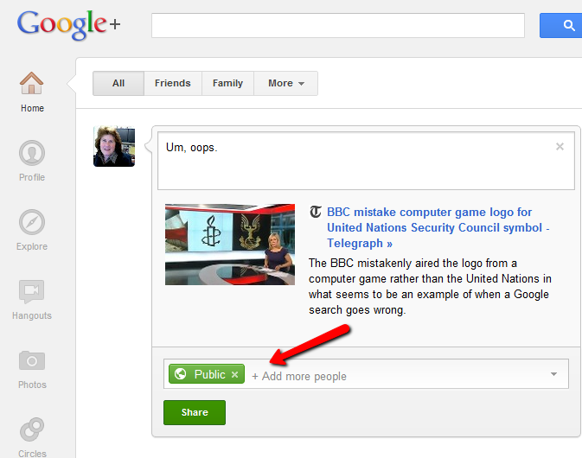
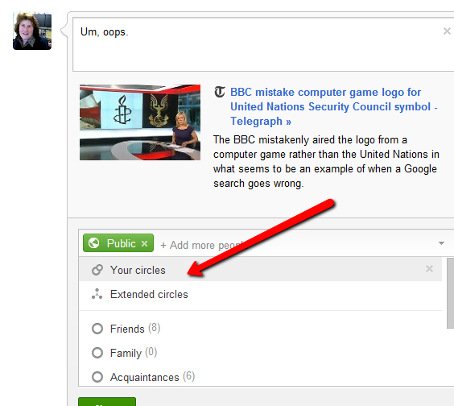
Google+
Set up Circles – they define your contacts
Share with Public, all your Circles, or only certain Circles.

Slide 11
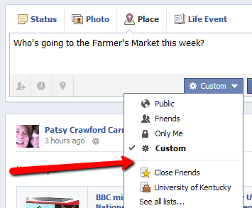
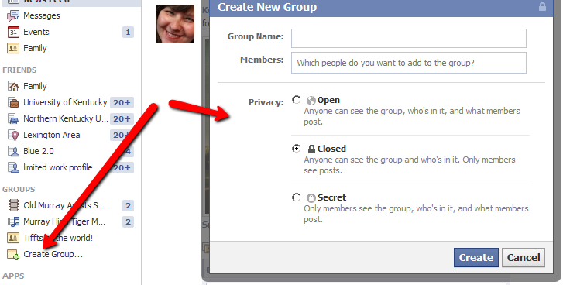
Facebook
Define groups of friends
Set a default for sharing, change anytime
Set up a group for sharing in public or private

Slide 12
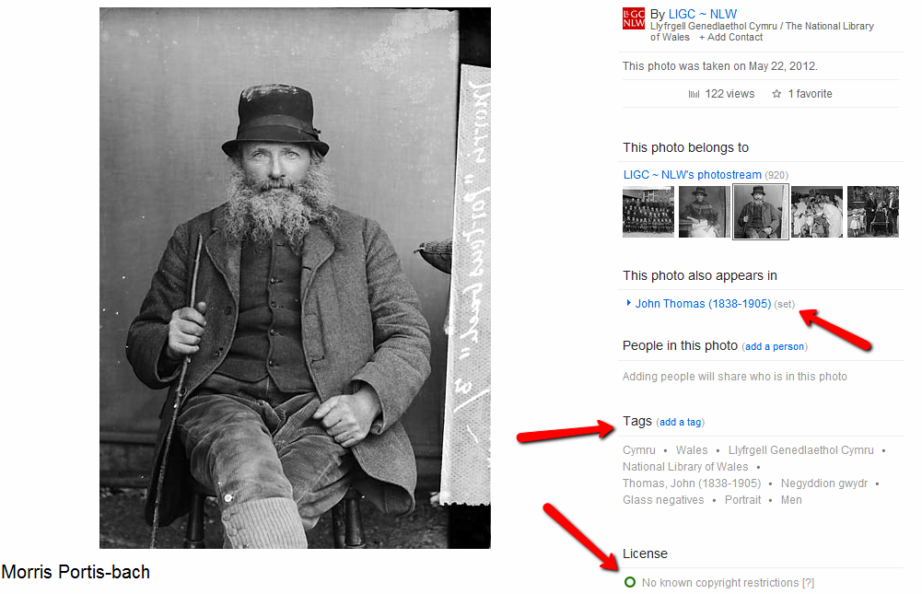
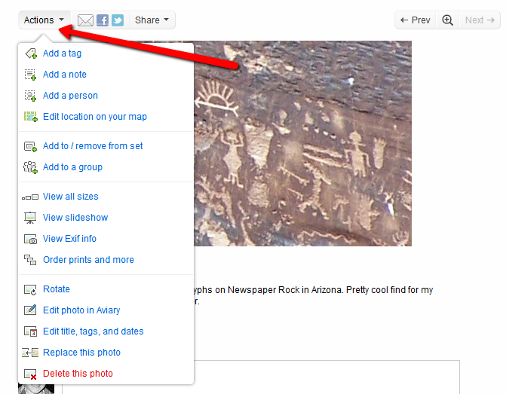
Flickr
Tag everything with at least one identifier
Create sets
Explore Commons (http://flickr.com/commons)

Slide 13
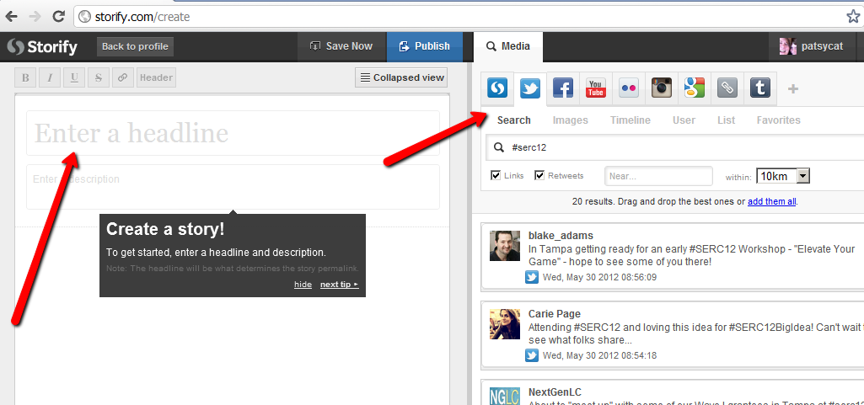
Storify
Choose a topic.
Choose the media.
Search and add to create in Storify
Example: http://storify.com/patsycat/social-media-on-campus

Slide 14
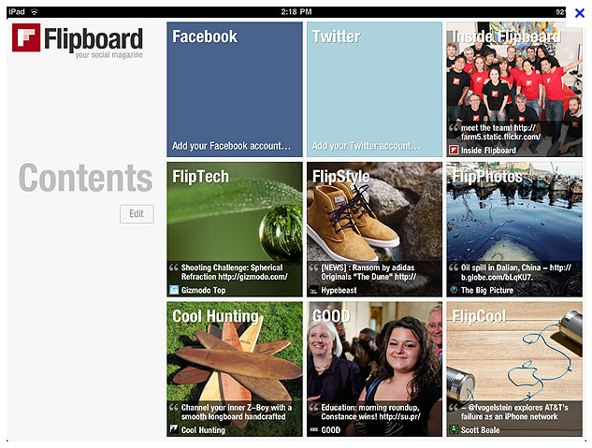
Flipboard
Download the app
Select items to include in your “magazine”

Slide 15
Explore More
YouTube (tag, organize, share)
VoiceThread (record, organize, comment)
Pinterest (visualize, share images, organize)
Path (app for organization and sharing)
Explore more tools to share thoughts, images, video, news …
Think about: How can you organize and integrate content and usage?

Slide 16
pcarr3@uky.edu @connectedcampus patsy.carruthers@gmail.com
http://storify.com/patsycat/
Get this presentation and materials: http://go.uky.edu/serc2012

