Slide 1
A Digital Story
How to create a digital story

Slide 2
Stage One
Define
Collect
Decide

Slide 3
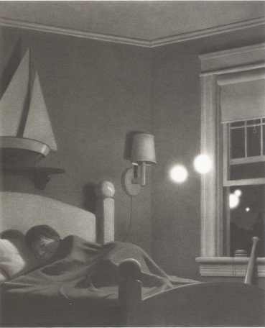

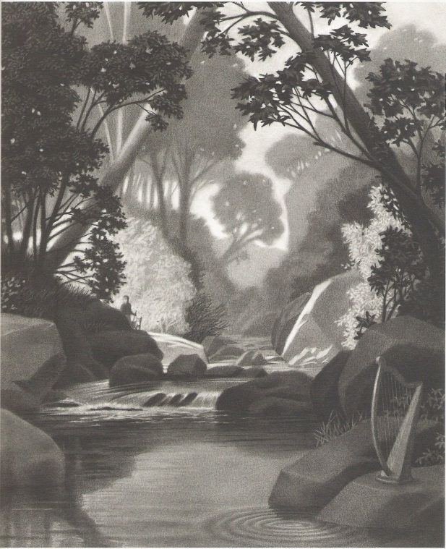
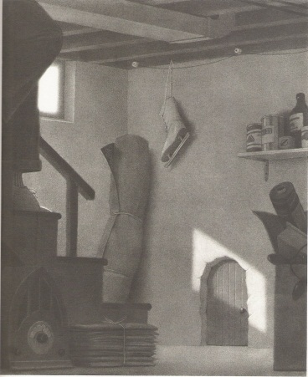
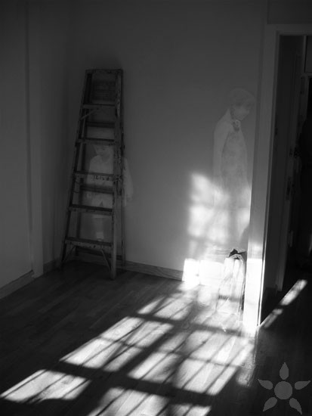
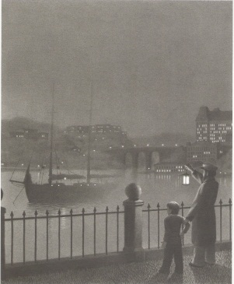
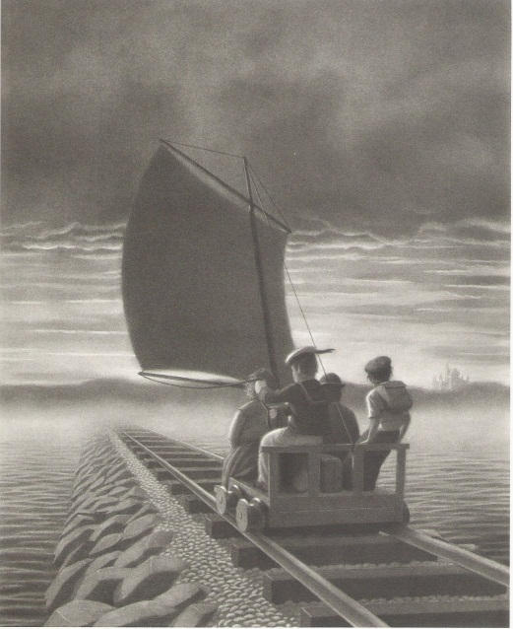
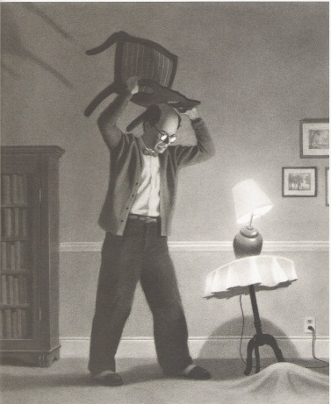
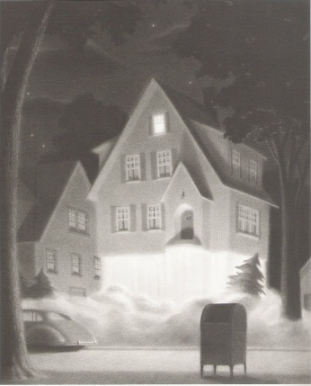
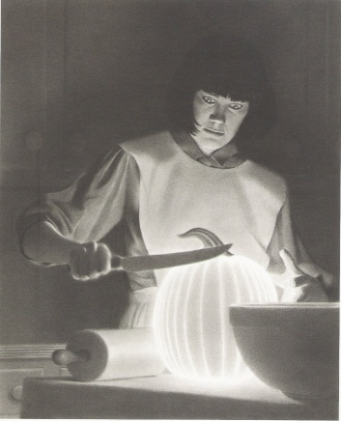
The
Unexplained

Slide 4
Martians

Slide 5
Strange
Phenomenon

Slide 6
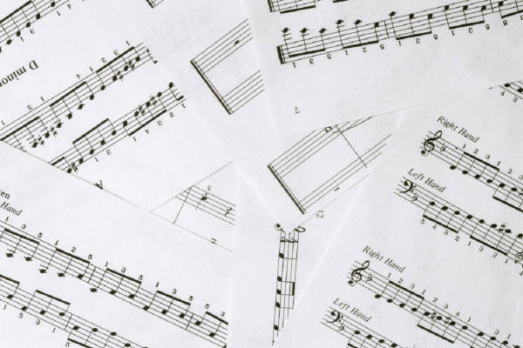

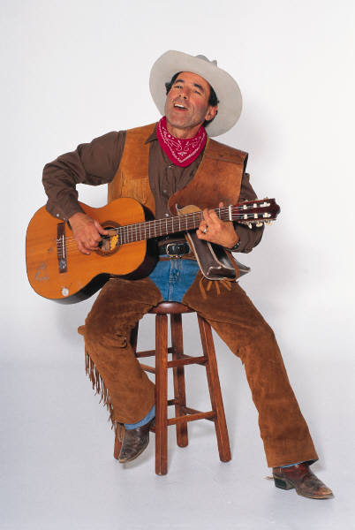
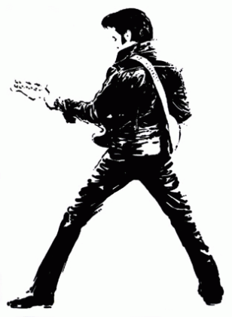
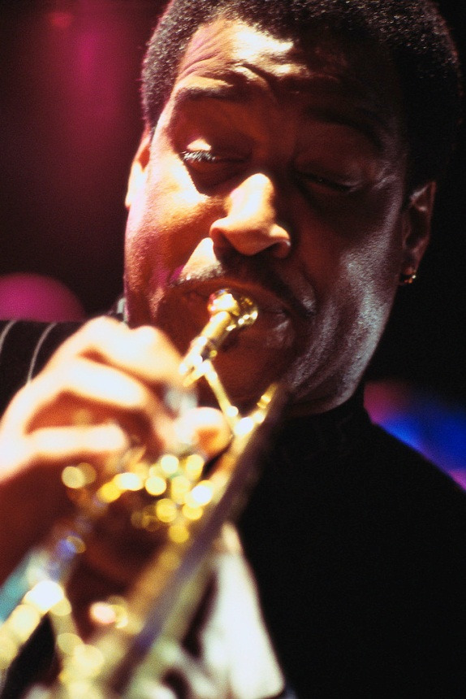
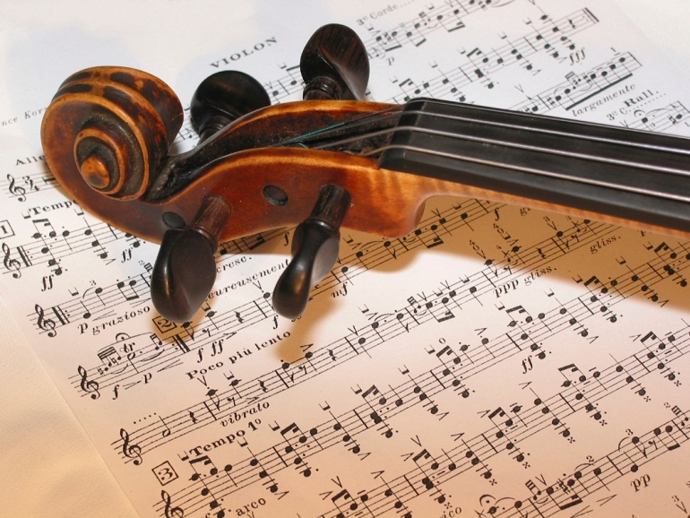
Smooth and Jazzy

Slide 7
Country Gritty

Slide 8
Soothing Classical

Slide 9


Slide 10
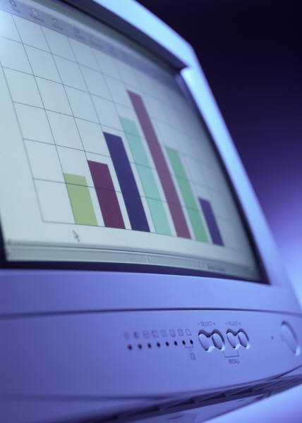
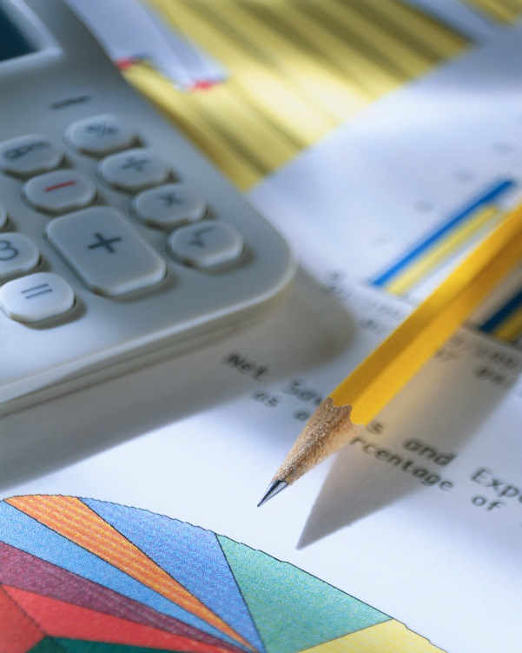


Slide 11



Slide 12
Define, Collect, Decide
Topic
Organization
Images
Audio
Information
Purpose

Slide 13
Stage Two
Select
Import
Create

Slide 16





Slide 17
Select, Import, Create
Images
Audio
Content
Import images
Import audio
Modify

Slide 18
Stage Three
Decide
Write
Record
Finalize

Slide 19

Strange
Phenomenon

Slide 20
Storyboard
Script of narration & music
Script of narration & music
Script of narration & music

Slide 21



Slide 22
Decide, Write, Record, Finalize
Purpose and Point-of-View
Write script
Record
Finalize movie

Slide 23
Stage Four
Demonstrate
Evaluate
Replicate

Slide 24



Slide 25



Slide 26
Demonstrate, Evaluate, Replicate
Share
Collect feedback
Teach

Slide 27


Slide 28


Slide 29


