Slide 1
Welcome to the 2013 EDUCAUSE Southeast Regional Conference Elevate Your Game: Content, Networking, and Next Steps. How to Make the Most of Your Conference Experience
Bill White, Valencia College
Lida Larsen and Julie Little, EDUCAUSE
May 29, 2013
Notes:
Some informal shout outs and connecting them as they are gathering – trivia quiz about the conference? (what was for lunch? Where is the connect lounge? Etc)

Slide 2
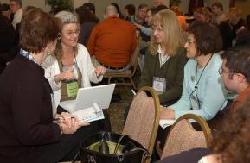
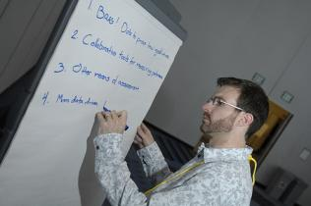
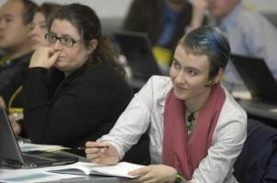
Today’s Agenda
Introductions
Conference networking opportunities
Navigating the conference experience
Getting the most out of your time here
After this week
Notes:
Lida – very brief – things to talk about

Slide 3
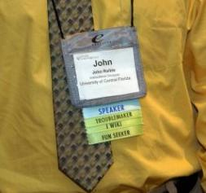
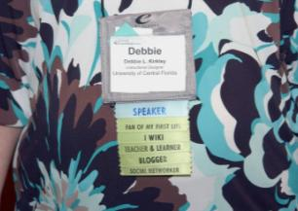
Introductions
At your tables:
Name and Institution
Title (or what do you do?)
Why did you decide to attend this conference?
What questions do you have for those who have attended before?
Goals for the next three days?
Information and networking needs
Specific things/answers you are hoping to find here
Notes:
Required - Main Body Slide

Slide 4
Engage with the Community
Networking Opportunities

Slide 5
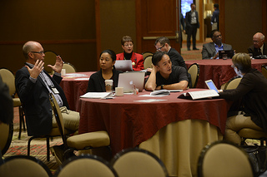
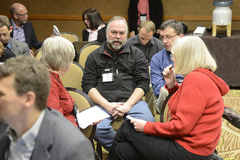
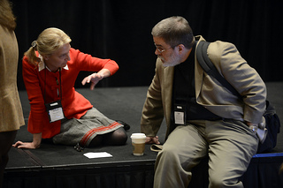
Networking Opportunities
Affinity ribbons/stickers
Welcome reception
Lunch and breaks
Network over dinners
Create, capture, be a reflective practitioner
Blogs, Twitter, Flickr, YouTube
and, of course,
Be an active participant in the sessions you attend!
Ask questions.
Contribute to discussions during and after sessions.

Slide 6
Navigating the Conference
Learning and Engagement Opportunities

Slide 7
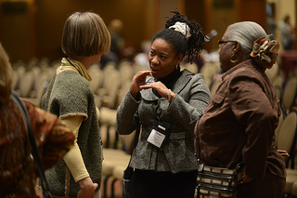
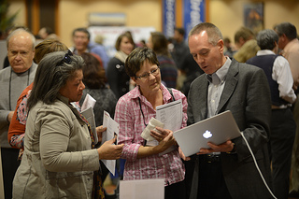
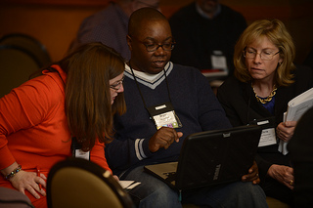
Learning and Engagement
Opportunities with practical take-aways and lessons learned
Pre-conference activities, corporate displays, and more
General sessions
Track sessions
Poster sessions
Discussion sessions
Workshops
Lunchtime roundtables
Post-conference resources

Slide 8
The Conference Program
General Sessions

Slide 9
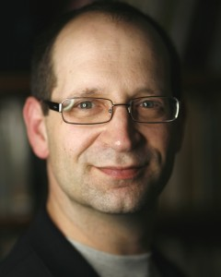
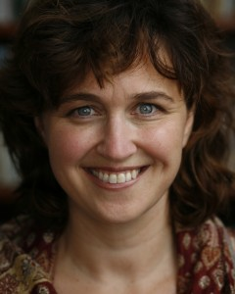
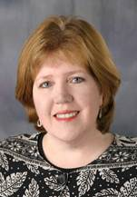
Conference Program
General Sessions
Paul Glen and Maria McManus
CEO and VP
Leading Geeks
Today @ 1:00
They Just Don’t Get It: Seven Ways Geeks and Non-Geeks Can Get Along
Terri Manning
Associate VP for Institutional Research
Central Piedmont Community College
Friday @ 10:15
Generations in the Classroom: New Complexities in Teaching and Learning

Slide 10
Conference Program
Continuous Improvement

Slide 11
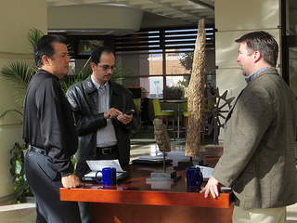
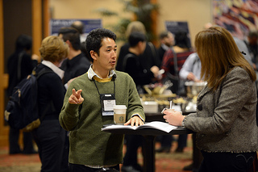
Continuous Improvement for us requires that YOU provide feedback
Here’s three ways:
EDUCAUSE Staff gathering feedback
Session evaluations
Overall conference evaluations
Feedback is essential to continuous improvement – as a speaker and as a conference host.

Slide 12
Engage with EDUCAUSE
and EDUCAUSE Staff

Slide 13
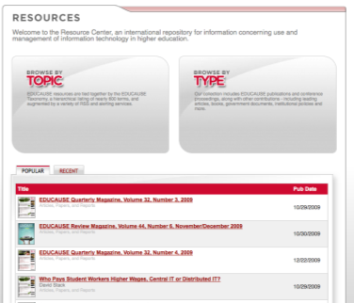
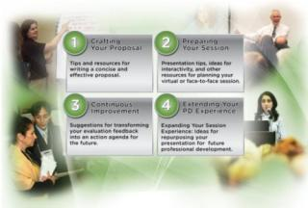
Explore our many resources. . .
Explore PD opportunities
http://www.educause.edu/careers
Join constituent groups
http://www.educause.edu/discuss
Attend free EDUCAUSE Live! seminars
http://www.educause.edu/live
Download traditional and rich media
http://www.educause.edu/library
Volunteer and grow expertise
http://www.educause.edu/volunteer

Slide 14
Making the Most of the Conference
How will YOU make the most of the conference?

Slide 15
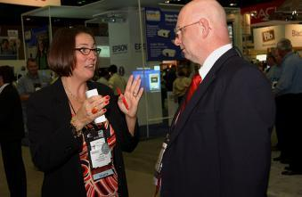
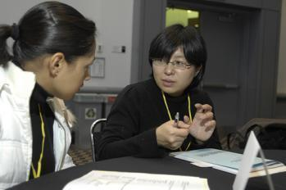
How will you make the most of the conference?
Jot down some ideas about the things you might do
while you are here at the conference
to remember ideas and people
to share ideas with others back on campus
when you return to campus three or six months from now

Slide 16
Ideas for Making the Most of the Conference

Slide 17
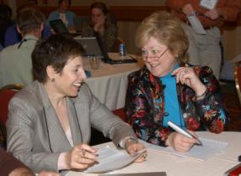
10 ways to get the most out of the conference
Review the program with colleagues to decide which sessions to cover (do this every time you attend a conference).
Attend sessions that will introduce you to new ideas, rather than those where you might feel the most comfortable (professional stretch).
Plan how you will disseminate new information when you return.
Adapted from… Ideas to Action: Ten Hints for Getting the most from a Conference. Joan Getman and Nikki Reynolds. EDUCAUSE Quarterly, No. 3, 2002
Notes:
Optional – Main Body Slide Option B
No header background image.

Slide 18
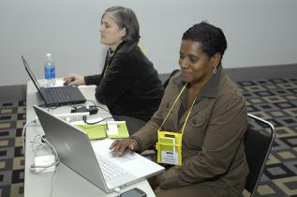
10 ways to get the most out of the conference
Understand the constraints on, and opportunities for, how much you’ll be able to do when you return. You’re not alone in feeling overwhelmed by the challenge of acting on the good ideas that you encounter.
Use your laptop or mobile device to send yourself “to do” reminders for when you return.
Adapted from… Ideas to Action: Ten Hints for Getting the most from a Conference. Joan Getman and Nikki Reynolds. EDUCAUSE Quarterly, No. 3, 2002
Notes:
Optional – Main Body Slide Option B
No header background image.

Slide 19
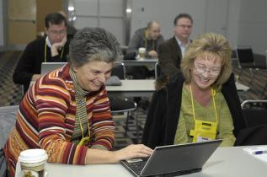
10 ways to get the most out of the conference
Talk to people at sessions to create a network of colleagues.
Write a summary of what you learned and think of audiences outside your own organization who might find the information useful.
After returning home, set up an action plan with milestones and resolve to carve out the time to reflect on and assess what you have learned.
Adapted from… Ideas to Action: Ten Hints for Getting the most from a Conference. Joan Getman and Nikki Reynolds. EDUCAUSE Quarterly, No. 3, 2002
Notes:
Optional – Main Body Slide Option B
No header background image.

Slide 20
10 ways to get the most out of the conference
Pass good ideas on to your staff. Commit to sharing with them, and discuss together what makes sense to implement or aim for within the IT operation and institutional mission.
Realize that the effect of attending the conference could be as subtle as a change in attitude.
Adapted from… Ideas to Action: Ten Hints for Getting the most from a Conference. Joan Getman and Nikki Reynolds. EDUCAUSE Quarterly, No. 3, 2002
Notes:
Optional – Main Body Slide Option B
No header background image.

Slide 21
Elevate Your Game: Taking "IT" Home
and Your Important Next Steps

Slide 22
Elevate Your Game: Taking "IT" Home and Your Important Next Steps
See slide show in this session resource area to obtain important tips and resources on how to take all you’ve learned at the conference and put it to good use when you return to your institution.
Ways to capture the networking/connections you've made at the conference and further develop these new professional relationships,
Your learning experiences and how to make good use of new ideas by taking personal action and sharing valuable content with others--including a quick dive into a conference report template, and
The next professional development steps for YOU!
Notes:
Optional – Main Body Slide Option B
No header background image.

Slide 23
Here’s to a Terrific Learning and Networking Experience!
Bill White bwhite@valenciacollege.edu
Lida Larsen llarsen@educause.edu
Julie K. Little jlittle@educause.edu
Notes:
Optional – Main Body Slide Option B
No header background image.

