Slide 1
Elevate Your Game: Taking "IT" Home and Your Important Next Steps
Lida Larsen and Julie Little, EDUCAUSE
May 2013
Notes:
Some informal shout outs and connecting them as they are gathering – trivia quiz about the conference? (what was for lunch? Where is the connect lounge? Etc)

Slide 2
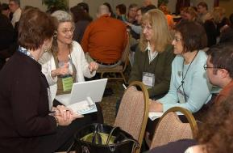
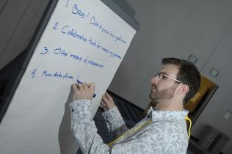
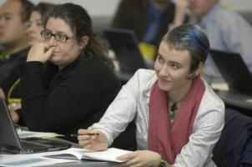
Today’s Agenda
Introductions
Assembling what we’ve learned/gained
  Ah Ha Experience
  Content Experience
  Connections and Networking Experience
Taking your comprehensive experience back to campus
Identifying your next professional development steps
Notes:
Lida – very brief – things to talk about

Slide 3
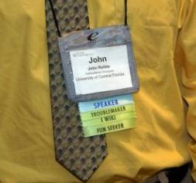
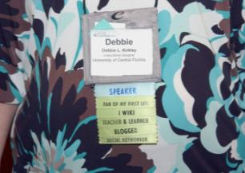
Introductions
At your tables:
Name and Institution
What did you learn and how will you use it back on campus?
Who did you meet and how will they help you in the future?
Notes:
Required - Main Body Slide

Slide 4
Assembling What We’ve Learned/Gained
Keep a running list of the things you’ve learned and who you’ve met while at the conference.

Slide 5
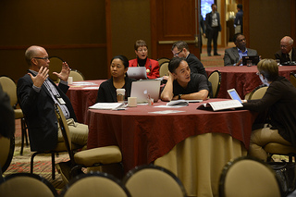
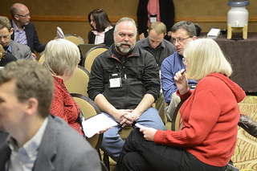
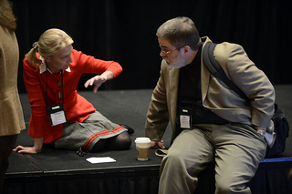
Ah Ha Experience
What was your most memorable moment/quote
What is your biggest takeaway?

Slide 6
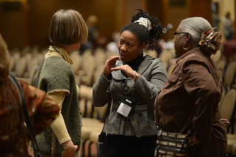
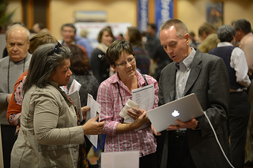
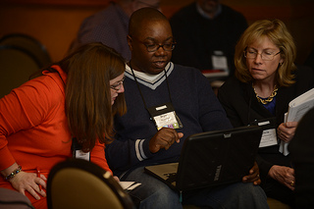
Content Experience
Specifically -
Did you learn something new?
What did you learn that will help you to do your jobs better?
What did you learn that provides insights into challenges/opportunities across the higher education/IT landscape?

Slide 7
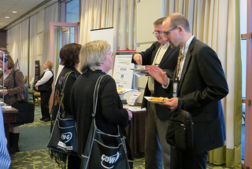
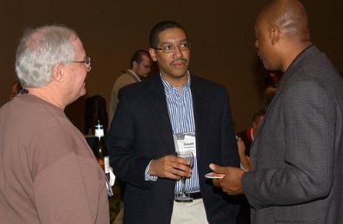
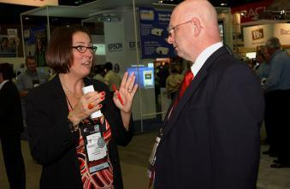
Connections/Networking Experience
Are you taking back names/contact information that you’ll use over the coming year?
How did/will they help you?
How will you stay in touch?

Slide 8
Taking Your Experience Back to Campus

Slide 9
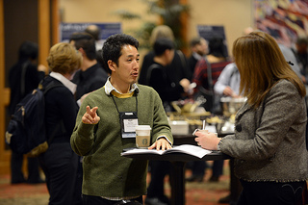
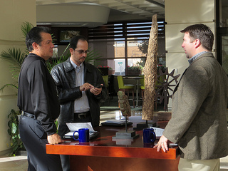
Learning and Engagement = Knowledge
What did you learn from other’s experiences and from sharing yours?
  Practical advice
  New information
  New tools
  Handy tips
  New skills and attitudes
  Confirmation there are others facing similar issues

Slide 10
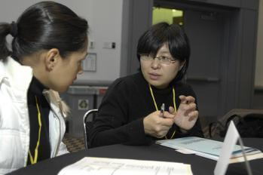
Sharing IT back on campus . . .
Conference trip report
Staff meeting discussion
Delegate ideas to staff and colleagues
Around water cooler convos
    What else will you do?

Slide 11
Conference Report
See session resources: EDUCAUSE-conference-report.docx
Notes:
Optional – Main Body Slide Option B
No header background image.

Slide 12
Basic Conference Trip Report Content
Header
  Conference Title, Date, Location, Your name and Institution
Introduction
  Offer a general statement about the value of the conference to you and your work. Include a statement of gratitude for the opportunity to attend the event.
Networking
  Who (institutional and corporate) did you meet and how will this connection be helpful in the future?
Wider Sharing
  How did you share information from your work at your institution with others at the conference?

Slide 13
Basic Conference Trip Report Content
(con’t.)
Strategic Issues
  How does the conference content relate to the strategic issues at your institution?
  What specific actions are you taking to incorporate what learned into your own work?
Discovering Solutions
  What did you specifically hear about in terms of ideas, tips, tools, resources, etc., that you are bringing back to your institution that will have an immediate impact?
  ... or inform future decisions and program implementations?
  What useful technology-related insights did you garner at the conference?

Slide 14
Basic Conference Trip Report Content
(con’t.)
Improving Speaking Skills/Content Delivery
  How did what you hear and see in the various conference presenters’ styles inform your own ability to speak and share information in the future?
Next Steps
  How have you changed as a result of attending the event and what steps will you take to act on these changes?
THANK the person who signed your travel request form!

Slide 15
Your Next Professional Development Steps

Slide 16
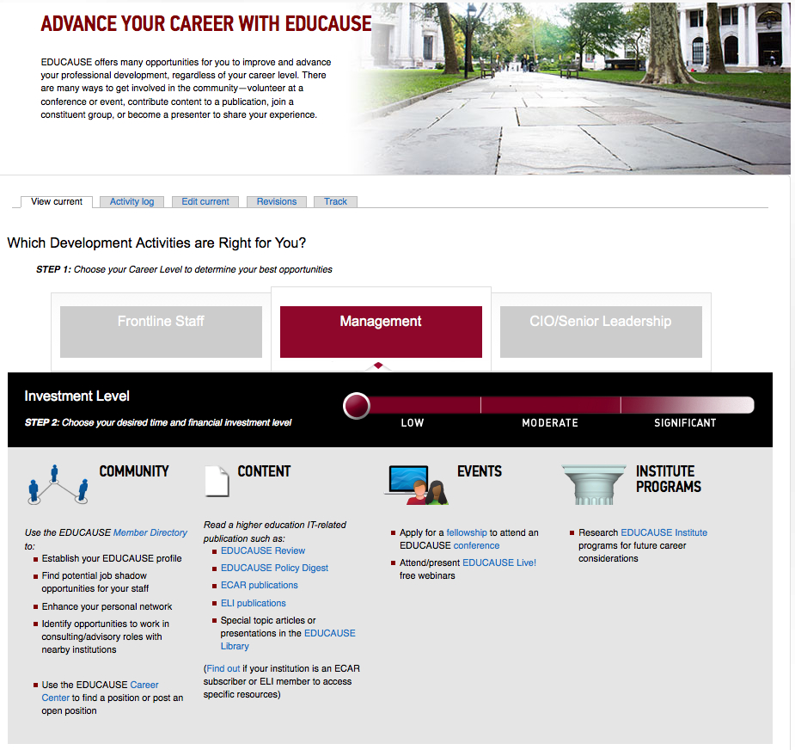
PD “Wayfinding Grid” www.educause.edu/careers/advance-your-career-educause

Slide 17
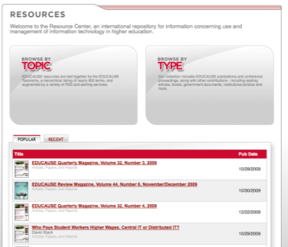
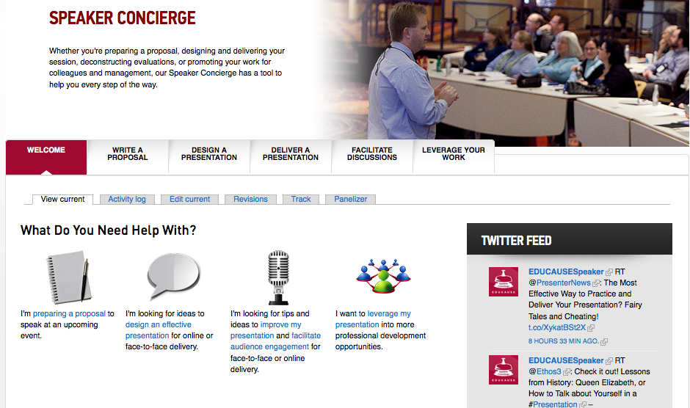
What’s Next for You?
Explore a wealth of PD opportunities www.educause.edu/careers
Grow your networks in constituent groups www.educause.edu/discuss
Attend free EDUCAUSE Live! seminars www.educause.edu/live
Mentoring is a career development tool www.educause.edu/mentoring
Volunteer and grow expertise www.educause.edu/volunteer
Notes:
Julie talks next steps

Slide 18
Justification Letter
See session resources: EDUCAUSE-conference-justification.docx
Notes:
Optional – Main Body Slide Option B
No header background image.

Slide 19
Elevate Your Game: Taking "IT" Home and Your Important Next Steps
Make the best use of everything you heard and everyone you met!
Lida Larsen: llarsen@educause.edu
Julie Little: jlittle@educause.edu
May 2013

