Slide 1
“A Transformational Leadership and
Staff Development Program”
Kathy Snizaski (1-1-1-1)
Susan Reeves (2-1-1-2)
Steve Fullerton (2-2-1-1)

Slide 2
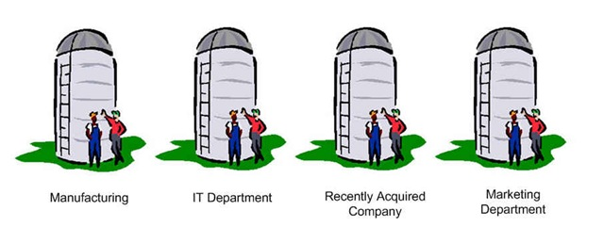
Why?
Clemson University
20,000 students
5,000 faculty and staff
Clemson Computing & Information Technology
353 Employees
28 Different Locations Across State
Networking
Programming
Data
Support
Notes:
2

Slide 3
Program Goals
Break Down Silos
Broaden staff knowledge base
Align strengths with opportunities
Empower individuals
Mentor future leaders
Encourage and develop critical thinkers
Networking
Programming
Data
Support
COMMUNICATING
Notes:
3

Slide 4
Learning Outcomes
Change Management
Less fear: Willingness to take risks
Coaching
Empower individuals
Creativity
Encourage and develop critical thinkers
Collaboration
Improved internal communication
Notes:
4

Slide 5
Implementation
Four Sessions per Year
50 Seats Each Session
Participants are Nominated
Notes:
5

Slide 6
Team Creation
Five Teams of 10
Different Thinking Styles
Hermann Brain Dominance Instrument (HBDI)
Different Departments
Cannot be in group with their Supervisor
Each Team is Assigned a Mentor (nominated from previous session)
Notes:
6

Slide 7
Class Activities
Patrick Lencioni’s Five Dysfunctions of a Team
Trust
Most Proud Moment at CCIT?
Debrief their HBDI
Whole Brain Walk Around: Employee Recognition
Coaching Methodology & Conversations
Dan Pink's Whole New Mind
new ways to collaborate and create
Project Assignment to Implement new Communication Tools
Notes:
7

Slide 8
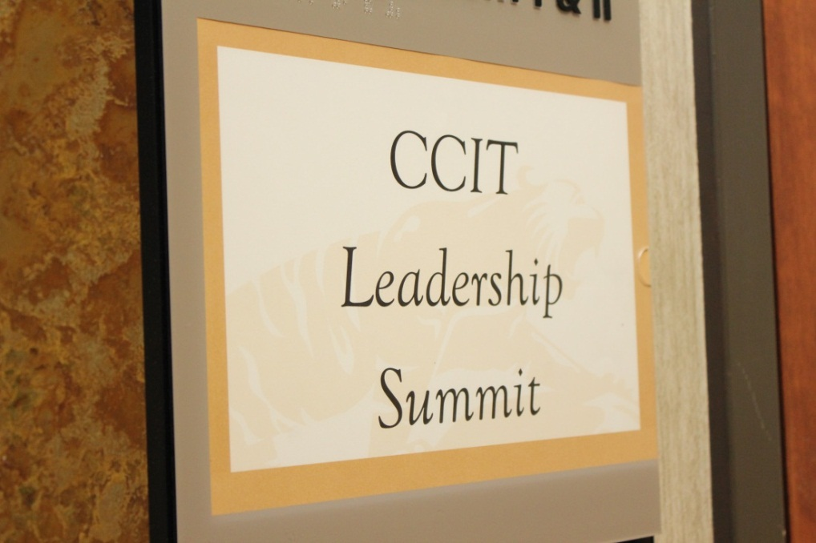
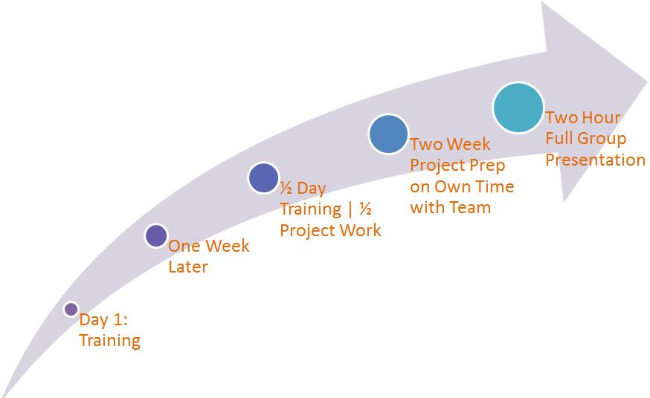
Commitment
Notes:
8

Slide 9
Project Assignment
Executive Summary
Each Team has a Portion of the Project
Two Weeks to Complete
Present to Clemson University Family

Slide 10
Inspired Programs
Staff Internship and Shadowing
Influenced Clemson’s HR On-Boarding Program
Influenced Clemson Public Affairs Staff/Faculty Communications
“Talk2Me” (CCIT Leadership Summit Season 2)
Building a Coaching Culture Seminar
Team HBDI Reviews
Manager’s Retreat
CCIT’s First Formal
Staff Recognition Program
Notes:
Editorial Guidelines on Bullets:
1. Vertical lists are best introduced by a grammatically complete sentence followed by a colon. No periods
are required at the end of entries unless at least one entry is a complete sentence, in which case a period
is necessary at the end of each entry.
Example: A university can be judged by three measures:
· The quality of its students
· The quality of it faculty
· The quality of its infrastructure
2. If a list completes the sentence that introduces it, items begin with lowercase letters, commas or semicolons
(if individual items contain commas) are used to separate each item, and the last item ends with a period.
Note that the introductory clause does not end with a colon.
Example: A university can be judged by
· the quality of its students,
· the quality of its faculty,
· the quality of its infrastructure.
3. Avoid mixing sentence and nonsentence items in a bulleted list.
10

Slide 11
Recognition and Reward
The Need for Recognition is Universal.
Extrinsic Factors
Intrinsic Factors
Achievement & Motivation are Ubiquitous
Notes:
11

Slide 12
Creating a Recognition Program
Get top level buy-in
Form a committee from all levels of organization
Set up award guidelines
Spread the word
Evaluate the nominations
Select the awardees
Notes:
12

Slide 13
Three Key Components
Targeted Audience
Timely Nominations
Public Recognition
Notes:
13

Slide 14
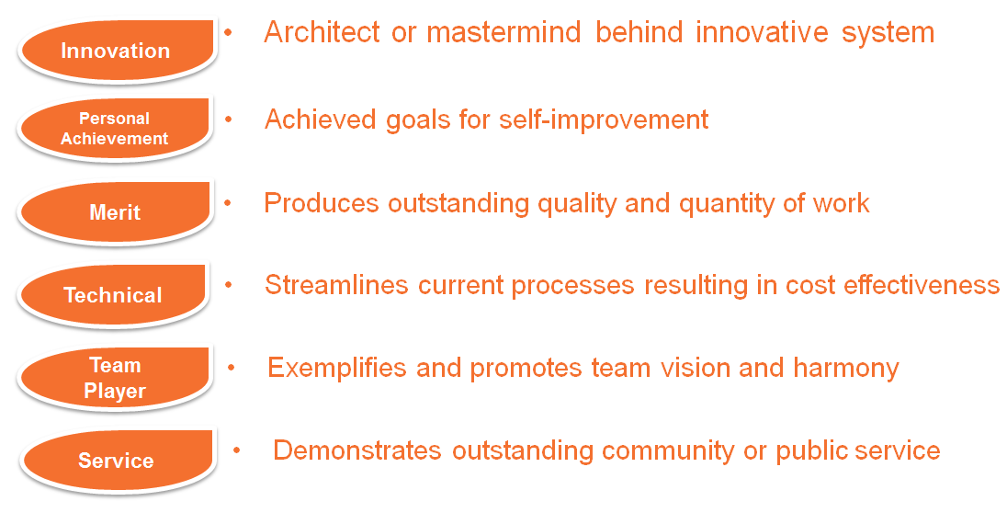
Award Categories
CCIT Staff Recognition
Notes:
14

Slide 15
Recognition Poster
Notes:
15

Slide 16
Return on Investment
When employees are recognized their motivation to produce increases.
They achieve more and the company wins with the increased productivity.
Recognition
Productivity
Achievement
Motivation
Notes:
16

Slide 17
A Beginner's Leadership Coaching Experience
What did I learn in the leadership training?
How do I use it to help my team grow new leaders?
I have even learned to coach myself to that “aha” moment.
Notes:
17

Slide 18
How I Learned to be an Effective Mentor Through Leadership
There are differences between coaching and mentoring.
What do I see as the difference between coaching and mentoring?
When do I, as a leader, take on the roll of a mentor?
When I mentor, what are my goals?
Notes:
18

Slide 19
What the staff are saying.
Not only did it make me feel empowered to make a difference in my workplace…it also made me feel good that CCIT management, overall, has the kind of respect for staff that they have chosen to make this program available to everyone in our organization.
I know I’m becoming a better leader because I’ve learned to be a better teammate and a more positive person in the world.
I found the ability to interact with other group members and I learned how to communicate with people you don’t see eye to eye with to be invaluable to my work.
Notes:
19

Slide 20
After One Year
162 Volunteer Staff 24 Volunteer Mentors
Notes:
20

Slide 21
Season Two
Talk 2 Me
Communications | Coaching | Critical Thinking

Slide 22
Questions?
Notes:
22

