Slide 1
FROM THE EYE to the STYLUS
Tablet Computing as a Means to Spatial Awareness
welcome

Slide 2
FROM THE EYE to the STYLUS
Tablet Computing as a Means to Spatial Awareness
Kyle Parker
Senior Software Engineer for Developing Technologies
Information Technology Services
Ball State University
Kp

Slide 3
FROM THE EYE to the STYLUS
Tablet Computing as a Means to Spatial Awareness
Kyle Parker
Senior Software Engineer for Developing Technologies
Information Technology Services
Ball State University
Les Smith
Professor of Landscape Architecture
Co-Director of
World Tour
College of Architecture and Planning Ball State University
Ls

Slide 4
FROM THE EYE to the STYLUS
Tablet Computing as a Means to Spatial Awareness
Kyle Parker
Senior Software Engineer for Developing Technologies
Information Technology Services
Ball State University
Les Smith
Professor of Landscape Architecture
Co-Director of
World Tour
College of Architecture and Planning Ball State University
Lohren Ray Deeg
Assistant Professor of Urban Planning
(Undergraduate) First Year Coordinator
College of Architecture and Planning Ball State University
Ld

Slide 5
This presentation will chronicle the use of Traveler at Ball State and its use in environmental design education.
agenda
Kp

Slide 6
This presentation will chronicle the use of Traveler at Ball State and its use in environmental design education.
We encourage and ask you to think about your own curriculum of travel at your respective universities.
Kp

Slide 7
This presentation will chronicle the use of Traveler at Ball State and its use in environmental design education.
We encourage and ask you to think about your own curriculum of travel at your respective universities.
After our slides, we will begin a group discussion and spend some time actually using Traveler on this array of devices
Kp

Slide 8
This presentation will chronicle the use of Traveler at Ball State and its use in environmental design education.
We encourage and ask you to think about your own curriculum of travel at your respective universities.
After our slides, we will begin a group discussion and spend some time actually using Traveler on this array of devices
Think about how an app like this could assist your field trips and experiential learning
Kp

Slide 9
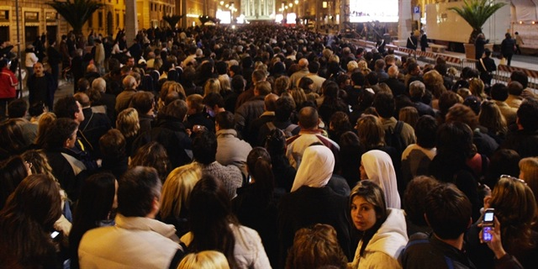
Funeral parade of Pope John Paul II
Ld
Source: MSNBC

Slide 10
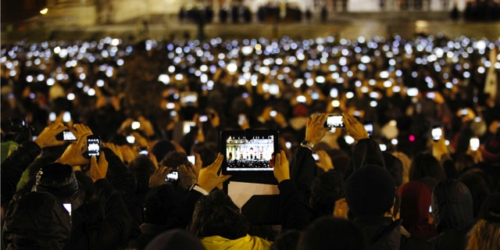
Funeral parade of Pope John Paul II
Introduction of Pope Francis I
Ld
Source: MSNBC

Slide 11
This is about an app.
Ld

Slide 12
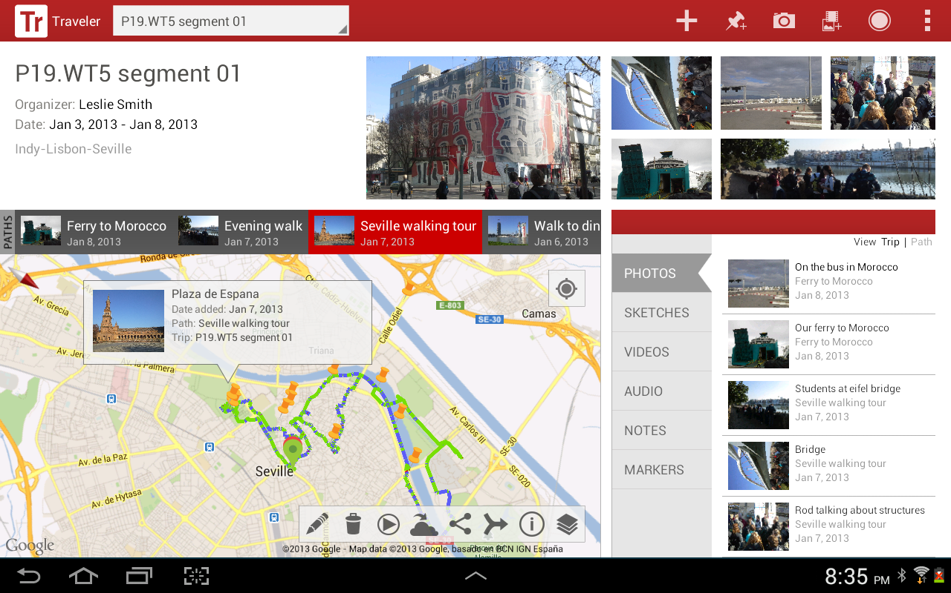
Kp

Slide 13
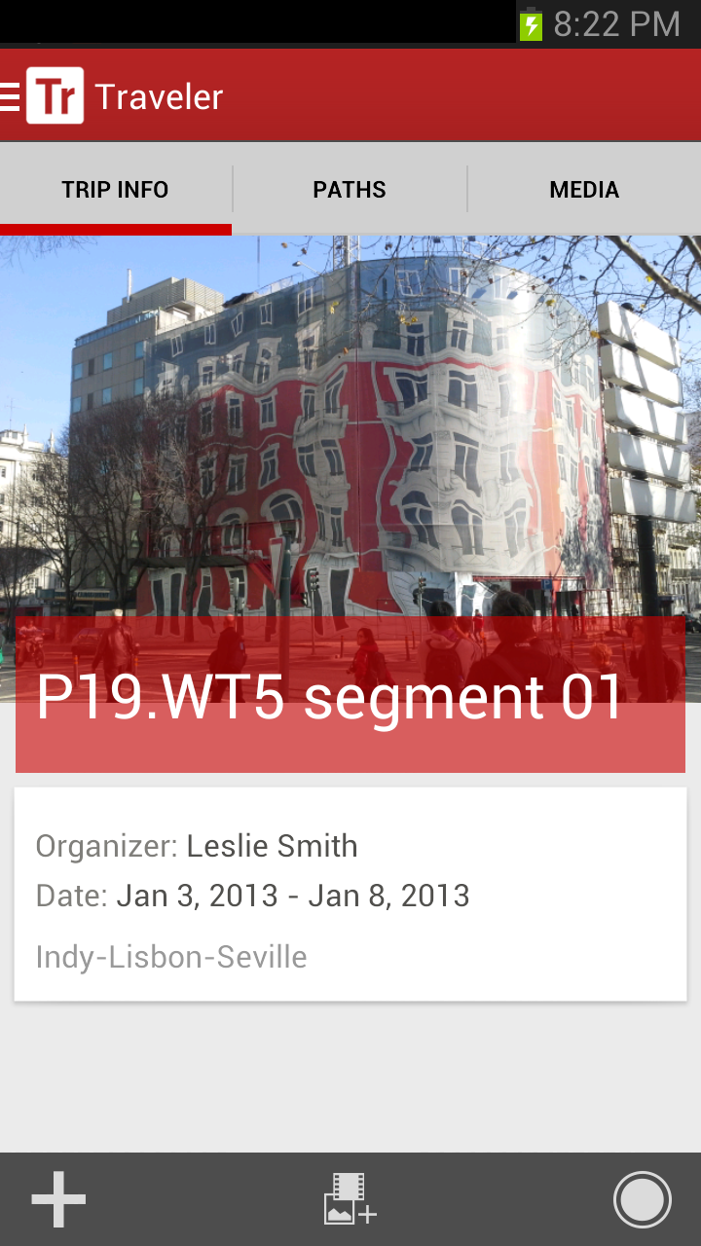
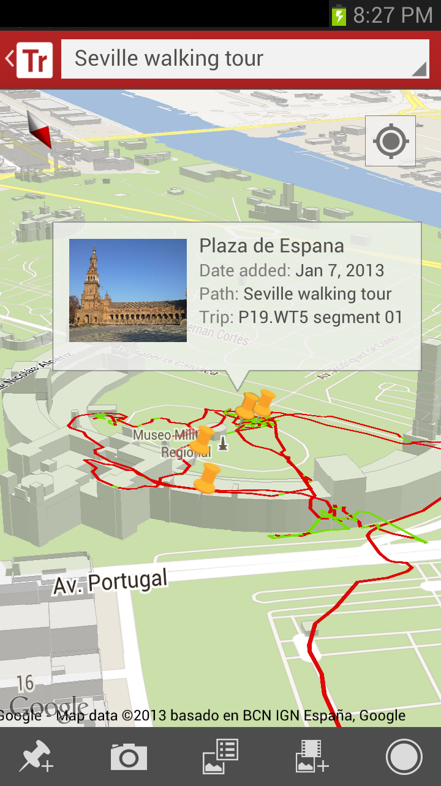
Kp

Slide 14
This is about the pedagogy of travel.
Ls

Slide 15
This is about confronting travelers with a mission to think critically, assess, and develop a set of self directed learning outcomes
Ls

Slide 16
HOW to develop:
Field sketching skills based in tradition
?
Ld

Slide 17
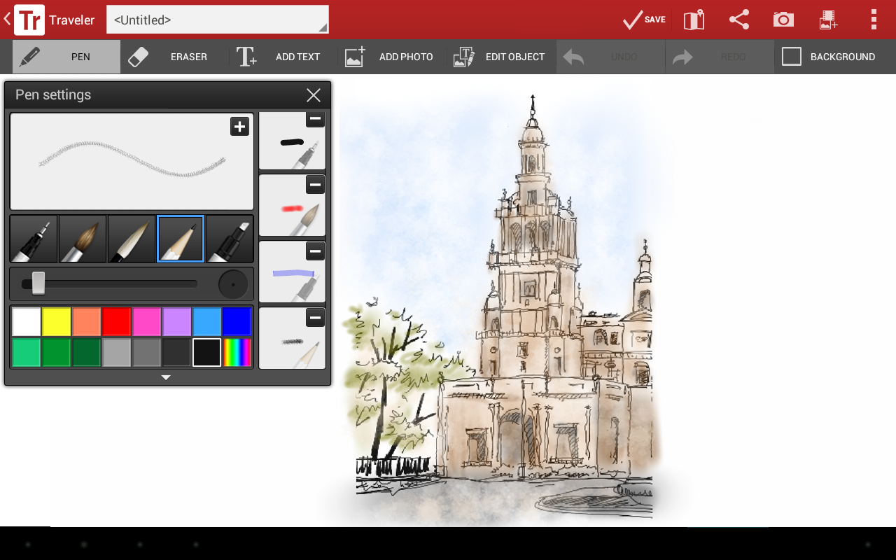
Ld

Slide 18
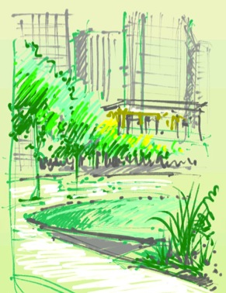
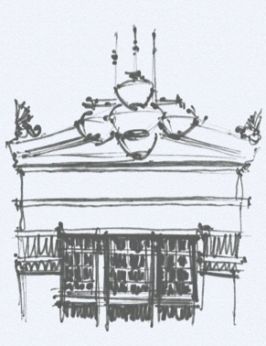
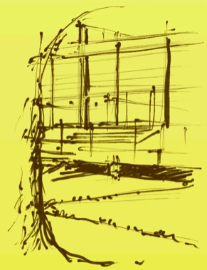
Park at Lakeshore East
Office of James Burnett
Chicago Public Library
Hammond Beeby & Babka
Crown Hall
Ludwig von Mies van der Rohe
Lohren Deeg
Ld

Slide 19
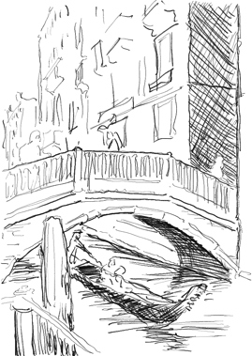
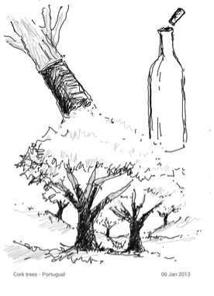
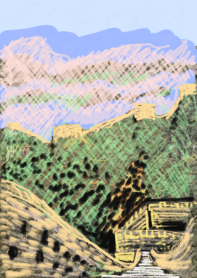
Venice, Italy
Cork Trees in Portugal
Great Wall of China
Les Smith
Ls

Slide 20
HOW to develop:
Field sketching skills based in tradition
Meaningful spatial and geographic awareness
?
Ld

Slide 21
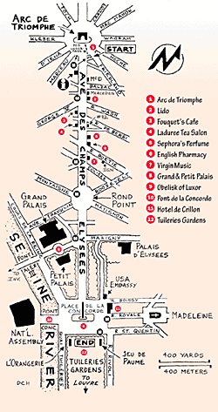
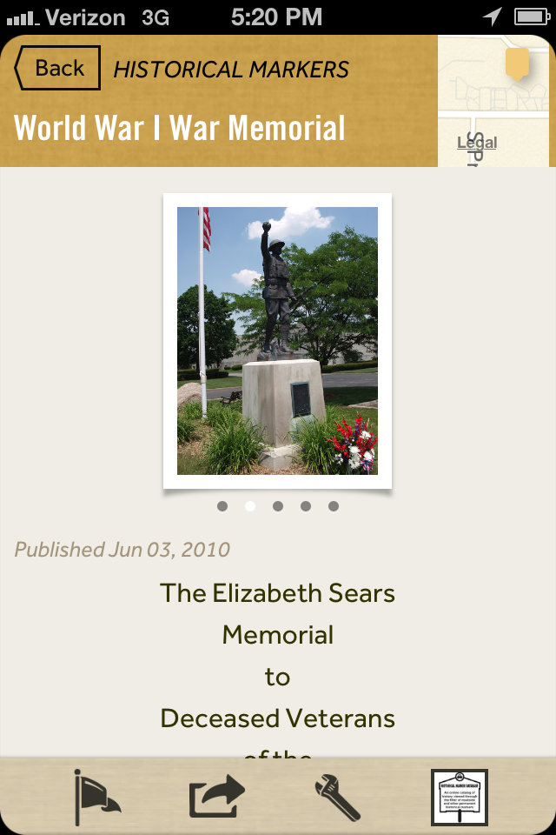
Rick Steves’s Europe Through the Back Door
Map My Run
Google Fieldtrip
Google Glass
Ld

Slide 22
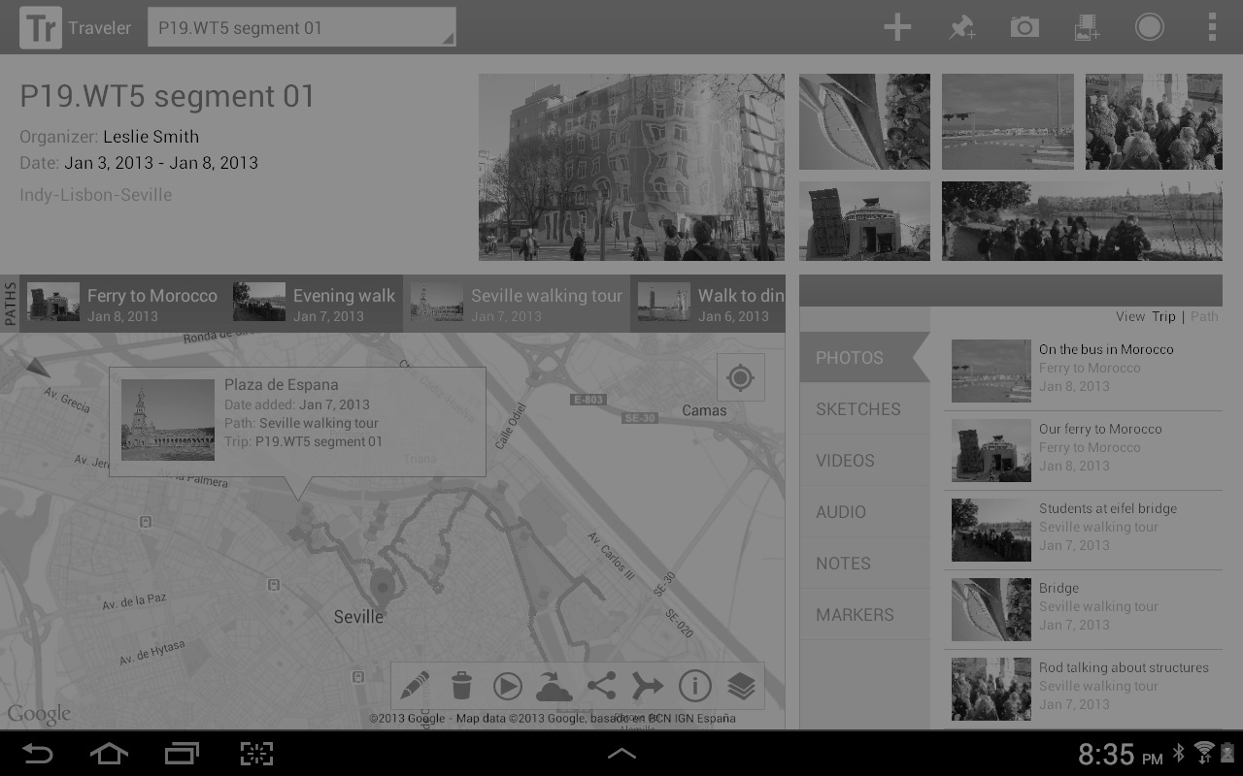
Kp

Slide 23
Integration with geospatial mapping
Kp

Slide 24
Kp

Slide 25
Record, save and share GPS referenced paths with a time stamp
Kp

Slide 26
HOW to develop:
Field sketching skills based in tradition
Meaningful spatial and geographic awareness
Bundled travel media on one device
?
Kp

Slide 27
Kp

Slide 28
Media is stored in a gallery and later in a backup server
Kp

Slide 29
Kp

Slide 30
A variety of media to capture
Kp

Slide 31
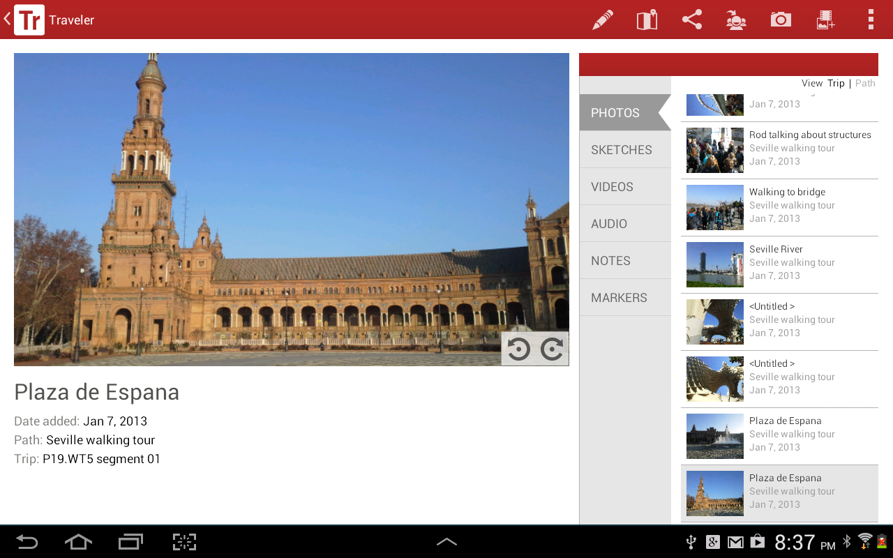
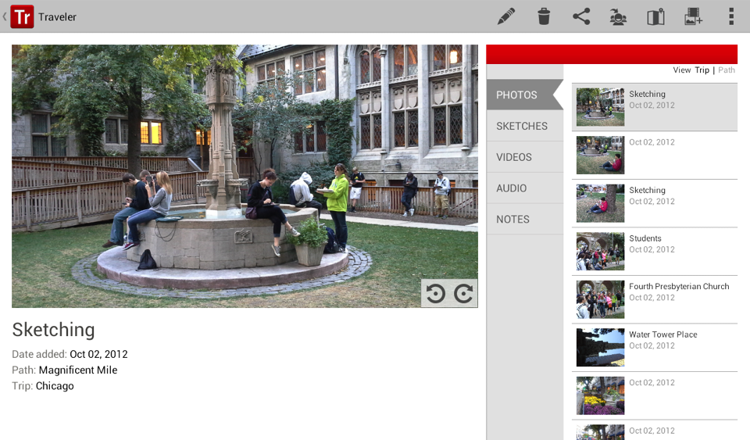
Kp

Slide 32
Add informational tags to media
Kp

Slide 33
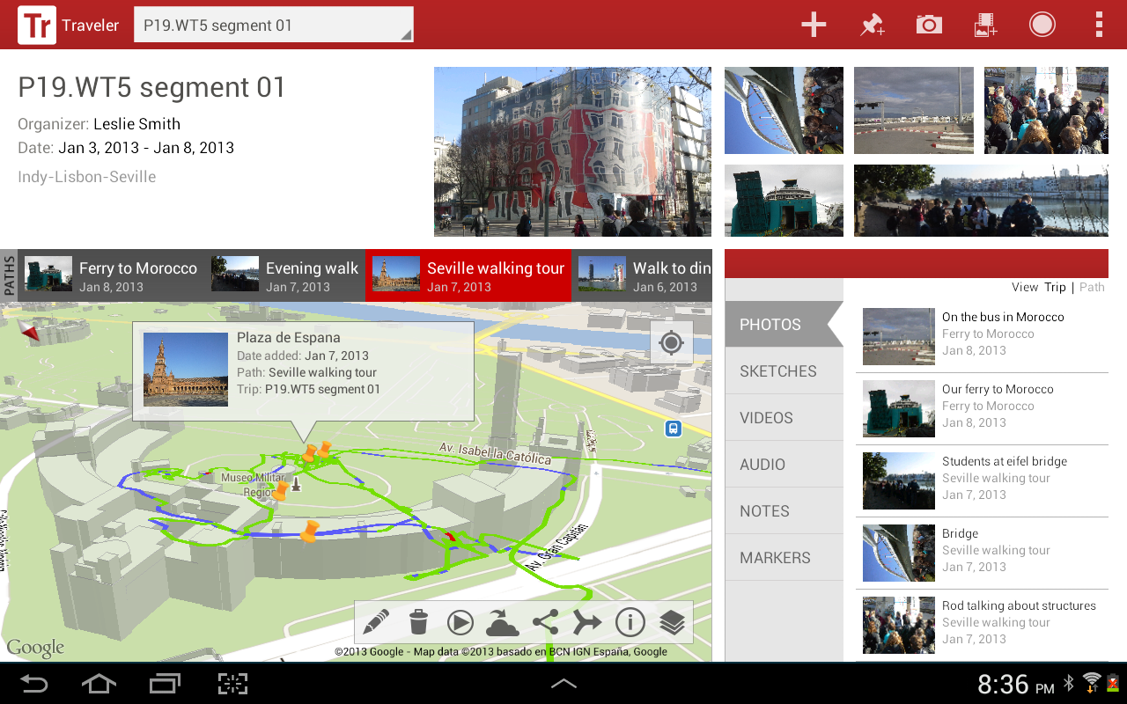
Kp

Slide 34
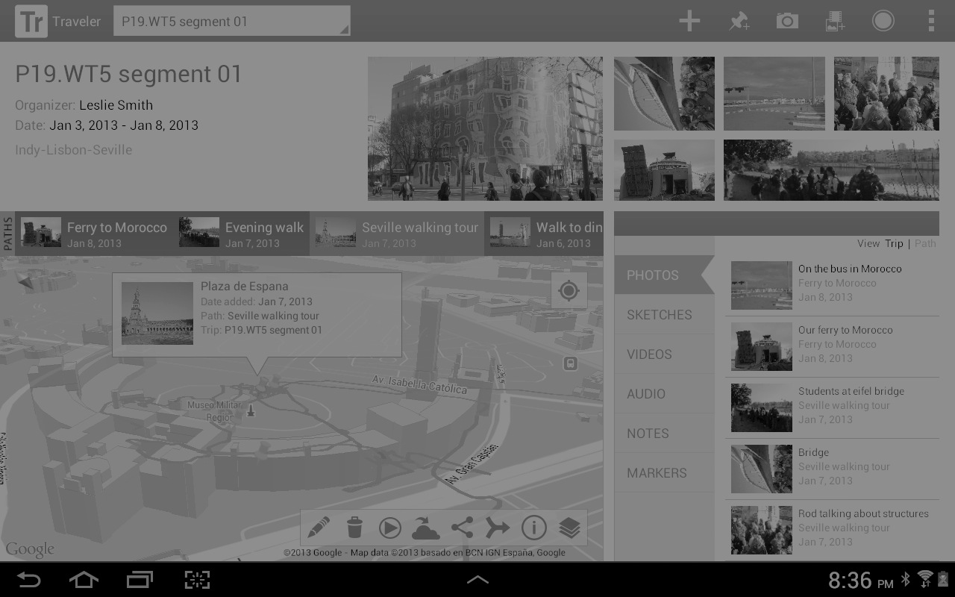
GPS markers locate the media recorded
Kp

Slide 35
HOW to develop:
Field sketching skills based in tradition
Meaningful spatial and geographic awareness
Bundled travel media on one device
Sharing, assessment, playback, and archive opportunities
?
Kp

Slide 36
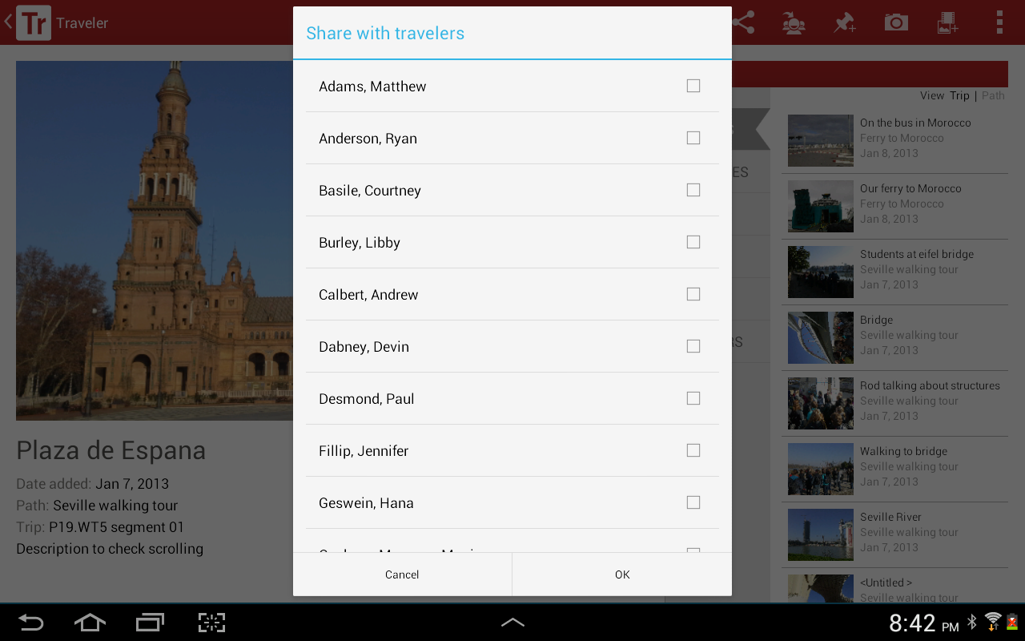
Kp

Slide 37
Share content with fellow travelers and social media
Kp

Slide 38
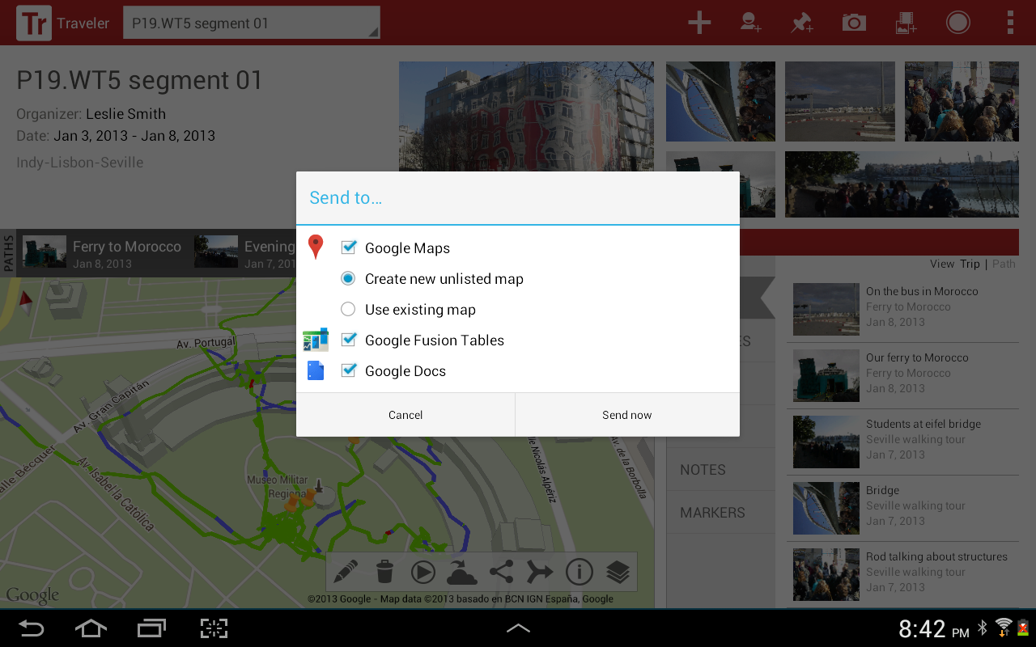
Kp

Slide 39
Integration with Google Maps and Google Earth
Kp

Slide 40
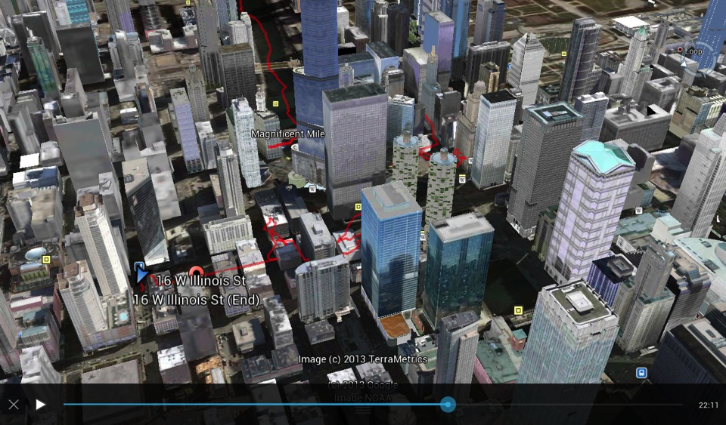
Kp

Slide 41
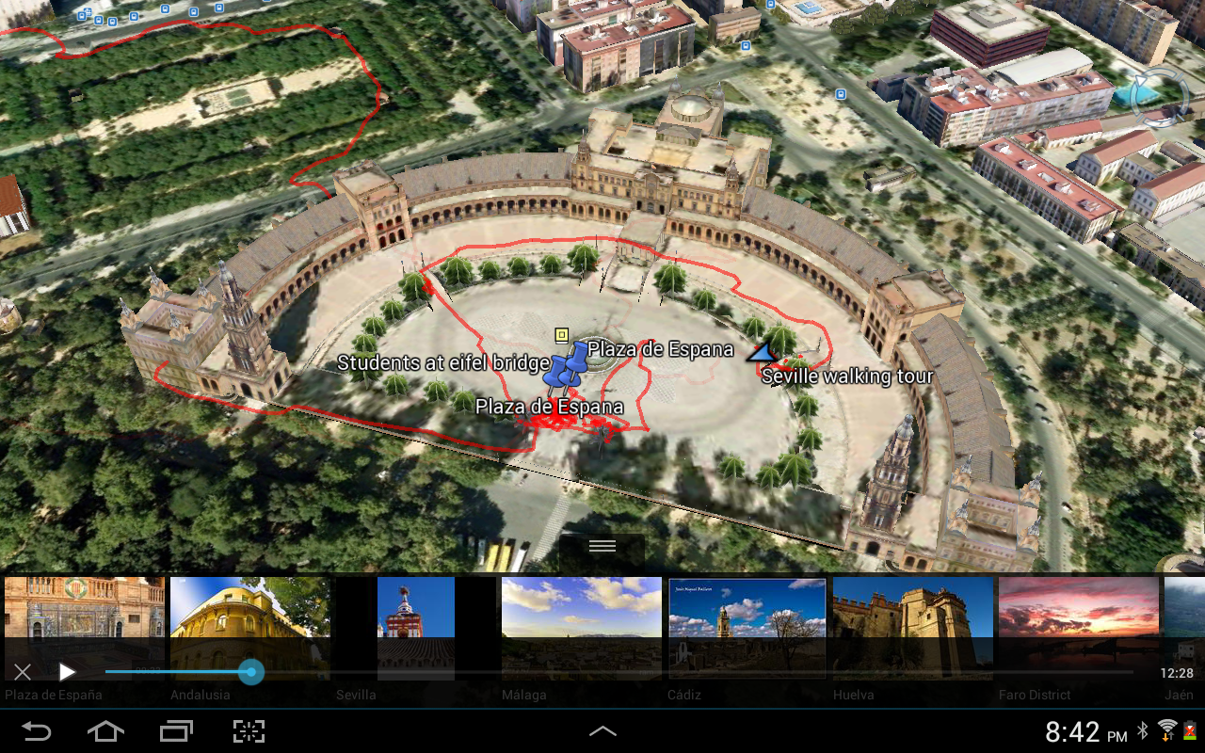
Kp

Slide 42
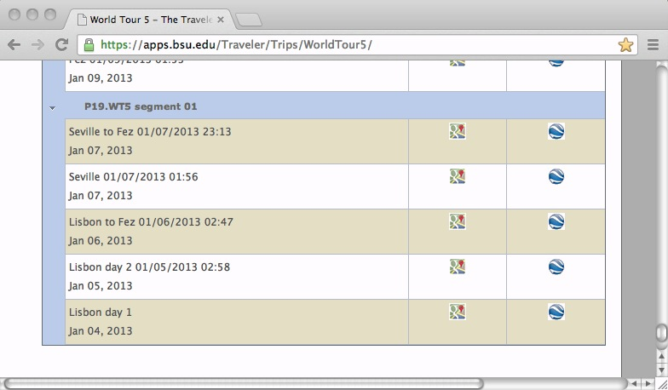
Kp

Slide 43
Share paths with the world wide web
Kp

Slide 44
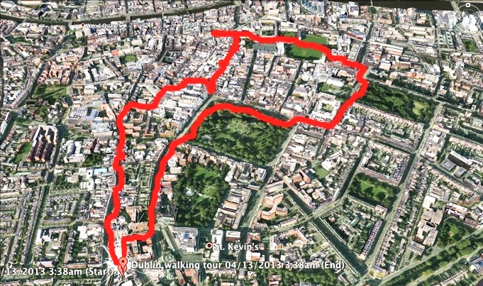
Kp

Slide 45
View paths in Google Maps or Google Earth
Kp

Slide 46
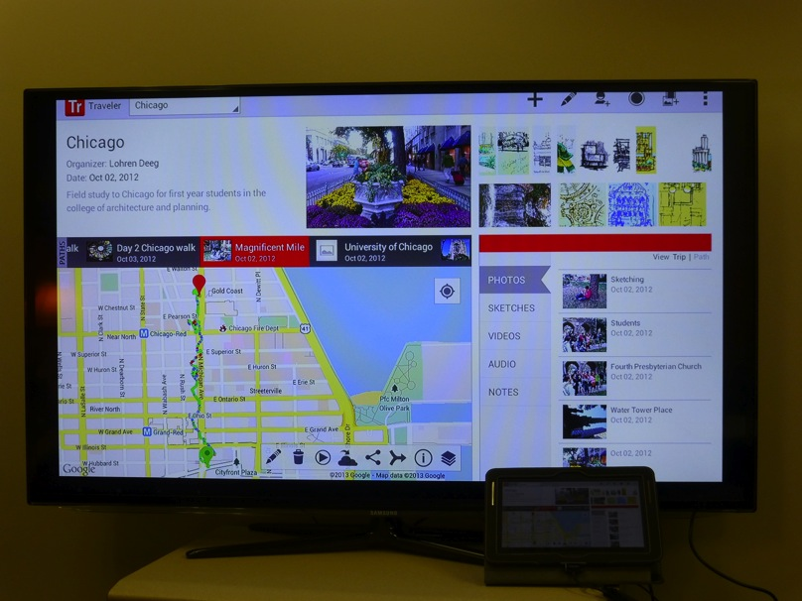
Kp

Slide 47
Review content in classroom
Kp

Slide 48
WHAT the students recorded
Ld

Slide 49
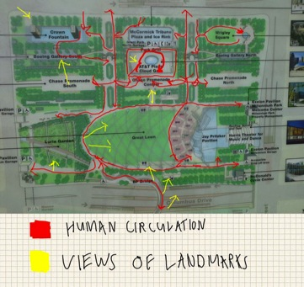
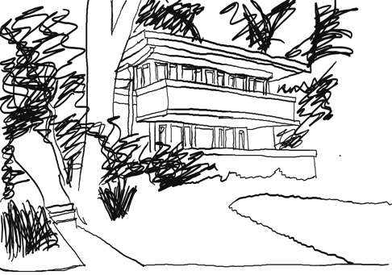
Millennium Park
Mrs. Thomas Gale House, F.L.Wright
Matt Arbore
Paige Story
Ld

Slide 50
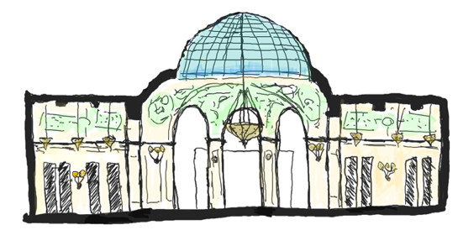
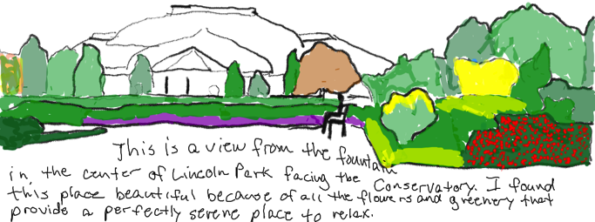
Chicago Cultural Center, Coolidge and Spencer
Logan Richmond
Lincoln Park,
F.L. Olmstead
Bryant Niehoff
Ld

Slide 51
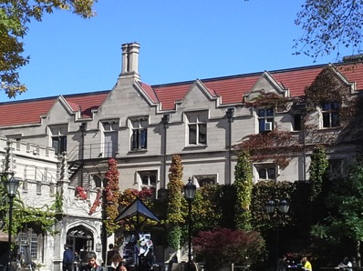
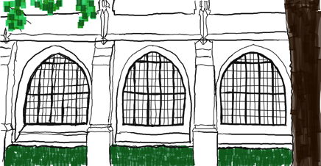
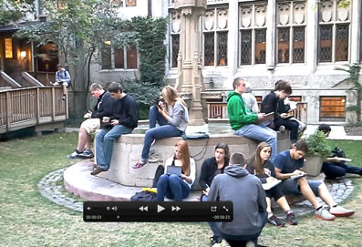
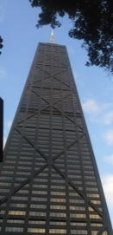
University of Chicago
Paige Story
Video clips of 4th Presbyterian and Hancock Tower
Charlie Rymer
Ld

Slide 52
Chicago Botanic Garden and Crown Hall
Taylor Sheppard
Ld

Slide 53
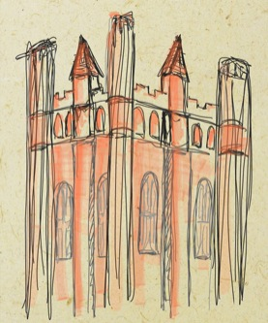
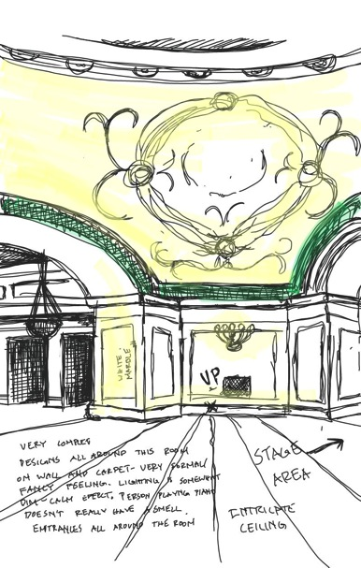
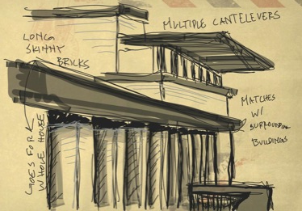
Ld
UC Campus, Robie House, Chicago Cultural Center
Craig Zehr

Slide 54
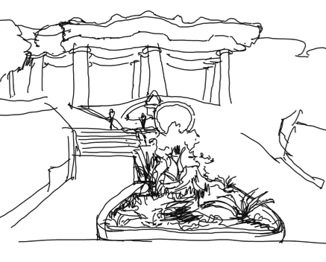
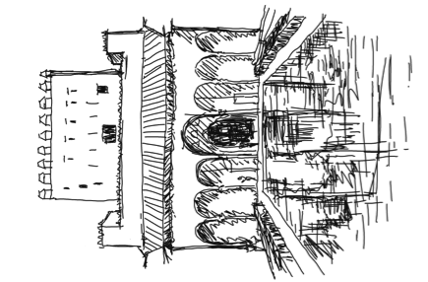
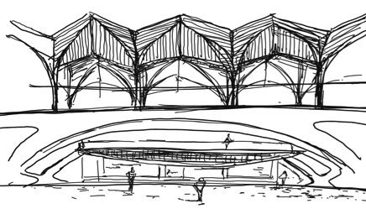
Alhambra, Parc Guell, Gare de Oriente
Lin Wang
Ls

Slide 55
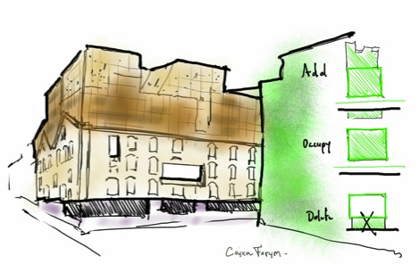
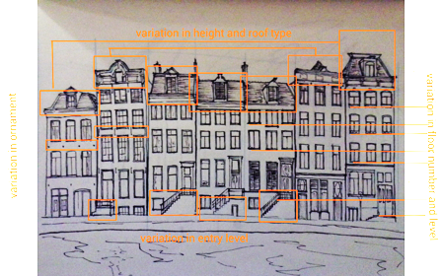
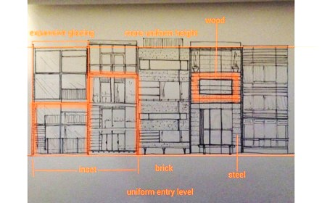
Brandenburg Gate, Caixa Forum, Facades
Ryan Anderson
Ls

Slide 56
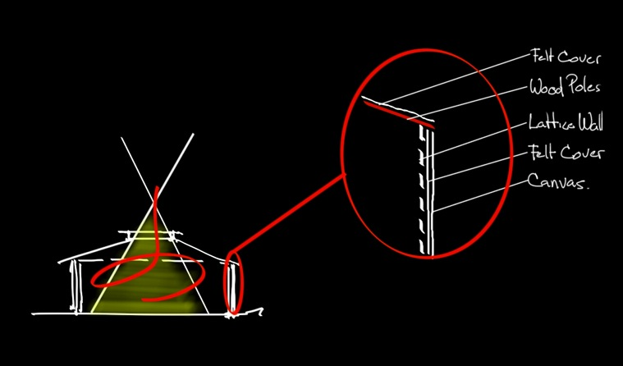
Analysis of vernacular housing, Mongolia
Ryan Anderson
Ls

Slide 57
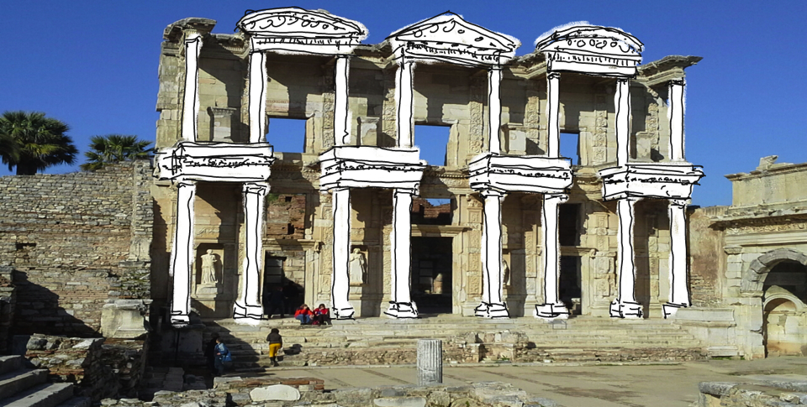
Library of Celcus, Ephesus Turkey
Andrew Calbert
Ls

Slide 58
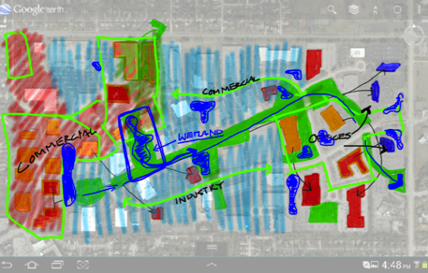
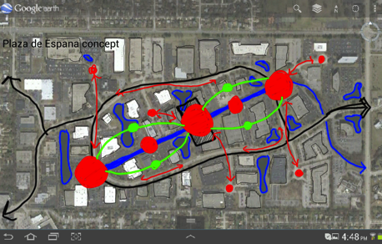
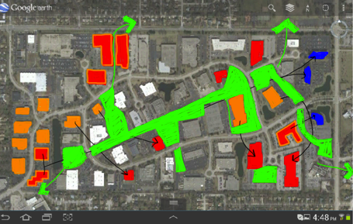
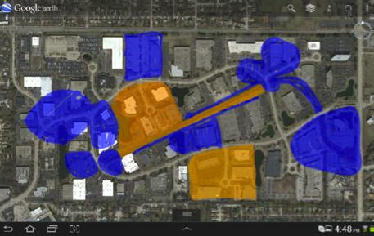
“Hometown Project”
Matt Adams
Ls

Slide 59
SURVEY and conclusions
Ld

Slide 60
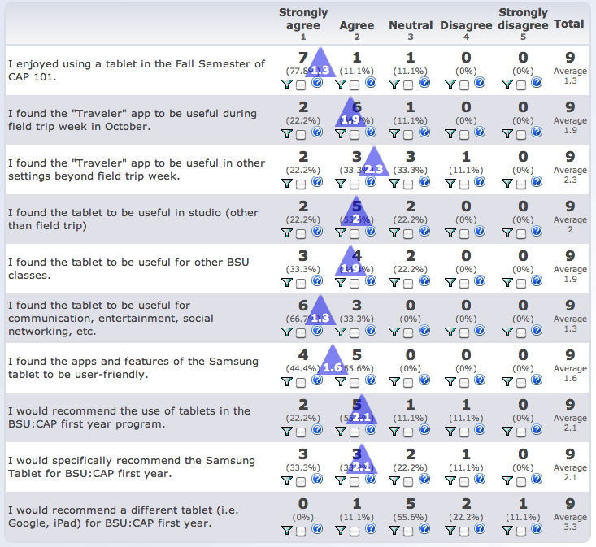
Ld

Slide 61
Ld

Slide 62
Ld

Slide 63
Ld

Slide 64
Conclusions:
Students responded well to path recording, sharing, and social networking capabilities
Ld

Slide 65
Conclusions:
Students responded well to path recording, sharing, and social networking capabilities
Some features of the app and tablet did not replace other cameras or sketchbooks / notebooks
Ld

Slide 66
Conclusions:
Students responded well to path recording, sharing, and social networking capabilities
Some features of the app and tablet did not replace other cameras or sketchbooks / notebooks
App provided immediate, diverse, and extended learning methods as well as ‘take-away’ learning outcomes
Ls

Slide 67
Conclusions:
Students responded well to path recording, sharing, and social networking capabilities
Some features of the app and tablet did not replace other cameras or sketchbooks / notebooks
App provided immediate, diverse, and extended learning methods as well as ‘take-away’ learning outcomes
App provided students with more comprehensive discoveries and conclusions throughout their study
Ls

Slide 68
Conclusions:
Students responded well to path recording, sharing, and social networking capabilities
Some features of the app and tablet did not replace other cameras or sketchbooks / notebooks
App provided immediate, diverse, and extended learning methods as well as ‘take-away’ learning outcomes
App provided students with more comprehensive discoveries and conclusions throughout their study
Helped shape conclusions about distinctive peoples and cultures, as well as their spaces, places, buildings, landscapes and sites of importance.
Ls

Slide 69
Kp

Slide 70
For additional information, visit our Google+ page

Slide 71
Thank you.

