Slide 1
“Listening” with Social Media in the Higher Ed Classroom
Hope Carroll
Ericka Hollis
Dr. Marjorie Shavers
May 30, 2013

Slide 2
Twitter Backchannel
Social Media in the Higher Ed Classroom
The Typical Lecture
Social Media Use of Students and Faculty
Benefits of Social Media
Barriers to Social Media Adoption in Education
Social Media Use in the Classroom
Social Media Listening
Defining Social Media Listening
Ways Social Media Listening is Used
Tools for Social Media Listening
Closing (Questions, Comments, & Prizes)

Slide 3
Live Tweeting
Prize Winner: Thanks for tweeting early.
Tweet throughout the session for a chance to win prizes.
Session Hashtag: #SERC13_Listen
Hope Carroll – @mhcarroll
Ericka Hollis – @ethollis
Marjorie C. Shavers – @drmshavers
Conference Hashtag: #SERC13

Slide 4
Social Media in the Higher Ed Classroom
Ericka Hollis | Morehead State University | e.hollis@moreheadstate.edu
Dr. Marjorie Shavers | Morehead State University | m.shavers@moreheadstate.edu

Slide 5
Some people talk in their sleep. Lecturers talk while other people sleep. – Albert Camus
Notes:
Students strong in learning styles other than auditory learning will have a harder time being engaged by lectures.
Students who are weak in note-taking skills will have trouble understanding what they should remember from lectures.
Students can find lectures boring causing them to lose interest.
Students may not feel that they are able to ask questions as they arise during lectures.
Teachers may not get a real feel for how much students are understanding because there is not that much opportunity for exchanges during lectures.

Slide 6
Students Social Media Use
Infographic credit: alivecampus.com (2012)
Notes:
94% of first year college students use social media sites (I've seen this even higher)

Slide 7
FYS Fall 2012 Student Statistics
28
(100%)
Notes:
Percentages

Slide 8
FYS Fall 2012 Student SM Preference
Twitter
Facebook
Instagram
Pinterest
Images from: joinchatnow.com (1), edudemic.com (1 &3), www.synergymarketingpro.com

Slide 9
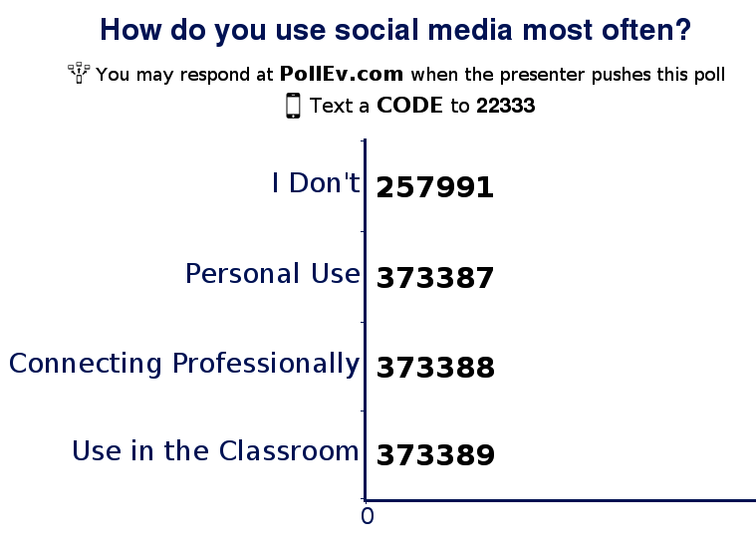

Slide 10
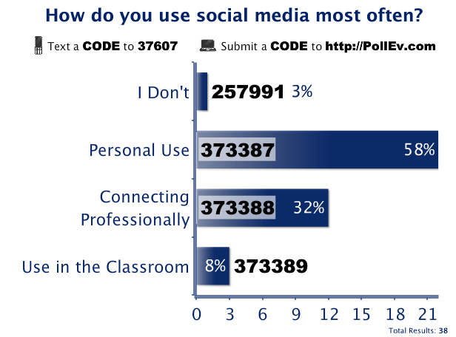

Slide 11
Presentation Participant Responses

Slide 12
Infographic credit: Pearson Learning Solutions (2012)

Slide 13
Infographic credit: Pearson Learning Solutions (2012)

Slide 14
Infographic credit: Pearson Learning Solutions (2012)

Slide 15
Benefits of Social Media Use
Increases Engagement¹
Higher G.P.A.¹
(2.79 vs. 2.28)
Co-constructing²
Makes lecture more relevant and interesting²
Improves preparation and non-classroom time²
Provides new ways for students to participate²
Active Participation²
Students are comfortable using social media²
Infographic from: komarketingassociates.com
Wright, S. (2013). Do Social Media Benefit College Students by Engaging Them in the Course Material? http://tinyurl.com/socialmediainhighered
Retelny, D. Birnholtz, J., Hancock, J. (2012). Tweeting for Class: Using Social Media to Enable Student Co-Construction of Lectures. http://socialmedia.northwestern.edu/files/2012/09/retelny2012_tweetingforclass.pdf

Slide 16
Why aren’t educators using social media more often?

Slide 17
Infographic credit: Pearson Learning Solutions (2012)
Notes:
Note that the barriers are decreasing for 2012 and that the idea that it takes too much time is changing as well.

Slide 18
Barriers to Using Twitter in FYS Course
Presentations: No Live Tweeting
Everyone did not have Smart Phone
Data Plan Limitations
Varying Comfort Levels
Image from: semanticweb.com

Slide 19
Twitter Usage in FYS Course
Extending conversations outside of class.
Live-Tweeting.
Monitoring & discussing current events.
Announcements.
Discussion about personal branding.
Image from: podcast.teachercast.net

Slide 20
How Do You Use Social Media?
Image from: shakethetech.com

Slide 21
Helping Faculty Use Social Media
Start small
Co-create a social media policy
Define the purpose
Check alignment with SLOs
Formative assessment
Image from: en.paperblog.com

Slide 22
Social Media Use in a Doctoral Program
Facebook page
Twitter: #UKSTL
Google+
Tumblr
Diigo
Branch
Image from: www.techmagz.com
Notes:
http://www.tumblr.com/blog/edtechphd

Slide 23
Social Media in the Higher Ed Classroom
Hope Carroll | Clemson University | hwayne@clemson.edu

Slide 24
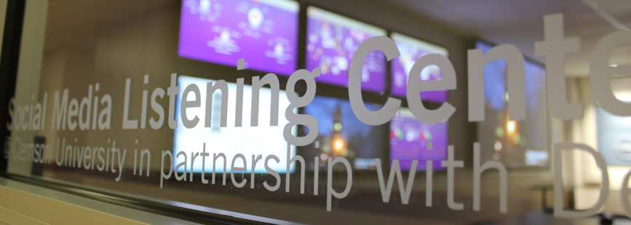
What is social media listening?
What is social media listening?
Why is it important for higher ed?
Social Media Listening Center @Clemson
Notes:
What is it?
SMLC @Clemson
The Social Media Listening Center at Clemson University is an interdisciplinary research lab and teaching facility that opened in early 2012.
the Listening Center brings together faculty, staff, students and external partners to support undergraduate creative inquiry, faculty research, pedagogy, and outreach through social media listening.
The Social Media Listening Center allows researchers to discover, listen to, measure and engage in conversations across the Web by capturing more than 150 million sources of social media conversations, including Facebook, Twitter, YouTube, LinkedIn, blogs and other online communities.
The SMLC has six large display screens that faculty and students monitor, similar to a small network operations center.
Salesforce Radian6 provides the platform to listen, discover, measure and engage in conversations across the Web by capturing more than 150 million sources of social media conversations, including Facebook, Twitter, YouTube, LinkedIn, blogs and other online communities. The Radian6 summary dashboard provides a graphic display of social media content to convey sentiment, share of voice, trend information, geo-location data and much more.

Slide 25
Vocab Lesson
Listening and monitoring = used interchangeably; see what people are saying via social media
Mentions = every time somebody says something with your keyword used
Sentiment = mentions that are pos/neg
Insights and Influencers = how many followers makes them stronger
Infographics = word clouds, trend lines, graphs, demographic displays
Notes:
Listening and monitoring – used interchangeably
Sentiment = Sentiment is the ratio of mentions that are generally positive to those that are generally negative.
Insights | Influencers = people who respond to your tweets (for example). When you share something on social media or in real life and people respond, that's influence; can weight influencers by how many follow them
Infographics/Visualization of data

Slide 26
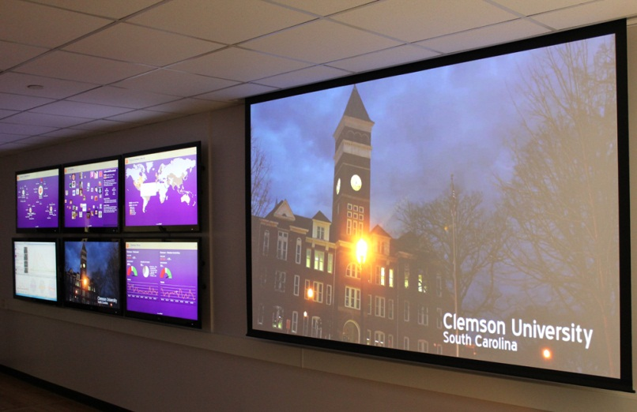
Ways Clemson is “listening”
Creative Inquiry classes
Industry partnerships
Faculty research
Departments getting involved
Notes:
The social web offers the opportunity to engage in conversation and collaborate with faculty and students across time and space. It offers a rich source of data and creative ideas for learning.
Creative Inquiry classes are small groups of undergraduate students engaged in research. Sometimes the investigations are student interests and sometimes they’re challenges introduced by professors.
Sample projects include student teams listening to:
the conversation among Millenials about an automobile brand to help another student team create an advertising campaign for a specific car.
conversations about emergency management issues to determine patterns in conversations that may help law enforcement deliver better services to citizens.
online conversation around college athletics. They are examining the words people use to describe college sports, patterns and conversations about different sports, and why differences exist in conversations around women and men's college sports.
Industry Partners
7-Eleven – wanted to see why coffee sales were down and which demographic group to market to
Cape Hatteras NPS – wanted to
Kemet Corporation – sells capacitors and wanted to see if going green meant something to their customers so they’d know if good investment
Faculty Research
Southern culture and if students are talking about North vs South (History dept)
Departments
PR, Athletics, Library, AAH, BBS, Student Govt, Admissions

Slide 27
Tools for “Listening”
Radian6 ($$)
Social Mention (FREE)
Hootsuite (FREE)
Topsy (FREE)
Notes:
Hootsuite
Hootsuite is a web-based dashboard that allows you to monitor multiple social networks in one place. You can collaborate with fellow employees, schedule messages, and assign tasks to your team. It’s particularly great for managing multiple accounts on the same platform. This is one of my personal favorites.
There’s a dept on campus that uses Hootsuite’s paid subscription. So it allows you to save a search as a stream so that conversations about that topic are always visible on your dashboard.
They have “Clemson Extension” saved as a stream and can keep track of convo that mentions extension or see when ppl share links from their website.
Social Mention
Track and measure who is talking about you, your company, your product, or any topic related to your industry. SocialMention pulls data from hundreds of social media services to give you the most accurate, real-time information.
Social Mention is a social media search engine that searches user-generated content such as blogs, comments, bookmarks, events, news, videos, and microblogging services. It allows you to track mentions of your brand across all of these areas.
The results are aggregated from the top social media sources, such as Flickr, YouTube, Digg, Delicious, Twitter and more. Like the other services, you can subscribe to your results by RSS or email.

Slide 28
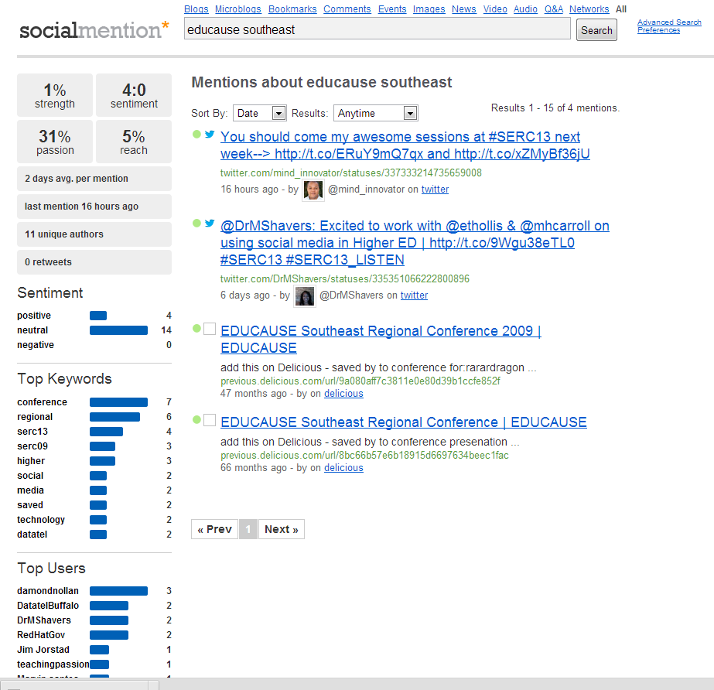
Example: Search for “educause southeast”
Sentiment is mostly neutral; some positive
Notes:
Social Mention
Track and measure who is talking about you, your company, your product, or any topic related to your industry. SocialMention pulls data from hundreds of social media services to give you the most accurate, real-time information.

Slide 29
Thank You!
Questions, discussion and PRIZE WINNERS!
For resources, visit https://groups.diigo.com/group/social-media-in-higher-ed

