Slide 1
Operating During a Hurricane
Jon Barnwell, Superintendent, Police Department
Hunter Ely, Chief Information Security Officer
May 30, 2013

Slide 2
The Disaster: Katrina
Operating During a Hurricane
Notes:
“The Disaster: Katrina”
Introduction- 5 min
Tulane has known Emergency Management was priority but who should house this function
-The story starts here.
-Time Before Katrina no longer matters because the extremely unlikely occurred
-Katrina made us keenly aware that there are avenues that we can improve in emergency management and disaster recovery

Slide 3
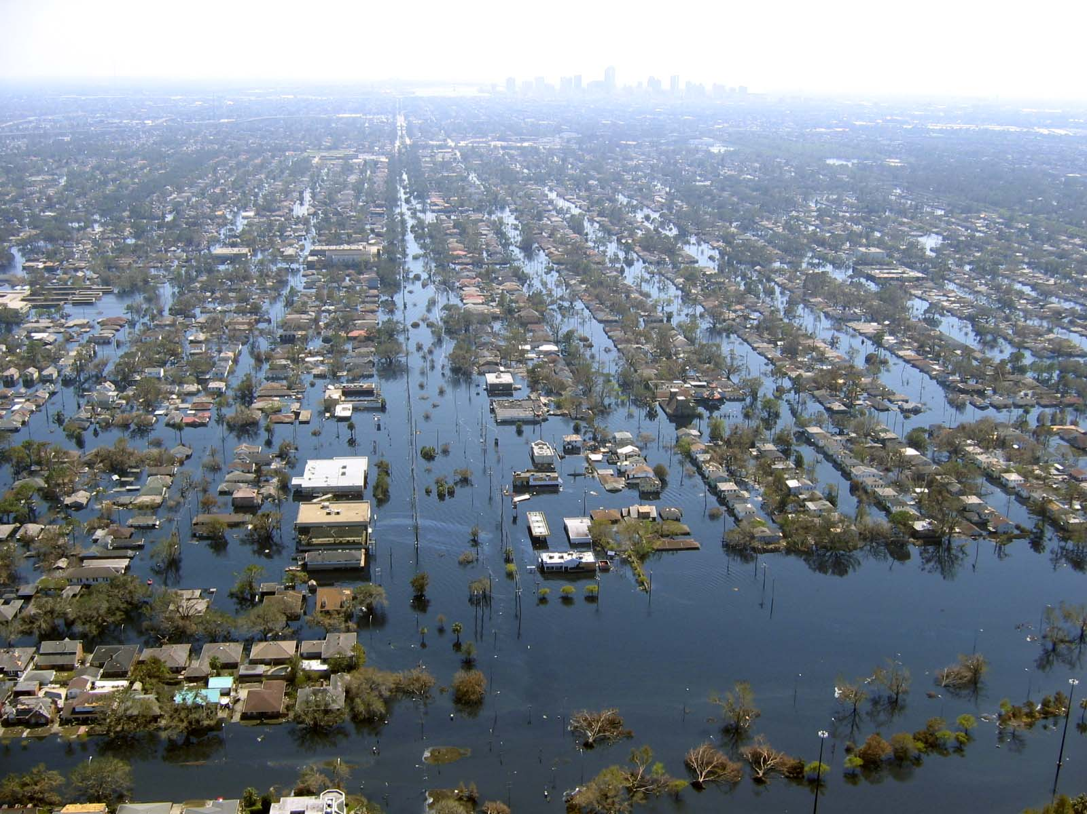
Notes:
New Orleans after Katrina
When a disaster reaches this scale you truly do have time to reflect on where things went right and where they went incredibly wrong
Katrina highlighted, among other things, that community members weren’t equipped, trained, or prepared to respond in a coordinated way.
We must improve collaboration, coordination, and communication to respond any extraordinary scenario

Slide 4
21st Century Emergency Management: Putting Action to a Plan
Operating during a Hurricane
Notes:
“21st Century Emergency Management: Putting Action to a Plan”
Planning- 20 minutes
-Wanted to build/ develop a partnership between the Tulane police department, Tulane Office of Emergency Management, and Tulane Technology Services to coordinate expedited emergency response.
-How do we build a platform that’s easy to learn/use and can demonstrate value to Emergency Responders?
-How do we change focus from just hurricane response to an All-Hazards approach?
-Build technologies for this purpose
-New players came to Tulane who understood the importance of collaboration for emergency management and disaster relief planning, how do you put this into action;
In the years following Katrina New Orleans just "recovered." It's time to start planning on what we do next time this happens
For us, this manifested in a "changing of the guard." Jon and I hail from institutions with more mature EM environments.

Slide 5
Solution: Intrapoint Crisis Manager
Operating During a Hurricane
Notes:
“The Solution”
Intrapoint Discusion- 10 minutes
-Can we do this internally? If so, how?
-There is an endless list of things to do in a disaster scenario; Intrapoint provides the full plan in one central location
-Intrapoint reached out with a solution designed with the Norwegian Oil Companies in mind. They reached out to us to help expand their Crisis Manager platform beyond Oil and Gas and into Higher Ed.
-We saw functionality that we knew we could grow
After struggling with homegrown solutions to manage all of the plans, documents, phone lists, etc., Intrapoint brought a flexible platform solution to build

Slide 6
Notes:
Incident commander dashboard – Custom 4 pane view
-Complete Operating Picture
-Status
-Todo list
-Users currently online – with instant messaging capability for real-time communication
-Local weather
-All tasks
Jim Bradley shoutout on interface

Slide 7
Notes:
Incident Commander To do list.
-List shows all tasks pulled directly from hurricane emergency response plan.
-Each list is tailored for each EOC position based upon the NIMS/ICS model.
During Isaac we had to weigh our options very carefully because students were on campus and moving in.

Slide 8
Notes:
List of all tasks that have been created and assigned to a user.
List of tasks
who assigned them
the responsible user to complete the task
deadline
whether the user accepted the task assignment
whether the user executed the task.

Slide 9
Notes:
Create and assign tasks to specific users or user groups, the task’s priority, and a deadline.
-we get a call that water is rising in a building, create a task for facilities to start water extraction
Categories and priorities can be pre-populated and listed in a pull-down menu

Slide 10
Notes:
Status page – this one lists what happened in real-time during hurricane Isaac
-Use to build an after-action report for post-incident debrief
-View all observations that have been reported to the system regarding the incident.
-Notes when users log in to the system, when a task has been completed, or an activity is added to the observation list
----- Meeting Notes (5/29/13 17:58) -----
This captures every task, observation, or deviance from the plan in the order in which they were logged.

Slide 11
Notes:
Resources
-Campus info
-Building details

Slide 12
Notes:
Executive oversight!!- Emergency Policy Group
-We want the executives to be informed for strategic decision-making but we don’t want them operationally involved during a crisis
Infoboard for others (like University President, Deans, Directors, Department heads to watch what is happening and stay informed without directing the incident themselves.)
-Observation list that includes tasks performed
-Storm tracking
-Personnel status
-Local weather
-Situational Report

Slide 13
Branch out and Manage all Events
Operating During a Hurricane
Notes:
“The Solution”
Intrapoint Discusion- 10 minutes
-Any event that deviates from normal operations to include things like concerts, move-in, game day, etc…
-Can we do this internally? If so, how?
-There is an endless list of things to do in a disaster scenario; Intrapoint provides the full plan in one central location
-Intrapoint reached out with a solution. Take a moment to sell the Intrapoint product
-Furthering the mission
-Game day operations
-Special events
-May 18. 2013- Dalai lama spoke at Commencement. Use experience to explain various applications

Slide 14
Shared Spaces and Other Initiatives
Operating During a Hurricane
Notes:
“Shared space and other initiatives”
10 Minutes
-Integrated Operations Center approach
-by using this space on a day-to-day basis, technology issues, ie, updates and problems are always being addressed and the space is ready at a moment’s notice to switch to an EOC
-Cost sharing, combined space, emergency operation center
-The new NOC space
-Shared office space
-Close working environment to facilitate better communication
----- Meeting Notes (5/29/13 17:58) -----By using this approach, equipment is always updated and operational. Do you want to walk into the EOC, turn on the lights, and see your PC stuck on updates during a crisis.

Slide 15
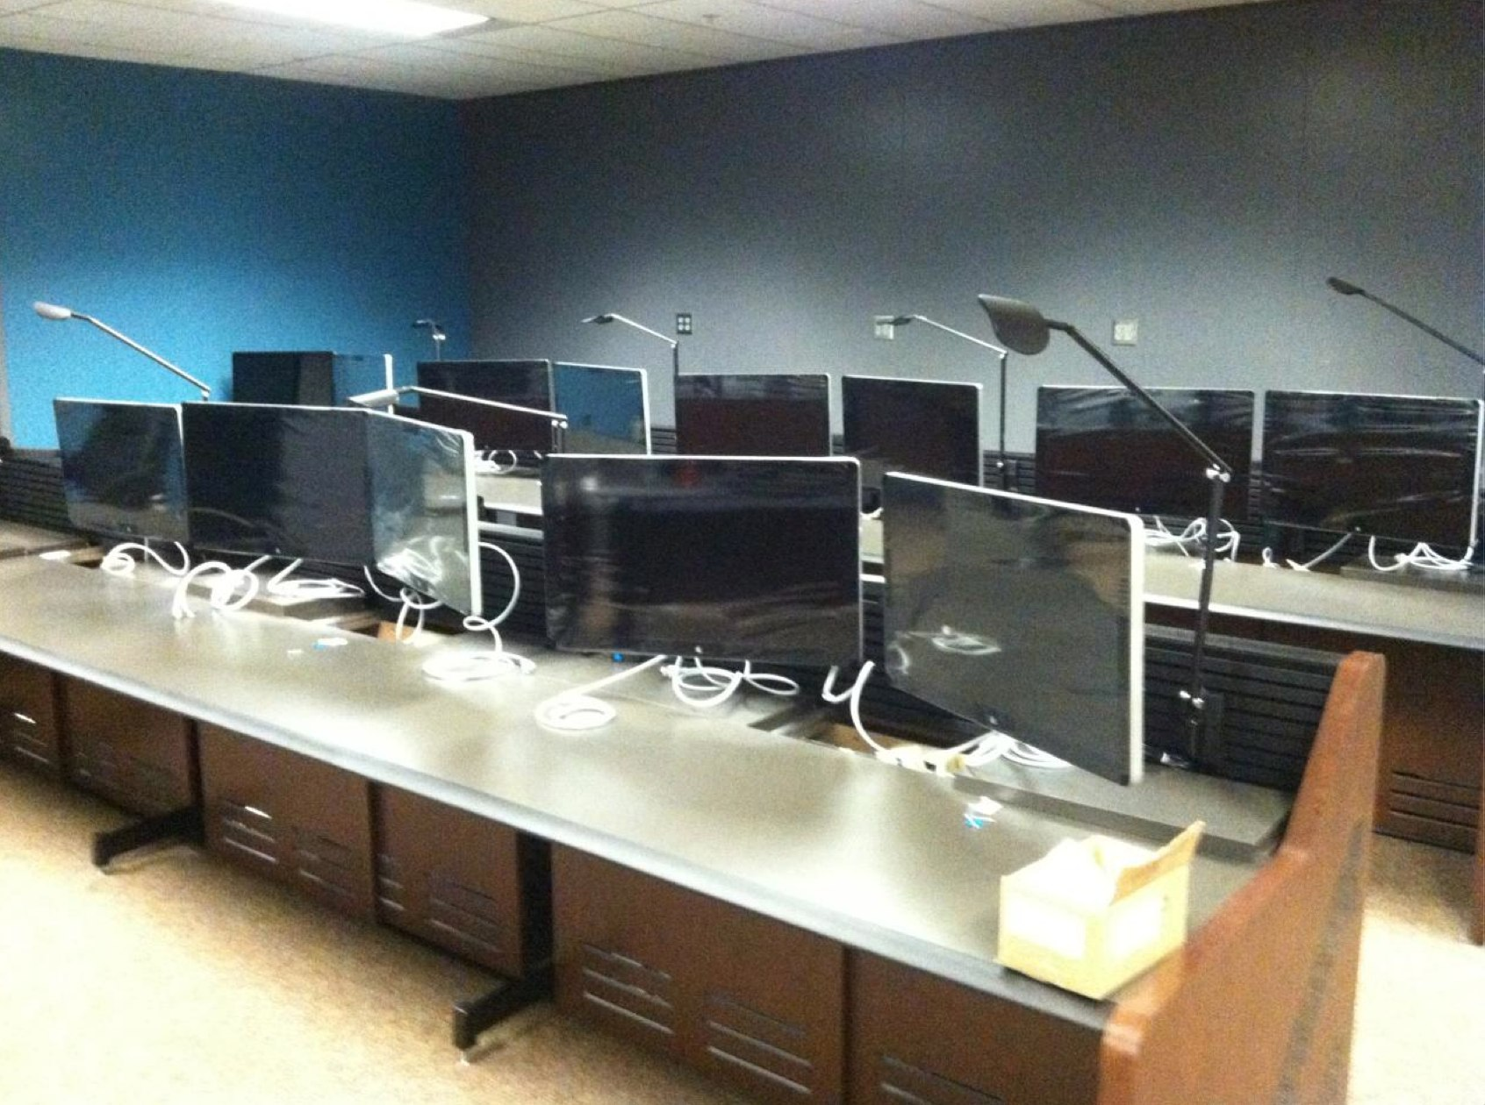
Notes:
Allie’s NOC
Add Picture of NOC/SOC in current build

Slide 16
Questions & Answers
Jon Barnwell, Superintendent, Police Department
jon@tulane.edu
Hunter Ely, Chief Information Security Officer
hunterely@tulane.edu

