Slide 1

Centralized Security Event Management
Chris Workman
Associate Director, UGA Office of Information Security, CISSP
Alex Merck
Security Analyst, UGA Office of Information Security

Slide 2
Problems we face
Attacks > defense
80,000 devices on our network
~50,000 users
Departmental IT contacts have different skill levels
SOC staff of 4.5
UGA IT is decentralized
~160 departments

Slide 3
Weighing Risks
Threat | x | Vulnerability | x | Impact
Severe |  | Critical |  | Sensitive, Restricted
 |  |  |  | Critical
High |  | High |  | Internal
 |  |  |  | High-Priority
Elevated |  | Medium |  | Public
 |  |  |  | Supportive
Low |  | Low |  | None
 |  |  |  | None

Slide 4
Response
SIEM
Security Information and Event Manager
Centralized Services
AntiVirus
Vulnerability Scanner
DLP
Firewall
Notes:
Given our decentralization, we have multi-tennant configs for each service.

Slide 5



Intelligence is needed to weigh risks
Threats
AntiVirus
IDP
Vulnerabilities
NeXpose
ASSETs
FireEye
Firewall
SNORT
DNS
Departmental devices
Departmental Nessus
Impact
DLP
SSNCap
Manual reporting
Bro
Notes:
Explain ASSETs; open source items

Slide 6


Incident Actions
Notification
Alarm
Ignore
True Positive Unknown False Positive

Slide 7
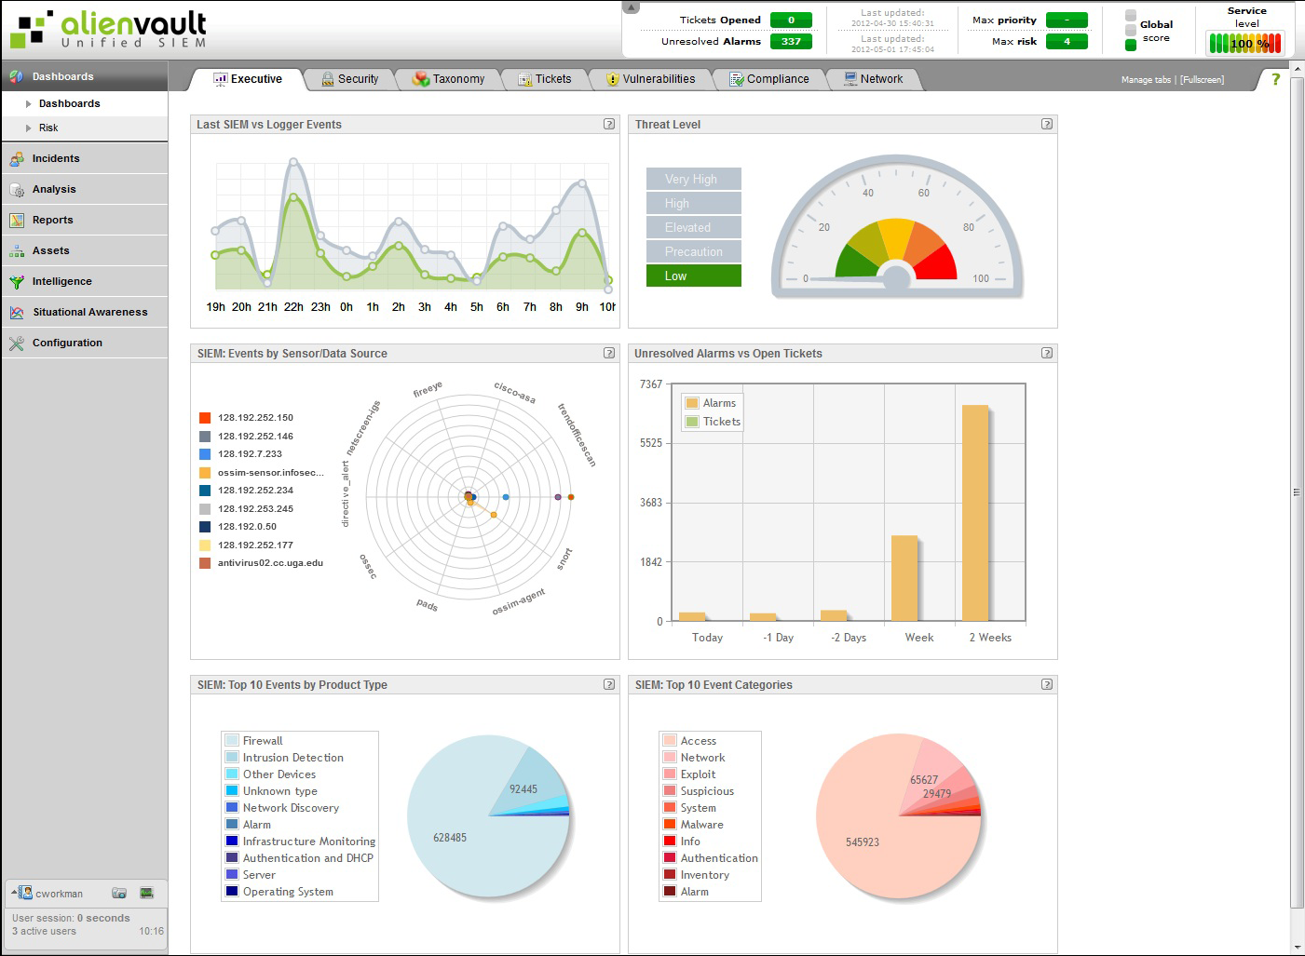
Notes:
Overview of SIEM: correlates logs, we can create directives to take any action once a risk level is hit

Slide 8
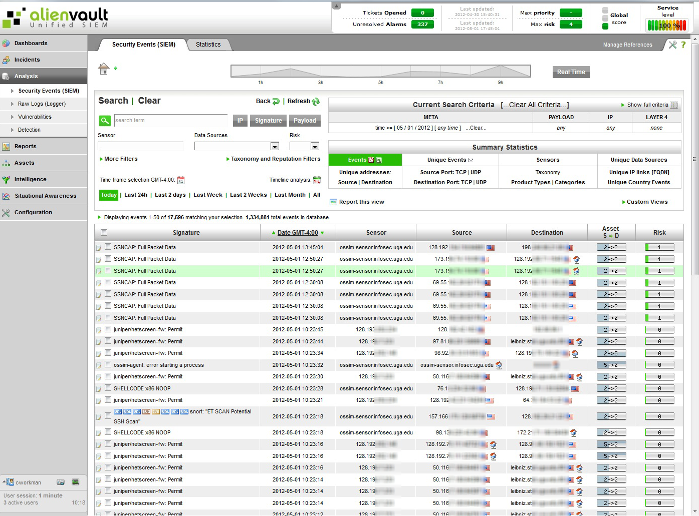
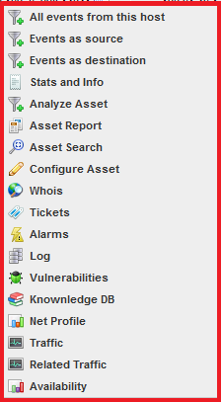
Notes:
Logs from multiple sources; multi tenancy leads to better network visibility; automated alerts – to departmental IT for incidents, to SOC for critical incidents; SIEM is open source

Slide 9
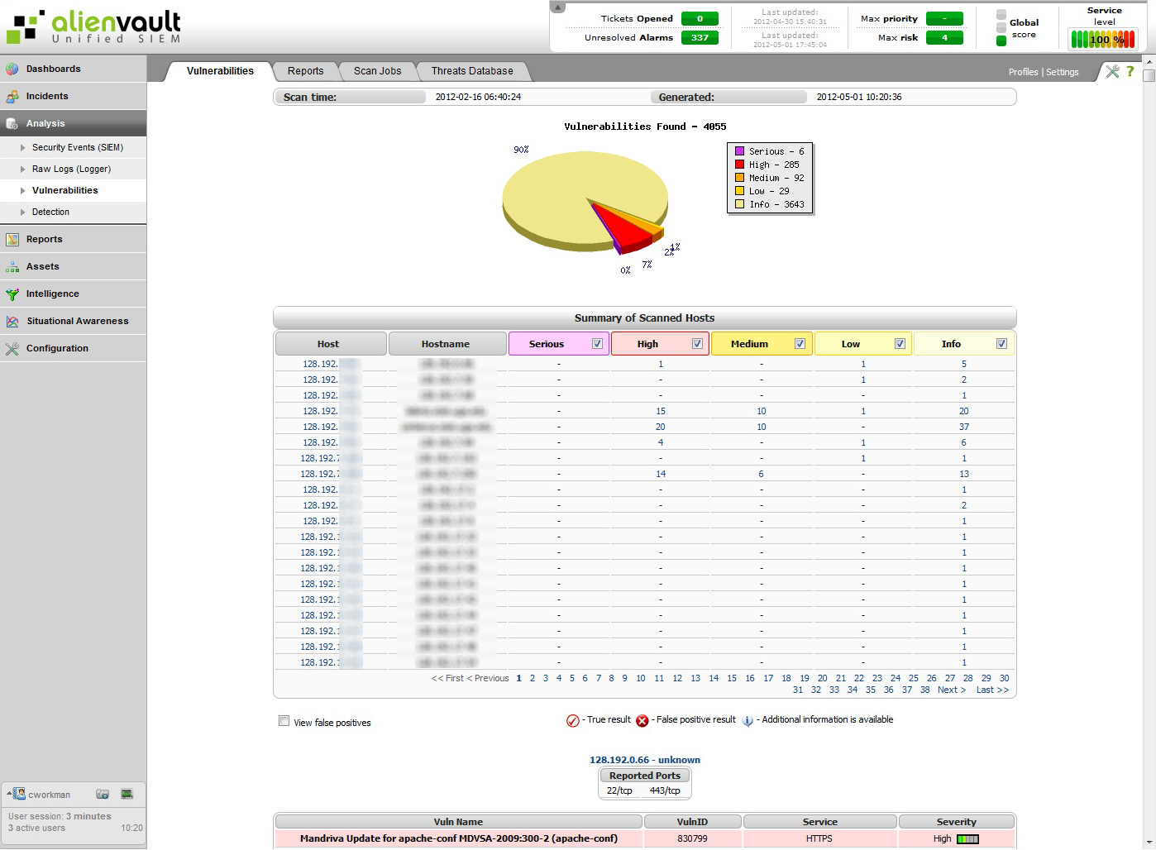
Notes:
Vulnerability data in SIEM for correlation. SQLi example

Slide 10
Notification
2012-02-09 17:58:52 128.192.x.6 0.0.0.0 OfficeScan Virus: Failed to Clean or Quarantine Mal_Hifrm
2012-02-06 13:18:56 128.192.x.6 98.139.135.21 snort: "ET DROP Known Bot C&C Server Traffic TCP (group 243) "
2012-02-01 14:48:36 128.192.x.6 0.0.0.0 Malicious Domain Lookup img717.imageshack.us malicious domain aggressive
2012-02-01 13:05:25 207.171.162.95 128.192.x.6 snort: "SPECIFIC-THREATS Microsoft IE malformed iframe buffer overflow attempt
Notes:
Sample notification – explain looking at these in context; we ask them to call us immediately if sensitive information; if not then format machine; 3 strikes for repeat offenders; students get 1
Link at the end of notices

Slide 11
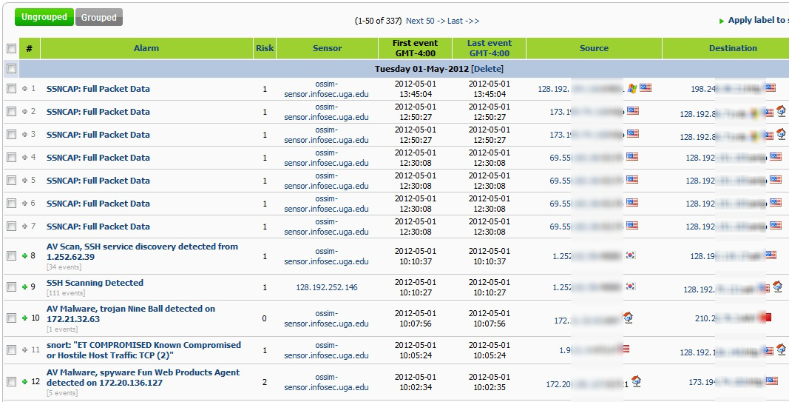
Alarms
Notes:
Departments can see alarms for their ranges and do the same (thereby giving us more intelligence to make decisions with).

Slide 12
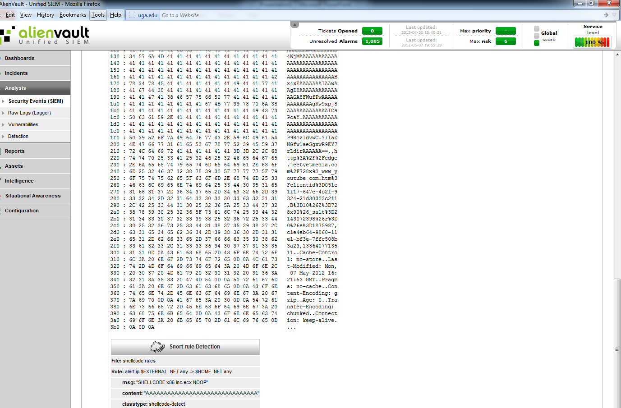
Notes:
They can drill down to see data collected from any device to help mark false-positives (which we then whitelist after some research on our part)

Slide 13
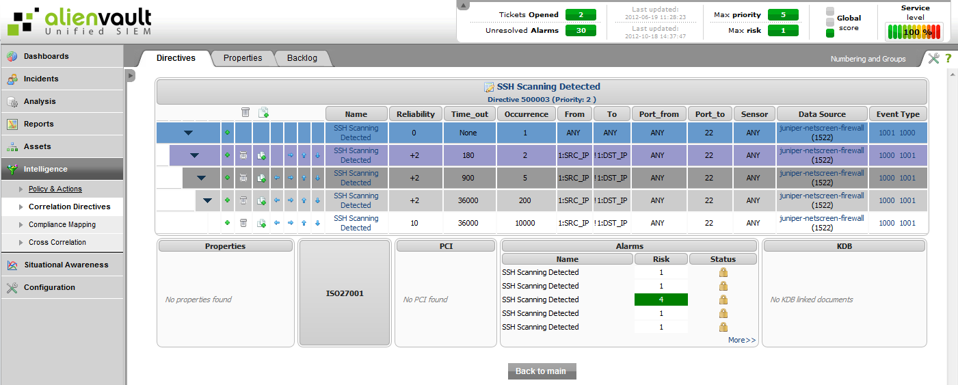
Correlation Directive

Slide 14
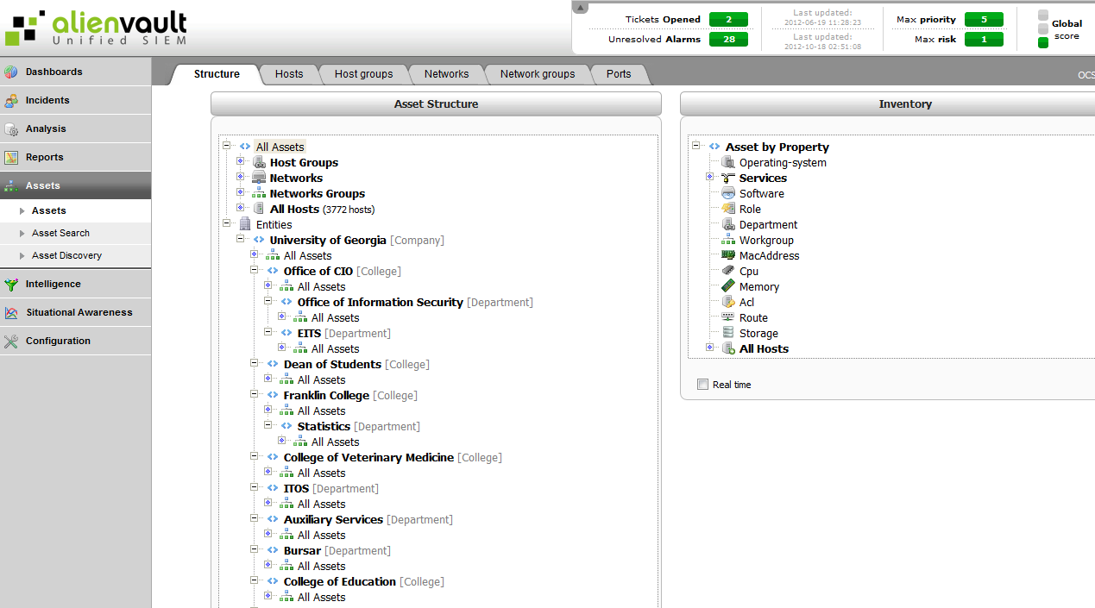
Multi-tenancy
Notes:
How we create departments, roles, users

Slide 15


Resulting Actions
Notice of incident sent to department or student
Repeat offenders blocked
SOC Incident Response Team handles critical incidents
Containment
Remediation
Resolution
Closure

Slide 16
Measuring Success
Incidents identified up from ~150/month 24 months ago to ~350/month
Critical incidents still between one and two per month, but turnaround time reduced from 5 days to 1.5; due to data availability, forensics capability
Notes:
Departmental IT staff now helping by logging, and by processing Alarms; increased visibility from departments

Slide 17
Sharing Directives
Business logic based on incidents
Question/answer pair incident
Vendor agnostic
SIEM log correlation, and resulting action

Slide 18
How do we get there?
Selecting a SIEM
Look at vendors
Use cases
Automated alerts to departments
Functionality
Designate logs sources
Elevated alerts to SOC
AV, SNORT
DLP
Multi-tenancy
Off-the-shelf features
Ability for customization
Notes:
Do Proof-of-concepts!

Slide 19
Questions?

Slide 20


Contact Info
Chris Workman
Alex Merck
Security Analyst, UGA Office of Information Security
alexm@uga.edu
Associate Director, UGA Office of Information Security, CISSP
cworkman@uga.edu

