Slide 1

Creating a University IT Service Portfolio
David Hakanson
Chief Information Officer
Samford University
May 31, 2013
Technology Services :: Samford University :: 800 Lakeshore Drive Birmingham, AL 35229

Slide 2
  IT Service Portfolio
Samford University Overview
Private University in Birmingham, AL
4,758 FTE students
Eight schools (Arts, Arts & Sciences, Business, Divinity, Education, Law, Nursing, Pharmacy)
Technology Services :: Samford University :: 800 Lakeshore Drive Birmingham, AL 35229

Slide 3
  IT Service Portfolio
Questions…
1) How many already have an IT Service Portfolio?
2) How many already have an IT Service Catalog?
Technology Services :: Samford University :: 800 Lakeshore Drive Birmingham, AL 35229

Slide 4
  IT Service Portfolio
Why an IT Service Portfolio is needed
Awareness of available services
Conduct quality assessment
Financial planning
Service Level Agreements (SLAs)
Increase transparency
Technology Services :: Samford University :: 800 Lakeshore Drive Birmingham, AL 35229

Slide 5
  IT Service Portfolio
IT Portfolio vs. IT Catalog
IT Service Portfolio | IT Service Catalog
Services | Products
Non-ordering document | Ordering document
High level | Detailed
Value proposition | Transactional
Technology Services :: Samford University :: 800 Lakeshore Drive Birmingham, AL 35229

Slide 6
  IT Service Portfolio
Building an IT Service Portfolio
Services, not products
Independent of organizational chart
Understandable by all constituents
Contains value statements
Approved by University leadership
Technology Services :: Samford University :: 800 Lakeshore Drive Birmingham, AL 35229

Slide 7
  IT Service Portfolio
Portfolio #1 - Services
Accounts & Access (VPN, Banner login)
Security (SSN Security, Intrusion Detection)
Communication & Collaboration (Anti-SPAM, Phones)
Applications (Oracle, Reporting, Web Applications)
Desktop Computing & Printing (Desktop repair, Printing)
Infrastructure (Data center, Application Hosting)
Web (SharePoint, Departmental Sites)
Instructional (Course Evaluations, Blackboard)
Technology Services :: Samford University :: 800 Lakeshore Drive Birmingham, AL 35229

Slide 8
  IT Service Portfolio
Portfolio #1 - Problems
Aligned directly to IT organizational chart
Most services were actually products
Not intuitive for users
Many items were not customer-focused (ex. DHCP)
Technology Services :: Samford University :: 800 Lakeshore Drive Birmingham, AL 35229

Slide 9
  IT Service Portfolio
Portfolio #2 - Services
Application Services (App Development, Finance)
Telephone Services (Telephone, Voice mail)
Network Services (Internet, Wired Network)
Systems Services (Monitoring, Disaster Recovery)
Security (Compliance, Incident Response)
IT Administration (IT Policy)
User Services (Email, Portal)
Technology Services :: Samford University :: 800 Lakeshore Drive Birmingham, AL 35229

Slide 10
  IT Service Portfolio
Portfolio #2 - Problems
Continued alignment to organizational chart
Listed items that are not services (IT Policy)
IT Administration is not a service
Technology Services :: Samford University :: 800 Lakeshore Drive Birmingham, AL 35229

Slide 11
  IT Service Portfolio
Portfolio #3 - Services
Academic Services (Course Delivery, Computer Labs)
Application Services (Ecommerce, SIS)
Workplace Services (Email, Training, File Storage)
Consulting Services (Project Management)
Strategic Initiatives
Technology Services :: Samford University :: 800 Lakeshore Drive Birmingham, AL 35229

Slide 12
  IT Service Portfolio
Portfolio #3 - Problems
Workplace Services was confusing
Two levels under Workplace Services
Strategic Initiatives is not technically a service
Technology Services :: Samford University :: 800 Lakeshore Drive Birmingham, AL 35229

Slide 13
  IT Service Portfolio
Portfolio #4 - Services
Academic Services (Course Delivery)
Application Services (Application Hosting, Survey)
My University Services (Email, Internet, Voicemail)
Consulting Services (Project Management)
Technology Services :: Samford University :: 800 Lakeshore Drive Birmingham, AL 35229

Slide 14
  IT Service Portfolio
Value Statement Design
Brief and concise
Use non-IT language
Show strategic nature of each service
Answer “Why use this service?”
Technology Services :: Samford University :: 800 Lakeshore Drive Birmingham, AL 35229

Slide 15
  IT Service Portfolio
Value Statement Example #1
Application Services – Accountable for deployment and support of highly effective enterprise applications and related systems, which will incorporate best practices to support all University constituents and enhance the business needs of the University.
Technology Services :: Samford University :: 800 Lakeshore Drive Birmingham, AL 35229

Slide 16
  IT Service Portfolio
Value Statement Example #2
Consulting Services – Technology experts who can assist users with review and implementation of technologies in support of specific academic or administrative needs. Our knowledge of technology integrations and our connections with best-practices organizations enables thorough and reliable guidance for new and emerging technologies.
Technology Services :: Samford University :: 800 Lakeshore Drive Birmingham, AL 35229

Slide 17
  IT Service Portfolio
IT Service Catalog
Focuses on products
Designed as a menu of products
May have costs associated with items
Multiple options for each service
Technology Services :: Samford University :: 800 Lakeshore Drive Birmingham, AL 35229

Slide 18
  IT Service Portfolio
IT Service Catalog Examples
Email Service – Request Generic Account
File Storage – Request Additional Space
Remote Access – Request VPN Access
Project Management – Request New Project
Banner Finance – Request New Report
Banner HR – Request a Modification
Computer Labs – Request New Software
Technology Services :: Samford University :: 800 Lakeshore Drive Birmingham, AL 35229

Slide 19
  IT Service Portfolio
Using the Portfolio - Financials
Assign Banner activity code to each service
Overhead accounts created for each department
Overhead activity codes linked to p-cards
Associated activity code with each Purchase Order
Determine easiest way to assess resource assignment
Technology Services :: Samford University :: 800 Lakeshore Drive Birmingham, AL 35229

Slide 20
  IT Service Portfolio
Using the Portfolio – Resource Allocation
Request staff to estimate time per service (percentage)
Associate each percentage of salary/benefits to service
Conduct exercise on a regular basis
No timesheets per service
Technology Services :: Samford University :: 800 Lakeshore Drive Birmingham, AL 35229

Slide 21
  IT Service Portfolio
Using the Portfolio – Resource Example
Technology Services :: Samford University :: 800 Lakeshore Drive Birmingham, AL 35229

Slide 22
  IT Service Portfolio
Using the Portfolio – Dashboard Goal
Technology Services :: Samford University :: 800 Lakeshore Drive Birmingham, AL 35229

Slide 23
  IT Service Portfolio
ITSM Tool
EasyVista used for ITSM
Requested that Service be assigned to all tickets
Service is automatically entered based on selection
Unable to provide value statements with portfolio
Technology Services :: Samford University :: 800 Lakeshore Drive Birmingham, AL 35229

Slide 24
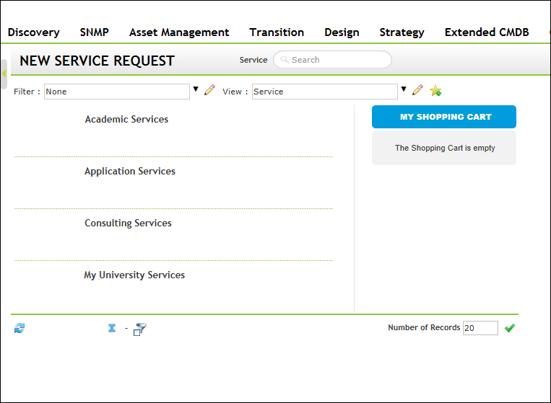
  IT Service Portfolio
Technology Services :: Samford University :: 800 Lakeshore Drive Birmingham, AL 35229

Slide 25
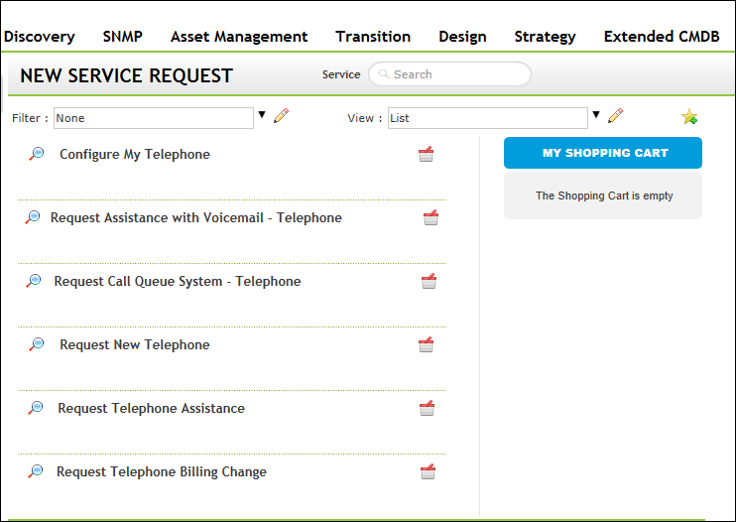
  IT Service Portfolio
Technology Services :: Samford University :: 800 Lakeshore Drive Birmingham, AL 35229

Slide 26
  IT Service Portfolio
Upcoming Tasks
Complete rollout of portfolio
Assign all purchases to a service
Draft value statements with each service
Begin creating dashboards to show key performance
Gain approval on SLAs
Technology Services :: Samford University :: 800 Lakeshore Drive Birmingham, AL 35229

Slide 27
  IT Service Portfolio
Questions?
Service Portfolio: http://www.samford.edu/ts/services.aspx
David Hakanson
dhakanson@samford.edu
Technology Services :: Samford University :: 800 Lakeshore Drive Birmingham, AL 35229

