Slide 1
Copyright Adam Northam 2009. This work is the intellectual property of the author. Permission is granted for this material to be shared for non-commercial, educational purposes, provided that this copyright statement appears on the reproduced materials and notice is given that the copying is by permission of the author. To disseminate otherwise or to republish requires written permission from the author.

Slide 2
Building a Digital Collection from the Ground Up

Slide 3
Adam Northam
Digital Collections Librarian,
Texas A&M University-Commerce

Slide 4
Technology Can Reach Beyond Traditional Boundaries
“We have technology, finally, that for the first time in human history allows people to really maintain rich connections with much larger numbers of people.”
--Pierre Omidyar, founder of Ebay
Notes:
This is a quote that I thought was very interesting, particularly in a library context. Traditionally, libraries have depended on people coming to where we are. People now expect things to come to them, wherever they might be. This is the reality in which libraries work now.

Slide 5
Libraries Must Adapt
Libraries have historically been adept at preserving, organizing, providing access to information
Technology means that libraries must change how information is organized and accessed
Digital information becoming more important
Notes:
As technology has proliferated, some have said it would be the end of libraries;
Not true—There is more information than ever that needs to be organized and accessed; Just in different way
Digital Collections are one way to use technology to our advantage

Slide 6
Libraries Can Bring Collections to Patrons
Some advantages of digital collections:
Available 24 x 7 x 365
Can be accessible from almost anywhere
Digitization can save physical collections from degradation
Notes:
Digital collections do have advantages over traditional ones;
Not bound or limited by geography;
Accessible all the time
Can prolong life of fragile or delicate materials

Slide 7
Where to Start??
Almost anyone can begin a digitization project
Can be daunting
Digital Collections are a relatively new field
Not a great deal of firm standards
Notes:
So the question is—Where do I begin?
Almost any individual or institution can explore digitization with relatively simple technology;
Can seem overwhelming at the beginning
Is a new field; not always consensus on practices, but there are some guidelines out there
Fun time to be in field; have some latitude

Slide 8
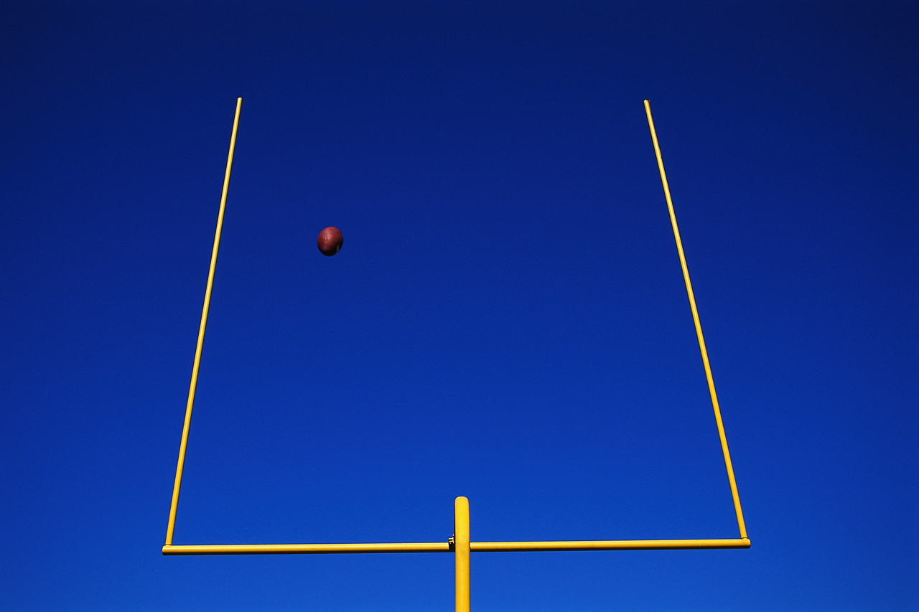
The Goal
This presentation aims to provide practical experience to those who wish to begin a digitization project of their own
Topics include:
Dealing with administrative issues ;planning for collections
Lessons learned from our experiences
Where our collection stands now
Notes:
This is what I plan to cover:
Want to talk a little about admin. Issues do deal w/ before digitization
Some mechanics of digitization
Where we started; where we are today
The information here is informed by my specific experiences with digital collections;
By no means is it comprehensive or definitive

Slide 9
Planning for a Digital Collection
How will collections be delivered to users?
Content management System (open source v. proprietary)
Which file formats should be used?
TIFF, JPEG, AVI, MPEG etc.
Where will the objects be stored?
Hard drive, server, backups, etc
Notes:
These next few slides address issues related to planning
It is important to try to do as much planning as possible before you start to make the process go more smoothly
These are some of the issues that will need to be addressed:
Software used, file formats, storage

Slide 10
Planning (cont.)
What standards and practices will be used to ensure quality and consistency?
Digitization standards, metadata scheme, etc.
Who will be responsible for maintaining the collection?
Current staff? New staff? Full time? Part time?
Who is the audience?
Faculty/staff? Students? General public?
Notes:
More issues—Standards are big—These will be addressed more as we go along
Some of these issues will be easy to identify at the beginning of the process
Some will be figured out on the fly, based on specific circumstances
May vary if there are multiple collections

Slide 11
Planning (cont.)
Copyright
Consider public domain, fair use
When in doubt try to find someone to ask for permission (publisher, creator, etc.)
If issue can’t be clearly resolved, exclude item from public collections
Notes:
Copyright is one that you have to be mindful of;
If you aren’t sure, err on the side of caution—leave it out
Whenever anything is served out over the Internet, there is a likelihood that it good be copied;
Can use banding, watermarking etc. to discourage unauthorized use

Slide 12
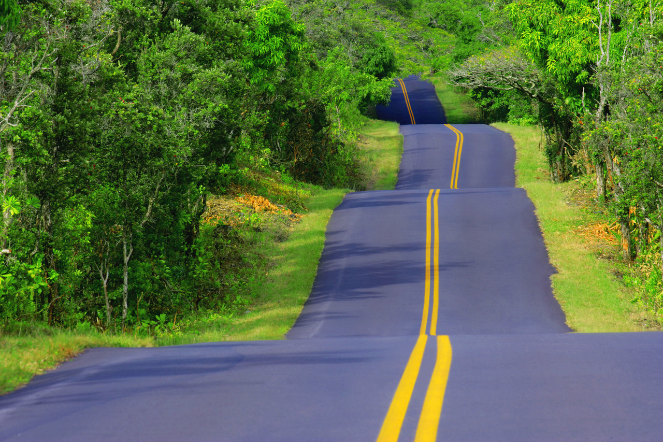
Our Experience (and some tips) for building Digital Collections
“If you don’t know where you’re going, any road will take you there”
--George Harrison
Notes:
This is how I felt at the beginning of our digitization project;
Didn’t have a lot of experience—just learned as much as a could;
You can’t really be lost if you don’t know where you are supposed to end up

Slide 13
A Bit About Our Journey into Digitization
We set forth:
We wanted a greater digital presence beyond traditional web
Two interested persons were given the opportunity to research building digital collections
Notes:
Now for our story and how our digital collections started.
Our digital collections started when our director asked “Do you know anything about digital libraries? I said no. He said, Do you want to? I said Yes. He said good—your on the project;
I was told to download Greenstone collection management software and play with it;
Another staff member was assigned as support;

Slide 14
A Bit About Our Journey into Digitization
We wanted to build our first collection on a shoestring budget
Borrowed unused equipment within our library
Found freely available software
Worked when not bound by other job responsibilities
Identified collections that we owned for possible digitization
Notes:
We wanted to build on the cheap;
Begged borrowed, but didn’t steal ☺
Building on virtually no budget relieved a lot of pressure, except what we put on ourselves because we really wanted to succeed;
There were times when the digitization worked got pushed aside because of regular duties
This caused some organizational issues—which I’ll discuss a little as we move along;
Looked for something that would make an interesting collection, but easy

Slide 15
A Bit About Our Journey into Digitization
Built a small pilot collection of World War II posters
Used for trial and error to see what was involved with collection building and maintenance
Used to solicit seed money to grow collection
Notes:
Decided to use posters that were in our archives Dept.
The WWII posters were ideal to start; a Discreet collection
Relatively easy to digitize; We owned them; most were public domain
Allowed us to really explore how the software worked;
Became clear early on that we could expand upon this one collection—aimed bigger—went for money to expand

Slide 16
Before Digitization Begins
Before you begin digitizing:
Research
Look at what others are doing (collections, software, standards, etc.)
Talk to Others
Contact others who have digital collections for advice
Notes:
There is quite a bit of work that really needs to be done before a digital collection project can really get off the ground
When starting a collection, researching what others have done, and actually talking to them can provide some of the most valuable information;
Can help you decide what you want to digitize;
Others who have been working in the field can warn you about issues etc. that you may not have thioght about;
Can also serve to validate what you are doing

Slide 17
Before Digitization Begins
Before you begin digitizing:
Identify potential collections for digitization
Try to plan for growth
Notes:
Determining what you want to digitize is important because different types of items are handled in different ways;
Documents may need to be scanned; B&W different than color
posters might need to be photographed instead, due to size
Some items may be born digital
Planning for growth may be difficult; our poster collection grew into a larger WWII collection with varied materials; quickly had a large back log; still not completely caught up, almost 2 years later

Slide 18
Before Digitization Begins
Before you begin digitizing:
Take Stock of your Institution’s resources
Hardware, Software, Technology Infrastructure, Staff
Set goals for your digitization project
What do you hope to accomplish? 3 mo. 1 yr. beyond?
Notes:
See what is readily available to begin;
In our case, we found out we didn’t need to buy new equipment to begin; had computers, scanners in the library;
Greenstone didn’t require a particularly powerful PC;
If you are part of a larger institution see if you can take advantage of computer network, servers etc; In our case University Technology Services Dept; offered to provide tech support, and supply server space, so we didn’t have to buy a new one;
If existing staff are working on collection, ask about specific interests/skills, and take advantage of them;
Measurable goals are very useful to determine/quantify progress—may change rapidly, particularly at first

Slide 19
Before Digitization Begins
Identify who will work on project
Define and divide essential responsibilities
Develop a rough workflow
Be organized and methodical
Notes:
Division of responsibilities is very important; will help make sure that people know what their expectations are, and that people aren’t unnecessarily doubling up on work etc.
Some sort of workflow will allow you to examine the processes used and make sure they are the most ideal;
Organization is KEY; ran into some issues where scanned files were dumped on hard drive w/out being renamed, sometimes weeks would go by before metadata could be added; Collection grew much faster than anticipated; was not always easy to remember exactly what it was; Finally getting caught up after almost 2 years

Slide 20
Building a Digital Collection
One of the major decisions will be which collection management software to use
Open Source (Greenstone, Dspace, FEDORA, etc.)
Proprietary (CONTENTdm)
Notes:
Now we’ll talk a bit about collection management systems; There are 2 ways you can go;
Both types have pros and cons—decision will depend on environmental factors, budget; These are examples of both kinds;

Slide 21
Building a Digital Collection
Advantages of open source software
Free of cost
Relatively quick, simple to download and try
Could have a basic collection up in a short period of time
Notes:
First, the advantages of open source—FREE;
We started with open source; Just downloaded the software and started reading a help wiki;
Initially liked Greenstone, because collections could be saved on CDs/DVDs, viewed on a computer/out and Internet connection
Had scanned images in a database in a matter of a couple hours; metadata, and minimal customization took a bit longer
We measured progress in baby steps, were thrilled to have images up

Slide 22
Our First Attempt at a Digital Collection
Search
Browse by
Title
Creator
Type
Notes:
This is the search page of our first simple collection all of the settings were default with minimum metadata displayed; only 16 items; only Title and Creator were indexed;
Could be browsed by Title, Creator, Type

Slide 23
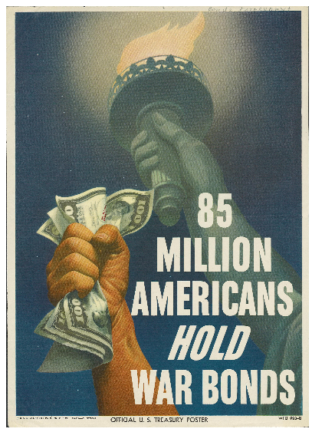
Notes:
This is a screenshot of basic metadata records, as displayed;
Displayed fields were Title, Subject; Creator; Resource Type; and Date
Right is a closer shot of one of our posters

Slide 24
Building a Digital Collection
Possible drawbacks of open source software
Steeper learning curve
Often requires specific programming knowledge
Support might be more difficult to get
May not be as functional as proprietary software
Notes:
Open source does have some short comings;
Greenstone was a really quite powerful program but there were issues for us;
Any level of customization required considerable HTML knowledge;
Those of us involved in the project didn’t have a great deal;
The main source of tech support was the wiki; was not always easy to find a clear answer for specific issues; Spent a lot of time on what ended up being relatively minor issues;
We came to the realization that you can either pay in money or time, but you will pay

Slide 25
Building a Digital Collection
Advantages of proprietary software
Often easier to use “right out of the box”
Professional tech support
May be possible to get structured training
Notes:
For us, it became clear that we open source was not the way to go; We needed more interms of support
We used our small collection with our free software as justification to get the money for CONTENTdm;
Was much more expensive, but with the cost came access to tech support, and access to optional training session with company reps;
Also a unique licensing arrangement where the software license could be distributed by us to other people/institutions has become a corner stone of our digital collections.

Slide 26
Building a Digital Collection
Possible drawbacks of proprietary software
Can be prohibitively expensive
May have to pay extra for advanced features
May have an annual maintenance fee
Proprietary software may not be interoperable with other technology
Notes:
Proprietary may not be right for all;
Cost is likely the most prohibitive aspects of proprietary software, particularly for smaller institutions;
Open source may work fine, particularly if some staff has good knowledge of HTML etc.; If we had had a dedicated programmer, we may very well have stayed with open source longer, if for no other reason than cost;
Such factors need to be taken into consideration when choosing the appropriate software
Also, you might explore consortia agreements where other institutions share the cost

Slide 27
Types of Files and Formats
Most collections comprised of 3 kinds of files
Master files-Highest quality; Other files derived from them
Access files-Mid quality; optimal for web delivery
Thumbnails-Lowest quality; act as an index image for quick reference
Notes:
After decisions about staffing, software etc, is necessary to start thinking about the mechanics of digitization, and what produces an acceptable level of quality for digitization;
There are 3 types of files to consider—Master files, Access files, Thumbnails;
One of the goals of digitization is often to get items accessible online, but not the only one;
It’s also important to retain a digital copy for archival purposes as well; That’s where the master file is important

Slide 28
Types of Files and Formats
Master files-Need to be as uncompressed as possible for highest quality
Appropriate format varies depending on media type
Photos/documents-TIFF-uncompressed image; Also supports LZW lossless compression; professional standard; files are large; other formats may be acceptable-PDF etc.
Video-Compression will vary depending on mode of capture; AVI applies no further compression to a video file; good for master files; can be very large
Notes:
Master files can often be one of the most problematic files because they are generally fairly large in size; unless you have a server, or very large hard drives, you can run out of space fairly quickly;
That has even been an issue for us, even though we have server space; the entire university uses the network, and our collection grew faster than anyone expected;
World War II collection, for example has become fairly focused on video files—A one hour mp4 video file is about 229 MB; A one hour AVI, which is the digital master, averages about 13GB; An uncompressed, or at least minimally compressed master is desirable

Slide 29
Types of Files and Formats
Audio-WAV or AIF; Both uncompressed file formats; not open source, but widely supported; are large in size
Ideally, quality of file should be main factor in choosing file type
Size often becomes as or more important than quality
Find balance
Notes:
Haven’t worked with much audio yet;
The 3 types of files are important regardless of whether you are dealing with images, documents, audio, or video
Standards and practices strongly recommend all 3 types of files, but there may be cases where it is simply not possible to maintain a set of all 3;
You have to create the highest quality that is feasible;

Slide 30
Types of Files and Formats
Access Files
Generally not archival quality; smaller size for more efficient delivery
Photos/documents—Typically JPEG; easier transmission via web or networks; suitable for onscreen display
Video-MPEG2 (DVD compatible files) MP4 or Flash for viewing via web
Notes:
Access files
Lower quality, but--If you don’t have server space or large hard drives, it may not feasible to keeps such large files;
In such cases the only option might be to keep lower resolution files, like MPEGS, or JPEGS;
If the files are not going to be edited and resaved in anyway, might be easier to get away with only the access files;
If files will be edited, or prints made, lower resolution will likely not suffice

Slide 31
Types of Files and Formats
Audio-MP3, WMV, RA-All of these formats are acceptable for access files
Desirable to have multiple formats available for various players
If only one format available provide at least a note telling user what is required
File security may be an issue for some collections
Notes:
With access files it is useful to try to have compatible formats with major online players;
If the player is free, may be able to simply put a note on the record saying what is needed;
Also maybe a link where to get the player;
With digital media there may be an issue with trying to prevent unauthorized use; Images could be banded, watermarked etc; Audio/video might be trickier, if perceived as a problem, might be necessary to restrict access;
Our philosophy so far has been to be as open as possible;
So far we haven’t had any major issues

Slide 32
Types of Files and Formats
Thumbnails
Typically low resolution JPEG files or GIF files
Helpful for making quick judgments about content
Notes:
The third file type; Think of it as an index print of the object

Slide 33
Storage and backup of files
File storage maintenance one of biggest challenges
Backup essential
Must try to prepare for hard drive crashes data corruption, data loss, etc.
Notes:
We are lucky to be able to take advantage of our university tech services department; They handle backups
Gets rid of much stress related to these issues

Slide 34
Storage and backup of files
If possible store on server that is backed up regularly
Not always practical
External hard drives, High capacity disks may be most practical solutions
Have multiple files stored in different places
Notes:
Many of the institutions we work with have limited technology infrastructures, or are limited by some constraint and many use external drives, discs etc.; Their collections reside on our servers and those online collections are backed up by us, but we typically don’t maintain master files for them; Point is, you need to try to follow as closely as you can, but must be practical too

Slide 35
Metadata
Literally means data about data
Specifically structured information that describes any information object, either print or digital
There are several metadata schemas in use
Notes:
Now, a little bit about metadata;
One of the benefits of using collection management software is that it gives the ability to attach a metadata record to each item;
Records can be easily indexed, edited

Slide 36
Metadata Schemas
MARC (Machine Readable Cataloging)
METS (Metadata Encoding and Transmission Standards)
VRA Core (Visual Resources Association)
Dublin Core
Notes:
These are just a few of the Schemas currently in use;
CONTENTdm supports Dublin Core, simple; and qualified
Also supports VRA Core
I believe you can make it use METS too but not supported natively

Slide 37
Dublin Core
Designed to be a relatively simple system
Succinctly describe a wide range of objects
Simple Dublin Core made up of 15 elements
Can be qualified to provide more detailed information
Fields can be repeated, renamed etc.
Notes:
Dublin Core is what we use;
Very flexible system; can describe a wide range of objects in a variety of formats
Not overwhelming
Mainly only descriptive metadata

Slide 38
Dublin Core
Imposes some structure on collections
Flexible
Makes data migration easier
http://www.dublincore.org
Notes:
More about DC can be found at it’s site, including definitions, usage guides etc.

Slide 39
Where we are Now
Digital Collections now its own Department
Full time digital collections librarian
No longer use open source software
Student worker to help with processing
Dedicated person in cataloging dept to handle digital object metadata
Notes:
Our Digital collections experiment started a little over 2 years ago;
We’ve grown into our own department with a full time librarian
We are under the umbrella of systems in our library;
Got more people helping

Slide 40
Where we are Now
Funding
First 2 years of our digital collections were funded by the President of our University
Direct result of pilot project
Recently received LSTA grant
Renewable up to 3 yrs
Notes:
Funding is always a concern;
We were lucky that our university president at the time we started was very enthusiastic about the possibilities of the project, based on what he saw with the pilot; Was very easy to sell;
We recently received an LSTA grant that will help to fund our efforts in working with external groups

Slide 41
Where we are Now
Collections
Currently have 5 collections online of varying size
Working with public libraries & historical societies to digitize collections
Notes:
5 collections with objects in them online;
More on the horizon; Digital collections department works very closely with archives/Special Collections dept;
Hope to digitize some new collections
Have put much effort into working with smaller local institutions and groups; We are in a position of offer access to resources and expertise to them; helps bring these unique collections to a wider range of people; Helps the university build valuable community relationships as well

Slide 43
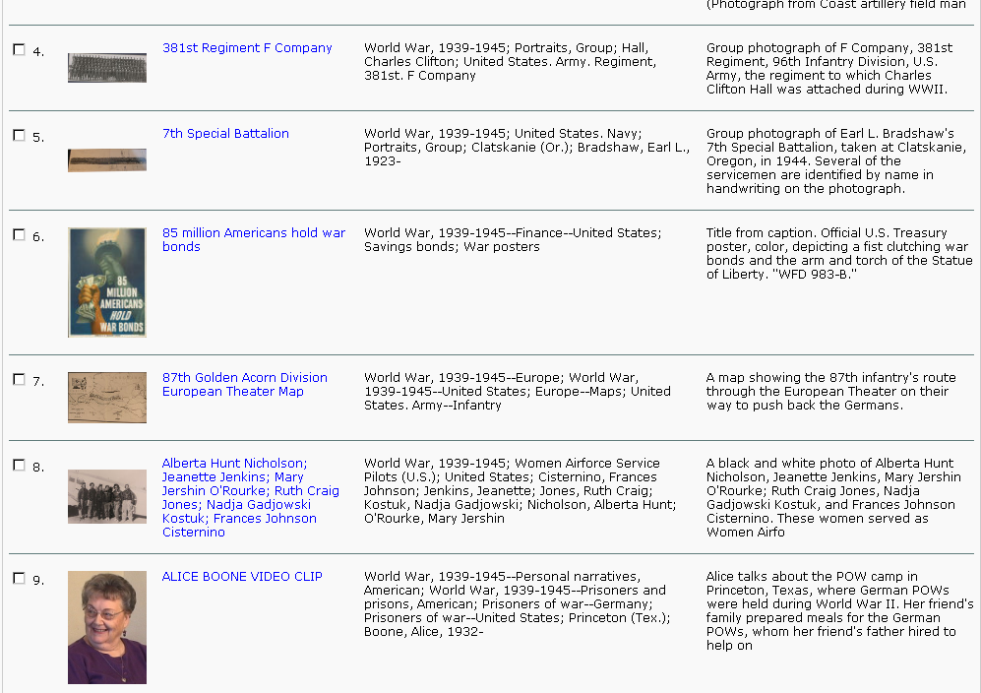

Slide 45
Where we are Now
Ongoing concerns
Standards & practices
Formats
Staffing
Funds
Storage
Notes:
Though we have progressed all the issues related to standards, formats etc. are ongoing;
The digital environment/technology is constantly evolving; important to stay informed and re-evaluate regularly
Recently our biggest problem is that we have run out of server space; We sill have room to put collections up via CONTENTdm, but we have no place on the server to place master files; we have approximately 2TB of AVI files to store w/ more on the way, and less than half of those currently reside on a server—That does not include MPEGs, JPEGS, TIFFS, WAVs etc. We will soon have our own server for the collections so we can continue to grow;
In the process of renewing our major grant to continue funding our efforts

Slide 46
Questions?

