Slide 1
There’s a Party in Security and Everyone’s Invited!
Geoff Wilson IT Security University of Oklahoma

Slide 2
Party Plan
Know if you are missing the party
Party foul example: malware infections
Making time for the party
Be the life of the party
Party favors

Slide 3
Security Incident Lifecycle
Proactive
Reactive
Detection
Triage
Analysis or other Response
Fix /
Resolution
Lessons Learned Feed
Proactive Processes & Strategy
Feeds
Communication & Outreach Strategy

Slide 4
Why balance is necessary
Reactive
Detection
Triage
Analysis or other Response
Fix /
Resolution
Incidents will happen. Are you able to react?
We must fix the problem this time around. We cannot leave problems lingering.

Slide 5
Why balance is necessary
Proactive
Lessons Learned Feed
Tough financial times require smart resource utilization.
Proactive measures often cost less than the incidents.
Free up time to work on bigger problems
Community effort can often ease your workload.
Proactive Processes & Strategy
Feeds
Communication & Outreach Strategy

Slide 6
Party Theme
Establish a healthy reactive-proactive balance so that you can build community.
Proactive
Reactive
Lessons Learned Feed
Detection
Triage
Analysis or other Response
Fix /
Resolution
Proactive Processes & Strategy
Feeds
Communication & Outreach Strategy

Slide 7
Party Plan
Know if you are missing the party
Party foul example: malware infections
Making time for the party
Be the life of the party
Party favors

Slide 8
Stuck in a reactive cycle?
Are you unable to invest time in community building or in staying up on the current trends in the industry?
Are you continually surprised by the incidents that face you?

Slide 9
Stuck in a reactive cycle?
Is the expected cost difference between continuing to react and implementing preventative measures unacceptable?
Is this type of event going to continue to be a problem?
Is not having a proactive process in place hurting how your team is perceived?

Slide 10
Party Plan
Know if you are missing the party
Party foul example: malware infections
Making time for the party
Be the life of the party
Party favors

Slide 11
Lifecycle of malware infection
Detection
Triage
Analysis or other Response
Fix /
Resolution
Malware infection alert
Examples
Hey Geoff, we’ve got a machine that looks like it’s infected. Can you take a look?
Symantec AV alert, “W32.Waledac.B 2011-01-20 09:55:58 c:\windows\temp\_ex-08.exe”
REN-ISAC alert

Slide 12
Lifecycle of malware infection
Detection
Triage
Analysis or other Response
Fix /
Resolution
Determine if escalation is required
Examples:
Look in security logs to see if machine has generated other alerts
Look up the virus common name (e.g. Waledac.B) in Microsoft Malware Encyclopedia and other knowledge bases to see if it is a known data stealer, rootkit, or backdoor Trojan.
Ask field tech to perform a secondary scan of machine and email results back

Slide 13
Lifecycle of malware infection
Detection
Triage
Analysis or other Response
Fix /
Resolution
Costly analysis

Slide 14
Lifecycle of malware infection
Detection
Triage
Analysis or other Response
Fix /
Resolution
Rebuild (usually) or clean

Slide 15
Increase in Malware-Related Incidents
In mid 2010 we saw a significant spike in malware-related incidents
Were we stuck in a reaction cycle?
Is the expected cost difference between continuing to react and implementing preventative measures unacceptable?
Yes, time lost in reaction cycle and cost of negative impacts is high

Slide 16
Increase in Malware-Related Incidents
In mid 2010 we saw a significant spike in malware-related incidents
Were we stuck in a reaction cycle?
Is this type of event going to continue to be a problem?
Yes, because root causes haven’t been addressed

Slide 17
Increase in Malware-Related Incidents
In mid 2010 we saw a significant spike in malware-related incidents
Were we stuck in a reaction cycle?
Is not having a proactive process in place hurting how your team is perceived?
It will eventually if it hasn’t already

Slide 18
Increase in Malware-Related Incidents
In mid 2010 we saw a significant spike in malware-related incidents
Were we stuck in a reaction cycle?
Are you unable to invest time in community building or in staying up on the current trends in the industry?
Yes, this is often the case

Slide 19
Increase in Malware-Related Incidents
In mid 2010 we saw a significant spike in malware-related incidents
Were we stuck in a reaction cycle?
Are you continually surprised by the incidents that face you?
No, because of root-cause analysis understanding

Slide 20
Increase in Malware-Related Incidents
In mid 2010 we saw a significant spike in malware-related incidents
Were we in a reaction cycle?
4/5 answers were, “yes,” so we were out of balance in a reaction cycle.

Slide 21
Party Plan
Know if you are missing the party
Party foul example: malware infections
Making time for the party
Be the life of the party
Party favors

Slide 22
Getting out of a reaction cycle
Reduce the time cost of reaction
Measure and analyze
Focus on lessons learned
Build community

Slide 23
Time Cost of Reaction
$$cost=cycles\left(d+t+e_{rate}\left(a+r\right)\right)$$
Detection
Triage
Analysis or other Response
Fix /
Resolution
Incoming Incidents

Slide 24
Time Cost of Reaction
$$cost=cycles\left(d+t+e_{rate}\left(a+r\right)\right)$$
Detection
Triage
Analysis or other Response
Fix /
Resolution
Incoming Incidents
Preventative measures can lower number of incoming incidents
However, they often take a while to implement.

Slide 25
Reduce the Number of Incoming Incidents
Develop preventative strategy based on root cause analysis results. For OU this is:
Patch Management
Increased security controls for systems that handle sensitive data
Storing sensitive data in a centralized and controlled place
Targeted monitoring of systems
Security awareness and training
Generate buy-in (easier to do with a community)

Slide 26
Time Cost of Reaction
$$cost=cycles\left(d+t+e_{rate}\left(a+r\right)\right)$$
Detection
Triage
Analysis or other Response
Fix /
Resolution
Making triage a defined process and automating where possible
Incoming Incidents

Slide 27
Time Cost of Reaction
$$cost=cycles\left(d+t+e_{rate}\left(a+r\right)\right)$$
Detection
Triage
Analysis or other Response
Fix /
Resolution
Incoming Incidents
Reduce number of incidents escalated

Slide 28
Reducing escalated incidents
Give front-line IT Pros more ownership of malicious software remediation
Before: Field techs would always defer to us on infections to determine what was worthy of being escalated to IT Security.
After: We are teaching field techs how to self-assess infections to determine if they are worthy of escalation
Minimize time of infection
Multi-stage attacks are cut off before they become a threat to data

Slide 29
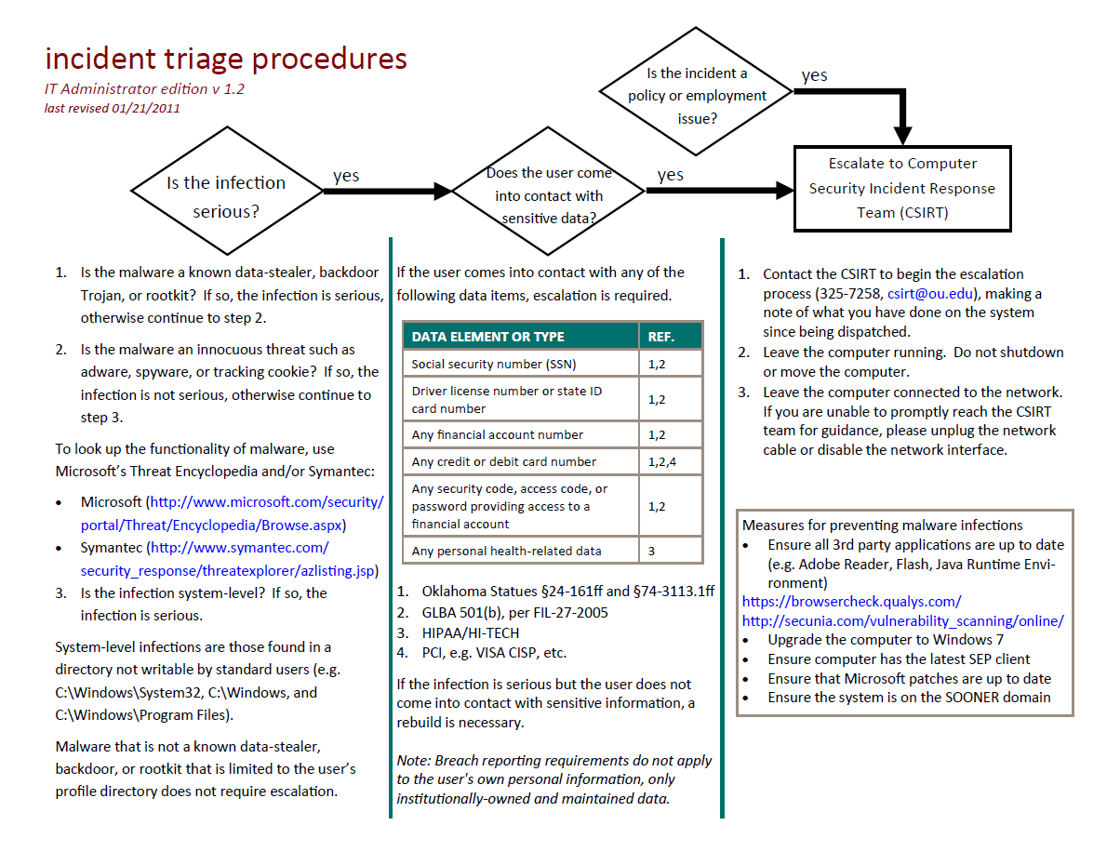

Slide 30
Time Cost of Reaction
$$cost=cycles\left(d+t+e_{rate}\left(a+r\right)\right)$$
Detection
Triage
Analysis or other Response
Fix /
Resolution
Incoming Incidents
This is often the most costly step

Slide 31
Reduce the time needed for analysis
Refrain from performing full analysis when:
The system definitely does not come into contact with sensitive data
The time of infection was minimal and network logs show no suspect flows
Train and empower others to perform the analysis
Automate the analysis where possible

Slide 32
Getting out of a reaction cycle
Reduce the time cost of reaction
Measure and analyze
Focus on lessons learned and what proactive processes can be fed by knowledge
Build community

Slide 33
Measure and Analyze
Quantify your reaction cycle
Why do we have a high number of incidents?
What’s the trend?
What’s the time lost on responding?
Make the business case for more resources/support
Understand the impact of your efforts
You don’t have to be exact, but be accurate

Slide 34
Getting out of a reaction cycle
Reduce the time cost of reaction
Measure and analyze
Focus on lessons learned and what proactive processes can be fed by knowledge
Build community

Slide 35
Throughout security lifecycle, ask yourself two questions.
Detection
Triage
Analysis or other Response
Fix /
Resolution
What did I learn here?
Can I create a proactive process?

Slide 36
Getting out of a reaction cycle
Reduce the time cost of reaction
Measure and analyze
Focus on lessons learned and what proactive processes can be fed by knowledge
Build community

Slide 37
Community Exercise!
Let’s build a community with those around you. Engage your community
Is there a part of your organization that is stuck in a reaction cycle?
Some examples could be:
Service outages
Copyright complaints
Access or account creation requests
IDS alerts
What’s one thing that your organization could do to get out of a reaction cycle?

Slide 38
Party Plan
Know if you are missing the party
Party foul example: malware infections
Making time for the party
Be the life of the party
Party favors

Slide 39
What is a Community?
Community is the Party!
A group of people who communicate regularly and who have something in common (e.g. a belief, experience, or goal)
Transcends boundaries such as physical location, organization chart, and other silos

Slide 40
Why Community?
Security needs to be everyone’s job. We cannot do this alone
Community building is a proactive measure
Community helps with generating advocacy of the security program and buy-in
Reaction becomes easier with established relationships

Slide 41
How to Plan for Community?
Visualize potential relationships to help with planning
Access to Sensitive Data
Org 2
Org 3
Org 1
Political Power
Org 5
Org 4

Slide 42
How to Plan for Community?
Visualize potential relationships to help with planning
Access to Sensitive Data
Org 3
Org 2
Org 1
Strength of Relationship
Org 5
Org 4

Slide 43
How to Build Community?
Give tech talks
Date Given | Presentation Title | Audience
1/11/2011 | Sandboxing and 3rd Party Patching Utilities | Campus IT Leaders
12/8/2010 | Malware Guest Lecture | CS Students
10/12/2010 | Removable Media Viruses | Campus IT Leaders
9/27/2010 | Security Incident Response | IT Field Services & Reps
9/14/2010 | Securing the University: Challenges and Opportunities, Incident Triage Procedures | Campus IT Leaders
8/14/2010 | Securing the University: Challenges and Opportunities | Deans & VPs
8/4/2010 | Security Awareness for Developers | IT Developers
7/13/2010 | Security Awareness for Developers | IT Developers
5/19/2010 | Emerging Threat Briefing | Various IT (workshop)

Slide 44
How to Build Community?
Generate buy-in by involving distributed IT Pros in the security processes
Open up security projects to distributed IT Pros
Give distributed IT Pros a greater stake in security
Example: OU is creating a security taskforce
Determine the greatest cyber security risks to the university
Determine the most scalable proactive measures
Work with IT Pros/departments to ensure the solutions are being implemented and work
Provide periodic reports to those interested in taskforce

Slide 45
How to Build Community?
Be Available
Give others something in return
Access to a SME
Access to a technology
Help with their needs and challenges
Be involved in more than just security
Give user-friendly, relevant handouts

Slide 46
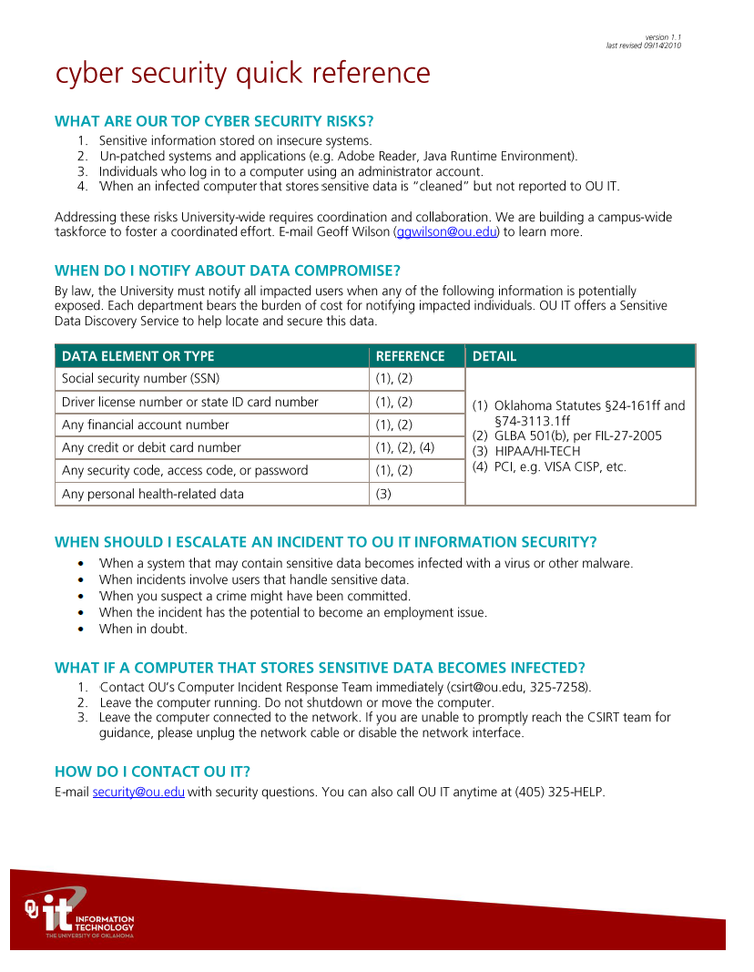

Slide 47
Community Exercise!
Discuss with your community
What’s another way that you could establish a more community-based approach to IT?

Slide 48
Party Plan
Know if you are missing the party
Party foul example: malware infections
Making time for the party
Be the life of the party
Party favors

Slide 49
What can you do on Monday?
Identify your institution’s top 5 reaction cycles
Schedule your first post-mortem to discuss incident root causes
Begin collecting statistics on your reactive cycles to help you measure actual cost
Pick the relevant criteria for your planning community building efforts. Plot 10 organizations on a graph to visualize your community building strategy

Slide 50
Don’t forget your party favor!
Geoff Wilson
ggwilson@ou.edu

