Slide 1
Pedagogical Approaches to Using E-Readers
Dr. Joan Wines & Julius Bianchi
Educause Southwest/West 2011

Slide 2
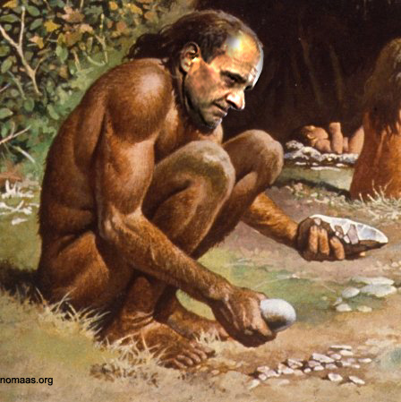
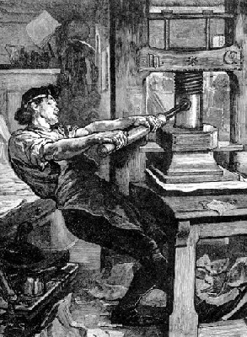
“You say you want a revolution?”
teakdoor.com
en.wikipedia.org
www2.svsd.net

Slide 3
The E-book Revolution Is Here Now— in Full Swing
2009-2011 Horizon Reports show sharp acceleration of e-book use
More students are reading more e-books on computers, e-readers, and, increasingly, on a wide variety of mobile devices.
Notes:
We know that an ebook/ereader revolution is here—part of what Adam Gopnik, in this week’s New Yorker (How the Internet Gets Inside Us) calls an unprecedented shift in communication, and what he quotes NYU prof Clay Shirky as calling “the coming of the digital millennium.”

Slide 4
Higher Education Is Helping to Determine the Shape of This Revolution
Our determination need not be haphazard
The academy’s pedagogical experience and best practices are valuable and applicable to the use of e-books and e-readers in higher education.
Notes:
We also know that post secondary institution will help shape this revolution—HOW we shape it doesn’t have to be a haphazard affair. We have a long history of successful pedagogy in the academy, pedagogy that happens to work very, very well with e-readers.

Slide 5
Faculty Can Deliberately Tie Teaching and Learning to E-Reader Functions: CLU’s Experiments
English – critical reading and writing courses
Religion – paperless course using Blackboard Mobile Learn and iPad e-reader app
Study Abroad –Fall semester at Oxford
Education – graduate leadership classes
Business –business communication courses testing rates of vocabulary acquisition w/Kindles
Psychology – Psy.D. cohort using Kindles for program reading
Notes:
At California Lutheran University, we’ve been mining this pedagogical history for best practices and tying them to the teaching and learning potential of e reader devices. The examples bulleted on the slide include an Oxford study abroad program that has made exceptional pedagogical use of Kindles and plans next Fall semester to use IPads to achieve additional program objectives. We can zoom in on another CLU Kindle pilot course to get a closer look at methodology.

Slide 6
three clear META goals for instructors who participate in e-reader projects
Improve student skill levels;
Increase student engagement; and
promote independent learning.
(See Business Communication)

Slide 7
Shaping the e-book/ereader revolution to serve our teaching and learning educational objectives
first identify the e-reader functions that best unleash the teaching and learning potential of the device
teach students to apply and practice these functions
help students learn to work interactively on their own — within a personal extended classroom, one that will intensify their learning experiences.
Instructors will then have helped students create new learning environments that are as portable as the e-books and e-readers themselves.
Notes:
To achieve those goals, to consciously participate and help shape this revolutionary e-book/e-reader moment, instructors need to spend time with these texts and devices. A necessary first step: IDENTIFY THE FUNCTIONS THAT BEST UNLEASH THE TEACHING AND LEARNING POTENTIAL OF THE DEVICE OR TEXT; SECONDLY, instructors have to take the time to teach students to apply these functions, and to practice building skills and engaging with course materials by using them. Finally, then, students will learn to work interactively and independently—in new learning environments that are as portable as the e-books and e-readers themselves.

Slide 8
Upcoming Projects
Intermediate French
Introductory Biology
Capstone Honors Seminar
Three Drama courses: acting, set design, script writing
Sociology research course

Slide 9
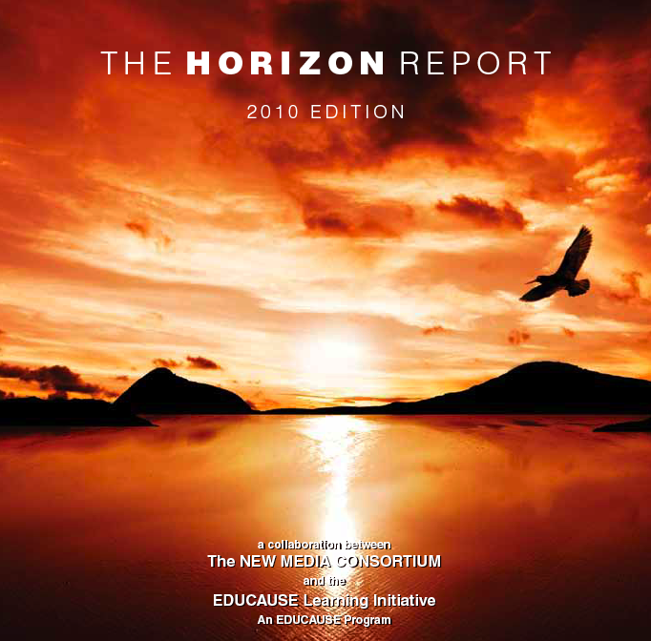
“Two well-established technologies have taken off . . . [via] global cellular networks: electronic books and simple augmented reality Both are . . .
February
entering the mainstream of popular culture;
already used in practice at a surprising number of campuses; and
expected to see much broader use across academia over the next two to three years.”

Slide 10
September
“On the near-term horizon —within the next 12 months — are electronic books and mobiles. “
Electronic books are emerging as something quite different from simple digitized versions of printed texts. . . electronic readers support note-taking and research activities, and are beginning to augment these basic functions with new capabilities . . . that are changing our perception of what it means to read.
The promise of mobiles is ubiquitous access to information, tools for learning and productivity, social networks, and more.
Notes:
By September that two to three year time frame shortened to 12 months.

Slide 11
September
“As the music industry has already discovered, consumers appreciate the ability to purchase raw content formatted for devices of their choice.
The content of books is becoming a commodity separate from the form of those books or the device used to access them.
The experience of reading electronic books will be more than simply viewing a digital version of a printed volume . . . Consumers are looking for interactive electronic content that is divorced from hardware, offered cheaply and conveniently, and provided in flexible and sharable formats.” back

Slide 12
Typical Library e-Book Offerings
Typical Library E-book Collection
Notes:
Some faculty understand that we have e-books and they use them – usually for reading small portions of a book or to look up facts.

Slide 13
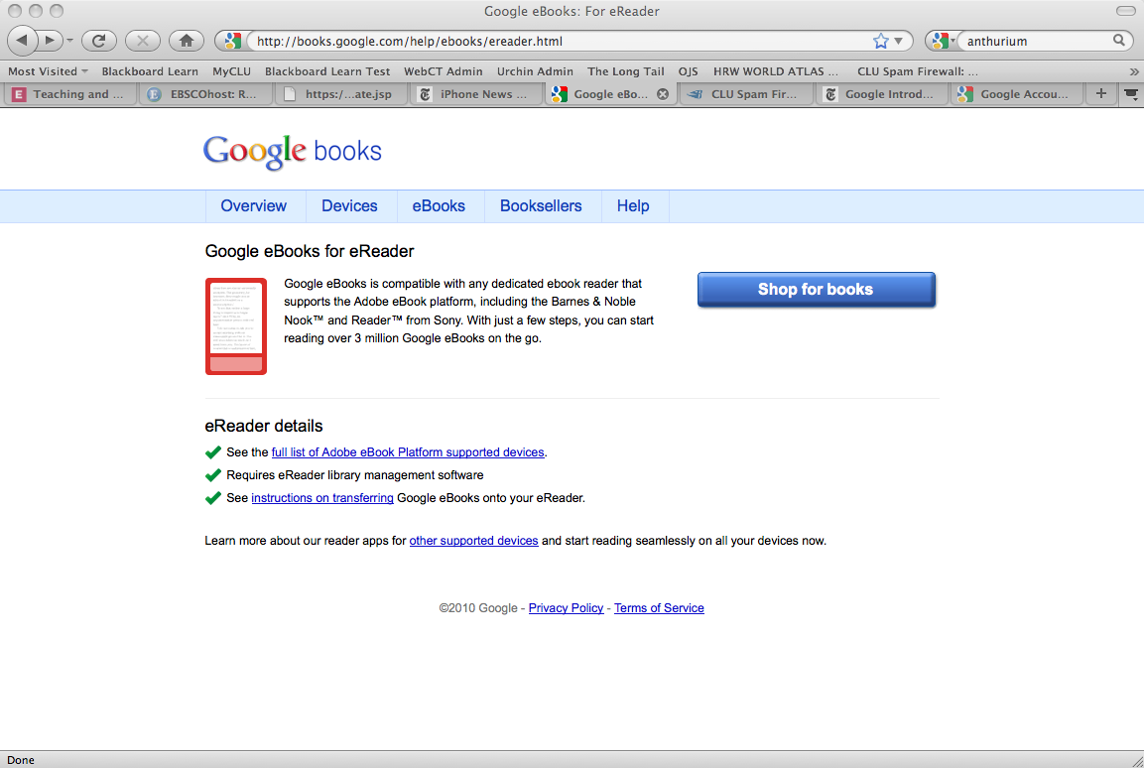
Formats
Google Books
http://books.google.com/ebooks?id=Y7sOAAAAIAAJ&printsec=frontcover&output=reader

Slide 14
Google E-book Readers

Slide 15
Google E-book Readers
Device
Independent

Slide 16
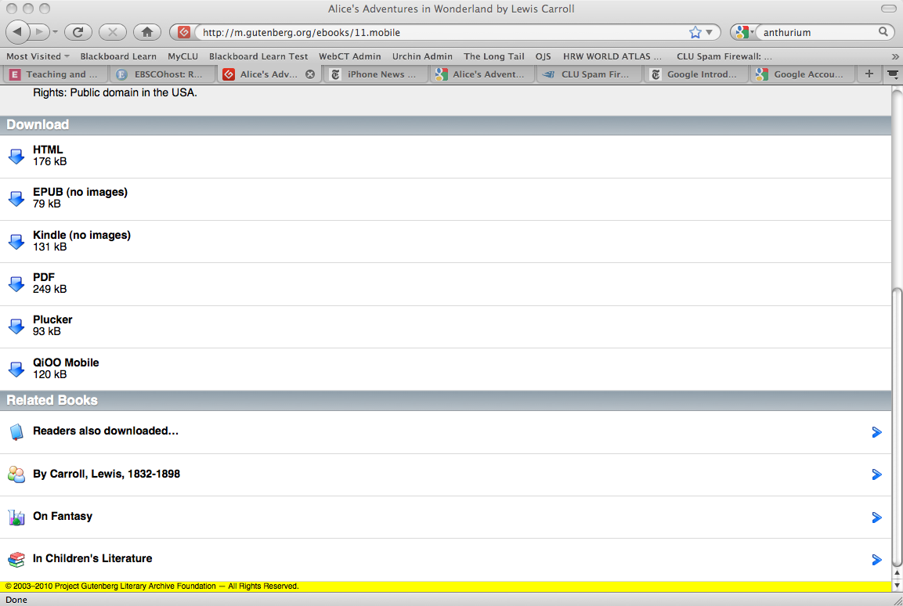
Project Gutenberg E-book Formats
Device
Independent

Slide 17
Amazon E-books
Device
Independent

Slide 18
back

Slide 19
Critical Reading and Writing Course

Slide 20
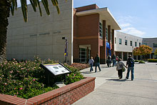
English Pilot Objectives and Outcomes
Learn to identify and write for varied audiences: created blogs about e-reader use for peers, faculty, and wider audiences
Learn and integrate at least 100 new vocabulary words: used e-reader dictionary to expand (and be tested on) new vocabulary
Engage in deep reading: “isolated page” experience
Develop the ability to write original, thesis-driven, well structured academic essays: used e-reader highlighting, note-taking, and text saving functions to help develop essays

Slide 21
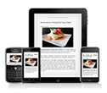
Identifying and Writing for Varied Audiences
Pilot students wrote “real world” essays (Andrea Lunsford’s phrase) about their use of e-readers (features, intercourse with other technologies, and learning outcomes).
Audiences included classmates, the instructor, and those who would be taking the class in subsequent semesters.
Students posted these essays as blogs on the course Blackboard site, knowing that they were setting the format for other students who would later contribute to the blog.
Notes:
Each of CLU's pilot students wrote an essay about the course use of an e-reader (its features, its intercourse with other technologies, and whether/how it enhanced learning). These essays addressed several audiences, including the students' classmates, their instructor, and those who would be taking the class in subsequent semesters. Students posted these critiques as blogs on the course Blackboard site, knowing that they were setting the format for other students who would later contribute to the blog.
Their clear understanding of audience and topic gave students a chance to practice "situational" writing, practice that sharpened their style, clarified their syntax, and gave them a confidence that transferred to later, more specifically academic papers.² The grades on these (and on subsequent pilot student papers) averaged a 10-point increase over the grades on papers in the instructor's previous English 111 classes. Even the essay portions of their tests (three quizzes, a midterm, and a final exam) showed significant improvement over those of students in previous semesters, especially in clarity and conciseness.

Slide 22
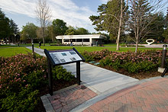
Learning and Integrating New Vocabulary Words
Vocabulary is one of the most important foundations for building critical thinking, reading, and writing skills.
Most students don't use print dictionaries to look up unfamiliar words as they plow through their reading assignments (although they may occasionally look up a word online).
Unless vocabulary words are specifically taught and tested, student interest in expanding vocabulary tends to be negligible.
http://www.educause.edu/EDUCAUSE+Quarterly/EDUCAUSEQuarterlyMagazineVolum/TeachingandLearningwithEReader/213704
Notes:
Increasing vocabulary is a traditional objective for the CLU introductory English course, since a developed vocabulary is one of the most important foundations for building critical thinking, reading, and writing skills. Most students, however, don't use print dictionaries to look up unfamiliar words as they plow through their reading assignments (although they may occasionally look up a word online). Unless vocabulary words are specifically taught and tested, student interest in expanding vocabulary tends to be negligible.
After learning to use the Kindle e-reader's built-in New Oxford American Dictionary, students did a 180. They were tested on vocabulary in assigned readings, and they formally learned seven to ten new words a week. But the informal learning was the pleasure and the surprise (see "Using the Dictionary"). Students in both pilots unanimously reported that they were looking up words in the reader on their own. These young gamers loved being able to, as one student put it, "get the definitions of words within seconds." Looking up two, three, or more words on a single page quickly became a habit. Creating a conscious, disciplined, and more self-directed approach to building vocabulary has given pilot students the tools and incentive to learn and assimilate vocabulary from their e-readings.

Slide 23
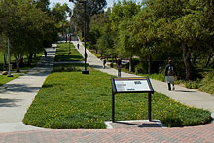
E-reader Dictionary
After learning to use the Kindle e-reader's built-in New Oxford American Dictionary, students did a 180.
They were tested on vocabulary in assigned readings, and they formally learned seven to ten new words a week. But the informal learning was the pleasure and the surprise.
Students in both pilots unanimously reported that they were looking up words in the reader on their own. These young gamers loved being able to, as one student put it, "get the definitions of words within seconds." Looking up two, three, or more words on a single page quickly became a habit.
Creating a conscious, disciplined, and more self-directed approach to building vocabulary has given pilot students the tools and incentive to learn and assimilate vocabulary from their e-readings.

Slide 24
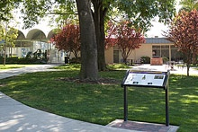
Developing the Desire to Engage in Deep and Sustained Reading
Students read more closely and were more engaged in the texts because they liked the "isolated page" experience.
Students noted that seeing only one page of an assigned text at a time eliminated a bundle of little distractions — distractions they had not realized were part of their previous reading experiences with print texts.³
Several students wrote that highlighting, annotating, and saving text in the e-reader's "My Clippings" resulted in a deeper engagement with readings.
Notes:
Jessica Pruitt, one of the pilot students, was convinced "that the Kindle is what's going to get our younger generation interested in reading." Other students agreed, offering a variety of reasons to support this conviction:
Some said they read more closely and were more engaged in the texts because they liked the "isolated page" experience.
Students noted that seeing only one page of an assigned text at a time eliminated a bundle of little distractions — distractions they had not realized were part of their previous reading experiences with print texts.³
Several students wrote that highlighting, annotating, and saving text in the e-reader's "My Clippings" resulted in a deeper engagement with readings than they had experienced in the pa

Slide 25
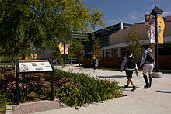
Developing Academic Writing Proficiency
A primary objective of CLU's English 111 course is that students develop the ability to write original, thesis-driven, well-structured academic essays.
We used the e-readers to help the pilot students achieve this objective. The result? The papers were more thorough and more detailed than the usual English 111 papers.
Students used e-readers in class to read, discuss, highlight, and take notes on specific passages.
As they developed their note taking and summary skills, the students created a body of material and saved it in "My Clippings," the e-reader's storage space for notes and highlights.
Notes:
A primary objective of CLU's English 111 course is that students develop the ability to write original, thesis-driven, well-structured academic essays. We used the e-readers to help the pilot students achieve this objective. The result, according to the instructor, was that their papers were more thorough and more detailed than the usual English 111 papers. Students used e-readers in class to read, discuss, highlight, and take notes on specific passages. As they developed their note taking and summary skills, the students created a body of material and saved it in "My Clippings," the e-reader's storage space for notes and highlights.
In previous semesters, the first step in helping students develop the ability to write a solid academic essay has been to assign a five-page freewrite — five pages of initial stream-of-consciousness-like responses to and ideas about a given topic or reading. Students often had difficulties with this assignment, even those who had marked passages in their print texts to use in their freewrites. In the pilot courses, students were shown how to access their e-reader "My Clippings" as a base for the freewrite assignment. Having notes and quotations stored in "My Clippings" meant they could download this material into a Word document, a process that saved them the time of having to find, type, and cite those quotations and notes. "What's so great about having these saved notes," said one student, "is that when I'm ready to write my paper, I have many ideas from many different parts of the text." Students revisited material they had already thought about, and their freewrites were, across the board, more thorough and more interesting than the "cold" (and choppier and shorter) freewrites of previous semesters.
Using the freewrite, English 111 students must next identify and craft a solid thesis. They locate the most interesting ideas in their freewrites and shape them into one-sentence theses or controlling ideas for their assigned papers. Gelena Correa wrote her five-page freewrite using material transferred from her "My Clippings" e-reader storage area, crafted her sketch of her emerging paper, and then wrote her first draft.
Writing successes like Gelena's were perhaps the most satisfying of the many positive results of CLU's pilot e-reader project. Another plus relative to the writing component of the course was that using e-reader functions to develop papers virtually eliminated plagiarism problems. Most of our pilot students became habituated to reading deeply, finding definitions for and using new vocabulary words, writing better and more engaging essays, and carrying their portable learning environment into their extracurricular lives. These results have convinced us that e-readers are great learning devices for gadget-addicted students, and that putting their texting and gaming skills to work within solid pedagogical structures can help them improve their reading and writing skills.

Slide 26
Freewrites
Freewrites, five pages of initial stream-of-consciousness-like responses to and ideas about a given topic, help students develop the ability to write solid academic essays
Students often have difficulties with freewrites, even those who mark passages in their print texts. In the pilot courses, students were shown how to access their e-reader "My Clippings" as a base for the freewrite assignment.
Students could download notes and quotations stored in "My Clippings," into Word documents, a process that saved them the time of having to find, type, and cite those quotations and notes.
"What's great about having these saved notes," said one student, "is that when I'm ready to write my paper, I have many ideas from many different parts of the text."
Students revisited material they had already thought about, and their freewrites were, across the board, more thorough and more interesting than the "cold" (and choppier and shorter) freewrites of previous semesters.

Slide 27
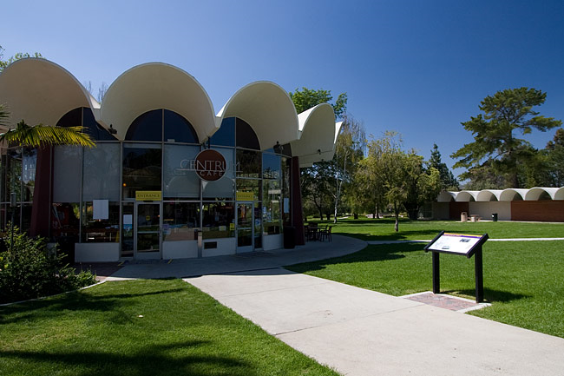
Writing Process
Using the freewrite, English 111 students must next identify and craft a solid thesis.
They locate the most interesting ideas in their freewrites and shape them into one-sentence theses or controlling ideas for their assigned papers.
Gelena Correa wrote her five-page freewrite using material transferred from her "My Clippings" e-reader storage area, crafted her sketch of her emerging paper, and then wrote her first draft.
http://www.educause.edu/EDUCAUSE+Quarterly/EDUCAUSEQuarterlyMagazineVolum/TeachingandLearningwithEReader/213704

Slide 28
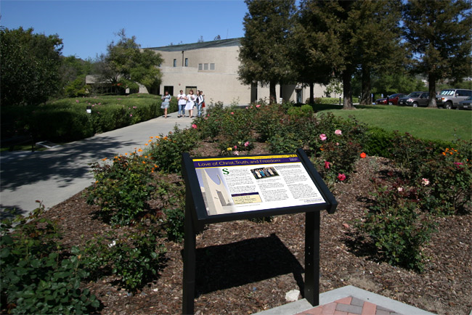
English E-reader Pilot Results
When gadget-addicted students combine their texting and gaming skills with solid pedagogies, they improve their reading and writing skills.
Tying e-reader functions to the first-year Critical Reading and Writing course objectives helped support and deepen student engagement in reading and writing.
Students became habituated to reading deeply, finding definitions for and using new vocabulary words, writing better and more engaging essays, and carrying their portable learning environment into their extracurricular lives.
Using e-reader functions to develop papers virtually eliminated plagiarism problems.
Students used the e-reader's interactive functions to create ubiquitous, personal, portable classrooms that extended and intensified their learning experiences.
back

Slide 29
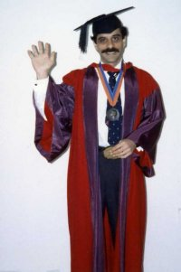
Oxford Study Abroad Program

Slide 30
CLU Mission Statement
. . . The mission of the University is to educate leaders for a global society who are strong in character and judgment, confident in their identity and vocation, and committed to service and justice.

Slide 31
Oxford Study Abroad Objectives and Outcomes
Immerse students in reading: Kindles provided mobility so that students could read everywhere--on planes, trains, inside/outside their residence halls.
Improve writing: students transferred tutorial papers to their Kindles
Improve presentation skills: used Kindles to present in class.
Familiarize students with locations abroad: loaded maps on Kindles to help find their way in new cities.
Bring ancient culture to life: used Kindles to present scenes from Greek tragedies on the very locations where they were first performed.

Slide 32
Four fundamental uses for mobile technology in study abroad programs http://public.clunet.edu/~brint/OxfordKindle/CLU%20Oxford%20Kindle%20FINAL.avi
Reading: The Oxford Program students read thousands of pages. Kindles or like devices are essential. Not only are they invaluable on long trips, they allow for many other options as well.
Exploring: Static maps in the Kindles and GPS navigation and mapping applications on iPads allow students to locate their position in real time and find their way back home.
Connecting: Using a common device to connect students and the faculty director is crucial for a travel program. Often US Cell phones do not operate properly and students do not always top-up their European sim cards. Instant Messaging, Texting, and Email are all compatible with the IPad.
Connectivity: Internet access is central to the program’s educational mission. Even in Oxford, the Internet is dodgy. WiFi and 3G capabilities make a significant difference.

Slide 33
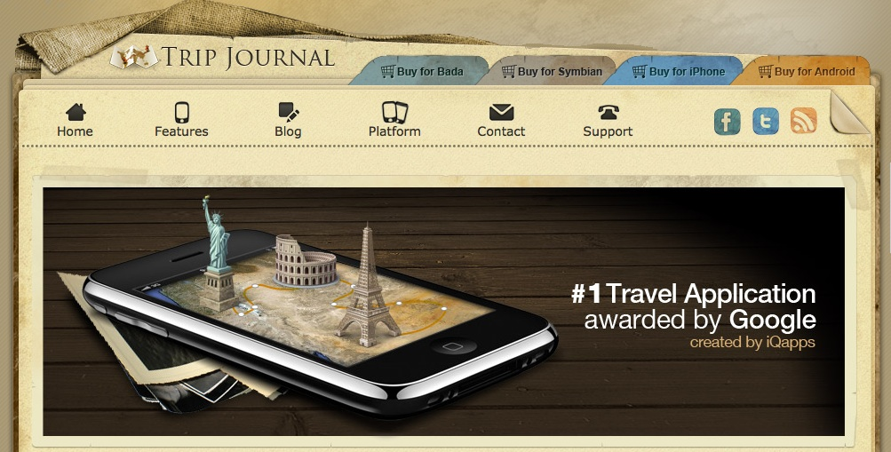
Plans for Using iPads in Future Study Abroad Programs
A new iPad pilot project can further exploit the e-readers’ potential for fulfilling the promise of ubiquitous learning abroad.
Students will create “Trip-Journals” as they explore European cities, journals they can share on Facebook and through Google Earth.
The Trip-Journal app has navigation capabilities, personal photo storage, and descriptions on Google Earth maps
http://www.trip-journal.com/features/features/

Slide 34
A Cityscape of Rome
In the “Politics and the Arts” travel seminar, students study urban design and the use of public space in Rome, including the history and use of specific piazzas.
Passing over parts of the piazzas on a Goggle map that describes and gives the history of the site, Students can use “Trip Journal” and a camera to create their own “cityscape.”
These maps can be saved so that each year new areas can be investigated and added to a growing cityscape of Rome.

Slide 35
Medieval and Renaissance Architecture in Florence
In Florence, we study Dante and Machiavelli as representatives of Florentine Medieval and Renaissance thought.
Students trace the architecture of Medieval and Renaissance Florence in a photographic/video essay. Like the cityscape of Rome, these visual essays can be associated with specific locations on a Google map through the use of the Trip Journal application.
We can then begin to see the outlines of Medieval and Renaissance Florence as each year’s students add to this architectural map.

Slide 36
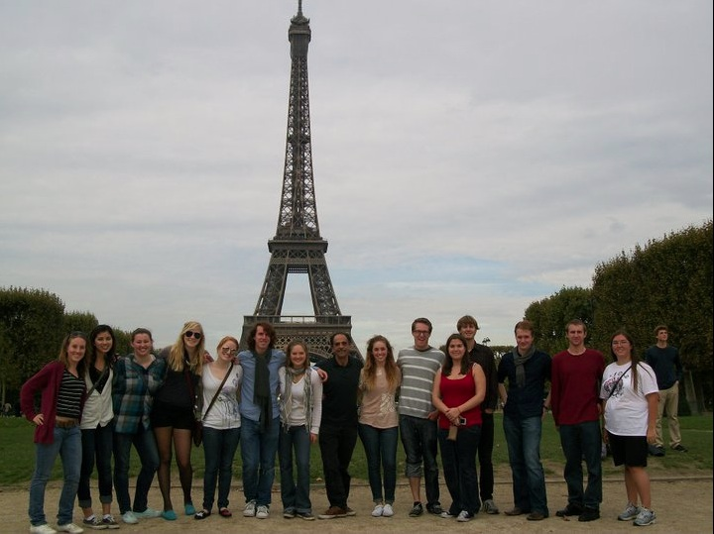
Restaurant Review Map
Throughout their travels, students write restaurant reviews in exchange for dinner stipends. The database of these reviews grows every year.
Using Trip Journal’s mapping feature, we can embed the reviews at the location of the restaurant creating a restaurant review map of London, Paris, Nice, Rome, Florence, and Barcelona.
back

Slide 37
Business Communication

Slide 38
Three Sections of a Business Communication Course: Objectives
Understand that the rules and language of business discourse communities are usually internal to those communities,
Develop skills in understanding and using the shared vocabulary of selected business communities,
Learn to standardize their discussions within the parameters set by a discourse community.
Notes:
Objective: to Help Students Understand the Language and Vocabulary of a Business Community Discourse Joining the Conversation : Using E-Readers
Case study participants included a total of 48 students enrolled in three sections of a 300-level Communication for Managers course.
Case study participants included a total of 48 students enrolled in three sections of a 300-level Communication for Managers course.

Slide 39
Methodology
Section 1 students used the e-reader’s internal functions to look up unfamiliar words and phrases and store them in the “clippings” sections, creating a customized business thesaurus.
Section 2 students were provided only with a link to the Oxford American Dictionary on the University’s Blackboard system.
Section 3 students were given no explicit instruction for looking up unfamiliar words.

Slide 40
Business Communications Outcomes
Students in all sections completed brief comprehension quizzes on the readings.
The Wall Street Journal, The Economist, The Financial Times, Bloomberg Businessweek, Forbes, Harvard Business Review, and China International Business and other academic and trade publications (journals, newsletters, etc.)
Company and professional society web sites (e.g., Federal or State Bar Association, the National Association of State Foresters, Society for Technical Communication)
Internal and external correspondence (including memos, reports, policy and procedure documents, forms, letters, applications, descriptions, reports)
Each of the students also completed vocabulary quizzes and a short essay response summarizing each article.
All students completed a survey to determine whether, how, and how often they had looked up unfamiliar words and terms.
back

Slide 41
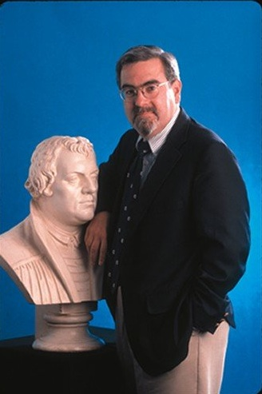
Religion: Christianity in America

Slide 42
Religion 334/History 335 Pilot Objectives and Outcomes
Centralizing the learning experience: Coordinated course on Blackboard, digitally collected all assignments and essays; delivered quizzes.
Created an entirely paperless course: Helped students become more organized.
Reduce text prices: all assigned texts were available on the Kindle platform for very low prices except the main textbook (much less expensive than the print version and available in digital form).
Notes:
Here is what I would need: enough tablets for two sections of 25 each (actually, I have 51 enrolled somehow.) I would prefer to work with iPads, since they're what I know, but any tablet that has interactive capacities and on which the Kindle app would work would be adequate.

Slide 43
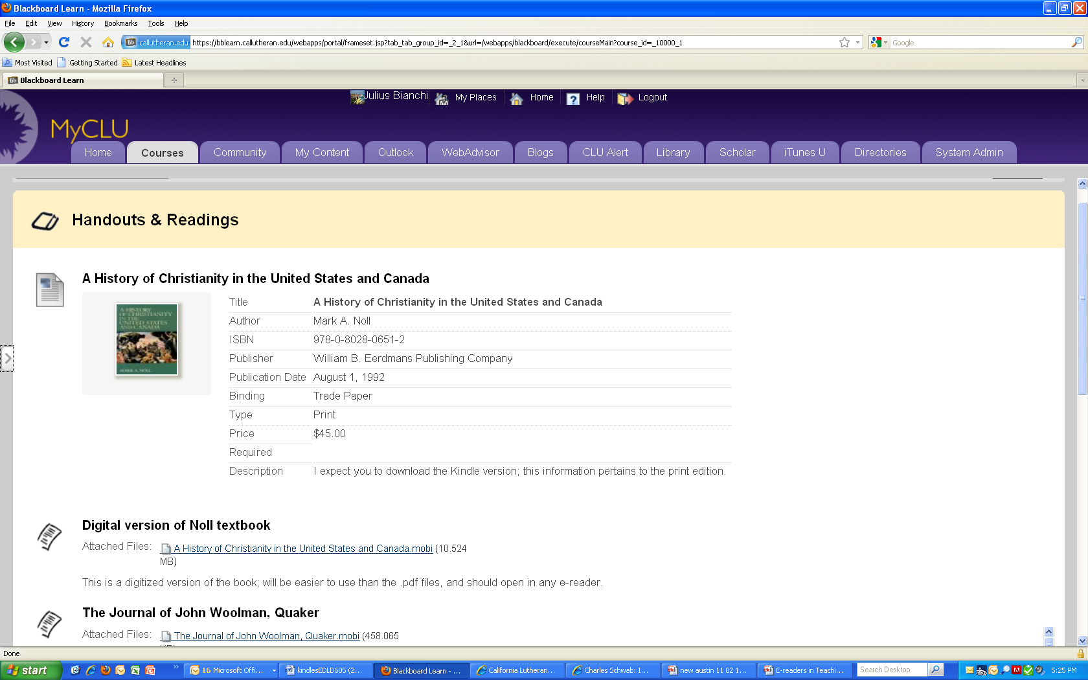
back

Slide 44
Graduate Psychology

Slide 45
Doctoral Cohort in Psychology Objectives and Outcomes
Collect research materials in one location: downloaded articles, book chapters, and books to be read at a later date.
Organize extensive research materials: arrange sources into manageable folders.
Identifying and selecting key research passages and quotations: highlighted and annotated text using e-reader functions.
back
Notes:
Students requested e-readers for their doctoral program
Kindle e-readers were distributed to 20 students
First use in a research seminar in Spring 2011
Accumulated data and response surveys will be analyzed at the completion of the course.

Slide 46
Education

Slide 47
Educational Leadership 605 Objective and Outcomes
Discover how students used and benefited from the Kindles
Increased efficiency in literature review process: most texts available in electronic format; highlighting and notation features streamline organization, summary, and retrieval of material.
Can read while doing other things with the multi-modal text-to-speech feature.
Particularly effective with narrative- style texts
Use text-to-speech and read along features simultaneously helps increase retention
back

