Slide 1
Leading the way to a “Green-er” Campus
Oscar Ramos and Link Alander
Lone Star College

Slide 2
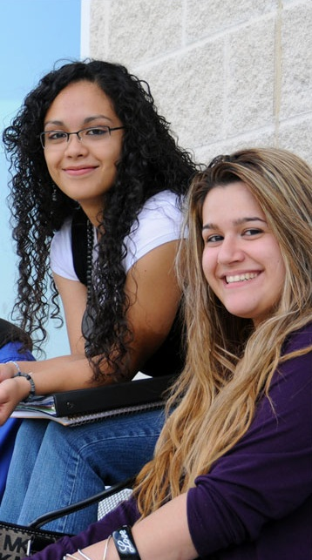

Presentation Overview
Introduction to Lone Star!
Phase I Recap
Data Center
Phase II - Partnerships
Campus
Students
Regional Institutions
Questions

Slide 3
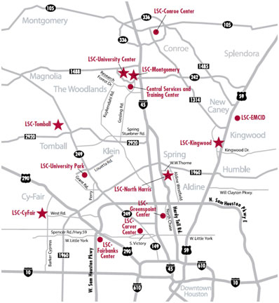
Overview LSCS - Enterprise
13 Locations across 1,400 square miles
5 Colleges
2 University Centers
5 Instructional Centers
Systems Office and Training Center
21 new buildings this year
5 new geographic locations
Our Customers (90,000 strong)
69,363 Credit Students
21,000 Non Credit Students
Average 25% growth per semester
Over 4,800 employees
Supported by 152 OTS staff members

Slide 4
GREEN it principles
As the trends of the Technology Industry move toward a more energy conscience, sustainable model; the LSCS Office of Technology Services has committed to being a leader in this arena by engaging in more Eco friendly practices.
There are two major factors that lead to this shift in focus.
As an institution of Higher Education, we have a social responsibility to address this issue and be a leader in our community
As stewards of tax payers’ dollars, we have a fiscal responsibility to manage costs and improve efficiencies.

Slide 5
Phase I Recap
Data Center enhancements will lead to a yearly savings of $428,978 per year
Advanced Desktop Power Management will save nearly $725,000 over three years!
Asset Recovery will keep old equipment and components out of the landfill!

Slide 6
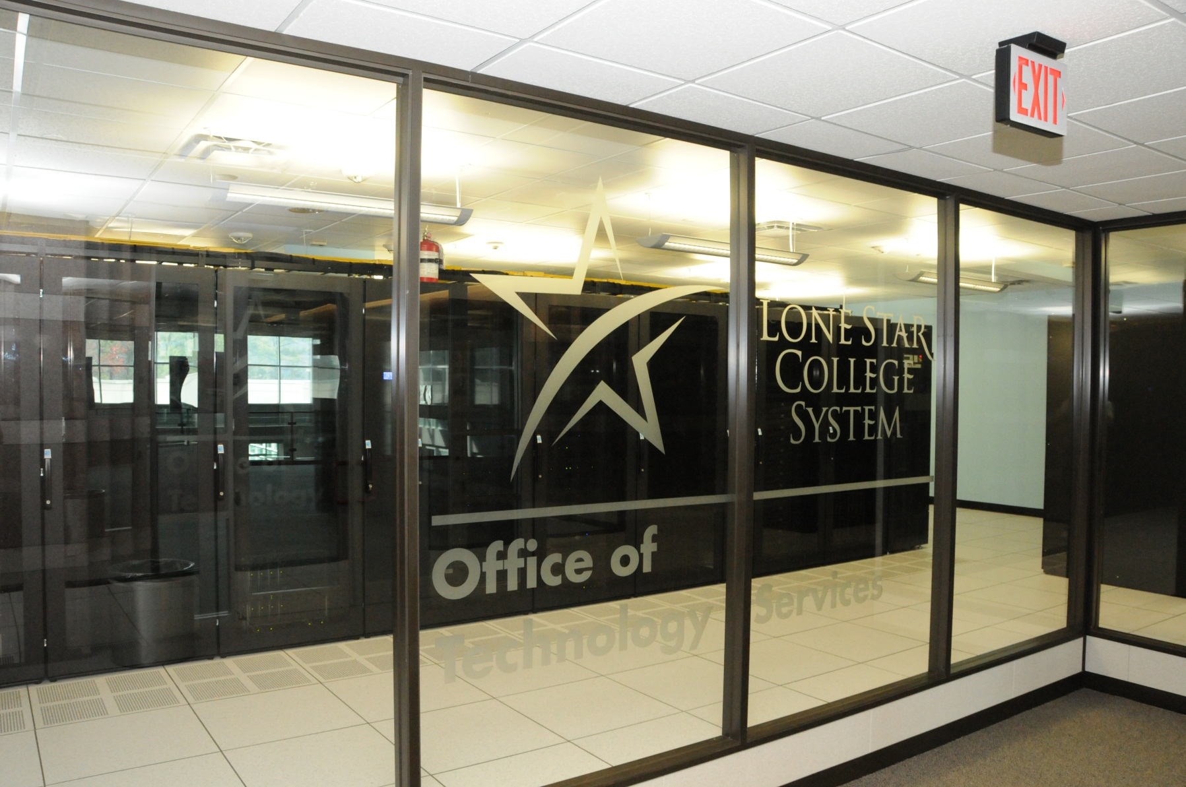
New Datacenter Efficiency by Design

Slide 7
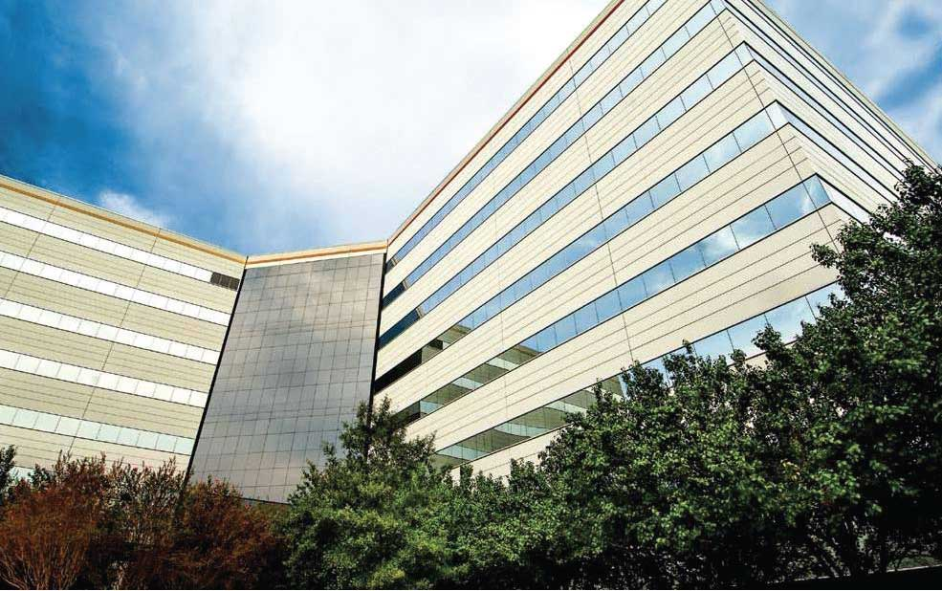
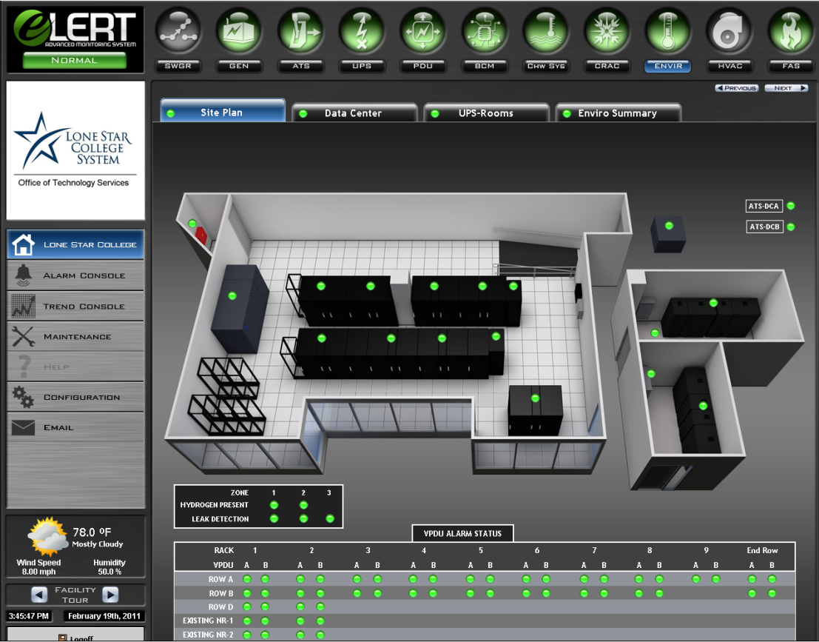
Efficiency by Design
As part of our 99.999% availability design LSCS completed a new co-located datacenter in November of 2010
This new facility was designed on a High Efficiency, High Density model
Tier IV design standards were used in building this new facility at LSC-University Park

Slide 8
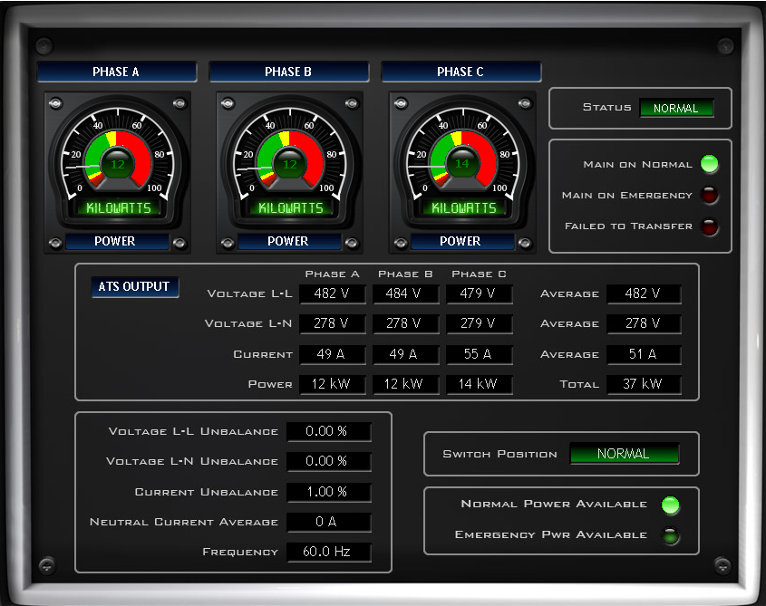
Power and Cooling
High Density
27 Rack enclosures
480Kw Max Load
High Efficiency
Liquid Cooled Racks
Line Bypass UPS
17 Kw rack power/cooling capacity
Lights-Out Design
Complete down to an individual Plug
In Rack Fire Suppression

Slide 9
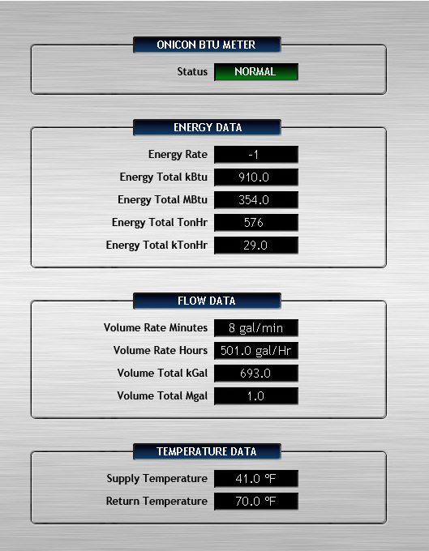
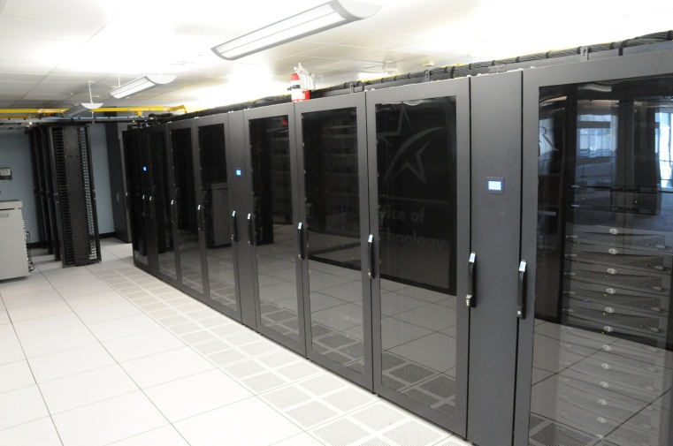
Power Utilization Efficiency
Side-by-Side Comparison
Both of our main datacenters have identical equipment loads
The Original Datacenter is traditional Forced Air
PUE – New Datacenter 1.37
PUE – Existing Datacenter
2009 – PUE 3.8
2010 – PUE 3.1
2011 – Est. 2.7

Slide 10
Next Steps
Continued improvements to our traditional datacenter – PUE goal of 2.2
Upgrades to our campus instructional datacenters

Slide 11
Phase II
Phase 2 of Lone Star College’s Green Computing project set out to lend credence and weight to the Office of Technology Services desire to be socially responsible and to be a leader in its community.
To achieve this we focused on creating partnerships with our campus faculty, staff, students and regional institutions.

Slide 12
Partnerships
Campus – Focus on campus initiatives with Faculty and Staff
Student – Focus on Outreach to students and sustainability education
Regional Institution – Focus on sharing information and strengthening relationships between institutions

Slide 13
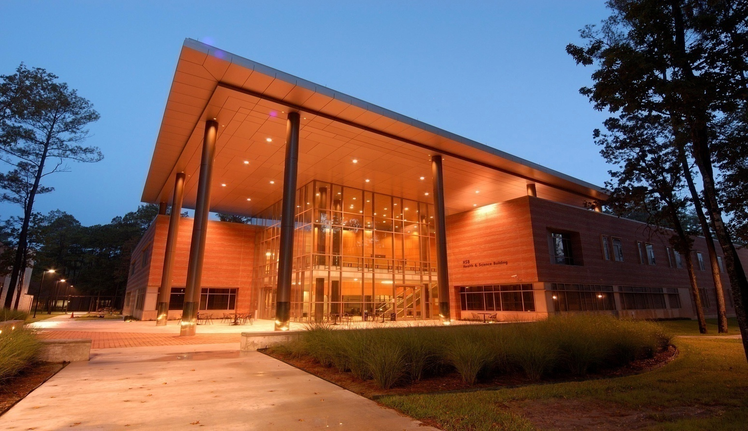
CAMPUS

Slide 14
System Sustainability Council
System Sustainability Council
Comprised of Administrators, Faculty and Staff system wide
Information Sharing
Collaboration
Sponsors of Student Clubs

Slide 15
System Sustainability Council
Projects
Coordinate Recycling Contracts
E-Waste
Education Forums
Document and Email Management
SharePoint and Collaboration

Slide 16
STUDENT

Slide 17
Eco Club
The Eco Club
Student organization that focuses on Environmental issues
Advisor to club
Educate on Green Initiatives
Coordinate on Campus Wide Projects

Slide 18
Eco club
Campus Projects
Earth Day and Others
Information about Campus Initiatives
Information about Student Initiatives
Information about Home Opportunities
Recruit membership

Slide 19
America’s Greenest campus
Campus Projects
America’s Greenest Campus
Nation Wide Competition
Focus on student education
Lone Star was 4th in the nation student sign up’s

Slide 20
Regional Institution

Slide 21
Education Roundtable
Sustainable Computing in Education Roundtable
Half Day Event with other institutions including Universities, Community Colleges and High Schools
International Speakers including Video Conference
Project Sharing
Further Collaboration

Slide 22
Consortium
Texas Educational Sustainable Technology Consortium
Group of Institutions that met after Roundtable
Created Mission
Created Goals and Objectives

Slide 23
Consortium
Texas Educational Sustainable Technology Consortium
Mission
The mission of this group is to enhance teaching and learning, collaboration between educational institutions, strength partnerships, and bring forth innovation through sustainable practices with technology.

Slide 24
Consortium
Texas Educational Sustainable Technology Consortium
Goals
To meet regularly throughout the year to share results and new technologies
To create standardized best practices
To create standard metrics that can be used for research and study
To host a yearly conference on Sustainable Technology

Slide 25
THANK YOU

