Slide 1
IT as a Service:
Leveraging Private, Public and Hybrid Clouds at Lone Star!
The Lone Star College system is leveraging Private, Public and Hybrid clouds to move from “IT” as a commodity to IT as a strategic enabler. Today’s instructors and students expect technology in the classroom to be as flexible as it is on their own personal systems. They want IT to be agile in meeting their needs; if we are not, they will go to the public cloud to get the service they expect. LSCS redesigned our enterprise core infrastructure on flexibility, agility and the cloud. This journey into the clouds has enabled us to deliver the IT services efficiently.
Link Alander,
Associate Vice Chancellor,
Technology Services
Shah Ardalan,
Vice Chancellor Technology Services
CIO

Slide 2
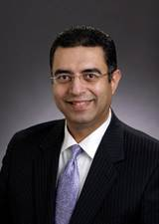

Presentation Overview
The Lone Star College System
What’s all the Hype about?
  Defining the Cloud
Enabling the Cloud
Lone Star’s Cloud Today
  LSCS Cloud Scenarios (Breaking it down)
  Public, Private and Hybrid
Top 5
  Reasons to use the Cloud
  Key Items to Remember
Questions and Answers

Slide 3
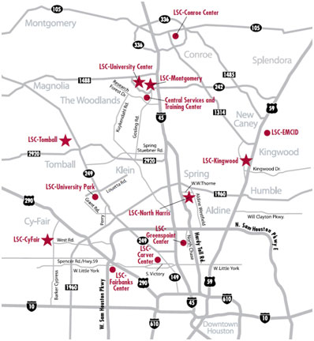
The Lone Star College System
13 Locations across 1,400 square miles
  5 Colleges, 2 University Centers, 5 Instructional Centers
  Systems Office / Training Center
  21 new buildings in 2010/11
    5 new geographic locations
Our Customers
  Over 90,000 Students
  Over 4,800 Employees
  Supported by 152 OTS staff members

Slide 4
The Enterprise Transformation
Business Alignment
Technology Foundation
Best Practices
Transformation using Best Practices, Business Alignment and a solid Technology Foundation to become a Strategic Partner and raise our enterprise
IT Maturity.
Strategic Alignment
Strategic Plan for IT aligned with the College Systems Strategic Plan
Organizational Transformation | Infrastructure Transformation | Business Transformation
Reorganized 6 into 1 (May 08) | WAN redesign (Apr 08) | ERP Assessment (Jan 09)
IT Standards (Jun 08) | AD/Exchange redesign (Nov 08) | ERP Selection (May 09)
Restructured Positions (Sep 08) | 5-nines Standard (Jan 09) | ERP Implementation (Sep 09)
IT Governance (Oct 08) | IT Service Continuity (Apr 09) | - Finance Live (Jan 10)
Established KPI’s (Dec 08) | VM First Policy (Apr 09) | - Employee Portal Live (Jan 10)
24/7 Service Desk (Jan 09) | Client Management (Mar 09) | - Student Portal (Jun 10)
ITSM Alignment (Feb 09) | Green Computing (Mar 09) | - Campus Solution (Dec 10)
Executive Reporting (Feb 09) | Advanced Power Mgt. (Dec 09) | - HR (Dec 10)
Managing Change (Oct 09) | New Green Data Center (Sep 10)

Slide 5
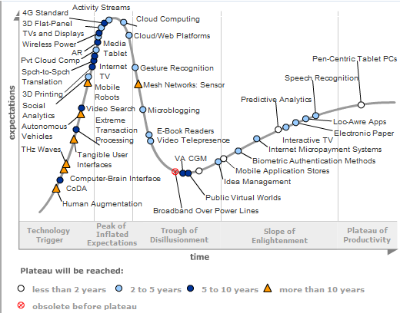
What’s all the Hype About

Slide 6
Defining the Cloud
Essential Characteristics
On-Demand Self-Service
Broad Network Access
Resource Pooling
Rapid Elasticity
Measured Service
Cloud Service Models
Software as a Service (SaaS)
Platform as a Service (PaaS)
Infrastructure as a Service (IaaS)
Deployment Models
Private Cloud
Community Cloud
Public Cloud
Hybrid Cloud
Definition from:
National Institute of Standards, Technology
http://www.nist.gov/itl/cloud/index.cfm

Slide 7
Enabling the Cloud
Virtualization First
  Critical when creating a Private Cloud
  Must be beyond Tier III and Tier II virtualization
    70 to 90 Percent Virtualization
Network Load Balancing
  Eases the transition to the Hybrid Cloud
  Application Awareness
Identity/Access Management (Federation)
  SAML OASIS
    Security Assertion Markup Language
  Secure LDAP

Slide 8
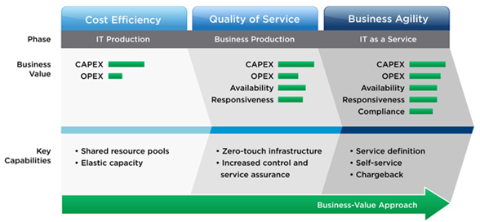
Enabling the Cloud
Rethink
Your staff now has to rethink how they will address a new business need
Retool
Your staff will need to leverage the technologies that enable the cloud
Retrain
Your staff needs more than just technology training they need to understand the organizations goal to add business value
VMware’s Model
IT as a Service
Business Value Approach

Slide 9


Lone Star’s Cloud today
Public Cloud Consumer
Facebook
Twitter
YouTube
Service
Now
Rackspace
Public
SaaS
Hybrid - IaaS
Blackboard
Hybrid - PaaS
IDC-KW
IDC-NH
Microsoft
Live.edu
IDC-CF
Dynamic
IDC-MC
Dynamic
IDC-TC
Dynamic Services
Hybrid
MDC-UP
LSCS Mgt.
MDC-SO
Public
Lone Star College System
Private Cloud
Microsoft
Live.edu

Slide 10
LSCS – Public Cloud
Public Cloud
  Higher education must embrace the public cloud
  Sets new expectations from our customers
  Simple and out of control
Public Cloud Consumer
Facebook
Twitter
You Tube
Microsoft
Live.edu
Essential Characteristics
On-Demand Self-Service
Broad Network Access
Resource Pooling
Rapid Elasticity
Measured Service
Challenges/Opportunities
Control – no contracts
Availability – no SLA
Expectations
Security – Where is your data
Policy

Slide 11
LSCS – Private Cloud
Virtualization is King!
  93% of LSCS servers are Virtualized
    Including our ERP!
  16 VM Farms
    All sites are interlinked
  Managed with vCloud Director
LSCS – Private Cloud
817 Active Servers
412 Standby Servers
50 Elastic Servers
IDC-KW
IDC-NH
IDC-CF
IDC-MC
IDC-TC
MDC-SO
MDC-UP
Essential Characteristics
On-Demand Self-Service
Broad Network Access
Resource Pooling
Rapid Elasticity
Measured Service
Challenges/Opportunities
Flexibility
High Availability
Elastic demand based
Structured controls
VM Sprawl

Slide 12
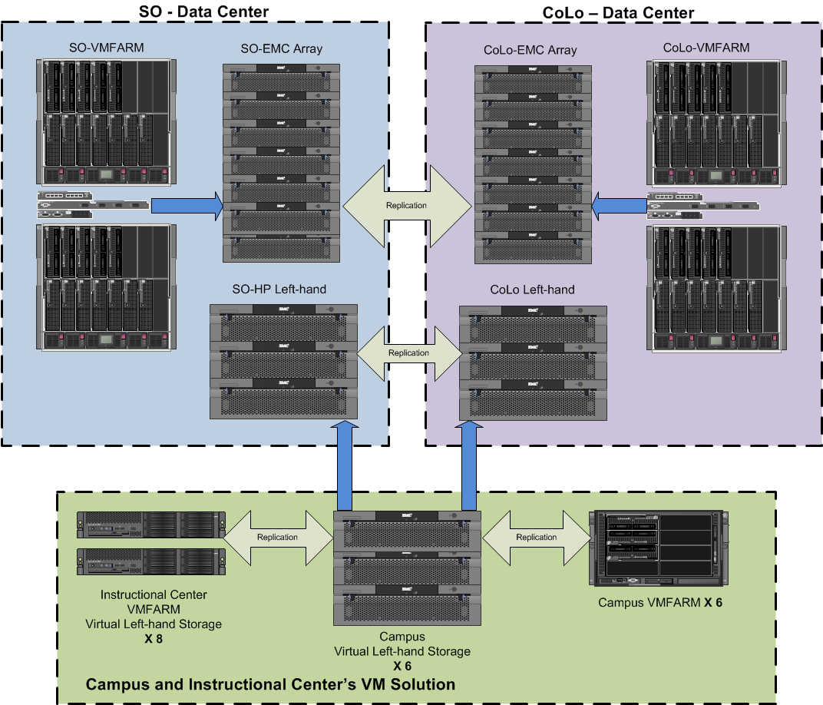
LSCS – Private Cloud
Example
Availability & Flexibility
Important the network must be designed for flexibility
More than vMotion and SRM
Simplified Maintenance
Enables – IT as a Service
VM-SRM moves servers
VM-SRM moves servers

Slide 13
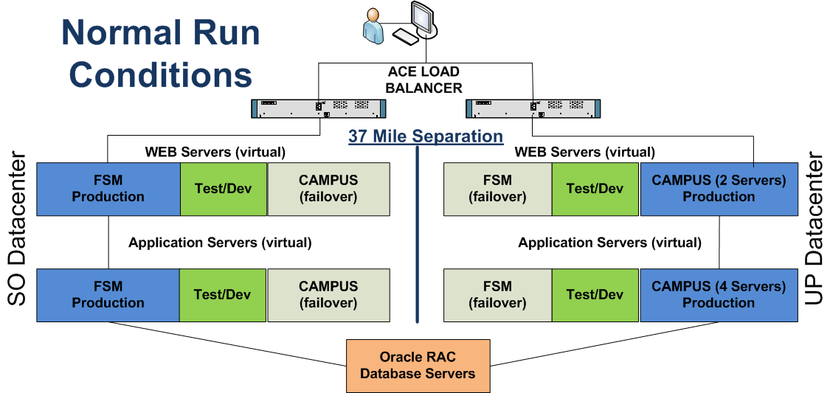
LSCS – Private Cloud
Example – Elasticity – Normal Operations
Application awareness
Peak demand management
Improved application service delivery

Slide 14
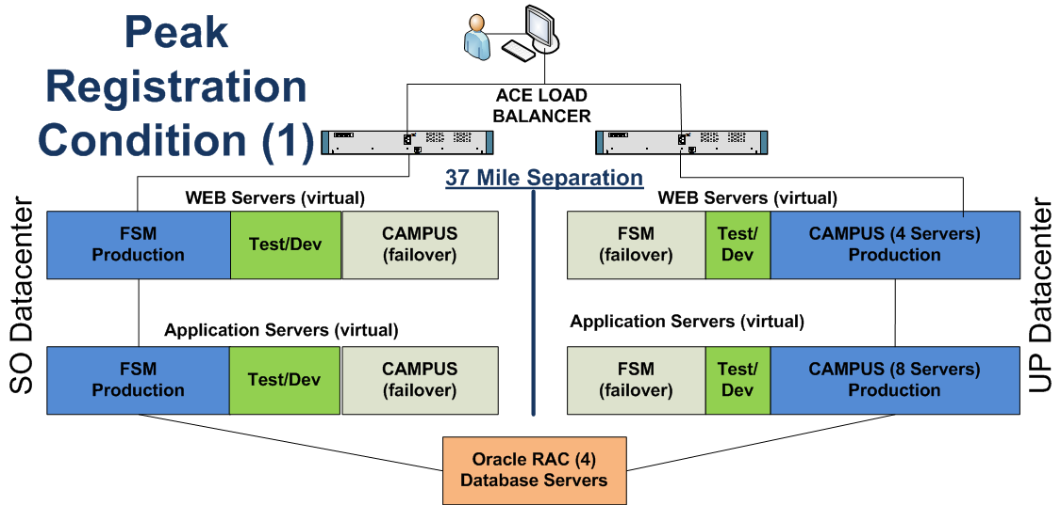
LSCS – Private Cloud
Example – Elasticity – Peak Registration
Dynamic expansion of capacity on the primary side
Increased production Web and Application Servers – Primary side
Reduced the size of the Test/Dev environment

Slide 15
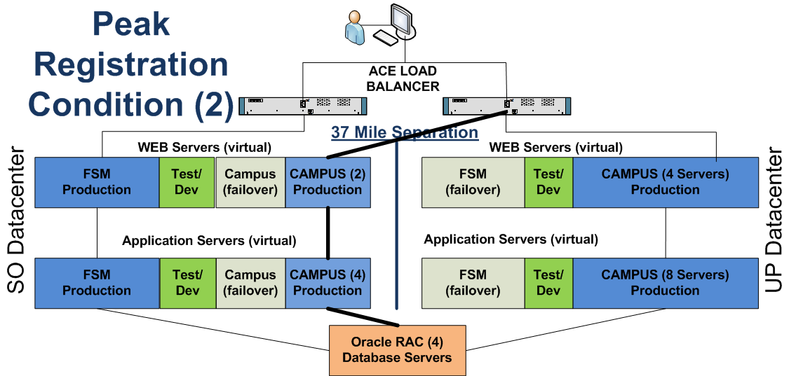
LSCS – Private Cloud
Example – Elasticity – Peak Registration
Dynamic expansion of capacity using both sides
Increased production Web and Application Servers
Reduced the size of the Test/Dev environment

Slide 16
LSCS – Hybrid Cloud
Software as a Service (SaaS)
  Service Now – IT Service Desk
    Just pay for what I need
  Microsoft Live.edu
    Student email
    Student apps & Storage
Service
Now
Microsoft
Live.edu
Microsoft
Live.edu
LSCS Mgt.
Essential Characteristics
On-Demand Self-Service
Broad Network Access
Resource Pooling
Rapid Elasticity
Measured Service
Challenges/Opportunities
Control – Contract Management
Availability – SLA
Expectations - Partnership
Security – Data Control

Slide 17
LSCS – Hybrid Cloud
Infrastructure as a Service (IaaS)
  Rack Space
    Additional external capacity
    vmWare infrastructure
    Ability to swing servers/services to the site
Platform as a Service (PaaS)
  Blackboard – Angel LMS
    Core Application Management
    Primary Hardware Management
    LSCS – manages users
Rackspace
Blackboard

Slide 18
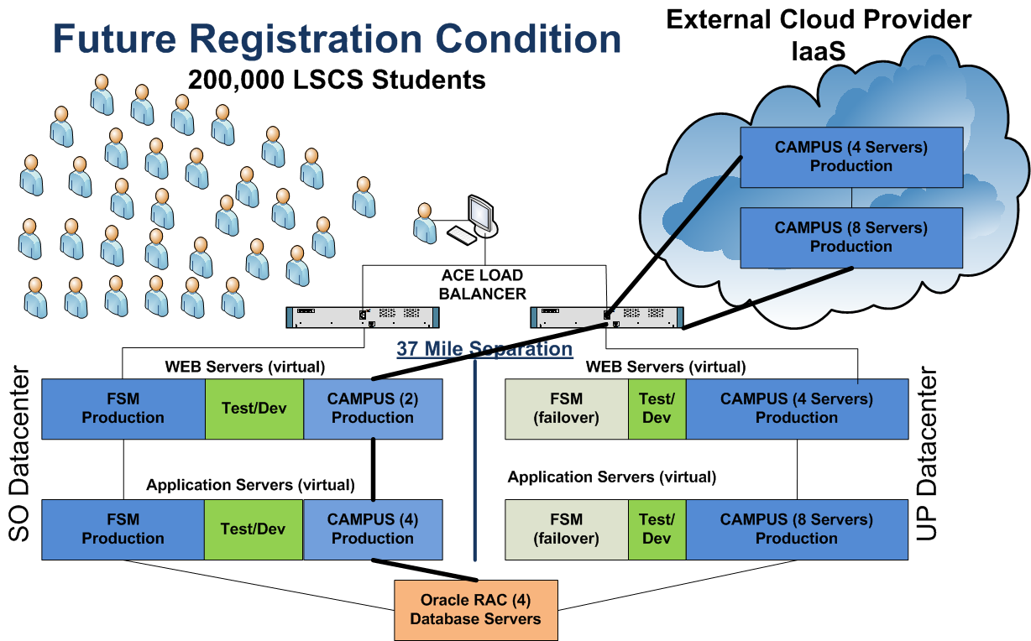
Hybrid Cloud – Next Level

Slide 19
5 Reasons to use the Cloud
Reduced Cost
Cloud technology is paid incrementally, saving organizations money.
Highly Automated
No longer do IT personnel need to wait for hardware provisioning.
Flexibility
Cloud computing offers more flexibility than past computing methods.
More Mobility
information can be accessed from anywhere.
Allows IT to Shift Focus
No longer having to worry about constant server updates and other computing issues, organizations will be free to concentrate on innovation.

Slide 20
5 Key Items to Remember
System Management
  You still have applications or servers that will need support
  You will need to monitor security & mitigate risks
Contract Management
  Strong partnership with your cloud provider
  Monitor SLA & KPI & Security
Cost Models
  You Pay for what you need
  CPU, Storage, Bandwidth, Licenses
  Yearly, Quarterly, Monthly
Capacity Management
  Monitor Capacity
  Plan 3-6 months ahead
Don’t Be Complacent
Regularly evaluate your cloud provided services.
A cost benefit analysis can tell you if you should bring the service in-house or out to the cloud.

Slide 21
IT as a Service:
Leveraging Private, Public and Hybrid Clouds at Lone Star!
Questions?
Presentation Resources
National Institute of Standards Technology
Version 15
Gartner
Key Issues for Cloud Computing
G00175264
IT Process Institute
IT Value Transformation Road Map
VMware
Evolutionary Approach to an IT Revolution
Link Alander,
Associate Vice Chancellor,
Technology Services
Shah Ardalan,
Vice Chancellor Technology Services, CIO

