Slide 1
Moving faculty and staff to Google Apps for Education
Mark Fitzgerald
Boise State University
markfitzgerald@boisestate.edu

Slide 2
About Boise state University

Slide 3
Our Agenda
The choice
Why we did not make the move
Why we did move
How we did the move
What we learned from the move
How Google is different

Slide 4
The choice

Slide 5
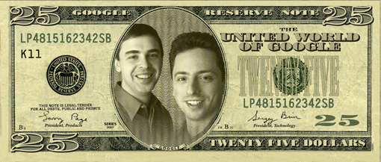
Why we didn’t do it
To Save Money!
To say we are in the cloud

Slide 6
Why we did it
Support
Security
Strategic Alignment

Slide 7
Why we did it
Strategic Alignment
Responsive to customer feedback
Platform Independence
Make a difference in the classroom and research
Align technology with the destination of the University

Slide 8
Why we did it
Security
Do we trust our limited network and system engineering resources to protect our data better than the security staff and resources available to Google?
Do we still own the data?
Will our data be used in ways that we, as owners of the data, do not approve?

Slide 9
Why we did it
Support
Free up system engineers
Reduce calls to the help desk
Few training classes
More intuitive
Less to install

Slide 10
How we did it
Personal Contact
Training
2 way communication

Slide 11
How we did it
Personal Contact
Visited each user
Worth the work
Gave people the chance to ask questions and dispel rumors

Slide 12
How we did it
Training
Task Specific Videos
Presentations: Getting to Know Google
Special Topic Seminars
Instructor Led Training Classes

Slide 13
How we did it
2 way communication
1 Way Communications: Emails, Website
Invigoration of our Blog, BroncoBytes, as a two way communication tool
Pre-migration Preparation Meetings
Post Migration Q&A
Emails to every manager/department chair

Slide 14
What we learned
Personal Contact
Training
Two Way Communications
Support
Security
Strategic Alignment

Slide 15
What we learned
Change is never easy
You are never going to please everyone
The issue is not about technology; it is about people and process
Should have communicated our strategic alignment much earlier
It is not about the cost savings, it is about matching technology with the need
Don’t just say you know business process, show you understand it

Slide 16
Google is different
Google Apps is not email – it is a collaboration platform
Documents
Forms
Sites
Blogs
Mail
Calendaring
Tasks
Contacts
Instant Messaging
Voice and Video

Slide 17
Google is different
It is a challenge to have features change on a daily or weekly basis
You have to search out information
To fully embrace you have to learn to think differently
(EG labels instead of folders)

Slide 18
Google is different
Learn to share
Learn to trust
Learn new ways to work
Learn to work together

Slide 19
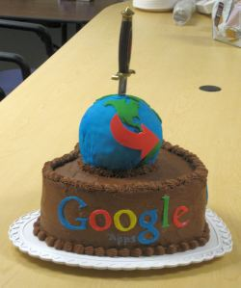
Would we do it again?
Absolutely

Slide 20
Questions
Questions ?

Slide 21
Resources
Strategic Alignment: http://oit.boisestate.edu/email/files/2011/02/Google-Apps-Charting-the-Course.pdf
Documentation: http://oit.boisestate.edu/email/
Our Blog: http://broncobytes.boisestate.edu
ECAR Study: www.educause.edu/Resources/ImplementingGoogleAppsforFacul/216957

