Slide 1
Lone Star College Nursing: Technology Enhancing Student Success ITOUCH - A Student Engagement and the Learning Experience.
Jim Crawford, Executive Director,
Office of Technology Services|
2/23/2011

Slide 2
Chancellor’s Faculty Technology Innovation Grant
The purpose of the Chancellor’s Faculty Technology Innovation Grant (CFTIG) is to support pioneering faculty in the development, deployment or implementation of new and emerging technologies into teaching and learning to increase student success.

Slide 3
Licia Clowtis, MSN, APRN-BC, FNP Professor Nursing
Gordon Carruth Professor, Computer Information Systems
Professor 5 years
Vivian Smith Scholar
University of Texas – Houston at the Medical Center PhD program
Professor 23 years
Founding Faculty member of
LSC – Montgomery 15 years

Slide 4
Linking technology with student success
LSC-Montgomery Nursing students equipped with iPod Touch
Linking technology to student learning outcomes
Measurable outcomes:
Increased student satisfaction and self reported learning
Increase in students passing exit exam by second attempt
Increased student retention
Decrease student error in clinical setting

Slide 5
Study Design
Students in second level of ADN and those enrolled in LVN program required to pass exit exam to graduate
Study participants pulled from the group
Approx. half of each cohort served as control group
Students were randomly assigned to the intervention group
40 students from the ADN program and 12 students from LVN program received an iPod Touch

Slide 6
Hardware and software
71 - Apple 32GB iPod Touch’s
2 - HD Camcorders and editing equipment
8 - Sony laptops (lightest in their class)
Unbound Medicine’s Nursing Central
Pepid’s Flash Cards and Board Review
English dictionary and language translator (support for English as a second language students)
Epocrates
AHRQ ePSS (evidence based practice access)
Podcasts - (content review and remediation)

Slide 7
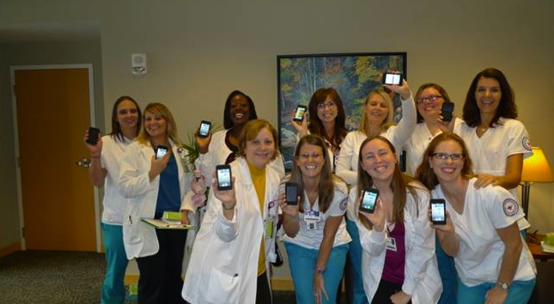
Initial Student response
“We love them!”
“Do we have to give them back?”
“The hospital nurses keep borrowing my iTouch.”

Slide 8
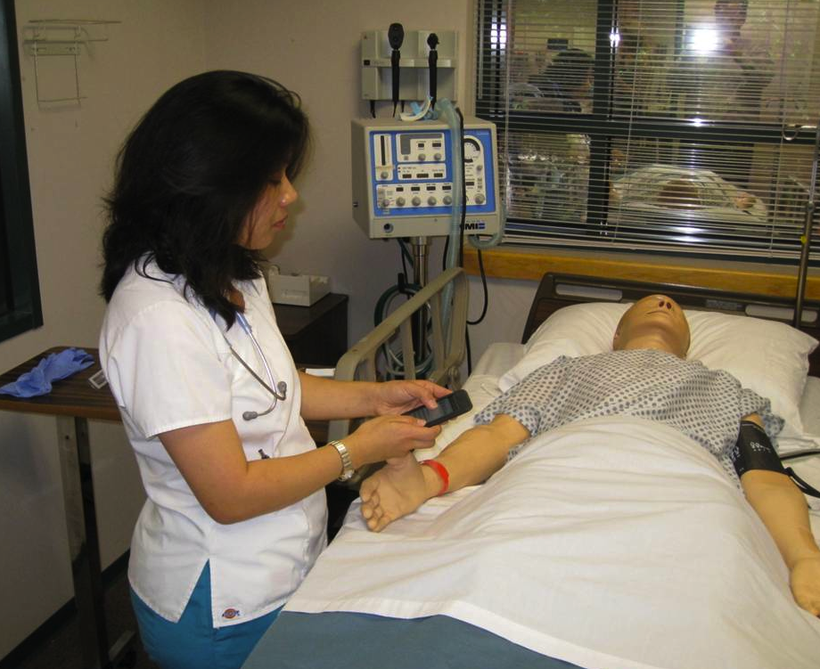
Lessons learned
Continual communication with clinical faculty is a necessity
Opportunity to socialize nurses
Requires considerable faculty investment

Slide 9
For more information
Licia Clowtis, MSN, APRN-BC, FNP
Licia.M.Clowtis@uth.tmc.edu

Slide 10
THANK YOU

