Slide 1
Understanding Users & Transforming IT to Deliver
Gary Kidney | 2-24-2011
© Gary Kidney 2011. This work is the intellectual property of the author. Permission is granted for this material to be shared for non-commercial, educational purposes, provided that this copyright statement appears on the reproduced materials and notice is given that the copying is by permission of the author. To disseminate otherwise or to republish requires written permission from the author.

Slide 2
Rice University

Slide 3
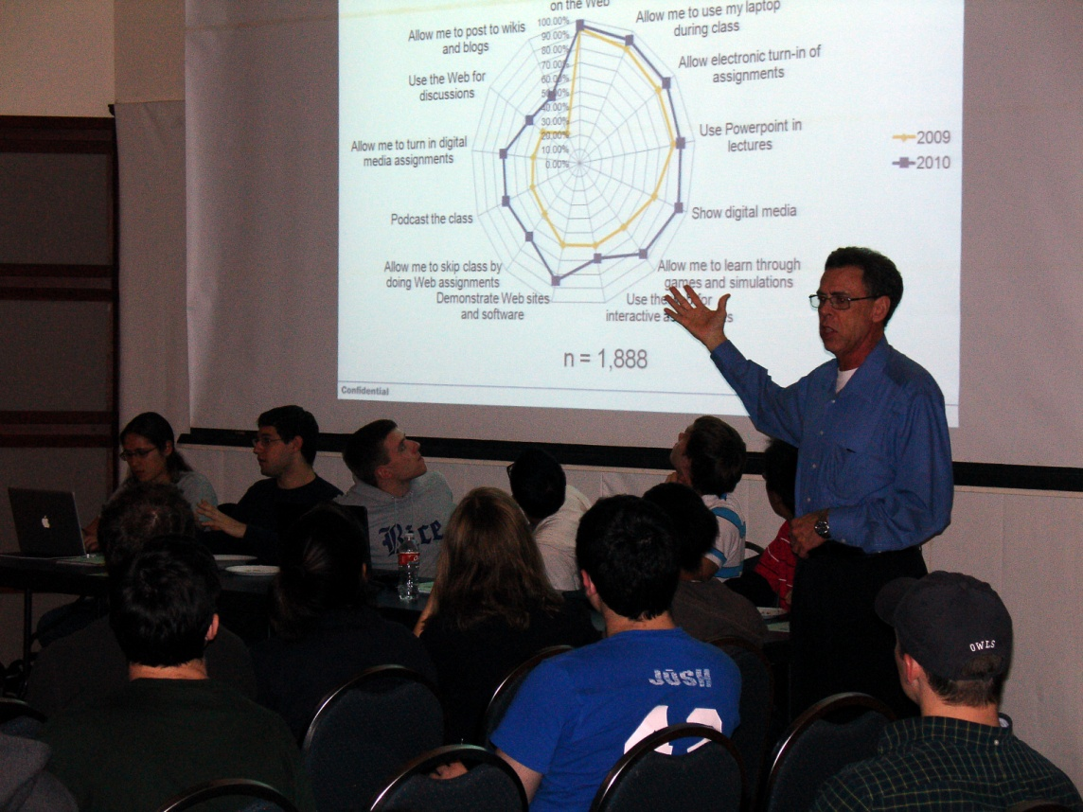
1. Surveys
Annual university community survey
Annual incoming freshman expectations survey
Service or incident satisfaction survey
Ad hoc or project-specific surveys

Slide 4
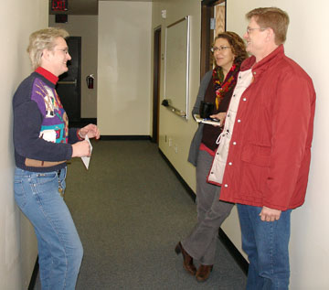
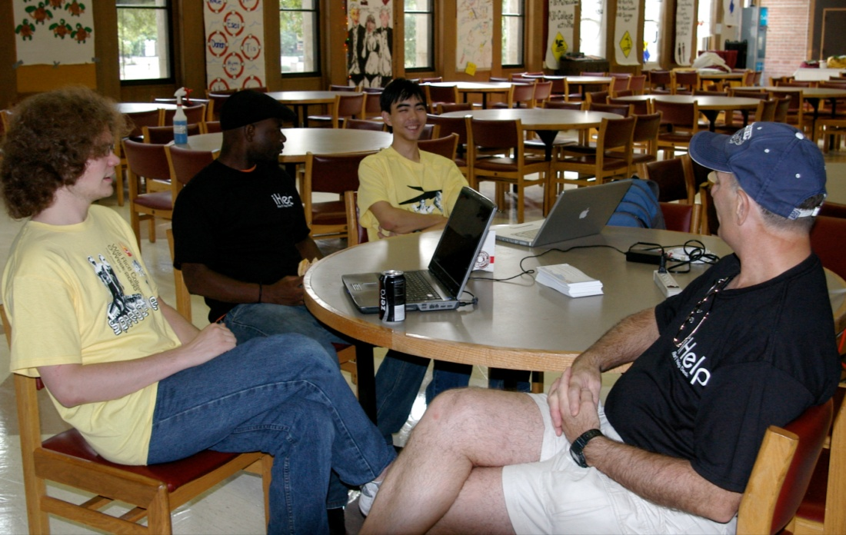
2. Man-in-the-street Interviews
Conducted every day
Usually just a question or two
Often used to probe for reasons behind other survey responses
Sometimes used to set direction
Occasionally done in confluence with an event

Slide 5
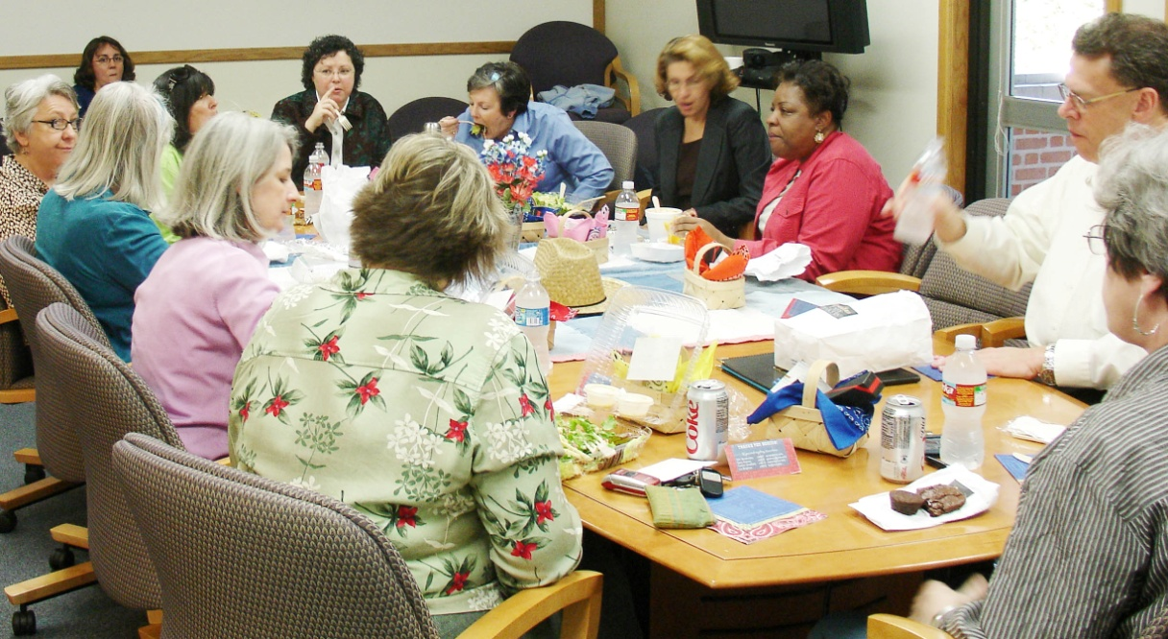
3. Focus Groups
Brainstorming
Information & requirements gathering
Service and product design
Planning
Service assessment
Formative evaluation
Garnering “buy-in” from stakeholders

Slide 6
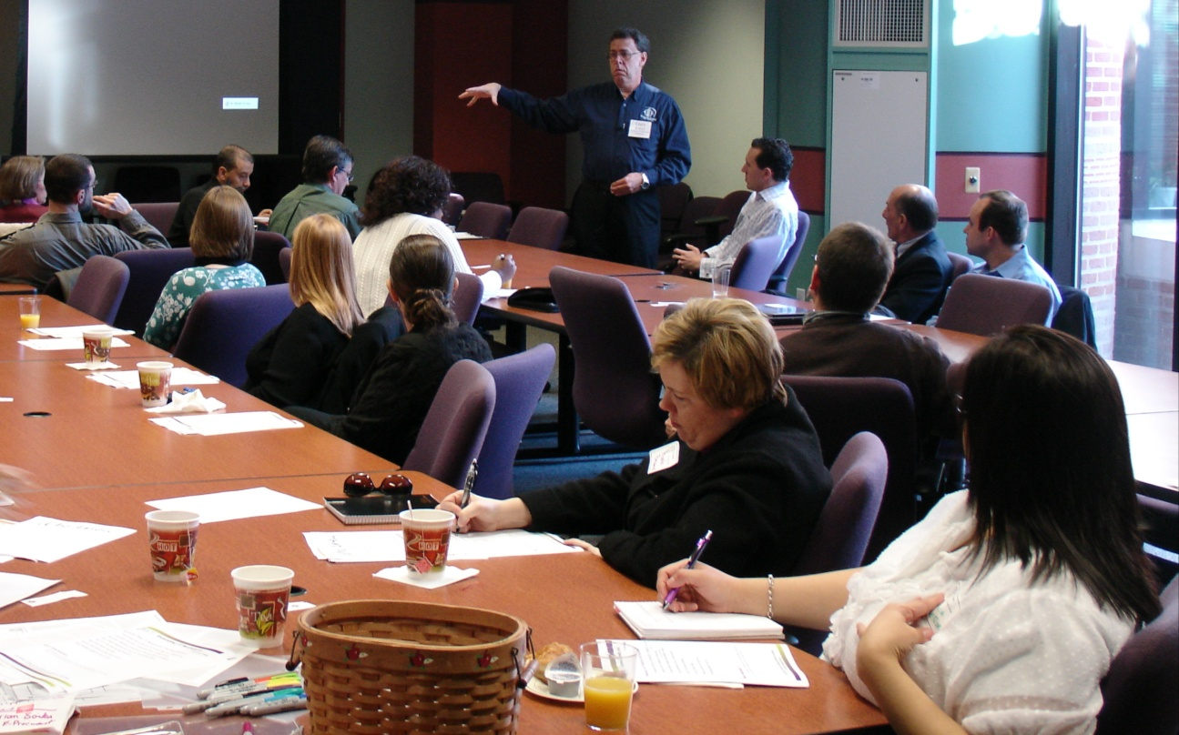
4. Listening Posts
Tactical:
Find unreported issues
Re-engage users with processes
Validate service methodologies
Strategic:
Discover unknown needs
Uncover perceptions
Match commonalities

Slide 7
5. User-Centered Design
Cooperative and participatory
Understand the audience (who, what, how, when, why, and how much)
Personas and/or use-cases
Rapid prototyping
Users embedded in both formative and summative evaluation

Slide 8
6. Spies
SCCs – Student Computing Consultants
Tech Liaisons
Secret shoppers
Canaries

Slide 9
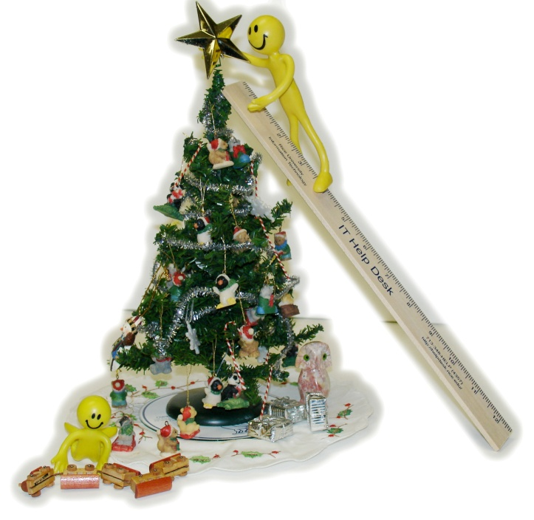
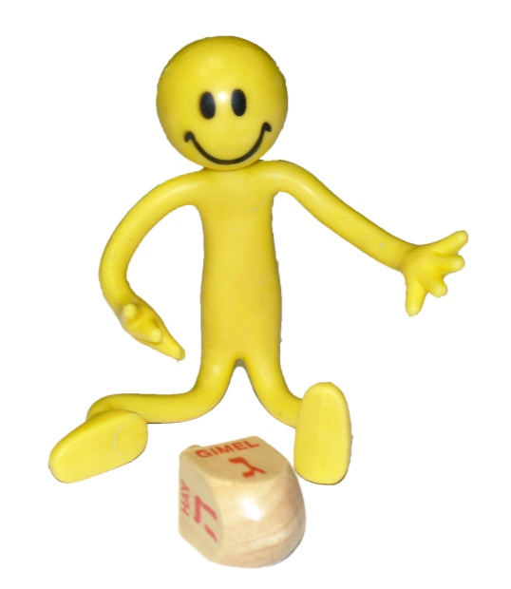
7. RFC’s and Web 2.0
Joe Itguy
t
Design documents collaboratively developed in a wiki
Request for Comment process using Blog

Slide 10
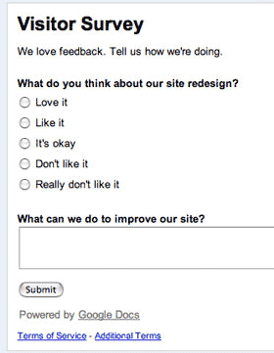
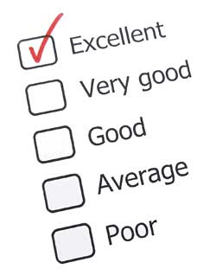
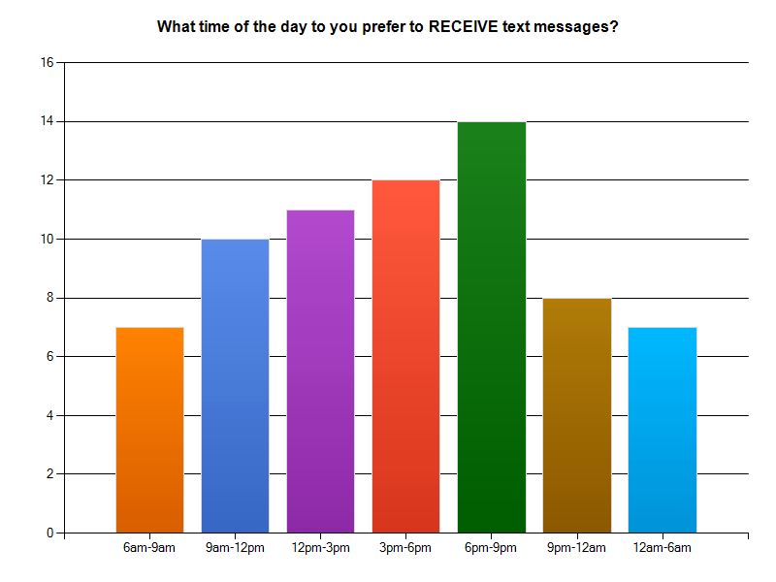
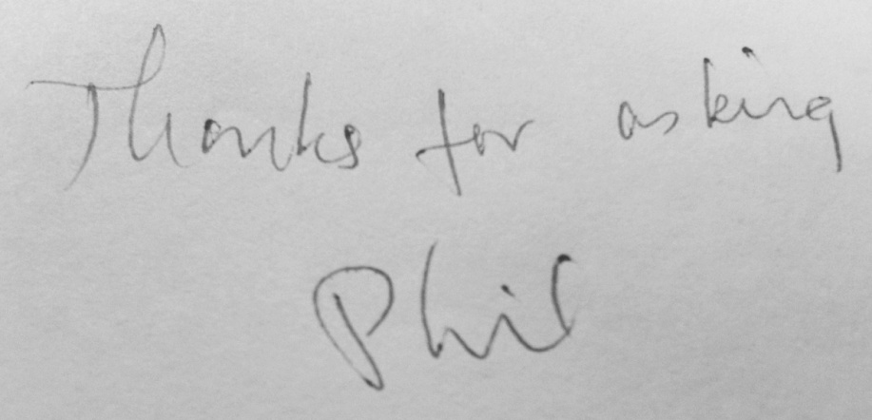
8. Polls and Plebiscites
Paper ballots
Email
Web voting tools
Within course management and collaboration system
On IT Web sites
On Web sites from others
“Clickers”
Mobile apps

Slide 11
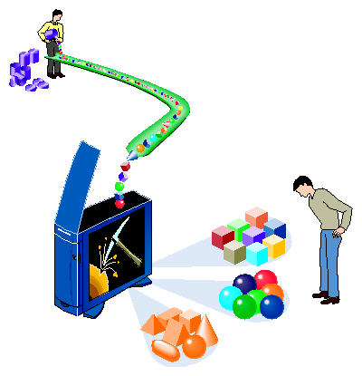
9. Data Mining – We have more data than we thought
ERP systems
Accounts
Email
Systems
File structures
WebTrends
Departments and Deans
Human networking
Google and Google analytics

Slide 12
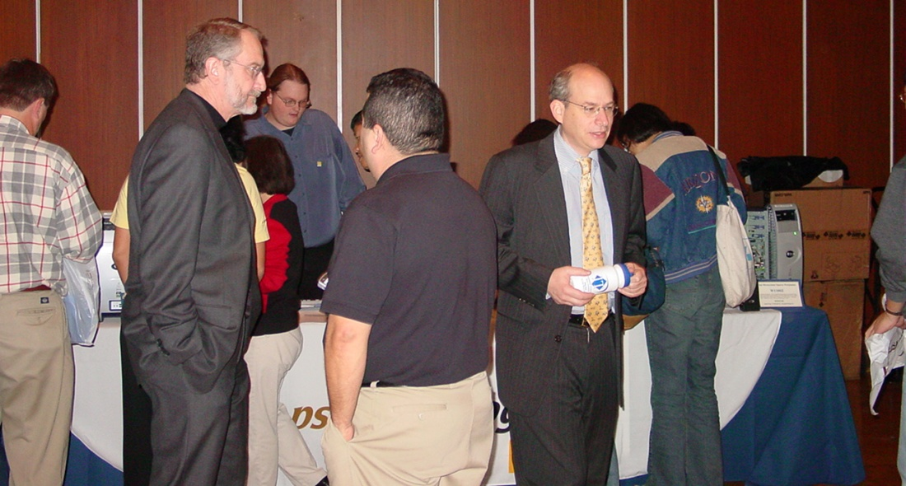
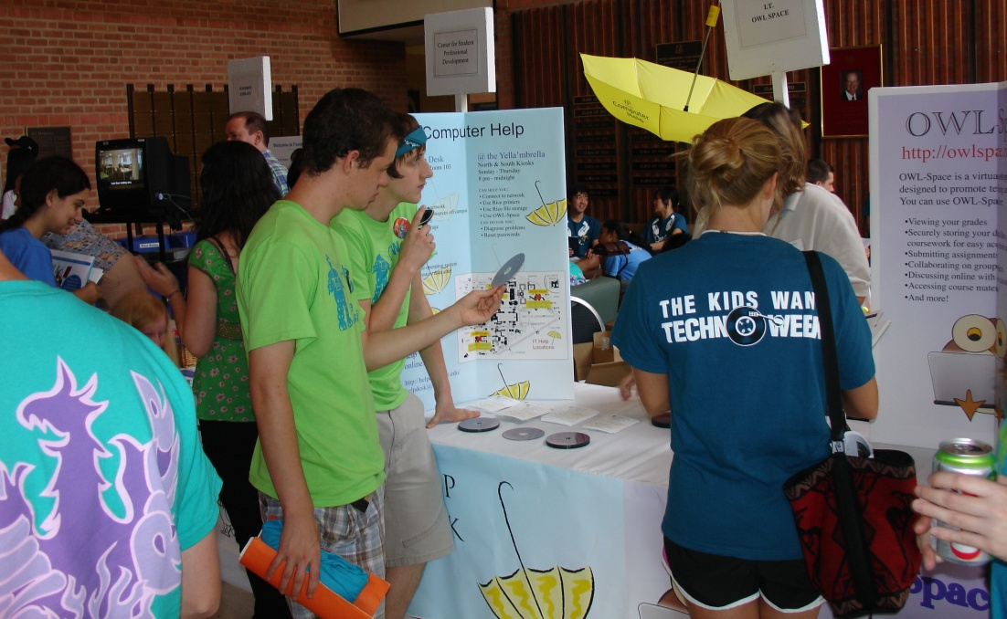
10. Fairs
Marketing
Gaging interest
Exposing services
Encouraging standardization
Exploring futures
Training
Developing transparency
Catalyzing change

Slide 13
Story: Service Transition
Spies reported dissatisfaction
Man-in-the-street interviews to understand issues
Focus Group to establish use cases
User-Centered Design with designated stakeholders
Requirements jointly developed in a Wiki
RFC vetted in a blog
Pilot test with design group
Poll to determine readiness for deployment
Data mining to determine pathways for use cases
Plebiscite to vote among options

Slide 14
Story: Change Management and Notification
Ticketing system reported problem. Spies confirmed.
Man-on-the-street interviews to determine extent of issues and to gather suggestions
Listening Post to understand issues & refine suggestions
Focus Group to implement solutions & suggestions
Internal Focus Group for adoption of ITIL Change Management protocols and deploy IT Alerts
Man-on-the-street interviews to validate Change Management and IT Alerts
User satisfaction survey

Slide 15
Story: Arrival of Wikis and Blogs
Listening Post reported significant interest in tools
Data mining to discovered interested users
Man-in-the-street interviews to refine service offering
Focus group surveyed tools and selected favorites
User-Centered design to implement tools
Poll to determine production status
Fairs to market new service
Survey to determine effectiveness and satisfaction

Slide 16
1. Listen to users instead of train or announce

Slide 17
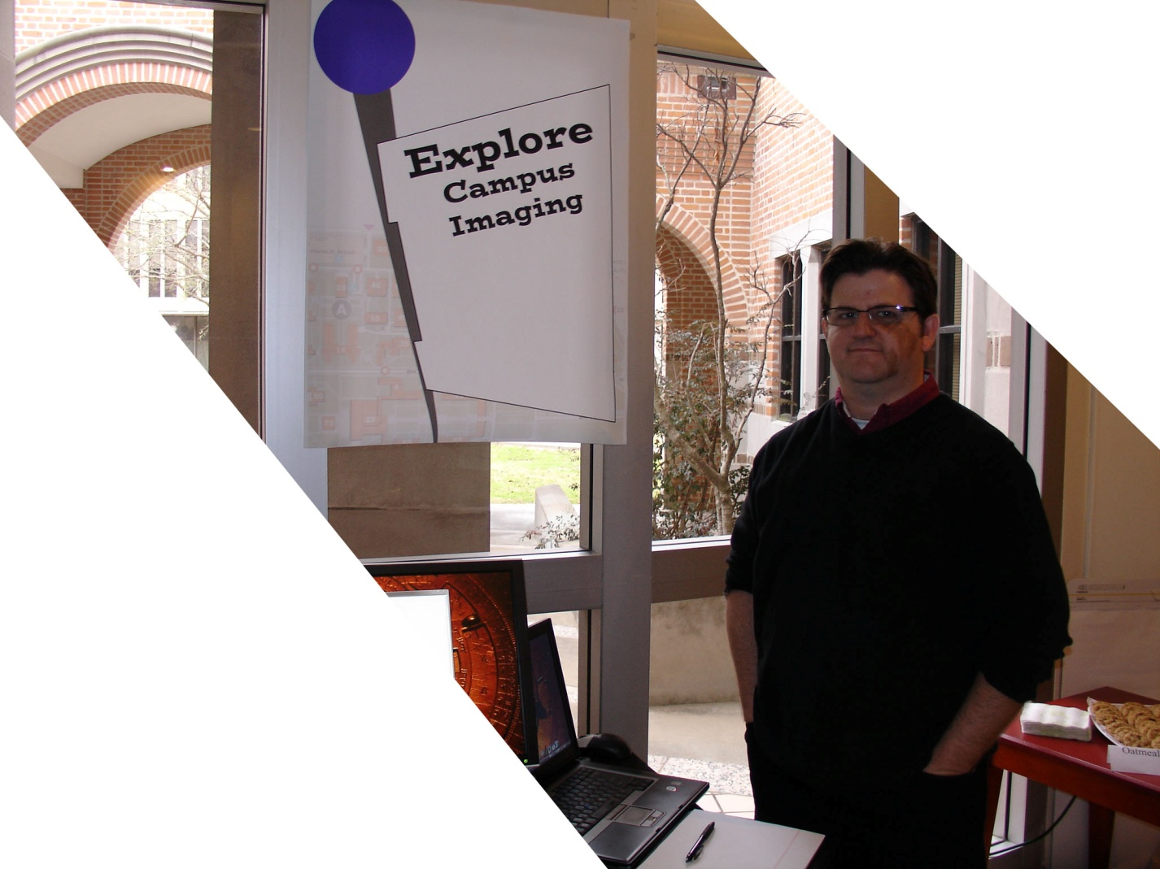
2. Design what the users need

Slide 18
3. Stay engaged until you see the smile

Slide 19
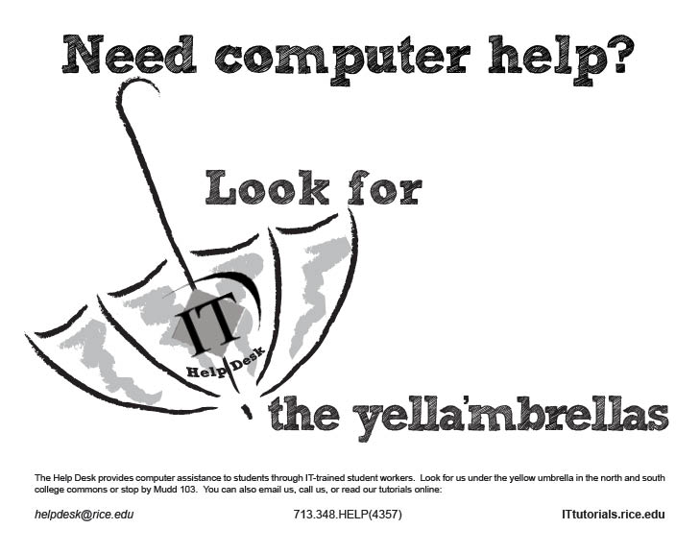
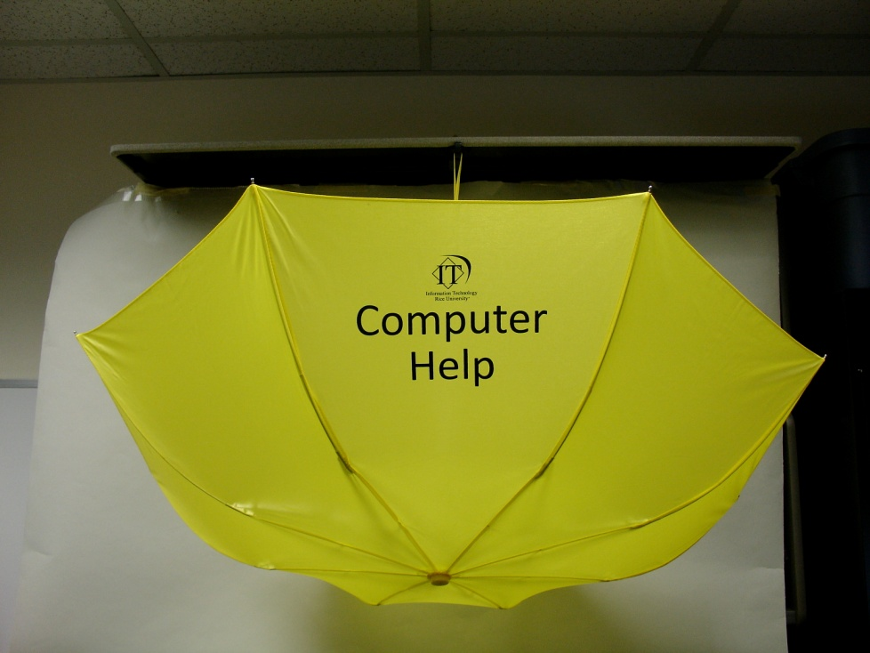
4. Focus on continual improvement

Slide 20
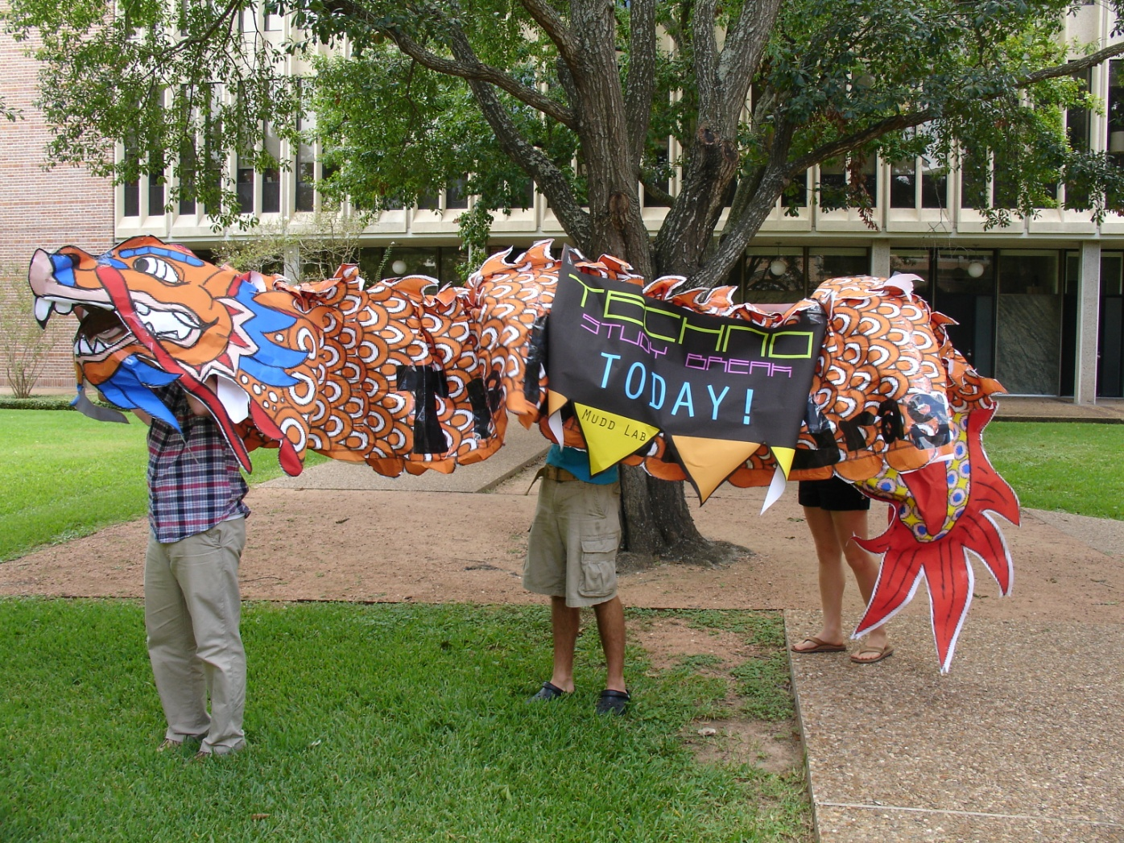
5. Provide constant effort and vigilance

Slide 21
Poll (share your communications strategies)
http://www.zoomerang.com/Survey/WEB22BVERZB5QK/
& Questions

Slide 22
THANK YOU

