Slide 1
LIKE THIS!
Using Facebook to Promote Your Organization

Slide 2
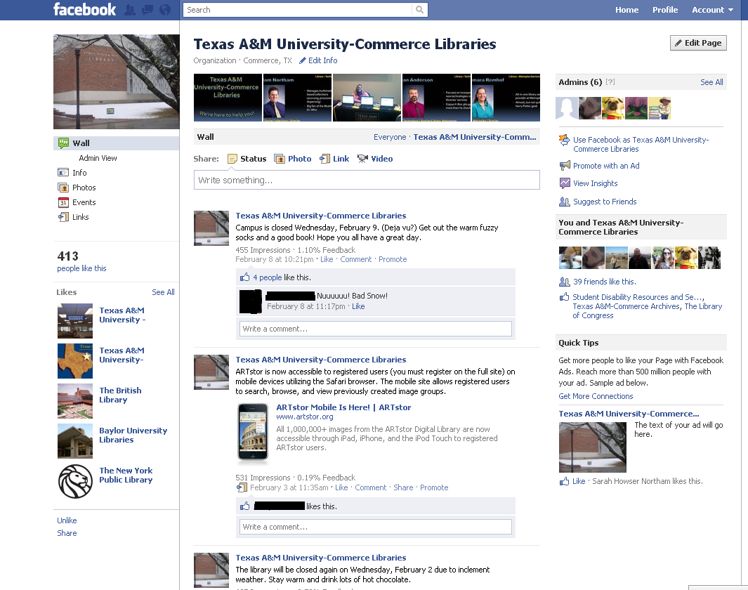
Simple to edit.
Can have multiple administrators
See who “likes” you!
Link back to related organizations!
Notes:
What you can do!
Extremely easy to set up and edit. 5 to 10 minutes.
Can have multiple administrators, one person is not left with primary responsibility.
Can spotlight related organizations, i.e. we spotlight other campus organizations.
Great place to post staff and organization photos, videos, and other multi-media items.
Does not require much technical/computer knowledge.
Once you hit 25 followers can create a custom URL. Easier to refer people to your page, post on websites, email, business cards, etc.

Slide 3
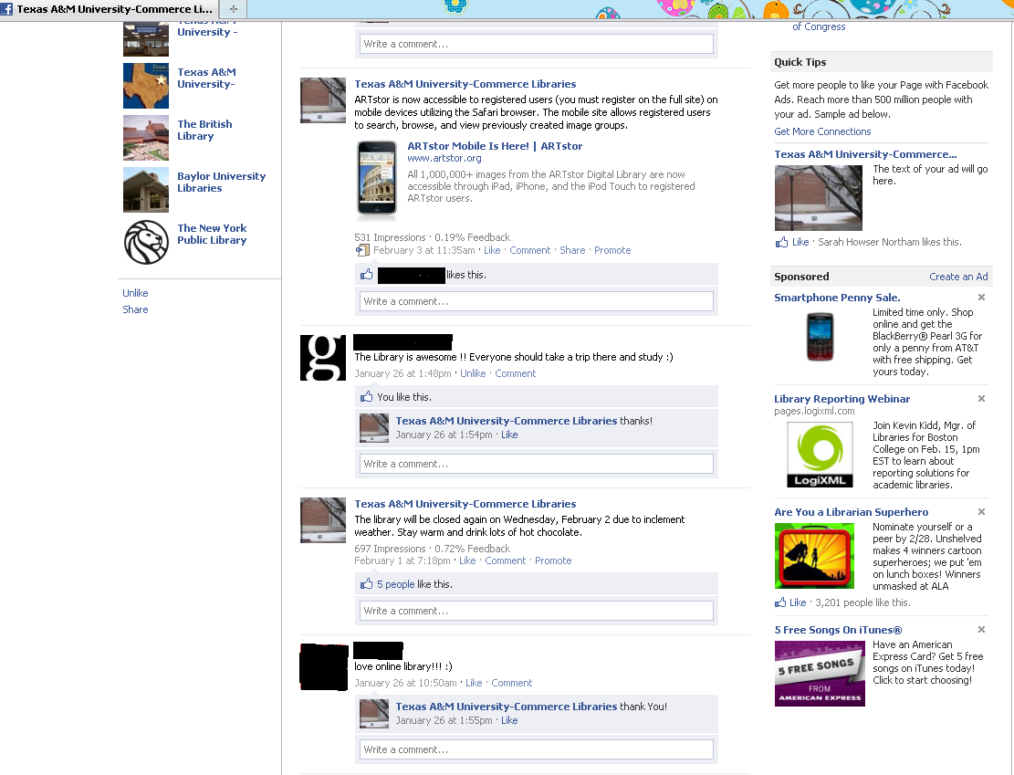
Keep followers updated!
Respond directly to feedback
Instant feedback from followers!
Notes:
Why useful?
See what people think of your organization.
Quickly respond to feedback.
Can instantly update organizational information and Facebook takes care of letting everyone know that you have updated information (hours, closings, special events, etc.”
Ability to send out event notices and remind “fans” that something is going on.

Slide 4
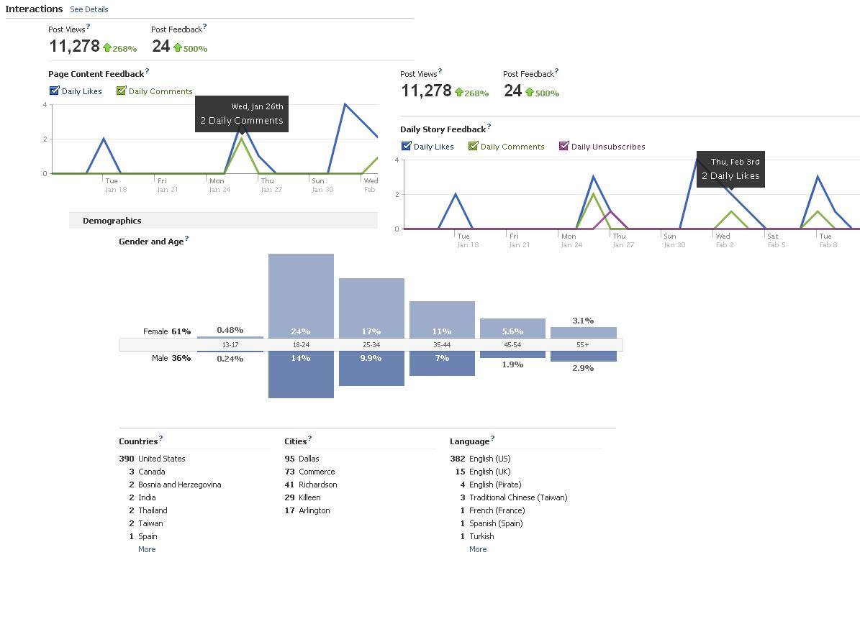
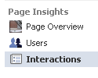
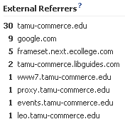
Insights is a built-in Stat Tool
Track daily interactions, including comments and “likes”.
See your demographics: Who & Where
See who’s referring you!
Notes:
Using Insights:
Who, What, When, Where
See Daily interaction Daily Likes, Daily Comments, Monthly Active Users, Post Views (# of times people (fans and non) have viewed a “story” posted by your page)
User Demographics (including pirates)

Slide 5
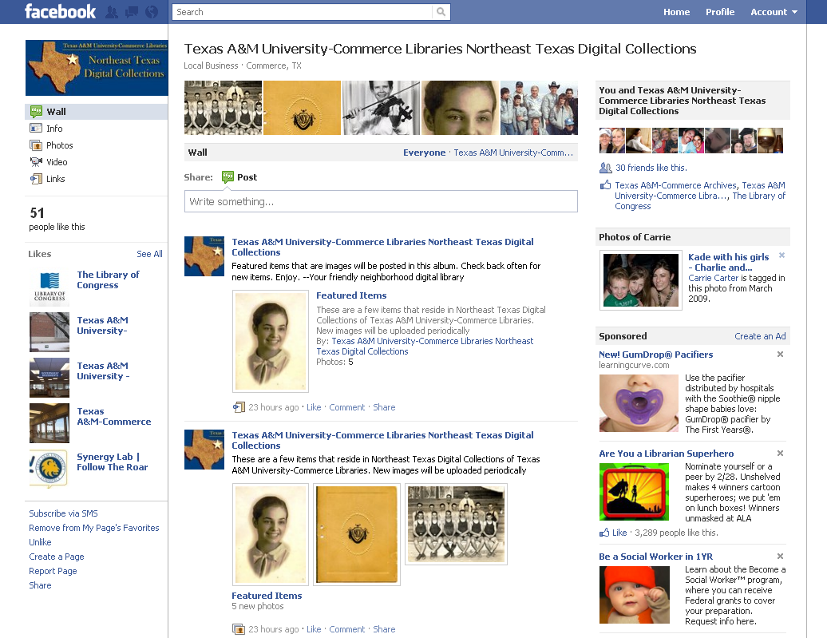
Are “fans” seeing you?
s
Balancing “Updates”
Facebook’s
“Advertising”
Notes:
Disadvantages
Are they paying attention, overloading “fans” , are you lost in the clutter (newsfeed)
Balancing Updates (over or under Updating news feed)
Maintaining page, need to have people willing to stay on top of page edits/stories
Having a presence but not maintaining or doing anything with it, stagnation.
In order to have interactivity, must allow posting by fans which can have drawbacks (Janda, ex). Can “block” people, organizations, problem posters. Does need relatively regular monitoring.
Facebook “Advertising”

Slide 6
Thanks!
Contact us:
Adam C. Northam Sarah H. Northam
Digital Collections Librarian Business Reference Librarian
Texas A&M University-Commerce Texas A&M University-Commerce
Adam_Northam@tamu-commerce.edu Sarah_Northam@tamu-commerce.edu
http://www.facebook.com/tamuc.lib.digital http://www.facebook.com/TAMUCLibraries

