Slide 1
Collaborative Leadership
Lanita Collette
Dina Barnese
Northern Arizona University

Slide 2
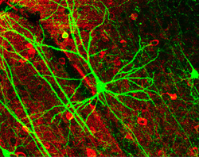
A Different Kind of Web

Slide 3
Workshop content
Introduction to the concept of collaborative leadership
Warm-up exercise
Self-Assessments (Leadership Readiness and Emotional Intelligence assessments)
Project meeting role play (yes, projects often necessitate meetings ☺)
Review and discussion
Handouts to guide further learning

Slide 4
Context for Collaborative Leadership
Recognition by leaders that there are critical business relationships “that cannot be controlled by formal systems but require a dense web of interpersonal connections.” Collaborative Advantage Rosabeth Moss Kanter, 1994 Harvard Business Review

Slide 5
Characteristics of the Collaborative Leader
Collaboration needs a different kind of leadership; it needs leaders who can safeguard the process, facilitate interaction and patiently deal with high levels of frustration. (Chrislip and Larson 1994)

Slide 6
Warm up: Six Thinking Hats
Based on Edward de Bono’s book “Six Thinking Hats”
Demonstrates the power of understanding different points of view
Discussion point: The importance of Impulse Control…

Slide 7
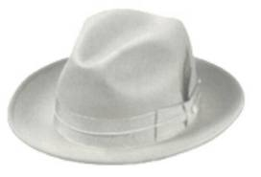
Focus on the data available.
Look at the information you have, and see what you can learn from it.
Look for gaps in your knowledge, and either try to fill them or take account of them.
This is where you analyze past trends, and try to extrapolate from historical data.
Look at problems using intuition, gut reaction, and emotion.
Try to think how other people will react emotionally.
Try to understand the responses of people who do not fully know your reasoning.
Notes:
White: With this thinking hat you focus on the data available. Look at the information you have, and see what you can learn from it. Look for gaps in your knowledge, and either try to fill them or take account of them.
This is where you analyze past trends, and try to extrapolate from historical data.
Red: 'Wearing' the red hat, you look at problems using intuition, gut reaction, and emotion. Also try to think how other people will react emotionally. Try to understand the responses of people who do not fully know your reasoning.

Slide 8
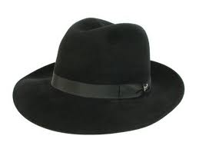
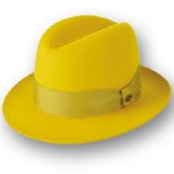
Look at all the bad points of the decision.
Look at it cautiously and defensively.
Try to see why it might not work.
Look at the decision from a positive perspective.
See the benefits and the value of the decision.
Notes:
Black: This is important because it highlights the weak points in a plan. It allows you to eliminate them, alter them, or prepare contingency plans to counter them.
Black Hat thinking helps to make your plans 'tougher' and more resilient. It can also help you to spot fatal flaws and risks before you embark on a course of action. Black Hat thinking is one of the real benefits of this technique, as many successful people get so used to thinking positively that often they cannot see problems in advance. This leaves them under-prepared for difficulties.
Yellow: The yellow hat helps you to think positively. It is the optimistic viewpoint that helps you to see all the benefits of the decision and the value in it. Yellow Hat thinking helps you to keep going when everything looks gloomy and difficult.

Slide 9
Develop creative solutions to a problem.
Think in a freewheeling fashion, in which there is little criticism of ideas.
Control the process
Facilitate the discussion
Help people stay on-task
Notes:
The Green Hat stands for creativity. This is where you can develop creative solutions to a problem. It is a freewheeling way of thinking, In which there is little criticism of ideas.
Blue: The Blue Hat stands for process control. This is the hat worn by people chairing meetings. When running into difficulties because ideas are running dry, they may direct activity into Green Hat thinking. When contingency plans are needed, they will ask for Black Hat thinking, etc.

Slide 11
Self Assessment
Now that you’re “warmed up” – Collaborative Leadership Readiness Assessment
Take-home emotional intelligence test: http://cl1.psychtests.com/take_test.php?idRegTest=2998 http://www.eiconsortium.org/index.html

Slide 12
Collaborative Leadership Self Reflection Self-Assessment Exercise
 | Behaviors | Seldom |  | Sometimes |  | Often |  | Almost Always
1 | I recognize the effect of my emotions on work performance. | 1 | 2 | 3 | 4 | 5 | 6 | 7
2 | I recognize the effect of my emotions on relationships. | 1 | 2 | 3 | 4 | 5 | 6 | 7
3 | I recognize my personal impact on group dynamics. | 1 | 2 | 3 | 4 | 5 | 6 | 7
4 | I can describe my strengths realistically. | 1 | 2 | 3 | 4 | 5 | 6 | 7
5 | I can describe my weaknesses realistically. | 1 | 2 | 3 | 4 | 5 | 6 | 7
6 | I work to understand others’ perspectives. | 1 | 2 | 3 | 4 | 5 | 6 | 7
7 | I read the dynamics of groups. | 1 | 2 | 3 | 4 | 5 | 6 | 7
8 | I listen to others actively, checking to ensure my understanding. | 1 | 2 | 3 | 4 | 5 | 6 | 7
9 | I read non-verbal communication accurately. | 1 | 2 | 3 | 4 | 5 | 6 | 7
10 | I use self-assessment tools such as personality inventories to inform my self reflections. | 1 | 2 | 3 | 4 | 5 | 6 | 7
11 | I seek feedback from all relevant constituencies about my behavioral impact. | 1 | 2 | 3 | 4 | 5 | 6

Slide 13
Six key practices
Assess the environment
Create Clarity
Build trust and create safety
Share power and influence
Develop People
Self-reflection (Personal CQI)

Slide 14
Group Project!
Role play to illustrate:
Using good facilitation/negotiation/conflict resolution skills to demonstrate the six key practices. See if you can “spot” the key practices.

Slide 15
Background
You are a member of the leadership team for a collaborative project at a university. The goal of the project is to develop a web-based service for people to compare degree plans side by side. Historically, this sort of information was maintained by departments on static web pages which became out of date when degrees changed. The project is charged with creating a central, authoritative data source for housing curriculum, and the web application which will pull comparison info from the central data store.

Slide 16
Purpose
Today’s meeting is to discuss which data fields will be displayed in the side-by-side comparison snapshot on the web page. Focus sessions leading up to today’s meeting selected ten top pieces of information that people might like to see in the comparison. This group has agreed to list a maximum of five fields; today the group will decide which five will be shown.

Slide 17
Data Fields
Degree Name Degree Description Math Requirement Language Requirement Locations Where Degree is Offered GPA Requirement Study Abroad Option Internship Requirement Admissions Requirements Eligibility Requirements Lab Science Requirement

Slide 18
Discussion
Take-away from the role play… what key practices did the facilitator exhibit? What did not work so well…
Stories from the field – yours and ours

Slide 19
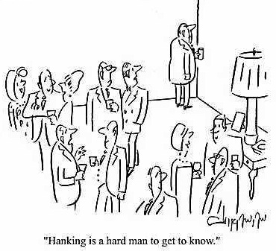
…Something to think about…
Challenge question: How do you engage introverts at the collaboration table?

Slide 20
For Further Reading
Article: The Suprising Benefits of Solitude (HBR) by Andrew McAfee
Book: Quiet: The Power of Introverts by Susan Cain
Book: The Collaborative Leadership Fieldbook by David Chrislip
Book: Six Thinking Hats by Edward de Bono
Book: Facilitating With Ease! Core skills for facilitators, team leaders and members, managers, consultants and trainers by Ingrid Bens

Slide 21
Sources
The Turning Point Project: http://www.turningpointprogram.org/Pages/leaddev.html
Mindtools: Six Thinking Hats: http://www.mindtools.com/pages/article/newTED_07.htm

