Slide 1
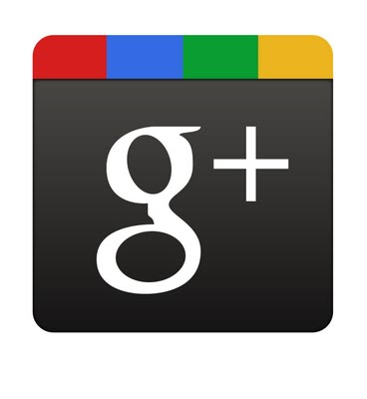
Experience IT Using Twitter and Google+ to Control Your Social Media Stream
Prerequisites:
Twitter ID and available on your device
Google+ ID and available on your device
Nancy Millichap and Shannon Smith | February 22, 2012

Slide 2
Why Use Twitter?
Originally to answer the question “What are you doing?”
And now -
Exercise: add your reasons for using Twitter to the Google Doc here …
http://tinyurl.com/TwitterandG

Slide 3
# - What and Why?
Purposes of hashtags …
One to use today, tomorrow, and Friday …
#wswrc12
Exercise: post a tweet to #wswrc12

Slide 4
Who should I follow?
Dedicated sites point the way …
Your own Twitter site: https://twitter.com/#!/
http://whotofollow.net/
http://followedu.com
Exercise: Find one new person to follow on two of these sites.

Slide 5
How’m I doing in Twitterland?
Tools to gauge your Twitter rank …
http://twitterholic.com
http://twitterscore.org/index.php
And lots more (graded and ranked!) at http://nowsourcing.com/2009/08/12/twitter-ranking-sites/
Exercise: Find how you rate at two of the above sites.

Slide 6
How can I control the flow?
Tweetdeck!
Decide how many columns, what order
Change and rearrange at will
Exercise: Set up Tweetdeck (if you don’t already use it) here: http://www.tweetdeck.com/ OR
Add a new column to follow the conference hashtag this week.

Slide 7
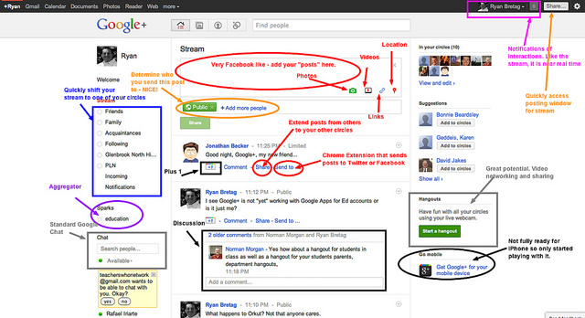
The Google+ Ecosystem
Google+ Stream Annotated by Ryan Bretag
http://notes.envato.com/tag/google/
Exercise: add your reasons for using (or not) Google+ to the Google Doc here …
http://tinyurl.com/TwitterandG
Notes:
40+ million users
Facebook is best used as a place to interact with people you already know. Google+, on the other hand, is the best place to discover and interact with interesting strangers.
Hotbed for early adopters, tech luminaries, marketers and businesses around the world.
The social network is a collection of different social products:
Stream (a newsfeed)
Circles (a friend management service)
Sparks (a recommendation engine)
Hangouts (a video chat service)
Games and Photos

Slide 8
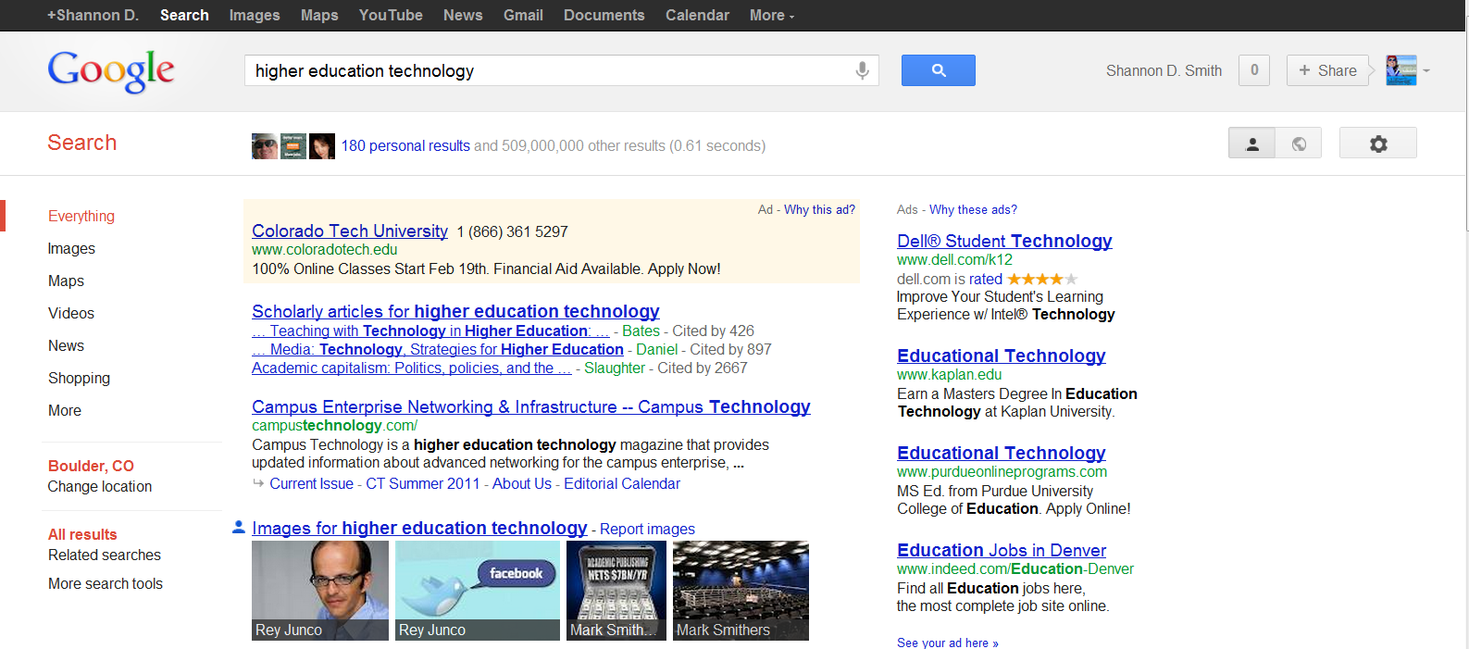
“Search Across Your World”
Show or hide personal results
Exercise: Conduct same search while
Logged out of Google+
Logged in
Show and then hide personal results
Notes:
Google’s master-plan for integrating Google+ ever more deeply into the Google ecosystem: Pour the whole thing into Google search.
Search Across Your World launched on Jan. 10, 2012. This new Google search feature integrates social search results from Google+ into the traditional search results.

Slide 9
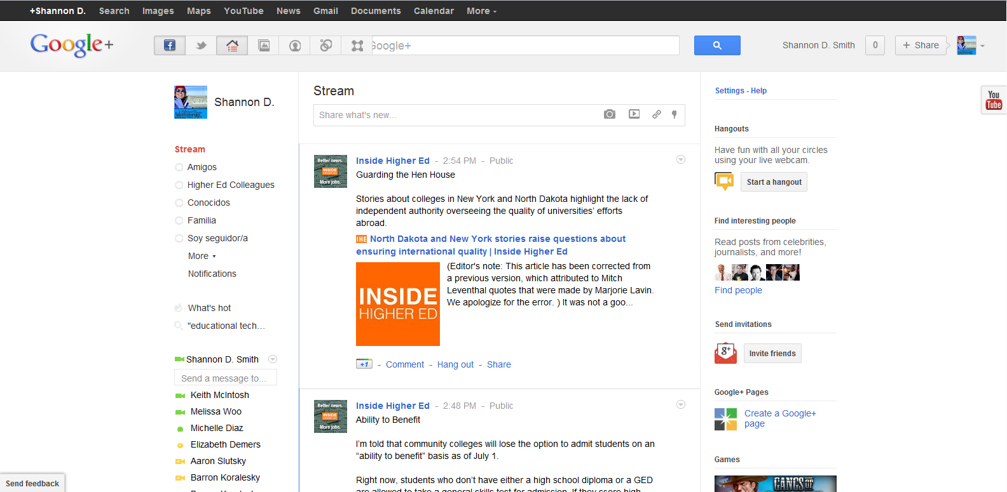
Ways to Control Your Stream
Add other social media streams
Saved searches and Sparks
Find people and make circles
Curate/Share
with +1
Notes:
The Google+ Navigation Bar is Now Sticky
It will stay at the top as you scroll down your Google+ stream so you can navigate to different areas within Google+ . The "stickiness" of the navigation bars will depend on the size of your browser window—if you make your window smaller, the gray Google+ bar will disappear as you move down your stream.

Slide 10
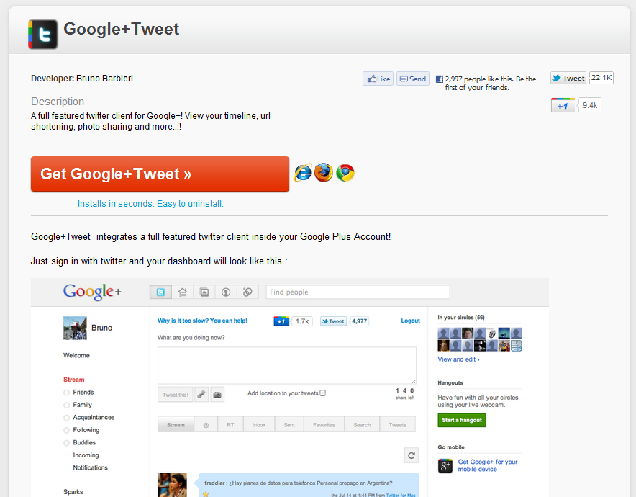
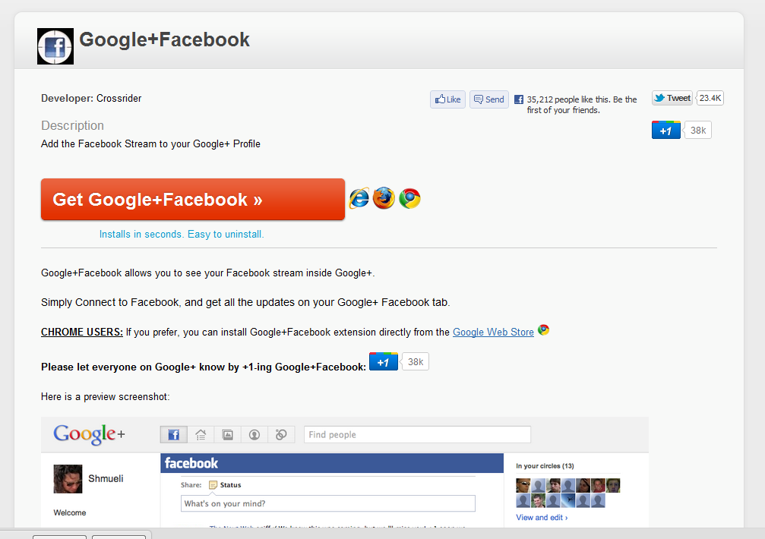
Add Twitter and/or Facebook
http://crossrider.com/install/529-google-tweet
http://crossrider.com/install/519-google-facebook
Notes:
The Google+ Navigation Bar is Now Sticky
It will stay at the top as you scroll down your Google+ stream so you can navigate to different areas within Google+ . The "stickiness" of the navigation bars will depend on the size of your browser window—if you make your window smaller, the gray Google+ bar will disappear as you move down your stream.
Read more: http://articles.businessinsider.com/2011-08-19/tech/30080767_1_navigation-louis-gray-permissions#ixzz1mlunKjTh

Slide 11
Google+ Circles
Find people
“Find people” link on your own Circles page
https://plus.google.com/getstarted/follow
http://findpeopleonplus.com
http://www.gpeep.com
Find shared circles
Google doc with list of shared circles: http://goo.gl/8ZEIM
Follow Shared Circles on G+ : http://goo.gl/6bqI3
Search “shared a circle with you” in G+ search bar
Exercise:
Find and follow people using one of the above methods
Make a WSWRC12 circle and add people in this room

Slide 12
Google+ Sparks, Saved Searches, and +1s
Everything
People and pages
Google+ posts
Sparks
Hangouts
Location (e.g., San Francisco, CA)
From Everyone
From your circles
From you
Notes:
Google+ Sparks are like an advanced combination of Google Alerts and Google Reader – without the dashboard and inbox clutter. Sparks let you use Google’s own query language to set up improved filters for the information you care about. You can then save your searches and have them appear under “Sparks” when you’re logged into Plus.
Sparks is similar to Twitter. It starts when the user chooses topics that they are interested in (sports teams, news headlines, etc.). Sparks will then customize their newsfeed to include micro-posts from other relevant users and relevant hashtags. Users have the ability to add or subtract topics to make their newsfeeds more interesting or more relevant to current events.
Each time you click +1, you're adding to the batch of cool, helpful, or just plain ridiculous things you've found across the web. You'll find your full list of +1's in a special tab on your public Google profile. You can show your +1's tab to the world or choose to hide it. Either way, it's the place you'll go to personally manage the ever-expanding record of things you love around the web.

Slide 13
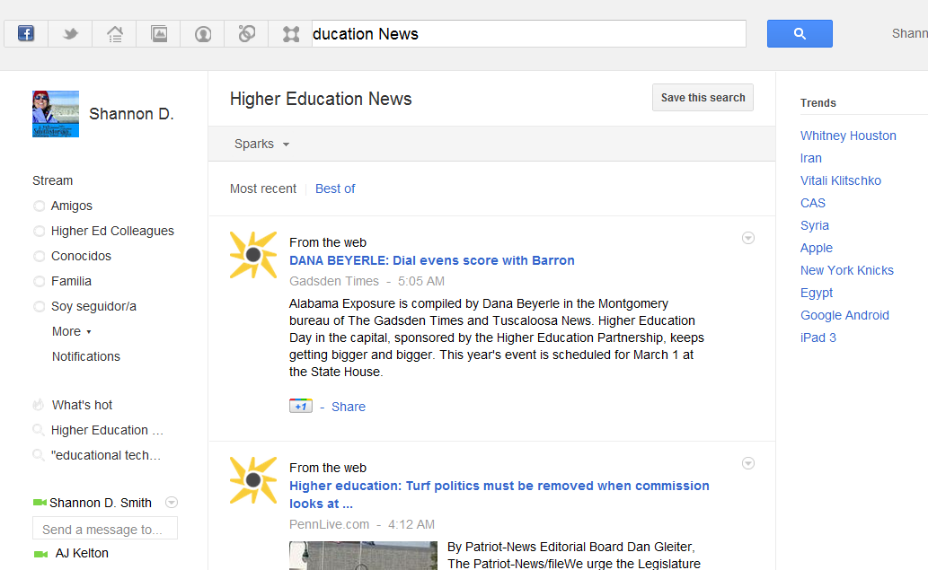
Google+ Sparks, Saved Searches, and +1s
Trending topics (what others are searching right now)
http://www.google.com/trends/
+1 to recommend and (optionally) share with your circles
http://www.google.com/+1/button/
Exercise:
Pick a topic and create a saved search
View Sparks from this topic
+1 an item in your stream
Notes:
Google+ Sparks are like an advanced combination of Google Alerts and Google Reader – without the dashboard and inbox clutter.
Sparks let you use Google’s own query language to set up improved filters for the information you care about.
You can then save your searches and have them appear under “Sparks” when you’re logged into Plus.
Sparks is similar to Twitter. It starts when the user chooses topics that they are interested in (sports teams, news headlines, etc.). Sparks will then customize their newsfeed to include micro-posts from other relevant users and relevant hashtags. Users have the ability to add or subtract topics to make their newsfeeds more interesting or more relevant to current events.
+1 gets conversations going. Click the +1 button to give something your public stamp of approval. Then, if you want to share right away, add a comment and send it to the right circles on Google+.
The next time your friends and contacts search on Google, they could see your +1. You’ll help them find the best stuff on the web – and you might just start up another conversation!
Each time you click +1, you're adding to the batch of cool, helpful, or just plain ridiculous things you've found across the web.
You'll find your full list of +1's in a special tab on your public Google profile. You can show your +1's tab to the world or choose to hide it.

Slide 14
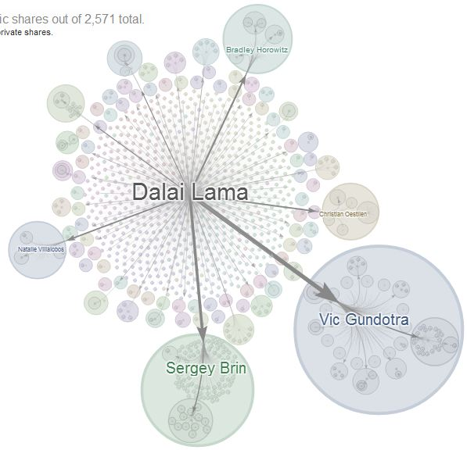
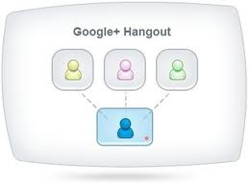
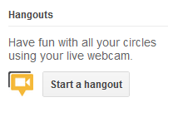
More Cool G+ Features
Ripples!
Hangout!
Exercise:
Find a popular PUBLIC post and click drop-down arrow at top right
Select Ripples
Let’s Hangout
Notes:
Google+ Ripples creates an interactive graphic of the public shares of any public post on Google+ to show you how a post has rippled through the network and help you discover new and interesting people to follow. Ripples shows you:
Who has publicly shared the post and the comments they’ve made
How a post was shared over time
Statistics on how a post was shared
While Ripples displays a lot of cool information, you’re not actually seeing all the action that’s taken place. For starters, Ripples only uses public shares, so there may be a discrepancy between the number of shares that you see on a post in the stream and the number of shares that Ripples displays. Additionally, Ripples only shows data for the previous 53 days.
You can access Ripples from any public post in your stream. Just click the dropdown arrow at the top of the post you’re curious about and click View Ripples.
Not sure if a post is public? Look at the top of the post next to the time stamp. If the post is public, ‘Public’ will be displayed.
If you find a particularly interesting Ripples visualization, it’s easy to share it with your circles. While viewing the ripple, just copy the URL and share the link in your stream.

