Slide 1
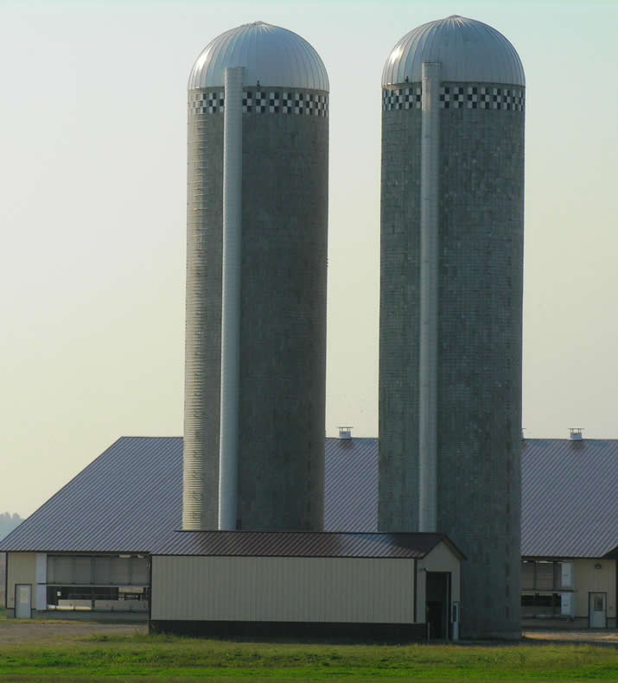
Ideas Labs: Breaking Down the Silos
Melody Buckner, MS University of Arizona
Robert Griffiths, PhD Ohio State University

Slide 2
Presentation Overview
Ohio State University
Impact Grant
Ideas Labs
University of Arizona
Online Initiative Grant and Online Education Program
Ideas Labs
Quality Matters as a Guide
Take-Aways and Questions

Slide 3
griffiths.44@osu.edu twitter: @griffiths44

Slide 4
Ohio State University Impact Grants
Silo Removal
Individual -> Departments
Semester Conversion
http://go.osu.edu/IG
http://ocio.osu.edu/grants

Slide 5
Impact Grant Key Stipulations
Research Project
Key or Large Course (250+)
$10,000; $5,000 phased funding
200 support hours
Buy-in for department
Cascading design, sharing results
Collaboration with recipients, various central units

Slide 6
Ohio State University The Process
Planning
2-3 months; Project Charter
$10,000 after charter completed
Preparation
5-6 months; Training, Project Work, Assessment Plan, and IRB Approval
$5,000 after IRB approval
Production
3-4 months; Implementation and Report
Blogging
http://go.osu.edu/impactblog

Slide 7
Ohio State University Ideas Labs
Monthly and as requested
Discussion-based
Outside experts
Previous recipients
Librarians
Accessibility
Quality Matters
IRB
Silo breakdown, builds self-efficacy
Perceptions change during grant process

Slide 8
Impact Grant Expansion
Expansion
Hired 2 FTE
2 → 6 recipients/year
Program-based
Expand previous work
Communities
HyFlex Model
Virtual Labs
Lecture Capture
Individualized Instruction

Slide 9
mbuckner@arizona.edu twitter: @Melody236

Slide 10
University of Arizona Online Initiative Grants and Online Education Project
2010 – 2011 Online Initiative Grants
13 programs
60+ faculty/graduate students
http://onlineinitiatives.oia.arizona.edu/content/welcome
2011 – 2012 Online Education Project
Expanded to 4 options
Hybrid Courses
Bottleneck Courses
Summer/Winter Courses
Fully Online Programs (30 courses)
http://oep.arizona.edu/

Slide 11
University of Arizona Online Initiative Grants and Online Education Project
2010 – 2011 Online Initiative Grants
Start the Ideas Lab
3 Labs for the grant
Open forum to share
Experts among the faculty
Resource Experts
2011 – 2012 Online Education Project
Option A – C
3 Labs for the grant with focus topics for all faculty
Option D
3 Labs for each program
Specifically for their interest

Slide 12
What goes on in an Idea Lab?
University of Arizona
Faculty share challenges and successes
Faculty experts present
Timelines
Module Demos
Communication Strategies
Outside experts present
QM Peer Review Process
Library Resources
How to use Elluminate

Slide 13
What goes on in an Idea Lab?
Agenda from an Ideas Lab
Welcome
The Presentations
Timeline for Instruction
D2L Module Demo
Online Initiative Posters
Quality Matters Review
Time to Share
Each group reports on progress
Wrap Up
Faculty Learning Community
Spending Report
LATTe Meeting
Looing to the next meeting

Slide 14
Quality Matters as a Development Guide
Quality Matters Rubric
8 General Standards or Categories
40 Review Standards
UA QM Design Rubric
Kept 8 General Standards
Used 21 of the Review Standards

Slide 15
Quality Matters as a Development Guide
Rubric used for:
Design Tool
Peer Review Tool
Quality Matters Website http://www.qmprogram.org/

Slide 16
Quality Matters Standards for Ideas Labs Activities
Application of QM Standards
The course learning objectives describe outcomes that are measureable.
The learning activities promote the achievement of the stated learning objectives.
The course employs accessible technologies and provides guidance on how to obtain accommodation.

Slide 17
Questions
Do you have funding opportunities on your campus?
Do either of these approaches resonate with your campus situation?
How would you build excitement or a passion for idea labs?
Who are key contacts on you your campus for idea labs?

