Slide 1
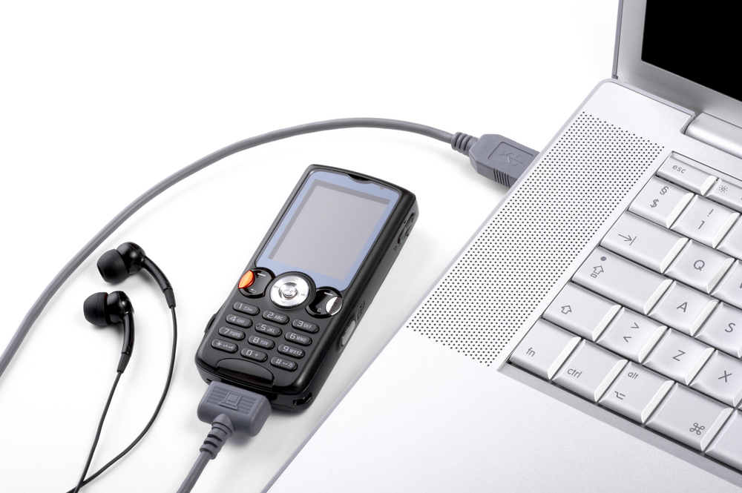
Mobile teaching and learning: Engaging students and measuring impact.
WSWRC 2012
Veronica Diaz, PhD
Associate Director
EDUCAUSE Learning Initiative

Slide 2
Agenda
Mobile learning’s evolution
Teaching and learning community and mobile learning
Strategies and methodologies to help measure the impact of mobile tools on teaching and learning
Notes:
HR last 5 years and see how the technology has developed
ELI focus sessions, one on mobility –how many have attended a FS
Look at what were some of the findings that came out of the focus session
Look at mobility examples
Frameworks to evaluate the effectiveness of mobile initiatives

Slide 3
Resources
http://tinyurl.com/mecar

Slide 4
Notes:
Have been working on m for at least a year, maybe 2 or 3
Have some pedagogies and T&L strategies that engage students, add time on task, or enhance their learning
Have well established frameworks to measure impact of m on T&L
Have used those frameworks and data collection strategies to make improvements
Have central support of your m initiatives

Slide 5
Notes:
Unit or department-based m initiative
Have some anecdotal evidence of how things are going
Haven’t yet incorporated feedback into future initiatives
Have addressed few challenges in mobility
What would it take to move to green

Slide 6
Notes:
Not sure if any m work is happening
Not planning anything centrally
Too many challenges
Too costly
What would it take to move to yellow or green

Slide 7
Mobility in Review

Slide 8
Notes:
Here I’d like to give you a short “state of the union” on mobile technologies
ELI/NMC HR, I’m on the advisory board for HR
HR is a good way to take the pulse of emerging technologies
Keep in mind that most HED institutions lag significantly behind the HR, so some of the technologies described may seem more advanced than what you recall

Slide 9
Mobility: 2005-2008
2006
The Phones in Their Pockets
(2-3 year adoption horizon)
2007
Mobile Phones
(2-3 year adoption horizon)
2008
Mobile Broadband
(2-3 year adoption horizon)
Notes:
Mobility didn’t show up on HR until 2006
2006, hope was to deliver content to the phone, 3G was emerging, text messaging was main communication method,
2007: phone now has storage, video, camera, keypads for input; apple was just announcing the iPhone,
2008: we saw video players, web browsers, document editors, better batteries; location-aware devices, news readers on our mobile devices;

Slide 10
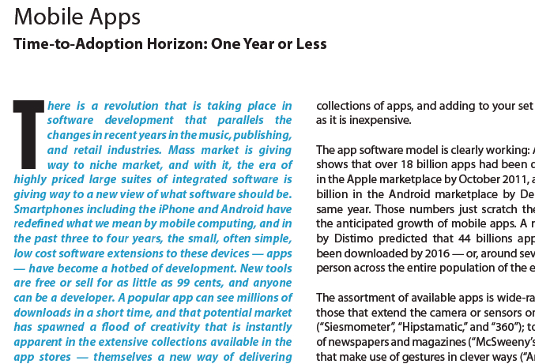
Mobility: 2009-2012
2009
Mobiles
(1 year or less adoption horizon)
2010
Mobile Computing
(1 year or less adoption horizon)
2011
Mobiles
(1 year or less adoption horizon)
Notes:
2009: surrounding software really helped mobile to take off; emergence and proliferation of cloud computing
multi-touch displays, the ability to access the Internet over increasingly higher-speed 3G networks or wifi,
capability for sensing motion and orientation.
Seeing institution-wide mobile initiatives, google develops everything w mobile capacity
2010: smart phones are fastest-growing sales segment—more people all over the world now own/use a computer that fits in their hand and able to connect wirelessly from almost anywhere
Proliferation of other mobile devices: netbooks, smartbooks, ipad
Greater move into teaching and learning, highly specialized mobile applications; uses that truly engage students, students involved in app development
2011:
Web content is developed that seamlessly adjusts for optimal display on any of these devices—increasing amount of Internet apps and info accessible to mobile users
HED: Mobiles embody the convergence of several technologies that lend themselves to educational use,
electronic book readers, location-aware services, annotation tools, applications for creation and composition, and social networking tools.
2012
Proliferation of apps (low cost and many to choose from) means move away from high prices suites of integrated software to a customized assembly of tools

Slide 11
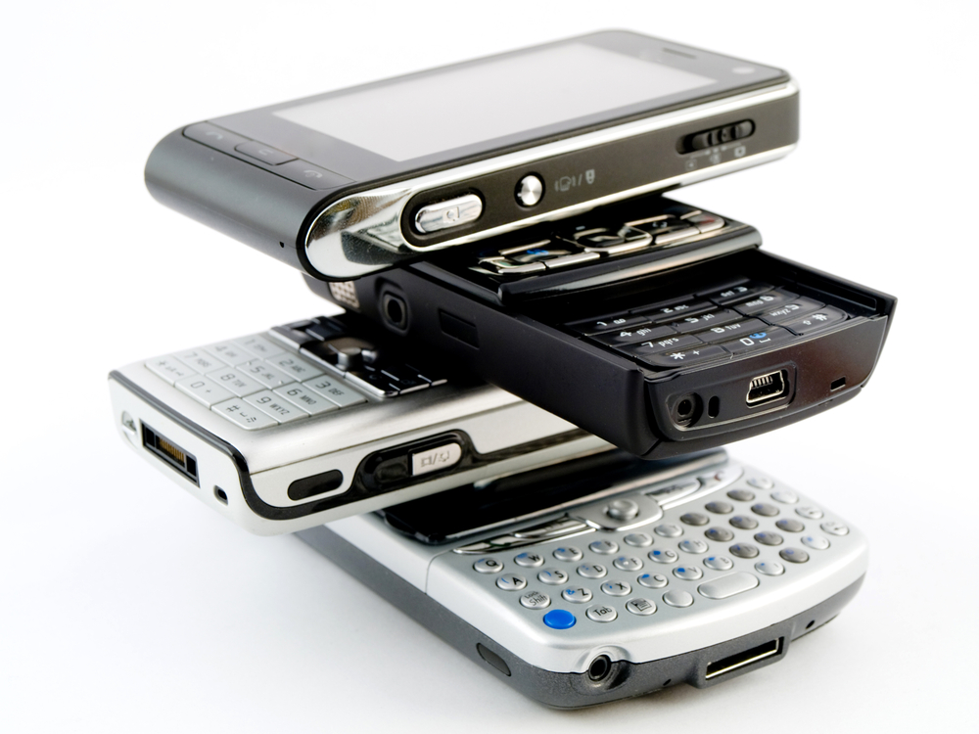
Mobile Learning 2.0: The Next Phase of Innovation in Mobility
Notes:
Like a two day study session on the topic
16 speakers included faculty members, administrators, even some students that developed apps
All session recordings are available now and are included in your resource list

Slide 12
Community’s Conclusions

Slide 13
Content Community Collaboration
Notes:
Content: the access of and working with course content, including course readings, lecture captures, the course web site, and student work
Community: venues, activities, and applications that contribute directly to a sense of being a member, a participant, or a contributor.
Collaboration: the collective and collaborative activities of faculty and students that create and generate knowledge and course content.

Slide 14
Content Community Collaboration
Notes:
Collaboration was the area that had the greatest potential for T&L as we conceived the program
“mobile” pedagogies were rare and a very new area
Application of mobility to T&L environment is still in a very early stage

Slide 15
At your tables:: Your mini mobile initiative
The mobile tools (tablet, smart phone, etc.)
The mobile applications (apps, cloud, etc.)
The goals (engagement, content delivery, etc.)
…………
Notes:
As we go through this presentation think about how you can enhance your initiative

Slide 16
Mobile technology is best suited for…
Notes:
Avoid translating what is currently done with laptops onto the mobile device
The most recent ECAR study of UG and IT documented use w mobile tools in short spurts:
relatively short, quick checks for news, updates, messages, and so forth.
hard to imagine many people typing a lengthy document, such as a term paper, using the cramped keyboard of mobile device
This theme of the “short duration” is a factor that needs to be taken into account when devising curriculum and course activities that utilize highly mobile devices.

Slide 17
Tapping into the PLE
Notes:
… is to access resources across the variety of devices and applications.
For learning, the capacity to access the student’s PLE is key to establishing mobile technology’s usefulness to learning
ACU has a network-based file service that provides a place for students to store their files. As they offered more services for the iPhone, the institution made sure that students could access their files using their mobile devices—made the mobile device an integrated part of the PLE.
The success of the mobile device in the curriculum = how thoroughly it is blended into current learning environment or toolbox

Slide 18
Content delivery is the low-hanging fruit
Notes:
This is not a difficult objective to achieve
Access anytime from anywhere is supportive of T&L
Maybe it’s ok to start here

Slide 19
Innovation doesn’t always start in the classroom
Notes:
other units—transportation services, marketing, outreach, admissions, and recruitment for instance—might be more interested in moving forward with mobile technologies, and so students might have some early exposure that will build a comfort level and interest in using mobile technologies in a more learning-oriented setting.
exposure builds
tolerance,
openness to experimentation
interest in exploring ways in which mobile technologies can support, facilitate, and enhance their learning

Slide 20
Rapid growth in mobile applications and their interoperability with other tools
Notes:
Apps that work on mobile devices also work on laptops, desktops, phones, etc.
All this supports the idea of mobility tools as part of the PLE

Slide 21
The new tool in the toolkit
Notes:
Mobile devices are part of the toolkit, continue to shrink the desktop market, but are not replacing the higher performing computer/laptop

Slide 22
Challenge of ownership patterns
Notes:
In a recent study on students and IT about 13% said they don’t access the Internet from their device because of the cost of the data service plan
One focus session presenter reported that as few as 2% of his CC students owned smart phones, almost all had feature phones.
Data plans vary as well, making for another digital divide which limits the curricular plans we can implement
we need to know what our students have
How many of your institutions collect data on device ownership and student data/text plans

Slide 23
At your tables:: Your mini mobile initiative
What will you do in your initiative?
…………
Notes:
Think about a brief tactical plan
EX: mobile flash cards, recordings from observations in the field, student response system

Slide 24
Review your plan and ask…
What would be the ramifications and opportunities for learning if this technology were adopted?
What kinds of teaching and learning engagements might this technology: make better or enable?
If we decide to do a pilot, what kind of evaluation methodology can we overlay on the project to assess outcomes?
What kind of additional research needs to be done concerning this technology (student)?
Notes:
4 questions that might help to frame any work that is intended to help us measure the impact of emerging technologies
Not to decide to move forward or not, but to be more thoughtful and deliberate about work in this area

Slide 25
Measuring the Impact: 5 Studies
Notes:
Studies share some research methods, but offer frameworks to use to evaluate mobile learning
Suggest questions you might ask

Slide 26
How do I ask?
Questionnaires
Paper
Online
Interviews
Individual
Focus Group
Observations
Classroom
Online
Focus groups
Surveys
Tracking tools
Journaling
Pre post tests
Debriefs

Slide 27
Types of Questionnaires
Paper distributed in class
Mail
E-mail
Online, e.g., SurveyMonkey
Twitter poll
Facebook

Slide 28
Types of Interviews
Face-to-face
Telephone or Skype
Teleconference
Synchronous Chat
Asynchronous forum
Focus group
Twitter poll
Facebook

Slide 29
Observation Options
Onlooker
Overt
Fully-explained
Once or limited
Narrow focus
Participant
Covert
Unexplained
On-going
Broad focus
Source: http://www.amazon.com/Conducting-Educational-Design-Research-McKenney/dp/0415618045/ref=sr_1_1?s=books&ie=UTF8&qid=1329938445&sr=1-1

Slide 30
Triangulate to Tell the Full Story
Q
I
Full
Story
O
Source: http://www.amazon.com/Conducting-Educational-Design-Research-McKenney/dp/0415618045/ref=sr_1_1?s=books&ie=UTF8&qid=1329938445&sr=1-1

Slide 31
Mobile research: Challenges and goals
Source: https://lra.le.ac.uk/bitstream/2381/8162/3/%5B14%5DVavoulaSharples-mlearn2008%5B1%5D.pdf
Notes:
Nice overall framework for studying mobile learning
lays the groundwork for issues and opportunities

Slide 32
Capturing learning context and learning across contexts
Challenge 1
Notes:
To establish and document the learning, we need to know:
the location of learning and the layout of the space (where);
the social setting (who, with whom, from whom);
The learning objectives and outcomes (why and what);
the learning method(s) and
activities (how);
and the learning tools (how)
Mlearning is unstructured, on-the-fly

Slide 33
Has anyone learned anything yet?
Challenge 2
Notes:
Doesn’t have a discrete beginning or end
instances where learners show responsibility for and initiate their own
are actively involved in learning (e.g. by absorbed, close examination of resources; or persevering with a task),
make links and transfer ideas and skills (e.g. by comparing evidence),
share learning with experts and peers (e.g. by asking each other questions)

Slide 34
An ethical question
Challenge 3
Notes:
Privacy issues in observing or tracking via the device’s usage
Could journal
Could measure learning outcome
Difficult to isolate the effect of mobility

Slide 35
The technology itself
Challenge 4
Notes:
As study shifts from mobility of the technology to the mobility of the learner, additional issues arise
learners move across multiple devices, in multiple locations.
Consider the extent to which mobile technologies are integrated into the PLE

Slide 36
The big picture
Challenge 5
Notes:
3 types of studies to measure technology’s impact:
Anticipatory studies: relate to pre-intervention intentions, opinions and attitudes;
ongoing studies: focus on analysing processes of integration;
achieved studies: are summative studies of technology no longer ‘novel’, but becomes established
Our research needs to look at the processes of integrating emerging with existing practices,
the implications that manifest after full deployment.

Slide 37
Formal vs informal
Challenge 6
Notes:
if the technology is mobile, so is the learning.
learning often takes place inconspicuously or is crammed in the short gaps between these transitions.
Studies should try to capture both
Additional time on task
Convenience connected to access and use of learning materials

Slide 38
5 recommendations
Capture and analyze learning in context with consideration of learner privacy
Assess the usability of the technology and how it affects the learning experience (PLE)
Look beyond measurable cognitive gains into changes in the learning process and practice
Consider organizational issues in the adoption of mobile learning practice and its integration with existing practices
Span the lifecycle of the mobile learning innovation that is evaluated, from conception to full deployment and beyond

Slide 39
Building a Successful mLearning framework
Source: http://www.irrodl.org/index.php/irrodl/article/view/346/875
Notes:
Study contributes 5 characteristics of a “good” mobile experience
Each of these could be “recast” into a survey or focus group questions or some other method to measure impact

Slide 40
Proportionate
Notes:
not more ponderous, onerous, or time-consuming than the actual learning experience or learning benefit
or the delivery and implementation of the learning itself
Will depend on the tools you use—students may already be familiar with many, like Google

Slide 41
Appropriate to the specific learning technologies, to the learners, and to the ethos of the learning – ideally built in, not bolted on
Notes:
Fit
Technology with outcome
Technology with learners and the tools they have
Technology with the style of the instructor
Integrated with the PLE
Is the course a blended or F2F course –does a mobile application make sense for the course delivery mode
Can the mobile application be used to add time on task (was that a goal—to extend learning exp or further engage learner)

Slide 42
Alignment between learning goals and technology
Notes:
Much of this criteria is a good evaluation of other technologies too
Good to map this for students, helps to justify the tech use, esp if experiment

Slide 43
Consistent
Notes:
Experience consistent across different groups or learners
Is the use or application reliable
Across devices and technologies are used
One way to look at the experience—consistency—there might be others
Think of ways to capture unintended results

Slide 44
At your tables:: Your mini mobile initiative
How and what will you measure?
…………
Notes:
What will success look like

Slide 45
Case study: Mobile learning in a blended course
Source: http://www.docstoc.com/docs/38964563/Assessing-the-Effectiveness-of-Mobile-Learning-in-Large-HybridBlended
Notes:
case study of mobility in the context of a blended course
a large hybrid/blended computer science classroom of 562 students (about 90% being online).
Looked at the impact of mLearning system and learning activities through pre- and post-surveys from 4 aspects:

Slide 46
Focus Areas
if student enjoyed the learning experience
how students feel about interacting with fellow learners
how students felt about their relationship to their instructors in the mobile blended learning environment
mobile blended classroom’s effects on students’ study habits

Slide 47
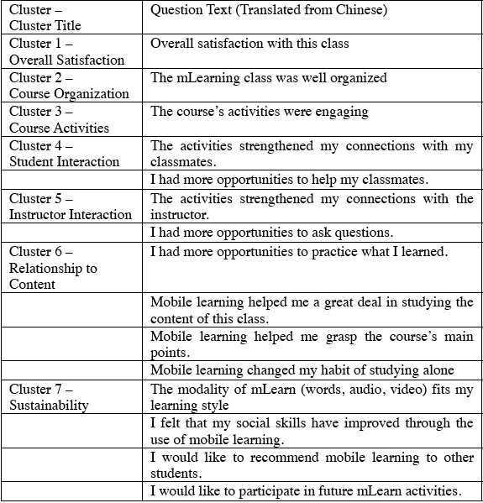
Notes:
IDed areas that were reliable measures of the mlearning experience
IDed some (though not necessarily all) of the important features of the mobile learning experience,
core issues that arise when evaluating mlearning:
measures of activity,
measures of efficiency,
measures of outcomes,
measures of organization of mlearning
measured a few important constructs to examine:
student satisfaction,
level of interaction (student-student, student-instructor),
sustainability of student participation in mLearning activities.
Can help you to organize your study

Slide 48
Overall Satisfaction Course Organization
Notes:
A student’s overall feeling of satisfaction after a course ends is important in the mobile learning environment.
Don’t discount the importance of ‘enjoyment’ or ‘satisfaction’ in the classroom. These feelings enable learning
surveys should ask whether students feel lost or confused by the course’s direction.
We can use this part of the survey to uncover the pedagogical organization of mobile instruction.

Slide 49
Course Activities Student Interaction
Notes:
The design of mobile activities requires special attention to mobile devices and the limitations and distances of virtual communication.
design course activities that make full use of the affordances of the technology.
Consider “how much” mobile activities are in the course
how learners react to the activities themselves
Are you asking students to engage w eachother or w content only
Some students may feel more or less comfortable with interaction in a mobile environment
Consider sync vs async engagement

Slide 50
Instructor Interaction Relationship to Content
Notes:
Research on mobile learning show a distinct increase in learner-instructor interaction
researchers at UCSD found that students asked more questions when they could submit their questions via forums and mobile devices.
it’s Important to study mobile interaction, this supports engagement
Mobility presents Lots of opps to enhance the relationship between students and course content.
Students can access learning materials at any time and from any location. This may well lead to changes in how students study.
mobility could also lead to more studying alone.

Slide 51
Sustainability
Notes:
‘sustainability’ refers to the long-term effects of mobile learning initiatives such as
long-term student satisfaction,
willingness to use mLearning tools,
integration of mLearning solutions into courses.

Slide 52
Case study: Mobile learning in medical school
Source: http://www.biomedcentral.com/1472-6920/10/57
Notes:
Another case study

Slide 53
Context
57 students in cohort
4-year
Bachelor of Medicine
Bachelor of Surgery
2 online tools
Blackboard
Interlearn
Access to
Internet
Customized software
Info repositories
Sharing info within and between cohorts
2 RQs
In what ways does mobility support learning?
What areas need further development?
Notes:
Mobile tech is popular in medical education
Sharing information within and between cohorts can increase the efficiency and effectiveness of educational programs
Examined qs in a qual and quant way

Slide 54
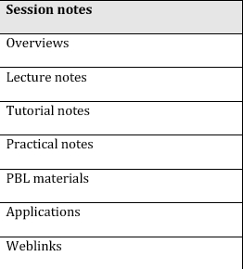
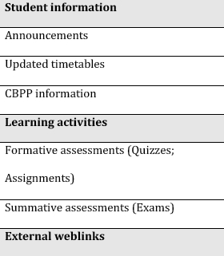
Notes:
This study could provide a useful framework for mobile learning that is designed to access content
This is all the content students had available to them in their mobile learning environs
They were asked to rate the degree to which they used each

Slide 55
Student Improvement Suggestions
Better and more electronic learning resources
more materials, especially audiovisual resources
more flexibility in accessing materials
Guidelines/support on managing the VLE
Improvements to VLE
Streamlining organization of information
Reduced the number of clicks to access resources
orientation for students
Notes:
More content
Support on how to use
Help via an organized environment **PLE, ease of use, one stop for content

Slide 56
Evaluating mobile applications
Johns Hopkins University 10/18/2010
Notes:
A model to evaluate mobile apps and their relationship to learning

Slide 57
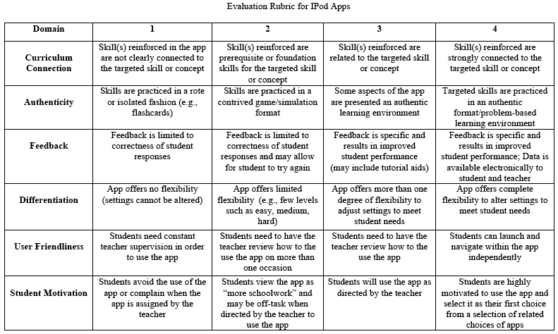
Curriculum Connection
Authenticity
Feedback
Differentiation
User Friendliness
Student Motivation
Notes:
Examined 6 domains

Slide 58
Notes:
Can be adapted to evaluate mobile applications or experiences

Slide 59
Discussion/questions
What are your challenges/opportunities in mobile learning?
What research in this area might be useful to the community to further mobility?
……….

Slide 60
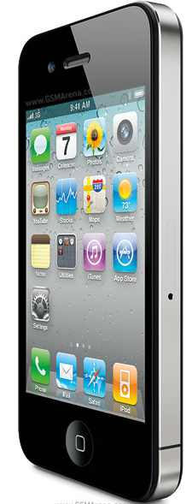
Veronica Diaz, PhD
Associate Director
EDUCAUSE Learning Initiative
vdiaz@educause.edu
http://www.educause.edu/eli

